Slide 1
Schnorr Zero-Knowledge Authentication
CISC 878 Project | 5-minute Progress Presentation
Goal: passwordless login with proof of key ownership, without revealing secret key
Presenter: Jialiang Cheng

Slide 2
1. Project Goal and Motivation
Why Schnorr-based authentication?
Problem We Address
Project Objectives
Traditional password login has leakage and replay risks.
Need authentication that proves identity without exposing secret.
Need a practical protocol that can be integrated into apps.
Implement interactive Schnorr identification end-to-end.
Implement Fiat-Shamir variant for non-interactive proof.
Compare runtime, communication cost, and round trips.
Validate correctness + replay resistance via tests.
Key message: security property + measurable performance tradeoff
CISC 878 | March 25, 2026

Slide 3
2. How It Works (High Level)
Interactive vs Fiat-Shamir login flow
Registration: client generates (x, y=g^x mod p), sends only public key y to server
Interactive Schnorr (2 round trips)
Fiat-Shamir Variant (1 round trip)
1) Client -> Server: commitment t = g^r
2) Server -> Client: random challenge c
3) Client -> Server: s = r + c*x (mod q)
4) Server checks g^s = t * y^c
1) Server sends one-time login_nonce
2) Client computes c = H(user, nonce, y, t)
3) Client sends proof (t, c, s, nonce)
4) Server recomputes c and verifies equation
CISC 878 | March 25, 2026

Slide 4
3. Implementation Snapshot
Code structure and security checks
Core modules
src/zk_auth/schnorr.py
Protocol primitives and Fiat-Shamir challenge derivation
src/zk_auth/app.py
Registration and two login workflows + session token issue
tests/test_auth.py
Correctness, forgery rejection, replay defense, subgroup checks
benchmark.py
Runtime + communication cost benchmark and CSV export
Security hardening: subgroup validation + one-time session/nonce consumption
CISC 878 | March 25, 2026

Slide 5
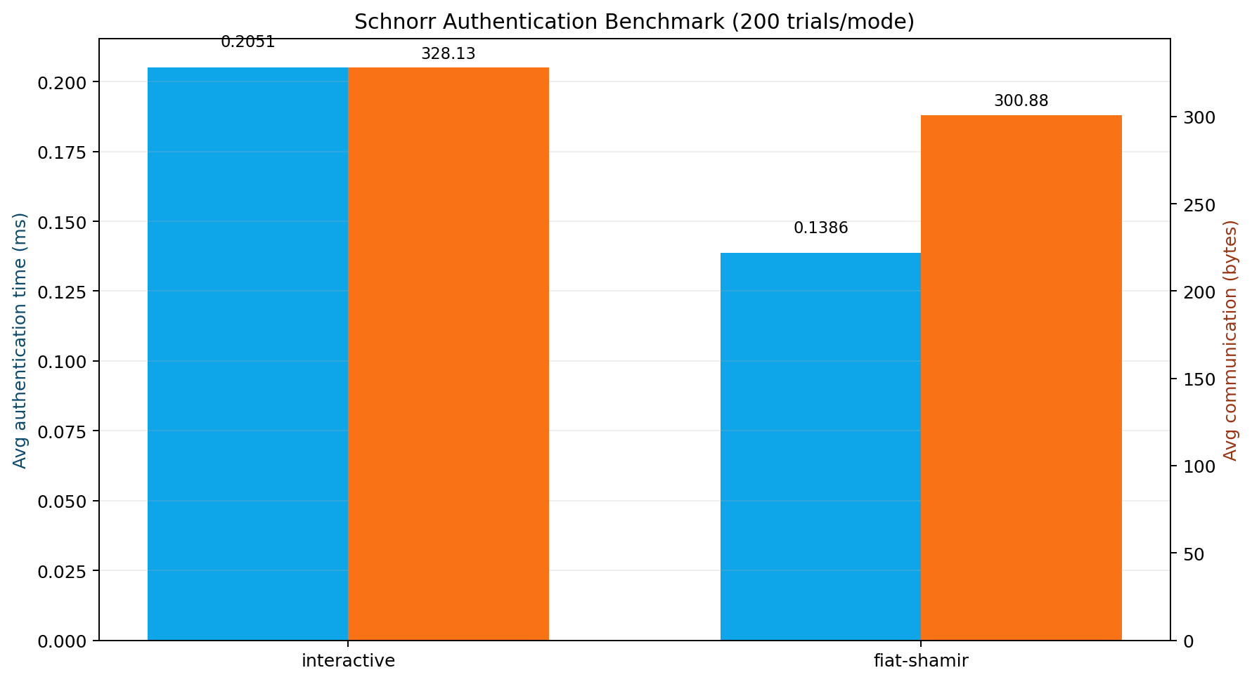
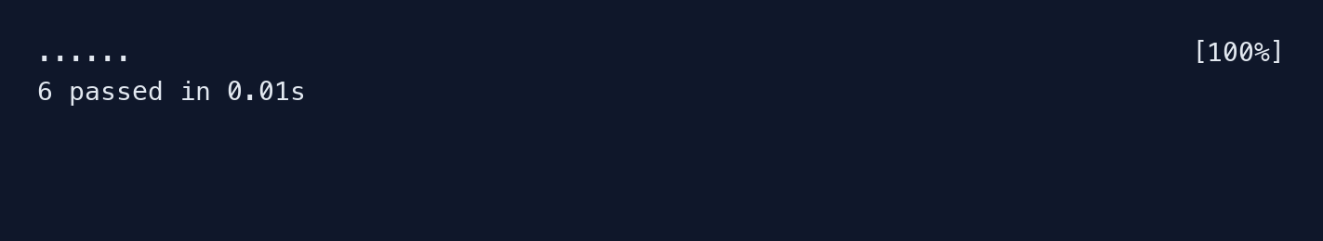
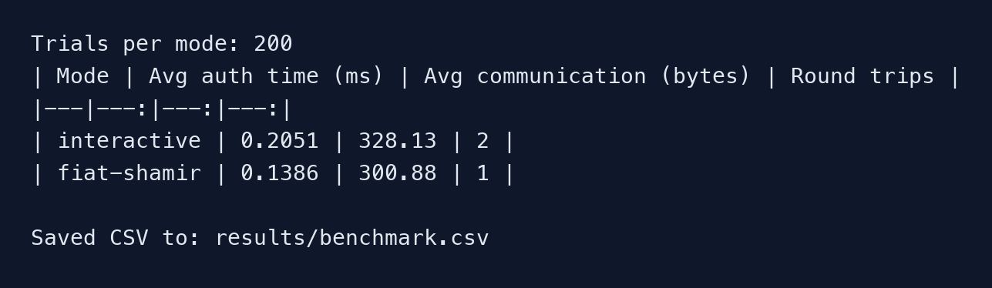
4. Current Results
Latest local run on March 25, 2026
Benchmark (200 trials/mode)
Key observations
Fiat-Shamir is faster (0.1386ms vs 0.2051ms).
Lower communication (300.88B vs 328.13B).
Round trips drop from 2 to 1.
Code test result screenshot (pytest)
Benchmark terminal screenshot
CISC 878 | March 25, 2026

Slide 6
5. Takeaways and Next Steps
Current progress and what we can improve next
Takeaways
We built a complete, runnable Schnorr-based passwordless authentication demo.
Both protocol correctness and key security properties are validated by tests.
Fiat-Shamir shows better communication/runtime behavior in current local benchmark.
Next steps (future work)
Integrate with HTTP API and persistent storage.
Evaluate under simulated network delay and larger parameters.
Add production-style protections (TLS, rate limits, lockout policy).
Thank you - Questions?
CISC 878 | March 25, 2026

