Slide 1
HL7: Standards for e-Health
CCOW Context Management Standard
Robert Seliger
CCOW Co-Chair
President and CEO, Sentillion, Inc.
robs@sentillion.com
Barry Royer
CCOW Co-Chair
Advisory Systems Designer, Siemens Medical Solutions
Barry.royer@smed.com

Slide 2
The Challenge
Multiple disparate applications:
    labs, meds, cardiology, scheduling, billing, etc.
Users in need of easy access to data and tools:
    physicians, nurses, therapists, administrators, etc.
Kiosk as well as personal workstations:
    hospitals, clinics, offices, homes, etc.

Slide 3


HL7 CCOW Technical Committee
( )
WHAT: Couple, Coordinate, Synchronize Applications at Point-of-Use.
HOW: “Easy” Standards Using Component-Based Technology.
WHY: Providers: Flexibility to Choose Applications They Want.
Vendors: Faster to Market with Best-of-Class Solutions.
Everyone: “Out-of-the-Box” Integration.
WHEN: NOW!

Slide 4
What They’re Saying …
“With CCOW, healthcare CIOs have an unparalleled opportunity to link their myriad applications together, achieving the oft-stated goal of getting the right information to the right person at the right time. It's difficult to overstate the significance of this breakthrough because it means physicians finally have intuitive access to the entire breadth and depth of clinical information.”
Leslie Kelly Hall, CIO, St. Alphonsus Regional Medical Center, Boise

Slide 5
What They’re Saying …
“Originally an ad hoc group created to solve the problem of insuring common context between different applications in simultaneous use on the desktop, CCOW is capturing extremely important space in web browser and user security areas.”
CHIM Standards Insight, Feb. 7, 2000

Slide 6
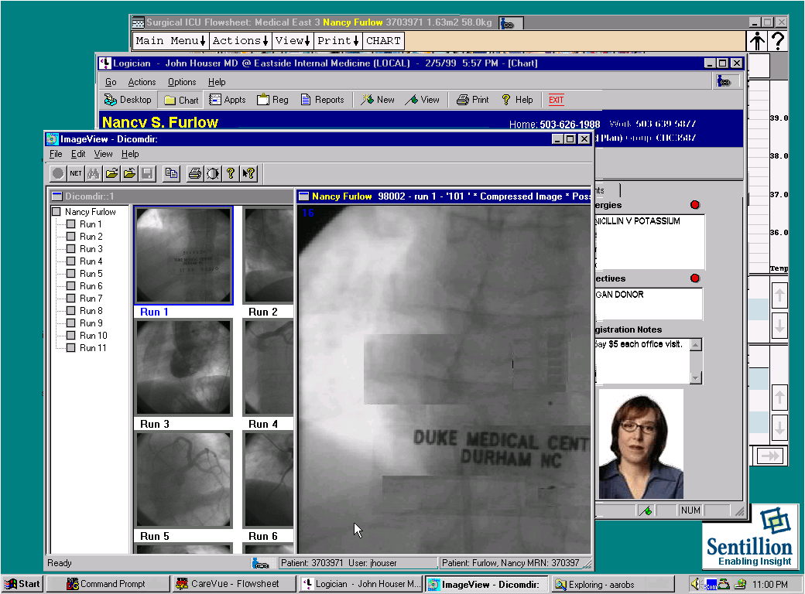
Example: Patient Link
Nancy Furlow

Slide 7
Standard Subjects
Ratified as of V1.3:
  User
  Patient
  Encounter
  Observation
  Certificate
Work in progress for CCOW V1.4:
  Various DICOM subjects
  Authenticate action subject

Slide 8
Other Capabilities
Secure Subjects - Only applications with access privileges may set or get (e.g., User)
Dependent Subjects - The value of a subject must be consistent with the value for another subject (e.g., Encounter depends on Patient)
Custom Subjects - May be defined by healthcare providers and/or vendors, distinct from HL7’s standard subjects
Annotation Subjects - Data that is in addition to a subject’s identity (e.g., a Certificate is an annotation for the User subject)

Slide 9
Subject Hierarchy
User*
Patient
Certificate*
Encounter
Observation
= identity subject
= annotation subject
* = secure subject

Slide 10
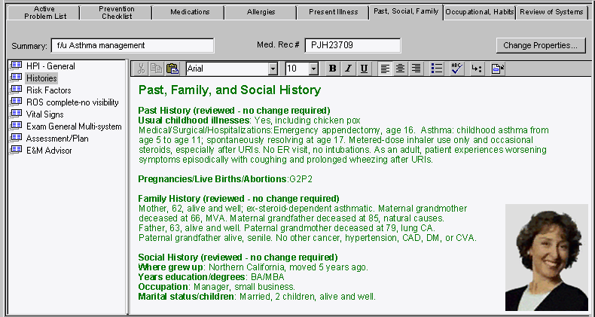
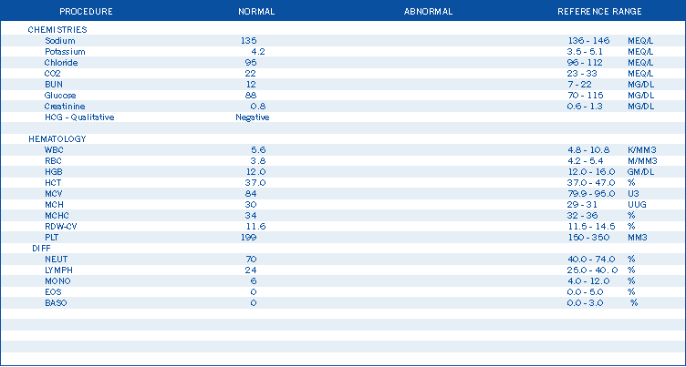
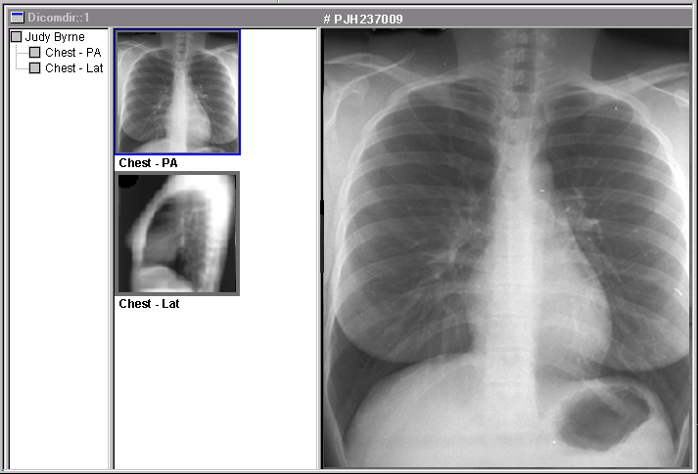
Architecture
Disparate Applications
/ CCOW Interfaces
CCOW
Context Manager
CCOW
Mapping
Agent
Annotation Agent
Copyright © 2000 Sentillion, Inc.

Slide 11
Implementations
Client-Centric
Server-Centric
Context Manager
Agent
Web Server
Agent
Web Server
DB
DB
Context Manager
Copyright © 2000 Sentillion, Inc.

Slide 12
Component Architecture
Application #1
Application #N
Implementation
Implementation
CP
CP
CM
CD
Context Manager
Implementation
II
Tool, etc.
Common
Context
Data
Interface Legend
CP context participant
CM context manager
CD context data
II implementation interface
MA mapping agent
CA context agent
MA
CA
or
Optional Mapping
II
Tool, etc.
CA
Agent Implementation
Optional Annotation
II
Tool, etc.
Agent Implementation

Slide 13
ActiveX Component Mapping
Application #1
Application #N
Implementation
Implementation
CP
CP
CM
SB
SD
CD
Context Manager
Windows
Registry
Implementation
Common
II
Tool, etc.
Context
Data
Interface Legend
CP context participant
CM context manager
CD context data
II implementation interface
MA mapping agent
CA context agent
AR authorization repository
SB secure binding
SD secure context data
CA
Optional Context
II
Tool, etc.
Agent Implementations
AR
SB
Optional External
Authentication
II
Tool, etc.
Repository
Implementation

Slide 14
Web Component Mapping
Application #1
Application #N
Implementation
Implementation
CP
CP
CM
SB
SD
CD
CMR
Context Manager
Context Management
Implementation
Registry
II
Tool, etc.
Common
Context
Data
Notify
Interface Legend
CP context participant
CM context manager
CD context data
II implementation interface
MA mapping agent
CA context agent
AR authorization repository
SB secure binding
SD secure context data
CMR context management registry
Applet
CA
Listener
Applet
Optional Context
II
Tool, etc.
Agent Implementations
AR
SB
Optional External
Authentication
II
Tool, etc.
Repository
Implementation

Slide 15
Simple Context Lifecycle
User
Application AAA
ContextManager
Application BBB
CM::JoinCommonContext(CP iface to AAA, surveyYes)
CM::JoinCommonContext(CP iface to BBB, surveyNo)
I choose "Sam Smith"
CM::StartContextChanges
CD::SetItemValues
CM::EndContextChanges
survey results: all applications accept
CM::PublishChangesDecision("accept")
"Sam Smith"
CP::ContextChangesAccepted
CD::GetItemValues
item values
CM::LeaveCommonContext

Slide 16
Context Change Process
Application tells the context manager to start
(2)
(
1)
User selects
a context change transaction and sets the context
(
6)
Each application indicates
the patient of
data to indicate the newly selected patient.
whether or not it can apply the new
interest from
(7)
If one or more of the applications
Application
context.
any application
cannot or prefers not to apply the new
YY
on the clinical
context, the user is asked to decided
desktop
whether to continue, or cancel.
(5)
Context manager tells the other applications that a new
Context
patient context has been proposed. The context manager
Application
surveys the applications to determine whether each can
XX
Manager
apply the new context.
(8)
Context manager tells each application to apply new
context, or that the transaction has been cancelled.
Application
(
9)
Each application applies the new
(
3)
Context manager tells patient
ZZ
context if instructed to do so by the
mapping agent that context change is
Patient
context manager. Each application
occurring; mapping agent supplies the
Mapping
gets the new patient context from the
context manager with other identifiers by
Agent
Demographics
context manager.
which the patient is known.
(Optional)
Annotation
(
4)
Context manager tells demographics
Agent
annotation agent that context change is
(Optional)
occurring; annotation agent supplies
context manager with authentic demographics data

Slide 17
CCOW Standard Status
1.0 (Ratified April 1999)
1.2 (Ratified May 2000)
Technology Mapping to Web
Component Architecture
Common Links: Patient Link
Secure Links: User Link
Component Interfaces for:
  Applications
  Context Manager
  Patient Mapping Agent
  User Mapping Agent
  Authentication Repository
Technology Mapping to COM
User Interface for Windows
1.3 (Ratified January 2001)
Additional Security Capabilities
Annotation Agents
Observation Link
Digital Certificate Annotation
1.4 (Scheduled January 2002)
Action Subjects (Authenticate)
DICOM Study Link
Multiple User Contexts / One Device
Change Event Filters
1.1 (Ratified January 2000)
1.5 (Scheduled May 2002)
Technology Mapping to SOAP
Nested contexts
Wireless Devices
Inter-dependent Subjects: Encounter Link
Custom Subjects and Items
Conformance Statements

Slide 18

Technology Neutral Standard
Technology Neutral Context Management Architecture
200 pgs
Technology Specific Component Mapping
40 pgs
30 pgs
COM
Technology-Neutral Subject Data Defn’s
Web
(CORBA)
Technology Specific User Interface
15 pgs
Windows/Browser
(Swing)
(other)

Slide 19
Some of the Active Participants
3M Health Information Systems
Agilent Technologies
Baylor Health Care System
Care Data Systems
Cerner Corporation
Center for Disease Control and Prevention
Community Sector Systems
CoreChange, Inc.
Digineer, Inc.
Duke University Health System
Eclypsis Corporation
Epic Systems Corp
Ernst & Young LLP
GartnerGroup
GE/Marquette Medical Systems
Healthcare.com
Healtheon
Health Network Ventures
Health Patterns, LLC.
MDeverywhere
IBM Global Healthcare
IDX Systems Corporation
Mayo Foundation
McKessonHBOC
Medic Computer Systems
Medical Manager, Inc.
MedicaLogic (Medscape)
Mortara Instrument, Inc.
NeoTool Development, LLC.
OSF HealthCare System
Oacis Healthcare Systems
Oceania, Inc.
Partners HealthCare System, Inc.
Per Se’ Technologies
Pitt County Memorial Hospital
Quadramed
Quantitative Medicine, Inc.
Regenstrief Institute for Health Care
Sentillion, Inc.
Shared Medical Systems Corporation
Spacelab/Burdick
Stockell Healthcare Systems
St. Alphonsus Regional Medical Ctr
Sunquest Information Systems
University of Texas-Houston
Vanderbilt University
VHA Inc.

Slide 20
Early Uptake
In Use: Rex (N.C.), Duke (N.C.), Marshfield Clinic (Wisc.), St. Josephs (Wisc.), others
Implementing: St. Alphonsus (Boise), Cottage (CA),
Sharp (CA), Maine Med Center (ME), Cox Health (MO),
30+ others early 2001
Shipping Applications: 3M, Agilent, Bionetrix, CoreChange,
Care Data Systems, Drager, DR Systems, Eclipsys, GE/Marquette, Medcon, Medscape, McKesson, SpaceLabs/Burdick, Stockell, many others in 2001
Shipping Platform/Tools: Sentillion
Acceptance: Worldwide (incl. U.S., Canada, Germany, France, Taiwan, Japan)

Slide 21
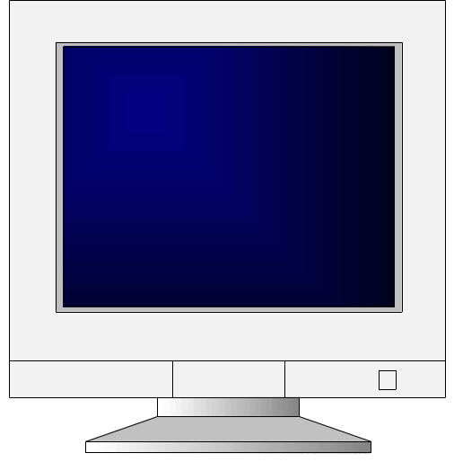
HIMSS 2001 Demonstration
Patient Link
User Link
Organization Component Technology
Agilent CIS Application Windows
Bionetrix Biometric Application Windows
Care Data Systems Patient Mapping Agent Windows
Digineer Ambulatory Application Web
Eclipsys CIS Application Windows
McKessonHBOC Portal Application Web
MedicaLogic EMR Application Windows
Sentillion Context Manager/ Windows + Web
User Mapping Agent

Slide 22
Additional Information
Web Sites:
Health Level Seven, www.hl7.org
Sentillion, www.sentillion.com
List server:
ccow@lists.hl7.org (see HL7 web site to join)
Co-Chairs:
Robert Seliger, Sentillion, robs@sentillion.com
Barry Royer, Siemens Medical Solutions, barry.royer@smed.com
Dr. Michael Russel, Duke University Medical Center, michael.russel@mc.duke.edu

