Slide 1
Care Record Summary
Implementation Guides for CDA Release 2
April 19, 2005
Keith W. Boone
keith.boone@dictaphone.com
Dictaphone Corporation

Slide 2
Agenda
What is a Care Record Summary?
Why is it Important?
What is in the Ballot Package?
Schematron Validation
Level 1 Implementation Overview
Level 2 Implementation Overview

Slide 3
What is a Care Record Summary?
Summary of Care Provided for a Patient
  Summary of Episode
  Discharge Summary
  Transfer Summary
Documents the Provision of Care Act
Commonly used in Transfer of Care scenarios

Slide 4
Why is it Important?
Common to every Inpatient Stay
Similar content is required for accreditation
Common first application of CDA
  Existing Projects in Germany, Finland and Greece
  New Projects in Canada and Japan, and elsewhere
  And now in the US
Notes:
Delete “R2”

Slide 5
What is in the Ballot Package?
The Implementation Guide Documentation
Sample CDA Release 2 documents
Rendering Stylesheet
Schematron Schema
XSLT Stylesheet for Validation
  Alternative to Schematron Validation
Supporting Vocabulary Data
Notes:
Suggest changing order:
IG
Sample – narrative style
Sample – table style
Rendering stylesheet
Schematron
Xslt
Vocab

Slide 6
Schematron Validation
Implementation Guide uses Schematron 1.5
  A language system for specifying and declaring assertions about arbitrary patterns in XML documents.
Schematron 1.5 implementation is via XSLT
  Convert Schema to a validation style sheet
  Apply it to the Instance
More at http://xml.ascc.net/schematron/.
Notes:
Change order of slides to match previous

Slide 7
Schematron Validation
Schema is a collection of patterns.
Patterns contain one or more rules with a context.
Rules assert that a test has passed.
Failures issue diagnostics
Now you can read the Schema

Slide 8
Sample Schema
<schema xmlns="http://www.ascc.net/xml/schematron">
<title>Sample Schematron schema</title>
<ns prefix="cda" uri="urn:hl7-org:v3" />
<pattern name='ClinicalDocument' see=‘Sample.htm#ClinicalDocument'>
<p>This schema applies to CDA Release 2.0 documents.</p>
<rule id='cda-root' context='/*'>
<assert diagnostics="CNF-1" test='self::cda:ClinicalDocument'>
The root of a Care Record Summary must be a ClinicalDocument
element from the <emph>urn:hl7-org-v3</emph> namespace.
</assert>
</rule>
</pattern>
<diagnostics>
<diagnostic id=‘CNF-1’>
Ensure the appropriate namespace declaration exists.
The root element must be ClinicalDocument.
</diagnostic>
</diagnostics>
</schema>

Slide 9
Level 1 Implementation Overview
Constrains elements of the CDA “Header”
  In most cases times are at least to the day
  Participants in general have a telephone number and address on the entity
  Telephone numbers use a restricted form of RFC-2806 to simplify interchange
Makes use of Existing Vocabularies
  HL7, LOINC, SNOMED CT
Introduces Policy Holder Role Vocabulary
  Simple Inversion of CoverageRoleType

Slide 10
Level 1 Implementation Overview
Describes how to represent various Participants
author authenticator dataEnterer informant informationRecipient legalAuthenticator | participant payers other supporting parties recordTarget performers
Considers Patient Authorship Issues

Slide 11
Level 1 Areas for Further Thought
The following elements are allowed, but not described in detail.
  Confidentiality
  Orders
  Authorizations

Slide 12
Level 2 Implementation Overview
Defines Required and Optional Sections
  Specifies LOINC Codes for Sections
  Order of required and optional sections is fixed.
  Other Sections can be included where necessary.
Derived from Existing and Draft Specifications
  JCAHO Guidelines
  British Columbia eb-MS Project
  Numerous Example Documents
  Common Practices
Specifies information expected of content
  Does not constrain presentation
  Consistent examples show the expected information

Slide 13
Required Sections
Conditions (Problems)
  Active
  Resolved
  Chief Complaint
  Reason for Visit
  Diagnoses
    Admission
    Discharge
    Preoperative
    Postoperative
Allergies and Intolerances
  Pharmacy
  Dietary
  General
Medications
  History
  Administered
  Discharge
  Current

Slide 14
Optional Sections
Advanced Directives
Functional Status
Procedures
Encounters
Family History
Social History
Immunizations
Vital Signs
Fetal Vital Signs
Lab Results
Plan of Care

Slide 15
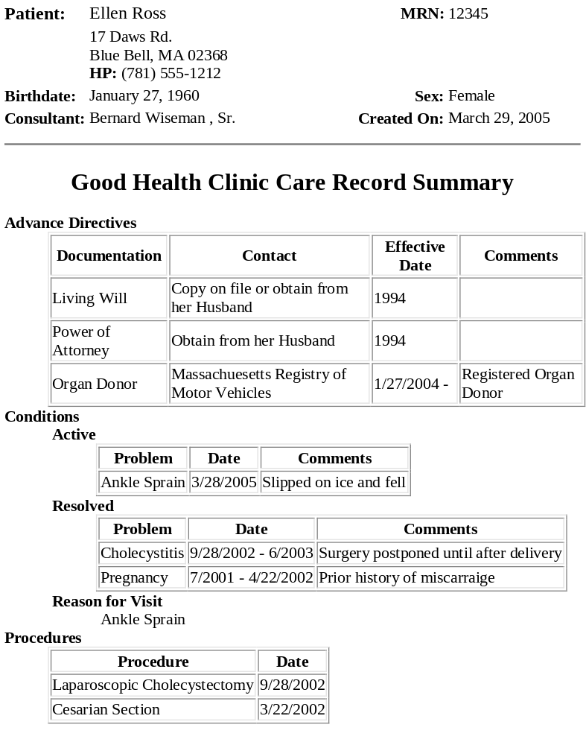
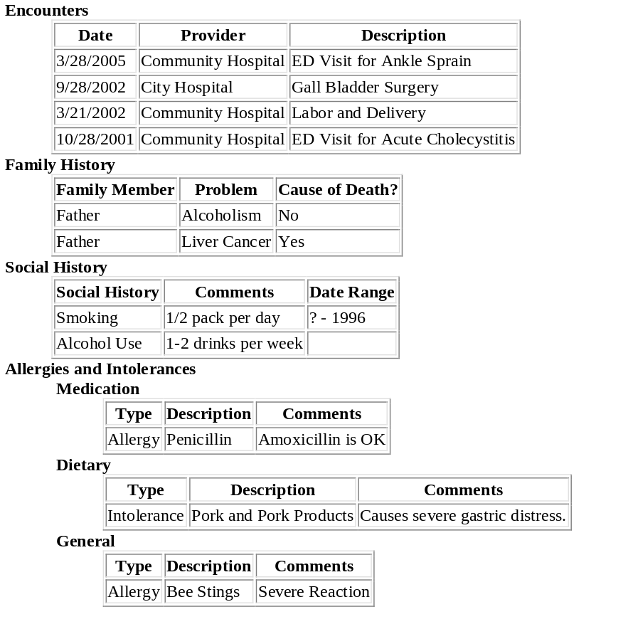
Sample CDA

Slide 16
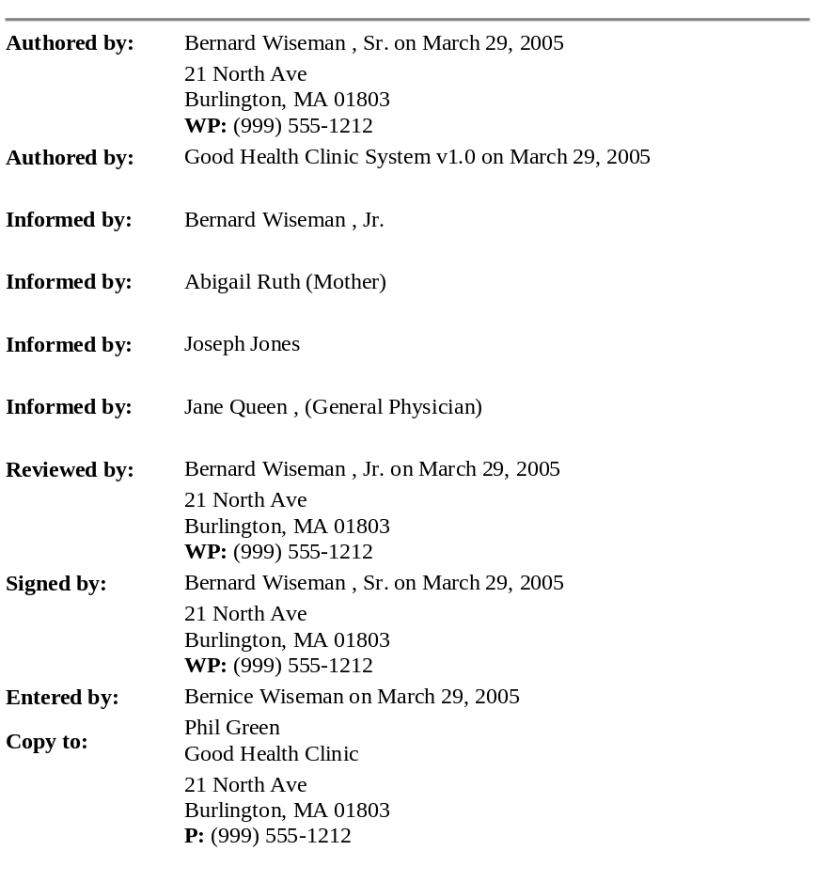
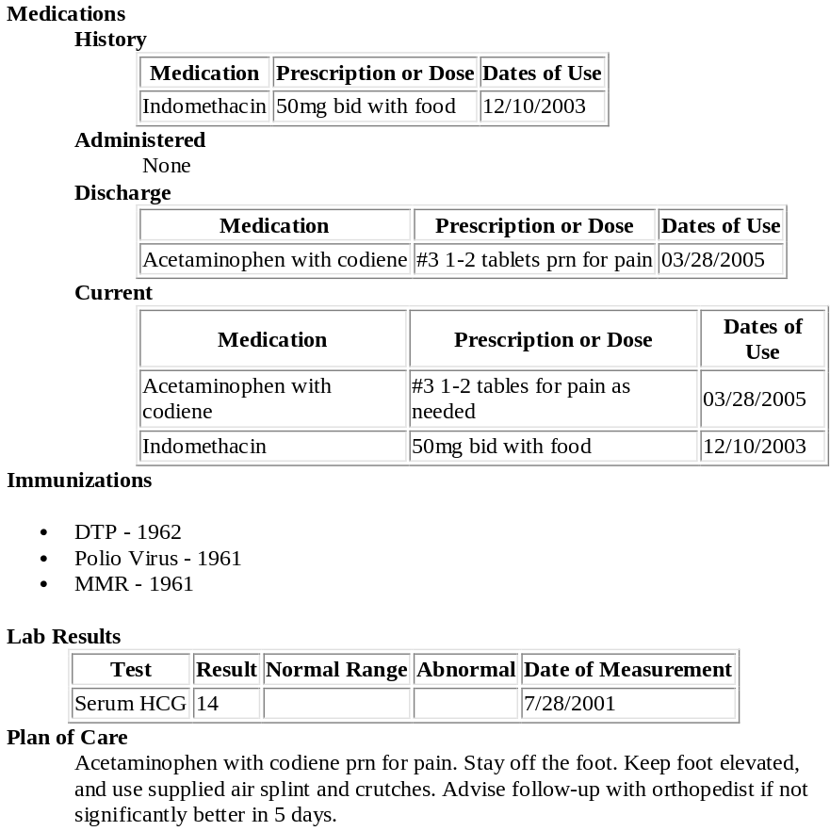
Sample CDA

Slide 17
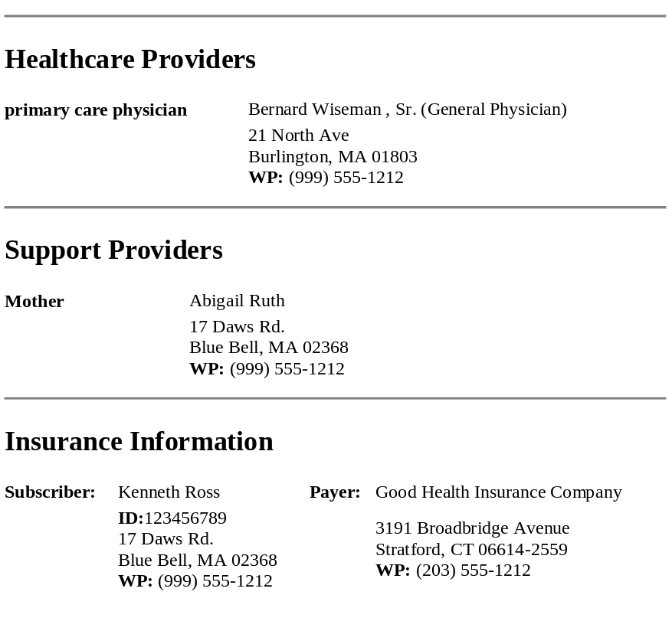
Sample CDA

Slide 18
Next Steps
Ballot Reconcilliation
Develop Implementation Profile with IHE
Level 3 IG with Patient Care
Possible Level 3 IG on CCR in partnership with ASTM
Additional Guides in other Domains
Internationalization
Notes:
Level 3 Guide or Guides: possibly a “CCR IG for CDA (L3)” in partnership with ASTM (tbd)

Slide 19
Questions?

Slide 20
References
HL7 Ballot Site
  http://www.hl7.org/ctl.cfm?action=ballots.home
Care Record Summary Level 1 IG
  http://www.hl7.org/documentcenter/ballots/2005may/downloads/CDACareRecordSummaryIGLevel1.zip
Care Record Summary Level 2 IG
  http://www.hl7.org/documentcenter/ballots/2005may/downloads/CDACareRecordSummaryIGLevel2.zip
Schematron
  http://xml.ascc.net/schematron/
Notes:
Show how to get to ballot site
Show how to get to SDTC web page, link to documents & p[resentations → ballots

