Slide 1
Early Implementations of WADO
Web Access to DICOM Persistent Objects
ISO TC125 / DICOM
San Diego January, 2004
Emmanuel Cordonnier, Bernard Hervault (ETIAM)
Koos Rommelse (GEMS-IT)
Dave Harvey (Medical Connections)
Fred M. Behlen (LAI Technology)

Slide 2
Examples of implementation
Web Client System
Web Access to Dicom Persistent Objects
Direct
Interface
Web Access to Dicom Persistent Objects
Web Gateway
Gateway
DICOM Q/R
DICOM Interface
Web Interface
DICOM Q/R
DICOM Interface
DICOM Objects Database
DICOM Objects Database
Flexibility for the client
to be implemented either
as new system
or on existing system

Slide 3
Implementation A): retrieval of DICOM images in jpeg format
Proof-of-concept implementation
Windows NT-based host
Microsoft IIS 5.1 WebServer
WADO JPEG functionality added to the Web Extension for the DICOM server product
Images retrieved using Internet Explorer 6.0 running on Windows XP using pre-determined UIDs
Full implementation, including retrieval of images in native DICOM format, likely available in next release of the product

Slide 4
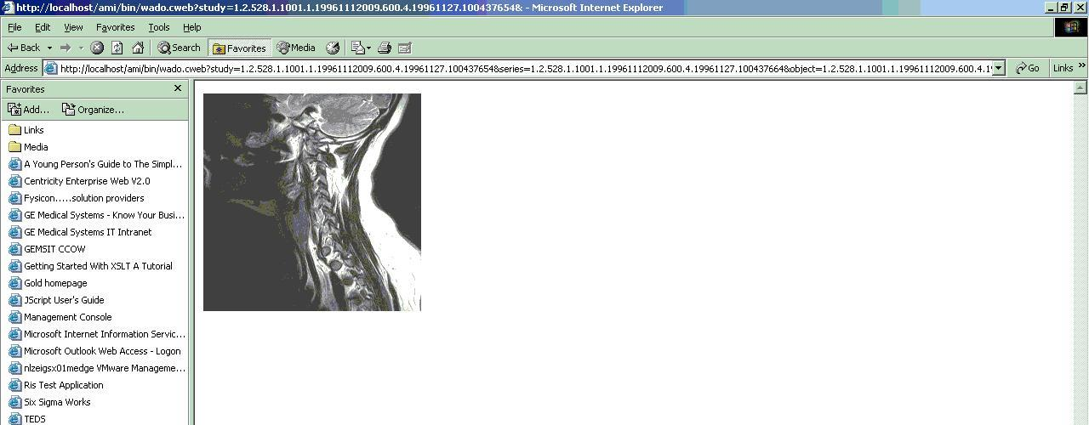
A) WADO in Internet Explorer
WADO URL
JPEG Image

Slide 5
Implementation B): WADO Trial
Moderately complete implementation apart non image objects, charset and anonymize params
All images accessed through a WADO gateway: wado.medicalconnections.co.uk/wado/wado.asp?...
Web server and DICOM server on the same machine, but logically completely independent (no direct connections to the DICOM servers tables)
Pre-existing patient root hierarchy for initial navigation, using completely different terms for the UIDs etc., and conveys series and study names etc. alongside. No need for re-engineering the system.

Slide 6
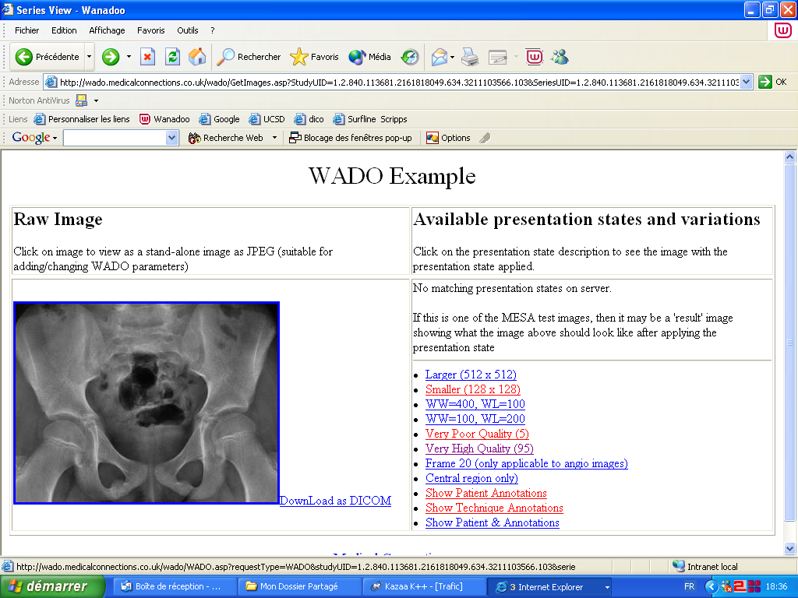
B) WADO Trial available on Internet

Slide 7
Implementation C): WADO viewer
Server build on Linux, access to DICOM image database through PHP scripts
WADO used for retrieving and displaying images in JPEG (IE 6/5/4, Netscape, …)
Params used: frameNumber, rows, columns, windowCenter, windowWidth, region
Prototype tested: WADO gateway accessing DICOM QnR SCP (retrieve DICOM/JPEG)

Slide 8
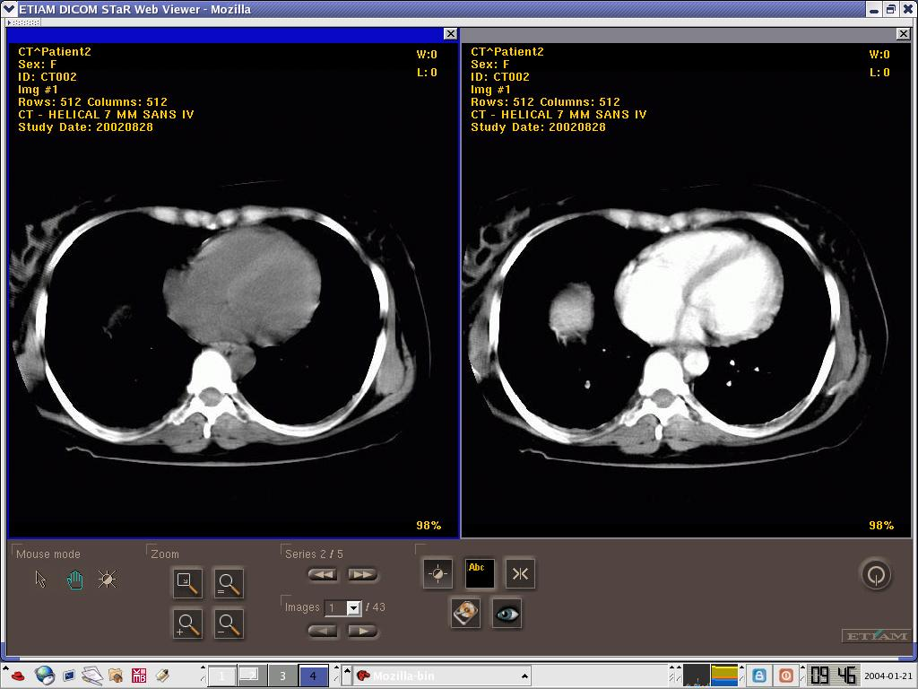
C) Viewer using WADO

Slide 9
Implementation D): SRs & images
Front-end process for Web repository containing DICOM objects.
Implemented using C++ modules in Apache Web server, running on Windows 2000 platform
Supported content-types
  Images:
    application/dicom
    image/jpeg
  SR objects:
    application/dicom
    text/xml

Slide 10
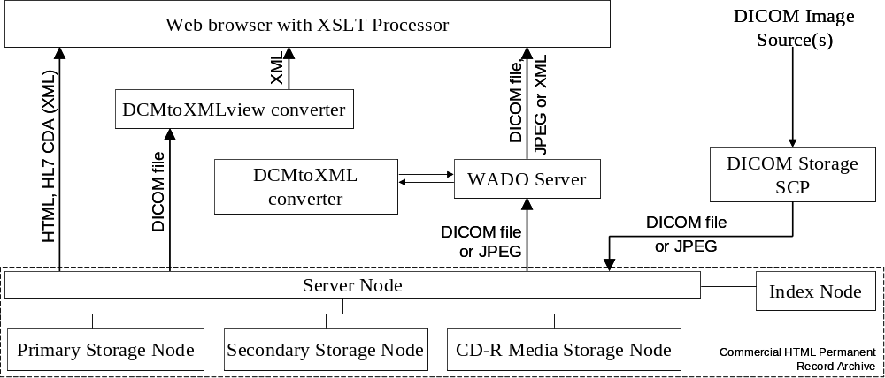
D) WADO Implementation diagram

Slide 11
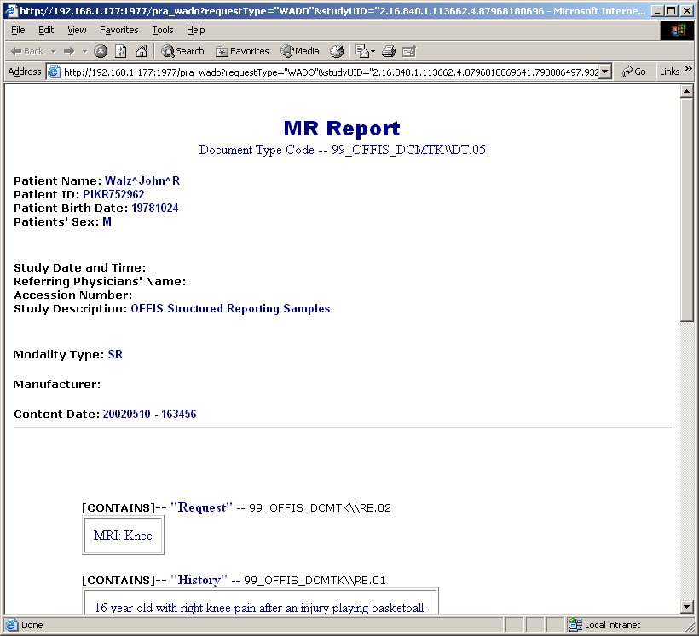
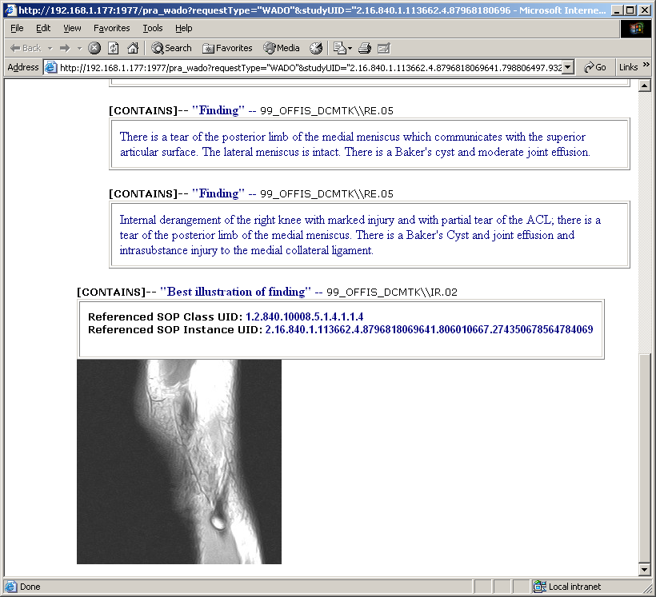
D) WADO Gateway for reports

Slide 12
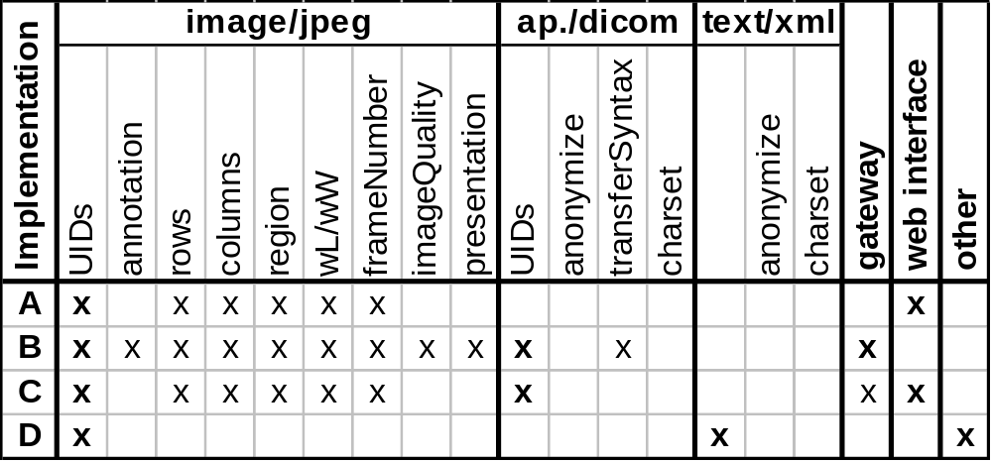
Implementations Overview

Slide 13
Conclusions
Nearly complete implementations (gw & web int.)
Quick developments on different systems and environments, without any difficulties
Contributed to harmonize http query syntax in the DICOM images web enabled servers
WADO provides essential services for standard image retrieval by SR rendered on browsers.
No apparent impact on web viewer performance
The method for obtaining the (three) UIDs for the images uses proprietary ways
There will be more implementations and tests, and we will find the way to promote it through IHE

