Slide 1
Spacemint - A Cryptocurrency Based on Proofs of Space
Prepared by MSSE student מיכאל טוצינסקי

Slide 2
Introduction
This project demonstrates a prototype implementation of a Proof of Space (PoSpace) mechanism on Ethereum. The goal is to explore how blockchain applications can use disk space as a resource for achieving consensus, reducing energy consumption compared to traditional Proof of Work (PoW) systems.
The prototype includes:
A smart contract to simulate storage commitments and proof validation.
A reward mechanism for miners based on committed space.
Testing conducted locally on a Ganache test blockchain using Remix IDE.

Slide 3
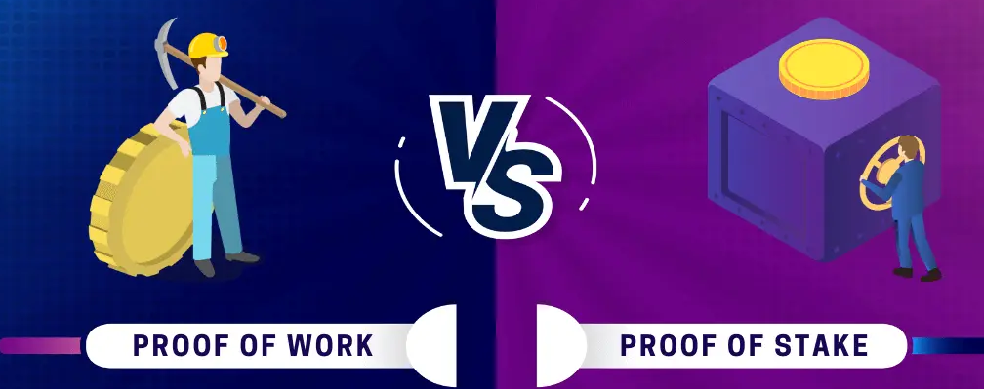
Introduction to Blockchain Consensus Mechanisms
What is a consensus mechanism? The process used by blockchains to validate transactions. Examples:
Proof of Work (PoW) → Energy-intensive.
Proof of Stake (PoS) → Capital-intensive.
Proof of Space (PoSpace) → Resource-efficient.

Slide 4
Current consensus mechanisms have theirs set of difficulties:
PoW → High energy consumption.
PoS → More eco-friendly, but depends on wealth (centralization risks).
PoH → verifying this sequence is crucial for the network's integrity.
There is a need for a better consensus mechanism that will accommodate speed needs and low energy consumption.

Slide 5

How to try?
To start mining, one must first initialize one's space, which for one terabyte takes about a day. Once this is done, miners only spend a fraction of a second per block mined. While miners are incentivized to invest in hard-disk capacity, this is a one-time cost, in contrast to the perpetual electricity expenditure for Bitcoin.
SpaceMint mining does not use up resources, and hard disks can be repurposed, unlike Bitcoin mining equipment. Since almost everyone has unused disk space and SpaceMint can be mined at very low setup and maintenance costs, this will lead to a well-distributed mining power.

Slide 6
SpaceMint is a cryptocurrency proposal by researchers from Inria/ENS, IST Austria and MIT, which introduces Proof of Space (PoSpace) as a blockchain consensus mechanism, replacing the traditional Proof of Work (PoW) used in systems like Bitcoin. Instead of relying on computational power, it leverages the unused storage space of miners, offering a more sustainable alternative.
Advantages:
Energy Efficiency: Unlike PoW, which consumes vast amounts of electricity, PoSpace minimizes energy consumption, making blockchain technology more environmentally friendly.
Accessibility: PoSpace reduces the need for specialized hardware like ASICs (used in PoW mining). Anyone with available disk space can participate.
Decentralization: By removing the reliance on high-end computational resources, PoSpace ensures broader participation, reducing risks of mining centralization.
How It Works in SpaceMint:
Storage Commitments: Miners dedicate disk space and generate a cryptographic proof of their commitment.
Proof Validation: The network verifies the proof, ensuring that miners cannot fake their storage claims.
Reward System: Miners are rewarded in proportion to the storage they have committed.
This can be used in decentralized cloud storage systems, like IPFS or Filecoin. This can be applied in energy-efficient blockchains for green finance and other eco-friendly projects.

Slide 7
Main Contributions
Security Features
Energy Efficiency: SpaceMint replaces energy-intensive computational puzzles with disk space allocation. This drastically reduces the energy consumption associated with mining, aligning blockchain technology with environmental sustainability goals.
Decentralized Participation: By eliminating the need for expensive hardware like GPUs or ASICs, SpaceMint makes mining accessible to everyday users with unused disk space. This reduces centralization risks caused by mining farms dominating PoW networks.
Incentive Mechanism: Rewards miners based on the size of their allocated disk space. Encourages fair participation without favoring wealthier miners, unlike PoS or PoW.
Proof Validation: SpaceMint uses cryptographic mechanisms to validate that miners are committing genuine storage space.
Prevents “fake” claims or manipulation of storage proofs.
Attack Resistance:
Incorporates defenses against common blockchain attacks, such as:
Nothing-at-Stake: Miners cannot mine on multiple chains simultaneously.
Challenge Grinding: Limits the ability to manipulate proof validation outcomes.

Slide 8

Our goals
Why This Project
Project Objectives
The main goal of this project is to create a prototype implementation of SpaceMint’s Proof of Space (PoSpace) mechanism, focusing on:
Energy efficiency: Exploring a blockchain mechanism that minimizes energy usage compared to Proof of Work (PoW).
Accessibility: Making blockchain participation more inclusive by relying on disk space instead of expensive mining hardware.
Decentralization: Reducing centralization risks by allowing a wider audience to participate without requiring significant capital.
Prototype Development:
Implement core functionality of PoSpace using a smart contract written in Solidity.
Simulate a system where miners can commit disk space and validate proofs.
Testing the Concept:
Verify the prototype functionality on a local Ethereum blockchain using Ganache.
Ensure the reward mechanism works as intended, distributing rewards based on committed disk space.
Hands-on Learning:
Gain practical experience with Ethereum development tools, including Remix IDE, MetaMask, and Ganache.
Understand challenges and limitations of implementing PoSpace in a blockchain environment.

Slide 9


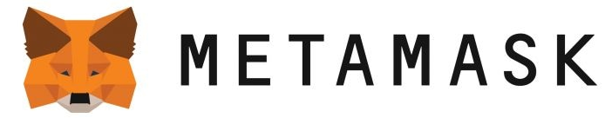
Our tools
For this project I decided to use:
Solidity: The programming language used to write the smart contract. It provides the functionality to implement the Proof of Space mechanism.
Remix IDE: A web-based development environment for writing, testing, and deploying smart contracts. I used it for coding, debugging, and interacting with the deployed contract.
MetaMask: A browser-based Ethereum wallet for connecting to blockchain networks. It is used to interact with the smart contract and Ganache.

Slide 10
Ganache: A personal Ethereum blockchain used for testing. It simulates a real Ethereum environment locally, avoiding the use of real ETH or a public testnet. Provides developers tools for monitoring transactions, gas usage, and debugging.
Local Blockchain Setup:
RPC URL: http://127.0.0.1:7545
Chain ID: 1337
Default accounts funded with 100 ETH for testing purposes

Slide 11
Core Components:
struct Miner: Stores the miner's commitment hash, space size, and proof status.
mapping(address => Miner) miners: Tracks all miners commitments.
mapping(address => uint256) rewards: Tracks miners earned rewards.
The smart contract was inspired by SpaceMint. It allows miners to commit their allocated disk space through cryptographic proofs; validate these proofs to earn rewards and to check their accumulated rewards.

Slide 12
commitSpace(bytes32 _commitment, uint256 _spaceSize)
Purpose: Allows miners to commit a cryptographic hash representing their storage proof and specify the space size (like 10GB).
Process:
Stores the commitment and space size in the miners mapping.
Emits an event SpaceCommitted for transparency.
submitProof(bytes32 _proof)
Purpose: Miners validate their storage by submitting the original proof used during commitment.
Process:
Compares the submitted proof with the stored commitment.
If valid, marks the miner as proven and distributes rewards.
Emits an event
ProofSubmitted.getRewardBalance()
Purpose: Allows miners to view their total earned rewards.
Process: Simply returns the reward balance stored in the rewards mapping.

Slide 13
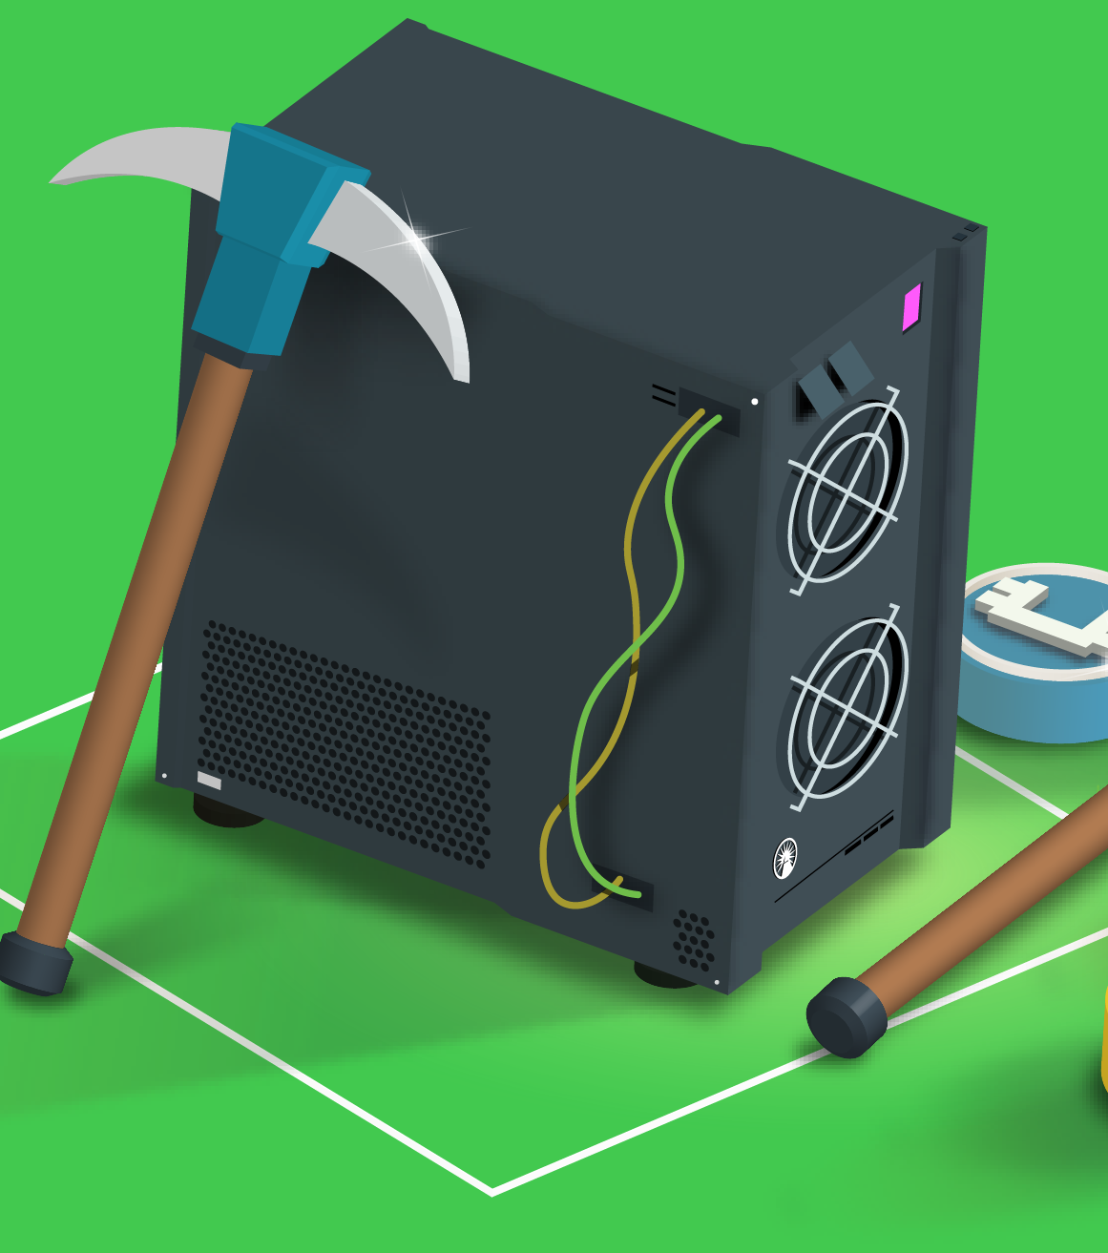
Rewarding
Rewards are proportional to the miner’s committed space:
Formula: Reward = Space Size (GB) * 1 ETH.
Example: A miner committing 10GB earns 10 ETH upon successful proof validation.
Total Rewards Pool: Set at 1000 ETH to ensure limited availability.

Slide 14
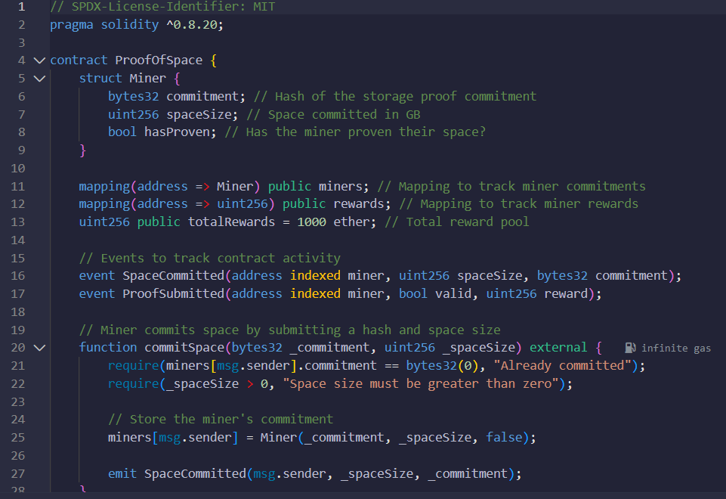
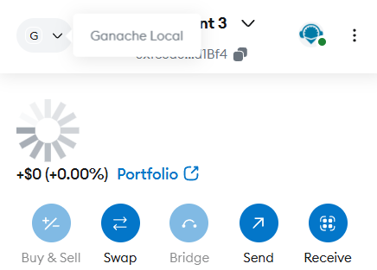
Steps in the Deployment Process
The Proof of Space smart contract was written in Solidity and deployed on a local blockchain (Ganache) using Remix IDE.
MetaMask was used to connect Remix to Ganache and interact with the deployed contract.
The deployed contract was tested to validate its functionality.

Slide 15
Test Cases Used
Test Case 1: Commit Space
Test Case 2: Submit Proof
Objective: Ensure that miners can successfully commit disk space by providing a cryptographic hash and size.
Inputs:
_commitment: A hash generated using web3.utils.keccak256("test-storage-proof").
_spaceSize: Size of committed disk space (e.g., 10 GB).
Expected outcome:
The miner's commitment is stored on-chain.
Event SpaceCommitted is emitted, confirming the action.
Objective: Validate that miners can submit their proofs and receive rewards based on committed space.
Inputs:
_proof: The same hash used during commitSpace.
Expected outcome:
The proof matches the stored commitment.
Miner receives rewards proportional to the space size (e.g., 10 ETH for 10 GB).
Event ProofSubmitted is emitted.

Slide 16
Insights Gained
Smart Contract Development: I learned the basics of writing, deploying, and testing Solidity contracts on a blockchain. Gained experience in implementing core blockchain concepts like state management, event logging, and gas optimization.
Consensus Mechanism Implementation: Understood how to design a simplified Proof of Space (PoSpace) mechanism. Explored the role of cryptographic proofs in ensuring trust and validation in decentralized systems.
Testing and Debugging: Gained practical experience using tools like Remix and Ganache for debugging contracts and tracking transaction logs.

Slide 17
Possible problems
Scalability: The prototype is limited to small-scale testing on Ganache and has not been tested for scalability.
Advanced Validation: Simplified proof validation lacks the robustness required for real-world deployment

Slide 18
Thanks for listening!
“Proof of Space presents an exciting opportunity to make blockchain technology more sustainable, inclusive, and practical for real-world applications. This project has been a stepping stone toward understanding and implementing innovative consensus mechanisms.”
Presentation was prepared by MSSE student מיכאל טוצינסקי

Slide 19
Authors: Sunoo Park, Albert Kwon, Georg Fuchsbauer, Peter Gaži, Joël Alwen, Krzysztof Pietrzak
Date: July 2017
SpaceMint: A Cryptocurrency Based on Proofs of Space.
https://fc18.ifca.ai/preproceedings/78.pdf

