Slide 1
MATRIX localization of autonomous model cars

Slide 2
What I did so far
Implemented MATRIX localization (in simulator)
  Generate force field
  Get usable image
  Apply force field to image to improve odometry
Created a wiki
Tried to experiment with the algorithm
  Made a camera calibration algorithm using OpenCV
  Calibrated omni-directional camera and forward-facing camera
  ...

Slide 3
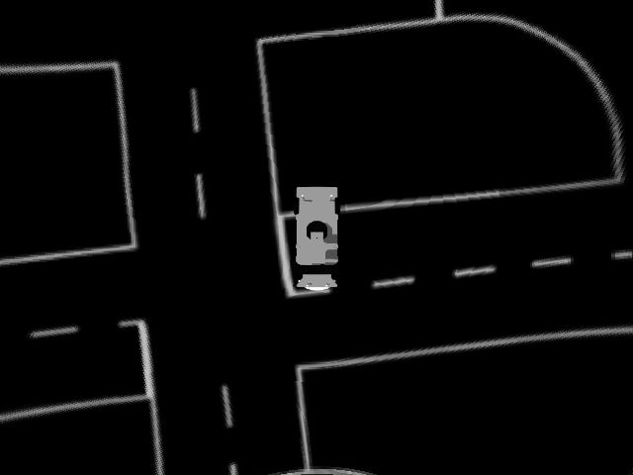
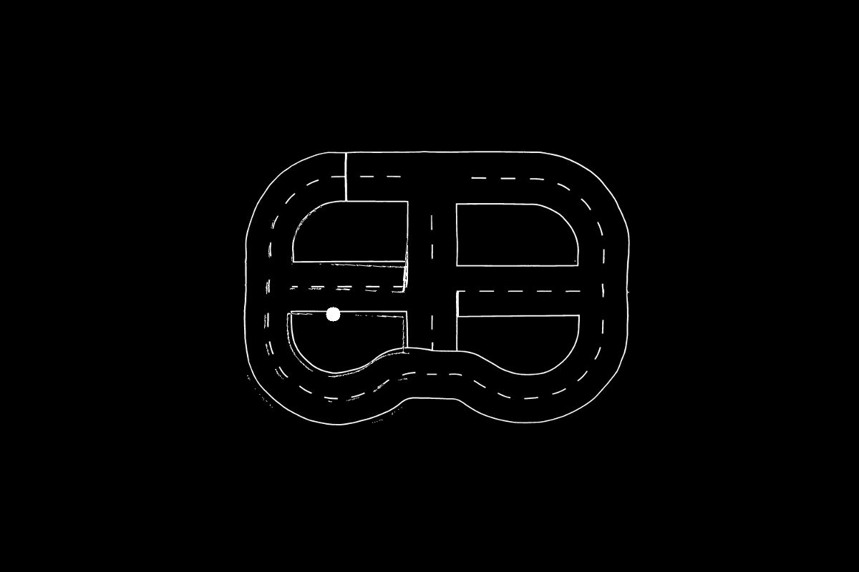
MATRIX localization
Image of the street
Odometry
Overlay image on map

Slide 4

MATRIX localization
Overlay image on map
Vector field
Improved Odometry

Slide 5


Generating the Force Field
Force field is double the size of the map
Orientation of the image is important
Nested loops:

Slide 7
Getting a good image – in simulator
Turn top camera around
Put it at ~40 cm above the car
Use the fisheye camera calibration of the AutoModelCar to correct lens distortion and approximate a perspective transform

Slide 8
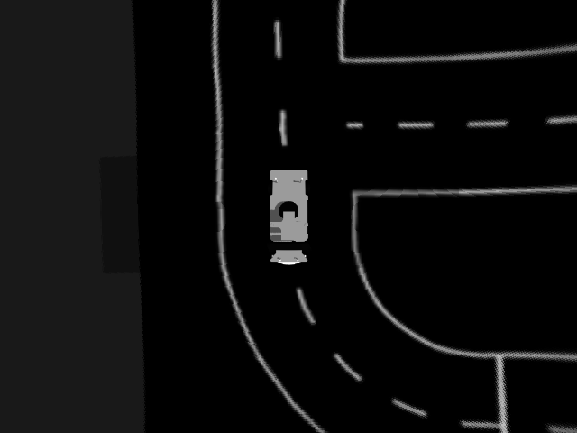

Slide 9
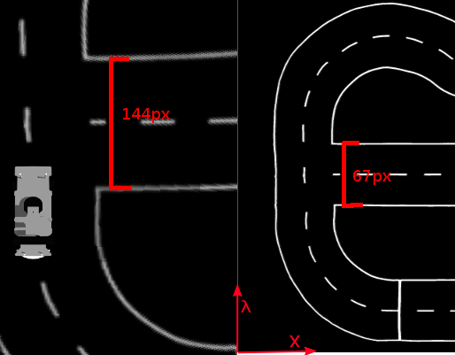
MATRIX application
Scale the image
Thresholding
Move the image to its correct position
Rotate the image

Slide 11
MATRIX application
Sum the force vectors for each white point of the image
Calculate and sum the torque for each white point of the image
Torque = (vector to white point) X (Force vector)
This returns the magnitude of the 3D-perpendicular vector, which signifies the rotation direction around the image center
Force vector
White point in image
Car position

Slide 12
Wiki
https://github.com/Draekwon/localization/wiki
API: https://draekwon.github.io/localization/

Slide 13
Experimenting
Omnidirectional camera
Forward facing camera
...

Slide 14
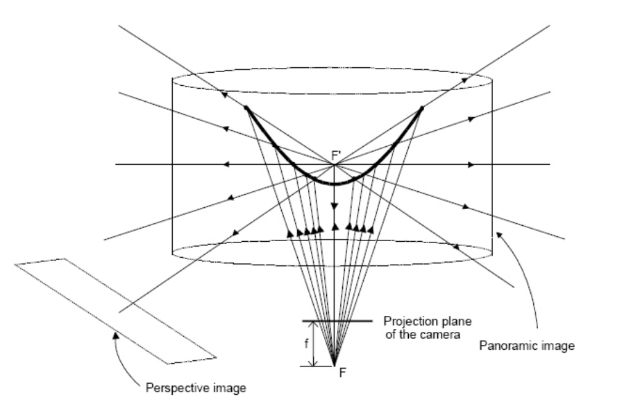
Omnidirectional camera
A basic requirement is for it to have a single viewpoint
Image: An Omnidirectional Camera Simulation for the USARSim World - Tijn Schmits and Arnoud Visser

Slide 15
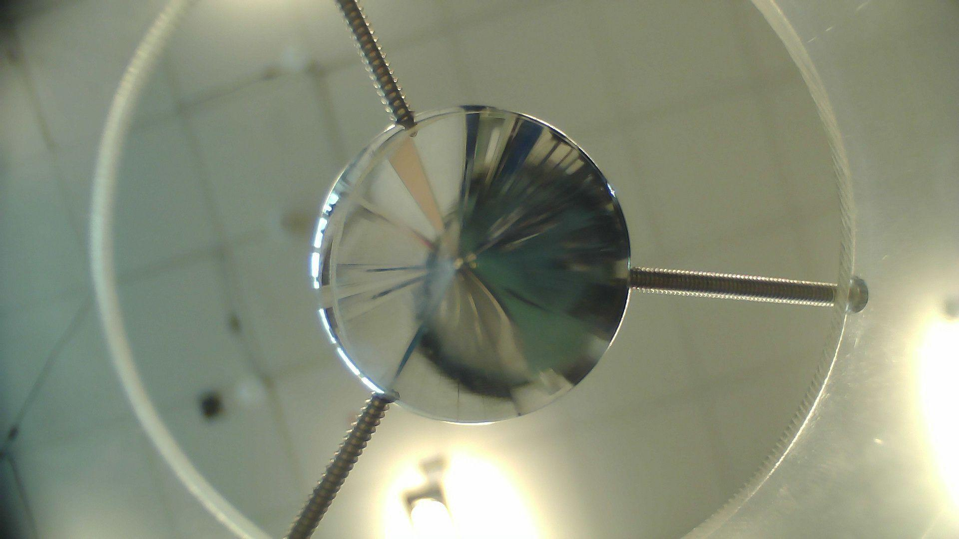

Slide 16
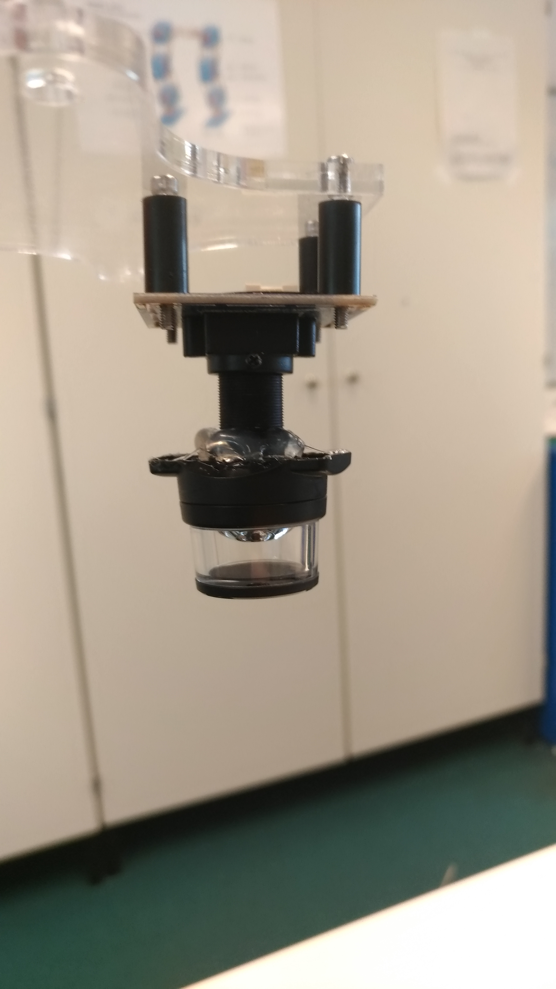
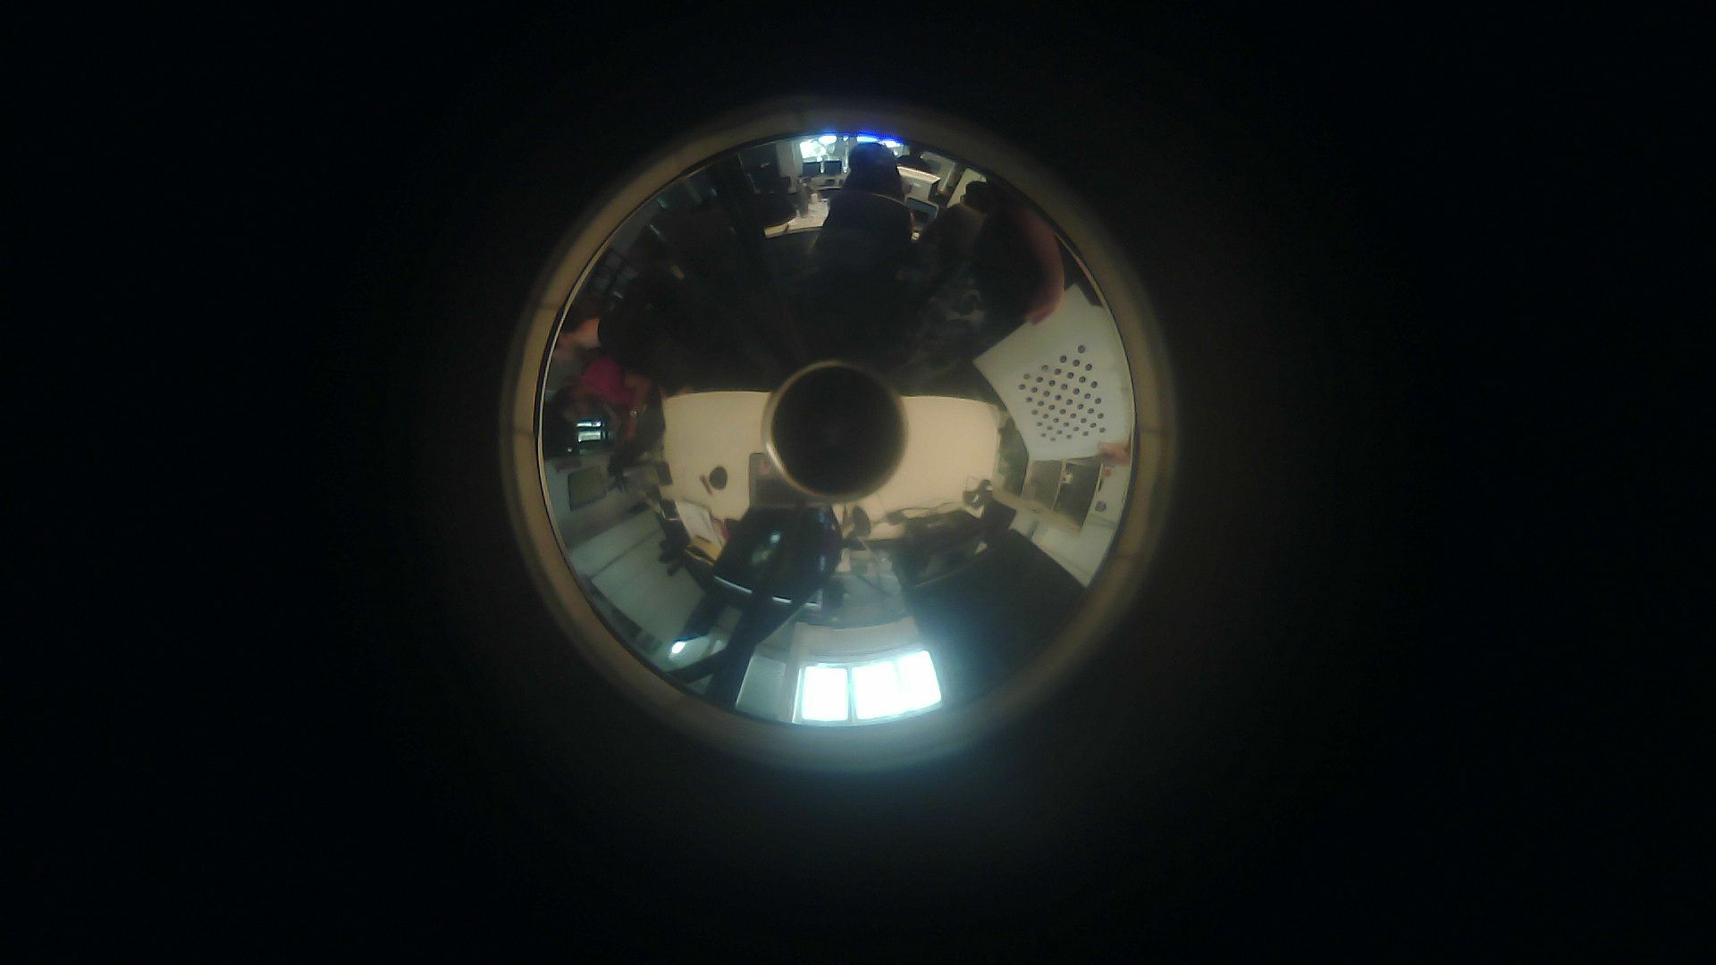
Sony mirror

Slide 17
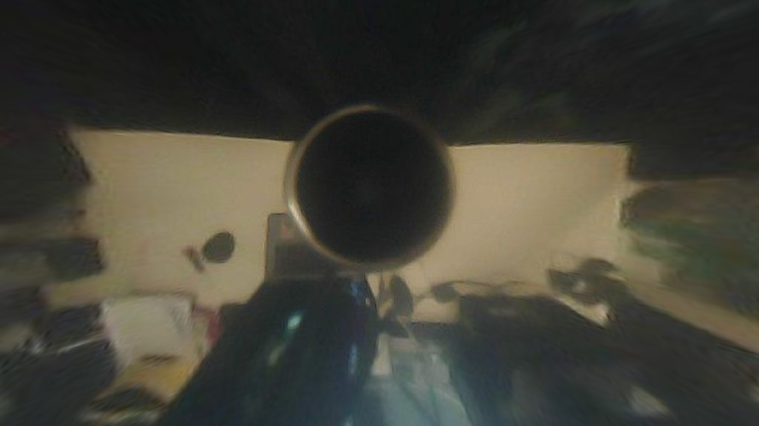

Slide 18
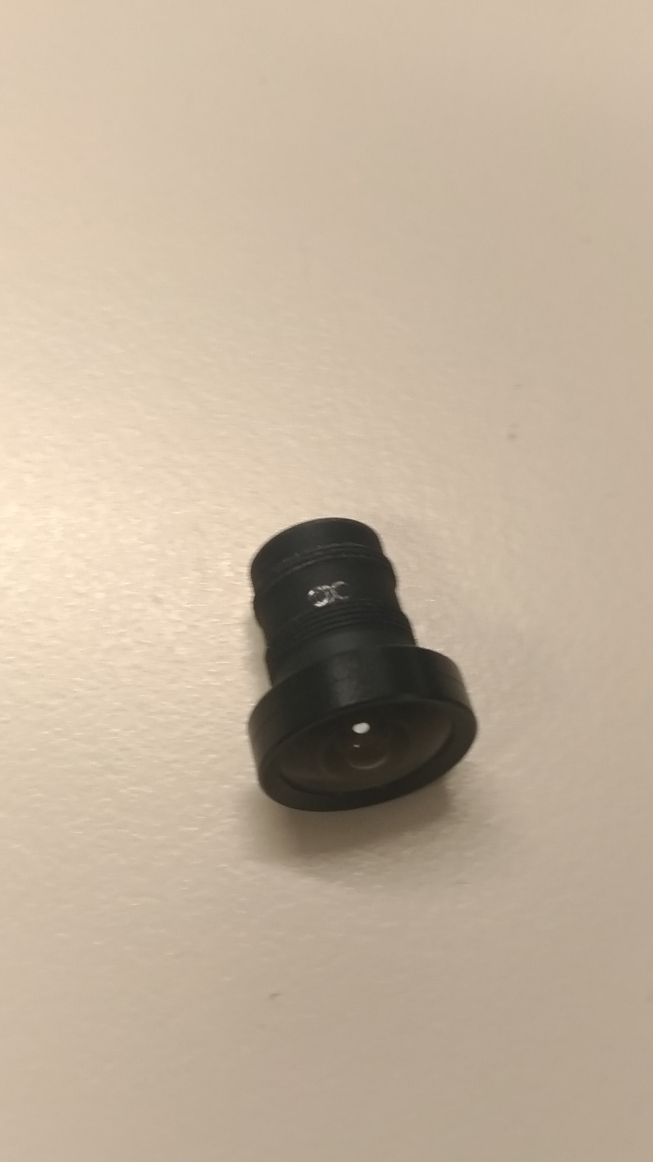
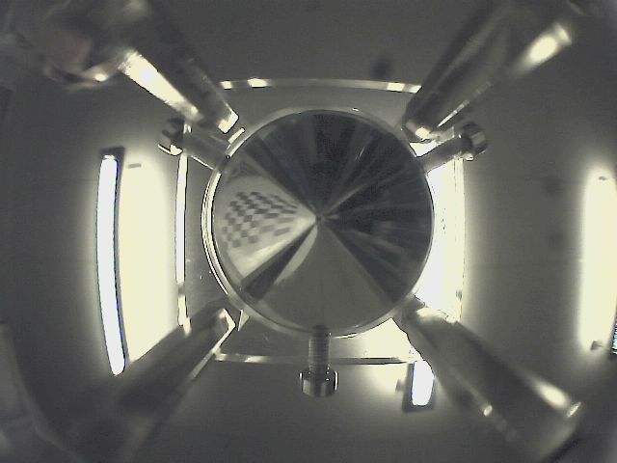
Custom mirror

Slide 19
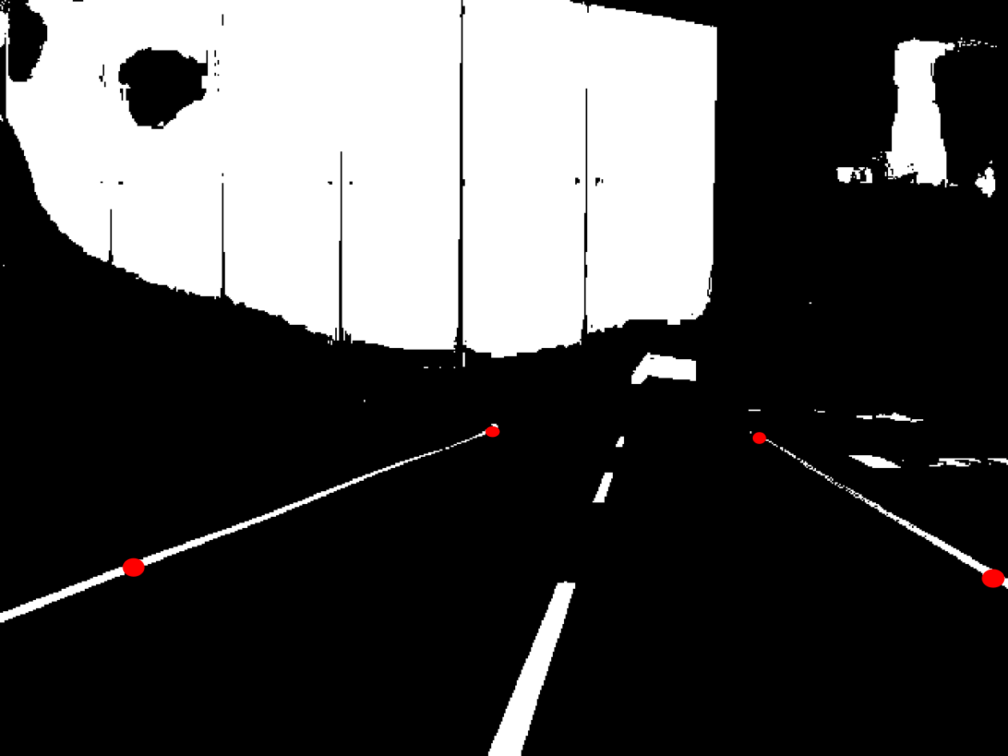
Forward facing camera

Slide 20
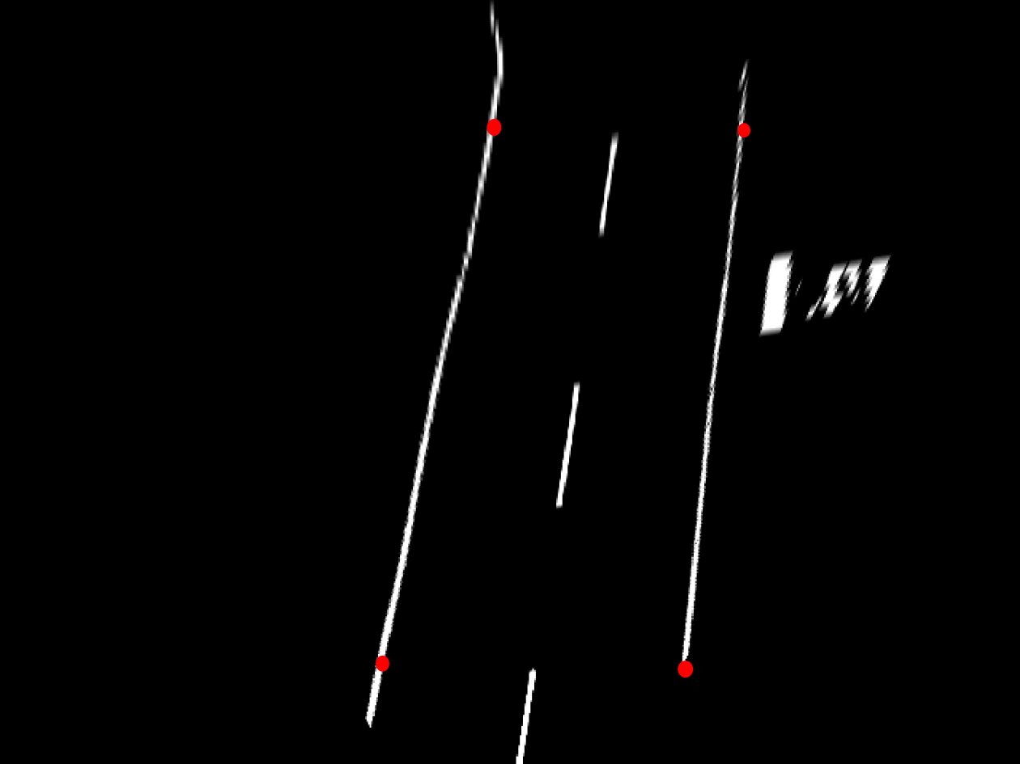

Slide 21
Next steps
Compare MATRIX localization to ceiling camera localization
Complete Wiki and API

