Slide 1

Springboard Capstone Project 3
House Prices Advanced Regression Techniques

Slide 2

House Prices Advanced Regression Techniques
The Ames Housing dataset was compiled by Dean De Cock for use in data science education. It's an incredible alternative for data scientists looking for a modernized and expanded version of the often cited Boston Housing dataset.

Slide 3
Project Proposal
The goal of this project is to showcase different ensamble methods when performing regression. It will be used a mix of techniques to best predict housing prices.

Slide 4
Problem Description
The price estimation can be based on few factors or external sources such as real estate agencies. The problem for the buyer is knowing the exact amount for the purchase price of the house.
For a real estate company, which can also pose as a buyer or broker, the problem is to negotiate for the best deal. This dataset has several factors.
It becomes crucial to know the levers that drive the price and develop a model to predict them with best accuracy.

Slide 5
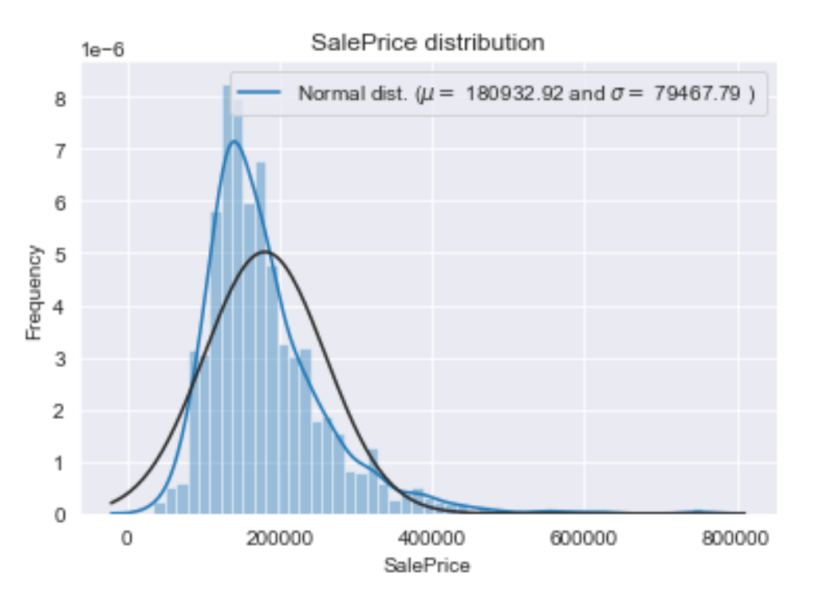
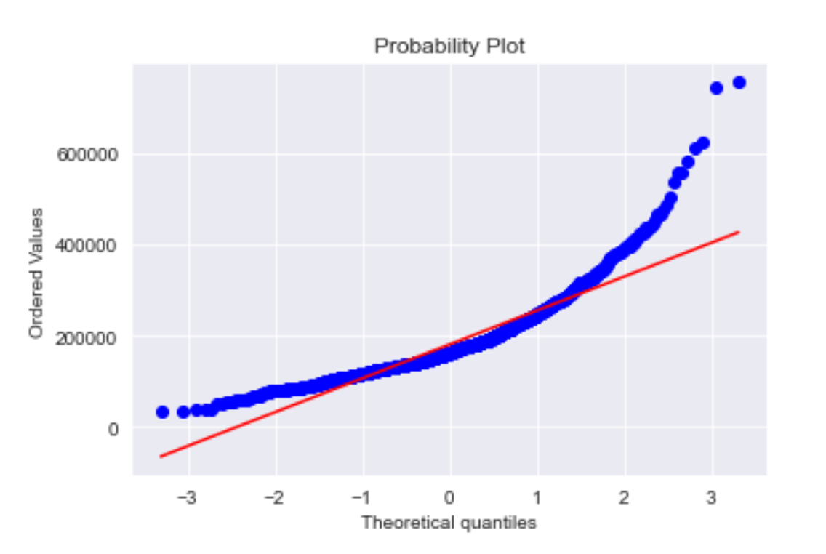
Exploratory Data Analysis
The distribution is not normal. Mean sale price and median sale price both have lower chances of occurrence than the mode. The blue line is the data and the black is the theoretical normal distribution.
Log transformation is just a special case of Box-Cox transformation which in this case is needed to be applied.

Slide 6
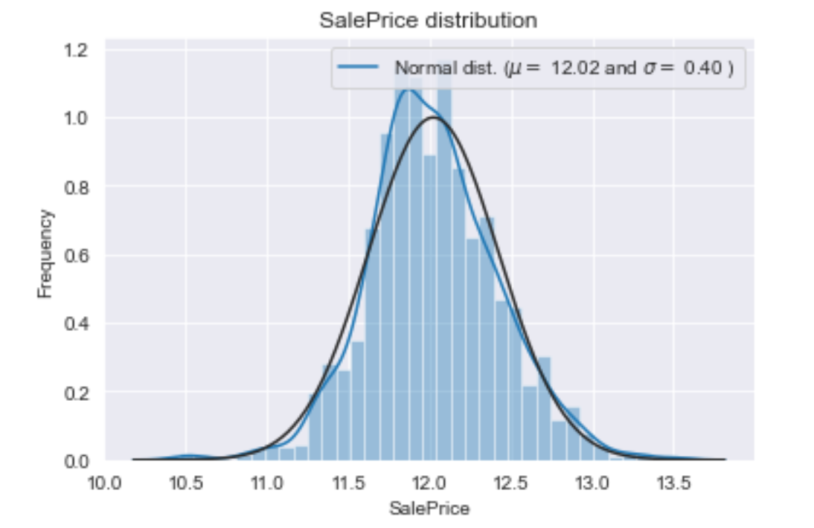
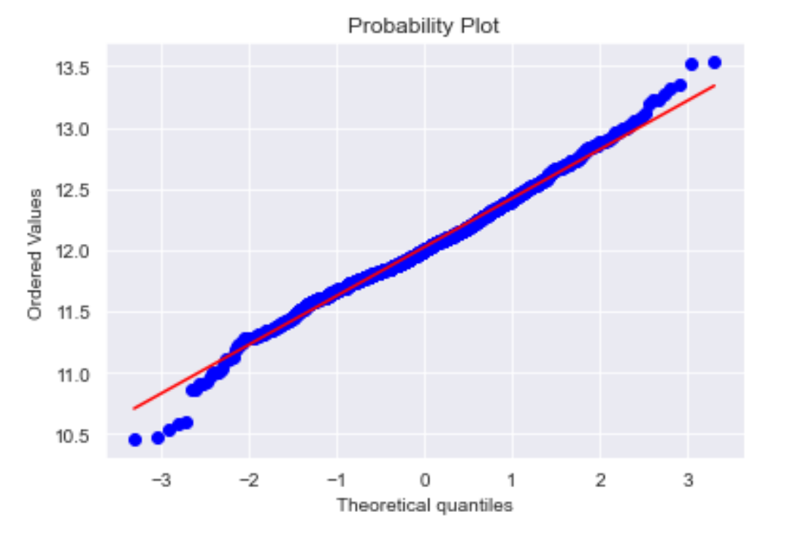
Exploratory Data Analysis
Now the distribution after the Box-Cox transformation.

Slide 7
Feature Engineering
Feature engineering is a process to select and transform variables when creating a predictive model using machine learning or statistical modeling. Feature engineering typically includes feature creation, feature transformation, feature extraction, and feature selection.
Nan values will be treated accordingly and some imputation will be applied as well.
Dataset is composed of 2917 observations and 79 features.

Slide 8
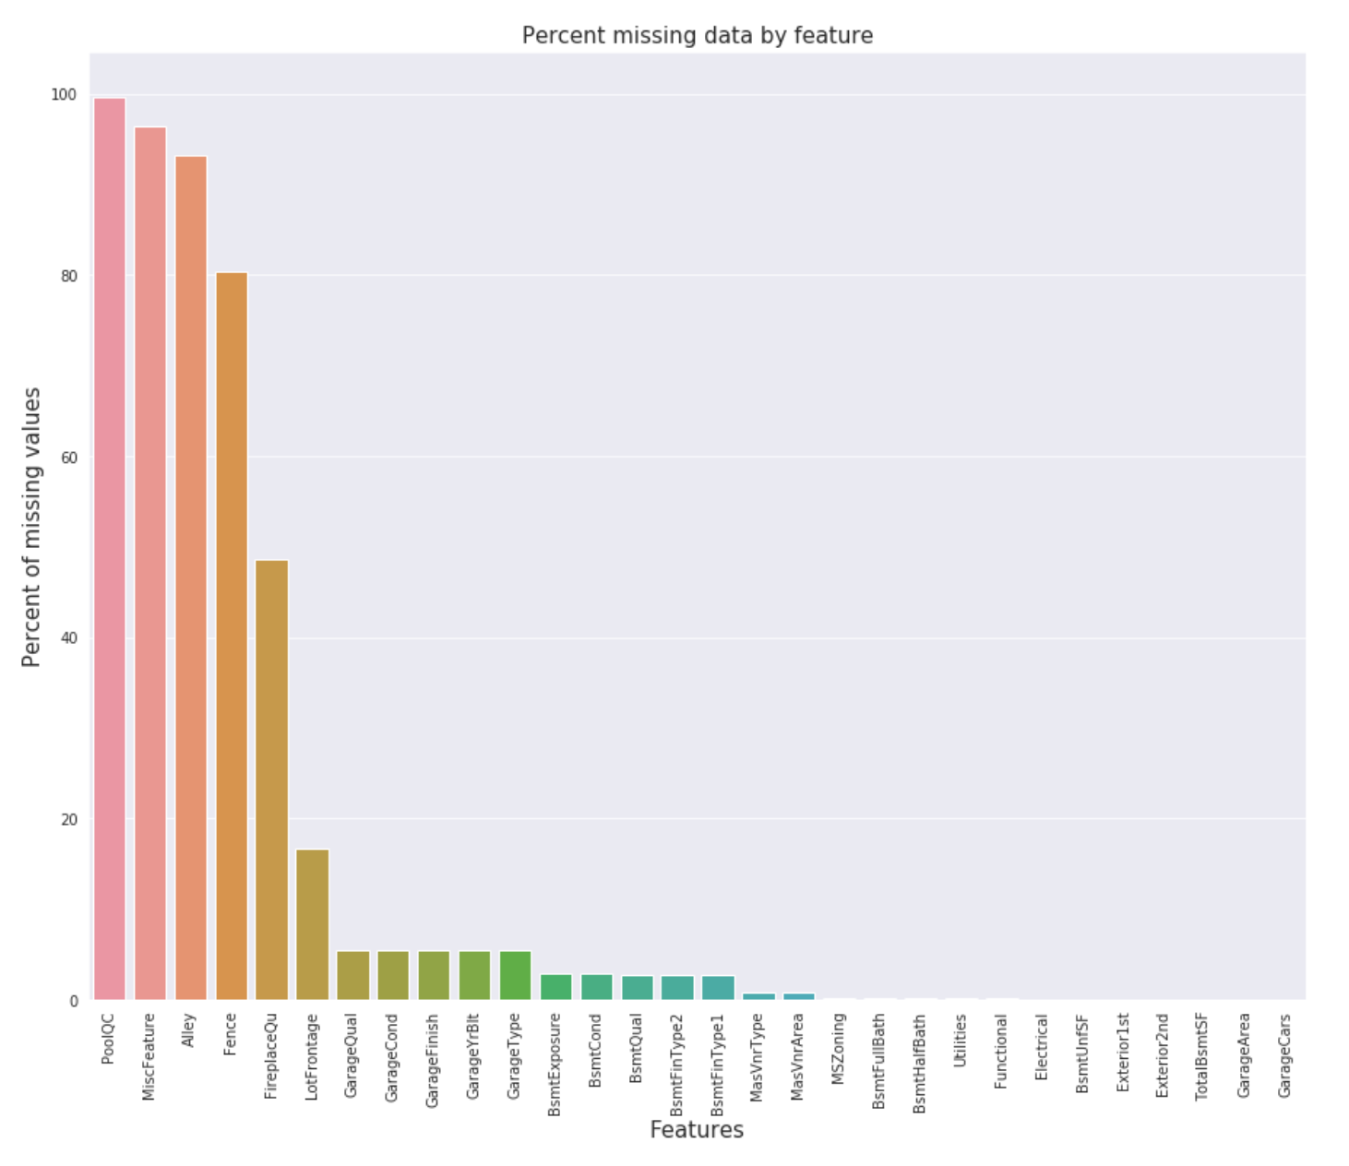
Dataframe Atributes
For the feature engineering both train and test will be grouped in one data frame and some work will be done like, count the missing ratio, impute values, fill NaN’s and so on.
Plot the distribution of missing values

Slide 9
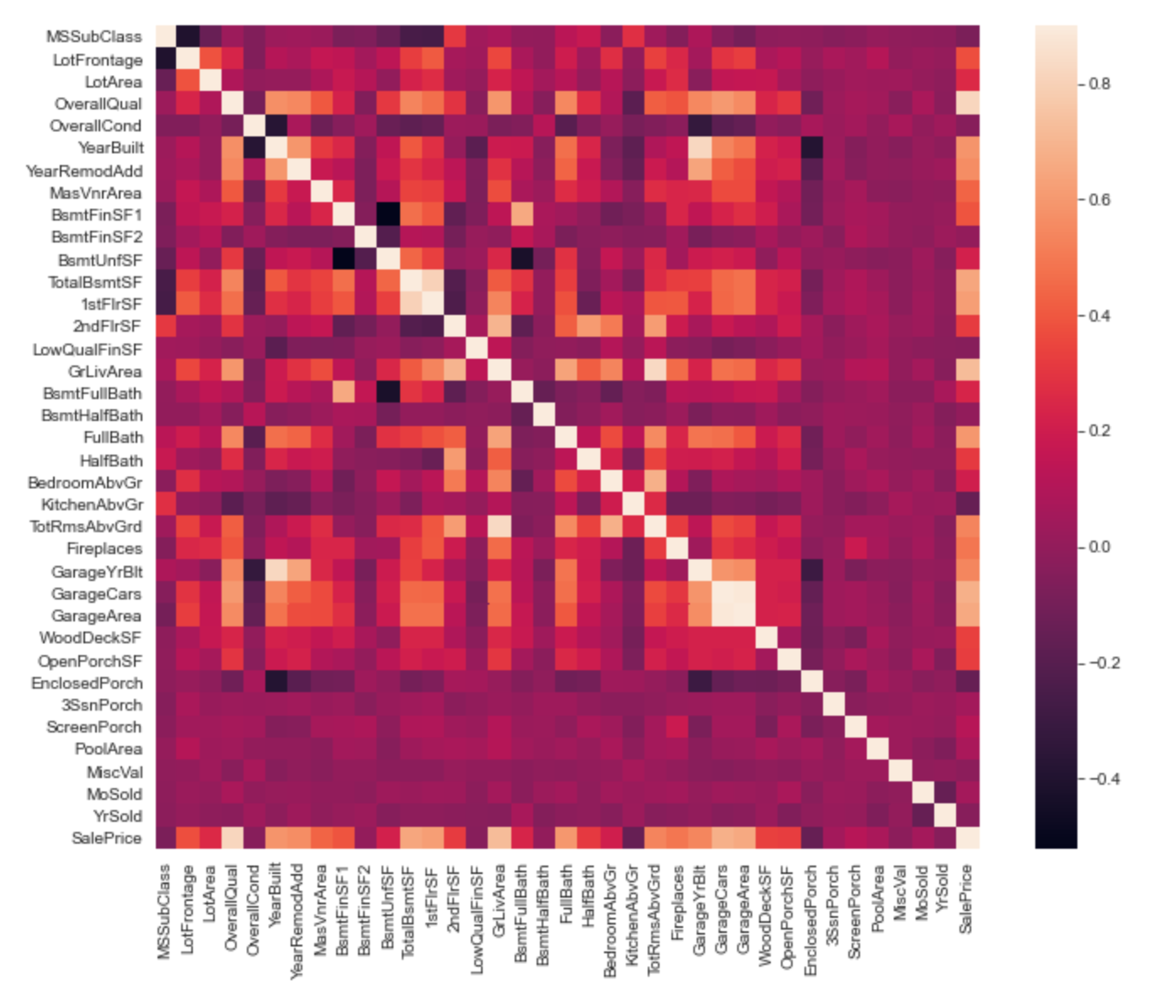
Data Correlation
The correlation coefficient is bound between -1 and 1 and tells you the linear relationship between these two variables. A coefficient close to 1 means a strong and positive association between the two variables.
Association does not mean necessarily a causal relation between both variables. If the coefficient is close to 0, it does not necessarily mean that there is no relation between the two variables. It means that is not a LINEAR relationship, but there might be another type of functional relationship.
Correlation map to see how features are correlated with sales price.

Slide 10
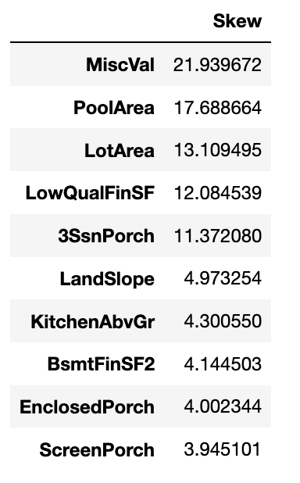
Outlier Treatment
So what is our next step in data processing?
We should note that ML algorithms can only process numerical data (it needs to be encoded in numerical format), hence we ought to label encode (if there is hierarchy in the independent variable, i.e. good, better best---0 ,1 ,2) or Dummy encode (0 and 1 vectors).
Next we should also think about what variables are actually categorical even tough they numerical or strings. For fully numerical values we should also think about skewness and how can we remedy it.
Is there any text that we can extract info from?
And finally what about scaling, we need to make our data comparable and robust to outliers.

Slide 11
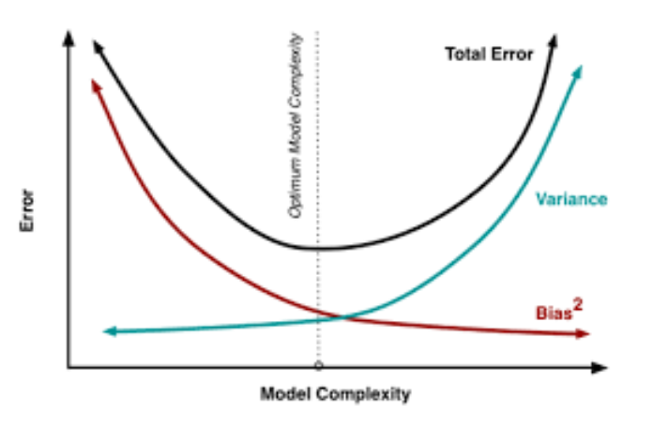
Modeling
The function below is the aim of the ensamble methods and it will be the approach adopted for this part which is averaging base models.

Slide 12
Stacking
It is an ensambling method were we use predictions of other models to make the final prediction. In short what happens is that we have moved one step toward the true solution and now for the final model (here it is xgboost) we will be using actually predictions as predictor variables.
So now if we have had on the initial M models n predictors that are used to make predictions. Than on the second model we will have M predictors (for M models) and the same number of rows in other words observations.
But here is the crucial part, what observations? k-fold cross validation has to be used when training the first set of models. In order to make sure that we really exploit weaknesses and strengths of different models we need to know were are they strong or weak, if we were not to use k-fold cross validation than we would not find out. Predictions from a validation (hold-out) set are going to be the new features of the final model.
Model | Score
Lasso | 0.1115 (0.0074)
ElasticNet | 0.1116 (0.0074)
Kernel Ridge | 0.1153 (0.0075)
Gradient Boosting | 0.1167 (0.0083)
Xgboost | 0.1158 (0.0064)

Slide 13
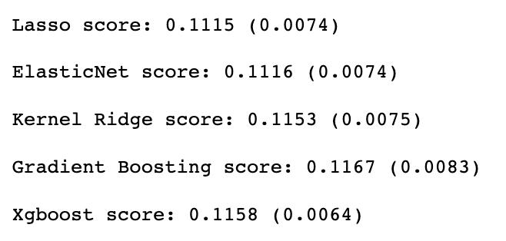
Conclusion
The client will be able to predict sale price of a house. Various aspects or features that have a strong influence on price can be known. The model can be useful to real estate agents and online companies as it would save additional costs and time in further examination and research. Having an idea of the most influential features would enable the client to plan and effect changes in the property vis a vis the cost and expected return from investment. One can also decide what features need to be included for the house construction or renovation as per budget.
Results

