Slide 1

Springboard Capstone Project One
Time Series Analysis with Arima and Prophet
Notes:
1

Slide 2
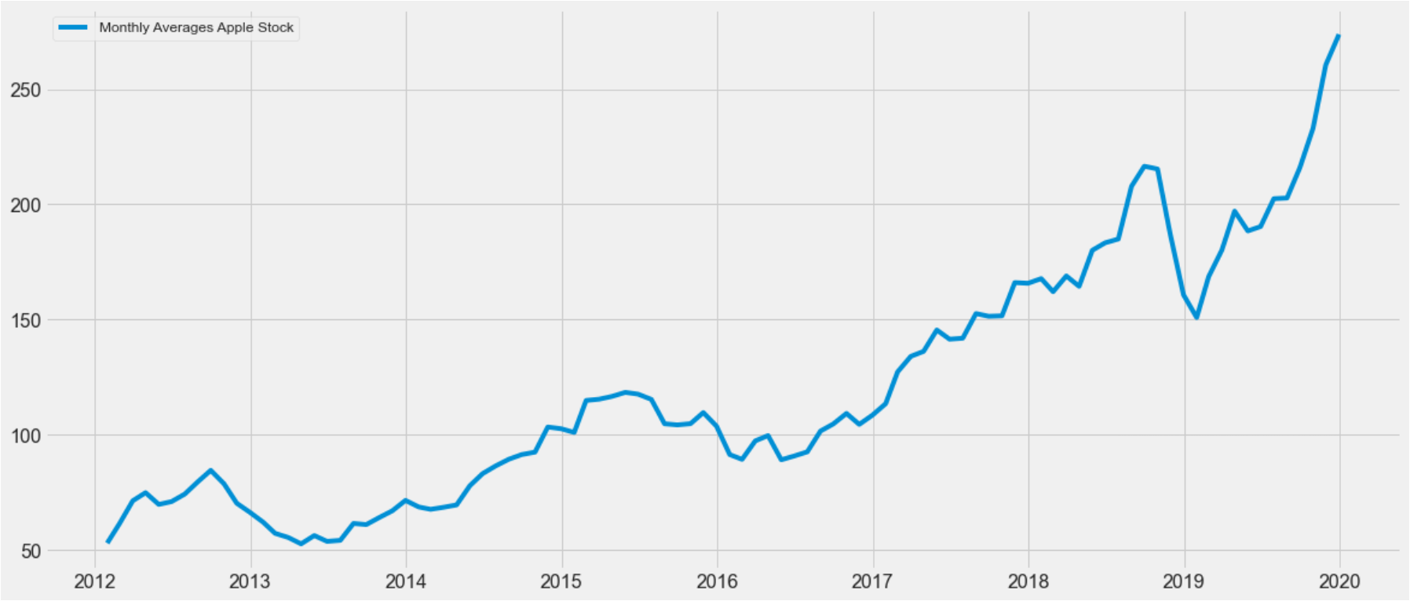
Problem Description
Analyze and Predict Apple’s stock market share prices from a period of 5 years from 2012 to 2019 using ARIMA and Prophet models.
Notes:
2

Slide 3
Problem Description
Time series data can be consider as a supervised learning problem. Given a sequence of numbers for a time series dataset, we can restructure the data to look like so. We can do this by using previous time steps as input variables and use the next time step as the output variable. The problem concists in predict the Apple Stock Market Share Price over a period of time.
Notes:
3

Slide 4
Dataset Information
This dataset lends itself to a some very interesting visualizations. It will have things like how prices change over time, graph an compare stocks over time, or generate and graph new metrics from the data provided. From these data informative stock stats such as volatility and moving averages will be also calculated. The main question to solve is: can a model be develop hat can beat the market and predicts its trends? That’s what this capstone project is about.
Notes:
4

Slide 5
Dataset Information
Dataset description:
Date – date of trading
Open – first trades’ prices
High – Highest price of the trading day
Low – Lowest price of the trading day
Close – Last stock traded durning the trading day
Adj Close - Price that is adjusts Corporate Actions on Closing Price
Volume – Number of shares that change hands during the trading day
Notes:
5

Slide 6
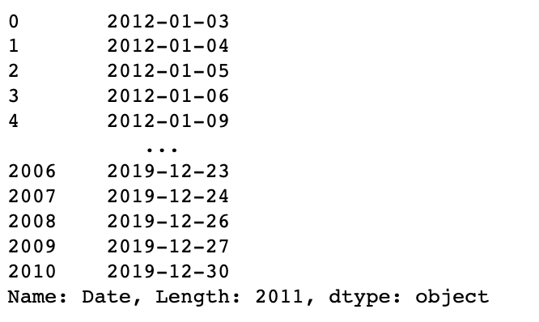
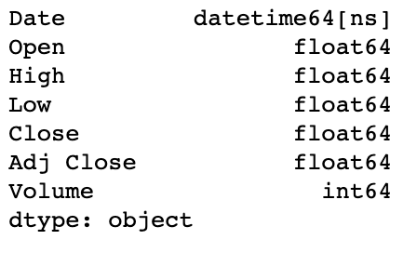
Data pre-processing
Convert Date column to tate time object
Notes:
6

Slide 7
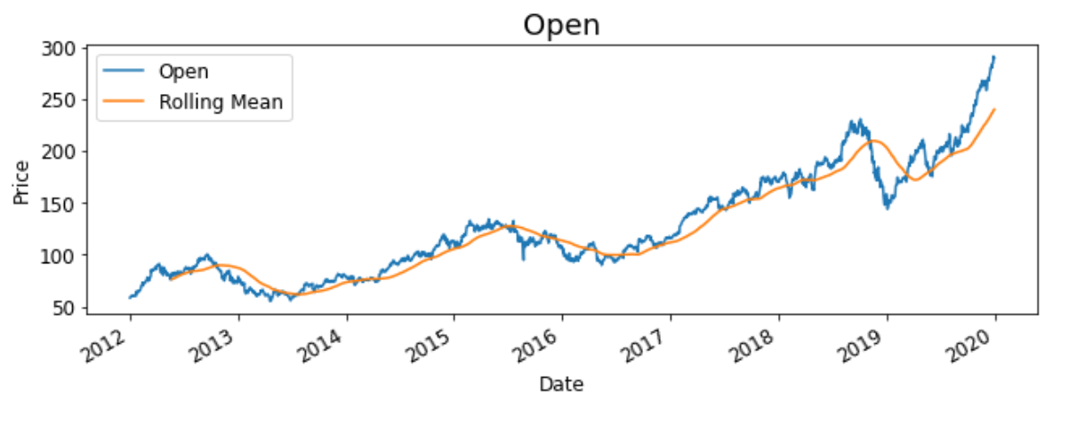
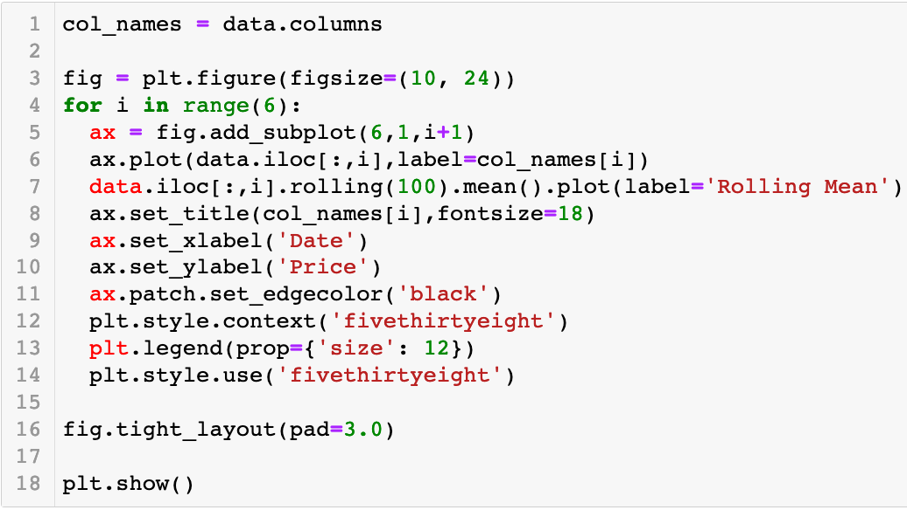
Visualizing
Notes:
7

Slide 8
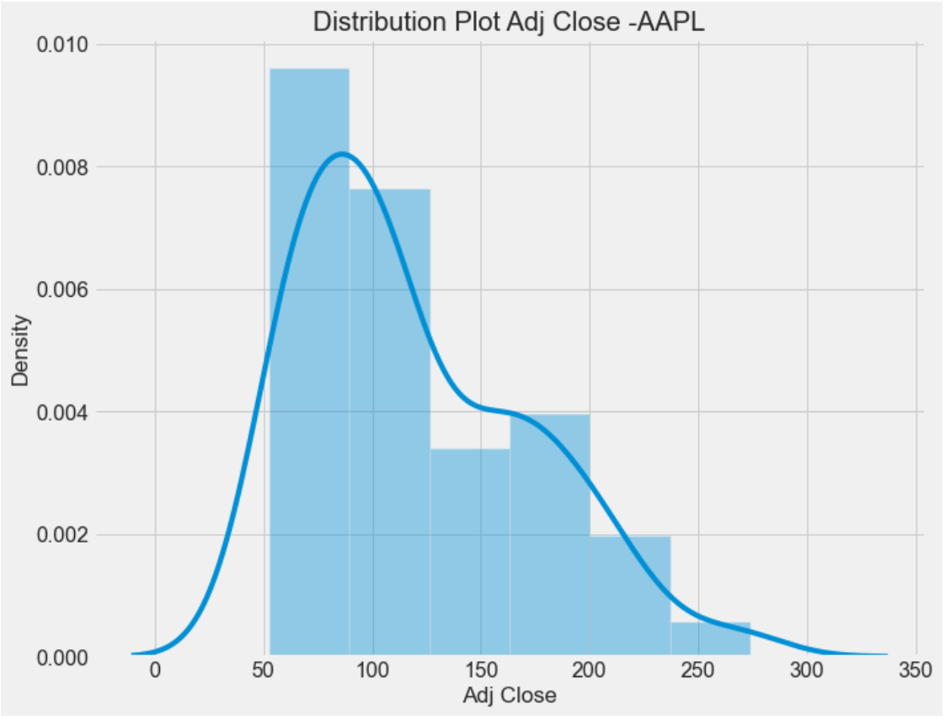
Exploratory Data Analysis
Distribution shows Right Skew
Notes:
8

Slide 9
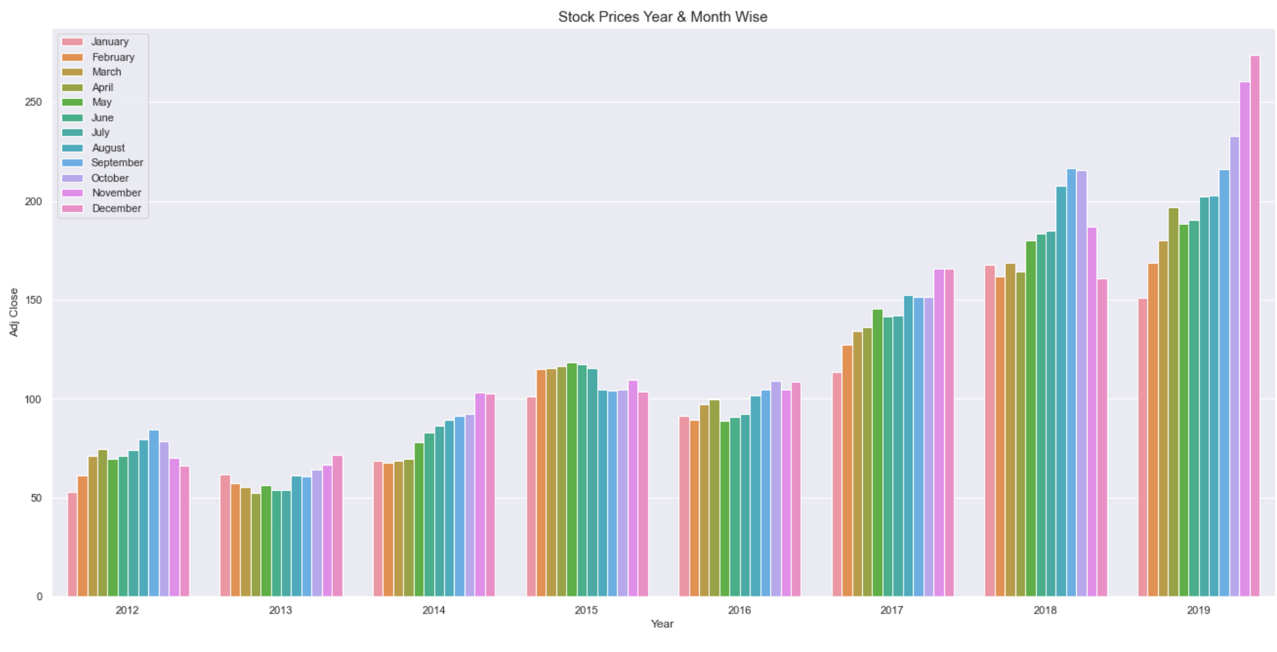
Exploratory Data Analysis
The figure shows that the Period from July-September seems to push stock price above in comparison to other months.
Notes:
9

Slide 10
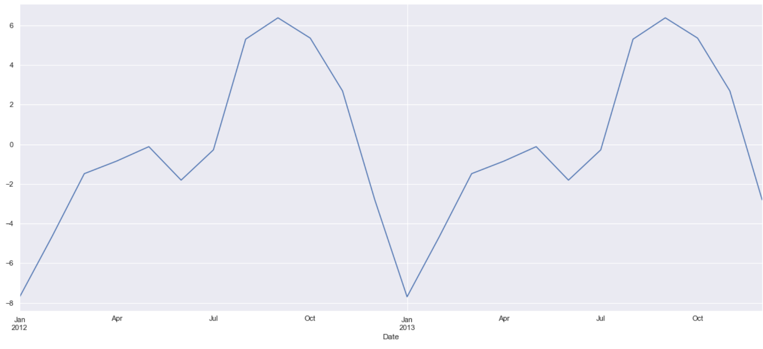
Decomposition of Time Series
Drilling down and observing seasonality shows an overall an upward trend.
Notes:
10

Slide 11
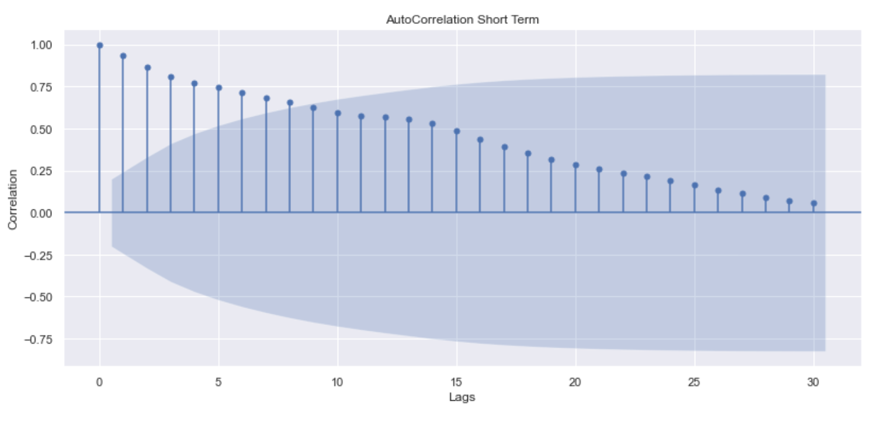
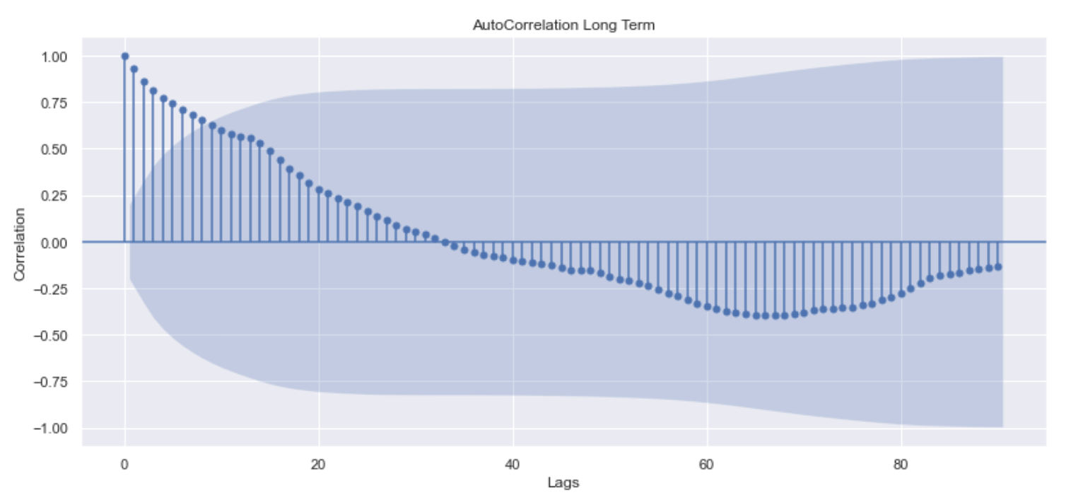
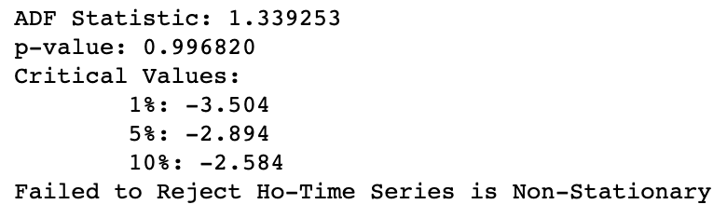
Stationarity of Time Series
Using Augmented Dickey-Fuller(ADF) Test
Null Hypothesis : Time series has a unit root. It is non-stationary.
Alternate Hypothesis : Time series does not have a unit root. It is stationary.
Notes:
11

Slide 12
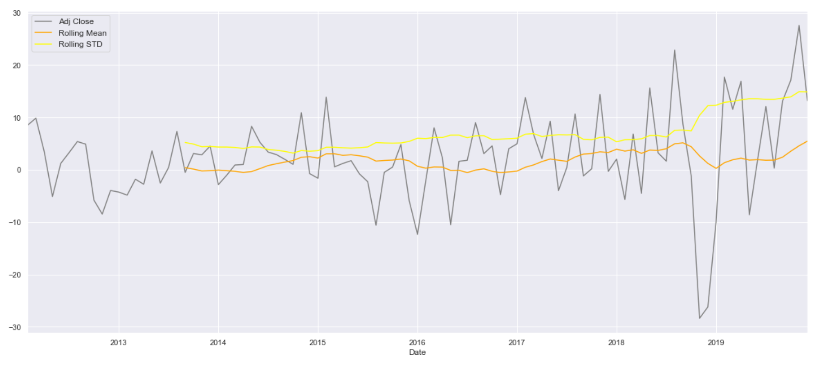
Transformations To Make Series Stationary
The series looks stationary as its having constant mean and variance .
Notes:
12

Slide 13
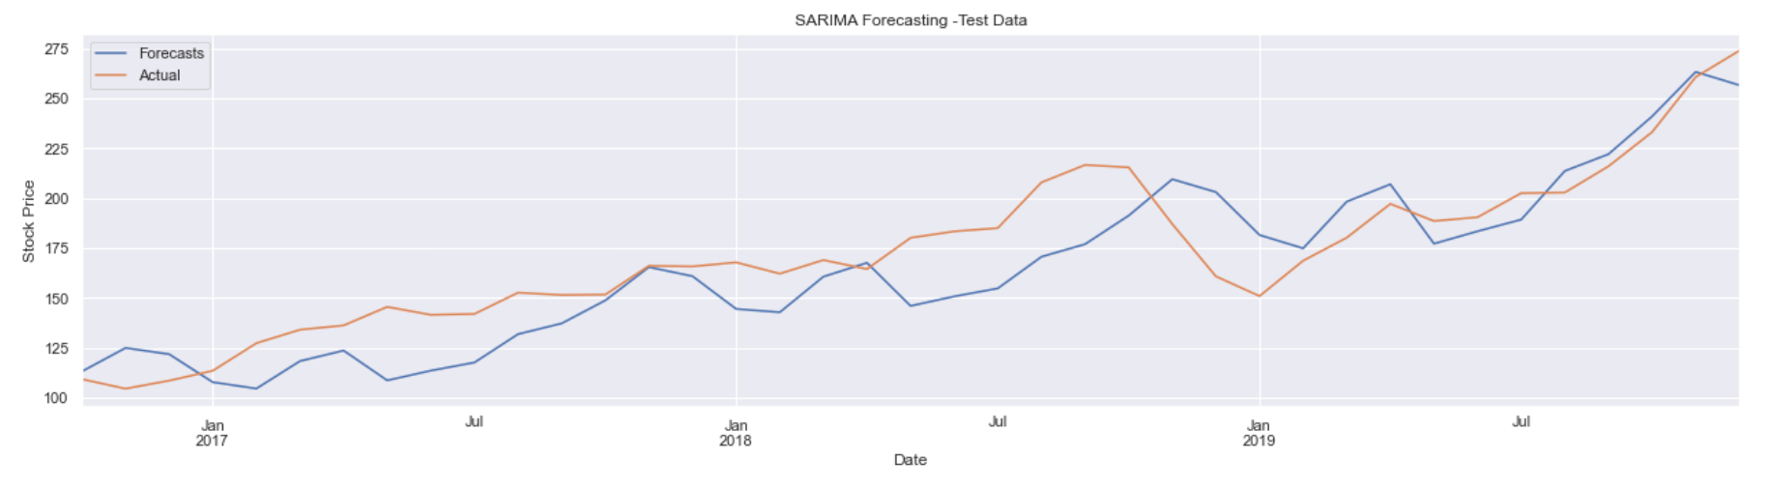
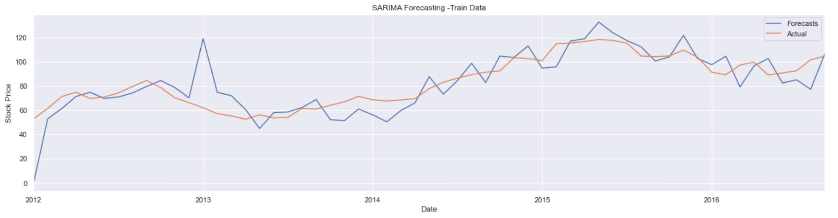
Forecasting Seasonal ARIMA
Notes:
13

Slide 14
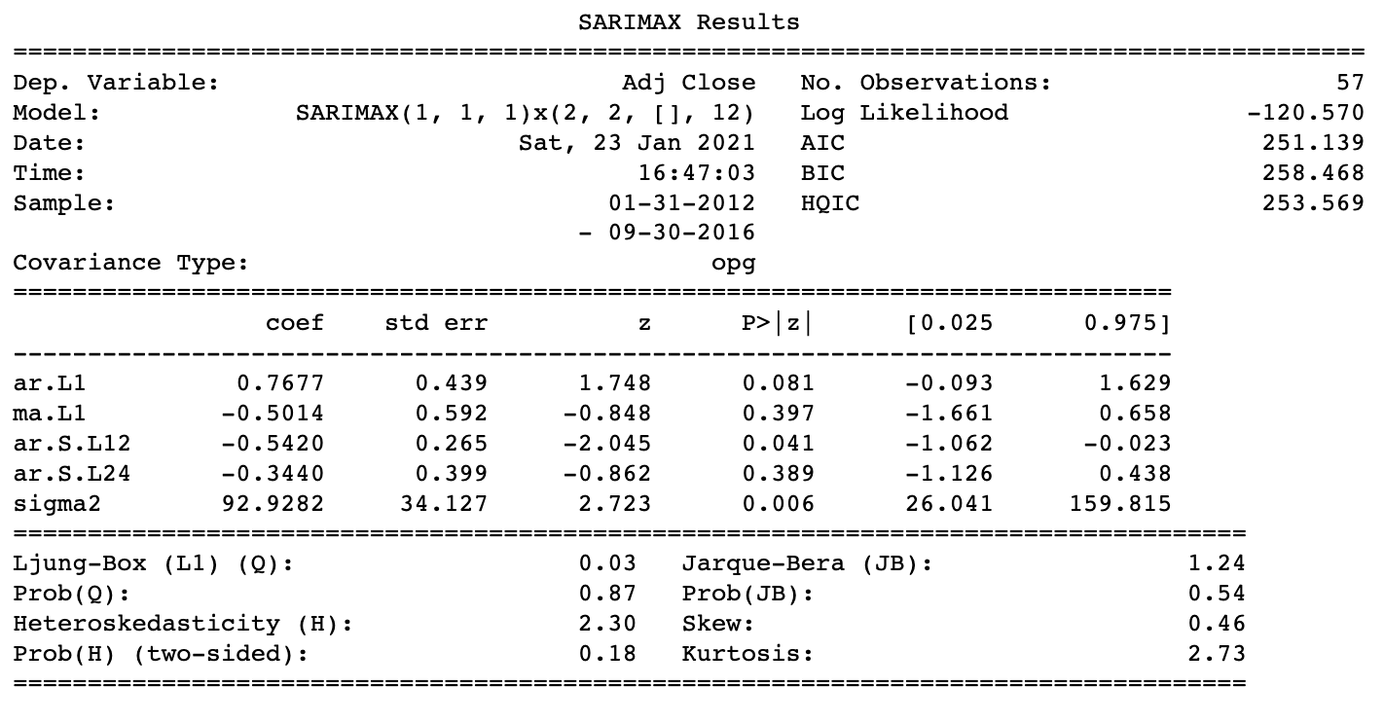
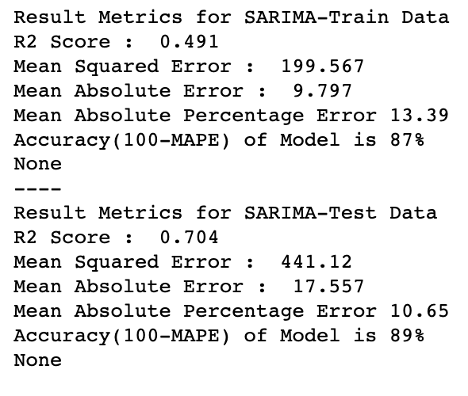
Forecasting Seasonal ARIMA
Training and Test Accuracy is equivalent. Model Fit is good, no overfit or underfit.
The mean value is close to zero but it suggests that there is some bias in the model. Overall the selected model has performed good for a problem like Stock Price Prediction.
Notes:
14

Slide 15
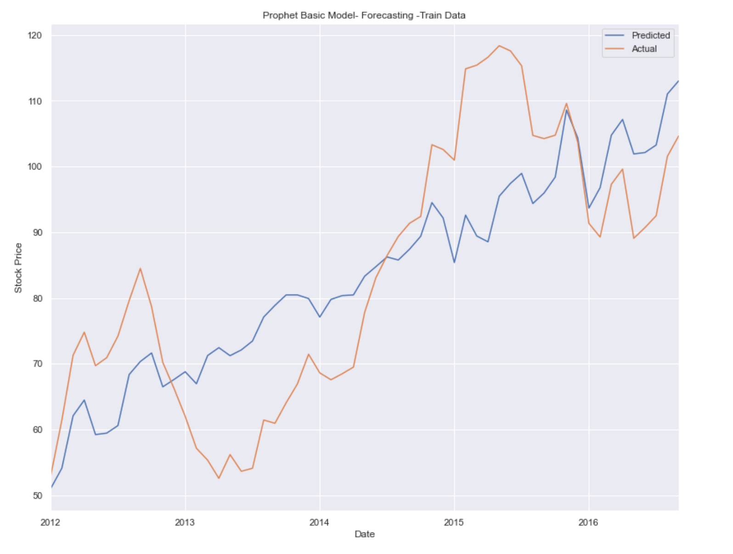
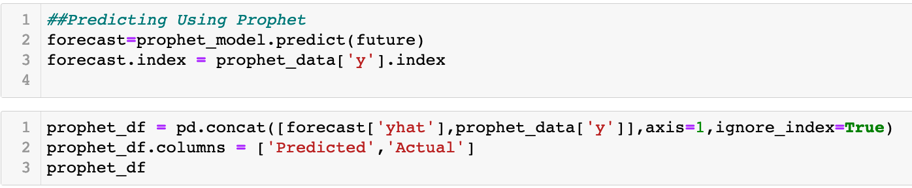
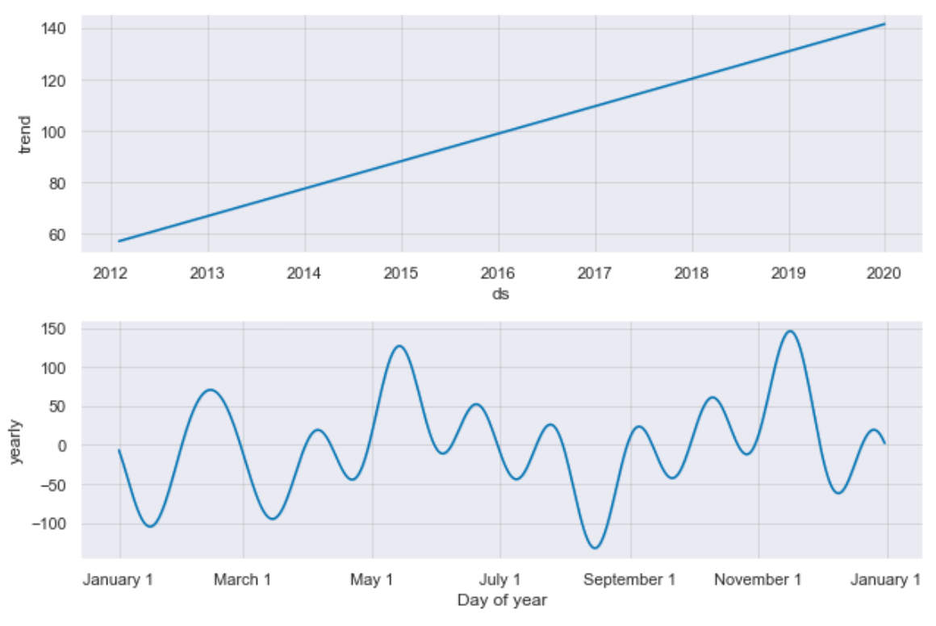
Facebook's Prophet Model for Time Series
The Basic Prophet Model with default parameters overfits into the model as represented by the Train Test Accuracy differences.
Notes:
15

Slide 16
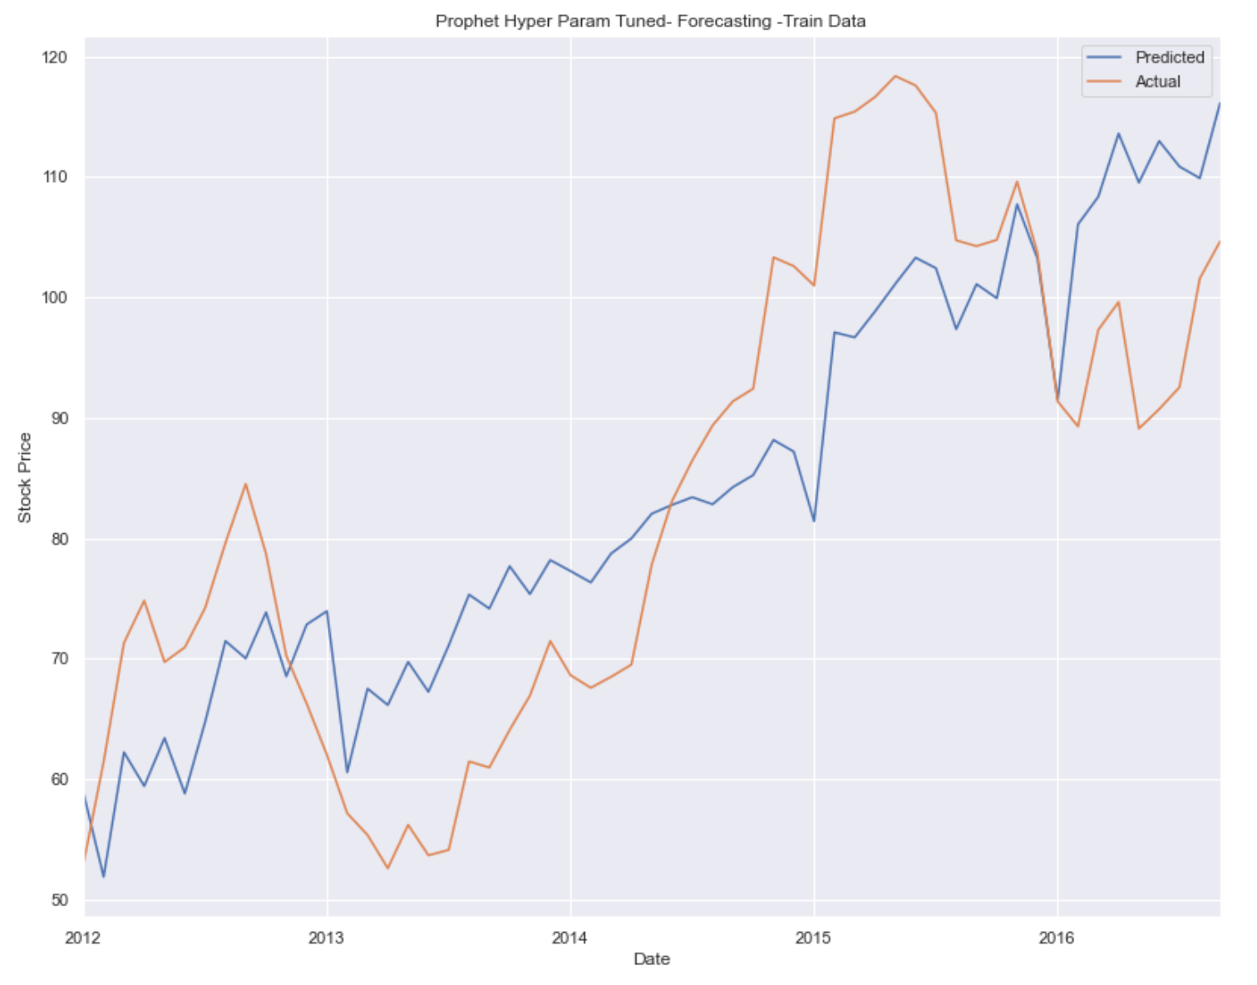
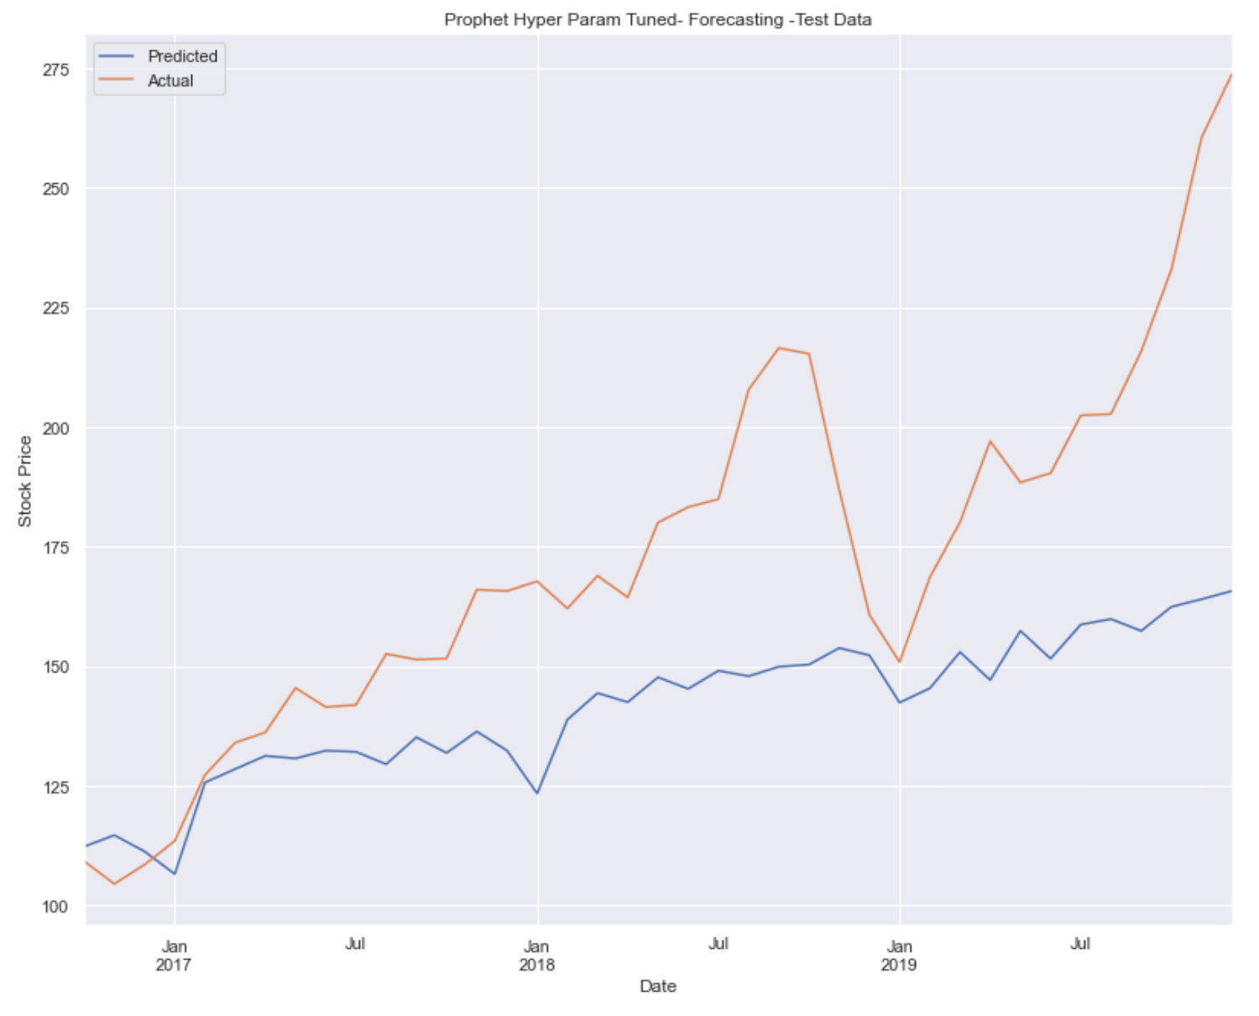
Facebook's Prophet Model for Time Series
Seasonal ARIMA Vs Facebook's Prophet
Advantages of Prophet includes very easy to implement, fast, and less statistical know-how model. In Seasonal ARIMA we had to follow lot of tests and process to generate predictions.
Seasonal ARIMA is better at capturing the seasonality part.
Prophet has a overfitting problem.
Overall Both models are robust.
Prophet is better at dealing with outliers.
Seasonal ARIMA is much better our at prediction problem. More confidence when predicting with Seasonal-ARIMA since its backed by Mathematical and Statistical tests.
Accuracy of SARIMA is 89% and 80% for Prophet.
Notes:
16

