Slide 1
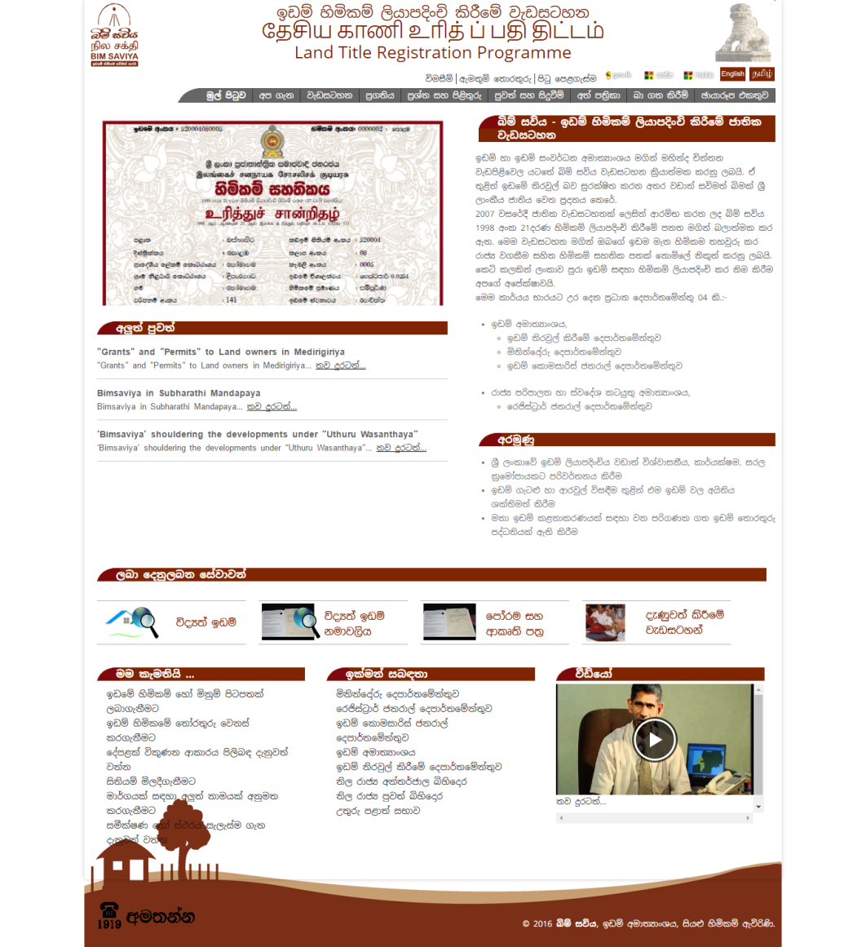
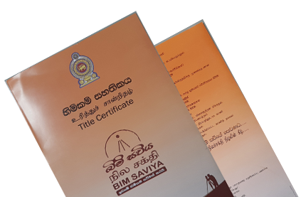
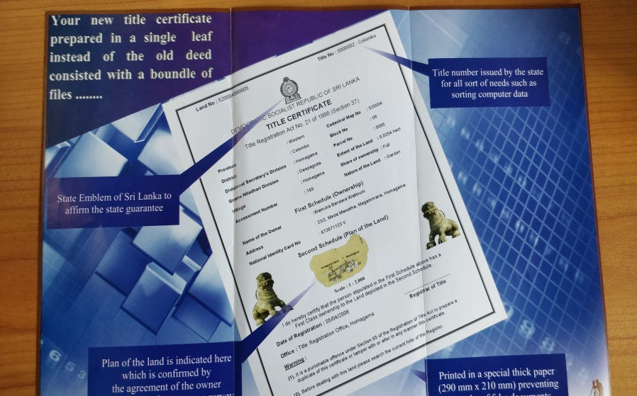
Practical Aspect of Registration of Title Act

Slide 2
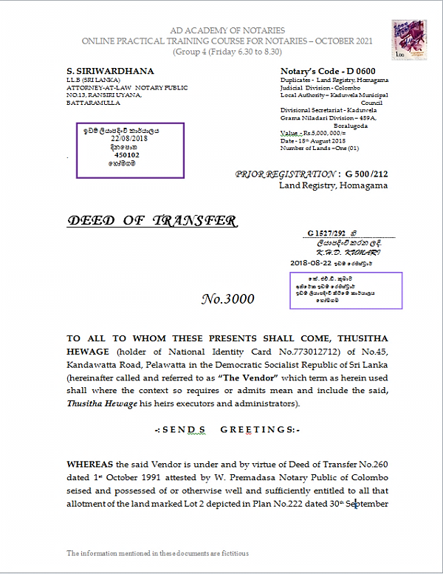
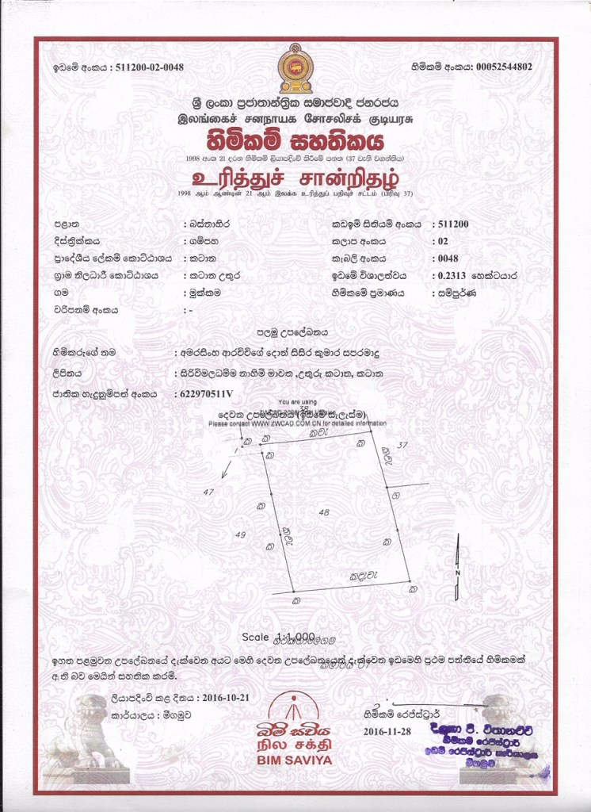
Registered Deed and Title Certificate

Slide 3
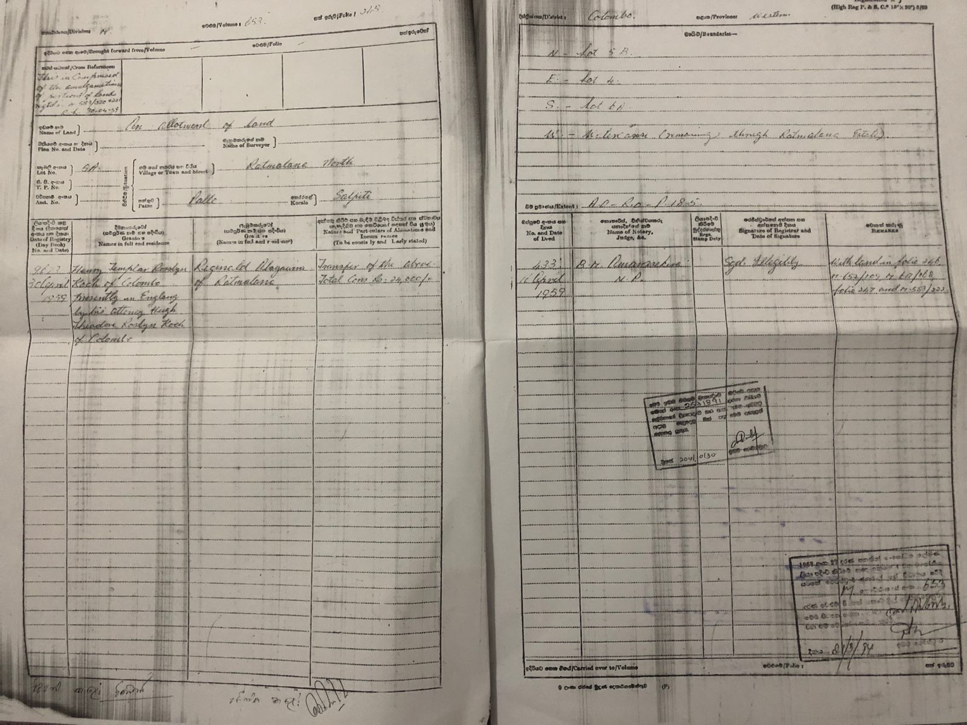

Slide 4
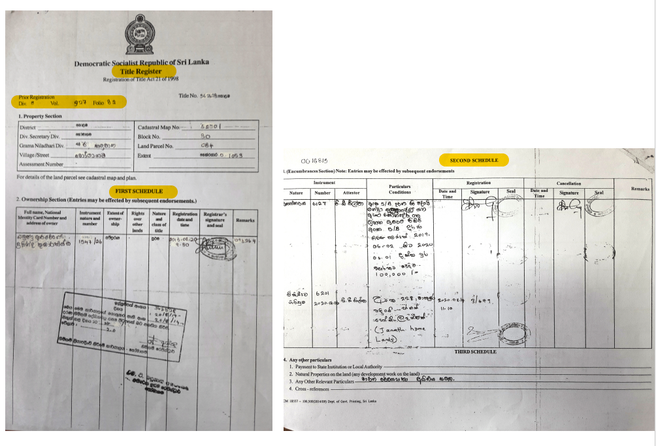
Title Registry

Slide 5
INITIALCOMPILATION
Specify the area (by the Minister) (S.1)
RGT –Register General of Title
SG- Surveyor General
CTS- Commissioner of Title Settlement
RT- Registrar of Title
TR- Title Registration
DC- District Court
On the request by CTS
Prepare cadastral map by SG (s.11)
CTS (s.11)
Publication of Notice in the Gazette (s.12)
Reference of claims to DC by the CTS
(if he forms an opinion –due to the nature of the claim/s) (S.21)
Calling for claimants (s.12)
Absolute Ownership 1stClass (s.14 (a)
Investigation of Title (s.13)
Absolute Ownership 2nd Class (s.14 (b)
Claimants aggrieved by any declaration made by CST under S.14 (S.22)
Determination (s.14)
Publish in Gazette (s.14)
Portion (a part of the land parcel) (s.14 (c)
Preparation of Schedule of Title (s.26)
Co-owners (s.14 (d)
dispatch
Register of Title (S.26)
SG
copy
Title (initials entries) [S.27(2)]
Issuance of Certificate of Title (S.37)
Owner / Interest holder of the land parcel [S.37]

Slide 6
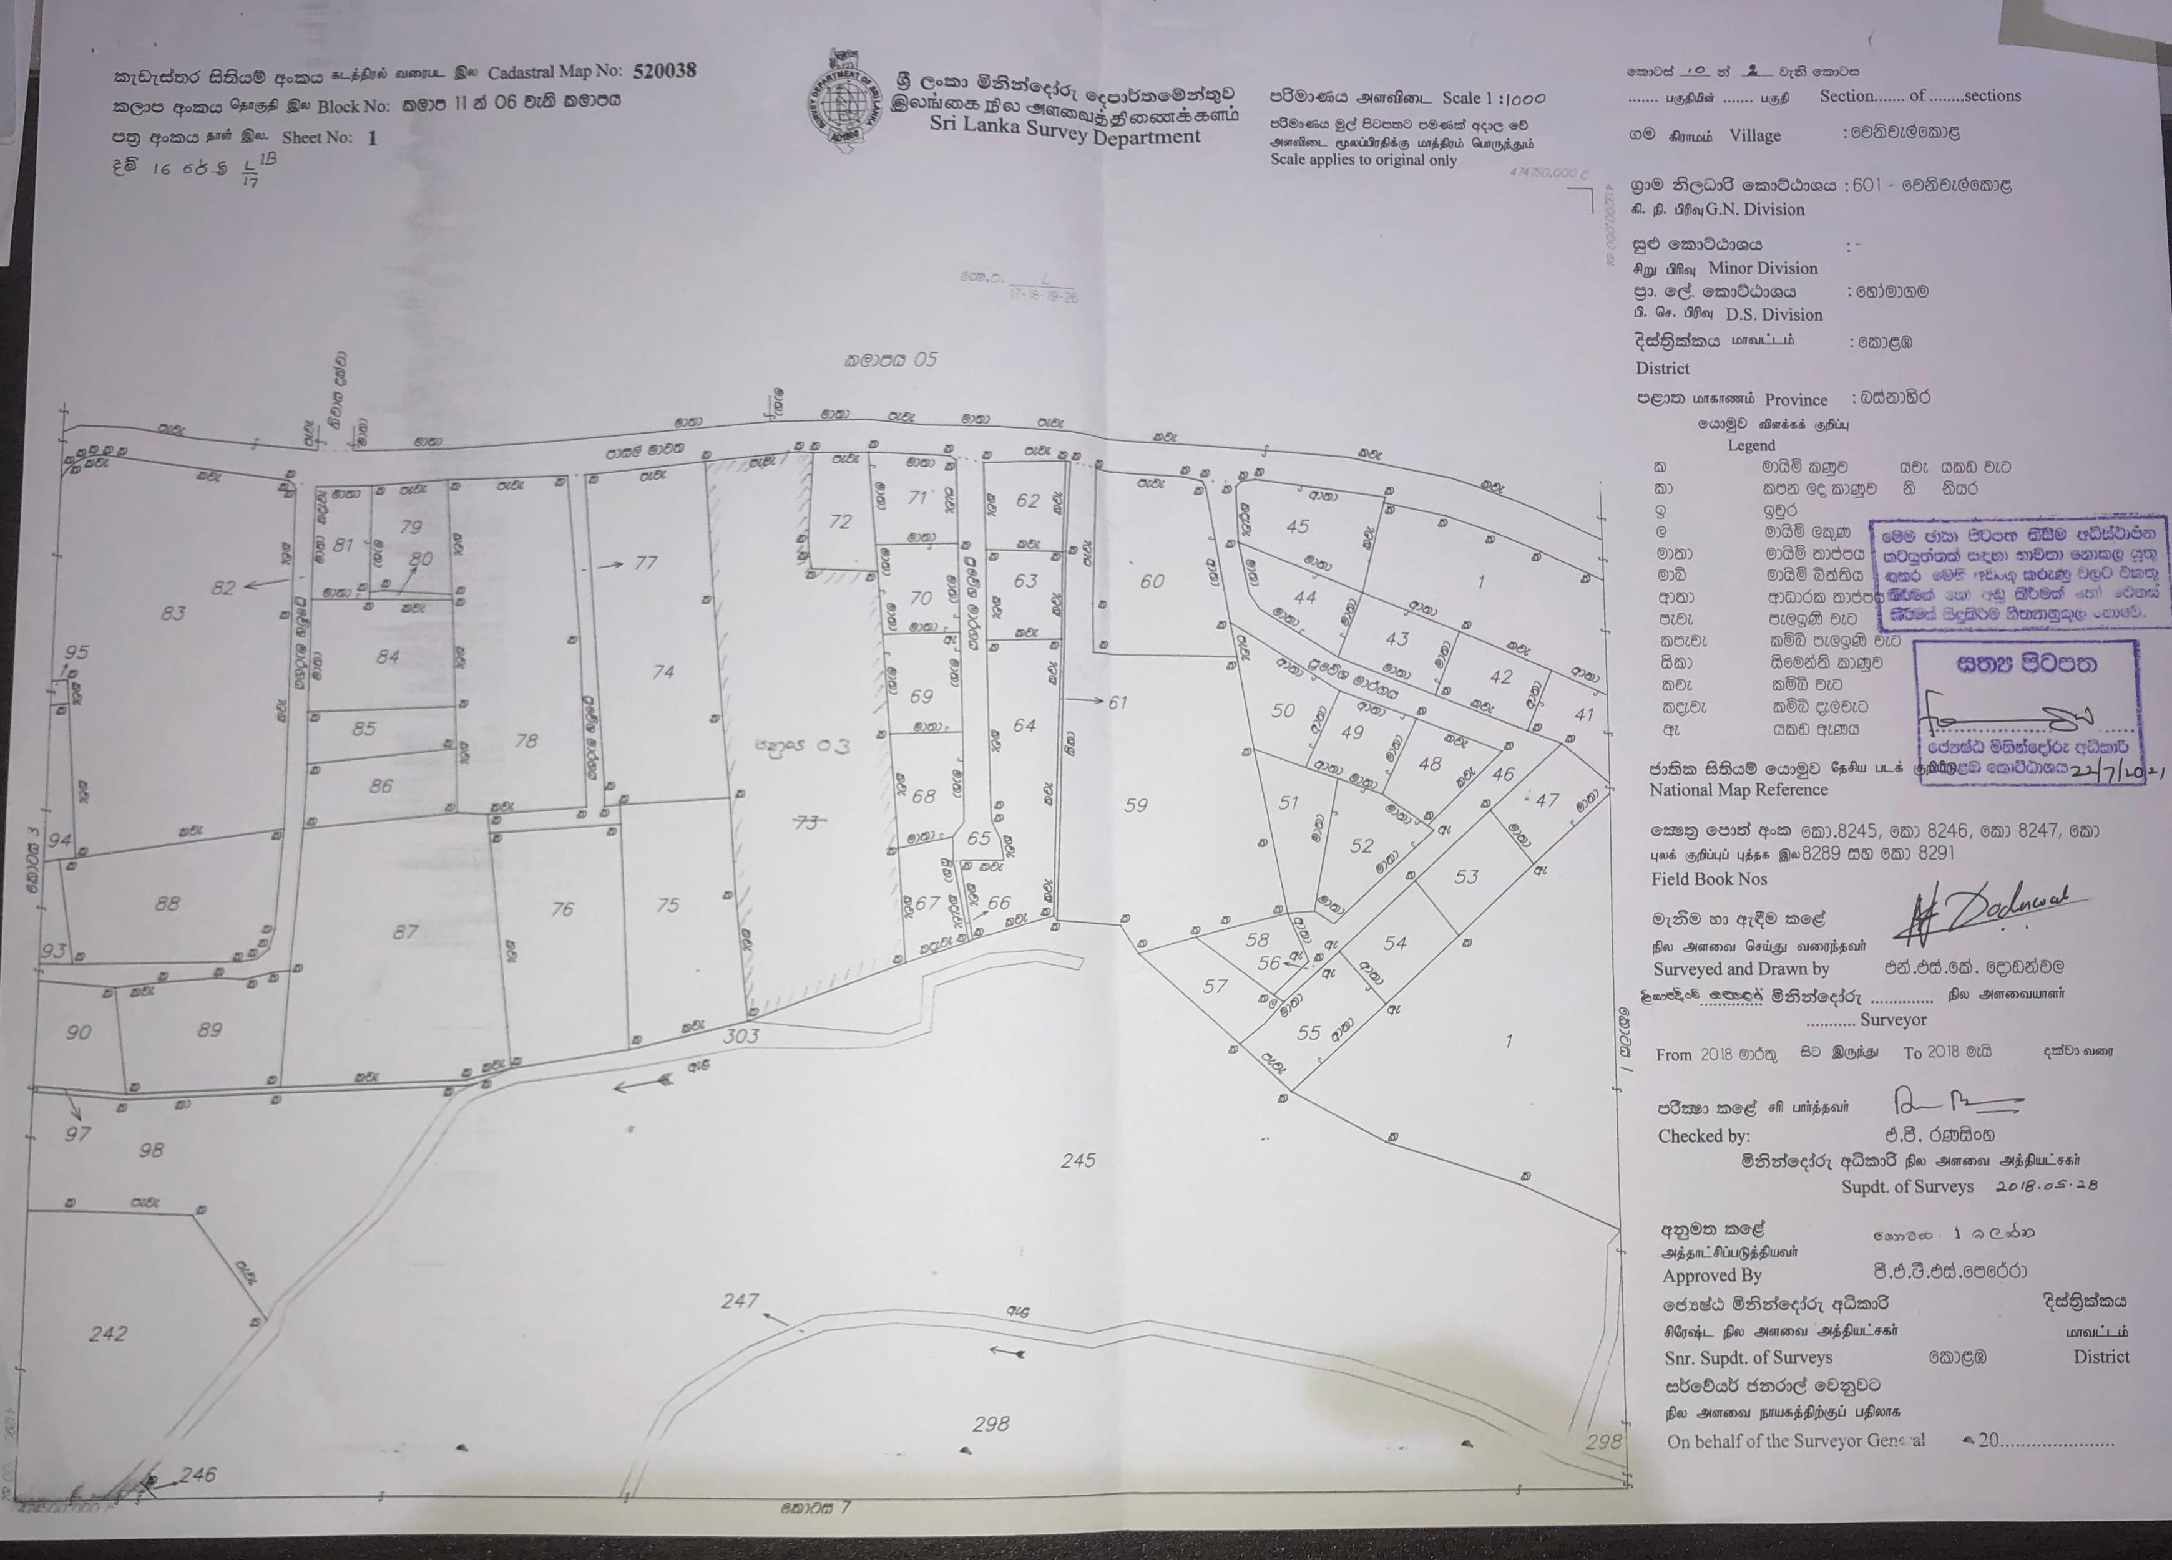
Section 10 – Registration of title to every land parcel under this Act shall be accordance with the cadastral map prepared.
Section 11 – The Commissioner of Title Settlement shall request the Surveyor General to prepare cadastral maps for the areas specified in the Order.

Slide 7
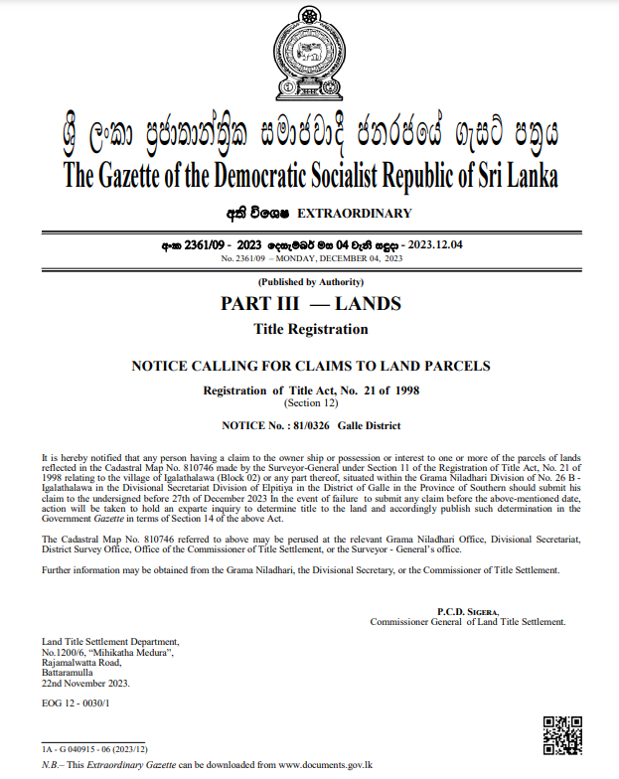
Section 12 –
The Commissioner of Title Settlement on receipt of certified copies of cadastral maps by the Surveyor General shall publish a Notice in the Gazette calling for any claimants to land parcel

Slide 8
TRANSMISSION OF TITLE
(Sections 54 & 55 of Registration of Title Act No.21 of 1998)
Registered Owner (dies)
testate
intestate
TESTATE ESTATE (s.54(1))
INTESTATE ESTATE
[S.55(1)]
Any person who becomes the owner by virtue of
1)Court Order or
2. Certificate of Sale
[Ss.56(1)]
Inform the death (by any Interested person) [Ss.55(1)]
1.Probate of the Will
2. Instrument (Executor’s Conveyance) [S. 54(1)]
to be forwarded subject to Ss. 54(2) & (3).
COMMISSIONER OF TITLE SETTLEMENT [S.55(1)]
APPLICATION
(with supporting documents [Ss.56(2)]
REGISTER OF TITLE
(RT)
Publication of NOTICE (for claimants)(CTS) [S.55 ](2)]
REGISTER OF TITLE (RT)
SECTIONS 13, 14 20, 21, 22, 23, 24, 25, 26 & 27 be applicable [S.55(3)]
Register in the Title Register
[Ss.55.(2)]
Register in the Title Register

Slide 9
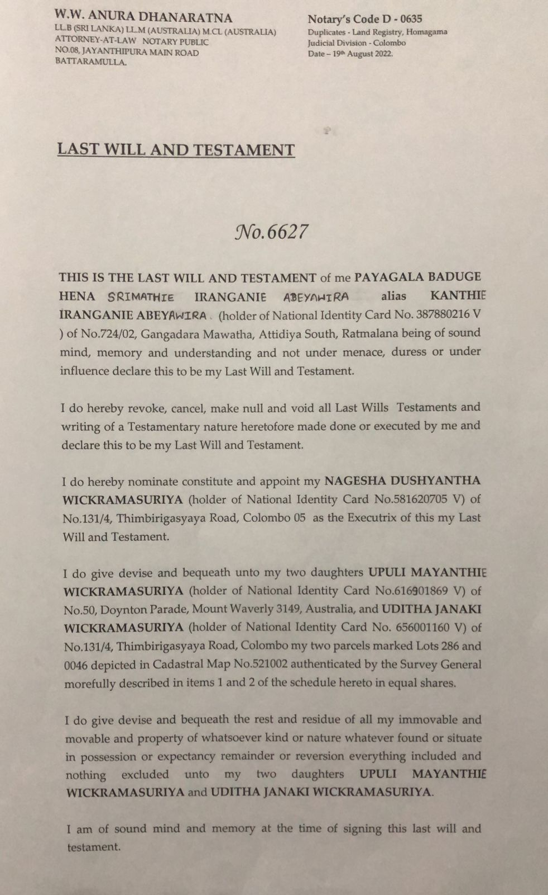
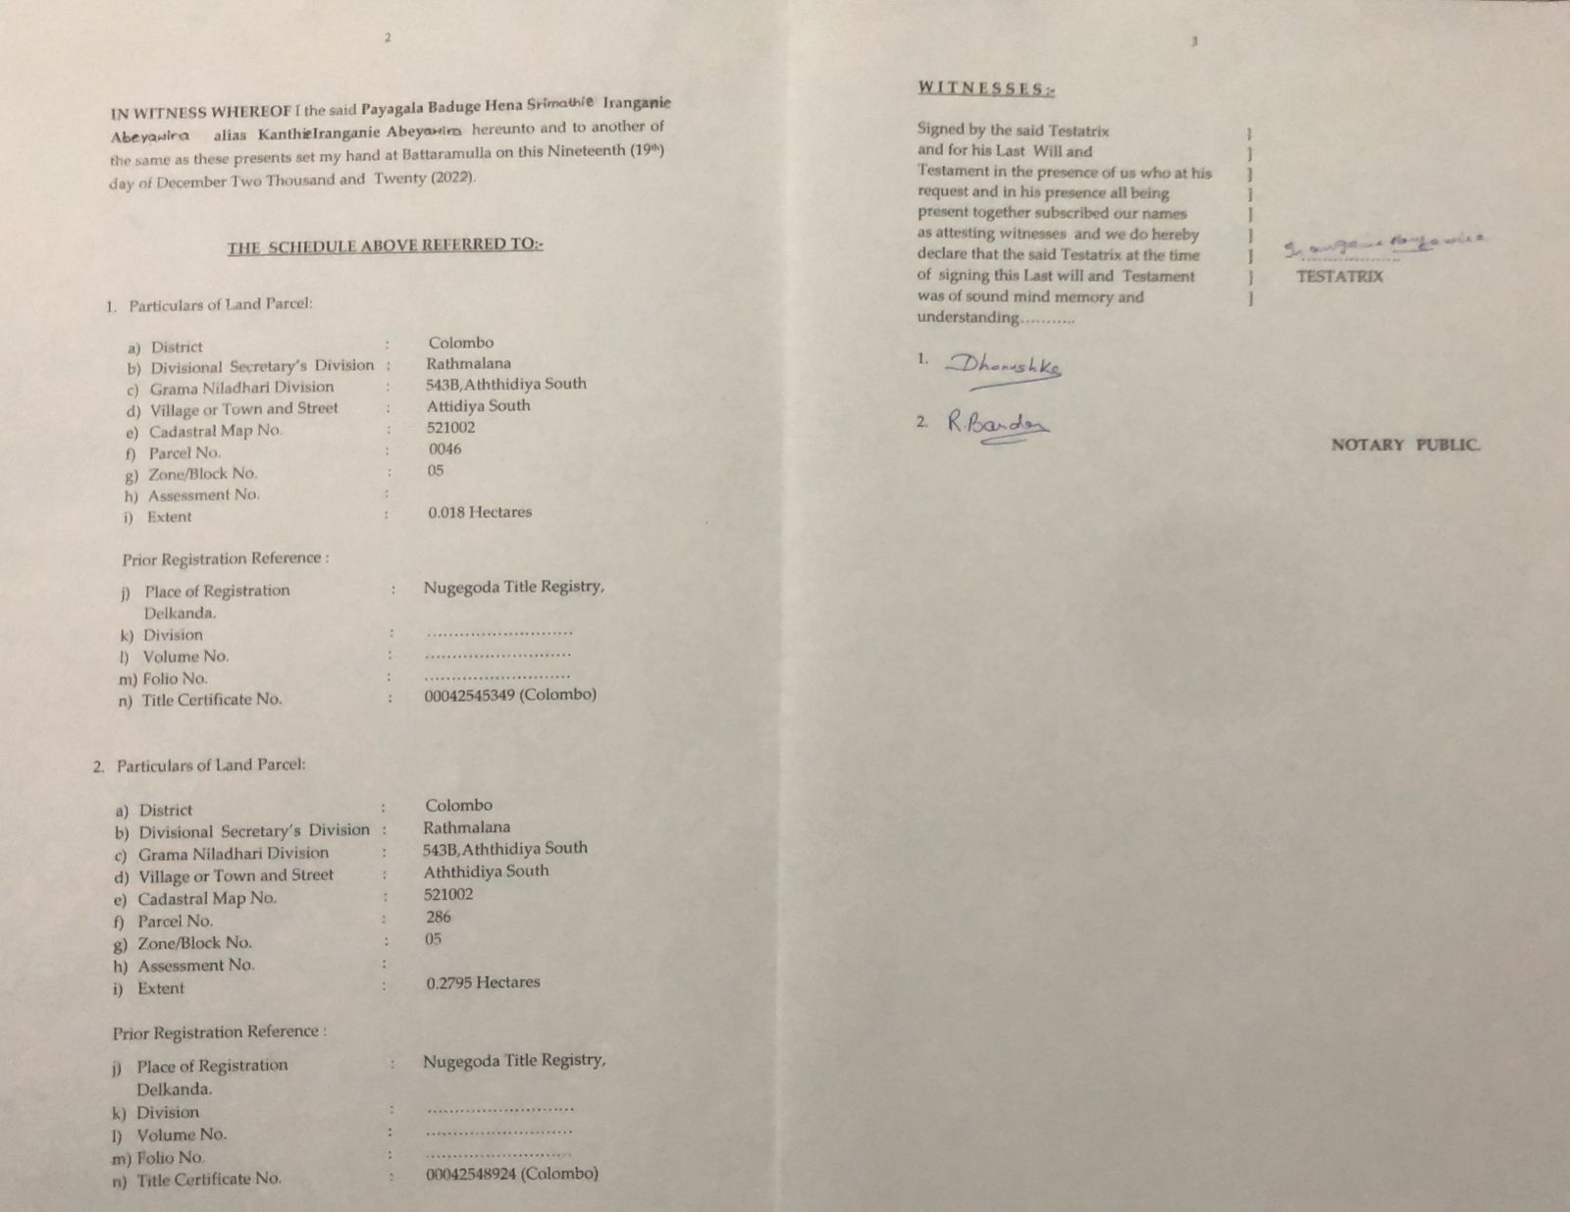

Slide 10
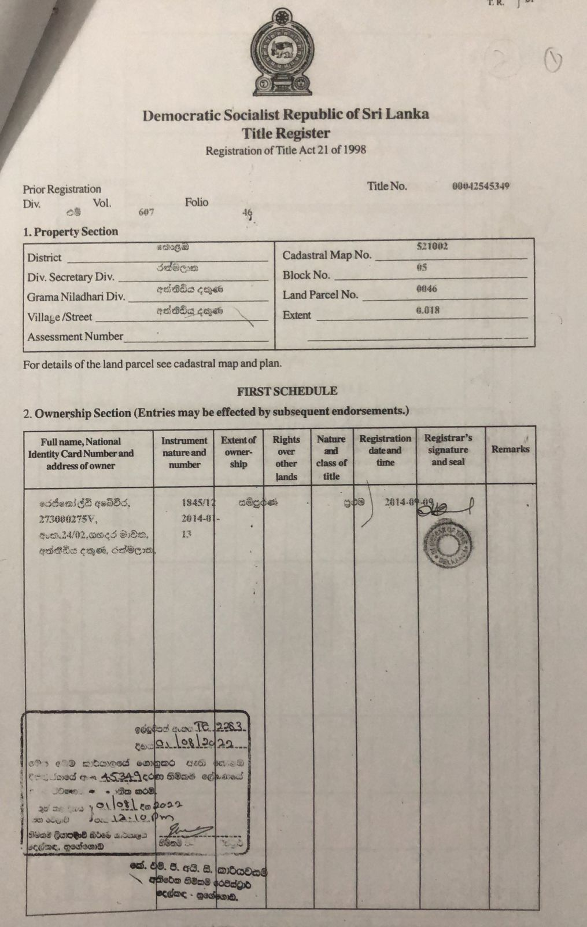
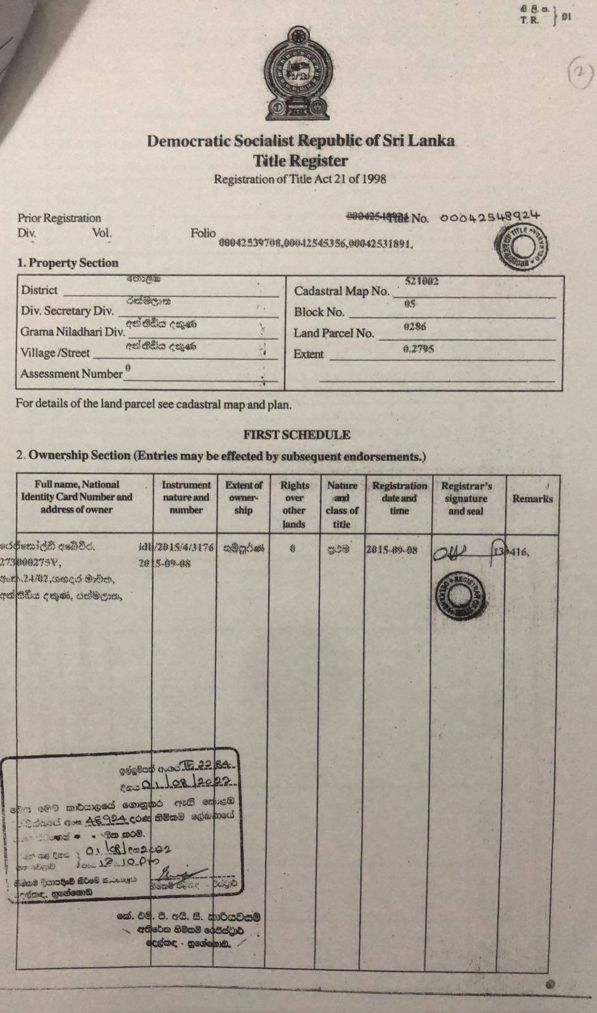

Slide 11
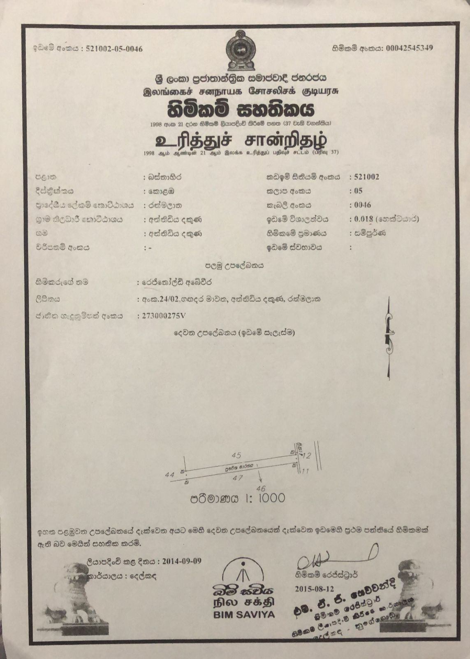
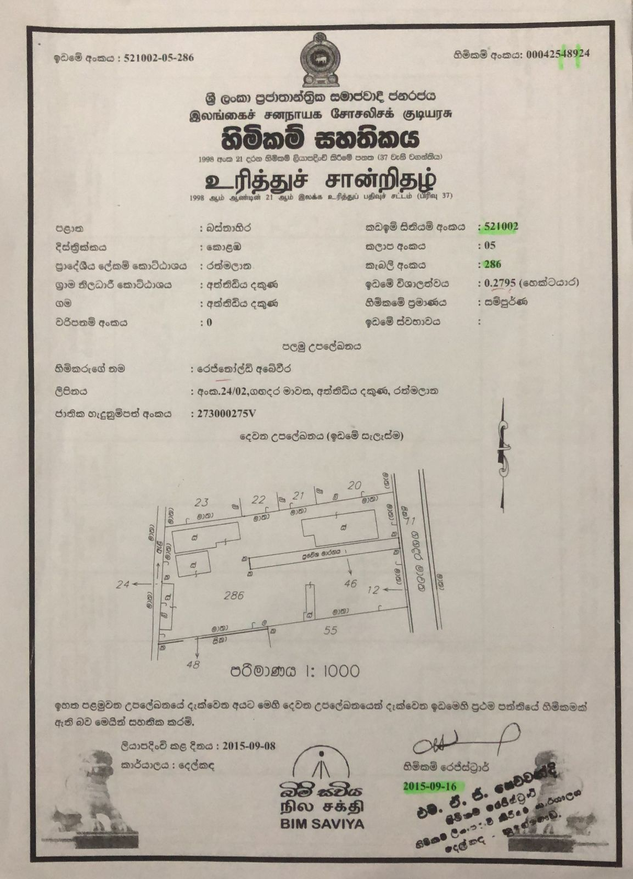

Slide 12
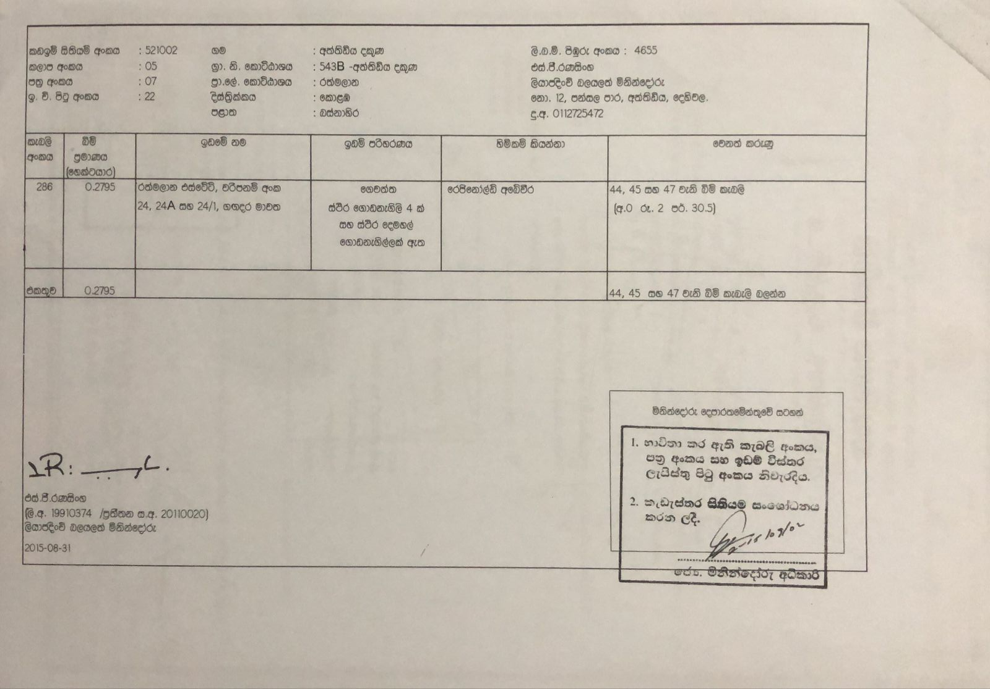
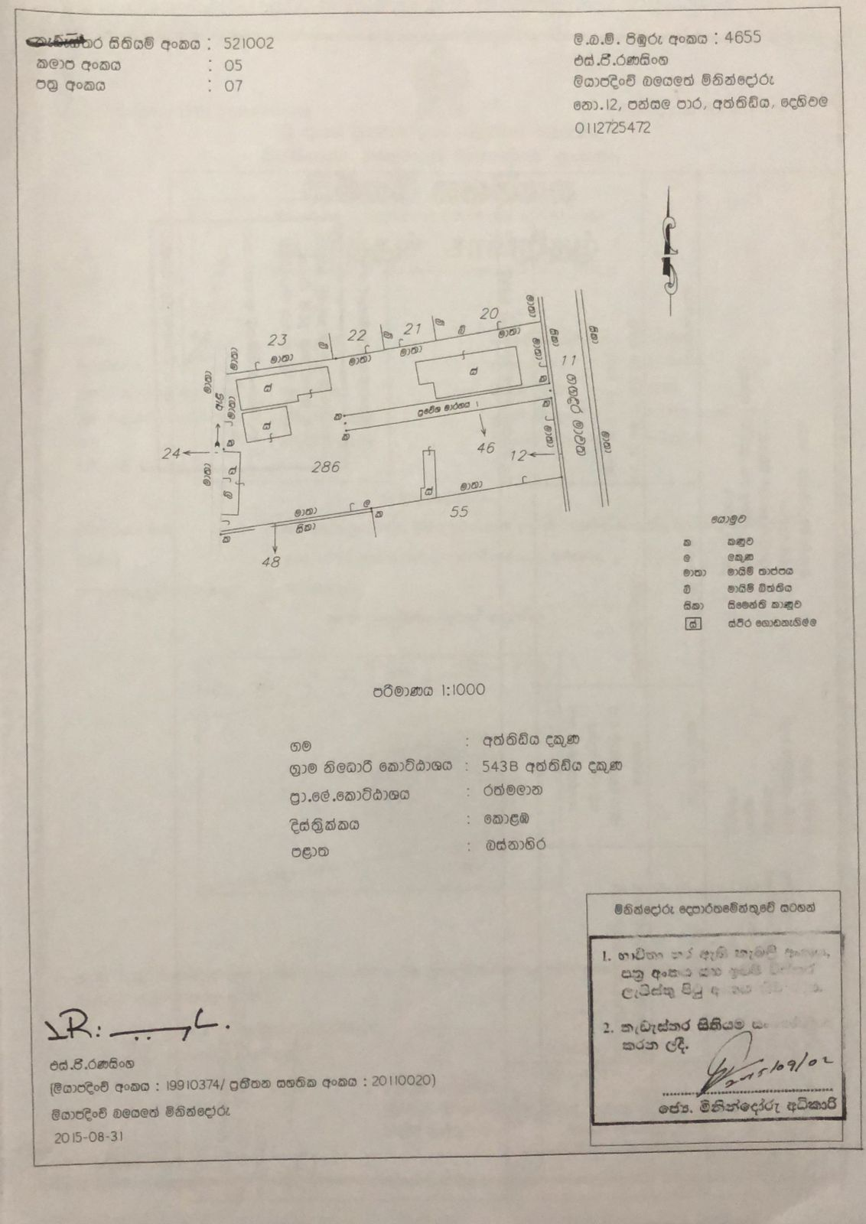

Slide 13
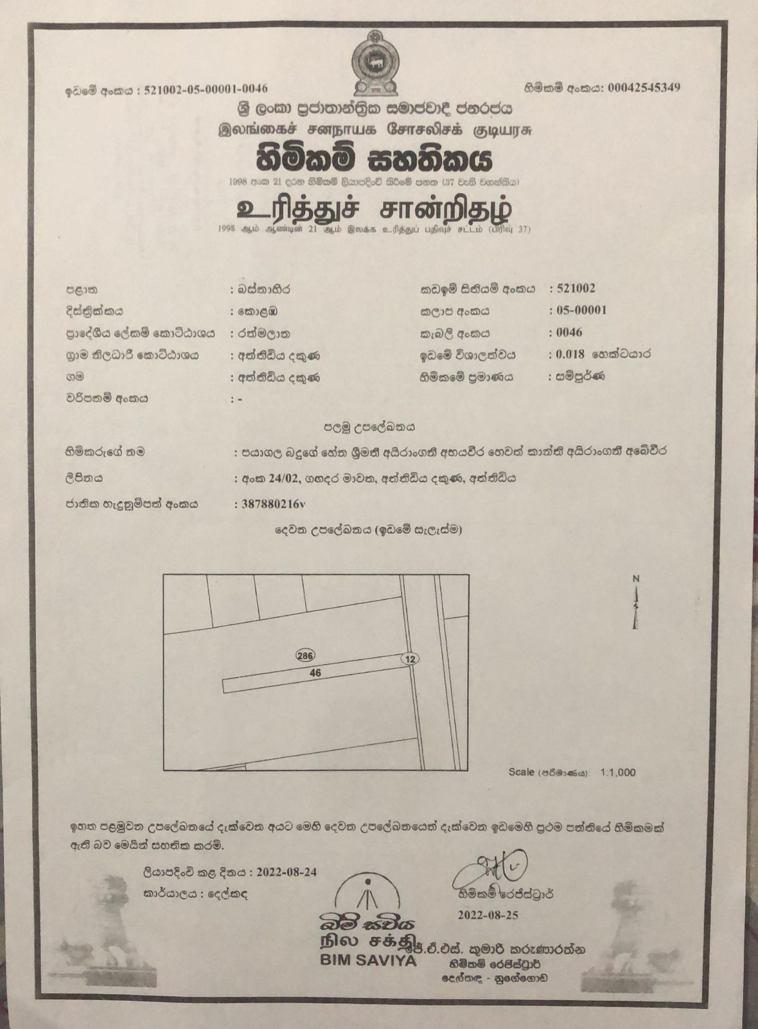
Husband
Wife

Slide 14
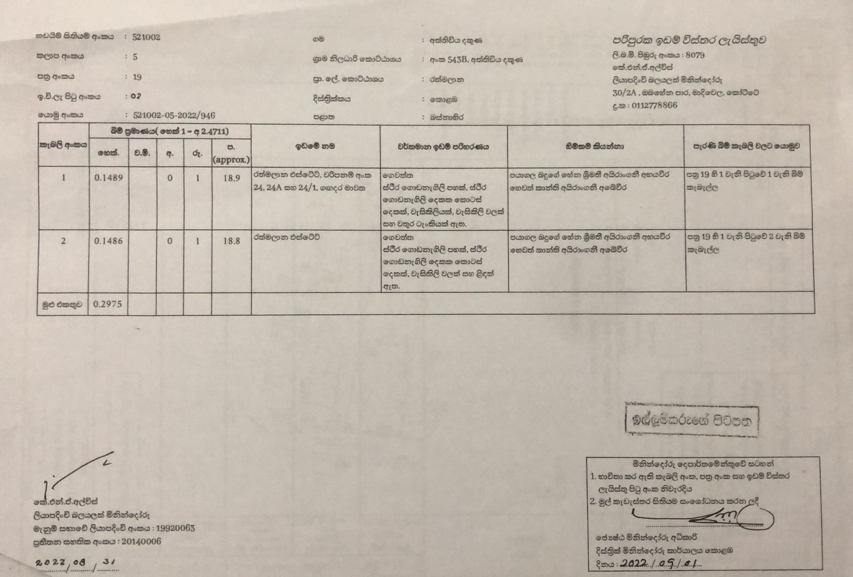
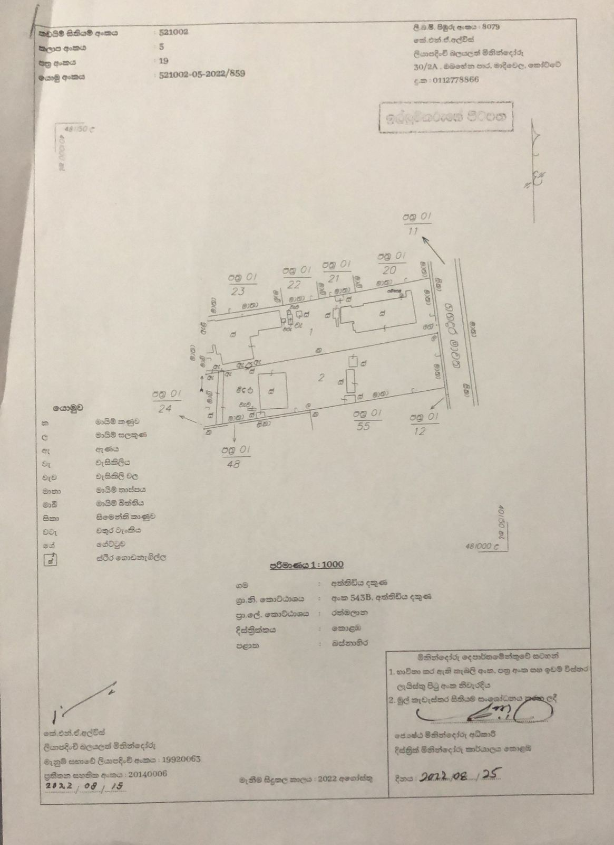

Slide 15
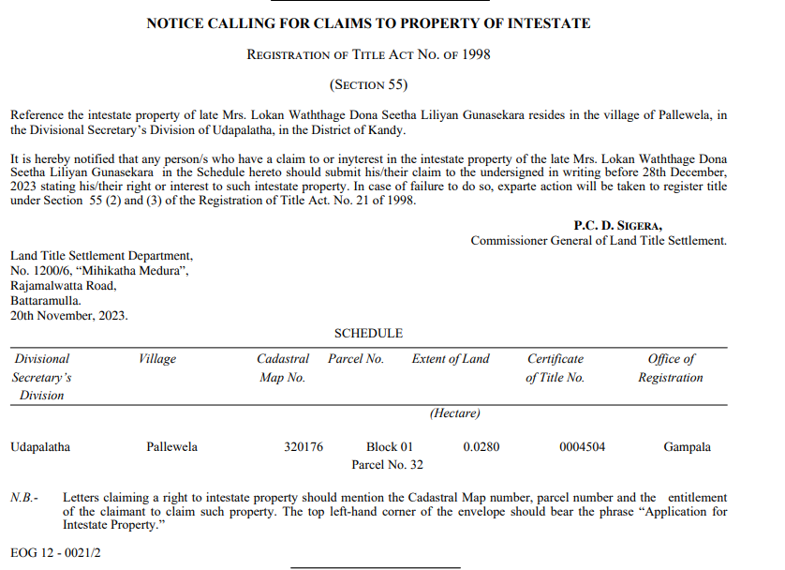
Section 55 – Registered owner dying intestate
Any party interested may inform the CTS of the death of such registered owner and CTS on being notified shall publish a notice in the prescribed manner calling for claimants to the land parcel registered in favor of such deceased person.

Slide 16
Section 13
How Investigation is done?
Land Search
Pedigree
Previous plans and deeds
Claim forms
Water bills and Electricity bills

Slide 17
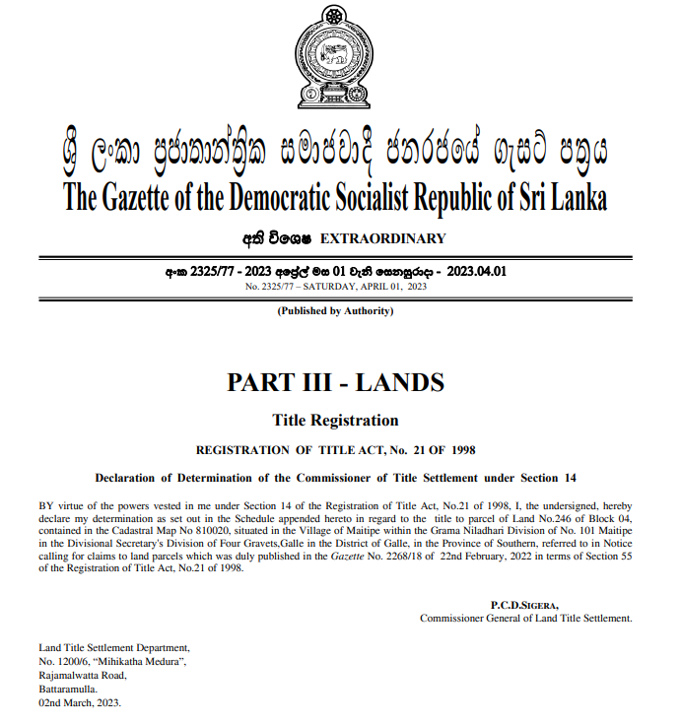
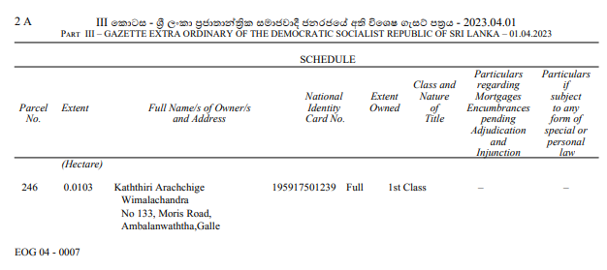
Section 14 -Declaration
Absolute ownership 1st class Title ownership
Second class Title ownership
Portion (part of the land parcel)
Co-owners

Slide 18
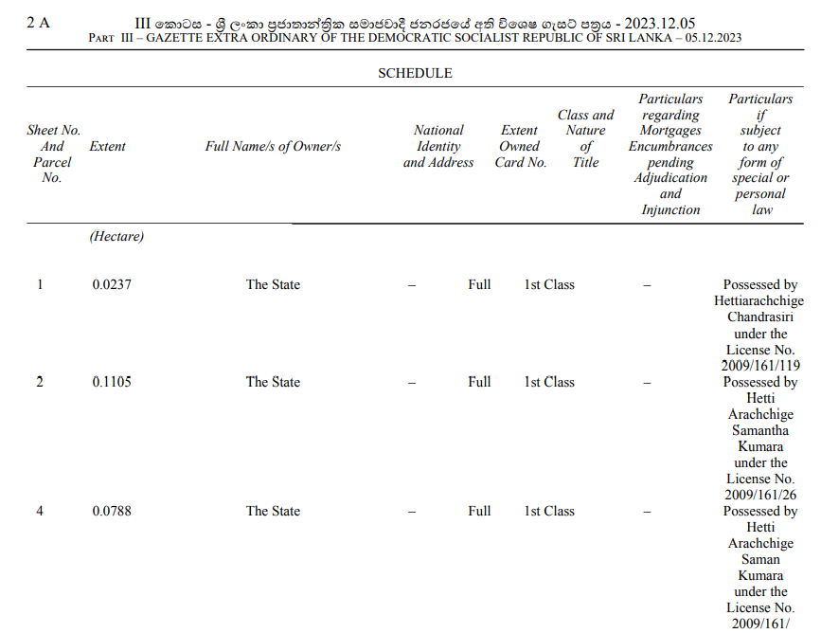
Section 19 – In case where the land in question is a state land CTS shall prepare a schedule of title for registration of a first class of Absolute ownership to such land.

Slide 19
SUB-DIVISION & AMALGAMATION
(Section 36 of Registration of Title Act No.21 of 1998)
By registering a Plan of redivision or amalgamation
DECLARATION (S.36(2)
Particulars of every encumbrance.
Lis Pendens, seizure. Order or decree (if any)(s.36 (2) (a).
References to Title Register & Cadastral Map(s.36 (2) (b).
A Survey Plan (made by a private Registered Surveyor)
with reference to Cadastral map (C/Map) & showing the proposed
sub-division/ amalgamation
[s.36 (2) (c)]
OWNER/S
[S.36(1)]
APPLICATION
(for sub-division or amalgamation
[shall contain a declaration] [s.36 (2)]
ORIGINAL
COPY
REGISTRAR OF TITLE
(RT)
Superintendent of Surveyors
(SS) [S.36(3)]
NOTIFY Applicant about the certification of the plan
If SS is satisfied, that
Plan conform to cadastral Map & Regulations [Ss.36(3)]
FORWARD
AND make necessary amendments showing the sub-division or amalgamation on the cadastral map
with a Certification on behalf of SG [Ss.36(3)]
A copy of the section of cadastral map showing the amendment [s.36(3)]
Original Plan (tended by the Applicant) be filed of record in the office of SS [s.36(4)]
REGISTRAR OF TITLE (RT)
Application & Documents to be filed in the relevant file [Ss.36(5(b)]
On receipt of relevant section of the C/Map from SS if RT satisfied such app for Sub/Amalgam. conforms the provision of RTA and regulations [s.36(5)]
Register in the Title Register
(with cross reference to former) [S.36.(5)]

Slide 20
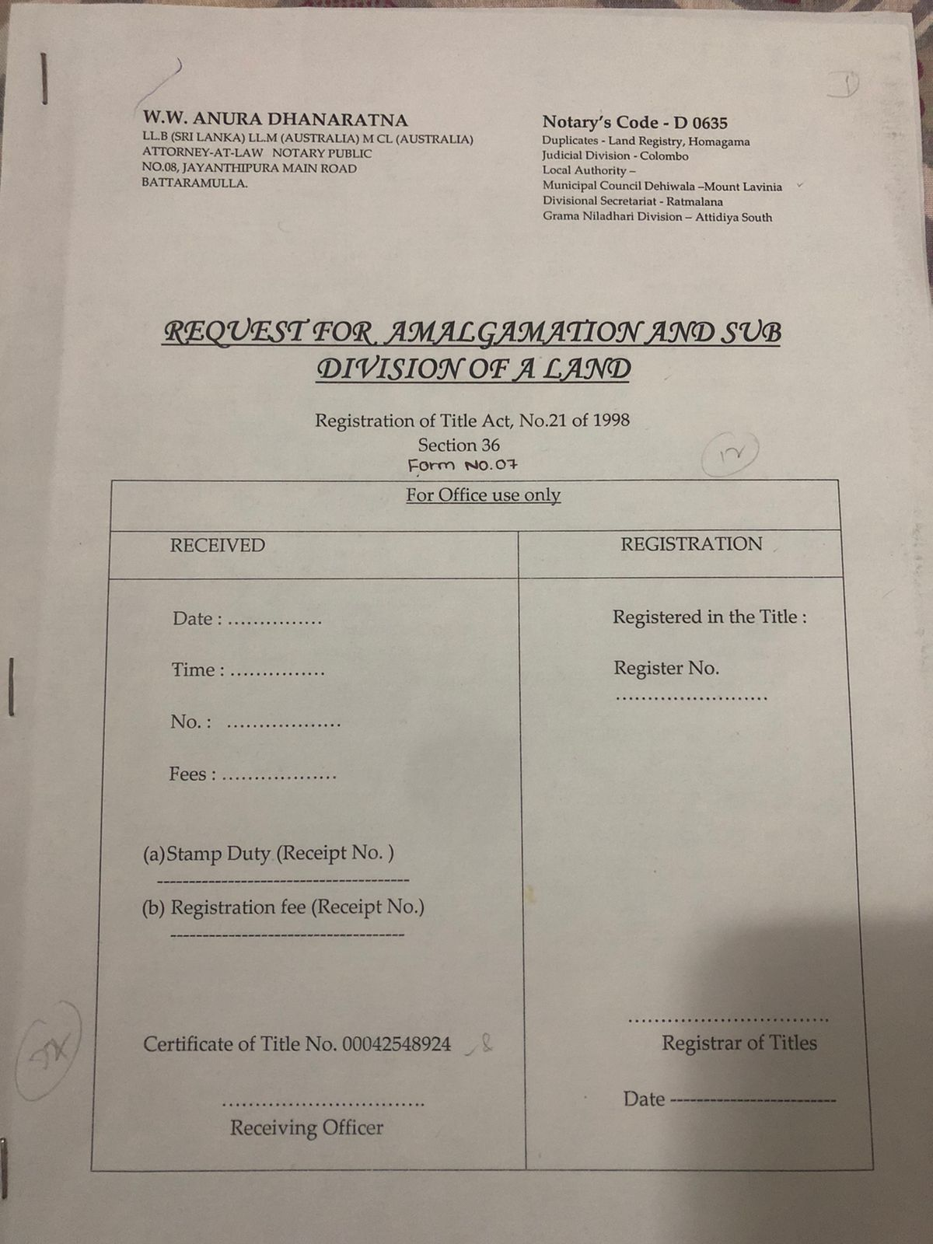
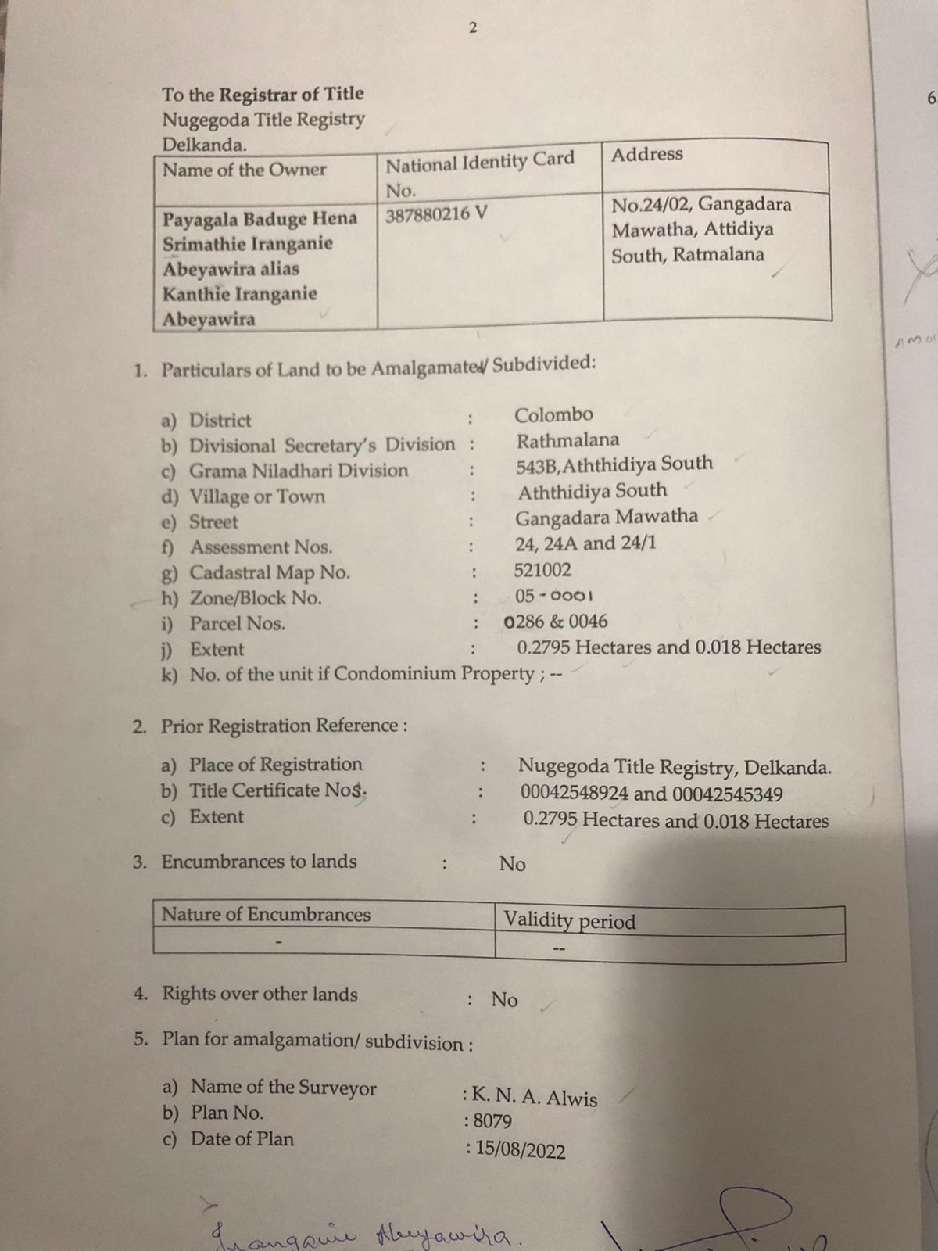

Slide 21
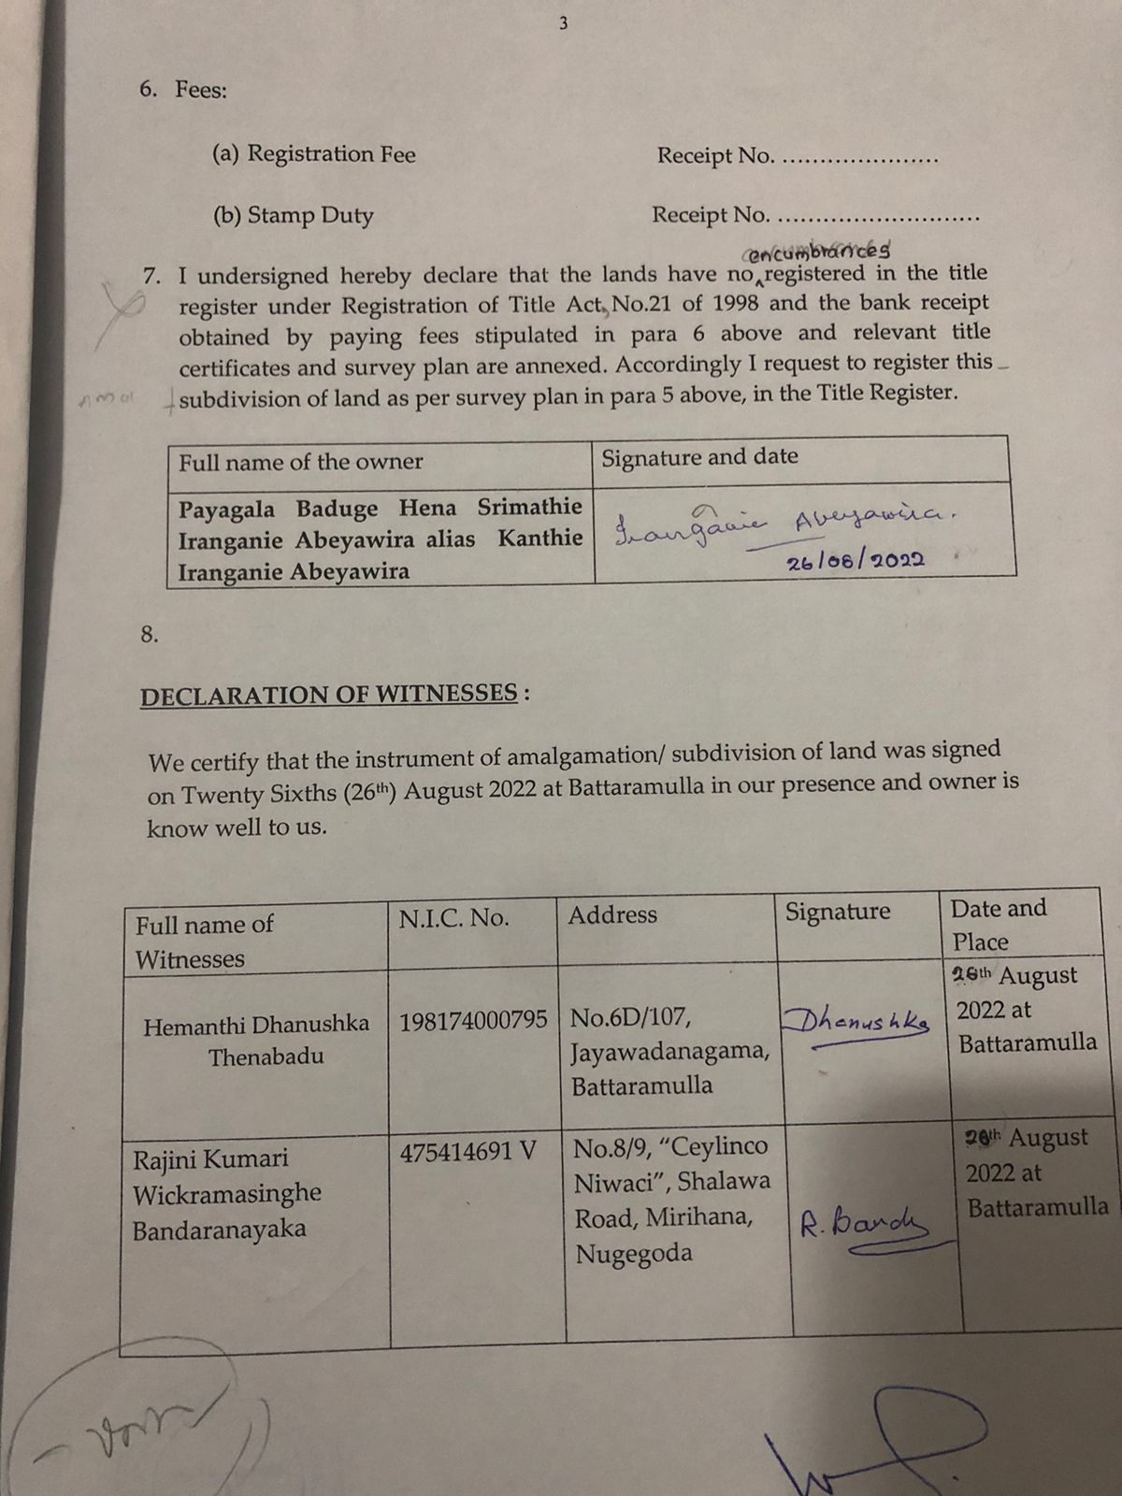
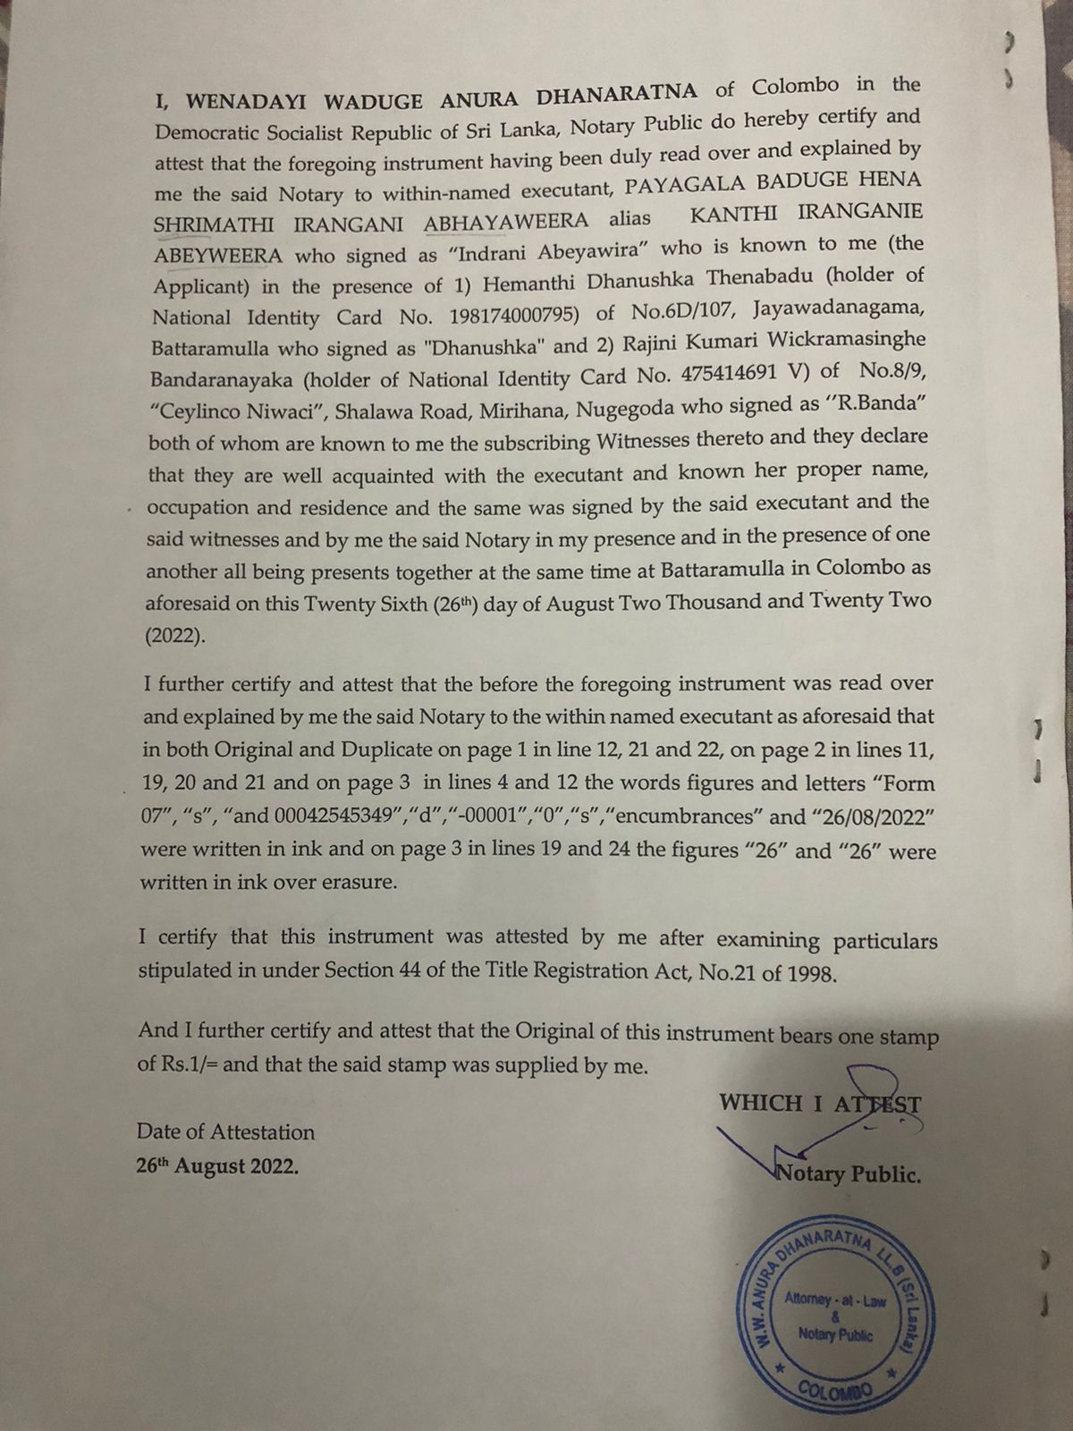

Slide 22
Functions of a Notary under RTA

Slide 23
1. Examination of Title
Section 34 – inspection of title registers and cadastral maps
Section 35 – certification by Registrar to be prima facie evidence
Section 37 - certificate of title form conclusive evidence of the title to such interest.
Section 38 – Interest in a land parcel is not acquired unless such title or interest is registered under the provisions of this Act.
Section 42 – Prior title
Section 49 – Instrument to take effect on registration

Slide 24
EXAMINATION OF TITLE – Part II
CHECK LIST
Original Title Certificate
Original approved survey Plan
Cadastral Map & CD
Encumbrances
  unexpired leases
  cancelled/ un settled mortgage bonds
  existing contracts
  Notices Caveats/ Seizure/ Priority/ lis pendens/ Seizure priority
(a)Petition
(b). Affidavit
(c). Letters of Administration
(d). Inventory
(e). Final Accounts
(f). Scheme of Distribution if any
(g). Last Journal Entry showing termination of proceedings
Utility bills
7. If the Owner is an incorporated body
1.Certificate of Incorporation. 2 Memorandum & Articles of Association 3.Form 1 and 15 ( or 40) 3. NIC’s of directors of the company 4. Photographs
of executants 5. company seal , Director seal 6.Resolution to sell the land
8. Local Authority certificates
1.street line , building line , ownership and non-vesting certificate 2. if there is a building –approved building plan & Certificate of Conformity

Slide 25
2. Drafting
Section 28 – no entries shall be made in respect of transactions relating to land parcels registered under this act in the Land Registers maintained under the RDO.
Section 39 – every land parcel, title to which has been registered under this act, or any interest therein shall be transferred or dealt according to the provisions of this act.
Section 43 (1) – every instrument conveying title or any interest in a land parcel presented for registration shall use the form prescribed in the RTA.
Section 46 – The Registrar of Title not to register instrument conveying title in future.
Section 47 - No part of land that has been registered with a First Class or Second Class Title of Ownership can be transferred or handled in any way unless the registered owner first divides the land into smaller parcels and registers these new parcels under this Act.
Section 48 – Instrument conferring co-ownership is invalid
Section 57 – Prescription Ordinance does not apply
Section 63 – Partition Act does not apply

Slide 26
Drafting Part II -Forms -Refer Gazettes
The Gazette (Extra Ordinary) No.1050/10 of 21/10/1998
The Gazette (Extra Ordinary No.1886/58 of 31/10/2014
The Gazette (Extra Ordinary No.2308/27 of 01/12/2022

Slide 27
3. Execution
Section 43 (2) - Instruments prepared under this Act shall be signed by the parties to the two witnesses and attested by a Notary Public.
In case of a state land, by a Notary Public or by any public officer authorized to do so, by or under any law.
Section 44 - A Notary Public must:
Verify the identity of all parties and witnesses using official ID or other reliable methods.
Check the parties' legal capacity using Title Registry records.
Confirm the land and its title details with the Certificate of Title and Title Registry records.

Slide 28
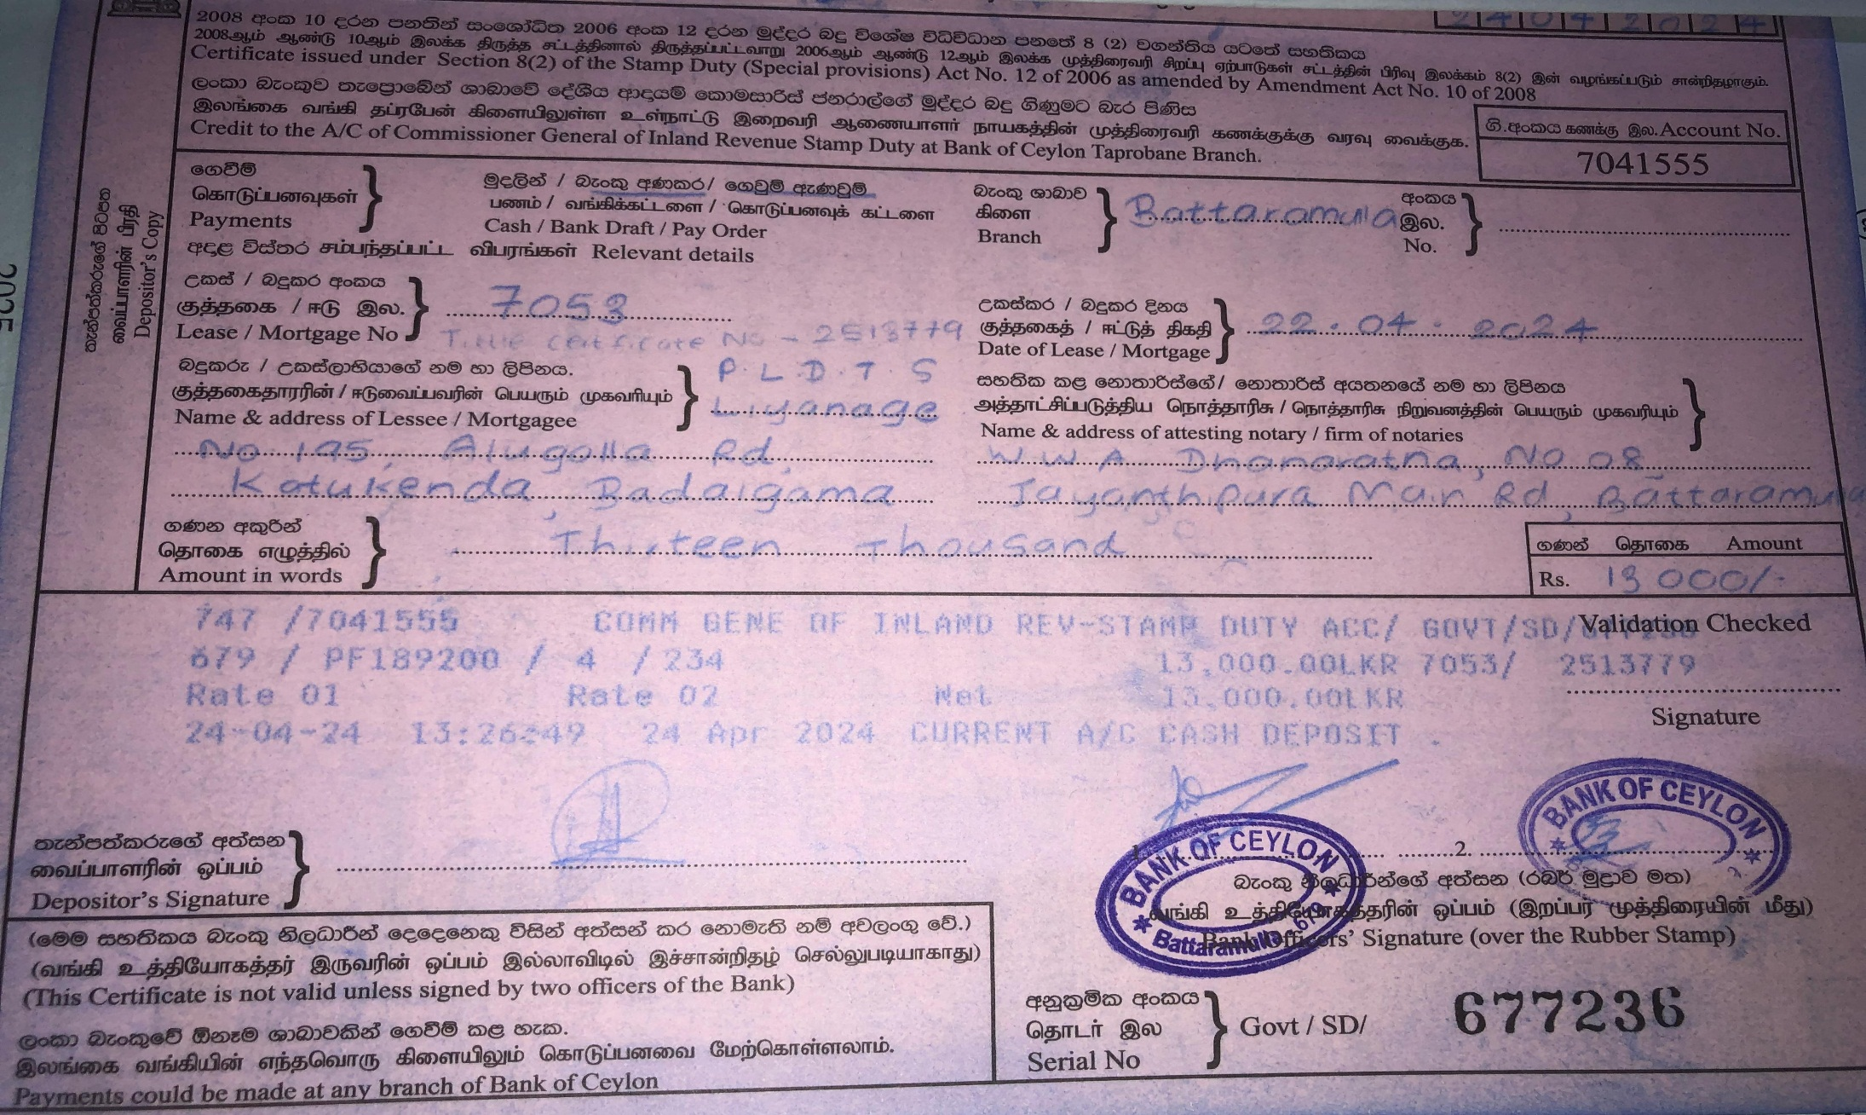
4. Stamping

Slide 29
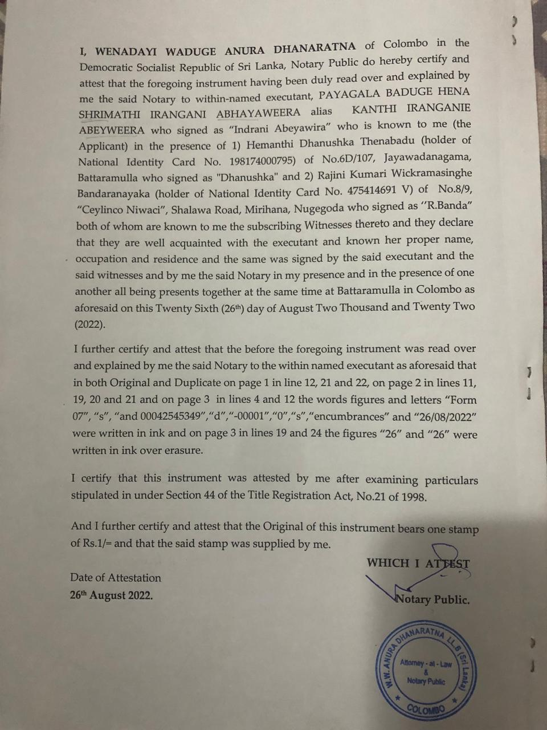
5. Attestation

Slide 30
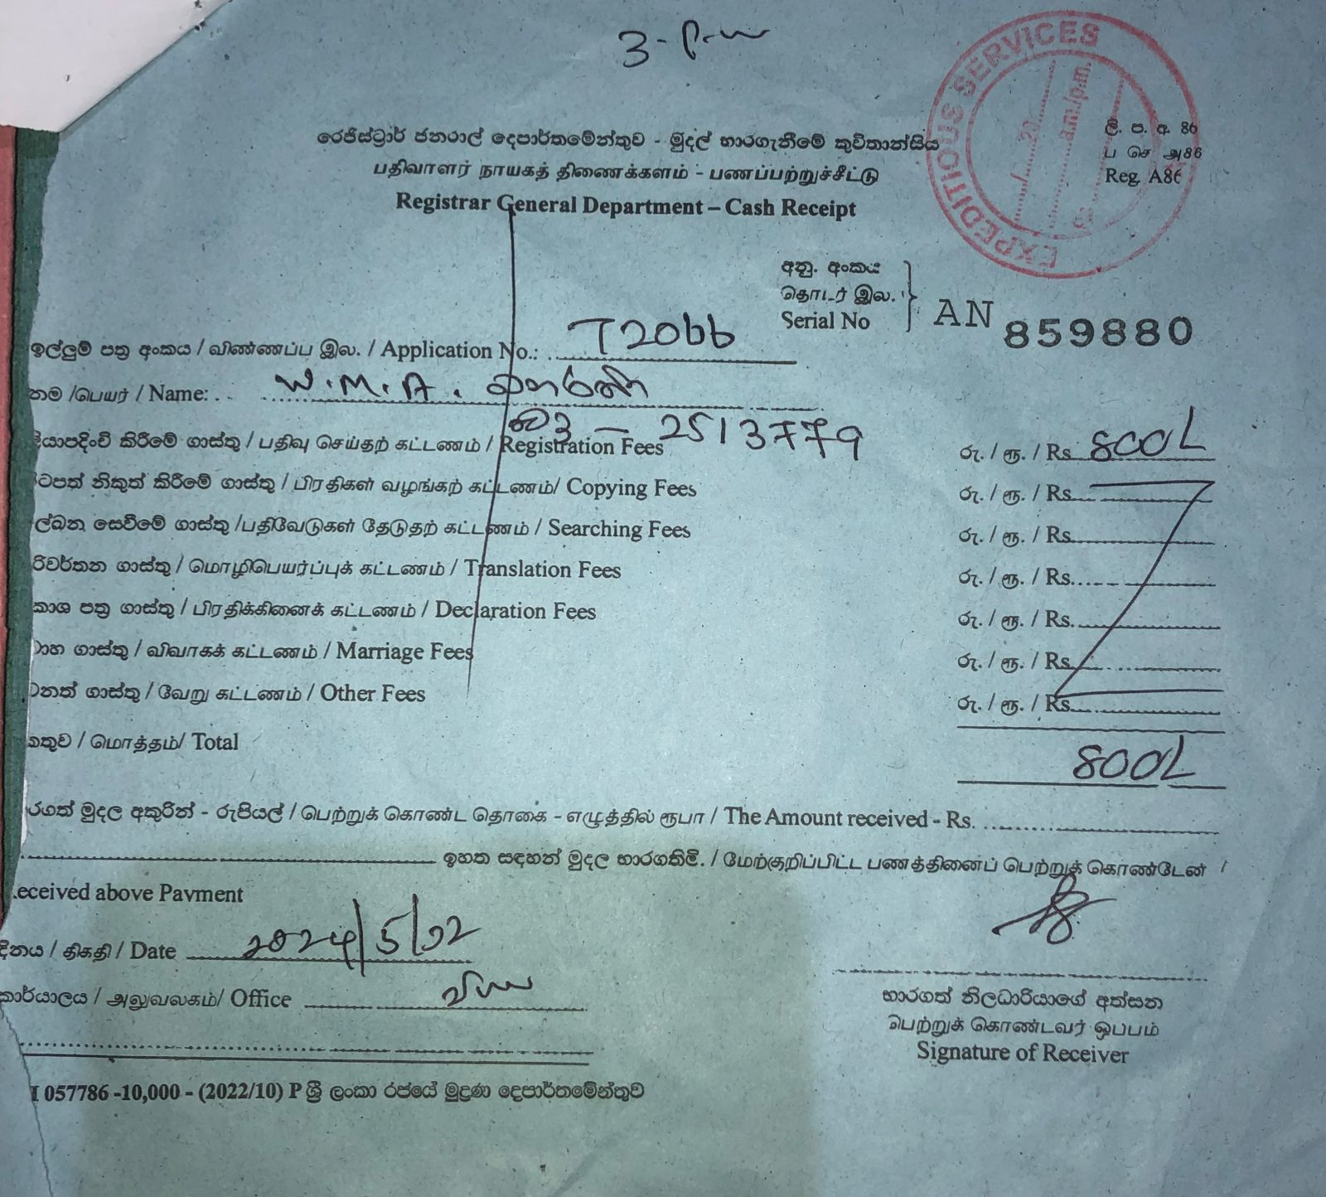
6. Registration
Section 40 –An instrument to transfer interest in land can be submitted for title registration by:
Anyone claiming an interest or benefit from it.
Anyone with a claim or charge on the affected land.
Anyone who witnessed the instrument
Section 41 –
Each Registrar of Title will maintain a "day book" to record details of every instrument presented for registration, including the day, hour, and, if requested, the minute of presentation. For priority purposes, the time of presentation is considered the time of registration.
If an instrument is sent by mail or under cover, it is considered presented for registration when the packet is opened.
Section 45 (1) –Notary Public should forward instruments attested within 7 days to Registrar of Title.

Slide 31
The End
Thank for your attention
Next seminar on:
Rules of Notary
(Topic 04)
On 09 /02/2025 (Sunday )
Thank you!

