Slide 1
UNIVERSITY OF MORATUWA · DEPARTMENT OF COMPUTER SCIENCE AND ENGINEERING
Draftly
A Lawyer-in-the-Loop Legal Document Drafting and Review
Platform for Sri Lankan Legal Workflows
GROUP 06
Dhanapala D.H.N. «Reg. No.»
Dilshan A.D.L. «Reg. No.»
De Silva B.K.P. «Reg. No.»
SUPERVISION
Supervisor: Dr. Nisansa de Silva
Teaching Assistant: Ovindu Atukorala
In23-S5-CS3501 (130134) — Mid-Project Progress Evaluation · August 2026

Slide 2
The Problem
Conveyancing in Sri Lanka is document-heavy, rule-driven and almost entirely manual
▪ Manual reconciliation of a document bundle
  – Deeds, title certificates, survey plans, assessment and identity records — cross-checked by eye
  – A missed lot number, extent or boundary can invalidate an instrument
▪ Four coexisting registration regimes
  – Matters routinely span several decades of instruments
▪ Fragmented sources of law
  – Statutes, amendments, gazettes, prescribed forms and case law, with no step-aware guidance
▪ Transcription risk in drafting
  – Particulars re-typed by hand; prescribed wording must be reproduced exactly
▪ No structured record of verification
  – Nothing records which facts were checked, by whom, against which evidence
WHY NOT A GENERAL-PURPOSE LLM?
Fluent but unverifiable answers and fabricated citations. In legal work this failure mode is disqualifying.
A system for this domain must ground every output in identifiable sources — and abstain when it cannot.
OUR POSITION
Draftly is lawyer-in-the-loop: the system proposes, the lawyer reviews, edits and approves.
Everything the pipeline produces carries status = unverified until a lawyer signs it off. That rule is enforced in code, not by convention.
Gap confirmed through preliminary discussions with practising Sri Lankan lawyers, notaries and conveyancing academics.
In23-S5-CS3501 (130134) · Progress Evaluation · August 2026
2

Slide 3
Objectives
First use case: notarial work under the Registration of Title Act, No. 21 of 1998
ENGINEERING OBJECTIVES▪ Matter workflow from document intake to an approved, exportable draft under continuous lawyer supervision
▪ Extract structured particulars from Sinhala and English conveyancing documents, each value carrying its source location
▪ Verification workspace — facts reviewed beside their evidence, moved through explicit verification states
▪ Deterministic consistency checks across deed schedule, survey plan and assessment records
▪ Generate prescribed instruments (Form 8 transfer) populated only from verified facts
▪ Versioned drafts, approval gates, DOCX/PDF export, full audit trail
RESEARCH OBJECTIVES▪ Grounded legal QA over a curated corpus where every claim carries a citation and the system abstains explicitly
▪ Recover the legal rule from judgments deterministically, abstaining rather than emitting a non-rule
▪ Model statutes temporally — resolve a citation against the date the court spoke, not today's text
▪ Authority-aware ranking by court level and binding force
▪ Evaluate every capability against a lawyer-verified set before it is presented as reliable
CENTRAL RESEARCH QUESTION
Can deterministic legal structure — citation graphs, section indexes and amendment histories — outperform embedding similarity for legally correct retrieval?
In23-S5-CS3501 (130134) · Progress Evaluation · August 2026
3

Slide 4
Literature Review and Research Gap
Each design decision is anchored to a published number — see proj-docs/…/retrieval-engine-methodology.md §9
ADOPTED — WITH THE NUMBER THAT JUSTIFIES IT▪ Topic-partitioned sub-indexes lift MRR/top-10 from ~29–42% to ~75–95% (2502.20364)
▪ HippoRAG: removing the graph walk drops avg R@5 from 72.9 → 56.2; its weakest part is the LLM-built KG (2405.14831)
▪ NyayGraph: 3-hop expansion buys +136.8% recall, but raw graph context dumped into a prompt drops F1 (nllp-1.11)
▪ BM25 is the best zero-shot retriever on legal text; general-domain dense retrievers can actively harm (2406.17186)
▪ CLERC mask-a-citation evaluation; citation false-positive rate is exactly computable on a closed corpus (2406.17186)
REJECTED — AND WHY▪ LLM-extracted knowledge graphs — noisier and sparser than the links we already own
▪ RAPTOR's cluster-summarise tree — nondeterministic, and loses to plain BM25 on cross-document lookup
▪ Vector DB / Neo4j stacks — our whole graph is two CSV files
▪ Silent vector fallback — deterministic systems fail loudly, probabilistic ones fail fluently
THE GAP
Local platforms (LawLanka, LawCeylon, Paralegal.lk) serve legal research. International platforms (Harvey, Legora) do not address Sri Lankan law, Sinhala documents or the local registration regimes.
No system combines bilingual extraction with lawyer verification, deterministic title checks, grounded QA over local law, and template-constrained generation of prescribed instruments.
Legal correctness is validity — in force, on a date, by which act. Similarity cannot express that: successive amended versions are near-identical in embedding space.
In23-S5-CS3501 (130134) · Progress Evaluation · August 2026
4

Slide 5
Methodology
Deterministic structure first; the model is used only where pattern matching genuinely cannot reach
01 Closed corpus, enforced in code
Scope is guarded by ALLOWED_KINDS, two runtime checks, a schema CHECK and the answering prompt — five separate guards, a matched set.
02 The validator, not the model, earns trust
Every extracted rule is rejected unless its supporting quote is a verbatim substring of the judgment; statute sections not in the closed catalogue are nulled.
03 Deterministic before LLM
Regex and layout parsing run first; LLM calls are spent only on the residue, bounded by --max-llm-calls and resumable via a per-case cache.
04 Content-addressed, reproducible artifacts
The index is named from a fingerprint of its inputs; a stale fingerprint triggers a rebuild rather than serving drifted results. Build scripts re-run byte-identical.
05 Abstain rather than approximate
Answers cite retrieved section IDs or report insufficient authority. Extraction abstains rather than emit a non-rule.
06 Nothing is verified until a lawyer says so
Every artifact carries status = unverified; lawyer review is a scheduled work package with a pre-registered acceptance criterion.
Consequence: a cheap 8B model is trustworthy inside this pipeline, because the grounding gate — not the model — decides what survives.
In23-S5-CS3501 (130134) · Progress Evaluation · August 2026
5

Slide 6
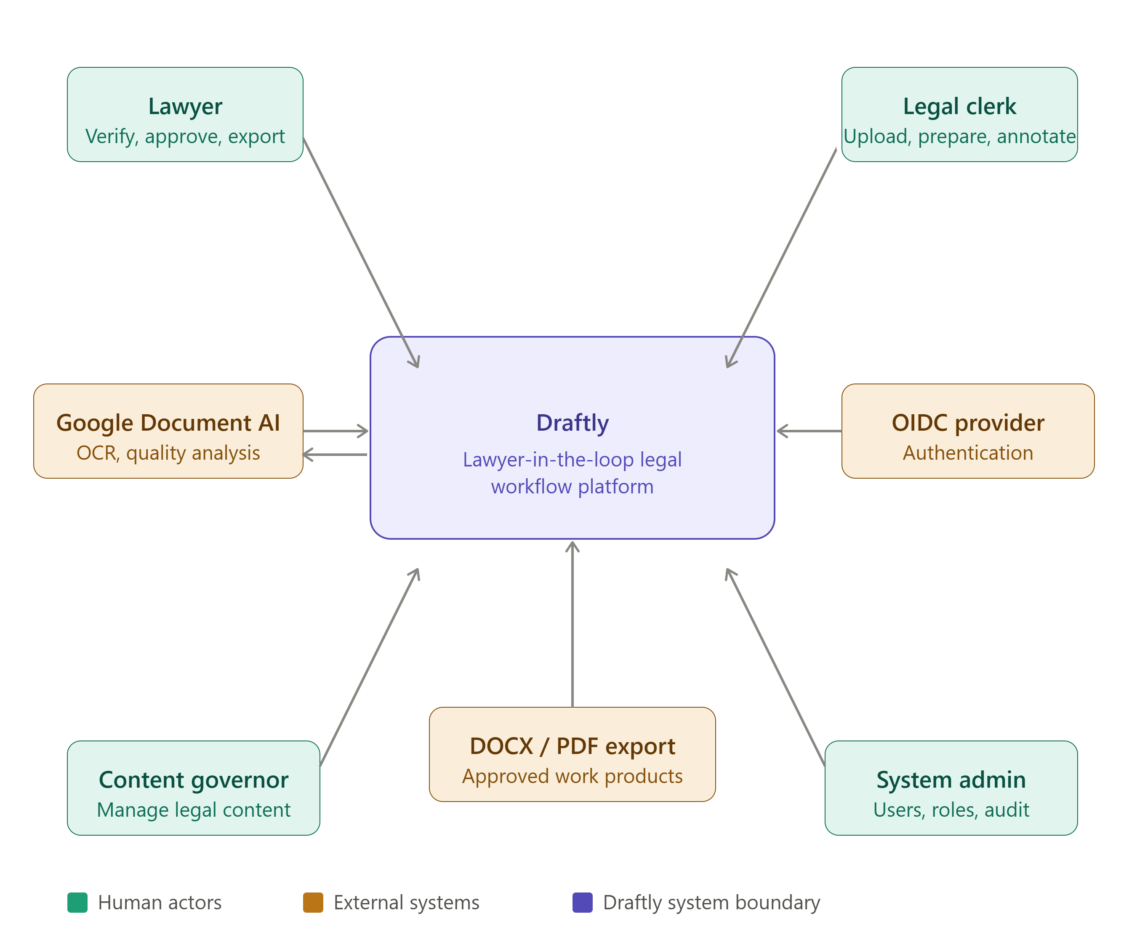
System Architecture — Context
From proj-docs/SRS/diagrams/draftly_system_context.png (SRS v1.0)
BOUNDARY DECISIONS▪ Two human roles inside the loop — lawyer verifies and approves, clerk uploads and prepares
▪ OCR is bought, not built: Google Document AI, so effort goes to verification and checks
▪ Export is a boundary, not a feature — approved work products leave as DOCX/PDF
▪ Content governance is a separate role: the legal corpus is curated, not crawled
In23-S5-CS3501 (130134) · Progress Evaluation · August 2026
6

Slide 7
System Architecture — Retrieval Engine
Three independent channels fused by reciprocal-rank fusion, then gated before an answer is allowed out
Question
question_analysis.py
intent · topic routing
LEXICAL
SQLite FTS5 / BM25
index.py
FUSION
reciprocal-
rank fusion
search.py
PER-PART EVIDENCE QUOTAS
every sub-question must be independently supported
CITATION GATE
each claim must cite a retrieved section ID
DENSE
Gemini embeddings, cached
embeddings.py
ENTAILMENT VERIFIER
claim-level check against its own citations
GRAPH
Personalised PageRank
graph.py
BOUNDED CORRECTIVE RETRY
rewrite + re-retrieve, once, for unverified parts
answering.py — gates, in order
Cited answer · or an explicit "insufficient authority"
Scope is enforced: 57 statutes + 18 amendments, no case law — five guards in code
Ablation switches for evaluation
DRAFTLY_DISABLE_DENSE · _GRAPH · SKIP_CORRECTIVE
The index is content-addressed: corpus_fingerprint() hashes the version tag, metadata CSVs and every document's text, so a stale index rebuilds instead of serving drifted results.
In23-S5-CS3501 (130134) · Progress Evaluation · August 2026
7

Slide 8
Progress — Corpus and Data Layer
Figures from README.md 'Corpus status'; both corpus artifacts are generated, and re-running produces byte-identical output
57 + 18
statutes + amendments in markdown
5,770
sections indexed across 66 statutes
872
amendment actions
3,703
reported judgments (NLR / SLR)
5,474
unreported SC / CoA judgments
14,665
case→statute mentions
BUILT AND WORKING▪ Two independent republishers cross-check each other, not two guesses — every entry records heading_source and present_in
  – That check already paid: one source returned 3 sections for the Marriage Registration Ordinance where the other returned 65
▪ Licence-risk gate: 4,628 of 5,770 sections (80%) survive if the subscription source falls through
▪ Reproducibility gate: 3,523 sections from official sources only
▪ Temporal alignment measured across 1,845 verified links
  – 67.0% applicable · 21.5% superseded since judgment · 11.5% history unknown
STATUTE LINK QUALITY — MOVEMENT THIS PERIOD
GRADE
in-index (section verified) 970 → 1,845
gap-in-index 525 → 94
statute-not-indexed 285 → 0
out-of-range (now visible) 11 → 44
Links failing for want of an index entry fell from 810 to 94 — a reduction of 716 (88.4%), against a projected 700. Read the table as a work list, not a score.
In23-S5-CS3501 (130134) · Progress Evaluation · August 2026
8

Slide 9
Progress — Retrieval Engine and Rule Extraction
122 commits, 10 July – 16 August 2026 · the engine is the only running application in this repository
RETRIEVAL ENGINE · complete▪ 15 modules under src/draftly/retrieval/
▪ Three-channel search with RRF fusion
▪ Citation gate + entailment verifier + one bounded corrective retry
▪ FastAPI service — /search, /answer, /topics, /sources, /health
▪ Streamlit Q&A demo over the statute corpus
▪ CLI: build · search · ask · evaluate · evaluate-questions
HEADNOTE RULE RECOVERY · complete▪ 3,521 of 3,703 judgments yield a rule — 95.1% — deterministic and verbatim, no LLM, $0
▪ 182 abstain and fall through to the bounded LLM track
▪ 531 section bundles: every judgment holding that a given section governs, in date order
  – Civil Procedure Code s.247 alone carries 46 judgments, 1895–1997
▪ 11,739-term topic index over 3,461 cases
SUPREME COURT PIPELINE · complete▪ 2,150 judgment PDFs scraped from supremecourt.lk
▪ Narrowed to 776 confirmed conveyancing cases, zero blank cells
▪ principle_statement filled on 95.5% (741 / 776); disposition on 100%
▪ Cost control: 405 cases skipped where regex already had the answer; anchored ~2,300-char windows
▪ Local Ollama → NVIDIA NIM cut per-case latency ~29 s → ~1.4–2 s
Documented honestly: 35 cases remain without a rule statement after two genuine attempts — recorded as an honest result, not a gap to keep chasing. One regex fix was built, measured, and reverted rather than risk a net-negative change to finalised data.
In23-S5-CS3501 (130134) · Progress Evaluation · August 2026
9

Slide 10
Implementation
What runs today, and where the demo screenshots go
SCREENSHOT PLACEHOLDER
Paste captures here from the draftly-platform repository
(frontend is a separate repository — not in this research repo)
Suggested: Streamlit Q&A answering a question with citations · FastAPI /answer response · matter workspace
RUNNABLE TODAY▪ uv run python -m draftly.retrieval build▪ OCR benchmark harness — shared field schema, normalisation, privacy assertions in code
▪ … ask "What makes a deed valid?"
▪ … serve (FastAPI, 5 endpoints)
▪ uv run streamlit run apps/statute-retrieval/app.py
SUPPORTING TOOLING
▪ Layout-driven CommonLII parsers (src/parsers/)
▪ 40+ corpus build and harvest scripts
▪ 7 analysis notebooks (EDA, baselines, rule recovery, extraction)
Both privacy rules are enforced in code, not policy: normalize.assert_no_raw_values() and config.assert_inputs_private() fail the run rather than leak client data into a report.
In23-S5-CS3501 (130134) · Progress Evaluation · August 2026
10

Slide 11
Testing and Results to Date
Machine-verified checks only — no legal-correctness claim is made at this stage
53 / 53
tests passing — tests/
34 + 10
OCR bench: passed + skipped
1.00
verbatim quote grounding, all arms
83.3%
best arm accept rate (A)
18 / 18
exam questions answered, 0 errors
CASE-LAW EXTRACTION ABLATION · n = 30 per arm
WHAT WE CANNOT YET CLAIM▪ No accuracy scores exist. Every metrics.json reports scored_questions: 0 and labelled_answers: 0
▪ evaluation/retrieval-gold.csv has zero rows; expected_case_ids is empty everywhere
▪ Recovery rates (95.1%, 95.5%) are yield, not accuracy
▪ Answer quality is machine checks only: 44 verified claims, part coverage 0.507, 4 parts returned insufficient authority
▪ 74 lawyer-label rows and a 60-row review sample are still blank
ARM SPECIFICATION ACCEPT GROUNDED
A Llama 3.1 8B · naive head/tail 0.833 1.00
B Llama 3.1 8B · cue-aware window 0.733 1.00
C Llama 3.1 8B · full text 0.633 1.00
Arm A wins on accept rate; grounding is 1.00 everywhere, which is the point — the validator holds regardless of window strategy, so the cheap model is safe to use.
Pre-registered go criterion: lawyer_legal_precision ≥ 0.9 with strict quote grounding = 1.0. The full extraction run is gated behind it and has not been released.
In23-S5-CS3501 (130134) · Progress Evaluation · August 2026
11

Slide 12
Challenges and How They Were Addressed
No free source carries the missing statute text
documents.gov.lk serves a placeholder, lawnet.gov.lk returns an empty body, and the one republisher paywalls each article part-way through at an unmarked point.
→ 18 of 20 fetched files stored with body_truncated: true and excluded from the corpus. A section missing from a truncated page is indistinguishable from one that does not exist — so only the arrangement and commencement dates are used.
Free-tier model quotas stalled two runs
The OCR benchmark and the SC/CoA extraction pilot both returned 401 UNAUTHENTICATED; zero fields scored, zero rules extracted from 5,474 judgments.
→ Recorded as failed runs rather than quietly dropped. Long evaluations moved early in each window and every stage checkpointed for resume. Credential fix is scheduled work, not a background hope.
Local LLM inference was too slow to be viable
Measured ~110 tok/s prefill and 19–20 tok/s generation — 45–70 s per case, projecting 27–42 hours for the backlog.
→ Targeted windows and skip-if-already-known cut it to ~29 s, then the move to NVIDIA NIM took it to ~1.4–2 s — 15–20× faster with the grounding gate unchanged.
Two extractions of the same PDF disagree
The generated section index holds 801 Civil Procedure Code sections; the live retrieval index holds 103, all marked parsed.
→ The gap is now measurable rather than hidden, because every entry is source-labelled. Fix is next in the queue, with a build assertion so a thin index fails loudly instead of quietly.
In23-S5-CS3501 (130134) · Progress Evaluation · August 2026
12

Slide 13
Remaining Work and Timeline
Work packages and dates from proj-docs/project Management/grantt-blueprint.md
AUGUST
SEPTEMBER
OCTOBER
R3
Benchmark construction (~100 qs)
R4
Gold labelling + agreement (κ)
R5
Battle-testing and ablations
R6
External baselines on our corpus
P2–P4
Platform wiring behind each surface
P5
Checks engine + rule catalogue
P6
Form 8, export, approval gate
X2
Document AI field extraction
I1
P0 demo path end to end
I3
Holdout evaluation + 11 gates
D9–D10
Test plan → test report
D11–D12
Final report, demo, viva
■ Research ■ Platform ■ Extraction ■ Integration ■ Documentation
Viva 28 Sep – 2 Oct (fixed) · final artefacts to 19 Oct
17 Aug
In23-S5-CS3501 (130134) · Progress Evaluation · August 2026
13

Slide 14
Conclusion and Next Steps
WHERE WE STAND▪ The data layer is built and reproducible — the corpus, section index and amendment actions all regenerate byte-identically
▪ The retrieval engine runs end to end, with scope and grounding enforced in code rather than by convention
▪ Rule extraction works on both tracks: deterministic recovery at 95.1% yield, and a bounded LLM track whose validator holds at 1.00 grounding
▪ The project's honesty discipline is intact — every unmeasured thing is labelled unmeasured
IMMEDIATE NEXT STEPS · ordered by what unblocks what
1. Build the evaluation gold set (~50 questions) — nothing can be measured, tuned or reported until this exists
2. Fix section_parser.py against the Civil Procedure Code, with a build assertion so a thin index fails loudly
3. Get lawyer sign-off against the pre-registered criterion; the full extraction run is gated behind it
4. Fix credentials, re-run the SC/CoA pilot, and confirm the gate rejects an injected fabricated quote
5. Build authority ranking — the most novel component relative to the literature, and currently unbuilt
Risk we are managing: mentor availability paces every verification gate. Review packs are batched into three checkpoints and booked in advance; if a pack slips, the dependent work package slips with it — nothing unverified is promoted in its place.
In23-S5-CS3501 (130134) · Progress Evaluation · August 2026
14

Slide 15
References
As recorded in proj-docs/project Management/retrieval-engine-methodology.md and the project proposal
METHOD AND EVALUATION LITERATURE
[1] HippoRAG — personalised PageRank over a citation graph for multi-hop retrieval. arXiv:2405.14831
[2] CLERC — mask-a-citation gold sets and closed-corpus hallucination metrics for legal retrieval. arXiv:2406.17186
[3] NyayGraph — knowledge-graph expansion for Indian legal statute retrieval. Proc. NLLP, 2025.nllp-1.11
[4] IL-PCSR — cross-task injection for prior-case and statute retrieval. arXiv:2511.00268
[5] RAPTOR — recursive abstractive processing for tree-organised retrieval. arXiv:2401.18059
[6] Topic-partitioned sub-indexes for scope-first retrieval. arXiv:2502.20364
[7] Dated section-versions and amendment events as first-class records. arXiv:2505.00039
[8] Metadata-as-nodes for multi-hop traversal and authority ranking. arXiv:2506.22165
LEGAL SOURCES AND COMPARABLE SYSTEMS
[9] Registration of Title Act, No. 21 of 1998 (Sri Lanka) — the "Bim Saviya" title-registration programme
[10] Legislative Enactments of Sri Lanka — statute text and arrangement of sections
[11] CommonLII — New Law Reports and Sri Lanka Law Reports archive
[12] Supreme Court of Sri Lanka — supremecourt.lk judgment archive
[13] LawLanka; LawCeylon; Paralegal.lk; AI PAZZ — Sri Lankan legal research platforms
[14] Harvey (harvey.ai) — international AI-assisted legal workspace
[15] Legora aOS — agentic operating system for legal work
[16] Orbital Copilot — title and survey workflow product
Citation keys are reproduced as recorded in the project's methodology document. Expand to the module's required citation style before submission.
In23-S5-CS3501 (130134) · Progress Evaluation · August 2026
15

