Slide 1

DRAFTLY
Grounded legal retrieval and a lawyer-controlled
conveyancing matter workflow for Sri Lanka
GROUP 06 · UNIVERSITY OF MORATUWA · DCS&E
Himath Dhanapala · Lahiru Dilshan · Praveen De Silva
Supervisor: Dr. Nisansa de Silva
Notes:
Slide 01 · draftly-cover · 0:20
Draftly is our final data science and engineering project. We built a statutory retrieval study and a matter workbench for Sri Lankan conveyancing. Both are grounded in evidence and keep legal decisions with the lawyer. We begin with the task practitioners face.

Slide 2

DRAFTLY · FINAL PRESENTATION
A conveyancing matter has two information bottlenecks
01
02
LEGAL INFORMATION RETRIEVAL
MATTER DOCUMENTS
One scenario can require several provisions. A missing section leaves the answer incomplete.
Key facts are buried in PDFs and scans. Lawyers must read and reconcile them.
DOCUMENT REVIEW + A MEASURED SEARCH FOR COMPLETE AUTHORITY
DRAFTLY / UNIVERSITY OF MORATUWA
02 / 22
Notes:
Slide 02 · matter-before-form · 0:40
Draftly addresses two related problems. First, a legal question can require several statutory provisions together. Search may surface one plausible section while missing a definition or exception. Our research paper measures that completeness problem. Second, ownership, parcel details, parties, and registered interests are buried in PDFs and scanned documents. Lawyers spend time reading and reconciling them, so extracted values must remain reviewable. We will show the legal retrieval research first, then the software workbench that handles documents and decisions.

Slide 3

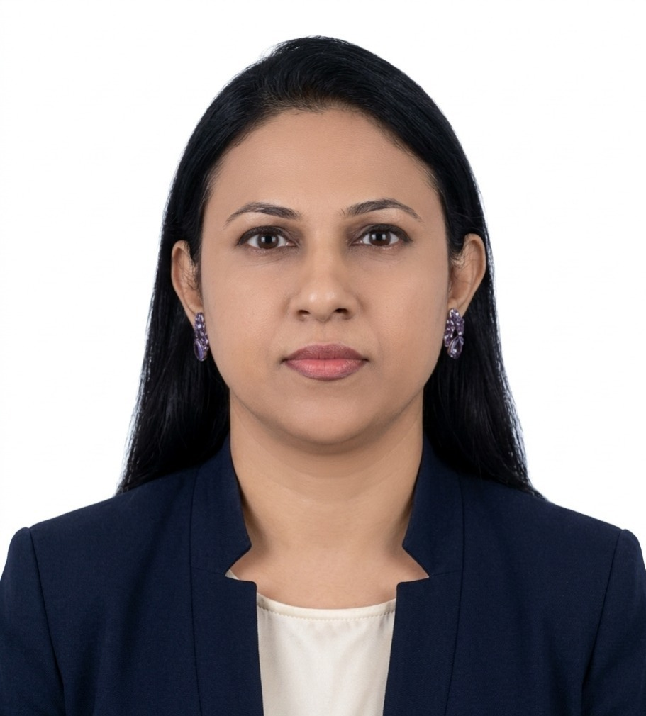
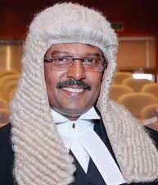

DRAFTLY · FINAL PRESENTATION
Practitioners shaped the corpus and the matter workflow
3 IN-PERSON CONSULTATIONS
Notarial curriculum
→
Topic map and statutory coverage
Sample matter documents
→
Document-reading trials
Practitioner feedback
→
Evidence review and lawyer decision gates
ANURA DHANARATNA
Lawyer · Notary · Law College lecturer
ADDITIONAL STAKEHOLDER CONVERSATIONS
DRAFTLY / UNIVERSITY OF MORATUWA
03 / 22
Notes:
Slide 03 · practitioner-constraints · 0:40
We held three in-person discussions with legal practitioners and experts. One was with Anura Dhanaratna, a lawyer and notary who teaches conveyancing at Sri Lanka Law College. His detailed notarial-practice curriculum helped us organize the conveyancing topic map and identify statutory coverage; we obtained the actual Acts from legal source collections. He also supplied sample matter documents that we used in document-reading trials. Those trials informed page handling and multilingual OCR design, but field-level extraction accuracy has not been established. The discussions gave us concrete workflow constraints: link proposed facts to their source, check the law that applied on the relevant date, and keep consequential decisions with the lawyer. This is stakeholder grounding of the problem and design, while legal labels and final instruments still need professional validation. We begin the research section with the data these sources helped us assemble.

Slide 4
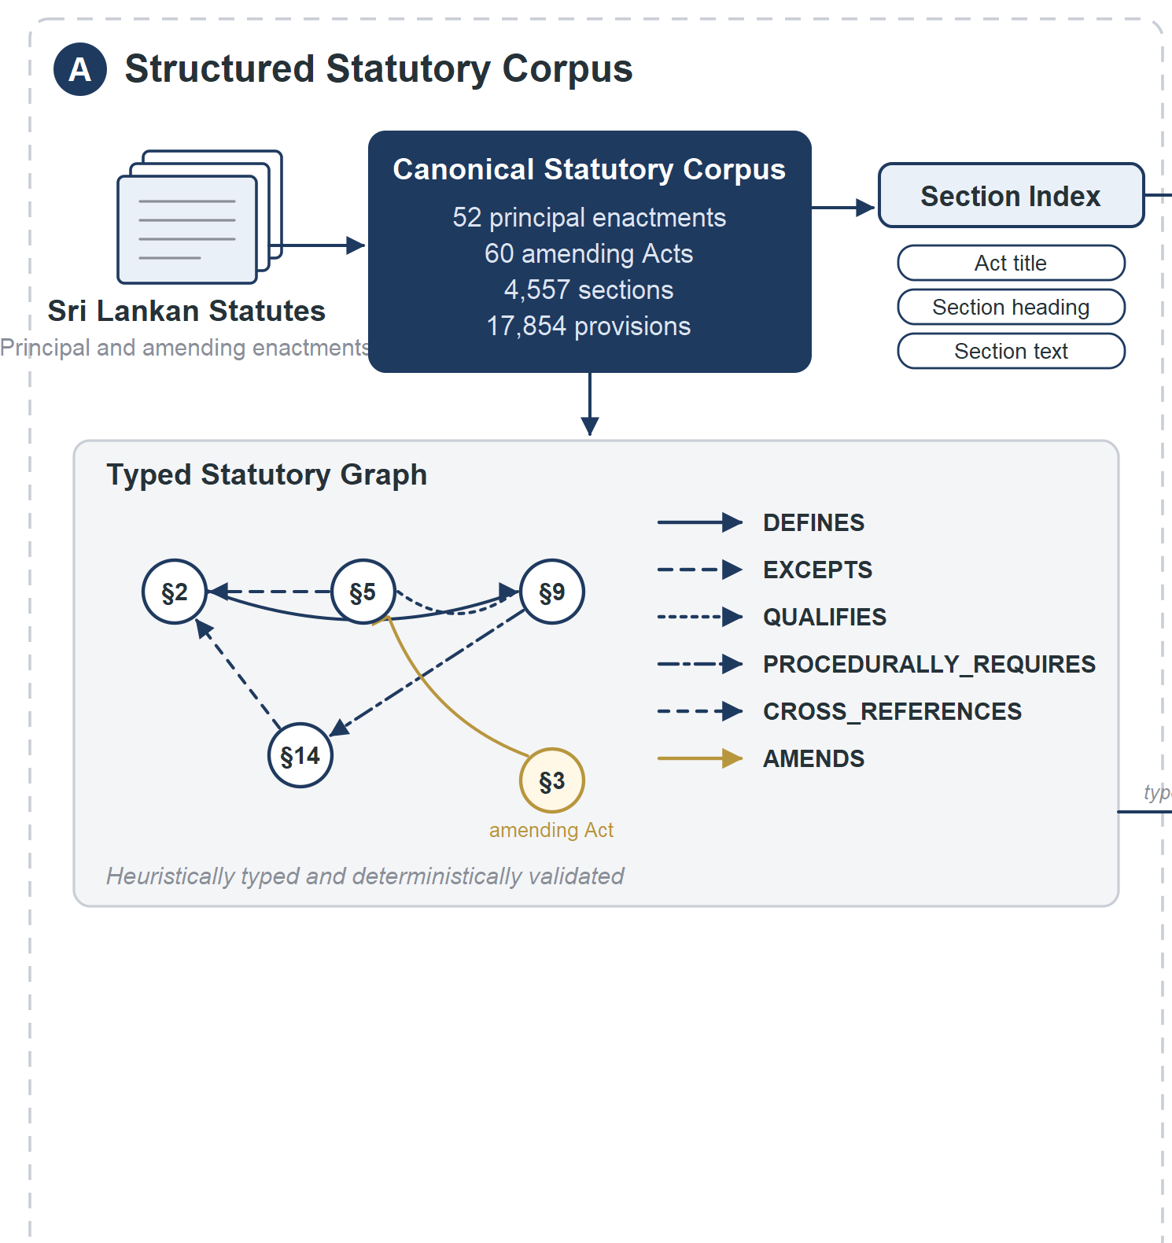

PART I · LEGAL INFORMATION RETRIEVAL
The notarial syllabus became a structured statutory search corpus
52 + 60
principal enactments + amending Acts
4,557
sections · 17,854 provisions
6,346
typed statutory edges
Public Act source-link index · parsed text stays internal
INTERNAL PARSED RESEARCH CORPUS
DRAFTLY / UNIVERSITY OF MORATUWA
04 / 22
Notes:
Slide 04 · statutory-corpus · 0:55
The practitioner curriculum gave us the notarial and conveyancing topic map. Principal enactments named in the Law College course tables became the starting set; we collected their amendments and parsed source PDFs into a frozen section index. Six edge types record definitions, exceptions, qualifications, procedural requirements, cross-references, and amendments. The section is the retrieval unit. The Hugging Face resource here is an Act metadata and source-link index, while the full parsed text used in the experiments remains internal. Alongside statutes, we assembled case law for legal research.

Slide 5
PART I · LEGAL INFORMATION RETRIEVAL
The case-law collection adds judgments, with provisional rule extraction
3,703
5,474
reported NLR / SLR conveyancing judgments
official Supreme Court / Court of Appeal judgment documents
3,521 / 3,703
reported cases yielded verbatim headnote rules
PROVISIONAL RULES · LAWYER VALIDATION PENDING
DRAFTLY / UNIVERSITY OF MORATUWA
05 / 22
Notes:
Slide 05 · case-law-corpus · 0:55
The case-law work complements statutory retrieval. We collected 3,703 reported conveyancing judgments from NLR and SLR and 5,474 official Supreme Court and Court of Appeal judgment documents. A deterministic headnote reader recovered a verbatim rule in 3,521 reported cases. For harder cases, a bounded model-assisted path required a quotation present in the judgment. On a held-out set, 74 of 100 outputs passed that quote gate; a provisional model judge rated 58.1 percent of accepted outputs fully usable, below our threshold. No extracted rule is lawyer approved, and case-law ranking was outside the scored statutory benchmark. The next slide shows the separate retriever built over these cases.

Slide 6
PART I · LEGAL INFORMATION RETRIEVAL
A separate retriever finds analogous conveyancing cases
5,121 CONVEYANCING-FLAGGED CASES / 9,177 COLLECTED
Fact pattern
Case index
BM25 text
Case graph
Rank fusion
Cited cases
→
→
→
→
→
Optional dense embeddings
Lexical / graph corroboration
inactive in the recorded pilot
or explicit no-similar-case state
14 / 20 → 10 / 20
proxy-correct initial → later corpus snapshot; no lawyer labels
DRAFTLY / UNIVERSITY OF MORATUWA
06 / 22
Notes:
Slide 06 · case-retrieval · 0:50
Alongside the statutory corpus, we assembled 3,703 reported conveyancing judgments and 5,474 official-court judgment documents. A separate case retriever indexes 5,121 cases flagged as conveyancing-related. Given a fact pattern, it searches judgment text and extracted rule statements lexically, expands through cases sharing statute or topic links, and fuses the ranked lists. The code also supports a dense channel, but no embedding key was available in the recorded evaluation, so those results reflect lexical plus graph retrieval only. A case needs lexical or graph corroboration to be returned. Twenty past-paper fact patterns were judged by LLM proxies: 14 of 20 initial results were judged to contain an analogous case, but a later corpus rebaseline fell to 10 of 20. This is exploratory evidence without lawyer-verified relevance labels. The case service is separate from the paper's statutory retriever and from the hosted BM25 research path.

Slide 7
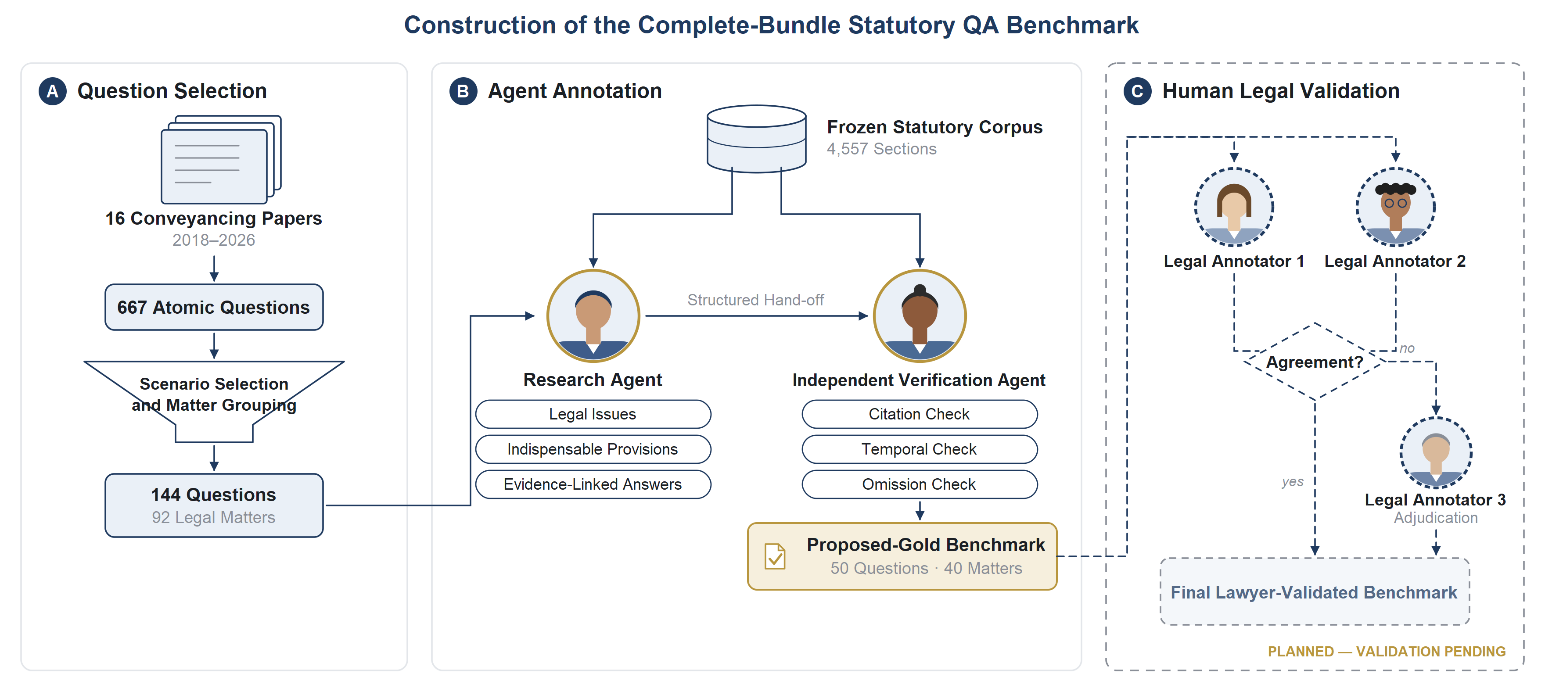
PART I · LEGAL INFORMATION RETRIEVAL
Law College scenarios became a provisional statutory QA benchmark
16 EXAM PAPERS → 667 ATOMIC QUESTIONS → 50 SCORED / 40 MATTERS
Provisional release
40 test questions / 32 matters · attorney adjudication pending
DRAFTLY / UNIVERSITY OF MORATUWA
07 / 22
Notes:
Slide 07 · qa-benchmark · 0:55
These questions came from sixteen Law College conveyancing examination papers, a different input from Anura Dhanaratna’s notarial curriculum. The papers yielded 667 atomic questions. Scenario selection and matter grouping produced fifty statute-only scored questions in forty matters; forty questions in thirty-two matters formed the test split. One agent proposed the indispensable provisions and evidence-linked answers, and an independent agent checked them. A deterministic validator confirmed identifiers and quotations in the frozen corpus. It could not decide legal indispensability. The three-attorney stage shown at right remains planned. The provisional benchmark is public on Hugging Face. We need a metric that reflects whether all proposed sections were found.

Slide 8
PART I · LEGAL INFORMATION RETRIEVAL
Retrieval succeeds only when it finds every required section
ILLUSTRATIVE QUESTION: AGENT-PROPOSED REFERENCE BUNDLE
TOP 20
Section A
Section B
Section C
→
A + B
C@20 = 0
SECTION C MISSING
Full credit only when every proposed section appears in the first 20 results.
DRAFTLY / UNIVERSITY OF MORATUWA
08 / 22
Notes:
Slide 08 · complete-bundle-metric · 0:40
A system can rank a plausible section first and still omit a definition, exception, or procedural requirement. Complete-indispensable recall at twenty gives full credit only if every proposed indispensable section appears in the first twenty results. This picture explains the metric; it is not an actual benchmark case. Because the labels have not been attorney adjudicated, the score uses provisional reference sets. We used the same frozen data and metric to compare seven retrieval configurations.

Slide 9
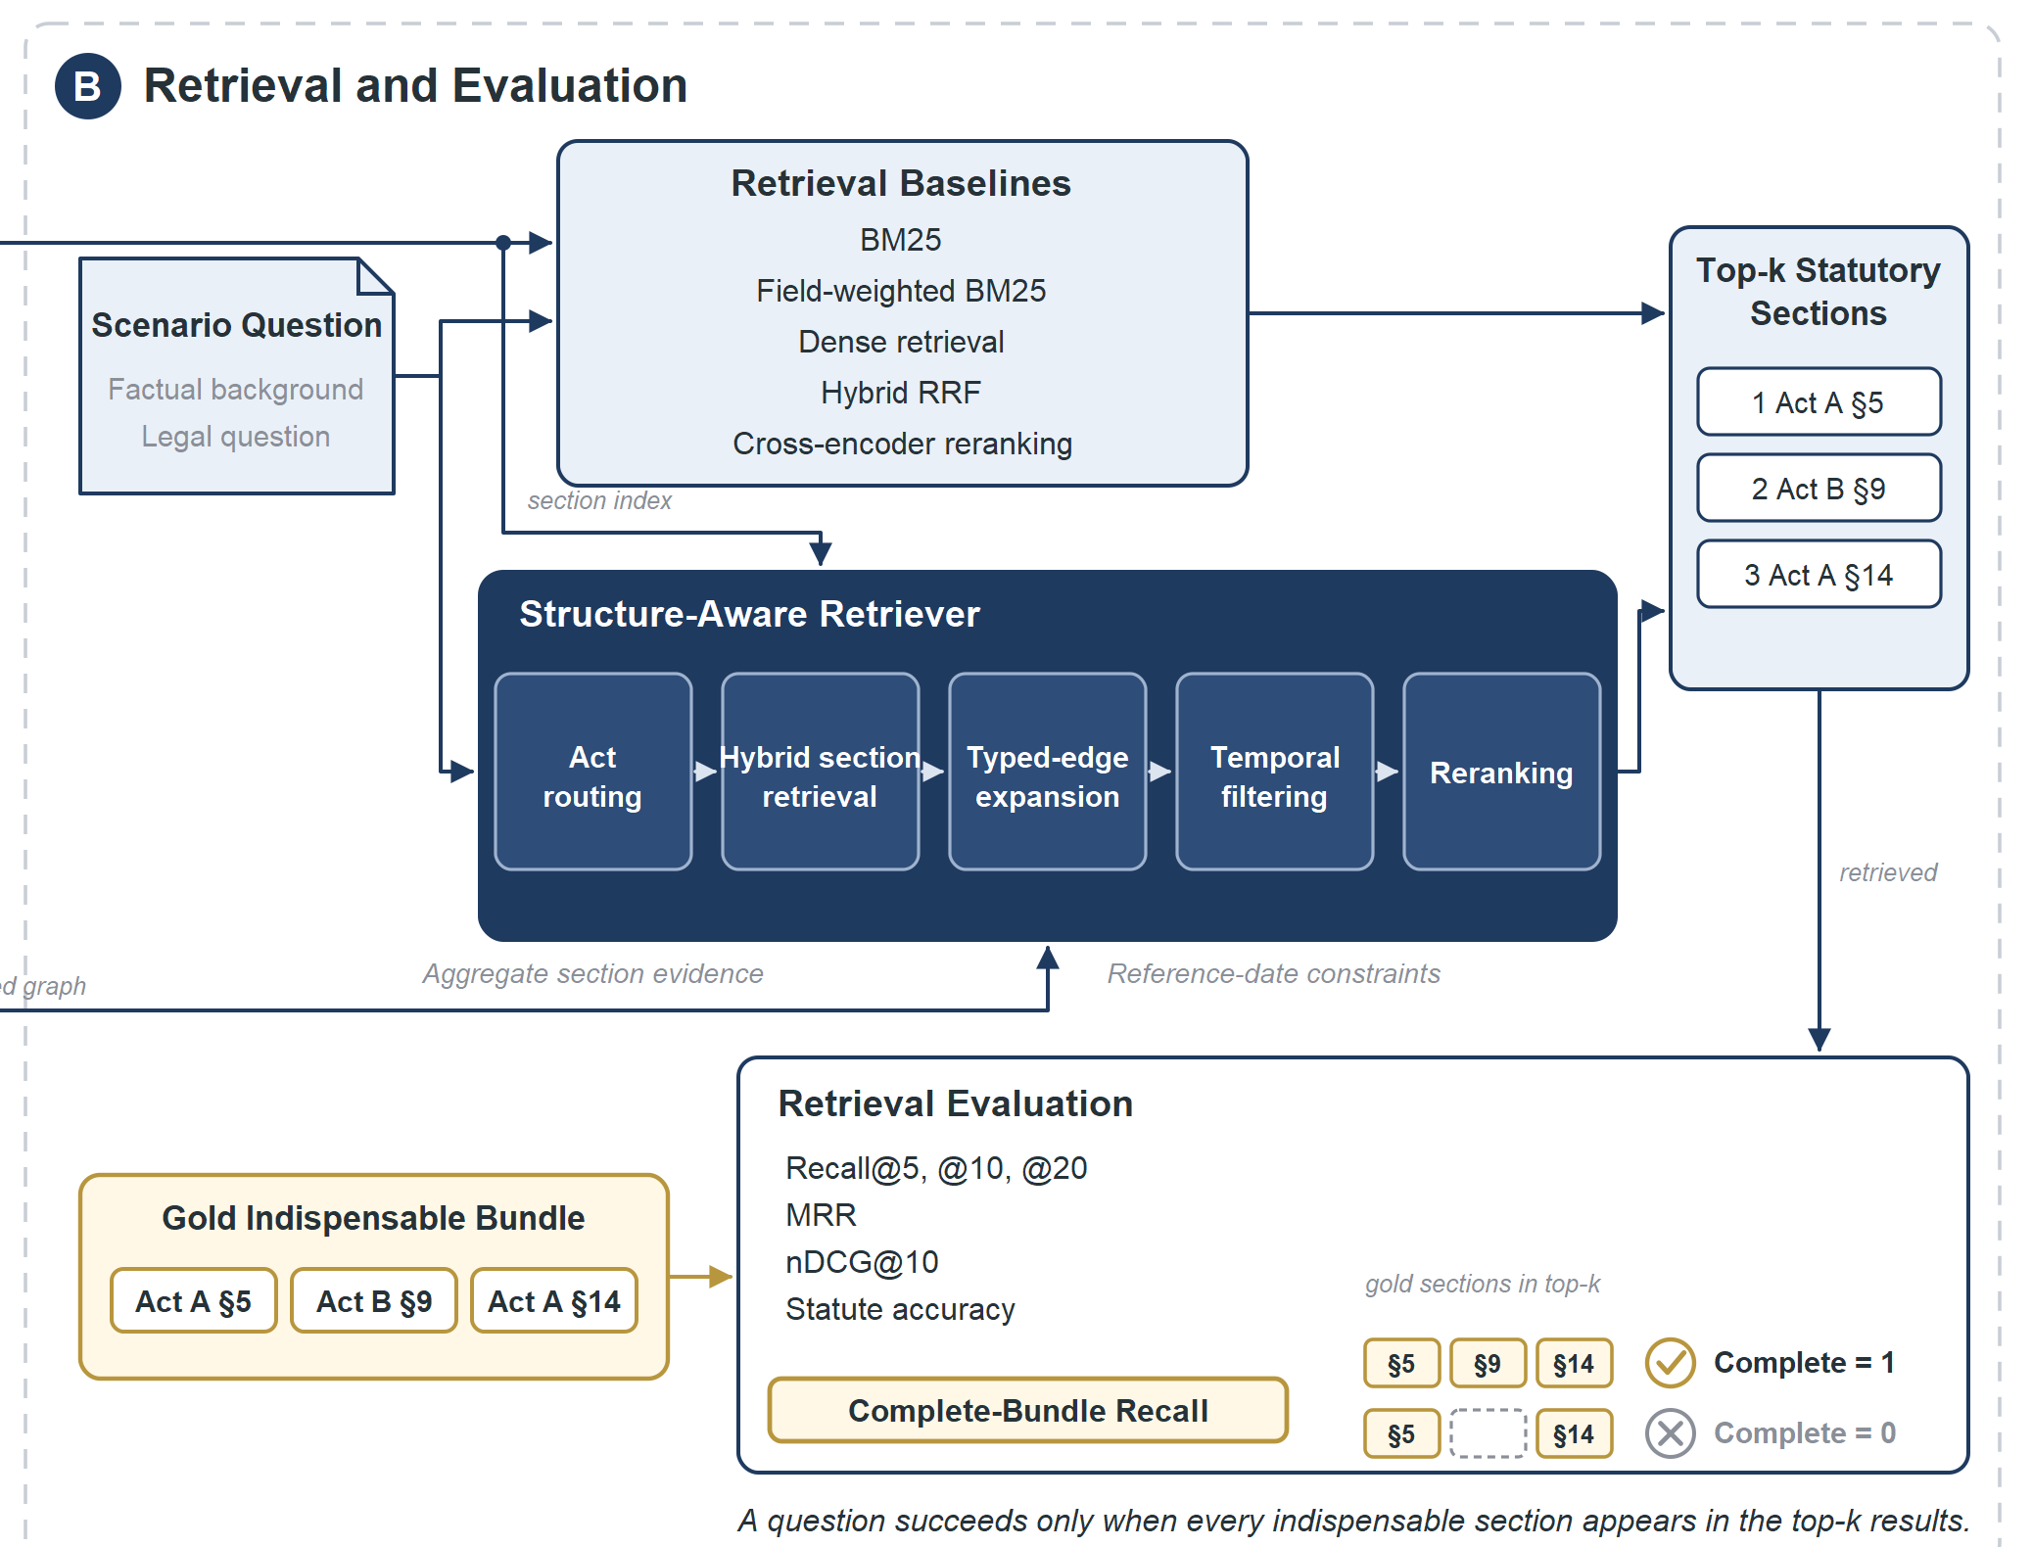
PART I · LEGAL INFORMATION RETRIEVAL
Seven offline retrieval systems used the same benchmark
LEXICAL
BM25 · field-weighted BM25
SEMANTIC / FUSION
Dense · hybrid · reranker
STRUCTURE
Hierarchical · typed expansion
OFFLINE RESEARCH · PROVISIONAL LABELS
Seven matched configurations · one frozen test split
DRAFTLY / UNIVERSITY OF MORATUWA
09 / 22
Notes:
Slide 09 · retrieval-systems · 0:55
The diagram shows where methods diverge after receiving the same scenario question. BM25 favors exact terminology; dense search uses semantic section windows; hybrid fuses rankings; a reranker is a separate variant. Hierarchical retrieval first routes to likely Acts, then retrieves sections. Typed expansion follows explicit legal relationships and applies a temporal filter. All seven were offline configurations scored on the same frozen questions and corpus. The live platform has a BM25 index, not seven selectable modes. The next slide shows which approaches recovered complete bundles.

Slide 10
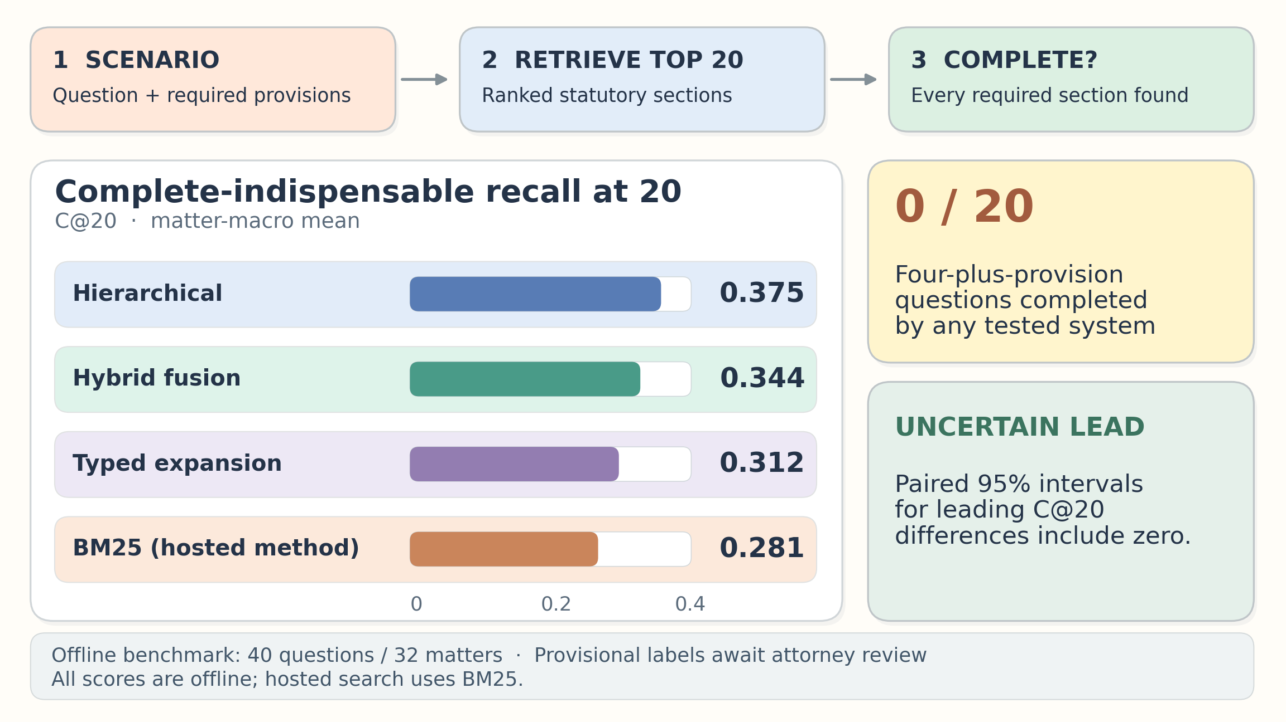
PART I · LEGAL INFORMATION RETRIEVAL
Complete recall peaked at 0.375, while hard bundles remained unsolved
0 / 20
questions needing ≥4 provisions completed
2 / 114
missed provisions one explicit edge away
Leading paired uncertainty intervals include zero
OFFLINE · PROVISIONAL LABELS · 40 TEST QUESTIONS / 32 MATTERS
DRAFTLY / UNIVERSITY OF MORATUWA
10 / 22
Notes:
Slide 10 · retrieval-results · 1:00
Hierarchical retrieval recorded the highest observed complete-bundle score, 0.375, while hybrid had the highest average indispensable recall. The paired intervals among leading systems include zero, so point estimates do not establish a certain winner. None of the twenty test questions needing four or more provisions was completed by any system. Of 114 indispensable sections missed by the structure-aware retriever, only two were one explicit edge from a retrieved seed. The graph holds useful explicit relationships, but most scenario dependencies were not encoded as reachable edges. These are offline results against provisional labels. The accepted paper packages this dataset, method, and negative result.

Slide 11
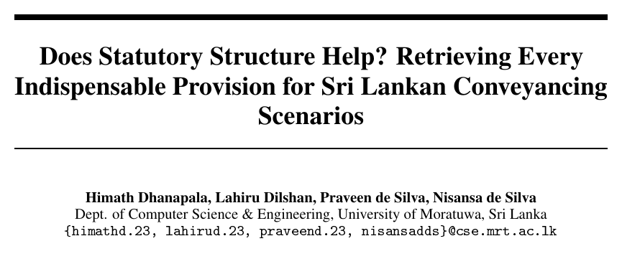
PART I · LEGAL INFORMATION RETRIEVAL
The accepted paper reports the complete-bundle retrieval result
01
Structured Sri Lankan statutory corpus
02
Provisional scenario QA benchmark
03
Seven-system retrieval evaluation
ACCEPTED FOR PRESENTATION
Typed-edge expansion did not demonstrate a complete-recall gain over hybrid retrieval.
NeurIPS 2026 GlobalSouthAI workshop
DRAFTLY / UNIVERSITY OF MORATUWA
11 / 22
Notes:
Slide 11 · accepted-research-paper · 0:45
This paper is accepted for presentation at the NeurIPS 2026 GlobalSouthAI workshop. It contributes the structured Sri Lankan statutory corpus, a scenario QA benchmark with proposed indispensable sections, and a matched seven-system retrieval evaluation. The tested typed-edge expansion did not demonstrate a gain over strong hybrid retrieval. The paper also reports the hard multi-provision failure and limited one-hop reachability of missed sections. Labels need attorney validation before we can claim legal gold. Our hosted search is currently BM25; a teammate is developing embedding-enabled retrieval with query rewriting, which the paper did not evaluate. That integration must be scored on the same complete-bundle question. We now move to the software workbench that uses legal research and document evidence in a lawyer-owned matter.

Slide 12
PART II · SOFTWARE ENGINEERING
Post-certificate RTA made the first document workflow tractable
FIRST SCOPE · POST-CERTIFICATE RTA TRANSACTIONS
DEFERRED
Handwritten pattiru / folio OCR
AT-form extraction
Historical title reconstruction
Initial title settlement
Title certificate
Cadastral / survey plan
Transaction evidence
→
→
Defined requirements + prescribed forms
support reviewable checks
DRAFTLY / UNIVERSITY OF MORATUWA
12 / 22
Notes:
Slide 12 · rta-scope · 0:50
Part two is the software engineering workbench. We chose post-certificate transactions under the Registration of Title Act No. 21 of 1998 after practitioner discussions. In this first lane, the lawyer can work from a title certificate, cadastral or survey plan information, and the relevant transaction documents, following defined requirements and prescribed forms. That gave us a bounded workflow in which to test source-linked document review and checks. The older deeds-registration path brings handwritten pattiru or folio records and historical title tracing; making Sinhala handwriting recognition reliable would have become a separate research project. After discussion with our supervisor, we deferred that OCR problem, AT-form extraction, and initial title settlement to later work. This does not mean every RTA input is clean or machine-readable: scans still need lawyer verification. The next slide shows how the selected matter moves through the workbench.

Slide 13
PART II · SOFTWARE ENGINEERING
One matter connects intake, review, checks, and audit
01 · MATTER AND EVIDENCE
02 · LAWYER REVIEW
03 · DRAFT AND RECORD
Create + classify matter
Verify or correct facts
Prepare form draft
↓
↓
↓
Upload source documents
→
Run checklist + checks
→
Check prerequisites
↓
↓
↓
Resolve finding / request evidence
Lawyer reviews + decides
Record candidate facts + evidence
↓
↓
Review cited research
Record approval / export + audit
Findings return to review; a rejected draft returns to verified facts.
DRAFTLY / UNIVERSITY OF MORATUWA
13 / 22
Notes:
Slide 13 · matter-route · 0:40
The matter is the unit of work. A user opens and classifies it, uploads documents, and sees candidate facts linked to evidence. A lawyer verifies or corrects those candidates before checks or form bindings. The versioned rule pack supplies requirements. The lawyer can discuss matter state with the Draftly Matter Agent and separately inspect cited legal research; direct agent-to-research calling remains planned. Draft, preflight, approval, and export are distinct records. The hosted demonstration later shows which screens and gates are connected today. First, look closely at the fact boundary.

Slide 14
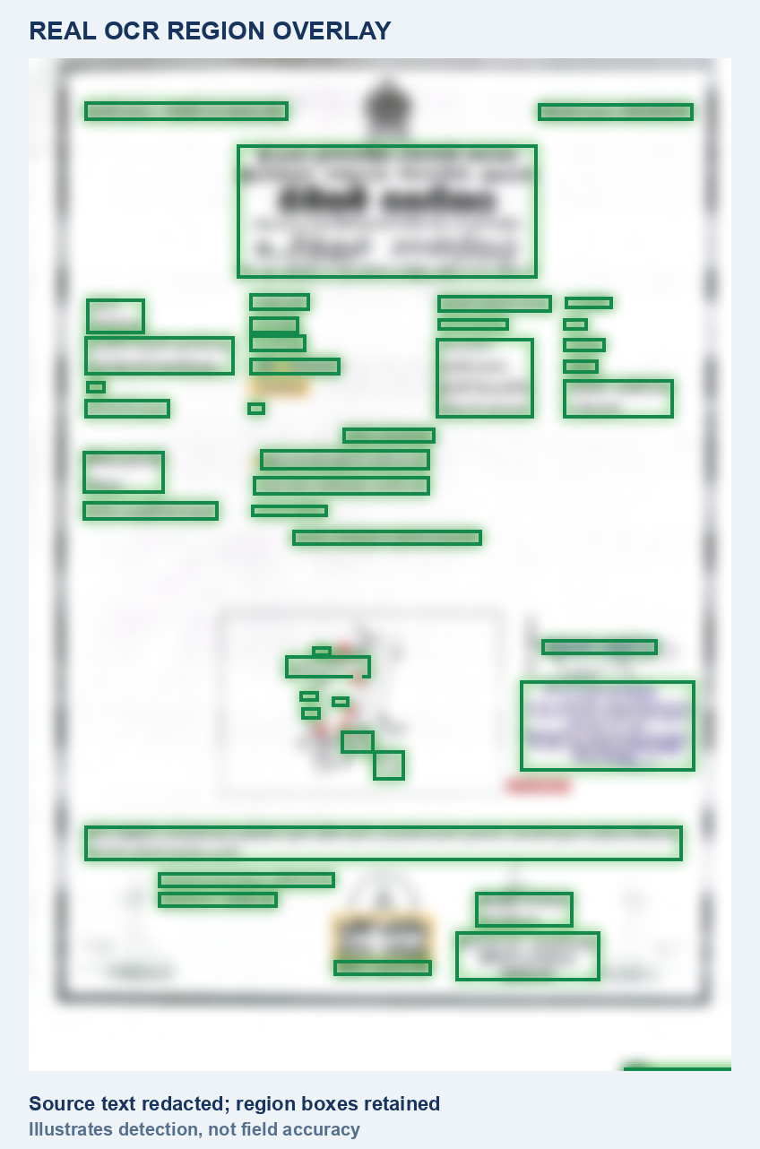
PART II · SOFTWARE ENGINEERING
OCR detects text regions, but field accuracy remains unscored
4 / 38 / 282
matters / documents / pages in inventory
26 / 26
pilot pages returned text
37 / 4 / 1
labelled fields / documents / matter
FIELD-LEVEL ACCURACY NOT YET SCORED
Real benchmark page · text redacted · OCR regions shown
DRAFTLY / UNIVERSITY OF MORATUWA
14 / 22
Notes:
Slide 14 · document-ocr-evaluation · 0:55
We tested document reading on a collection of four matters, 38 documents, and 282 pages. That is the available inventory, not a claim that every engine processed every page. This actual title-document page shows the OCR regions found in one benchmark run; the source text has been redacted for the presentation. In a 26-page Vision pilot, text was returned on every page. That measures coverage, not correctness. One matter also has 37 labelled fields across four documents, but the extraction comparison was not scored after credential and availability failures. A detected box is evidence of a text region, not a verified title fact. The next slide shows how such evidence would travel through the full document-processing design.

Slide 15
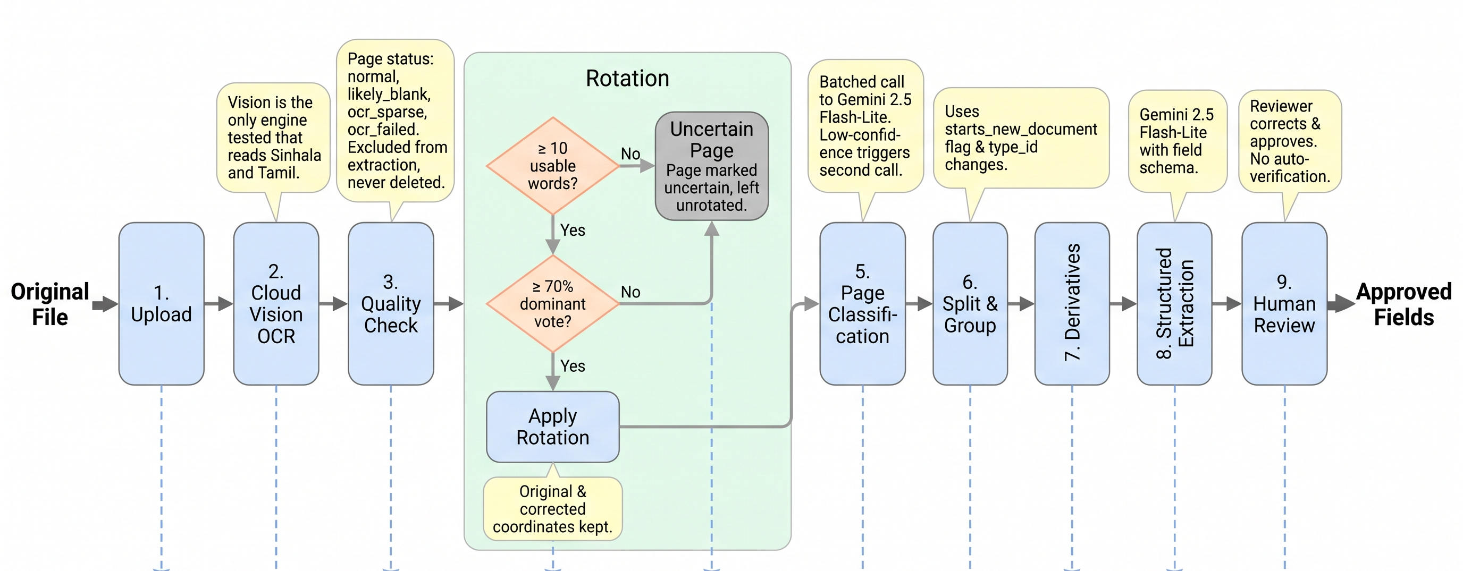
PART II · SOFTWARE ENGINEERING
The full processing design ends at lawyer review
RESEARCH PIPELINE DESIGN · LATER EXTRACTION STAGES NOT HOSTED
Hosted: upload → run / stub candidates → lawyer review
DRAFTLY / UNIVERSITY OF MORATUWA
15 / 22
Notes:
Slide 15 · document-processing-pipeline · 0:50
Here is the complete document-processing sequence we designed from the OCR trials. It starts with upload, OCR and quality checks, then handles orientation before classifying and grouping pages. The later stages create derivatives and propose structured fields for human review. The diagram is a research design reference, and its original storage lanes were removed because they no longer match the VPS. In the hosted workbench, the source file and processing run persist, but extraction currently supplies stub candidates. A lawyer must verify or correct a candidate before it becomes a versioned fact for drafting. So the pipeline image shows the full intended flow and its review gate, while the status strip names what is running today. Next is the separate statutory research service.

Slide 16
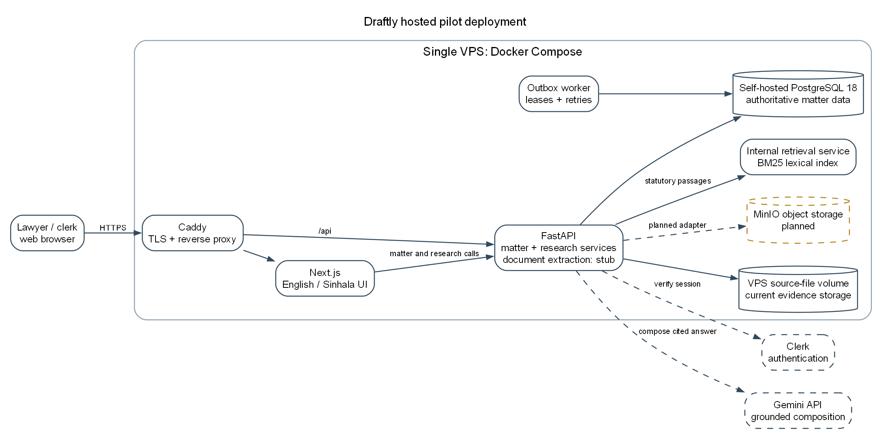
PART II · SOFTWARE ENGINEERING
The shipped research service returns cited statutory passages
HOSTED RESEARCH PATH · BM25
Lawyer question
Research view
FastAPI
BM25 index
Cited passages
→
→
→
→
Grounded response
or insufficient authority
Current VPS topology
Next version in progress: embeddings + query rewriting
DRAFTLY / UNIVERSITY OF MORATUWA
16 / 22
Notes:
Slide 16 · shipped-retrieval · 0:55
The hosted research workspace takes a lawyer's question through the workbench and API to an internal retrieval container. That container currently ranks statutory sections with BM25; it is not the paper's offline hybrid or hierarchical system. Retrieved passages retain Act and section citations. The research API can use those passages to compose a grounded response, and it abstains with insufficient authority when no usable passage is returned. This path is separate from the Draftly Matter Agent today: the agent's direct legal-research tool is not connected. A teammate is building embedding-enabled retrieval and query rewriting, but we should update the solid diagram only after the deployed configuration and a smoke test confirm it. The assistant has a similar authority boundary.

Slide 17
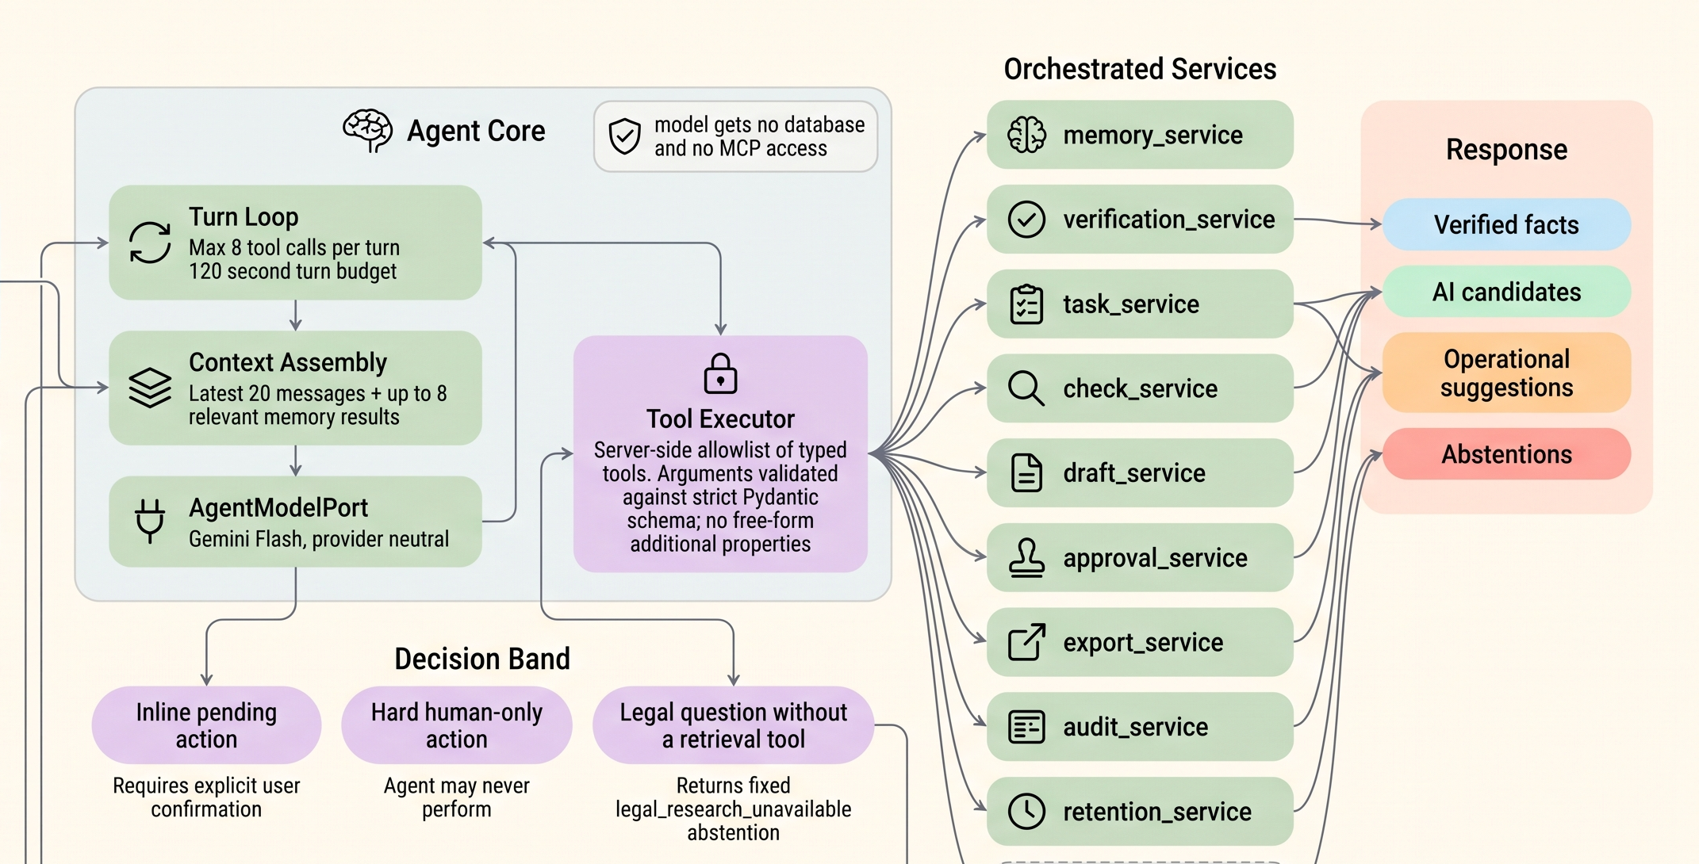
PART II · SOFTWARE ENGINEERING
The assistant can propose actions; the server and lawyer control them
Matter-scoped session
Allowlisted server tools
Action → explicit confirmation
Legal question → abstention
Cited research → separate view
EARLIER DESIGN REFERENCE
DRAFTLY / UNIVERSITY OF MORATUWA
17 / 22
Notes:
Slide 17 · agent-boundary · 0:50
The Draftly Matter Agent is organized around a matter session, not unrestricted access to the database. It can read authorized matter context through allowlisted tools, while consequential proposed actions require confirmation. A model suggestion cannot directly write a verified legal fact. The agent's direct statute-search tool is still to be connected; legal questions abstain there today. The separate research workspace returns cited statutory material or an insufficient-authority response. This image is a design reference, so its older storage and provider labels do not describe the current VPS. The rule pack carries the same control into drafting.

Slide 18
PART II · SOFTWARE ENGINEERING
The rule pack can stop an unsafe drafting path
Versioned RTA
rule pack
Checklist +
findings
Verified facts +
form bindings
Preflight +
lawyer approval
→
→
→
UNRESOLVED STATUTORY BLOCKER → STOP
An unapproved draft cannot be exported as approved.
DRAFTLY / UNIVERSITY OF MORATUWA
18 / 22
Notes:
Slide 18 · rules-and-gates · 0:45
The RTA rule pack is versioned content, not a free-form prompt. It records transaction types, required documents, checklist items, checks, forms, and each requirement's source class. A matter's checklist is pinned to the rule-pack version used. Findings send the lawyer back to missing or conflicting evidence; they are not a determination of title. Unresolved statutory blockers stop relevant progression, and an unapproved form cannot be exported as approved. Legal wording still needs professional sign-off, so no registration-ready export is claimed. We can now demonstrate these gates in a synthetic matter.

Slide 19
PART II · SOFTWARE ENGINEERING
Inspect a synthetic RTA matter from evidence to refusal gate
LIVE PRODUCT DEMONSTRATION · SYNTHETIC RTA MATTER
Matter
Documents
Candidate review
Checks
Matter chat
Cited research
Draft / preflight
→
→
→
→
→
→
Show the refusal gate and the evidence trail.
HOSTED STATUS
Stub extraction · BM25 search
Switch to the rehearsed live app or verified recording.
DRAFTLY / UNIVERSITY OF MORATUWA
19 / 22
Notes:
Slide 19 · product-demo · 2:30
This is a synthetic RTA matter, so no client information is being shown. Open the matter and its persisted document record. At the candidate view, show the source and the separate lawyer-review action; hosted extraction supplies a stub candidate here. Open a checklist finding. If the matter chat is available, show a short conversation about matter state. Then move to the separate research workspace for a cited statute passage or insufficient-authority state; do not imply the agent called research. End at draft preflight with an unresolved value or refusal, not an approved instrument. Return to activity history. If a live screen fails, switch to the recorded path and state what the capture shows.

Slide 20
PART II · SOFTWARE ENGINEERING
Five test tracks show what Draftly has measured
STATUTORY IR
7 systems · 40 questions / 32 matters
C@20 0.375 · provisional labels
SIMILAR CASES
20 queries · 14/20 → 10/20
LLM judged · dense inactive
CASE-LAW RULES
74/100 quote-grounded
58.1% proxy-usable
DOCUMENT READING
26/26 pilot pages returned text
field accuracy unscored
PLATFORM
3,906 backend + 348 frontend passed
3 browser refusal tests · one journey
WIDER BROWSER RUN: 4 PASSED · 9 FAILED · 2 SKIPPED
DRAFTLY / UNIVERSITY OF MORATUWA
20 / 22
Notes:
Slide 20 · testing-rundown · 1:15
Five tracks test different parts of the project. The accepted-paper statutory study compared seven systems on 40 questions, with a highest observed complete-bundle score of 0.375 on provisional labels. The separate similar-case retriever was tried on 20 past-paper fact patterns: an LLM judged 14 initial results correct, but only 10 after a corpus rebaseline; the dense channel was inactive. In held-out case-law rule extraction, 74 of 100 cases passed quote grounding and 58.1 percent of accepted rules were judged fully usable by a provisional model judge. The Vision pilot returned text on 26 of 26 pages, while field accuracy remains unscored. Platform tests recorded 3,906 backend passes, 348 frontend passes, three browser refusal passes, and 15 fixed defects. The wider browser run had nine failures. None of the legal relevance or field results is lawyer-validated. The [testing evidence map](TESTING_EVIDENCE.md) holds the methods and gates.

Slide 21
DRAFTLY · FINAL PRESENTATION
Three contributors connected research and the product
HIMATH DHANAPALA
LAHIRU DILSHAN
PRAVEEN DE SILVA
Statutory corpus + benchmark lead
Case-law collection + retrieval
BM25 search work
Retrieval evaluation
OCR research
Templates + output flow
High Court case-law work
Document-extraction research
Lawyer-facing review interface
Research-paper first draft
SHARED: INTEGRATION, TESTING, AND FINAL PROJECT REVIEW
DRAFTLY / UNIVERSITY OF MORATUWA
21 / 22
Notes:
Slide 21 · team-contributions · 0:45
These contributions overlap, so the slide names the main outputs each person drove. Himath led the statutory corpus and benchmarking, worked on the High Court case-law strand, and produced the first draft of the research paper. Lahiru worked on case-law collection and retrieval alongside the OCR and extraction research. Praveen worked on BM25 search and the templates, output flow, and lawyer-facing interface. Integration and testing drew on the team. We are showing the actual research and engineering strands rather than assigning artificial percentage shares.

Slide 22
Measured retrieval.
Versioned evidence.
Lawyer-owned decisions.
NEXT VALIDATION
Attorney labels · document fields · form review · complete browser journeys
THANK YOU
Notes:
Slide 22 · takeaway · 0:25
Draftly measured a hard statutory retrieval problem and built a matter workflow that keeps evidence and lawyer decisions inspectable. The next validation steps are attorney adjudication, document-field accuracy, form wording, and complete browser journeys. Thank you; we welcome questions.

