Slide 1
TASK 3
Sub-Domain : http://testasp.vulnweb.com/

Slide 2
Title : SQLi in vulnweb application.
Domain : vulnweb.com
Subdomain : testasp.vulnweb.com
Affected Parameter : login panel ( POST method )
Severity : Critical

Slide 3
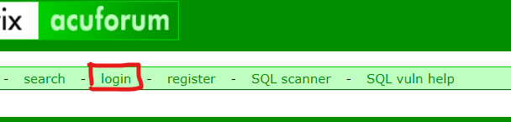
Observations:
On navigating the application on http://testasp.vulnweb.com/ , we could see a login button as shown below.
On clicking login button there, we get redirected to the admin login panel.

Slide 4
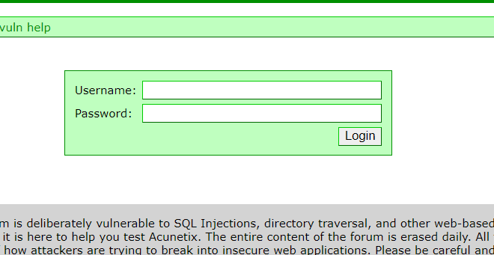
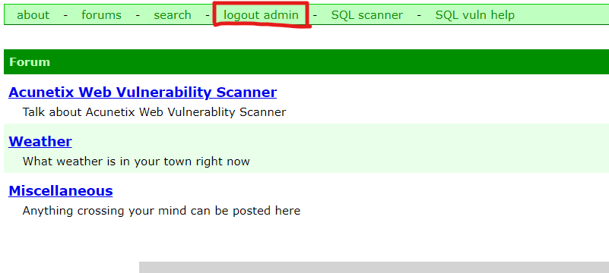
Observations:
In the login panel, entering the credentials, username as ‘admin’ and using the SQLi payload as the password : ‘ pass’or ‘1’=‘1 ’ to bypass the login page and to gain the admin access on the application.
As shown below, we got the admin access to the application.

Slide 5
Business Impact : Critical
Gaining the admin access on the application an attacker can steal all the sensitive and private or critical information about the organization or the users of it, like their account info or any personal information.
This could lead to the defamation of the application leading to a great loss of reputation and trust among the users.

Slide 6
Recommendation
Take the following precautions to avoid exploitation of SQL injections:
Whitelist User Input: Whitelist all user input for expected data only. For example if you are expecting a flower name, limit it to alphabets only upto 20 characters in length. If you are expecting some ID, restrict it to numbers only
Prepared Statements: Use SQL prepared statements available in all web development languages and frameworks to avoid attacker being able to modify SQL query
Character encoding: If you are taking input that requires you to accept special characters, encode it. Example. Convert all ‘ to \’ , “ to \”, \ to \\. It is also suggested to follow a standard encoding for all special characters such has HTML encoding, URL encoding etc
Do not run Database Service as admin/root user
Disable/remove default accounts, passwords and databases
Assign each Database user only the required permissions and not all permissions

Slide 7
References
https://www.owasp.org/index.php/SQL_Injection
https://en.wikipedia.org/wiki/SQL_injection

Slide 8
THANK YOU
For any further clarifications/patch assistance, please contact:
7058487344

