Slide 1
Your gonna hate this

Slide 2
We will speak about:
What your code should do
Three simple programming principles
One not very simple programming principle

Slide 3
Your code should:

Slide 4
Work!

Slide 5


Slide 6
Do the job
Work
Cover edge cases

Slide 7
If you do something known – do it good
If you do something risky – make it work

Slide 8
Not only happy case

Slide 9
public class VirtualApi
{
public string Do(int x)
{
using (WebClient xx = new WebClient())
{
return xx.DownloadString("https://some.super.url");
}
}
}

Slide 10
public class VirtualApi
{
public string Do(int x)
{
using (WebClient xx = new WebClient())
{
return xx.DownloadString("https://some.super.url");
}
}
}
Exceptions

Slide 11
public string Do(int x)
{
using (WebClient xx = new WebClient())
{
try
{
return xx.DownloadString("https://some.super.url");
}
catch (Exception e)
{
Log(e);
}
return "";
}
}

Slide 12
All third party inputs should be treated as
invalid and dangerous

Slide 13
Easy to read
Be maintainable
Easy to change

Slide 14
Naming
public string Do(int x)
{
using (WebClient xx = new WebClient())
{
try
{
return xx.DownloadString("https://some.super.url");
}
catch (Exception e)
{
Log(e);
}
return "";
}
}

Slide 15
«There are only two hard things in Computer Science: cache invalidation and naming things.»
(C) Phil Karlton

Slide 16
public string GetUserName(int userId)
{
using (var http = new WebClient())
{
try
{
return http.DownloadString(Api.GetUserNameUrl);
}
catch (Exception e)
{
_logger.Log(e);
}
return string.Empty;
}
}

Slide 17
Big ball of mud != Easy to change

Slide 18
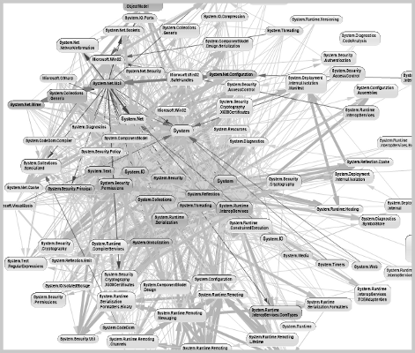
Big ball of mud

Slide 19
Keep the same code style

Slide 20
Be performant

Slide 21
Be performant enough

Slide 22
NEW GMAIL

Slide 23
I/O operation
public string GetUserName(int userId)
{
using (var http = new WebClient())
{
try
{
return http.DownloadString(Api.GetUserNameUrl);
}
catch (Exception e)
{
Log(e);
}
return string.Empty;
}
}

Slide 24
public async Task<string> GetUserName()
{
using (var request = new HttpClient())
{
try
{
return await request.GetStringAsync(userUrl);
}
catch (Exception)
{
Log(e);
}
}
return string.Empty;
}

Slide 25
Be tested with reasonable coverage

Slide 26
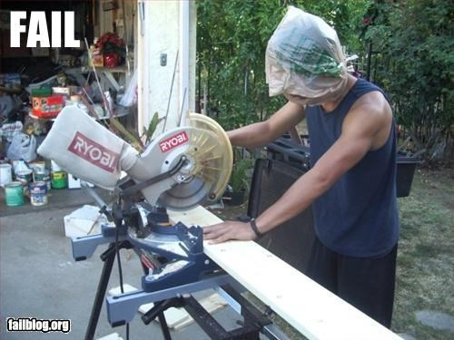
CODE COVERAGE = 100%

Slide 27
Simple principles to make your life easier

Slide 28

Keep
It
Simple
Stupid
Design principle noted by the U.S. Navy in 1960

Slide 29
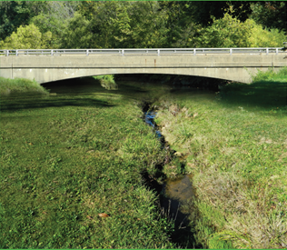
You
Aren’t
Gonna
Need
It
Extreme programming principle

Slide 30
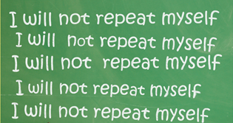
Don’t
Repeat
Yourself

Slide 31
S.O.L.I.D

Slide 33
Single-responsibility Principle

Slide 34
Open-closed Principle

Slide 35
Liskov substitution principle

Slide 36
Interface segregation principle

Slide 37
Dependency Inversion principle

