Slide 1
Chapter 4
VISUALIZING REAL DATA
Members
DuongPTH
BaoPQ
PhatNH

Slide 2
Introduction
VISUALIZATION
WHAT IS VISUALIZATION DATA?
Visualization = Numberic → Picture (like graph)
IS IT IMPORTANT?
Yes! Visualization data is common request in many application.
WHY?
Because graphical data is easier to understand than text,

Slide 3
Contents
VISUALIZATION
CORDINATES STUFF
How to present cordinates, normal cordinate vs device cordinates.
EXPECTED SHAPE
Line, Column, Circle, Area,...
MAPPING
Mapping real points to devices point and drawing in component.

Slide 4
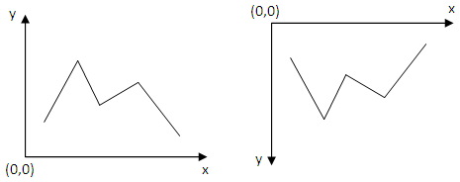
Cordinates
Difference betwwen normal and device cordinates
NORMAL
DEVICE

Slide 5
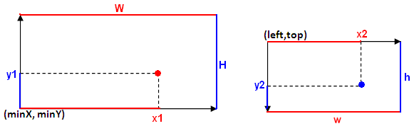
Mapping
Calculate the device point from the given real point.
X2
(x1-minX)/W = (x2-left)/w → x2 = left + (x1-minX)*w/W
Let C_{W} = w/W
x2 = left + C_{W}(x1-minX)
x2 = C_{w}x1 + left – C_{w}minX

Slide 6
Mapping
Calculate the device point from the given real point.
Y2
(y1-minY)/H = (top+h-y2)/h
(y1-minY)*h/H = top +h –y2
Let C_{h} = h/H
y2 = top + h – C_{h}(y1-minY)
y2 = -C_{h}y1 + C_{h}minY + top + h

Slide 7
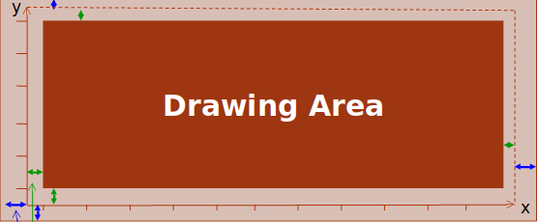
Services
MORE QUALITY LESS QUANTITY
GAPS SHOULD BE RESERVED
Gaps between component’s boundaries and coordinates' boundaries
Gaps between coordinates' boundaries and drawing boundaries

Slide 8
Demo
A TIME SERIES APPLICATION WITH JAVA
A time series is a sequence of data points, typically consisting of successive measurements made over a time interval. Examples of time series are electrocardiograms (ECG), ocean tides, counts of sunspots, and the daily closing value of the Dow Jones Industrial Average. Time series are very frequently plotted via line charts. (Wikipedia)

Slide 9
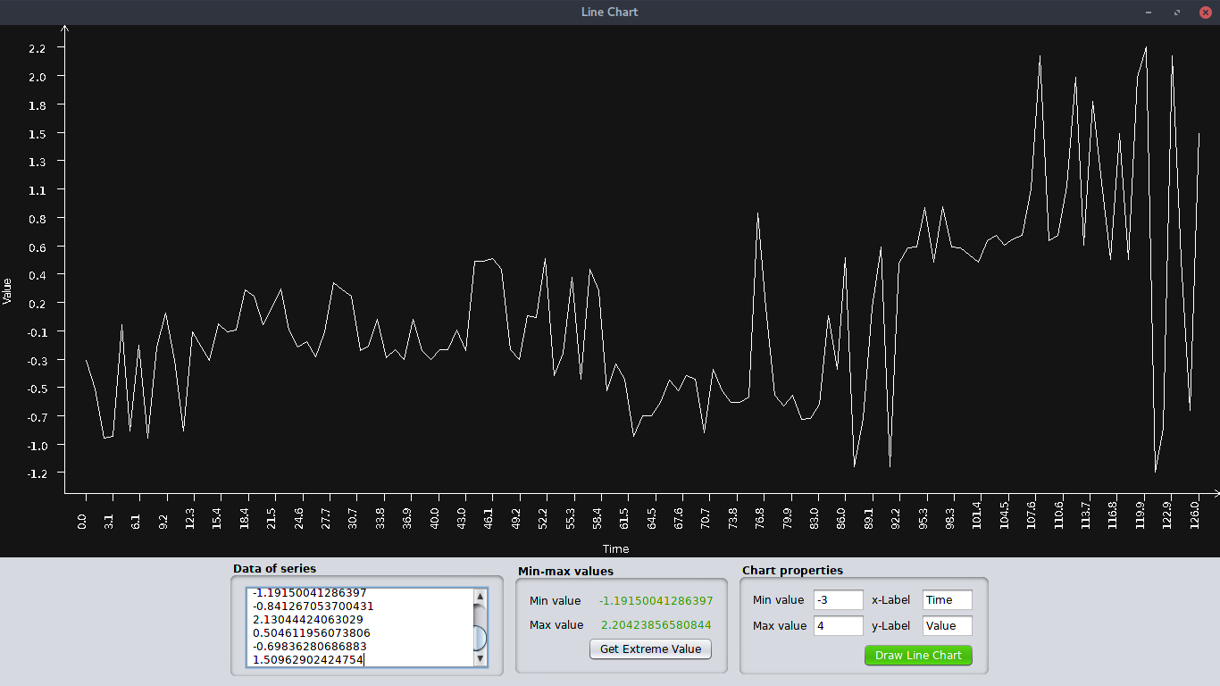
What will you get?
<= a product like the picture,
with below features
Enter data series
Datas are sent via the text area.
Automatic setting interval
Our graph is smart enough to know where it should stadding.
Emtremelly value
Calculating max and min value of the time series.

Slide 10
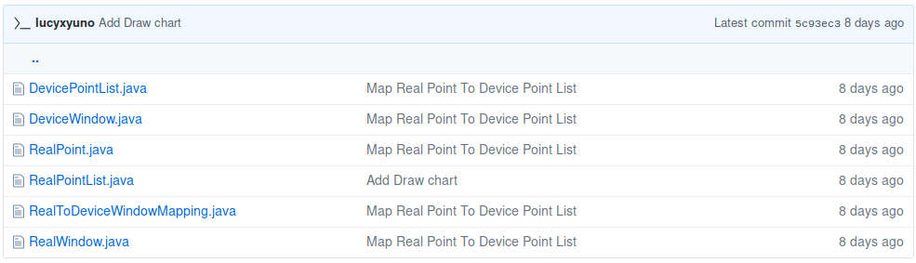
Map
- BY DUONG

Slide 11
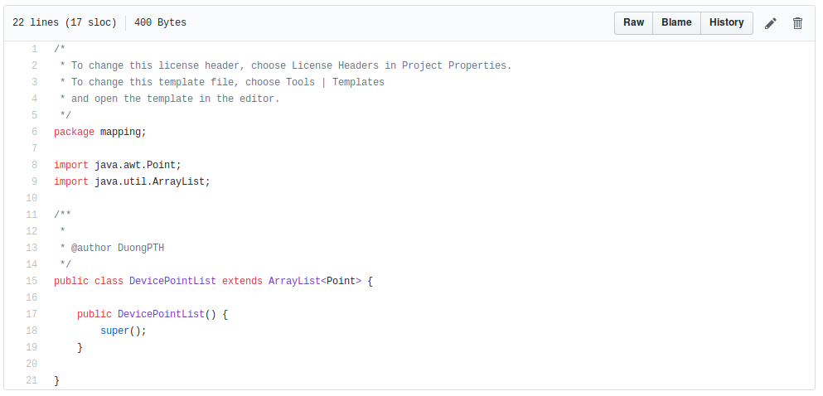
DeviceWindow.java
- mapping

Slide 12
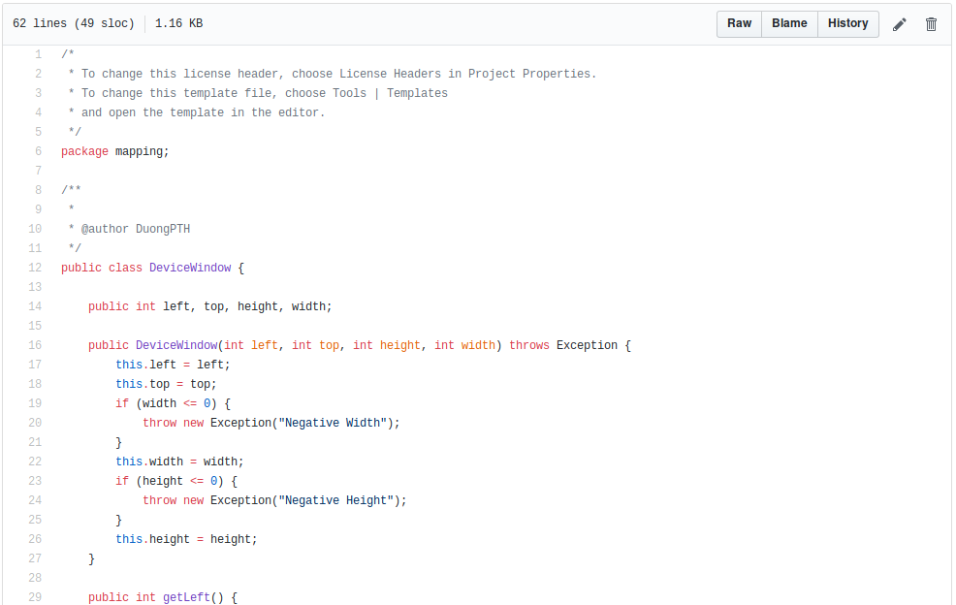
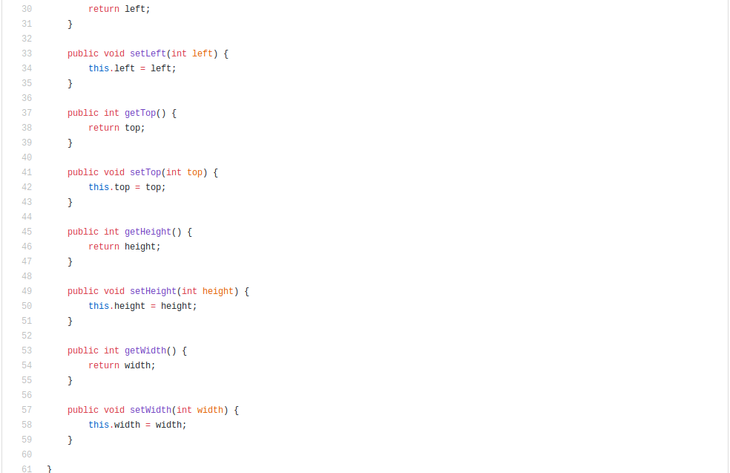
DevicePointList.java
- mapping

Slide 13
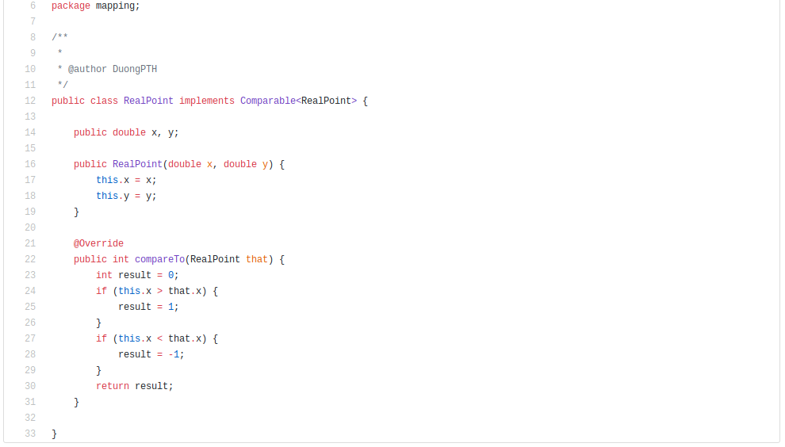
RealPoint.java
- mapping

Slide 14
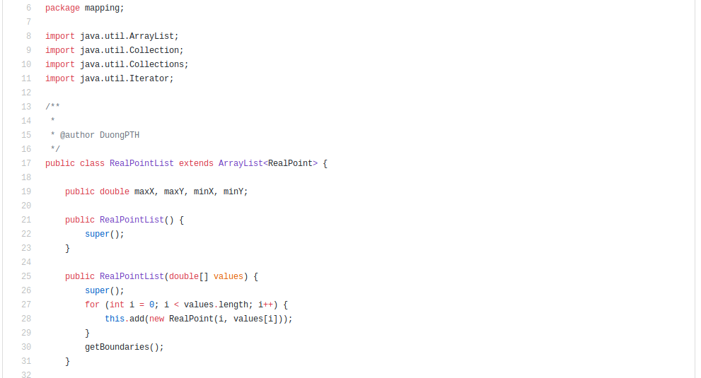
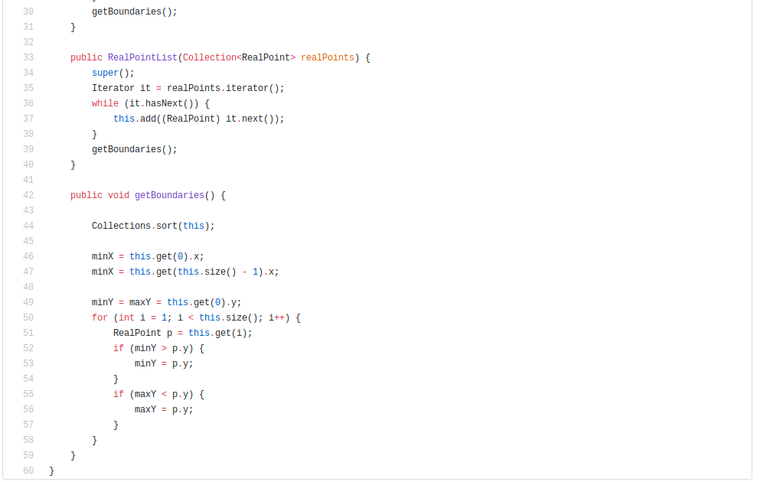
RealPointList.java
- mapping

Slide 15
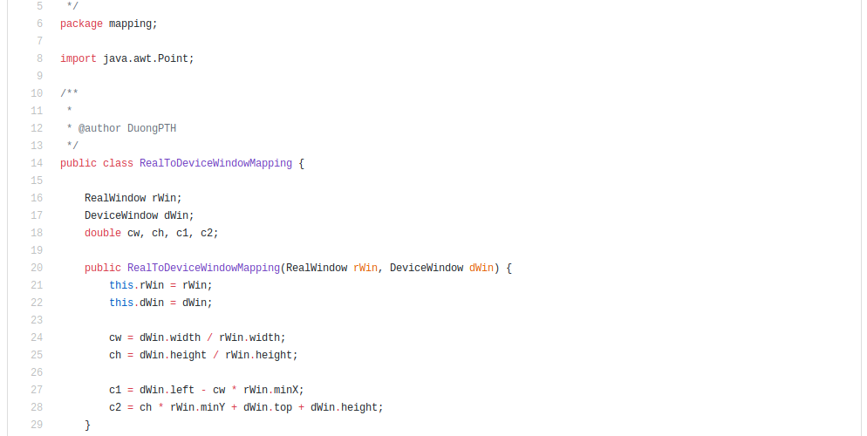
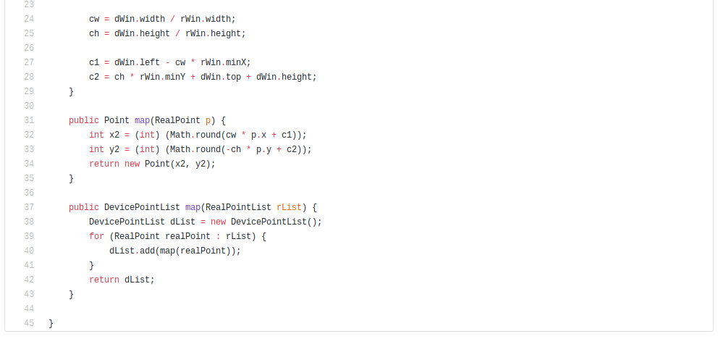
RealToDeviceWindowMapping.java
- mapping

Slide 16
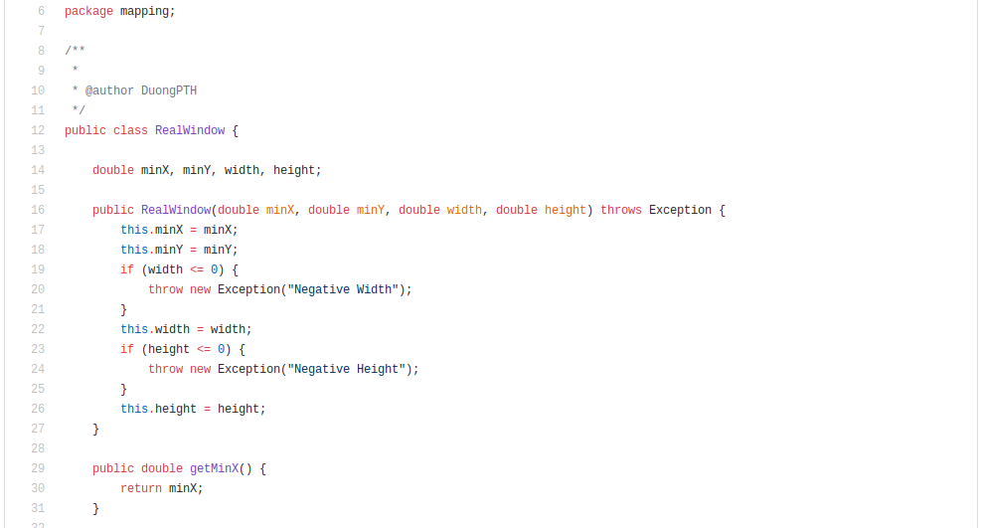
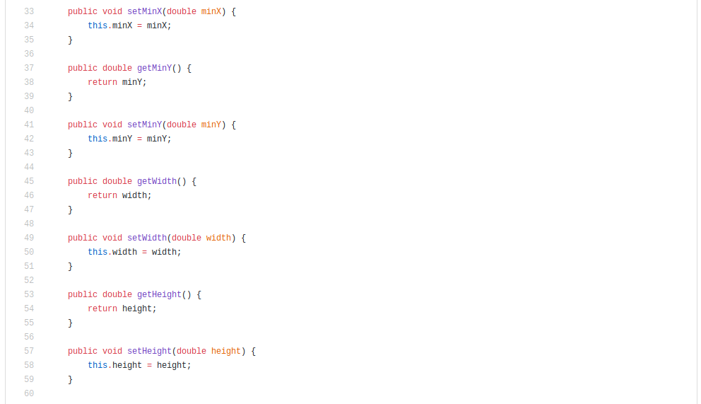
RealWindow.java
- mapping

Slide 17
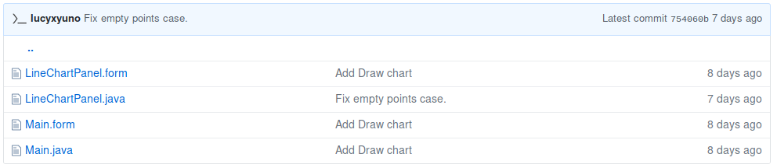
Draw
- BY BAO

Slide 18
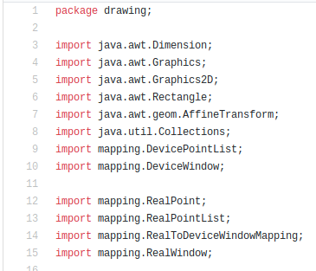
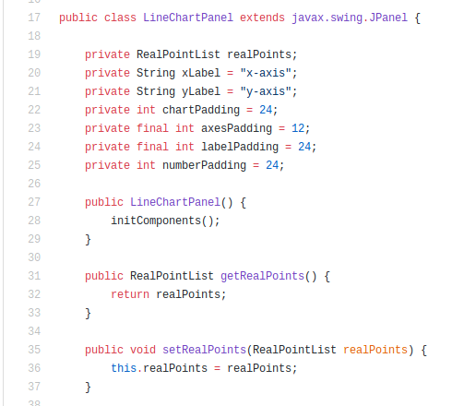
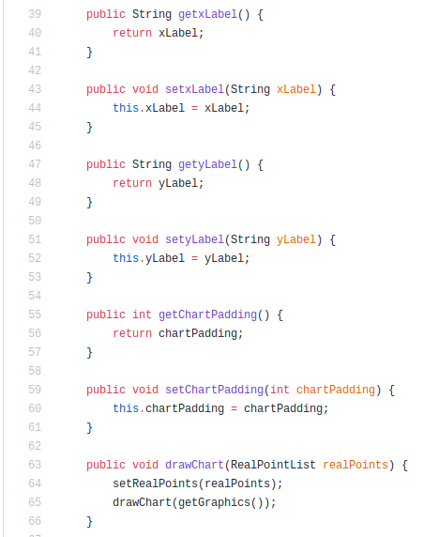
LineChartPanel.java
- drawing

Slide 19
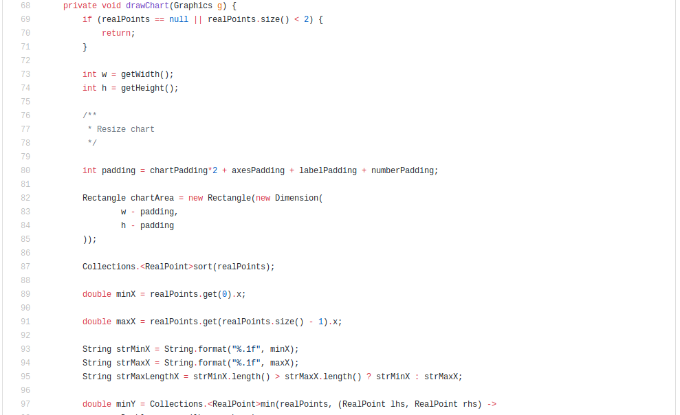
LineChartPanel.java
- drawing

Slide 20
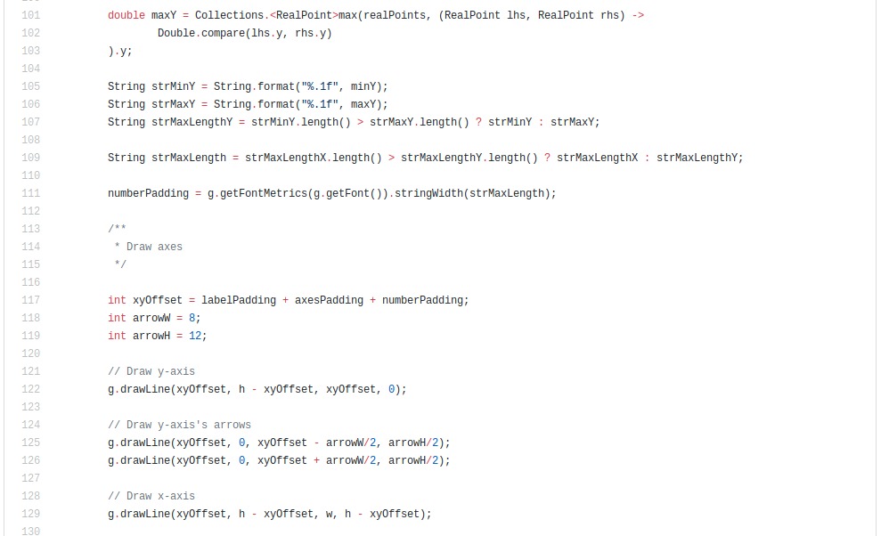
LineChartPanel.java
- drawing

Slide 21
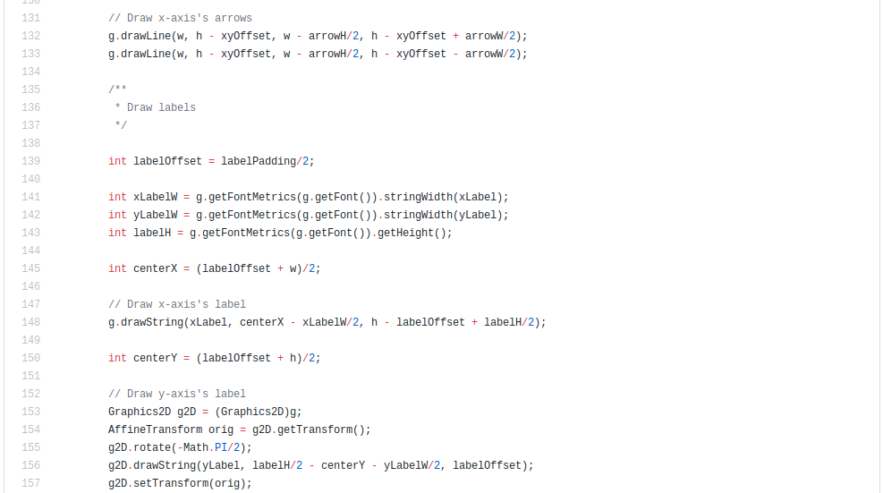
LineChartPanel.java
- drawing

Slide 22
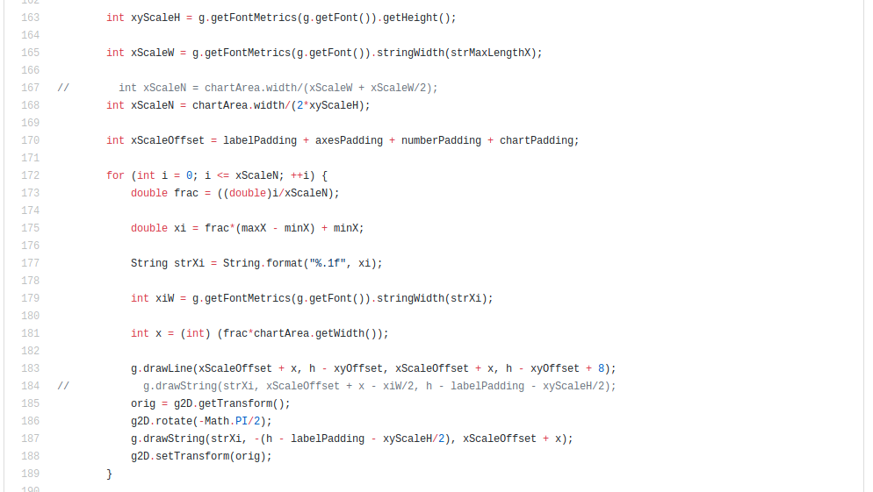
LineChartPanel.java
- drawing

Slide 23
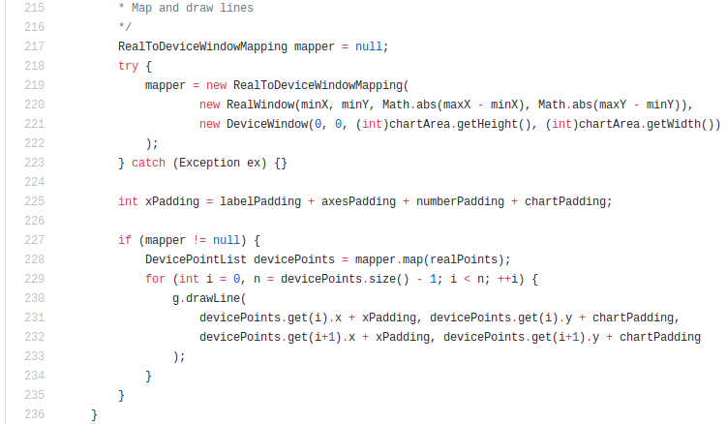
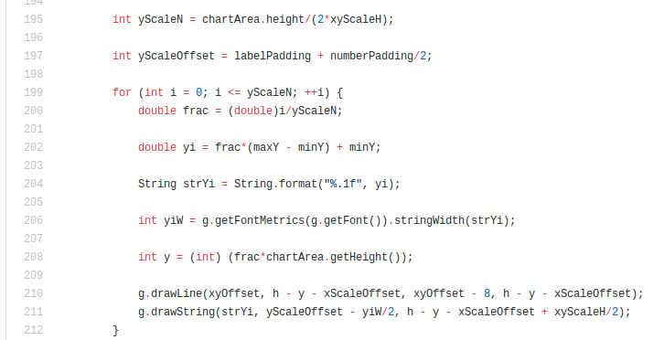
LineChartPanel.java
- drawing

Slide 24
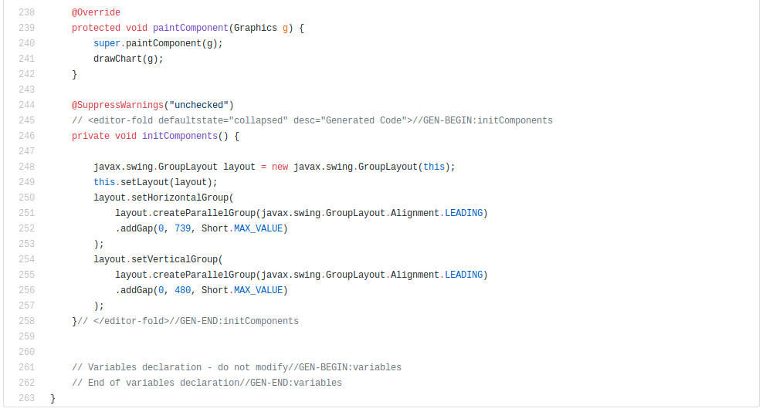
LineChartPanel.java
- drawing

Slide 25
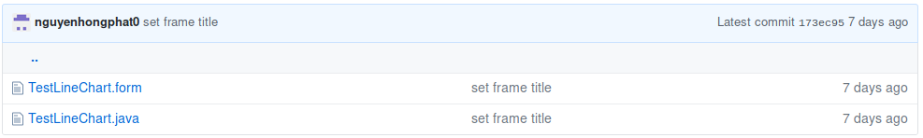
View
- BY PHAT

Slide 26
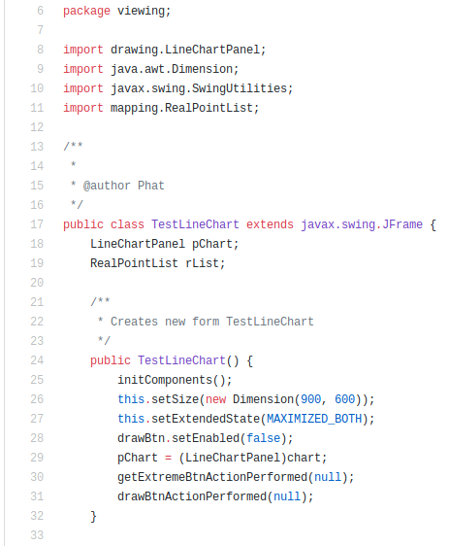
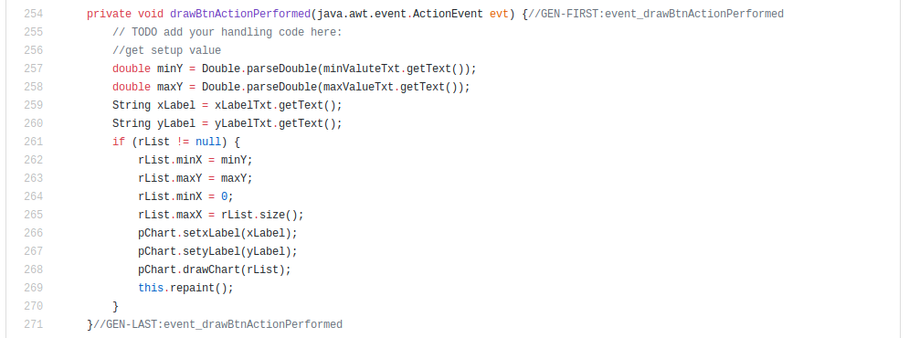
TestLineChart.java
- viewing

Slide 27
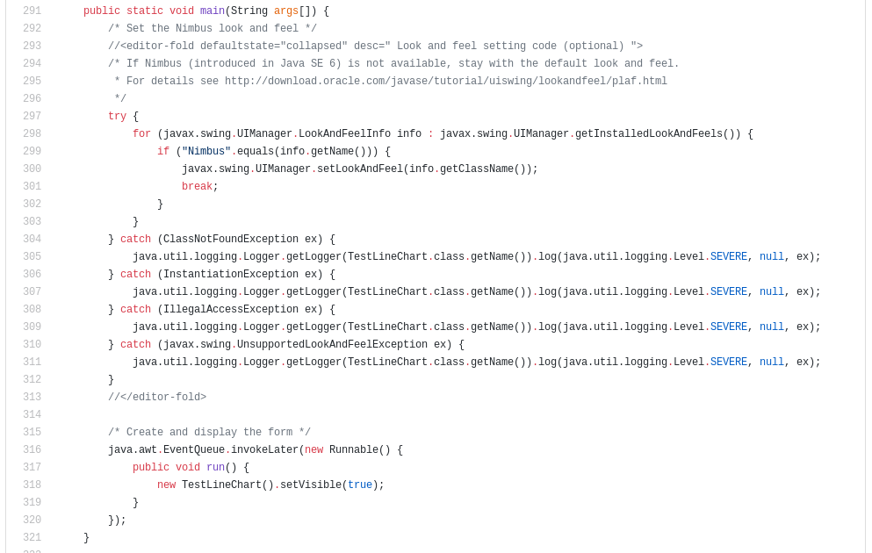
TestLineChart.java
- viewing

Slide 28

Thank you
for speding time demoing with us!
After demoing, hoping you will understand the concept about visualization, how to convert real points to device points, expected shape, mapping it to the program and drawing area in a component of Java.

