Slide 1
Freelance Canvas
Presented by: TYP-HD
Group member: Yi, Pranay, Zhengqi, Trevor

Slide 2
Introduction

Slide 3
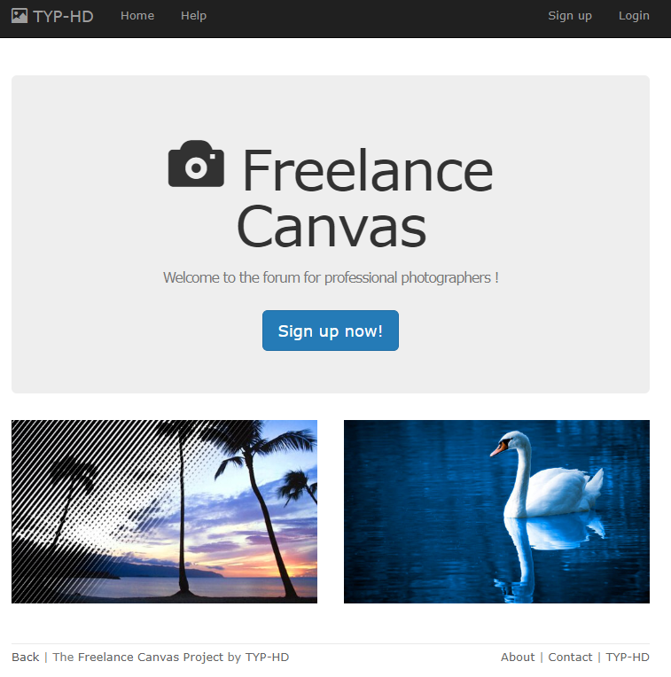
Introduction

Slide 4
How to get start？
Account Registration
Click the signup button
Fill out correct information
An email would send to your mailbox. Remind that the link in the confirmation email is using prefix: 'localhost:3000/'. Please click that link on your localhost. Don't click that on your phone as it's not deployed to a server yet. If the link doesn't work (you cannot access a localhost url, then you need to do the following
$ rails c
>> User.find_by(name: "example").confirm
>> exit
$ rails s
After confirm, login the website with correct password
Explore various feature, which includes Post a photo, Follow other users, like a public post, make a comment, Update profile, and etc..

Slide 5
Database Design
What do we need for a photographers’ website?

Slide 6
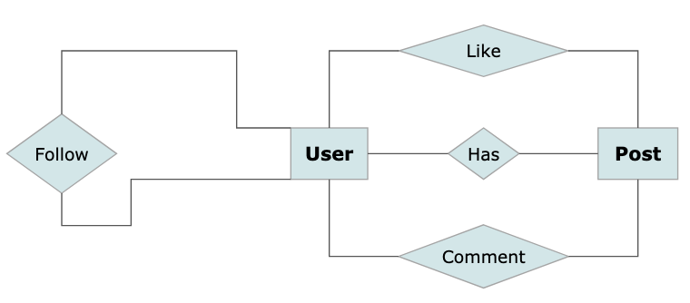
Entity-Relationship Diagram (Simplified)

Slide 7
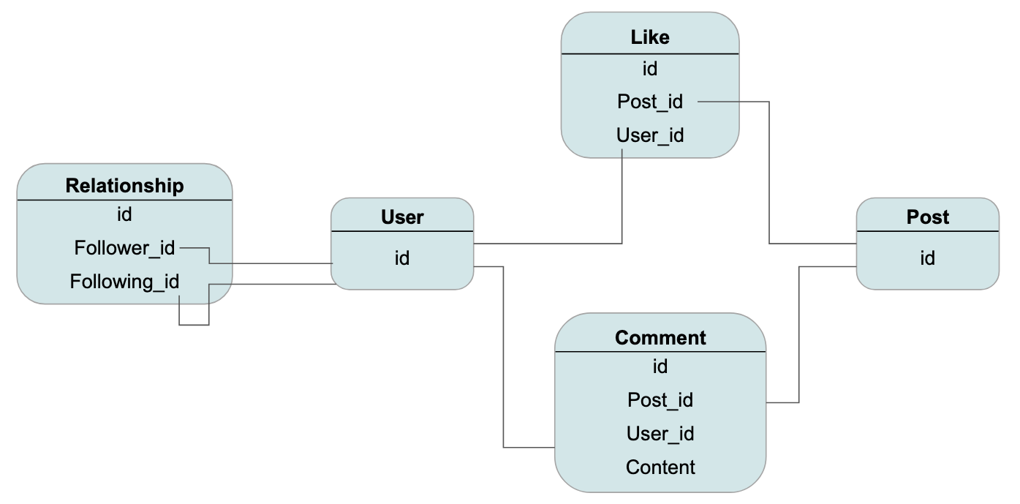

Slide 8
User

Slide 9
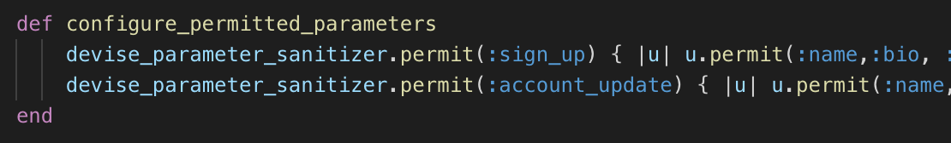
Add Attributes to Devise:User
Devise modules included in setup.
Need give permission to customized columns.
Add profile image using Paperclip.

Slide 10
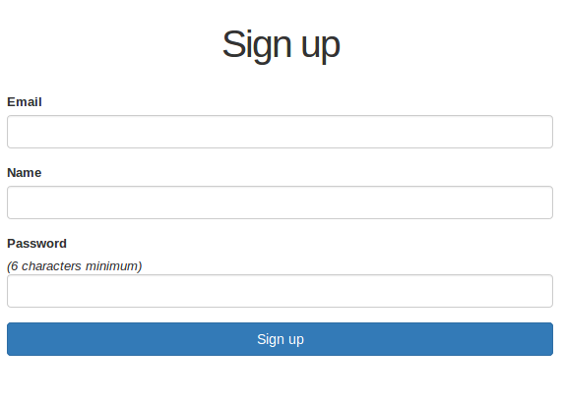
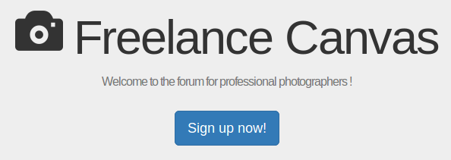
User Sign Up / Login
First time user sign up page
Confirms user email
Can remember user

Slide 11
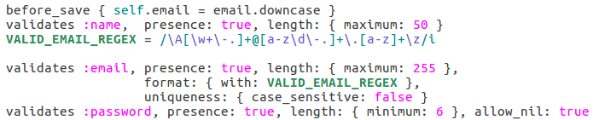
User Model
User information validation
User profile picture

Slide 12
Post

Slide 13
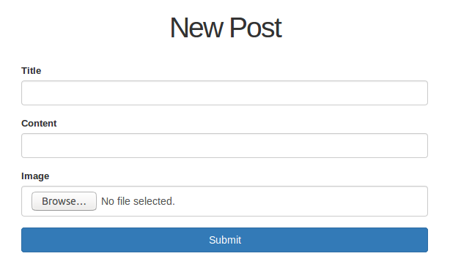
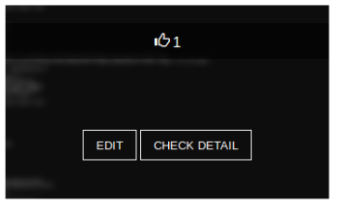
Post Creation
User posts contain a picture, title and content
New post form
Once a post is created hovering
over the image will show options

Slide 14
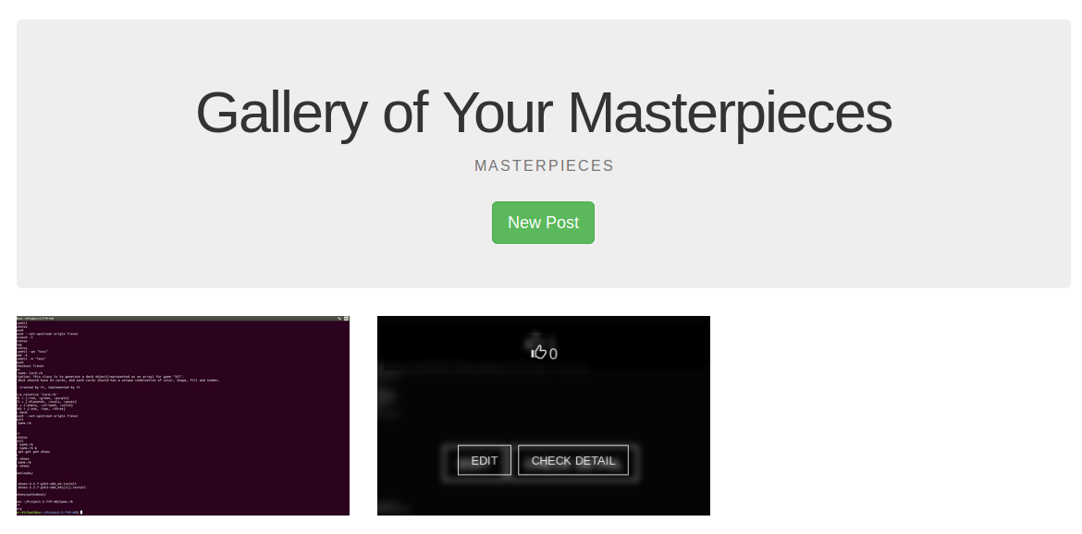
Post Gallery
User has a post page to view all of their posts
Click “My Posts” after logging in will bring up the gallery

Slide 15
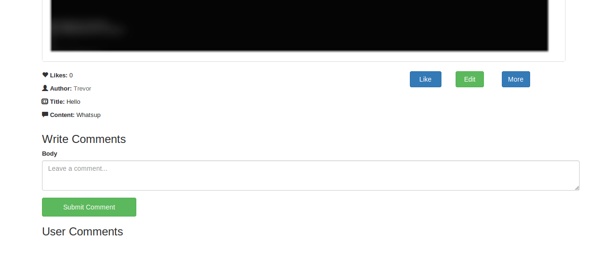
Post Details Page
After clicking on the post the post details page appears
Can edit if owner of post

Slide 16
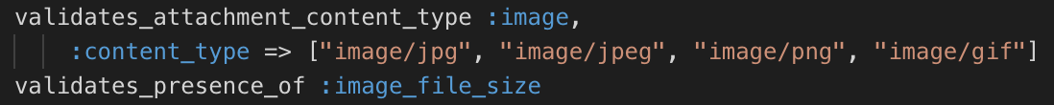
Model: Post
Define styles for image column
Add validations of presence

Slide 17

Model: Post
Associate N:1 relationship with User.
Add column to Post: user_id
User.rb:
Post.rb:

Slide 18
Follow

Slide 19
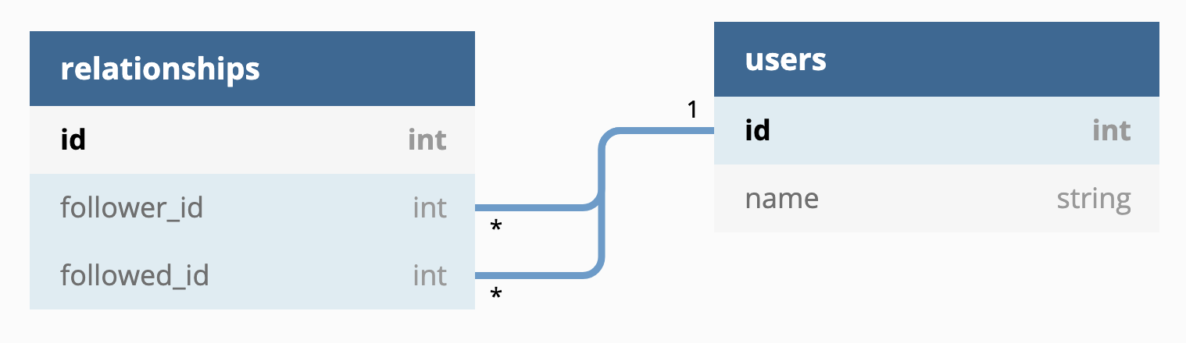
Model: Relationship
When Tom follows Jim, they have a relationship
Follower : Tom, Followed: Jim
Relationship is not symmetric!

Slide 20
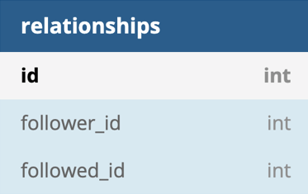
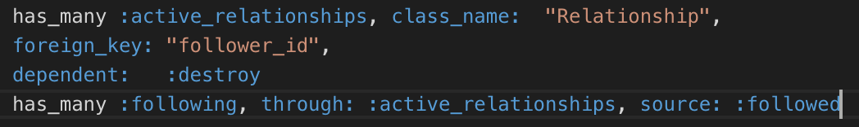

Model: Relationship
Build active_relationship
User.rb
Relationship.rb
What did we get from these association?
User.first.active_relationships
User.first.following
User.first.active_relationships.create(followed_id: other_user.id)

Slide 21
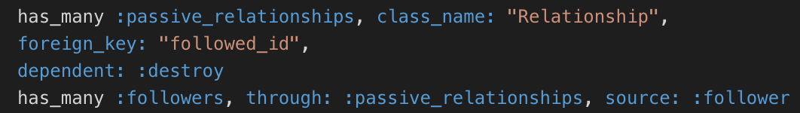

Model: Relationship
How about passive_relationship?
SAME IDEA!

Slide 22
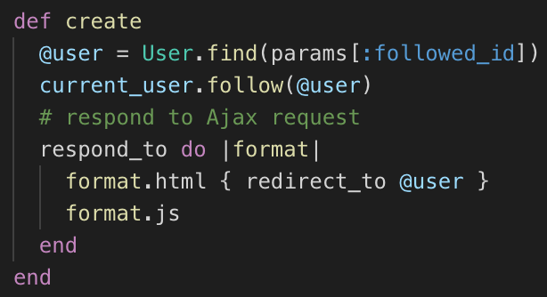
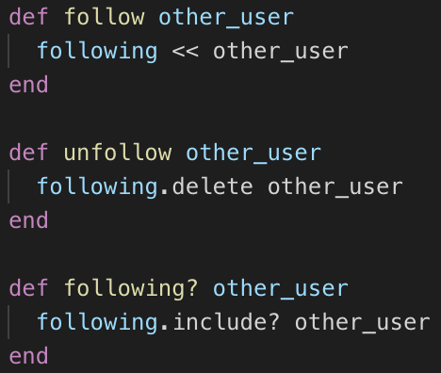
Controller: Relationships
Create and Destroy

Slide 23
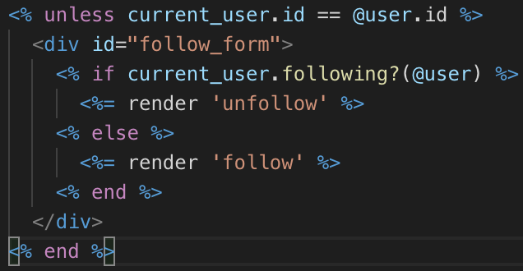
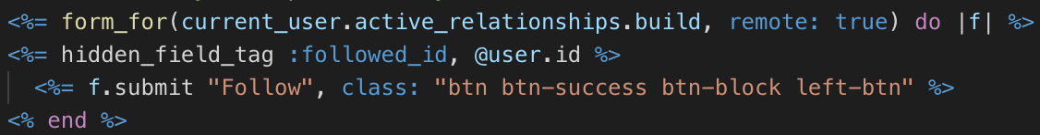
Views: User related to Relationship

Slide 24
DEMO
Demo Link

Slide 25


Likes, Comments

Slide 26

Like
User has the ability to like a post
Only logged in users can perform this operation
Cannot like more than once

Slide 27
DEMO

Slide 28
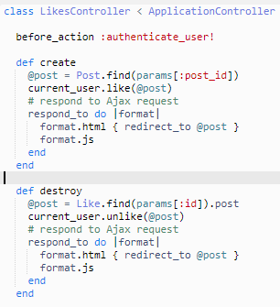
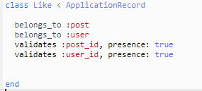
MVC
Controller
Model

Slide 29
Comments
Logged in users have the ability to comment on a post
Date/Time of comment are displayed
User can also delete comments

Slide 30
DEMO

Slide 31

MVC
Model

Slide 32
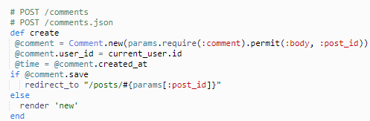
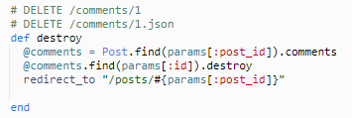
MVC
Controller

