Slide 1
Freelance Canvas
Presented by: TYP-HD
Group member: Yi, Pranay, Zhengqi, Trevor

Slide 2
Introduction

Slide 3

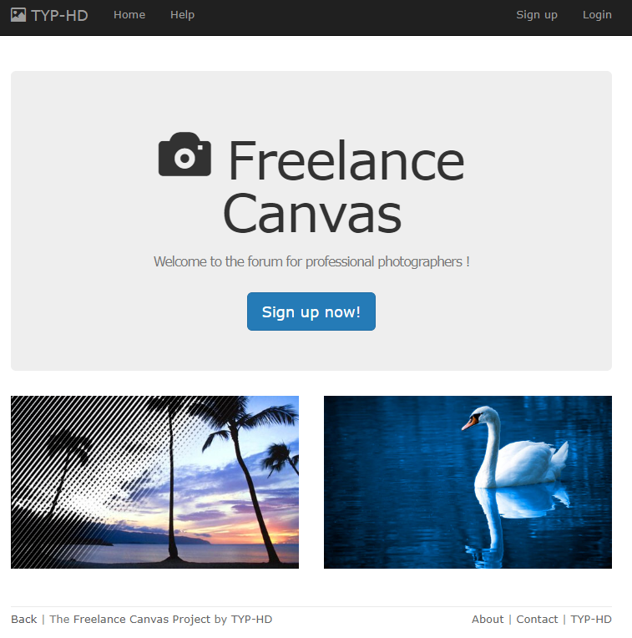
Front page design

Slide 4
How to get start？
Environment setup
$ bundle update
$ bundle install
$ rails s
Account Registration
Click the signup button
Fill out correct information
An email would send to your mailbox. Remind that the link in the confirmation email is using prefix: 'localhost:3000/'. Please click that link on your localhost. Don't click that on your phone as it's not deployed to a server yet. If the link doesn't work (you cannot access a localhost url, then you need to do the following
$ rails c
>> User.find_by(name: "example").confirm
>> exit
$ rails s
After confirm, login the website with correct password
Explore various feature, which includes Post a photo, Follow other users, like a public post, make a comment, Update profile, and etc..

Slide 5
Database Design
What do we need for a photographers’ website?

Slide 6
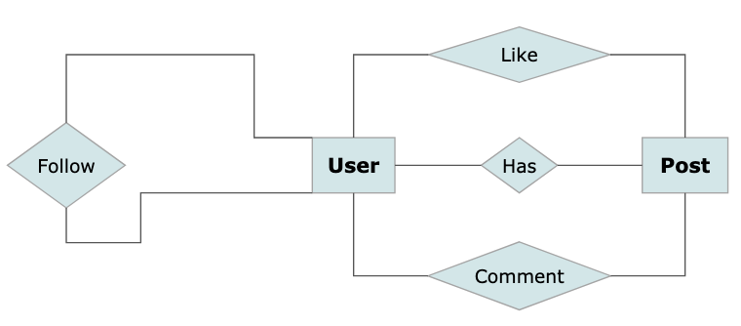
Entity-Relationship Diagram (Simplified)

Slide 7
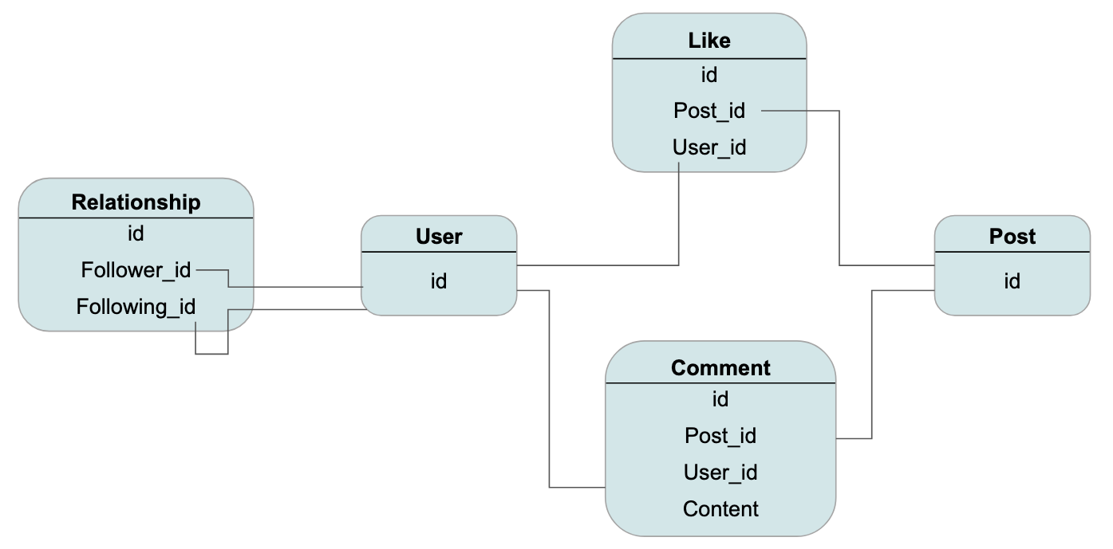

Slide 8
User

Slide 9
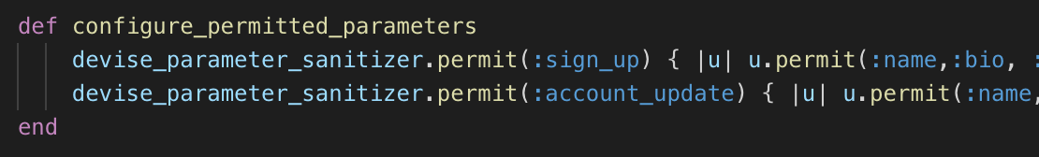
Add Attributes to Devise:User
Need give permission to customized columns.
Add profile image using Paperclip.

Slide 10
Post

Slide 11
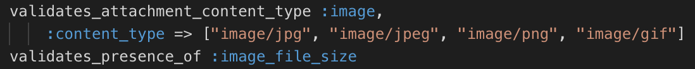
Model: Post
Define styles for image column
Add validations of presence

Slide 12

Model: Post
Associate N:1 relationship with User.
Add column to Post: user_id
User.rb:
Post.rb:

Slide 13


Likes, Comments

Slide 14
Like
User has the ability to like a post
Only logged in users can perform this operation
Cannot like more than once

Slide 15
DEMO

Slide 16
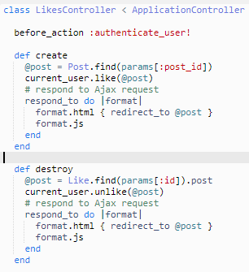
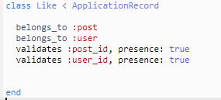
MVC
Controller
Model

Slide 17
Comments
Logged in users have the ability to comment on a post
Date/Time of comment are displayed
User can also delete comments

Slide 18
DEMO

Slide 19

MVC
Model

Slide 20
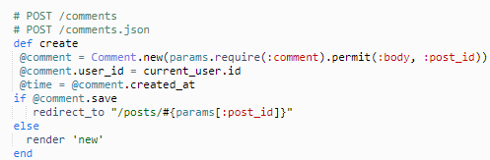
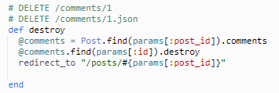
MVC
Controller

