Slide 1

南京大学
计算机金融工程实验班
Economics
南京大学工程管理学院
赵雪舟
2021.12

Slide 2
Lecture 11
Market Structure (C)

Slide 3
Agenda
04
Oligopoly
01
Competitive Markets
03
Monopolistic competitive
Monopoly
02

Slide 4
Monopolistic Competition
Imperfect competition
Between perfect competition and monopoly
Oligopoly
Monopolistic competition
Oligopoly
Few sellers
Offer similar or identical products

Slide 5
Monopolistic Competition
Concentration ratio
Percentage of total output in the market supplied by the four largest firms
Highly-concentrated industries
Electric lamp bulbs (75%)
Breakfast cereal (80%)
Aircraft manufacturing (81%)
Household laundry equipment (98%)
Cigarettes (98%)

Slide 6
Monopolistic Competition
Monopolistic competition
Many sellers
Product differentiation
Not price takers
Downward sloping demand curve
Free entry and exit
Zero economic profit in the long run

Slide 7
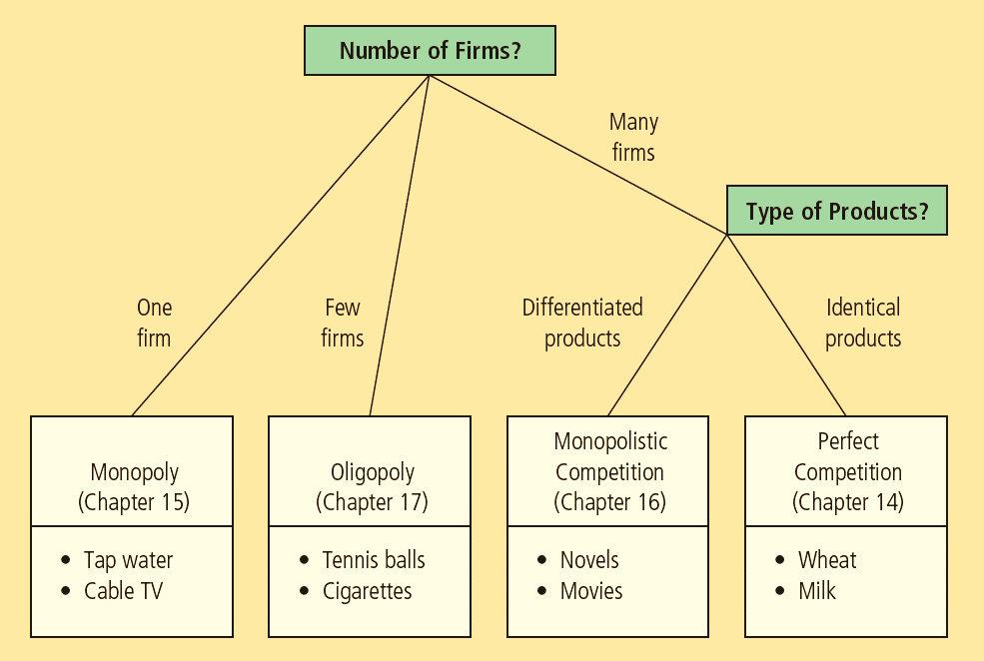
The Four Types of Market Structure
Economists who study industrial organization divide markets into four types—monopoly, oligopoly, monopolistic competition, and perfect competition.

Slide 8
Short Run Equilibrium
Profit maximization
Produce the quantity
where marginal revenue = marginal cost
Price: on the demand curve
If P > ATC: profit
If P < ATC: loss
Similar to monopoly

Slide 9
Monopolistic Competitors in the Short Run
(a) Firm makes profit
(b) Firm makes losses
Price
Price
MC
MC
ATC
Price
ATC
ATC
ATC
Price
Profit
Demand
Losses
Demand
MR
MR
0
Profit-maximizing
quantity
Quantity
0
Loss-minimizing
quantity
Quantity
Monopolistic competitors, like monopolists, maximize profit by producing the quantity at which marginal revenue equals marginal cost. The firm in panel (a) makes a profit because, at this quantity, price is above average total cost. The firm in panel (b) makes losses because, at this quantity, price is less than average total cost.

Slide 10
Long Run Equilibrium
If firms are making profit in short run
New firms - incentive to enter the market
Increase number of products
Reduces demand faced by each firm
Demand curve shifts left
Each firm’s profit declines until: zero economic profit

Slide 11
A Monopolistic Competitor in the Long Run
Price
MC
ATC
Price = ATC
Demand
MR
0
Profit- maximizing
quantity
Quantity
In a monopolistically competitive market, if firms are making profit, new firms enter, and the demand curves for the incumbent firms shift to the left. Similarly, if firms are making losses, some of the firms in the market exit, and the demand curves of the remaining firms shift to the right. Because of these shifts in demand, monopolistically competitive firms eventually find themselves in the long-run equilibrium shown here. In this long-run equilibrium, price equals average total cost, and each firm earns zero profit.

Slide 12
Long Run Equilibrium
Zero economic profit
Demand curve
Tangent to average total cost curve
At quantity where marginal revenue = marginal cost
Price = average total cost
Price exceeds marginal cost

Slide 13
Long Run Equilibrium
Monopolistic versus perfect competition
Monopolistic competition
Quantity: not at minimum ATC
Excess capacity
P > MC, markup over marginal cost
Perfect competition
Quantity: at minimum ATC
Efficient scale
P = MC

Slide 14
Monopolistic versus Perfect Competition
(a) Monopolistically Competitive Firm
(b) Perfectly Competitive Firm
Price
Price
MC
MC
ATC
Price
ATC
P=MC
P=MR
(demand curve)
Markup
MC
Demand
MR
0
Quantity
produced
Efficient
scale
Quantity
0
Quantity produced
= Efficient scale
Quantity
Excess capacity
Panel (a) shows the long-run equilibrium in a monopolistically competitive market, and panel (b) shows the long-run equilibrium in a perfectly competitive market. Two differences are notable. (1) The perfectly competitive firm produces at the efficient scale, where average total cost is minimized. By contrast, the monopolistically competitive firm produces at less than the efficient scale. (2) Price equals marginal cost under perfect competition, but price is above marginal cost under monopolistic competition.

Slide 15
Welfare of Society
Sources of inefficiency
Markup of price over marginal cost
Deadweight loss of monopoly pricing
Too much or too little entry
Product-variety externality
Positive externality on consumers
Business-stealing externality
Negative externality on producers

Slide 16
Advertising
Incentive to advertise
When firms sell differentiated products and charge prices above marginal cost
Advertise to attract more buyers
Advertising spending
Highly differentiated goods: 10-20% of revenue
Industrial products: Little advertising
Homogenous products: No advertising

Slide 17
Advertising
Debate over advertising
Wasting resources?
Valuable purpose?
The critique of advertising
Firms advertise to manipulate people’s tastes
Psychological rather than informational
Creates a desire that otherwise might not exist

Slide 18
Advertising
The critique of advertising
Impedes competition
Increase perception of product differentiation
Foster brand loyalty
Makes buyers less concerned with price differences among similar goods

Slide 19
Advertising
The defense of advertising
Provide information to customers
Customers - make better choices
Enhances the ability of markets to allocate resources efficiently
Fosters competition
Customers - take advantage of price differences
Allows new firms to enter more easily

Slide 20
Advertising and the price of eyeglasses
What effect does advertising have on the price of a good?
Consumers – view products as being more different than they otherwise would
Markets less competitive
Firms’ demand curves less elastic
Higher prices

Slide 21
Advertising and the price of eyeglasses
What effect does advertising have on the price of a good?
Consumers – easier to find firms with the best prices
Markets – more competitive
Firms’ demand curves more elastic
Lower prices

Slide 22
Advertising and the price of eyeglasses
1972, economist Lee Benham
States that prohibited advertising
Average price = $33 ($248 in 2012 dollars)
States that did not restrict advertising
Average price = $26 ($196 in 2012 dollars)
Advertising
Reduced average prices
Fosters competition

Slide 23

Advertising
Advertising as a signal of quality
Little apparent information
Real information offered – a signal
Willingness to spend large amount of money
= signal about quality of the product
Content of advertising = irrelevant
Is it rational for consumers to be impressed that Wang Yibo is endorsing this product?

Slide 24
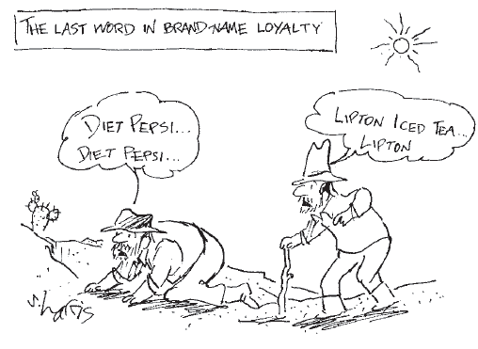
Advertising
Brand names
Spend more on advertising and charge higher prices than generic substitutes

Slide 25
Advertising
Critics of brand names
Products – not differentiated
Irrationality: consumers are willing to pay more for brand names
Defenders of brand names
Consumers – information about quality
Firms – incentive to maintain high quality

Slide 26
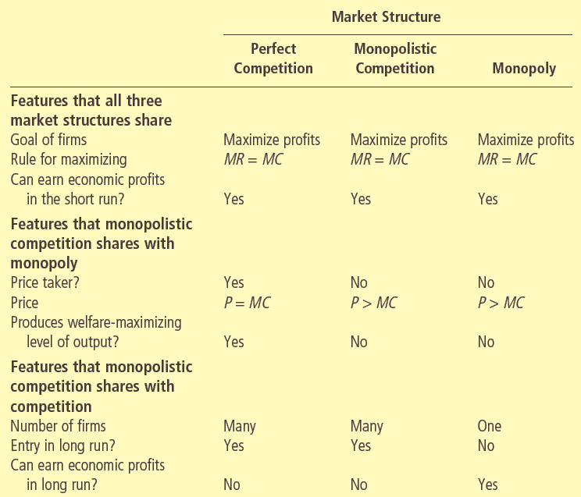
Monopolistic Competition:
Between Perfect Competition and Monopoly

Slide 27
Thanks

