Slide 1
ECE/CS 552: Course Introduction
© Prof. Mikko Lipasti
Lecture notes based in part on slides created by Mark Hill, David Wood, Guri Sohi, John Shen and Jim Smith

Slide 2
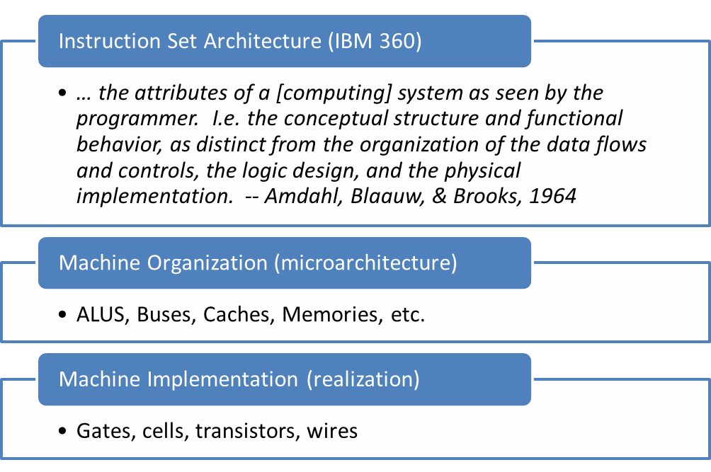

Computer Architecture

Slide 3
552 In Context
Prerequisites
  252/352 – gates, logic, memory, organization
  252/354 – high-level language down to machine language interface or instruction set architecture (ISA)
This course – 552 – puts it all together
  Implement the logic that provides ISA interface
  Must do datapath and control, but no magic
  Manage tremendous complexity with abstraction
Follow-on courses explore trade-offs
  ECE 752, ECE 555/ECE 755, ECE 757

Slide 4
Why Take 552?
To become a computer designer
  Alumni of this class helped design your computer
To learn what is under the hood of a computer
  Innate curiosity
  To better understand when things break
  To write better code/applications
  To write better system software (O/S, compiler, etc.)
Because it is intellectually fascinating!
  CPUs are arguably the most complex highly-integrated man-made devices

Slide 5
Abstraction and Complexity
Application Program
CS302
Abstraction helps us manage complexity
Complex interfaces
  Specify what to do
  Hide details of how
Operating System
Scope of this
course
Compiler
CS536
CS537
Machine Language (ISA)
CS354
Digital Logic
ECE352
Goal: remove magic
Electronic circuits
ECE340
Semiconductor devices
ECE335

Slide 6
Computer Architecture
Exercise in engineering tradeoff analysis
  Find the fastest/cheapest/power-efficient/etc. solution
  Optimization problem with 100s of variables
All the variables are changing
  At non-uniform rates
  With inflection points
  Only one guarantee: Today’s right answer will be wrong tomorrow
Two high-level effects:
  Technology push
  Application Pull

Slide 7
Technology Push
What do these two intervals have in common?
  1776-1999 (224 years)
  2000-2001 (2 years)
Answer: Equal progress in processor speed!
The power of exponential growth!
Driven by Moore’s Law
  Device per chips doubles every 18-24 months
Computer architects work to turn the additional resources into speed/power savings/functionality!

Slide 8
Some History
Date | Event | Comments
1939 | First digital computer | John Atanasoff (UW PhD ’30)
1947 | 1st transistor | Bell Labs
1958 | 1st IC | Jack Kilby (MSEE ’50) @TI Winner of 2000 Nobel prize
1971 | 1st microprocessor | Intel
1974 | Intel 4004 | 2300 transistors
1978 | Intel 8086 | 29K transistors
1989 | Intel 80486 | 1.M transistors, pipelined
1995 | Intel Pentium Pro | 5.5M transistors
2005 | Intel Montecito | 1B transistors

Slide 9
Performance Growth
Unmatched by any other industry !
[John Crawford, Intel]
Doubling every 18 months (1982-1996): 800x
  Cars travel at 44,000 mph and get 16,000 mpg
  Air travel: LA to NY in 22 seconds (MACH 800)
  Wheat yield: 80,000 bushels per acre
Doubling every 24 months (1971-1996): 9,000x
  Cars travel at 600,000 mph, get 150,000 mpg
  Air travel: LA to NY in 2 seconds (MACH 9,000)
  Wheat yield: 900,000 bushels per acre

Slide 10
Technology Push
Technology advances at varying rates
  E.g. DRAM capacity increases at 60%/year
  But DRAM speed only improves 10%/year
  Creates gap with processor frequency!
Inflection points
  Crossover causes rapid change
  E.g. enough devices for multicore processor (2001)
Current issues causing an “inflection point”
  Power consumption
  Reliability
  Variability

Slide 11
Application Pull
Corollary to Moore’s Law:
Cost halves every two years
  In a decade you can buy a computer for less than its sales tax today. –Jim Gray
Computers cost-effective for
  National security – weapons design
  Enterprise computing – banking
  Departmental computing – computer-aided design
  Personal computer – spreadsheets, email, web
  Mobile computing – smartphones

Slide 12
Application Pull
What about the future?
Must dream up applications that are not cost-effective today
  Virtual reality
  Telepresence
  Mobile applications
  Sensing, analyzing, actuating in real-world environments
This is your job!

Slide 13
Abstraction
Difference between interface and implementation
  Interface: WHAT something does
  Implementation: HOW it does so

Slide 14
Abstraction, E.g.
2:1 Mux (352)
Interface
Implementations
  Gates (fast or slow), pass transistors
X
Y
S | F
0 | X
1 | Y
S
Mux
F

Slide 15
What’s the Big Deal?
Firefox, MS Excel
Windows 7
Tower of abstraction
Complex interfaces implemented by layers below
Abstraction hides detail
Hundreds of engineers build one product
Complexity unmanageable otherwise
Visual C++
x86 Machine Primitives
Von Neumann Machine
Logic Gates & Memory
Transistors & Devices
Quantum Physics

Slide 16
Basic Division of Hardware
In space (vs. time)
Memory
Control
Output
Data
path
Input
Processor

Slide 17
Basic Division of Hardware
In time (vs. space)
  Fetch instruction from memory add r1, r2, r3
  Decode the instruction – what does this mean?
  Read input operands read r2, r3
  Perform operation add
  Write results write to r1
  Determine the next instruction pc := pc + 4

Slide 18
Building Computer Chips
Complex multi-step process
  Slice silicon ingots into wafers
  Process wafers into patterned wafers
  Dice patterned wafers into dies
  Test dies, select good dies
  Bond to package
  Test parts
  Ship to customers and make money

Slide 19
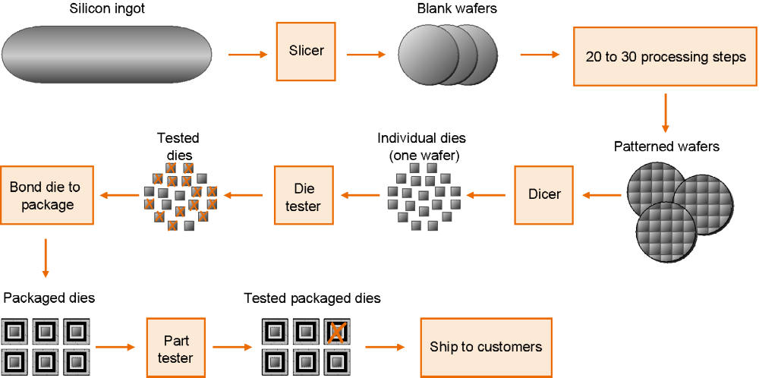
Building Computer Chips

Slide 20
Performance vs. Design Time
Time to market is critically important
E.g., a new design may take 3 years
  It will be 3 times faster
  But if technology improves 50%/year
  In 3 years 1.5³ = 3.38
  So the new design is worse!
  (unless it also employs new technology)

Slide 21
Summary
The ART and Science of Instruction-Set Processor Design
[Gerrit Blaauw & Fred Brooks, 1981]
CPU designers must know BOTH software and hardware
Both contribute to layers of abstraction
IC costs, design time and performance

