Slide 1
ECE/CS 552: Benchmarks, Means and Amdahl’s Law
© Prof. Mikko Lipasti
Lecture notes based in part on slides created by Mark Hill, David Wood, Guri Sohi, John Shen and Jim Smith

Slide 2
Which Programs
Execution time of what program?
Best case – you always run the same set of programs
  Port them and time the whole workload
In reality, use benchmarks
  Programs chosen to measure performance
  Predict performance of actual workload
  Saves effort and money
  Representative? Honest? Benchmarketing…

Slide 3
How to Average
 | Machine A | Machine B
Program 1 | 1 | 10
Program 2 | 1000 | 100
Total | 1001 | 110
One answer: for total execution time, how much faster is B?
1001 / 110 = 9.1x

Slide 4
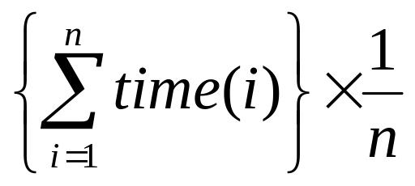
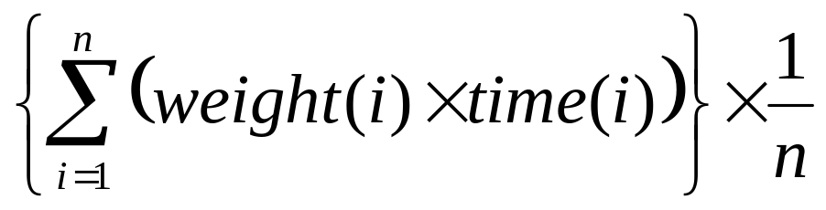
How to Average
Another: arithmetic mean (same result)
Arithmetic mean of times:
AM(A) = 1001/2 = 500.5
AM(B) = 110/2 = 55
Speedup: 500.5/55 = 9.1x
Valid only if programs run equally often, so use weighted arithmetic mean:

Slide 5


Other Averages
E.g., 30 mph for first 10 miles, then 90 mph for next 10 miles, what is average speed?
Average speed = (30+90)/2 WRONG
Average speed = total distance / total time
= (20 / (10/30 + 10/90))
= 45 mph

Slide 6
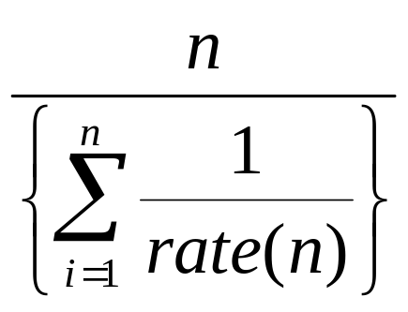
Harmonic Mean
Harmonic mean of rates =
Use HM if forced to start and end with rates (e.g. reporting MIPS or MFLOPS)
Why?
  Rate has time in denominator
  Mean should be proportional to inverse of sums of time (not sum of inverses)
  See: J.E. Smith, “Characterizing computer performance with a single number,” CACM Volume 31 , Issue 10 (October 1988), pp. 1202-1206.

Slide 7


Dealing with Ratios
 | Machine A | Machine B
Program 1 | 1 | 10
Program 2 | 1000 | 100
Total | 1001 | 110
If we take ratios with respect to machine A
 | Machine A | Machine B
Program 1 | 1 | 10
Program 2 | 1 | 0.1
Average | 1 | 5.05

Slide 8
Dealing with Ratios
Avg. wrt. machine A: A is 1, 5.05
If we take ratios with respect to machine B
Can’t both be true!!!
Don’t use arithmetic mean on ratios!
 | Machine A | Machine B
Program 1 | 0.1 | 1
Program 2 | 10 | 1
Average | 5.05 | 1

Slide 9
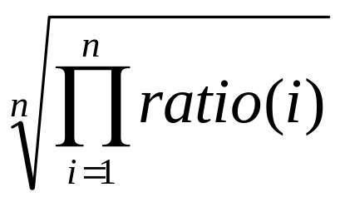
Geometric Mean
Use geometric mean for ratios
Geometric mean of ratios =
Independent of reference machine
In the example, GM for machine a is 1, for machine B is also 1
  Normalized with respect to either machine

Slide 10

But…
GM of ratios is not proportional to total time
AM in example says machine B is 9.1 times faster
GM says they are equal
If we took total execution time, A and B are equal only if
  Program 1 is run 100 times more often than program 2
Generally, GM will mispredict for three or more machines

Slide 11



Summary
Use AM for times
Use HM if forced to use rates
Use GM if forced to use ratios
Best of all, use unnormalized numbers to compute time

Slide 12
Benchmarks: SPEC2000
System Performance Evaluation Cooperative
  Formed in 80s to combat benchmarketing
  SPEC89, SPEC92, SPEC95, SPEC2000, SPEC2006
12 integer and 14 floating-point programs
  Sun Ultra-5 300MHz reference machine has score of 100
  Report GM of ratios to reference machine

Slide 13
Benchmarks: SPEC CINT2000
Benchmark | Description
164.gzip | Compression
175.vpr | FPGA place and route
176.gcc | C compiler
181.mcf | Combinatorial optimization
186.crafty | Chess
197.parser | Word processing, grammatical analysis
252.eon | Visualization (ray tracing)
253.perlbmk | PERL script execution
254.gap | Group theory interpreter
255.vortex | Object-oriented database
256.bzip2 | Compression
300.twolf | Place and route simulator

Slide 14
Benchmarks: SPEC CFP2000
Benchmark | Description
168.wupwise | Physics/Quantum Chromodynamics
171.swim | Shallow water modeling
172.mgrid | Multi-grid solver: 3D potential field
173.applu | Parabolic/elliptic PDE
177.mesa | 3-D graphics library
178.galgel | Computational Fluid Dynamics
179.art | Image Recognition/Neural Networks
183.equake | Seismic Wave Propagation Simulation
187.facerec | Image processing: face recognition
188.ammp | Computational chemistry
189.lucas | Number theory/primality testing
191.fma3d | Finite-element Crash Simulation
200.sixtrack | High energy nuclear physics accelerator design
301.apsi | Meteorology: Pollutant distribution

Slide 15
Benchmark Pitfalls
Benchmark not representative
  Your workload is I/O bound, SPEC is useless
Benchmark is too old
  Benchmarks age poorly; benchmarketing pressure causes vendors to optimize compiler, hardware, software to match benchmarks
  Need to be periodically refreshed

Slide 16



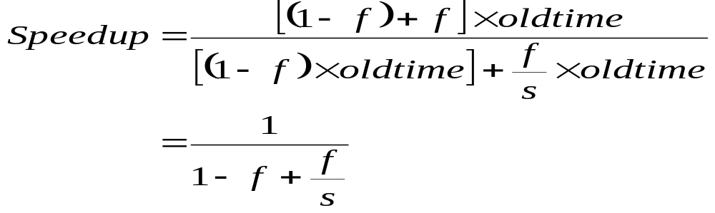



Amdahl’s Law
Motivation for optimizing common case
Speedup = old time / new time = new rate / old rate
Let an optimization speed fraction f of time by a factor of s
  New_time = (1-f) x old_time + (f/s) x old_time
  Speedup = old_time / new_time
  Speedup = old_time / ((1-f) x old_time + (f/s) x old_time)
Math: If f is small, s will have limited impact.
Notes:
If f is small, s will have limited impact

Slide 17





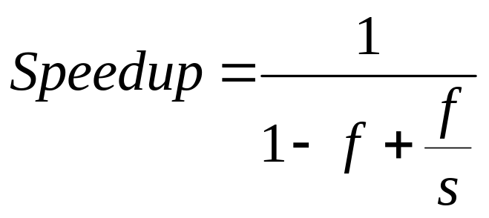
Amdahl’s Law Example
Your boss asks you to improve performance by:
  Improve the ALU used 95% of time by 10%
  Improve memory pipeline used 5% of time by 10x
f | s | Speedup
95% | 1.10 | 1.094
5% | 10 | 1.047
5% | ∞ | 1.052

Slide 18
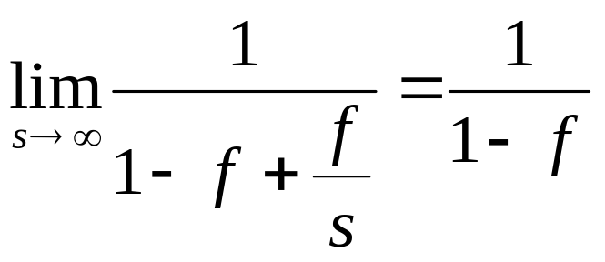
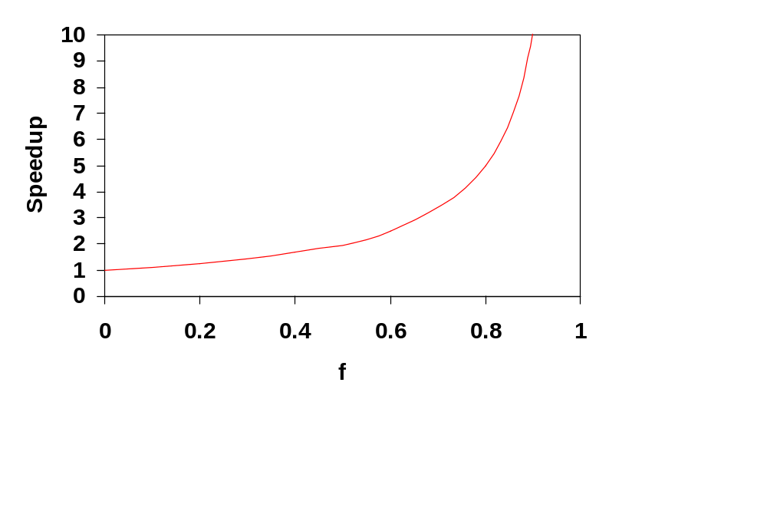


Amdahl’s Law: Limit
Make common case fast:

Slide 19

Amdahl’s Law: Limit
Consider uncommon case!
If (1-f) is nontrivial
  Speedup is limited!
Particularly true for exploiting parallelism in the large, where large s is not cheap
  GPU with e.g. 1024 processors (shader cores)
  Parallel portion speeds up by s (1024x)
  Serial portion of code (1-f) limits speedup
  E.g. 10% serial portion: 1/0.1 = 10x speedup with 1000 cores

Slide 20
Summary
Benchmarks: SPEC2000
Summarize performance:
  AM for time
  HM for rate
  GM for ratio
Amdahl’s Law:

