Slide 1
ECE/CS 552:
Single Cycle Control Path
© Prof. Mikko Lipasti
Lecture notes based in part on slides created by Mark Hill, David Wood, Guri Sohi, John Shen and Jim Smith

Slide 2
Control Overview
Single-cycle implementation
  Datapath: combinational logic, I-mem, regs, D-mem, PC
    Last three written at end of cycle
  Need control – just combinational logic!
  Inputs:
    Instruction (I-mem out)
    Zero (for beq)
  Outputs:
    Control lines for muxes
    ALUop
    Write-enables

Slide 3
Control Overview
Fast control
  Divide up work on “need to know” basis
  Logic with fewer inputs is faster
E.g.
  Global control need not know which ALUop

Slide 4
ALU Control
Assume ALU uses
000 | and
001 | or
010 | add
110 | sub
111 | slt (set less than)
others | don’t care

Slide 5
ALU Control
Instruction | Operation | Opcode | Function
add | add | 000000 | 100000
sub | sub | 000000 | 100010
and | and | 000000 | 100100
or | or | 000000 | 100101
slt | slt | 000000 | 101010
ALU-ctrl = f(opcode,function)

Slide 6
But…don’t forget
Instruction | Operation | Opcode | function
lw | add | 100011 | xxxxxx
sw | add | 101011 | xxxxxx
beq | sub | 000100 | 100010
To simplify ALU-ctrl
  ALUop = f(opcode)
  2 bits 6 bits

Slide 7
ALU Control
10 | add, sub, and, …
00 | lw, sw
01 | beq
ALU-ctrl = f(ALUop, function)
3 bits 2 bits 6 bits
Requires only five gates plus inverters

Slide 8
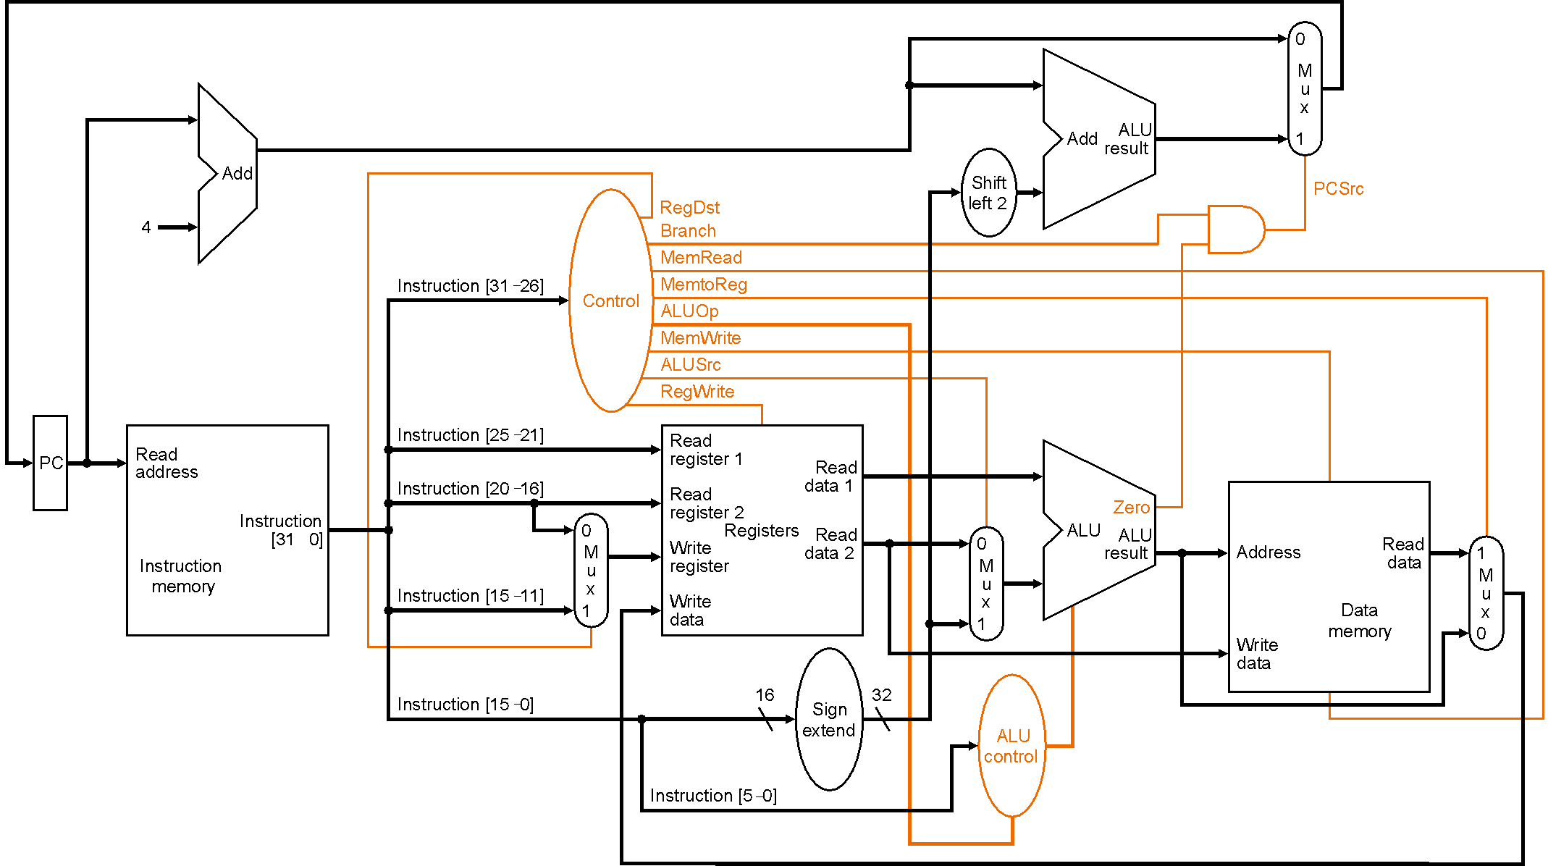
Control Signals Needed

Slide 9
Global Control
R-format: opcode rs rt rd shamt function
    6 5 5 5 5 6
I-format: opcode rs rt address/immediate
    6 5 5 16
J-format: opcode address
    6 26

Slide 10
Global Control
Route instruction[25:21] as read reg1 spec
Route instruction[20:16] are read reg2 spec
Route instruction[20:16] (load) and and instruction[15:11] (others) to
  Write reg mux
Call instruction[31:26] op[5:0]

Slide 11
Global Control
Global control outputs
  ALU-ctrl - see above
  ALU src - R-format, beq vs. ld/st
  MemRead - lw
  MemWrite - sw
  MemtoReg - lw
  RegDst - lw dst in bits 20:16, not 15:11
  RegWrite - all but beq and sw
  PCSrc - beq taken

Slide 12
Global Control
Global control outputs
  Replace PCsrc with
    Branch beq
    PCSrc = Branch * Zero
What are the inputs needed to determine above global control signals?
  Just Op[5:0]

Slide 13
Global Control
Instruction | Opcode | RegDst | ALUSrc
rrr | 000000 | 1 | 0
lw | 100011 | 0 | 1
sw | 101011 | x | 1
beq | 000100 | x | 0
??? | others | x | x
RegDst = ~Op[0]
ALUSrc = Op[0]
RegWrite = ~Op[3] * ~Op[2]

Slide 14
Global Control
More complex with entire MIPS ISA
  Need more systematic structure
  Want to share gates between control signals
Common solution: PLA
  MIPS opcode space designed to minimize PLA inputs, minterms, and outputs
Refer to MIPS Opcode map

Slide 15
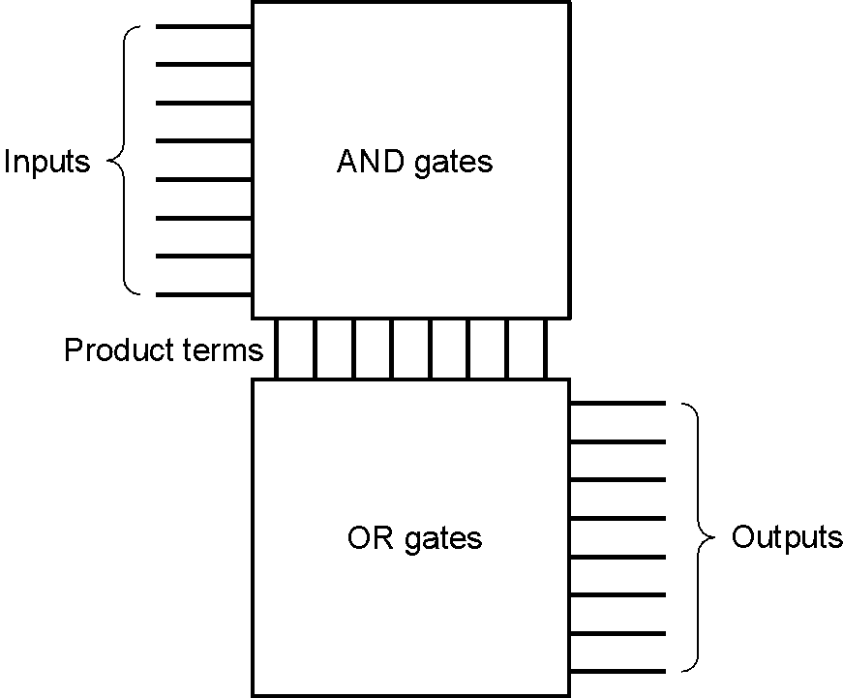
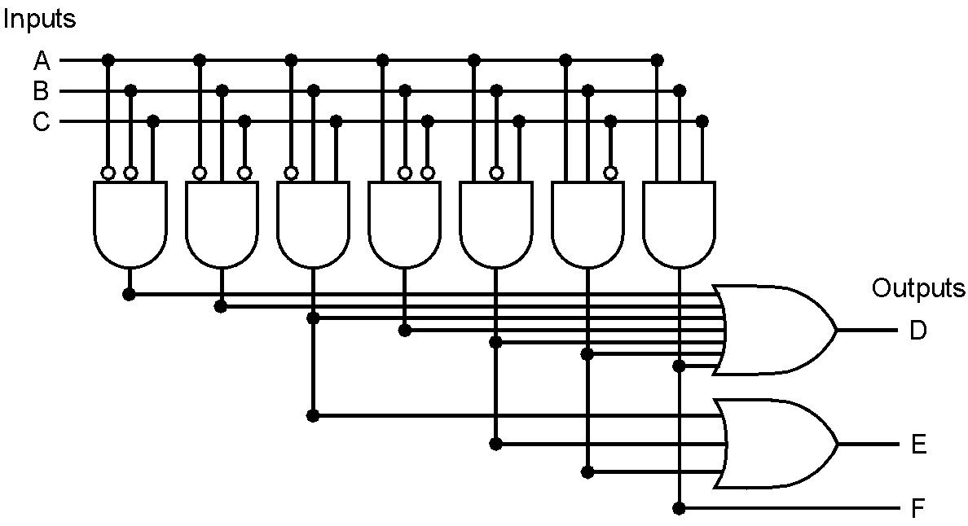
PLA
In AND-plane, & selected inputs to get minterms
In OR-plane, | selected minterms to get outputs
E.g.

Slide 16
Control Signals; Add Jumps

Slide 17
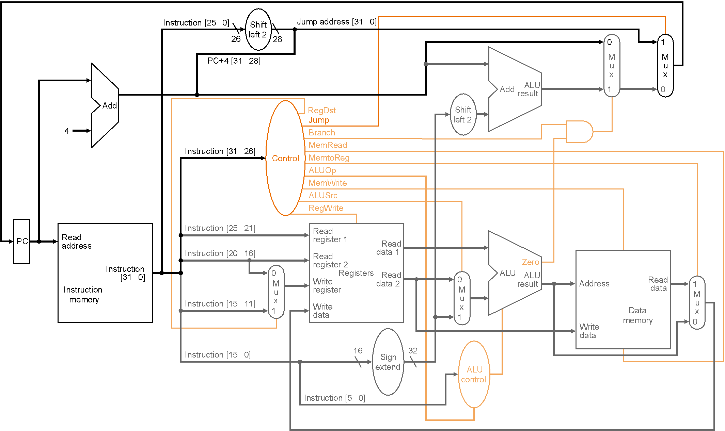
Control Signals w/Jumps

Slide 18
What’s wrong with single cycle?
Instructions
Cycles
Time
X
X
Program
Instruction
Cycle
(code size)
(CPI)
(cycle time)
Critical path probably lw:
  I-mem, reg-read, alu, d-mem, reg-write
Other instructions faster
  E.g. rrr: skip d-mem
Instruction variation much worse for full ISA and real implementation:
  FP divide
  Cache misses (what the heck is this? – later)

Slide 19
Single Cycle Implementation
Solution
  Variable clock?
    Too hard to control, design
  Fixed short clock
    Variable cycles per instruction
Multicycle control (next lecture)

Slide 20
Summary
Processor implementation
  Datapath
  Control
Single cycle implementation

