Slide 1
ECE/CS 552: Introduction to Superscalar Processors and the MIPS R10000
© Prof. Mikko Lipasti
Lecture notes based in part on slides created by Mark Hill, David Wood, Guri Sohi, John Shen and Jim Smith

Slide 2
Superscalar Processors
Challenges & Impediments
  Instruction flow
  Register data flow
  Memory data flow
MIPS R10000 reading
  [Kenneth C. Yeager. The MIPS R10000 Superscalar Microprocessor, IEEE Micro, April 1996]
  Exemplifies the techniques described in this lecture

Slide 3
Limitations of Scalar Pipelines
Scalar upper bound on throughput
  IPC <= 1 or CPI >= 1
Inefficient unified pipeline
  Long latency for each instruction
Rigid pipeline stall policy
  One stalled instruction stalls all newer instructions

Slide 4
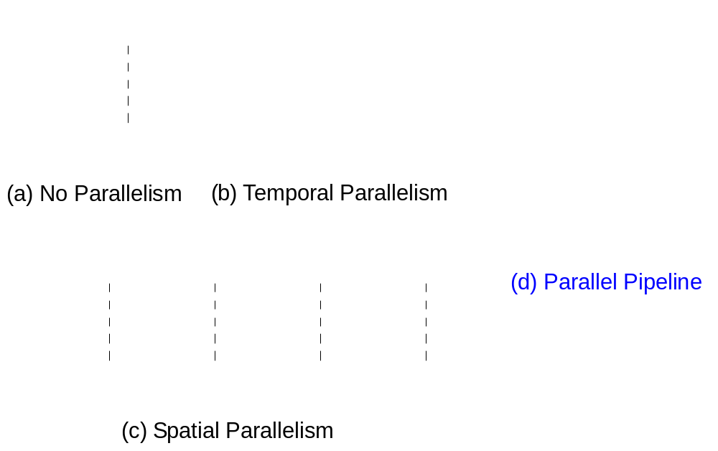
Parallel Pipelines
Notes:
Temporal vs. Spatial vs. Both

Slide 5
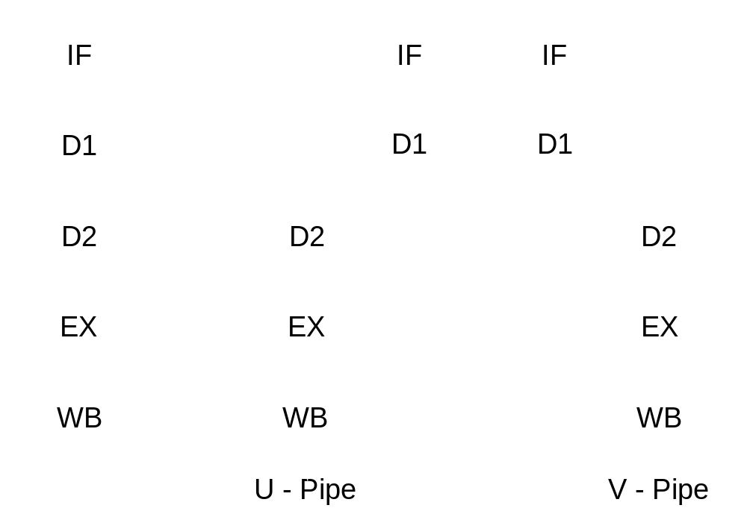
Intel Pentium Parallel Pipeline
Notes:
486 pipeline on the left: 2 decode stages due to complex ISA
Pentium parallel pipeline: U pipe is universal (can handle any op), V pipe can’t handle the most complex ops
Stages: Fetch and align, decode & generate control word, decode control word & gen mem addr, ALU or D$
Used branch prediction
Approximates dual-ported D$ with 8-way interleaved banks; have to deal with occasional bank conflicts

Slide 6
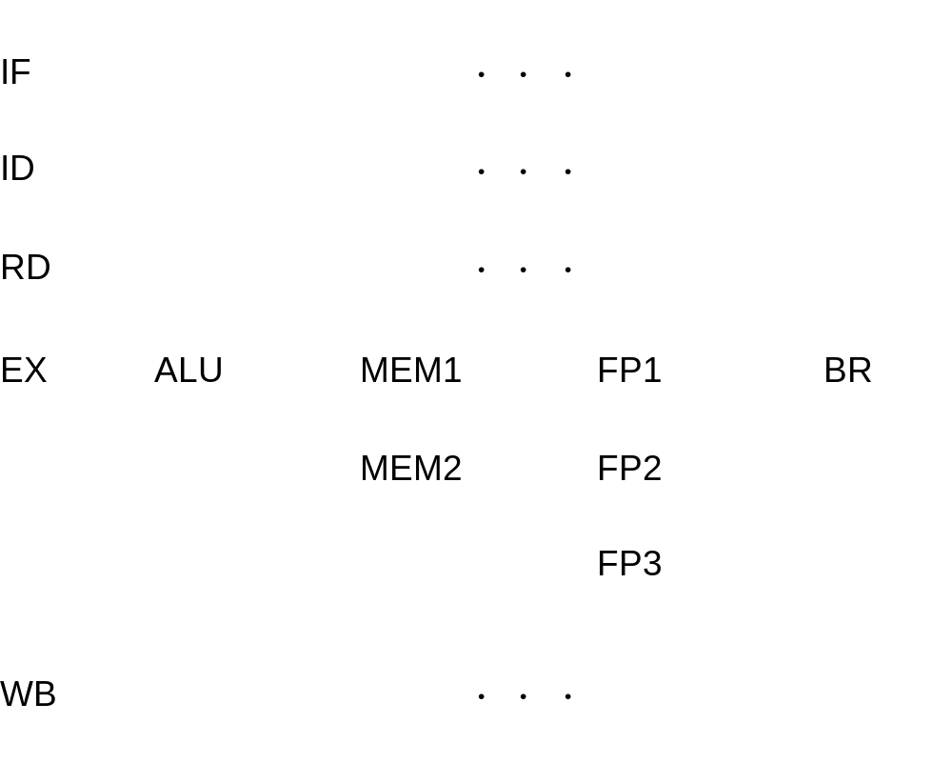
Diversified Pipelines
Notes:
Unified pipelines are inefficient and unnecessary. In a scalar organization they make sense.
With multiple issue, specialized pipelines make much more sense.
Note that all instructions are treated identically in IF, ID, (also RD, more or less), and WB. Why? Because they behave very much the same way.
What mix? 1st generation: Int & FPU, later: more; must determine for your workload.

Slide 7
IBM Power4 Diversified Pipelines
I-Cache
PC
Fetch Q
BR
Scan
Decode
BR
Predict
FP
Issue Q
FX/LD 1
Issue Q
FX/LD 2
Issue Q
BR/CR
Issue Q
Reorder Buffer
FP1
Unit
FP2
Unit
FX1
Unit
LD1
Unit
LD2
Unit
FX2
Unit
CR
Unit
BR
Unit
StQ
D-Cache
Notes:
IBM Power4, introduced in 2001. Leadership performance at 1.3GHz. Most recently used in the Apple PowerMac G5, running at 2GHz. The G5 also has an Altivec unit for media processing instructions, not shown in this diagram.
All units shown are fully pipelined
Note two clusters of integer units, separate FP cluster, also BR and CR units.

Slide 8
Rigid Pipeline Stall Policy
Backward
Propagation
of Stalling
Bypassing
Stalled
of Stalled
Instruction
Instruction
Not Allowed
Notes:
Think McDonalds: even though looking over the menu is pipelined with ordering, food prep, and delivery, the two are stalled: if the person in front of you has a special order (no ketchup or pickles) and the employee can’t find it under the heatlamp, all customers behind this customer are stalled. Stupid. Wendy’s model is much better, where ordering is in-order, but food prep and order delivery occur out of order. Although I noted recently that Wendy’s is giving up on this as well.

Slide 9
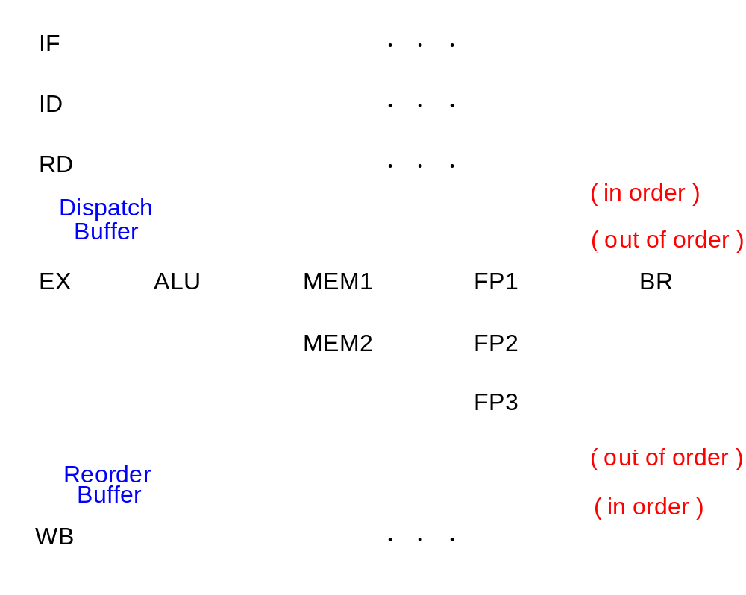
Dynamic Pipelines
Notes:
Like Wendy’s: once ID/RD has determined what you need, you get queued up, and others behind you can get past you.
In-order front end, OOO or dynamic execution in a micro-dataflow-machine, in-order backend
Interlock hardware (later) maintains dependences
Reorder buffer tracks completion, exceptions, provides precise interrupts: drain pipeline, restart
Inorder machine state follows the sequential execution model inherited from nonpipelined/pipelined machines

Slide 10
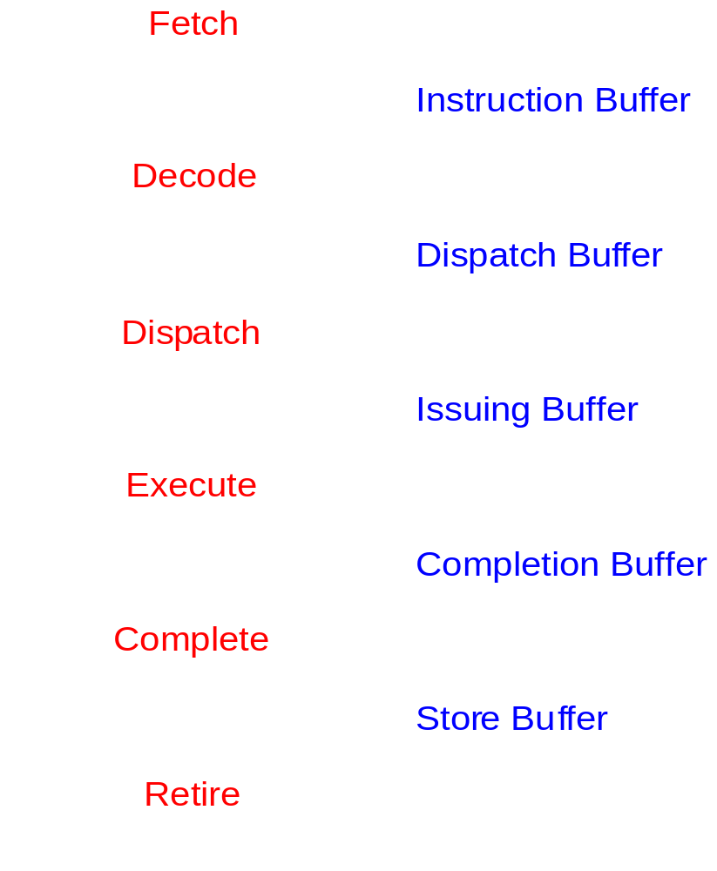
Superscalar Pipeline Stages
In
Program
Order
Out
of
Order
In
Program
Order

Slide 11
Limitations of Scalar Pipelines
Scalar upper bound on throughput
  IPC <= 1 or CPI >= 1
  Solution: wide (superscalar) pipeline
Inefficient unified pipeline
  Long latency for each instruction
  Solution: diversified, specialized pipelines
Rigid pipeline stall policy
  One stalled instruction stalls all newer instructions
  Solution: Out-of-order execution, distributed execution pipelines

Slide 12
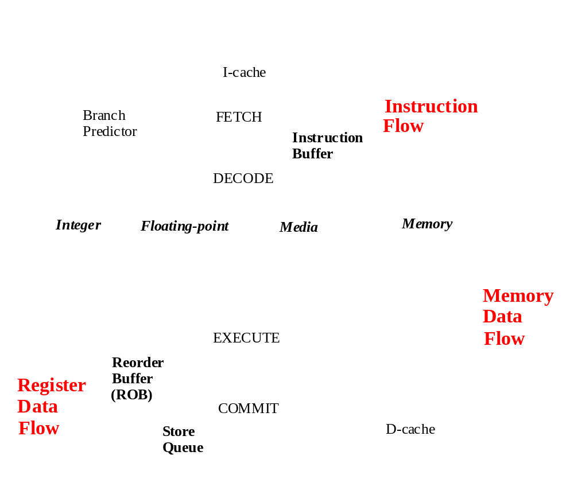
Impediments to High IPC
Notes:
Any of the three flows can become performance bottleneck. Must address all in a balanced fashion.

Slide 13
Instruction Flow
Objective: Fetch multiple instructions per cycle
Challenges:
  Branches: control dependences
  Branch target misalignment
  Instruction cache misses
Solutions
  Alignment hardware
  Prediction/speculation
  Nonblocking cache
PC
Instruction Memory
3 instructions fetched
Notes:
Don’t starve the pipeline: n/cycle
Must fetch n/cycle from I$

Slide 14
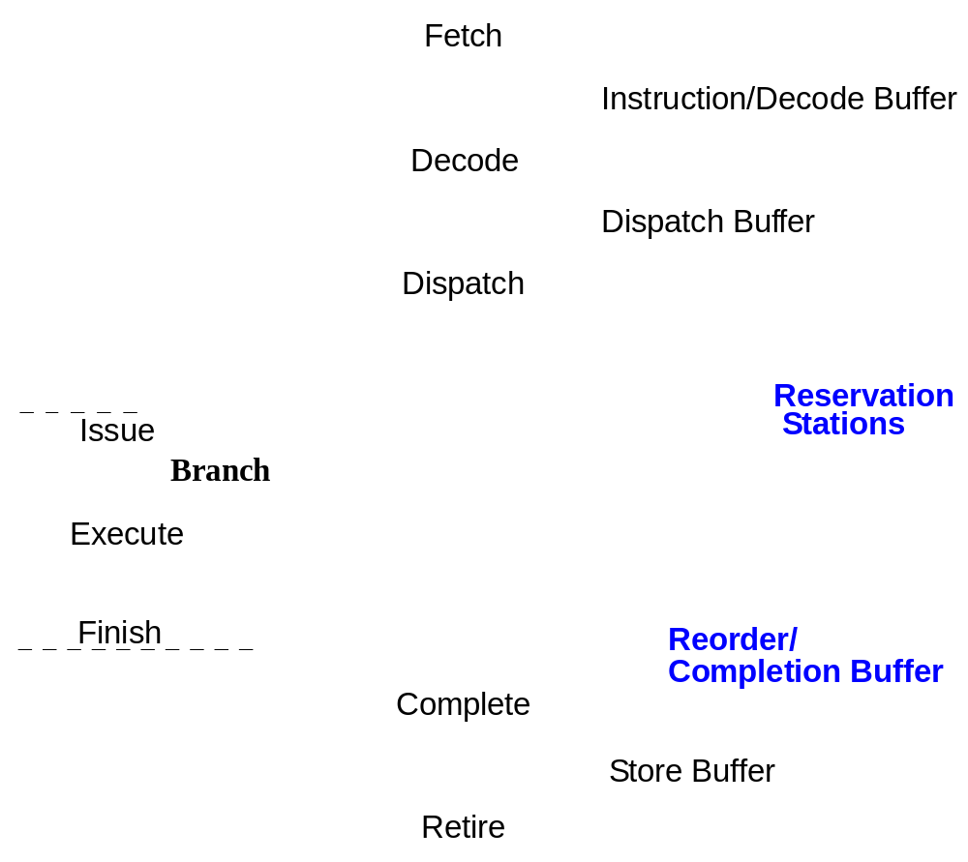
Disruption of Sequential Control Flow
Notes:
Penalty (increased lost opportunity cost): 1) target addr. Generation, 2) condition resolution
Sketch Tyranny of Amdahl’s Law pipeline diagram

Slide 15
Branch Prediction
Target address generation → Target Speculation
  Access register:
    PC, General purpose register, Link register
  Perform calculation:
    +/- offset, autoincrement
Condition resolution → Condition speculation
  Access register:
    Condition code register, General purpose register
  Perform calculation:
    Comparison of data register(s)
Notes:
Non-CC architecture requires actual computation to resolve condition

Slide 16
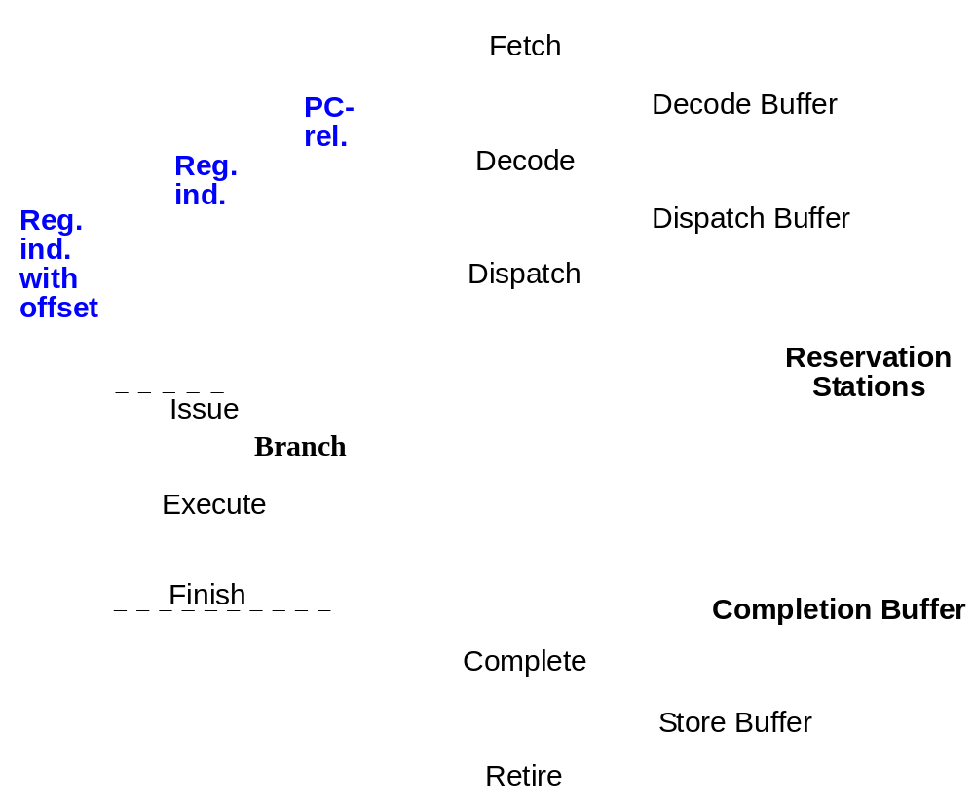
Target Address Generation
Notes:
Decode: PC = PC + DISP (adder) (1 cycle penalty)
Dispatch: PC = (R2) ( 2 cycle penalty)
Execute: PC = (R2) + offset (3 cycle penalty)
Both cond & uncond
Guess target address? Keep history based on branch address

Slide 17
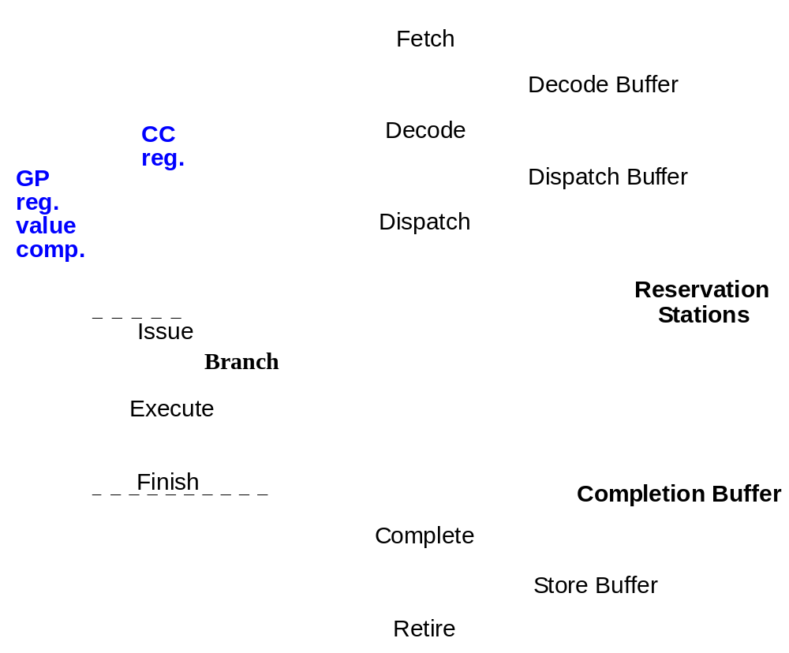
Condition Resolution
Notes:
Dispatch: RD (2 cycle penalty)
Execute: Status (3 cycle penalty)
Both cond & uncond
Guess taken vs. not taken

Slide 18
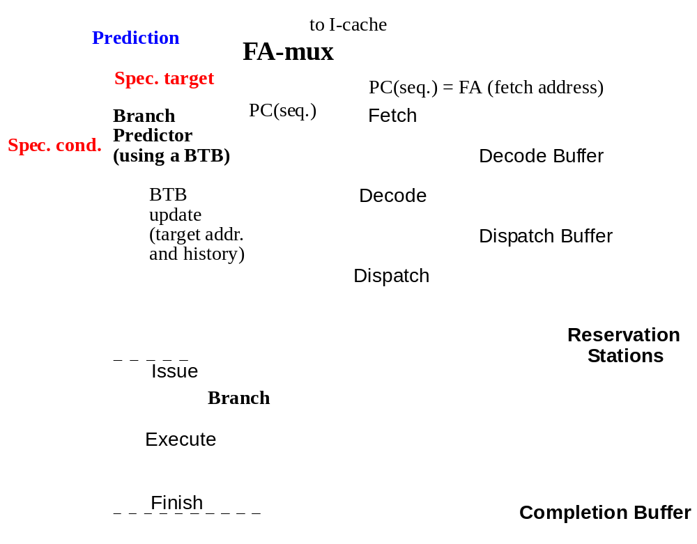
Branch Instruction Speculation
Notes:
Fetch: PC = PC + 4
BTB (cache) contains k cycles of history, generates guess
Execute: corrects wrong guess

Slide 19
Static Branch Prediction
Single-direction
  Always not-taken: Intel i486
Backwards Taken/Forward Not Taken
  Loop-closing branches have negative offset
  Used as backup in Pentium Pro, II, III, 4

Slide 20
Static Branch Prediction
Profile-based
  Instrument program binary
  Run with representative (?) input set
  Recompile program
    Annotate branches with hint bits, or
    Restructure code to match predict not-taken
Performance: 75-80% accuracy
  Much higher for “easy” cases

Slide 21
Dynamic Branch Prediction
Main advantages:
  Learn branch behavior autonomously
    No compiler analysis, heuristics, or profiling
  Adapt to changing branch behavior
    Program phase changes branch behavior
First proposed in 1980
  US Patent #4,370,711, Branch predictor using random access memory, James. E. Smith
Continually refined since then

Slide 22
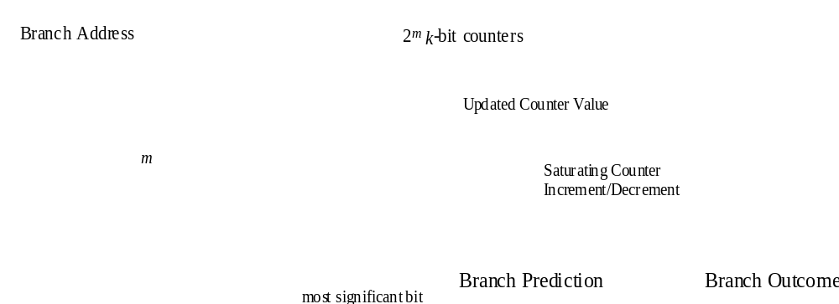
Smith Predictor Hardware
Jim E. Smith. A Study of Branch Prediction Strategies. International Symposium on Computer Architecture, pages 135-148, May 1981
Widely employed: Intel Pentium, PowerPC 604, MIPS R10000, etc.
More sophisticated predictors used in more recent designs
  Covered in detail in 752

Slide 23
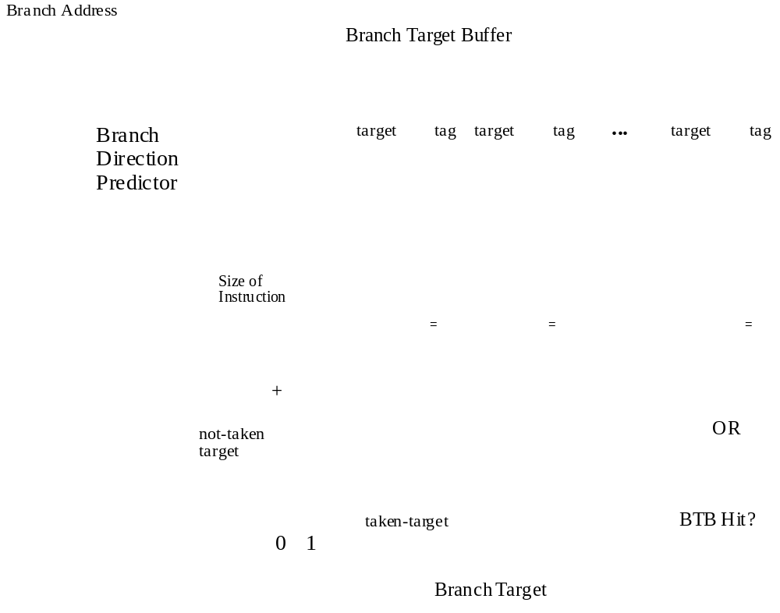
Branch Target Prediction
Does not work well for function/procedure returns
  Special return address stack (RAS) structure covered in 752

Slide 24
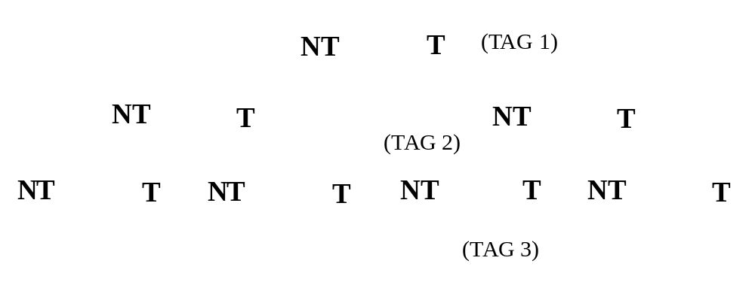
Branch Speculation
Leading Speculation
  Typically done during the Fetch stage
  Based on potential branch instruction(s) in the current fetch group
Trailing Confirmation
  Typically done during the Branch Execute stage
  Based on the next Branch instruction to finish execution

Slide 25
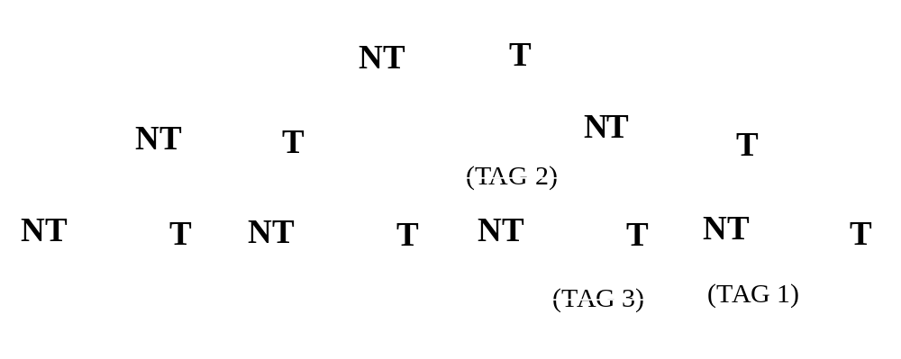
Branch Speculation
Start new correct path
  Must remember the alternate (non-predicted) path
Eliminate incorrect path
  Must ensure that the mis-speculated instructions produce no side effects
Notes:
“squash” on instructions following NT prediction

Slide 26
Mis-speculation Recovery
Start new correct path
  Update PC with computed branch target (if predicted NT)
  Update PC with sequential instruction address (if predicted T)
  Can begin speculation again at next branch
Eliminate incorrect path
  Use tag(s) to deallocate resources occupied by speculative instructions
  Invalidate all instructions in the decode and dispatch buffers, as well as those in reservation stations

Slide 27
Parallel Decode
Primary Tasks
  Identify individual instructions (!)
  Determine instruction types
  Determine dependences between instructions
Two important factors
  Instruction set architecture
  Pipeline width
Notes:
RISC vs. CISC: inherently serial
Find branches early: redirect fetch
Detect dependences: nxn comparators (pairwise)
RISC: fixed length, regular format, easier
CISC: can be multiple stages (lots of work), P6: I$ => decode is 5 cycles, often translates into internal RISC-like uops or ROPs

Slide 28
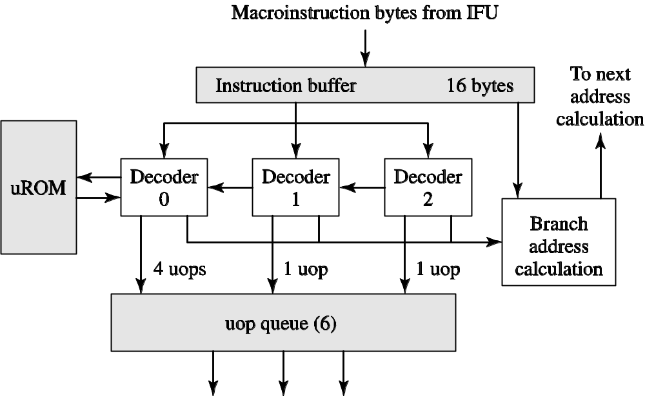
Pentium Pro Fetch/Decode
Notes:
16B/cycle delivered from I$ into FIFO instruction buffer
Decoder 0 is fully general, 1 & 2 can handle only simple uops.
Enter centralized window (reservation station); wait here until operands ready, structural hazards resolved.
Why is this bad? Branch penalty; need a good branch predictor.
Other option: predecode bits

Slide 29
Dependence Checking
Dest
Src0
Src1
Dest
Src0
Src1
Dest
Src0
Src1
Dest
Src0
Src1
?=
?=
?=
?=
?=
?=
?=
?=
?=
?=
?=
?=
Trailing instructions in fetch group
  Check for dependence on leading instructions

Slide 30
Summary: Instruction Flow
Fetch group alignment
Target address generation
  Branch target buffer
Target condition generation
  Static prediction
  Dynamic prediction
Speculative execution
  Tagging/tracking instructions
  Recovering from mispredicted branches
Parallel decode

Slide 31
Register Data Flow
Parallel pipeline
  Centralized instruction fetch
  Centralized instruction decode
Diversified pipeline
  Distributed instruction execution
Data dependence linking
  Register renaming to eliminate WAR/WAW
  Issue logic to support out-of-order issue
  Reorder buffer to maintain precise state

Slide 32
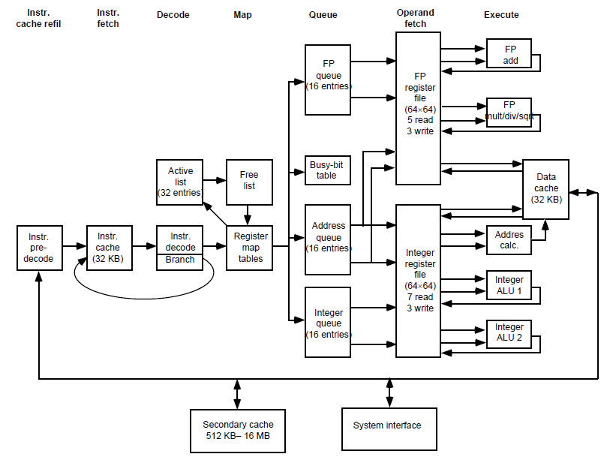
MIPS R10000 Issue Queues
Notes:
Distributed, with localized control (easy win: break up based on data type, I.e. FP vs. integer)
Less efficient utilization, but each unit is smaller since can be single-ported (for dispatch and issue)
Must tune for proper utilization

Slide 33
Register Data Dependences
Program data dependences cause hazards
  True dependences (RAW)
  Antidependences (WAR)
  Output dependences (WAW)
When are registers read and written?
  Out of program order!
  Hence, any/all of these can occur
Solution to all three: register renaming

Slide 34
Register Renaming: WAR/WAW
Widely employed (Core i7, MIPS R10000, …)
Resolving WAR/WAW:
  Each register write gets unique “rename register”
  Writes are committed in program order at Writeback
  WAR and WAW are not an issue
    All updates to “architected state” delayed till writeback
    Writeback stage always later than read stage
  Reorder Buffer (ROB) enforces in-order writeback
Add R3 <= … P32 <= …
Sub R4 <= … P33 <= …
And R3 <= … P35 <= …

Slide 35
Register Renaming: RAW
In order, at dispatch:
  Source registers checked to see if “in flight”
    Register map table keeps track of this
    If not in flight, can be read from the register file
    If in flight, look up “rename register” tag (IOU)
  Then, allocate new register for register write
Add R3 <= R2 + R1 P32 <= P2 + P1
Sub R4 <= R3 + R1 P33 <= P32 + P1
And R3 <= R4 & R2 P35 <= P33 + P2

Slide 36
Register Renaming: RAW
Advance instruction to instruction queue
  Wait for rename register tag to trigger issue
Issue queue/reservation station enables out-of-order issue
  Newer instructions can bypass stalled instructions

Slide 37
Physical Register File
Fetch
Decode
Rename
Issue
RF Read
Execute
Agen-D$
ALU RF Write
D$
Load RF Write
Map Table
R0 => P7
Physical Register File
R1 => P3
…
R31 => P39
Used in MIPS R10000, Core i7, AMD Bulldozer
All registers in one place
  Always accessed right before EX stage
  No copying to real register file at commit

Slide 38
Managing Physical Registers
Map Table
Add R3 <= R2 + R1 P32 <= P2 + P1
Sub R4 <= R3 + R1 P33 <= P32 + P1
…
…
And R3 <= R4 & R2 P35 <= P33 + P2
Release P32 (previous R3) when this instruction completes execution
R0 => P7
R1 => P3
…
R31 => P39
What to do when all physical registers are in use?
  Must release them somehow to avoid stalling
  Maintain free list of “unused” physical registers
Release when no more uses are possible
  Sufficient: next write commits

Slide 39
Memory Data Flow
Resolve WAR/WAW/RAW memory dependences
  MEM stage can occur out of order
Provide high bandwidth to memory hierarchy
  Non-blocking caches

Slide 40
Memory Data Dependences
Load/Store RS
Agen
Mem
WAR/WAW: stores commit in order
  Hazards not possible. Why?
RAW: loads must check pending stores
  Store queue keeps track of pending store addresses
  Loads check against these addresses
  Similar to register bypass logic
  Comparators are 64 bits wide (address size)
Major source of complexity in modern designs
  Store queue lookup is position-based
  What if store address is not yet known?
Store
Queue
Reorder Buffer

Slide 41
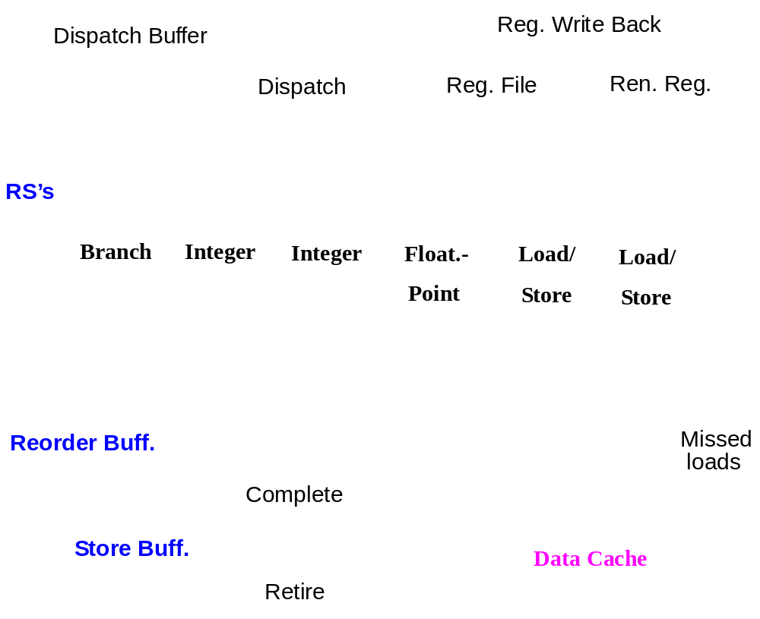
Increasing Memory Bandwidth
Notes:
Duplicating load/store pipelines is fundamentally harder because they contain shared state (in the cache)
Loads that miss can be set aside in a “missed load buffer” or “miss status handling register” (MSHR)
Subsequent loads that hit can still be handled

Slide 42
Maintaining Precise State
Out-of-order execution
  ALU instructions
  Load/store instructions
In-order completion/retirement
  Precise exceptions
Solutions
  Reorder buffer retires instructions in order
  Store queue retires stores in order
  Exceptions can be handled at any instruction boundary by reconstructing state out of ROB/SQ
Notes:
Precise exception – clean instr. Boundary for restart
Memory consistency – WAW, also subtle multiprocessor issues (in 757)
Memory coherence – RAR expect later load to also see new value seen by earlier load

Slide 43
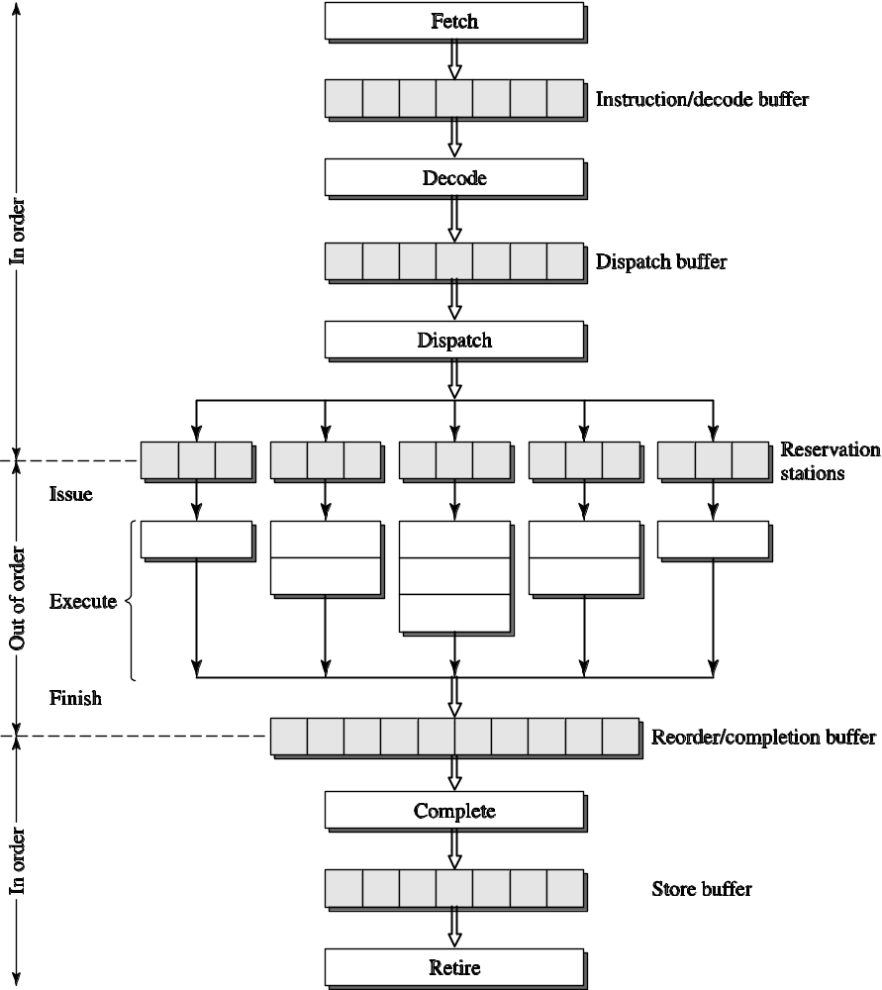
A Dynamic Superscalar Processor
Notes:
ROB – preallocated at dispatch: bookkeeping, store results, forward results (possibly)
Complete – commit results to RF (no way to undo)
Retire – memory update: delay stores to let loads go early

Slide 44
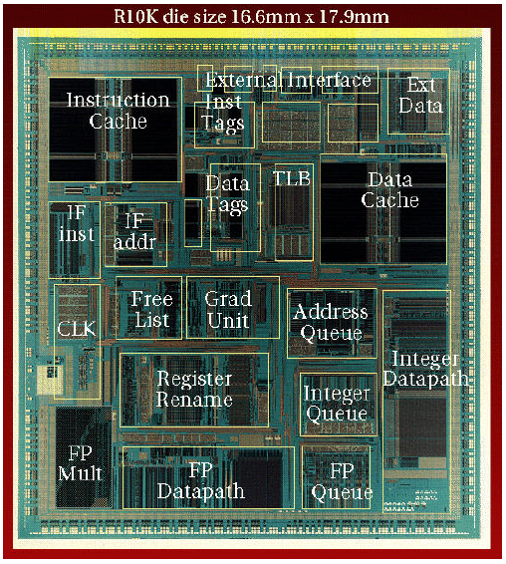
MIPS R10000
Details in paper [Kenneth C. Yeager. The MIPS R10000 Superscalar Microprocessor, IEEE Micro, April 1996]
Clean, straightforward implementation of many of the concepts presented in this lecture

Slide 45
Superscalar Summary

