Slide 1
ECE/CS 552: Single Cycle Datapath
© Prof. Mikko Lipasti
Lecture notes based in part on slides created by Mark Hill, David Wood, Guri Sohi, John Shen and Jim Smith

Slide 2
Processor Implementation
Forecast – heart of 552 – key to project
  Sequential logic design review (brief)
  Clock methodology (FSD)
  Datapath – 1 CPI
    Single instruction, 2’s complement, unsigned
Next:
  Control
  Multiple cycle implementation (information only)
  Microprogramming
  Exceptions

Slide 3
Review Sequential Logic
Logic is combinational if output is solely function of inputs
  E.g. ALU of previous lecture
Logic is sequential or “has state” if output function of:
  Past and current inputs
  Past inputs remembered in “state”
  Of course, no magic

Slide 4

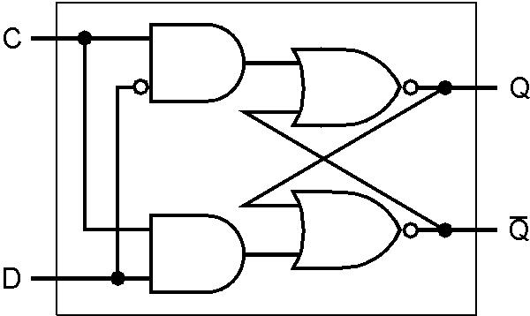

Review Sequential Logic
Clock high, Q = D, ~Q = ~D after prop. Delay
Clock low Q, ~Q remain unchanged
  Level-sensitive latch

Slide 5
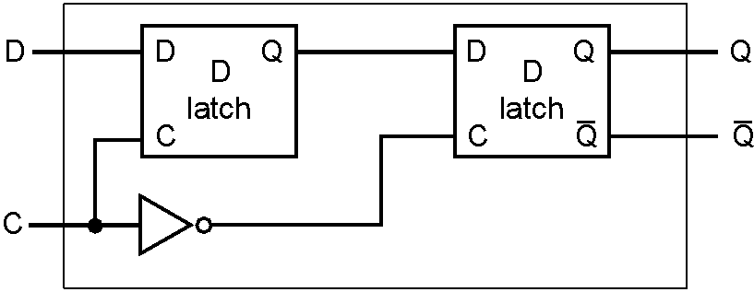
Review Sequential Logic
Master/Slave D flip-flop
  While clock high, Q_{M} follows D, but Q_{S} holds
  At falling edge Q_{M} propagates to Q_{S}
  Opaque except at falling (rising) clock edge

Slide 6
Review Sequential Logic
D FF
+1
Why can this fail for a latch?
  Latch is transparent when clock is high (low)
  Creates combinational loop
  Increment evaluates unknown number of times

Slide 7
Clocking Methology
Motivation
  Design data and control without considering clock
Use Fully Synchronous Design (FSD)
  Just a convention to simplify design process
  Restricts design freedom
  Eliminates complexity, can guarantee timing correctness
  Not really feasible in real designs: off-chip I/O
  Even in ECE 554 you will violate FSD

Slide 8
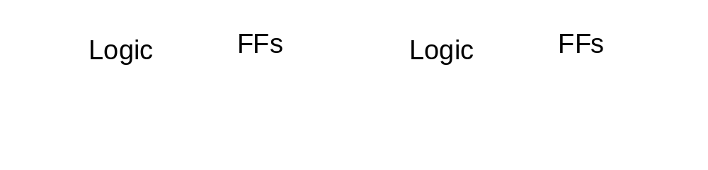
Our Methodology
Only flip-flops
All on the same edge (e.g. falling)
All with same clock
  No need to draw clock signals
All logic finishes in one cycle

Slide 9

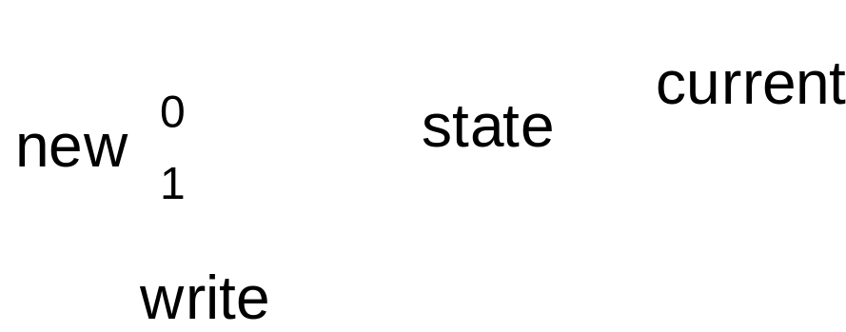
Our Methodology, cont’d
No clock gating!
  Book has bad examples
Correct design:

Slide 10
Delayed Clocks (Gating)
Clock
Delay
X
D
Y
D
Gated clock
Clock
X
Delay
Y
Problem:
  Some flip-flops receive gated clock late
  Data signal may violate setup & hold req’t

Slide 11

FSD Clocking Rules
Clock
Delay
D
Y
D
Y
Clock
T_{clock} = cycle time
T_{setup} = FF setup time requirement
T_{hold} = FF hold time requirement
T_{FF} = FF combinational delay
T_{comb} = Combinational delay
FSD Rules:
  T_{clock} > T_{FF} + T_{combmax} + T_{setup}
  T_{FF} + T_{combmin} > T_{hold}

Slide 12
Datapath – 1 CPI
Assumption: get whole instruction done in one long cycle
Instructions:
  and, lw, sw, & beq
To do
  For each instruction type
  Putting it all together

Slide 13
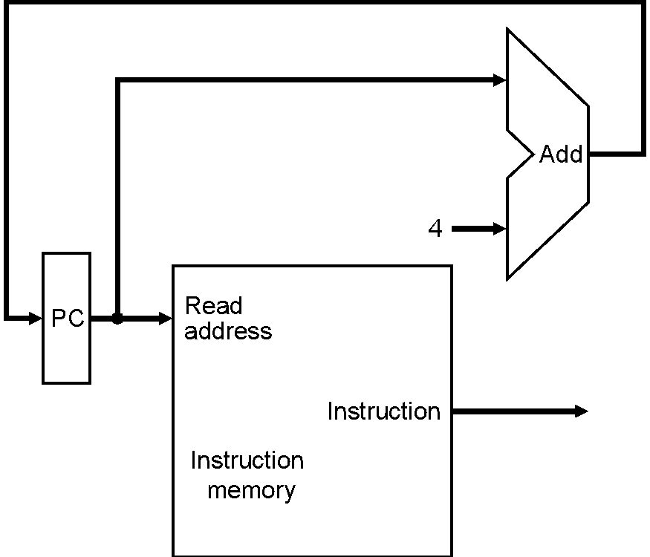
Fetch Instructions
Fetch instruction, then increment PC
  Same for all types
Assumes
  PC updated every cycle
  No branches or jumps
After this instruction fetch next one

Slide 14
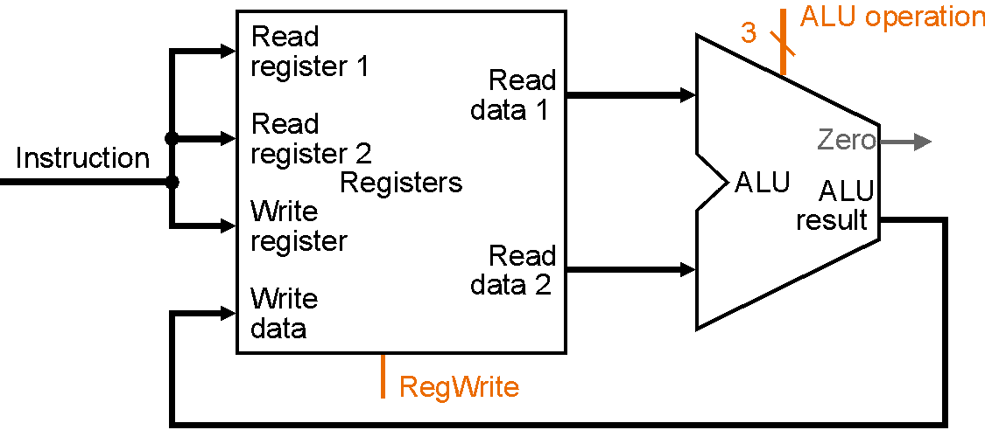
ALU Instructions
and $1, $2, $3 # $1 <= $2 & $3
E.g. MIPS R-format
  Opcode rs rt rd shamt function
  6 5 5 5 5 6

Slide 15
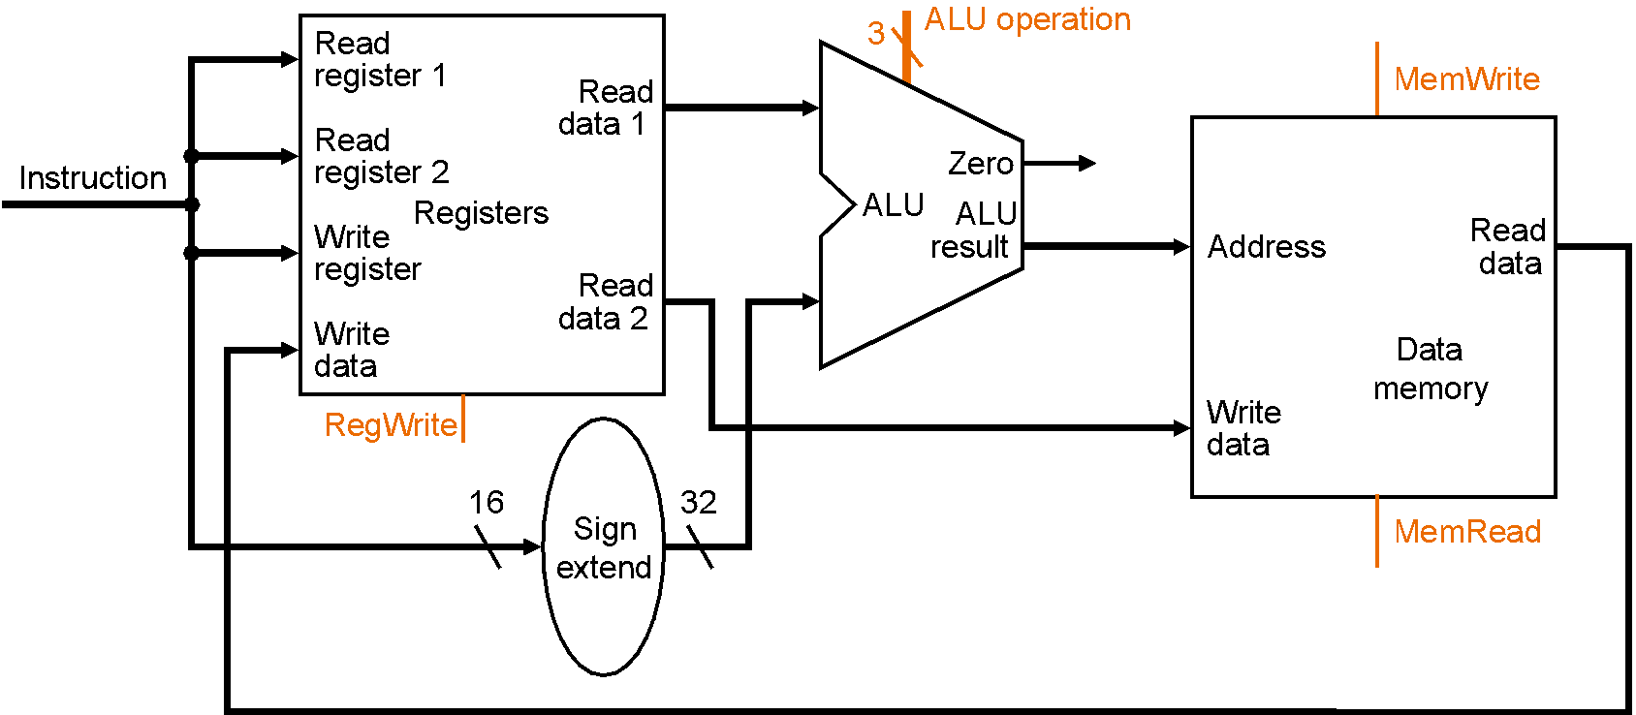

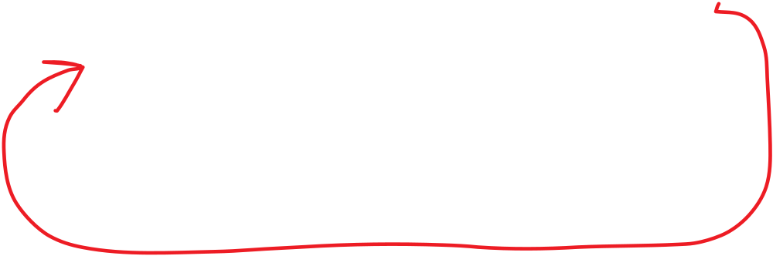
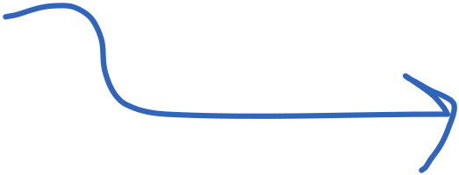

Load/Store Instructions
lw $1, immed($2) # $1 <= M[SE(immed)+$2]
E.g. MIPS I-format:
  Opcode rt rt immed
  6 5 5 16

Slide 16
Branch Instructions
beq $1, $2, addr # if ($1==$2) PC = PC + addr<<2
Actually
  newPC = PC + 4
  target = newPC + addr << 2 # in MIPS offset from newPC
  if (($1 - $2) == 0)
    PC = target
  else
    PC = newPC

Slide 17
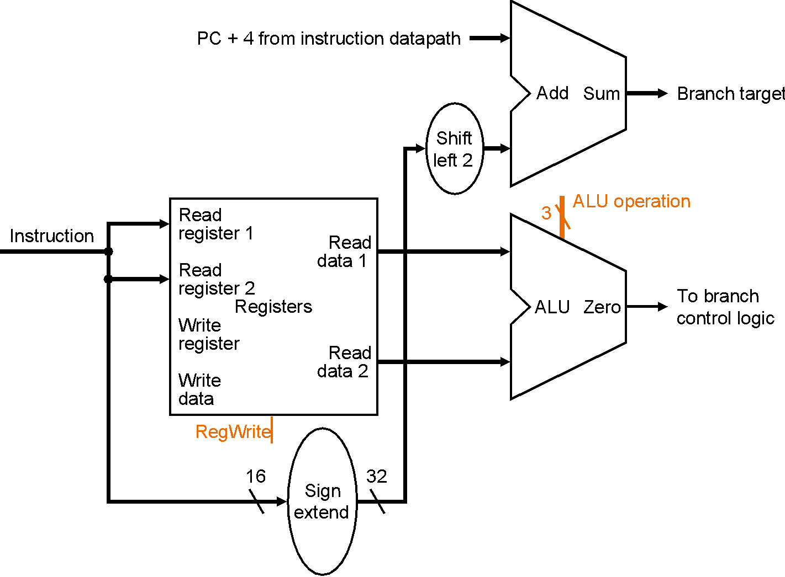
Branch Instructions

Slide 18

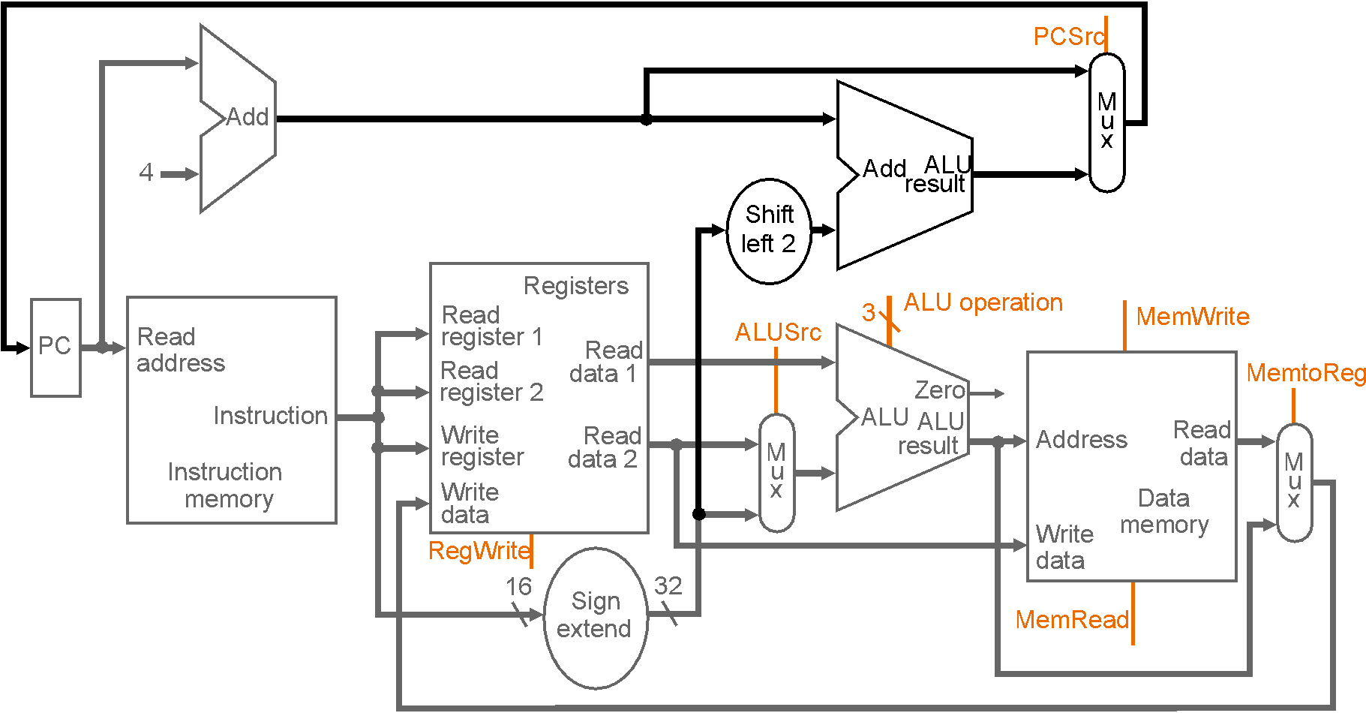


All Together

Slide 19
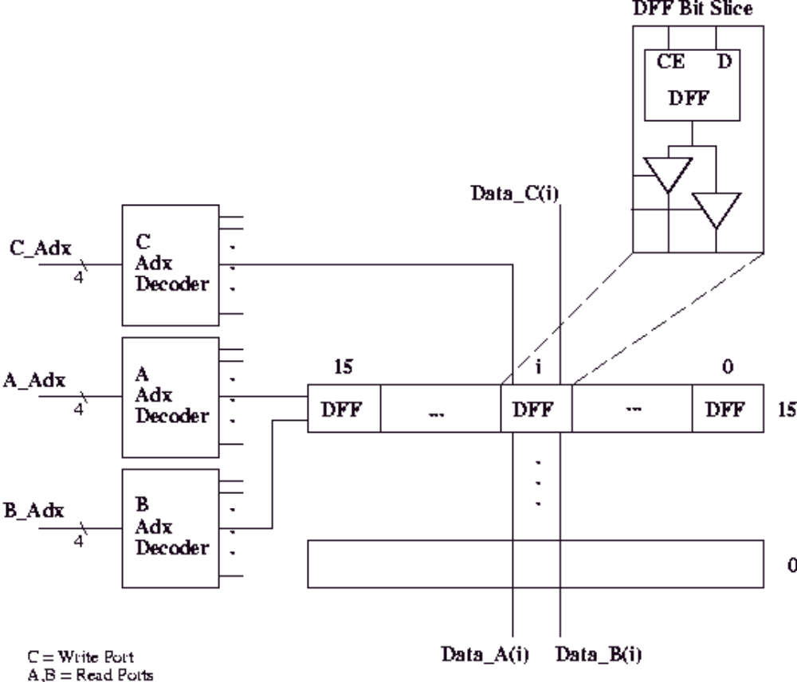

Register File?

Slide 20
Summary
Sequential logic design review (brief)
Clock methodology (FSD)
Datapath – 1 CPI
  ALU, lw, sw, beq instructions

