Slide 1
ECE/CS 552: Cache Concepts
© Prof. Mikko Lipasti
Lecture notes based in part on slides created by Mark Hill, David Wood, Guri Sohi, John Shen and Jim Smith

Slide 2
Big Picture
Memory
  Just an “ocean of bits”
  Many technologies are available
Key issues
  Technology (how bits are stored)
  Placement (where bits are stored)
  Identification (finding the right bits)
  Replacement (finding space for new bits)
  Write policy (propagating changes to bits)
Must answer these regardless of memory type

Slide 3
Types of Memory
Type | Size | Speed | Cost/bit
Register | < 1KB | < 1ns | $$$$
On-chip SRAM | 8KB-6MB | < 10ns | $$$
Off-chip SRAM | 1Mb – 16Mb | < 20ns | $$
DRAM | 64MB – 1TB | < 100ns | $
Disk | 40GB – 1PB | < 20ms | ~0

Slide 4
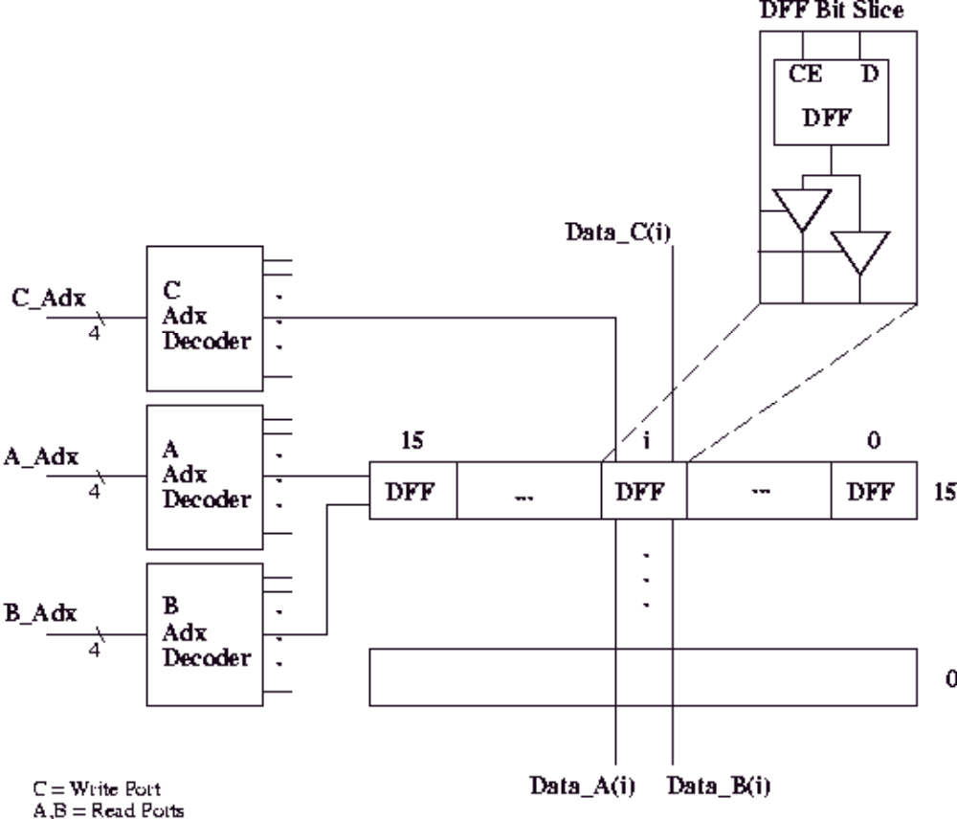
Technology - Registers

Slide 5
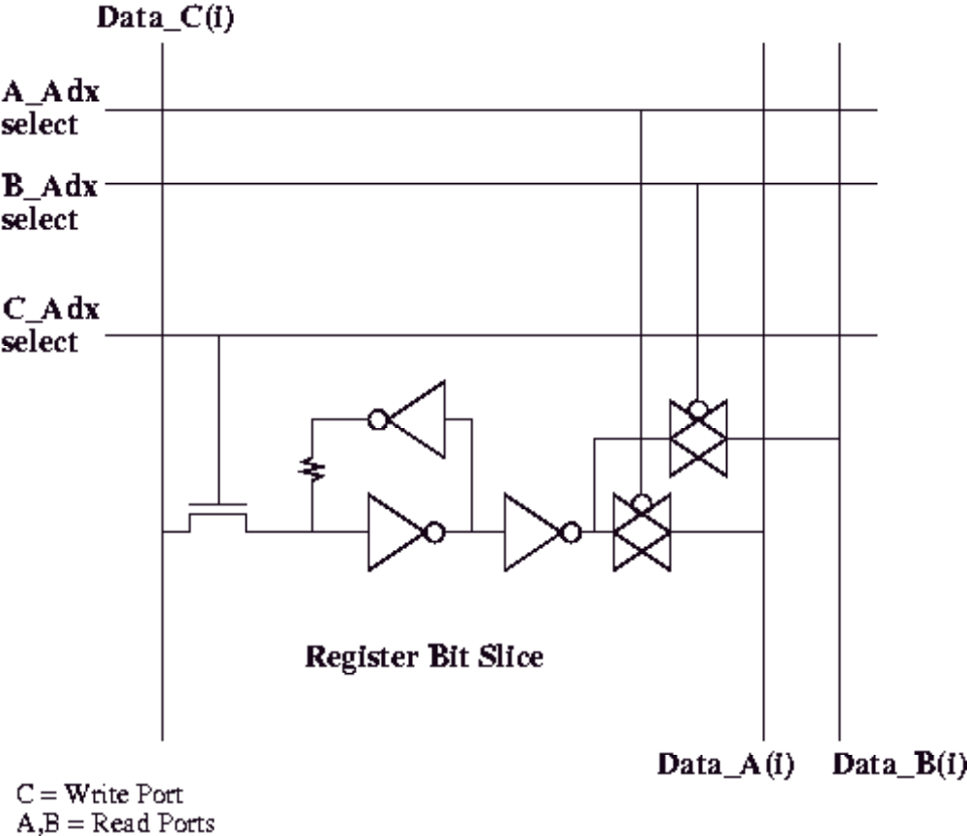
Technology – SRAM
“Bit” Lines
-carry data in/out
“Word” Lines
-select a row

Slide 6
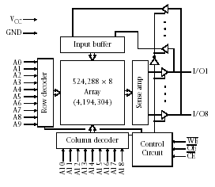
Technology – Off-chip SRAM
Commodity
  1Mb – 16Mb
554 Lab SRAM
  AS7C4096
  512K x 8b
    512KB
    Or 4Mb
  10-20ns
Note: sense amp
  Analog circuit
  High-gain amplifier

Slide 7
Technology – DRAM
Logically similar to SRAM
Commodity DRAM chips
  E.g. 1Gb per chip
  Standardized address/data/control interfaces
Very dense
  1T per cell (bit)
  Data stored in capacitor – decays over time
    Must rewrite on read, refresh
Density improving vastly over time
Latency barely improving

Slide 8
Memory Timing – Read
Addr
EN1
EN0
Data
Chip 0
Chip 1
t_{EN}
Addr
t_{D}
t_{O}
Data
EN
Latch-based SRAM or asynchronous DRAM (FPM/EDO)
  Multiple chips/banks share address bus and tristate data bus
  Enables are decoded from address to select bank
    E.g. bbbbbbb0 is bank 0, bbbbbbb1 is bank 1
Timing constraints: straightforward
  t_{EN} setup time from Addr stable to EN active (often zero)
  t_{D} delay from EN to valid data (10ns typical for SRAM)
  t_{O} delay from EN disable to data tristate off (nonzero)
Notes:
Easy: can generate addr/data/en synchronously at beginning of cycle, read data at end.
If tD>tO, safe to not worry about contention on the shared data bus

Slide 9
Memory Timing - Write
Addr
WR
EN1
EN0
Data
Chip 0
Chip 1
t_{S}
t_{P}
t_{H}
Addr
WR
Data
EN
WR & EN triggers write of Data to ADDR
Timing constraints: not so easy
  t_{S} setup time from Data & Addr stable to WR pulse
  t_{P} minimum write pulse duration
  t_{H} hold time for data/addr beyond write pulse end
Challenge: WR pulse must start late, end early
  >t_{S} after Addr/Data, >t_{H} before end of cycle
  Requires multicycle control and/or glitch-free clock divider

Slide 10
Technology – Flash
Similar 2D array as SRAM/DRAM, but nonvolatile
  Moving to 3D with stacked bit cells
Bits stored as charge in floating gate
  Coincident selection detects presence of charge
  Multilevel cells (MLC) now common (not binary)
Writes
  Requires high voltage for writes to store charge
  Writes are slow, done in bulk
  Endurance issues – write leveling required in firmware

Slide 11
Technology – Disk
Covered in more detail later (input/output)
Bits stored as magnetic charge
Still mechanical!
  Disk rotates (3600-15000 RPM)
  Head seeks to track, waits for sector to rotate to it
  Solid-state replacements in the works
    MRAM, etc.
Glacially slow compared to DRAM (10-20ms)
Density improvements astounding (100%/year)

Slide 12
Memory Hierarchy
CAPACITY
SPEED and COST
Registers
On-Chip
SRAM
Off-Chip
SRAM
DRAM
Disk

Slide 13
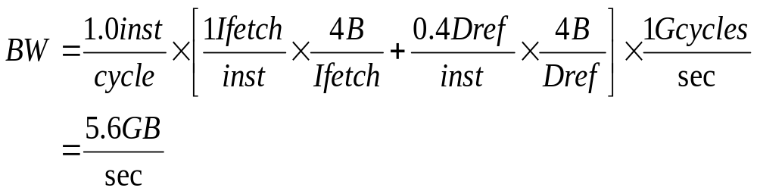
Why Memory Hierarchy?
Need lots of bandwidth
Need lots of storage
  64MB (minimum) to multiple TB
Must be cheap per bit
  (TB x anything) is a lot of money!
These requirements seem incompatible

Slide 14
Why Memory Hierarchy?
Fast and small memories
  Enable quick access (fast cycle time)
  Enable lots of bandwidth (1+ L/S/I-fetch/cycle)
Slower larger memories
  Capture larger share of memory
  Still relatively fast
Slow huge memories
  Hold rarely-needed state
  Needed for correctness
All together: provide appearance of large, fast memory with cost of cheap, slow memory

Slide 15
Why Does a Hierarchy Work?
Locality of reference
  Temporal locality
    Reference same memory location repeatedly
  Spatial locality
    Reference near neighbors around the same time
Empirically observed
  Significant!
  Even small local storage (8KB) often satisfies >90% of references to multi-MB data set

Slide 16
Why Locality?
Analogy:
  Library (Disk)
  Bookshelf (Main memory)
  Stack of books on desk (off-chip cache)
  Opened book on desk (on-chip cache)
Likelihood of:
  Referring to same book or chapter again?
    Probability decays over time
    Book moves to bottom of stack, then bookshelf, then library
  Referring to chapter n+1 if looking at chapter n?

Slide 17
Memory Hierarchy
Temporal Locality
Keep recently referenced items at higher levels
Future references satisfied quickly
CPU
Spatial Locality
Bring neighbors of recently referenced to higher levels
Future references satisfied quickly
I & D L1 Cache
Shared L2 Cache
Main Memory
Disk

Slide 18
Summary
Memory technology
Memory hierarchy
Temporal and spatial locality
Cache design issues in following lecture

