Slide 1
ECE/CS 552: Cache Performance
© Prof. Mikko Lipasti
Lecture notes based in part on slides created by Mark Hill, David Wood, Guri Sohi, John Shen and Jim Smith

Slide 2
Memory Hierarchy
Temporal Locality
Keep recently referenced items at higher levels
Future references satisfied quickly
CPU
Spatial Locality
Bring neighbors of recently referenced to higher levels
Future references satisfied quickly
I & D L1 Cache
Shared L2 Cache
Main Memory
Disk

Slide 3
Caches and Performance
Caches
  Enable design for common case: cache hit
    Cycle time, pipeline organization
    Recovery policy
  Uncommon case: cache miss
    Fetch from next level
      Apply recursively if multiple levels
    What to do in the meantime?
What is performance impact?
Various optimizations are possible

Slide 4
Performance Impact
Cache hit latency
  Included in “pipeline” portion of CPI
    E.g. IBM study: 1.15 CPI with 100% cache hits
  Typically 1-3 cycles for L1 cache
    Intel/HP McKinley: 1 cycle
      Heroic array design
      No address generation: load r1, (r2)
    IBM Power4: 3 cycles
      Address generation
      Array access
      Word select and align

Slide 5
Cache Hit continued
AGEN
CACHE
Cycle stealing common
  Address generation < cycle
  Array access > cycle
  Clean, FSD cycle boundaries violated
Speculation rampant
  “Predict” cache hit
  Don’t wait for tag check
  Consume fetched word in pipeline
  Recover/flush when miss is detected
    Reportedly 7+ cycles later in Intel Pentium 4
AGEN
CACHE

Slide 6
Cache Hits and Performance
Cache hit latency determined by:
  Cache organization
    Associativity
      Parallel tag checks expensive, slow
      Way select slow (fan-in, wires)
    Block size
      Word select may be slow (fan-in, wires)
    Number of blocks (sets x associativity)
      Wire delay across array
      “Manhattan distance” = width + height
      Word line delay: width
      Bit line delay: height
Array design is an art form
  Detailed analog circuit/wire delay modeling
Word Line
Bit Line

Slide 7
Cache Misses and Performance
Miss penalty
  Detect miss: 1 or more cycles
  Find victim (replace line): 1 or more cycles
    Write back if dirty
  Request line from next level: several cycles
  Transfer line from next level: several cycles
    (block size) / (bus width)
  Fill line into data array, update tag array: 1+ cycles
  Resume execution
In practice: 6 cycles to 100s of cycles

Slide 8
Cache Miss Rate
Determined by:
  Program characteristics
    Temporal locality
    Spatial locality
  Cache organization
    Block size, associativity, number of sets

Slide 9
Improving Locality
Instruction text placement
  Profile program, place unreferenced or rarely referenced paths “elsewhere”
    Maximize temporal locality
  Eliminate taken branches
    Fall-through path has spatial locality

Slide 10
Improving Locality
Data placement, access order
  Arrays: “block” loops to access subarray that fits into cache
    Maximize temporal locality
  Structures: pack commonly-accessed fields together
    Maximize spatial, temporal locality
  Trees, linked lists: allocate in usual reference order
    Heap manager usually allocates sequential addresses
    Maximize spatial locality
Hard problem, not easy to automate:
  C/C++ disallows rearranging structure fields
  OK in Java

Slide 11
Cache Miss Rates: 3 C’s [Hill]
Compulsory miss
  First-ever reference to a given block of memory
Capacity
  Working set exceeds cache capacity
  Useful blocks (with future references) displaced
Conflict
  Placement restrictions (not fully-associative) cause useful blocks to be displaced
  Think of as capacity within set

Slide 12
Cache Miss Rate Effects
Number of blocks (sets x associativity)
  Bigger is better: fewer conflicts, greater capacity
Associativity
  Higher associativity reduces conflicts
  Very little benefit beyond 8-way set-associative
Block size
  Larger blocks exploit spatial locality
  Usually: miss rates improve until 64B-256B
  512B or more miss rates get worse
    Larger blocks less efficient: more capacity misses
    Fewer placement choices: more conflict misses

Slide 13
Cache Miss Rate
Subtle tradeoffs between cache organization parameters
  Large blocks reduce compulsory misses but increase miss penalty
    #compulsory = (working set) / (block size)
    #transfers = (block size)/(bus width)
  Large blocks increase conflict misses
    #blocks = (cache size) / (block size)
  Associativity reduces conflict misses
  Associativity increases access time
Can associative cache ever have higher miss rate than direct-mapped cache of same size?

Slide 14
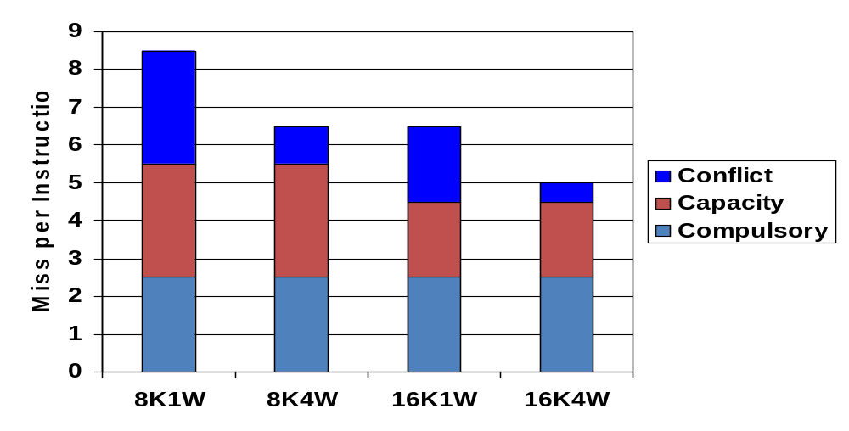
Cache Miss Rates: 3 C’s
Vary size and associativity
  Compulsory misses are constant
  Capacity and conflict misses are reduced

Slide 15
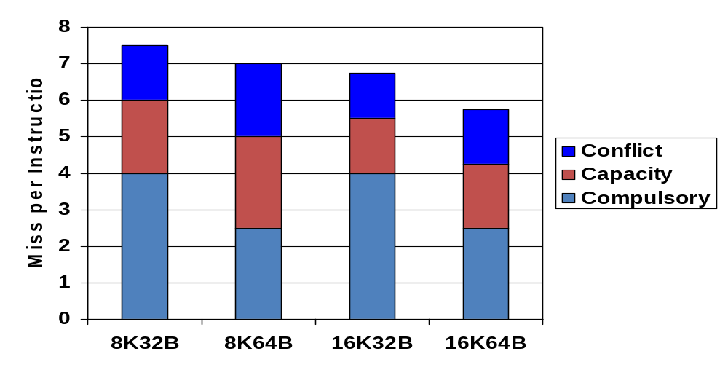
Cache Miss Rates: 3 C’s
Vary size and block size
  Compulsory misses drop with increased block size
  Capacity and conflict can increase with larger blocks

Slide 16
Cache Misses and Performance
How does this affect performance?
Performance = Time / Program
Cache organization affects cycle time
  Hit latency
Cache misses affect CPI
=
Instructions
Cycles
Time
X
X
Program
Instruction
Cycle
(code size)
(CPI)
(cycle time)

Slide 17
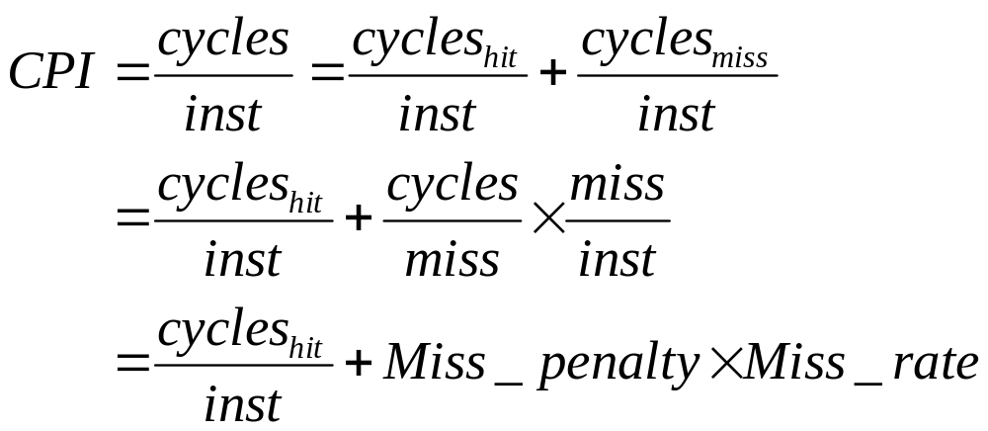
Cache Misses and CPI
Cycles spent handling misses are strictly additive
Miss_penalty is recursively defined at next level of cache hierarchy as weighted sum of hit latency and miss latency

Slide 18
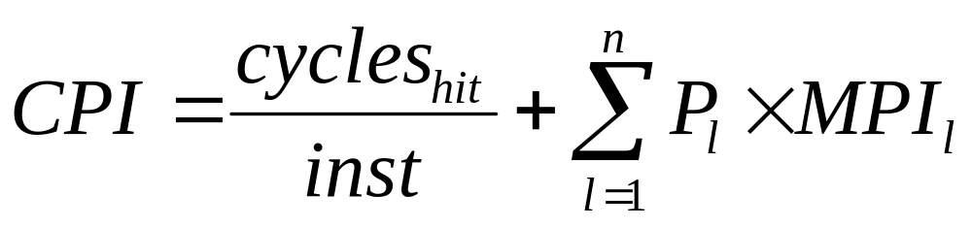
Cache Misses and CPI
P_{l} is miss penalty at each of n levels of cache
MPI_{l} is miss rate per instruction at each of n levels of cache
Miss rate specification:
  Per instruction: easy to incorporate in CPI
  Per reference: must convert to per instruction
    Local: misses per local reference
    Global: misses per ifetch or load or store

Slide 19
Cache Performance Example
Assume following:
  L1 instruction cache with 98% per instruction hit rate
  L1 data cache with 96% per instruction hit rate
  Shared L2 cache with 40% local miss rate
  L1 miss penalty of 8 cycles
  L2 miss penalty of:
    10 cycles latency to request word from memory
    2 cycles per 16B bus transfer, 4x16B = 64B block transferred
    Hence 8 cycles transfer plus 1 cycle to fill L2
    Total penalty 10+8+1 = 19 cycles

Slide 20
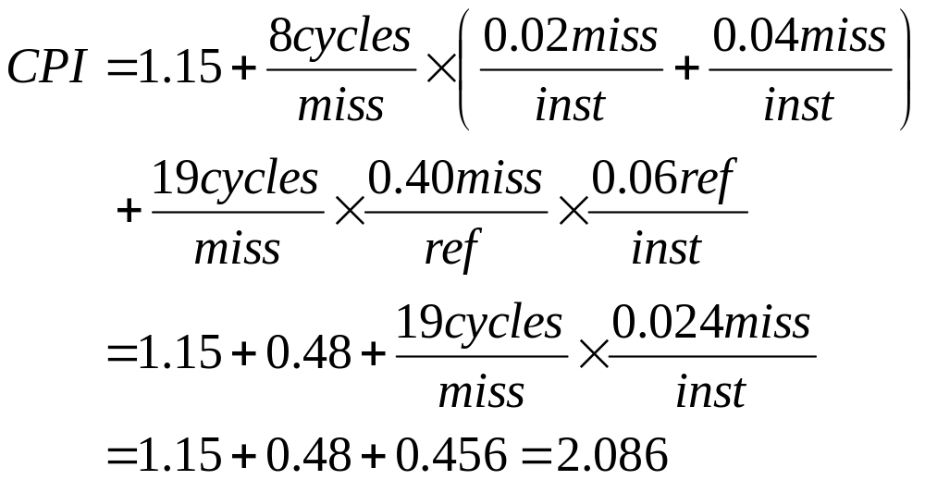
Cache Performance Example

Slide 21
Cache Misses and Performance
CPI equation
  Only holds for misses that cannot be overlapped with other activity
  Store misses often overlapped
    Place store in store queue
    Wait for miss to complete
    Perform store
    Allow subsequent instructions to continue in parallel
  Modern out-of-order processors also do this for loads
    Cache performance modeling requires detailed modeling of entire processor core

Slide 22
Cache Performance Summary
Hit latency
  Block size, associativity, number of blocks
Miss penalty
  Overhead, fetch latency, transfer, fill
Miss rate
  3 C’s: compulsory, capacity, conflict
  Determined by locality, cache organization

