Slide 1
ECE/CS 552: Virtual Memory
© Prof. Mikko Lipasti
Lecture notes based in part on slides created by Mark Hill, David Wood, Guri Sohi, John Shen and Jim Smith

Slide 2
Memory Hierarchy
CAPACITY
SPEED and COST
Registers
On-Chip
SRAM
Off-Chip
SRAM
DRAM
Disk

Slide 3
Memory Hierarchy
Temporal Locality
Keep recently referenced items at higher levels
Future references satisfied quickly
CPU
Spatial Locality
Bring neighbors of recently referenced to higher levels
Future references satisfied quickly
I & D L1 Cache
Shared L2 Cache
Main Memory
Disk

Slide 4
Four Burning Questions
These are:
  Placement
    Where can a block of memory go?
  Identification
    How do I find a block of memory?
  Replacement
    How do I make space for new blocks?
  Write Policy
    How do I propagate changes?
Consider these for registers and main memory
  Main memory usually DRAM

Slide 5
Placement
Memory Type | Placement | Comments
Registers | Anywhere; Int, FP, SPR | Compiler/programmer manages
Cache (SRAM) | Fixed in H/W | Direct-mapped, set-associative, fully-associative
DRAM | Anywhere | O/S manages
Disk | Anywhere | O/S manages

Slide 6
Register File
Registers managed by programmer/compiler
  Assign variables, temporaries to registers
  Limited name space matches available storage
  Learn more in CS536, CS701
Placement | Flexible (subject to data type)
Identification | Implicit (name == location)
Replacement | Spill code (store to stack frame)
Write policy | Write-back (store on replacement)

Slide 7
Main Memory and Virtual Memory
Use of virtual memory
  Main memory becomes another level in the memory hierarchy
  Enables programs with address space or working set that exceed physically available memory
    No need for programmer to manage overlays, etc.
    Sparse use of large address space is OK
  Allows multiple users or programs to timeshare limited amount of physical memory space and address space
Bottom line: efficient use of expensive resource, and ease of programming

Slide 8
Virtual Memory
Enables
  Use more memory than system has
  Program can think it is the only one running
    Don’t have to manage address space usage across programs
    E.g. think it always starts at address 0x0
  Memory protection
    Each program has private VA space: no-one else can clobber
  Better performance
    Start running a large program before all of it has been loaded from disk

Slide 9
Virtual Memory – Placement
Main memory managed in larger blocks
  Page size typically 4K – 16K
Fully flexible placement; fully associative
  Operating system manages placement
  Indirection through page table
  Maintain mapping between:
    Virtual address (seen by programmer)
    Physical address (seen by main memory)

Slide 10
Virtual Memory – Placement
Fully associative implies expensive lookup?
  In caches, yes: check multiple tags in parallel
In virtual memory, expensive lookup is avoided by using a level of indirection
  Lookup table or hash table
  Called a page table

Slide 11
Virtual Memory – Identification
Virtual Address | Physical Address | Dirty bit
0x20004000 | 0x2000 | Y/N
Similar to cache tag array
  Page table entry contains VA, PA, dirty bit
Virtual address:
  Matches programmer view; based on register values
  Can be the same for multiple programs sharing same system, without conflicts
Physical address:
  Invisible to programmer, managed by O/S
  Created/deleted on demand basis, can change

Slide 12
Virtual Memory – Replacement
Similar to caches:
  FIFO
  LRU; overhead too high
    Approximated with reference bit checks
    Clock algorithm
  Random
O/S decides, manages
  CS537

Slide 13
Virtual Memory – Write Policy
Write back
  Disks are too slow to write through
Page table maintains dirty bit
  Hardware must set dirty bit on first write
  O/S checks dirty bit on eviction
  Dirty pages written to backing store
    Disk write, 10+ ms

Slide 14
Virtual Memory Implementation
Caches have fixed policies, hardware FSM for control, pipeline stall
VM has very different miss penalties
  Remember disks are 10+ ms!
  Even SSDs are (at best) 1.5ms
  1.5ms is 3M processor clocks @ 2GHz
Hence engineered differently

Slide 15
Page Faults
A virtual memory miss is a page fault
  Physical memory location does not exist
  Exception is raised, save PC
  Invoke OS page fault handler
    Find a physical page (possibly evict)
    Initiate fetch from disk
  Switch to other task that is ready to run
  Interrupt when disk access complete
  Restart original instruction
Why use O/S and not hardware FSM?

Slide 16
Address Translation
VA | PA | Dirty | Ref | Protection
0x20004000 | 0x2000 | Y/N | Y/N | Read/Write/Execute
O/S and hardware communicate via PTE
How do we find a PTE?
  &PTE = PTBR + page number * sizeof(PTE)
  PTBR is private for each program
    Context switch replaces PTBR contents

Slide 17
Address Translation
Virtual Page Number
Offset
PTBR
+
D
VA
PA

Slide 18
Page Table Size
How big is page table?
  2³² / 4K * 4B = 4M per program (!)
  Much worse for 64-bit machines
To make it smaller
  Use a multi-level page table
  Use an inverted (hashed) page table

Slide 19
Multilevel Page Table
Offset
PTBR
+
+
+

Slide 20
Hashed Page Table
Use a hash table or inverted page table
  PT contains an entry for each real address
    Instead of entry for every virtual address
  Entry is found by hashing VA
  Oversize PT to reduce collisions: #PTE = 4 x (#phys. pages)

Slide 21
Hashed Page Table
Virtual Page Number
Offset
PTBR
Hash
PTE0
PTE1
PTE2
PTE3

Slide 22
High-Performance VM
VA translation
  Additional memory reference to PTE
  Each instruction fetch/load/store now 2 memory references
    Or more, with multilevel table or hash collisions
  Even if PTE are cached, still slow
Hence, use special-purpose cache for PTEs
  Called TLB (translation lookaside buffer)
  Caches PTE entries
  Exploits temporal and spatial locality (just a cache)

Slide 23
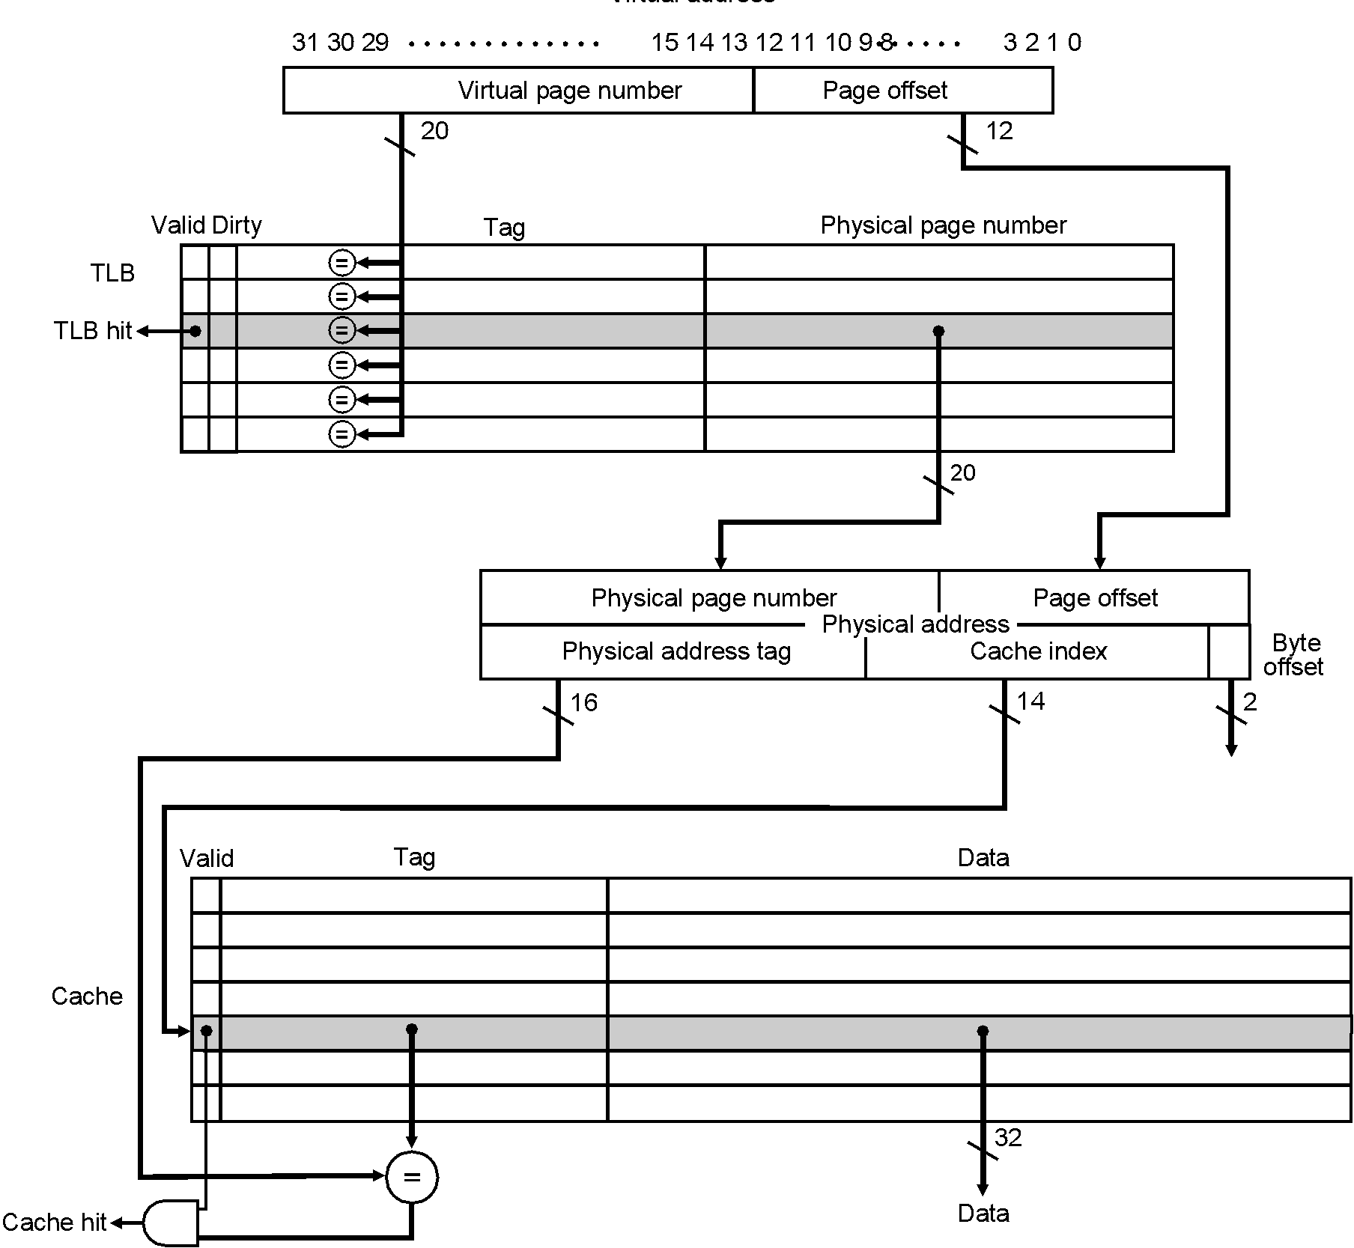
TLB

Slide 24
Virtual Memory Protection
Each process/program has private virtual address space
  Automatically protected from rogue programs
Sharing is possible, necessary, desirable
  Avoid copying, staleness issues, etc.
Sharing in a controlled manner
  Grant specific permissions
    Read
    Write
    Execute
    Any combination
  Store permissions in PTE and TLB

Slide 25
VM Sharing
Share memory locations by:
  Map shared physical location into both address spaces:
    E.g. PA 0xC00DA becomes:
      VA 0x2D000DA for process 0
      VA 0x4D000DA for process 1
  Either process can read/write shared location
However, causes synonym problem

Slide 26
VA Synonyms
Virtually-addressed caches are desirable
  No need to translate VA to PA before cache lookup
  Faster hit time, translate only on misses
However, VA synonyms cause problems
  Can end up with two copies of same physical line
Solutions:
  Flush caches/TLBs on context switch
  Extend cache tags to include PID & prevent duplicates
    Effectively a shared VA space (PID becomes part of address)

Slide 27
Summary
Memory hierarchy: Register file
  Under compiler/programmer control
  Complex register allocation algorithms to optimize utilization
Memory hierarchy: Virtual Memory
  Placement: fully flexible
  Identification: through page table
  Replacement: approximate LRU using PT reference bits
  Write policy: write-back

Slide 28
Summary
Page tables
  Forward page table
  Multilevel page table
  Inverted or hashed page table
  Also used for protection, sharing at page level
Translation Lookaside Buffer (TLB)
  Special-purpose cache for PTEs

