Slide 1
ECE/CS 552: Pipelining
© Prof. Mikko Lipasti
Lecture notes based in part on slides created by Mark Hill, David Wood, Guri Sohi, John Shen and Jim Smith

Slide 2
Pipelining
Motivation
Datapath
Control

Slide 3
Single Cycle Performance
Instructions
Cycles
Time
X
X
Program
Instruction
Cycle
(code size)
(CPI)
(cycle time)
Single cycle implementation
  CPI = 1
  Cycle = imem + RFrd + ALU + dmem + RFwr + muxes + control
  E.g. 500+250+500+500+250+0+0 = 2000ps
  Time/program = IPP x 1 CPI x 2ns = IPP x 2ns

Slide 4
Multicycle Performance
Multicycle implementation:
Cycle: Instr: | 1 | 2 | 3 | 4 | 5 | 6 | 7 | 8 | 9 | 10 | 11 | 12 | 13
i | F | D | X | M | W
i+1 |  |  |  |  |  | F | D | X
i+2 |  |  |  |  |  |  |  |  | F | D | X | M
i+3 |  |  |  |  |  |  |  |  |  |  |  |  | F
i+4

Slide 5
Multicycle Performance
Multicycle implementation
  CPI = 3, 4, 5
  Cycle = max(memory, RF, ALU, mux, control)
  = max(500,250,500) = 500ps
  Time/prog = IPP x 4 x 500 = IPP x 500ps = IPP x 0.5ns
Would like:
  CPI = 1 + overhead from hazards (later)
  Cycle = 500ps + overhead
  In practice, ~3x improvement

Slide 6
Latency vs. Throughput
Instruction latency = 5 cycles
Instruction throughput = 1/5 instr/cycle
CPI = 5 cycles per instruction
Instead
  Pipelining: process instructions like a lunch buffet
  ALL microprocessors use it
    E.g. Intel Core i7, AMD Jaguar, ARM A9

Slide 7
Instruction Throughput
Instruction Latency = 5 cycles (same)
Instruction throughput = 1 instr/cycle
CPI = 1 cycle per instruction
CPI = cycle between instruction completion = 1

Slide 8
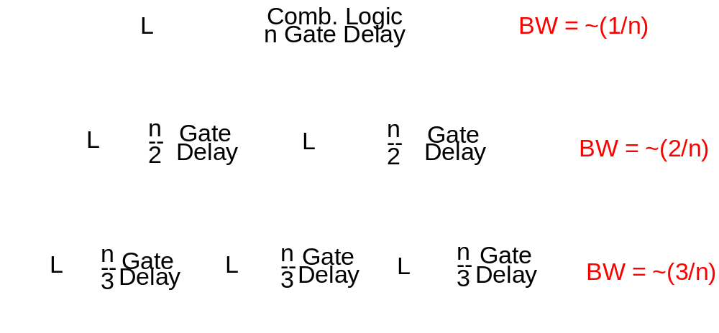
Ideal Pipelining
Bandwidth increases linearly with pipeline depth
Latency increases by latch delays

Slide 9
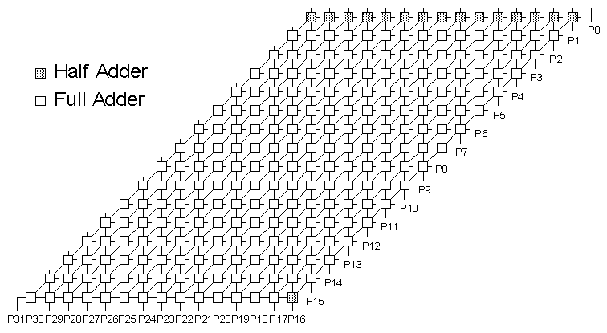
Example: Integer Multiplier
m_{i+7}
m_{i}
m_{i+6}
m_{i+5}
m_{i+4}
m_{i+1}
m_{i+2}
m_{i+3}
[Source: J. Hayes, Univ. of Michigan]
16x16 combinational multiplier
  ISCAS-85 C6288 standard benchmark
Tools: Synopsys DC/LSI Logic 110nm gflxp ASIC

Slide 10
Example: Integer Multiplier
Configuration | Delay | MPS | Area (FF/wiring) | Area Increase
Combinational | 3.52ns | 284 | 7535 (--/1759)
2 Stages | 1.87ns | 534 (1.9x) | 8725 (1078/1870) | 16%
4 Stages | 1.17ns | 855 (3.0x) | 11276 (3388/2112) | 50%
8 Stages | 0.80ns | 1250 (4.4x) | 17127 (8938/2612) | 127%
Pipeline efficiency
  2-stage: nearly double throughput; marginal area cost
  4-stage: 75% efficiency; area still reasonable
  8-stage: 55% efficiency; area more than doubles
Tools: Synopsys DC/LSI Logic 110nm gflxp ASIC

Slide 11
Ideal Pipelining
Cycle: Instr: | 1 | 2 | 3 | 4 | 5 | 6 | 7 | 8 | 9 | 10 | 11 | 12 | 13
i | F | D | X | M | W
i+1 |  | F | D | X | M | W
i+2 |  |  | F | D | X | M | W
i+3 |  |  |  | F | D | X | M | W
i+4 |  |  |  |  | F | D | X | M | W

Slide 12
Pipelining Idealisms
Uniform subcomputations
  Can pipeline into stages with equal delay
Identical computations
  Can fill pipeline with identical work
Independent computations
  No relationships between work units
  No dependences, hence no pipeline hazards
Can we guarantee these conditions all the time?
  No, but can get close enough to get significant speedup

Slide 13
Complications
Datapath
  Five (or more) instructions in flight
Control
  Must correspond to multiple instructions
Instructions may have
  data and control flow dependences
  I.e. units of work are not independent
    One may have to stall and wait for another

Slide 14
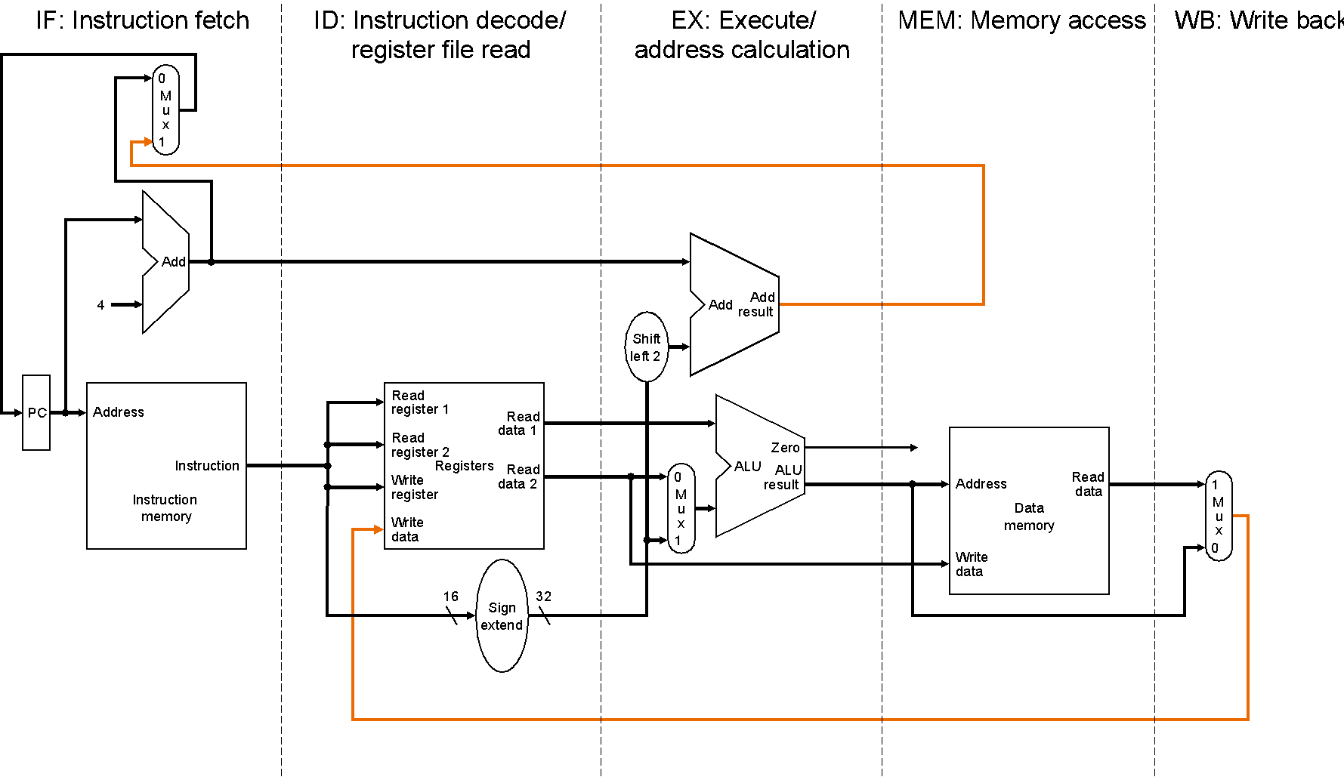
Datapath

Slide 15
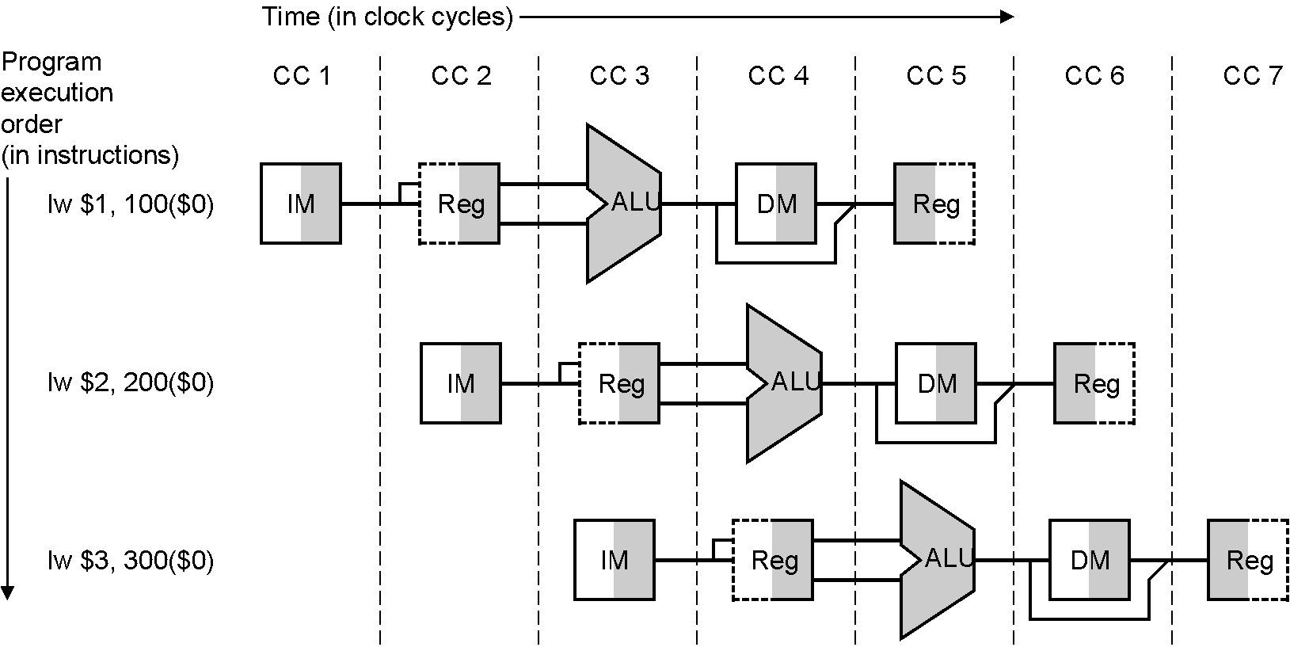
Datapath

Slide 16
Control
Control
  Concurrently set by 5 different instructions
  Divide and conquer: carry IR down the pipe

Slide 17
Pipelined Datapath
Start with single-cycle datapath
Pipelined execution
  Assume each instruction has its own datapath
  But each instruction uses a different part in every cycle
  Multiplex all on to one datapath
  Latches/flip-flops separate cycles (like multicycle)
Ignore dependences and hazards for now
  Data
  control

Slide 18
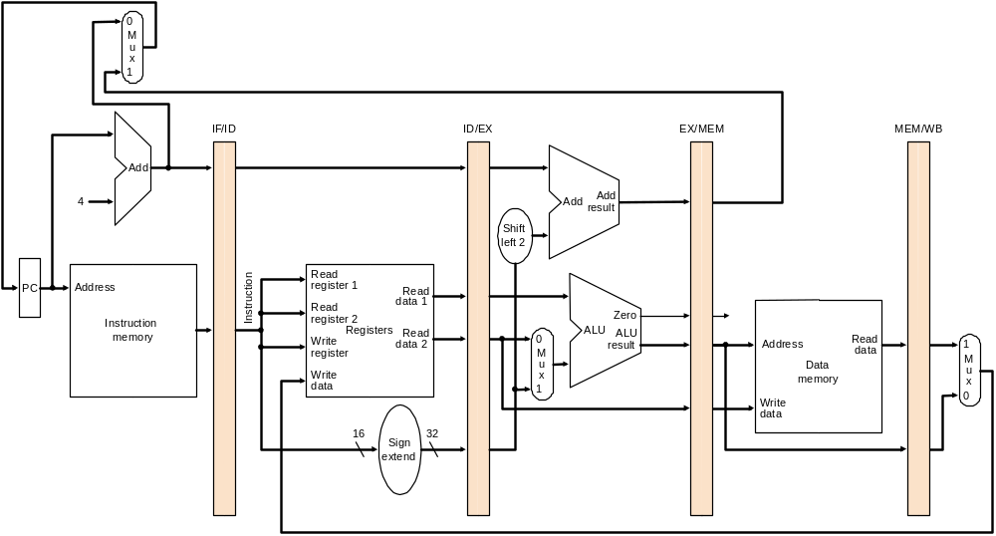
Pipelined Datapath
add
load

Slide 19
Pipelined Datapath
add
load

Slide 20
Pipelined Datapath
Instruction flow
  add and load shown, work through beq, st, …
  2 instructions in 6 cycles
  n instructions in n+1 cycles, for large n CPI ~ 1
Any info needed by a later stage gets passed down the pipeline
  E.g. store value through EX

Slide 21
Pipelined Control
IF and ID
  None in IF
  Implicit in ID, decoded from instruction word stored in IF/ID latch
EX
  ALUop, ALUsrc, RegDst
MEM
  Branch, MemRead, MemWrite
WB
  MemtoReg, RegWrite

Slide 22
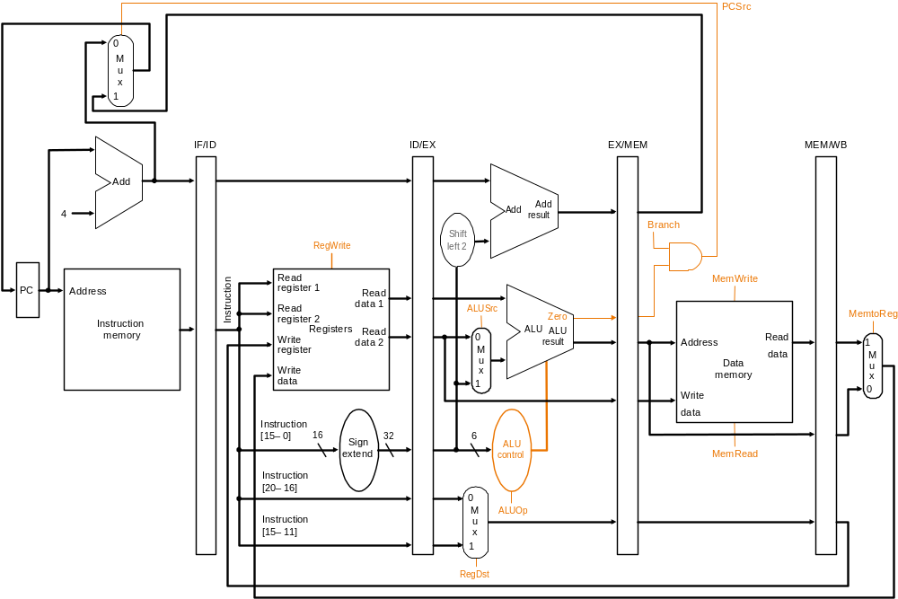
Datapath Control Signals

Slide 23
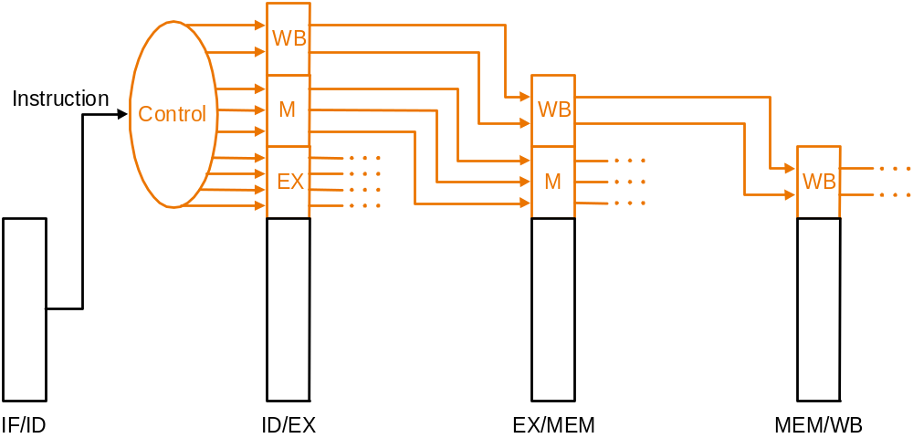
Pipelined Control

Slide 24
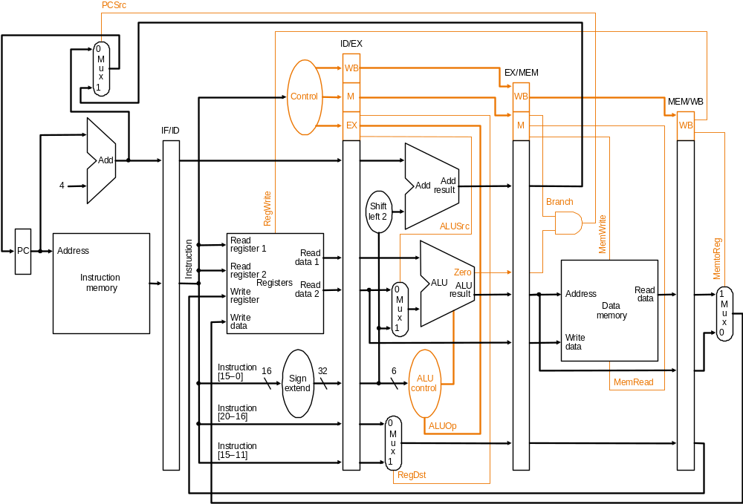
All Together

Slide 25
Pipelined Control
Controlled by different instructions
Decode instructions and pass the signals down the pipe
Control sequencing is embedded in the pipeline
  No explicit FSM
  Instead, distributed FSM (hard to verify)

Slide 26
Summary
Motivation
Datapath
Control
Next
  Program dependences
  Pipeline hazards

