Slide 1
ECE/CS 552: Pipeline Hazards
© Prof. Mikko Lipasti
Lecture notes based in part on slides created by Mark Hill, David Wood, Guri Sohi, John Shen and Jim Smith

Slide 2
Pipeline Hazards
Forecast
  Program Dependences
  Data Hazards
    Stalls
    Forwarding
  Control Hazards
  Exceptions

Slide 3
Sequential Execution Model
MIPS ISA requires the appearance of sequential execution
  Precise exceptions
  True of most general purpose ISAs

Slide 4
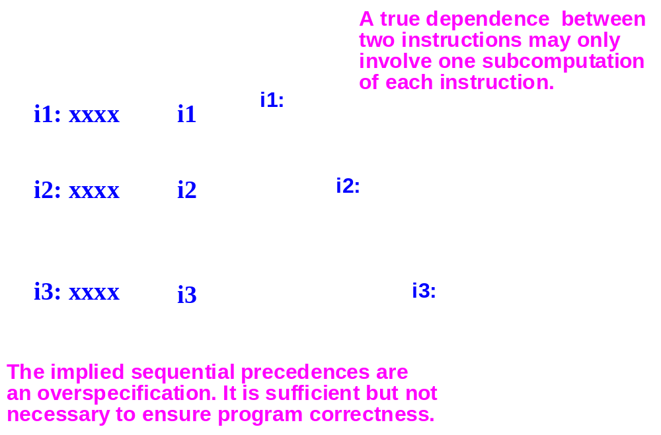
Program Dependences

Slide 5
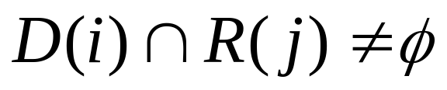
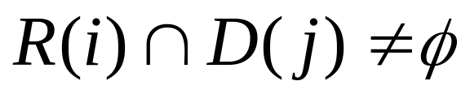
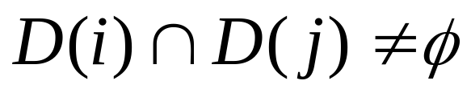
Program Data Dependences
True dependence (RAW)
  j cannot execute until i produces its result
Anti-dependence (WAR)
  j cannot write its result until i has read its sources
Output dependence (WAW)
  j cannot write its result until i has written its result

Slide 6
Control Dependences
Conditional branches
  Branch must execute to determine which instruction to fetch next
  Instructions following a conditional branch are control dependent on the branch instruction

Slide 7
Example (quicksort/MIPS)
    # for (; (j < high) && (array[j] < array[low]) ; ++j );
    # $10 = j
    # $9 = high
    # $6 = array
    # $8 = low
    bge done, $10, $9
    mul $15, $10, 4
    addu $24, $6, $15
    lw $25, 0($24)
    mul $13, $8, 4
    addu $14, $6, $13
    lw $15, 0($14)
    bge done, $25, $15
    cont:
    addu $10, $10, 1
    . . .
    done:
    addu $11, $11, -1

Slide 8
Pipeline Hazards
Pipeline hazards
  Potential violations of program dependences
  Must ensure program dependences are not violated
Hazard resolution
  Static: compiler/programmer guarantees correctness
  Dynamic: hardware performs checks at runtime
Pipeline interlock
  Hardware mechanism for dynamic hazard resolution
  Must detect and enforce dependences at runtime

Slide 9
Pipeline Hazards
Necessary conditions:
  WAR: write stage earlier than read stage
    Is this possible in IF-RD-EX-MEM-WB ?
  WAW: write stage earlier than write stage
    Is this possible in IF-RD-EX-MEM-WB ?
  RAW: read stage earlier than write stage
    Is this possible in IF-RD-EX-MEM-WB?
If conditions not met, no need to resolve
Check for both register and memory

Slide 10
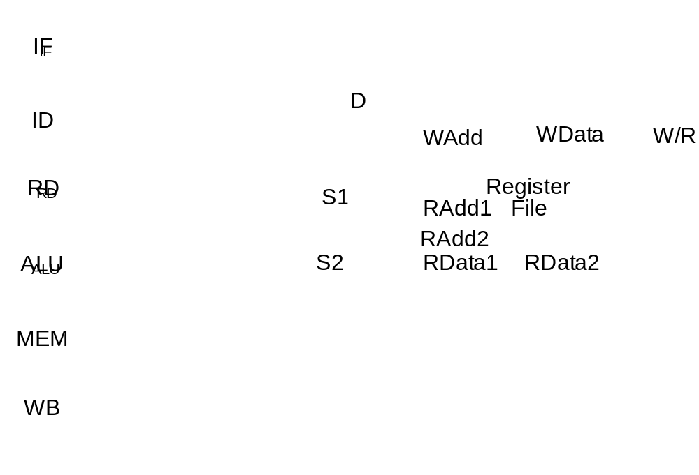
Pipeline Hazard Analysis
WAR: write stage earlier than read?
WAW: write stage earlier than write?
RAW: read stage earlier than write?
Memory hazards
  WAR: Yes/No?
  WAW: Yes/No?
  RAW: Yes/No?
Register hazards
  WAR: Yes/No?
  WAW: Yes/No?
  RAW: Yes/No?

Slide 11
RAW Hazard
Earlier instruction produces a value used by a later instruction:
  add $1, $2, $3
  sub $4, $5, $1
Cycle: Instr: | 1 | 2 | 3 | 4 | 5 | 6 | 7 | 8 | 9 | 10 | 11 | 12 | 13
add | F | D | X | M | W
sub |  | F | D | X | M | W

Slide 12
RAW Hazard - Stall
Detect dependence and stall:
  add $1, $2, $3
  sub $4, $5, $1
Cycle: Instr: | 1 | 2 | 3 | 4 | 5 | 6 | 7 | 8 | 9 | 10 | 11 | 12 | 13
add | F | D | X | M | W
sub |  |  |  |  |  | F | D | X | M | W

Slide 13
Control Dependence
One instruction affects which executes next
  sw $4, 0($5)
  bne $2, $3, loop
  sub $6, $7, $8
Cycle: Instr: | 1 | 2 | 3 | 4 | 5 | 6 | 7 | 8 | 9 | 10 | 11 | 12 | 13
sw | F | D | X | M | W
bne |  | F | D | X | M | W
sub |  |  | F | D | X | M | W

Slide 14
Control Dependence - Stall
Detect dependence and stall
  sw $4, 0($5)
  bne $2, $3, loop
  sub $6, $7, $8
Cycle: Instr: | 1 | 2 | 3 | 4 | 5 | 6 | 7 | 8 | 9 | 10 | 11 | 12 | 13
sw | F | D | X | M | W
bne |  | F | D | X | M | W
sub |  |  |  |  | F | D | X | M | W

Slide 15
Pipelined Control
Controlled by different instructions
Decode instructions and pass the signals down the pipe
Control sequencing is embedded in the pipeline
  No explicit FSM
  Instead, distributed FSM

Slide 16
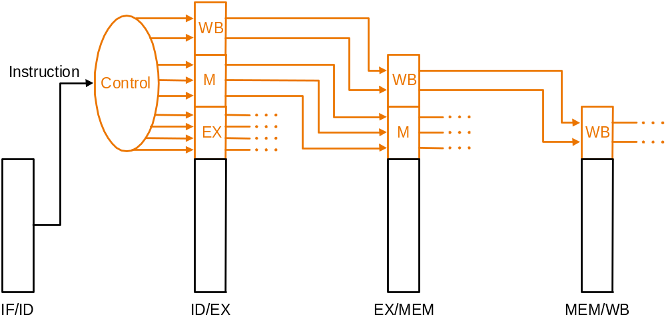
Pipelined Control

Slide 17
RAW Hazards
Must first detect RAW hazards
  Pipeline analysis proves that WAR/WAW don’t occur
ID/EX.WriteRegister = IF/ID.ReadRegister1
ID/EX.WriteRegister = IF/ID.ReadRegister2
EX/MEM.WriteRegister = IF/ID.ReadRegister1
EX/MEM.WriteRegister = IF/ID.ReadRegister2
MEM/WB.WriteRegister = IF/ID.ReadRegister1
MEM/WB.WriteRegister = IF/ID.ReadRegister2

Slide 18
RAW Hazards
Not all hazards because
  WriteRegister not used (e.g. sw)
  ReadRegister not used (e.g. addi, jump)
  Do something only if necessary

Slide 19
RAW Hazards
Hazard Detection Unit
  Several 5-bit comparators
Response? Stall pipeline
  Instructions in IF and ID stay
  IF/ID pipeline latch not updated
  Send ‘nop’ down pipeline (called a bubble)
  PCWrite, IF/IDWrite, and nop mux

Slide 20
RAW Hazard Forwarding
A better response – forwarding
  Also called bypassing
Comparators ensure register is read after it is written
Instead of stalling until write occurs
  Use mux to select forwarded value rather than register value
  Control mux with hazard detection logic

Slide 21
Forwarding Paths
(ALU instructions)
IF
ID
RD
i+1:
R1
i+2:
R1
i+3:
R1
c
b
a
ALU
i: R1
R1
i+2:
R1
i+1:
ALU
MEM
i: R1
i+1:
FORWARDING
PATHS
i: R1
WB
(i i+1)
(i i+2)
(i i+3)
Forwarding
Forwarding
i writes R1
via Path a
via Path b
before i+3
reads R1
Notes:
USPTO -- Basic Modern Processor Design
© 2005 Mikko Lipasti
Path c is not needed if “write-before-read” register file (write occurs in first phase of clock cycle, read in second phase).

Slide 22
Write before Read RF
Register file design
  2-phase clocks common
  Write RF on first phase
  Read RF on second phase
Hence, same cycle:
  Write $1
  Read $1
No bypass needed
  If read before write or DFF-based, need bypass

Slide 23
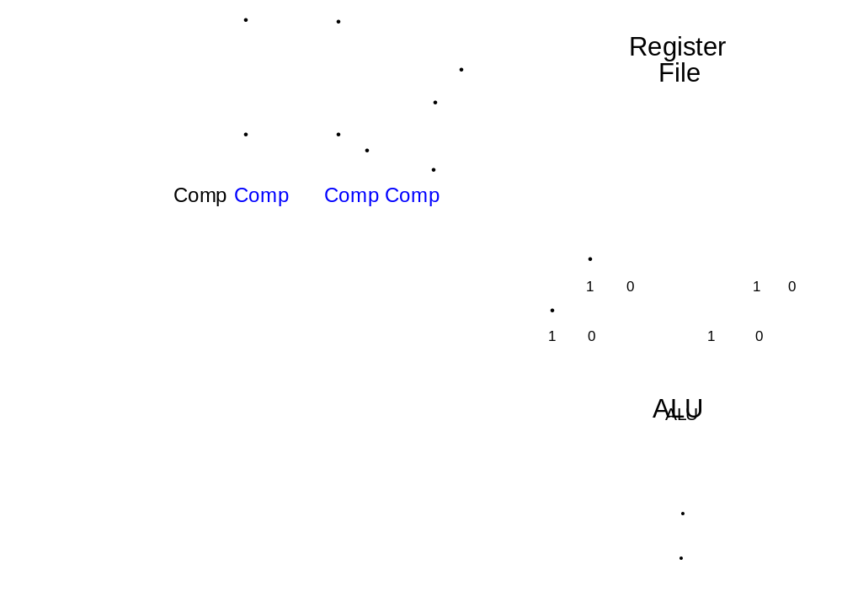
ALU Forwarding
Notes:
USPTO -- Basic Modern Processor Design
© 2005 Mikko Lipasti
Note “priority ordering” of muxes→must select matching operand from nearest instruction (i.e. choose ALU output over MEM output)

Slide 24
Forwarding Paths
(Load instructions)
IF
ID
RD
i+1:
R1
R1
i+1:
R1
i+2:
e
d
ALU
LOAD
i:R1
MEM[]
i+1:
R1
FORWARDING
PATH(s)
MEM
i:R1
MEM[]
WB
i:R1
MEM[]
(i i+1)
(i i+1)
(i i+2)
Stall i+1
Forwarding
i writes R1
before i+2
via Path d
reads R1
Notes:
USPTO -- Basic Modern Processor Design
© 2005 Mikko Lipasti
Why is (d) different from (b) two slides back? Logically, it is the same forwarding path. Physically it is (probably) different, since cache output is “far away” from ALU output.

Slide 25
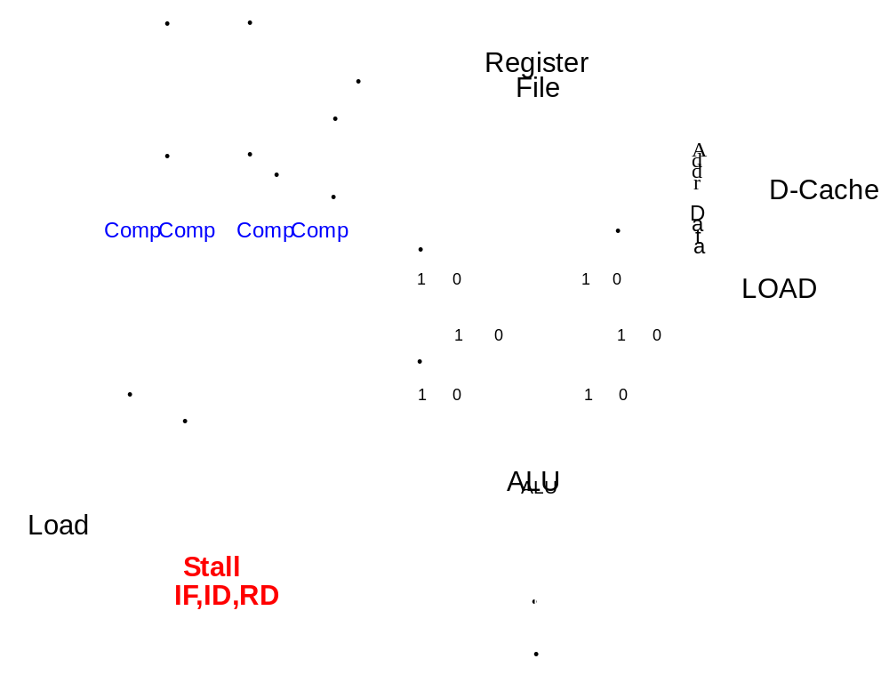
Implementation of Load Forwarding

Slide 26
Control Flow Hazards
Control flow instructions
  branches, jumps, jals, returns
  Can’t fetch until branch outcome known
  Too late for next IF

Slide 27
Control Flow Hazards
What to do?
  Always stall
  Easy to implement
  Performs poorly
  1/6th instructions are branches
    each branch takes 3 cycles
  CPI = 1 + 3 x 1/6 = 1.5 (lower bound)

Slide 28
Control Flow Hazards
Predict branch not taken
Send sequential instructions down pipeline
Kill instructions later if incorrect
Must stop memory accesses and RF writes
Late flush of instructions on misprediction
  Complex
  Global signal (wire delay)

Slide 29
Control Flow Hazards
Even better but more complex
  Predict taken
  Predict both (eager execution)
  Predict one or the other dynamically
    Adapt to program branch patterns
    Lots of chip real estate these days
      Core i7, ARM A15
    Current research topic
  More later, covered in detail in ECE752

Slide 30
Control Flow Hazards
Another option: delayed branches
  Always execute following instruction
  “delay slot” (later example on MIPS pipeline)
  Put useful instruction there, otherwise ‘nop’
A mistake to cement this into ISA
  Just a stopgap (one cycle, one instruction)
  Superscalar processors (later)
    Delay slot just gets in the way

Slide 31
Exceptions and Pipelining
add $1, $2, $3 overflows
A surprise branch
  Earlier instructions flow to completion
  Kill later instructions
  Save PC in EPC, set PC to EX handler, etc.
Costs a lot of designer sanity
  554 teams that try this sometimes fail

Slide 32
Exceptions
Even worse: in one cycle
  I/O interrupt
  User trap to OS (EX)
  Illegal instruction (ID)
  Arithmetic overflow
  Hardware error
  Etc.
Interrupt priorities must be supported

Slide 33
Pipeline Hazards
Program Dependences
Data Hazards
  Stalls
  Forwarding
Control Hazards
Exceptions

