Slide 1
Unit 9 Neural Networks
EE-UY 4563/EL-GY 9123: Introduction to machine learning
Prof. Sundeep rangan

Slide 2
Learning Objectives
Mathematically describe a neural network with a single hidden layer
Describe mappings for the hidden and output units
Manually compute output regions for very simple networks
Select the loss function based on the problem type
Build and train a simple neural network in Keras
Write the formulas for gradients using backpropagation
Describe mini-batches in stochastic gradient descent

Slide 3
Outline
Motivating Idea: Nonlinear classifiers from linear features
Neural Networks
Neural Network Loss Function
Stochastic Gradient Descent
Building and Training a Network in Keras
Synthetic data
In-class exercise
MNIST
Backpropagation Training

Slide 4
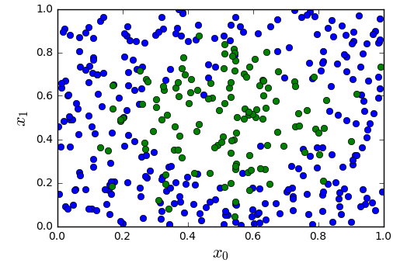
Most Datasets are not Linearly Separable
Consider simple synthetic data
See figure to the left
2D features
Binary class label
Not separated linearly
All code in https://github.com/sdrangan/introml/blob/master/neural/synthetic.ipynb

Slide 5
From Linear to Nonlinear
Idea: Build nonlinear region from linear decisions
Possible form for a classifier:
Step 1: Classify into small number of linear regions
Step 2: Predict class label from step 1 decisions

Slide 6
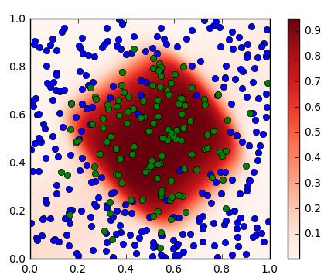
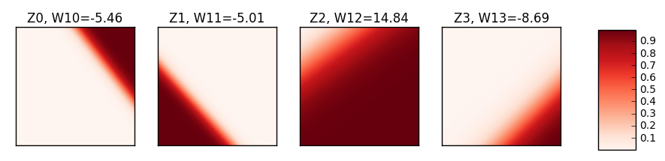


Step 1 Outputs and Step 2 Outputs
$$x_{1}$$
$$x_{0}$$
Each output from step 1 is from a linear classifier with soft decision
Similar to logistic regression
Final output is a weighted average of step 1 outputs using the weights
Weights are indicated on top of the figures

Slide 7
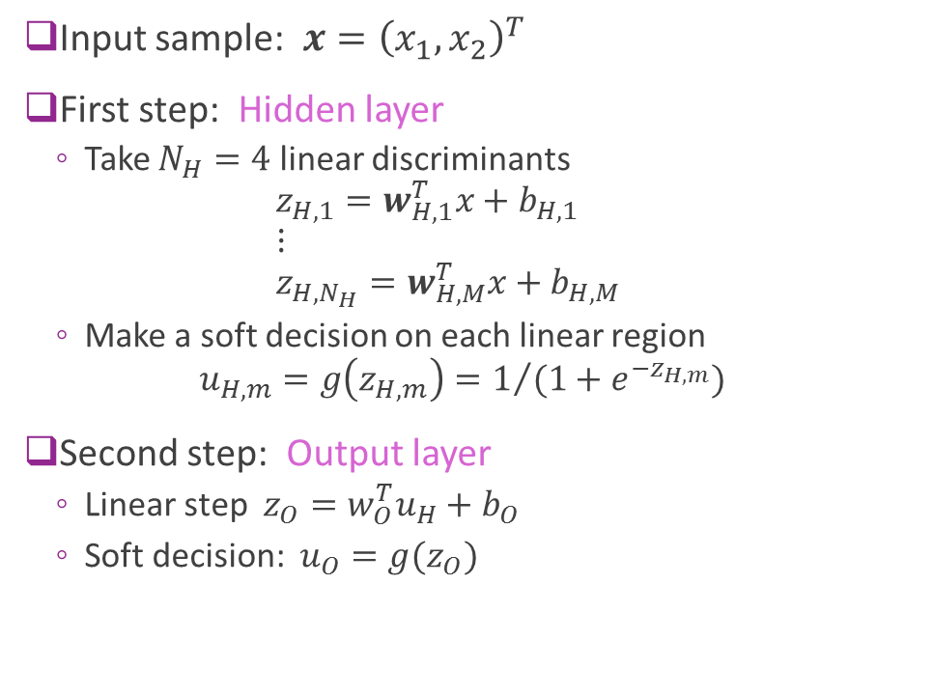
A Possible Two Stage Classifier
Input sample: $x={\left(x_{1},x_{2}\right)}^{T}$
First step: Hidden layer
Take $N_{H}=4$ linear discriminants $z_{H,1}=w_{H,1}^{T}x+b_{H,1}$ $⋮$ $z_{H,N_{H}}=w_{H,M}^{T}x+b_{H,M}$
Make a soft decision on each linear region $u_{H,m}=g\left(z_{H,m}\right)=1/{(1+e^{−z_{H,m}})}$
Second step: Output layer
Linear step $z_{O}=w_{O}^{T}u_{H}+b_{O}$
Soft decision: $u_{O}=g(z_{O})$

Slide 8

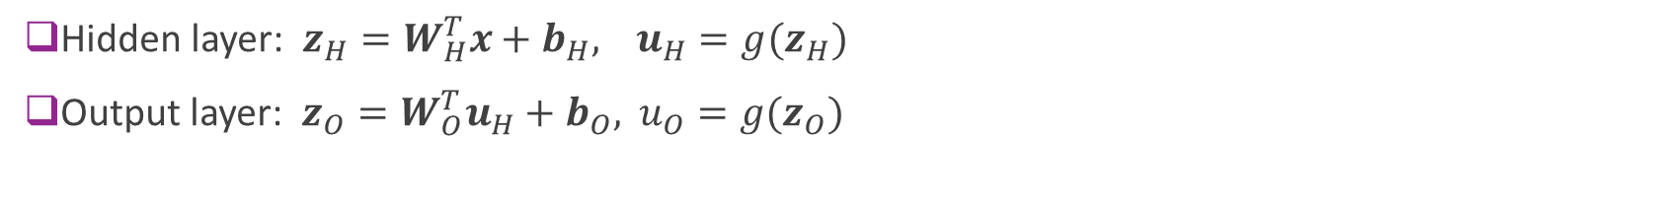

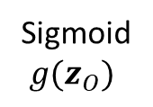
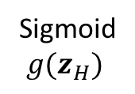

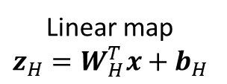


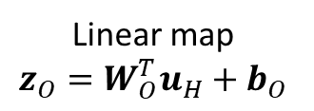
Model Block Diagram
Hidden layer: $z_{H}=W_{H}^{T}x+b_{H},$ $u_{H}=g(z_{H})$
Output layer: $z_{O}=W_{O}^{T}u_{H}+b_{O},$ $u_{O}=g(z_{O})$
Linear map $$z_{H}=W_{H}^{T}x+b_{H}$$
Sigmoid $g(z_{H})$
Linear map $$z_{O}=W_{O}^{T}u_{H}+b_{O}$$
Sigmoid $g(z_{O})$
$$z_{O}$$
$$u_{O}$$
$$x$$
Soft binary decision
Input
$$z_{H}$$
$$u_{H}$$
Hidden layer
Output layer

Slide 9
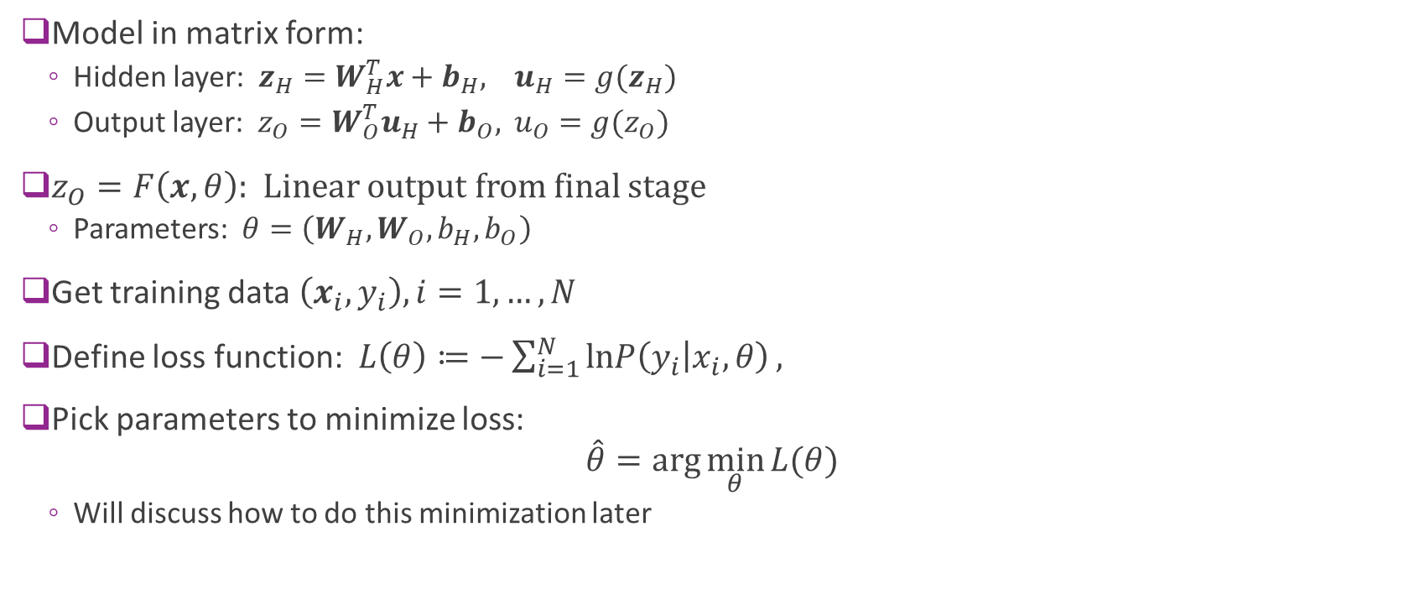
Training the Model
Model in matrix form:
Hidden layer: $z_{H}=W_{H}^{T}x+b_{H},$ $u_{H}=g(z_{H})$
Output layer: $z_{O}=W_{O}^{T}u_{H}+b_{O},$ $u_{O}=g(z_{O})$
$z_{O}=F\left(x,θ\right)$: Linear output from final stage
Parameters: $θ=\left(W_{H},W_{O},b_{H},b_{O}\right)$
Get training data $\left(x_{i},y_{i}\right), i=1,…,N$
Define loss function: $L\left(θ\right)≔−\sum_{i=1}^{N}{lnP\left(y_{i} | x_{i},θ\right)},$
Pick parameters to minimize loss: $\hat{θ}=\arg{\min_{θ}{L(θ)}}$
Will discuss how to do this minimization later

Slide 10



Results
Neural network finds a nonlinear region
Plot shows:
Blue circles: Negative samples
Greed circles: Positive samples
Red color: Classifier soft probability $g(z_{O})$
$$x_{1}$$
$$x_{0}$$

Slide 11
Hidden Layer outputs and final outputs
$$x_{1}$$
$$x_{0}$$
Each hidden node is a linear classifier with soft decision (Logistic regression)
Final output is a weighted average of step 1 outputs using the weights indicated on top of the figures

Slide 12
Outline
Motivating Idea: Nonlinear classifiers from linear features
Neural Networks
Neural Network Loss Function
Stochastic Gradient Descent
Building and Training a Network in Keras
Synthetic data
MNIST
Backpropagation Training

Slide 13
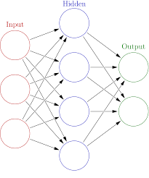
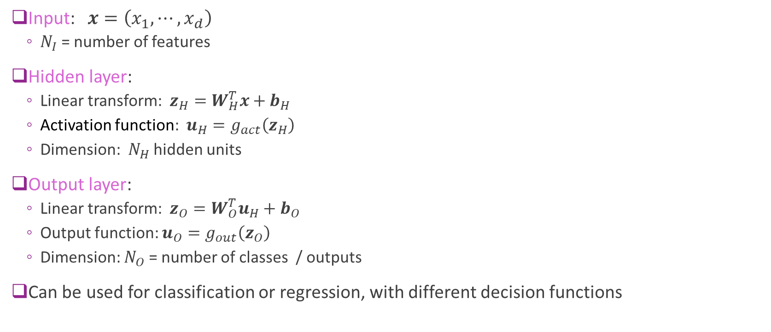
General Structure
Input: $x=\left(x_{1},⋯,x_{d}\right)$
$N_{I}$ = number of features
Hidden layer:
Linear transform: $z_{H}=W_{H}^{T}x+b_{H}$
Activation function: $u_{H}=g_{act}\left(z_{H}\right)$
Dimension: $N_{H}$ hidden units
Output layer:
Linear transform: $z_{O}=W_{O}^{T}u_{H}+b_{O}$
Output function: $u_{O}=g_{out}\left(z_{O}\right)$
Dimension: $N_{O}$ = number of classes / outputs
Can be used for classification or regression, with different decision functions

Slide 14

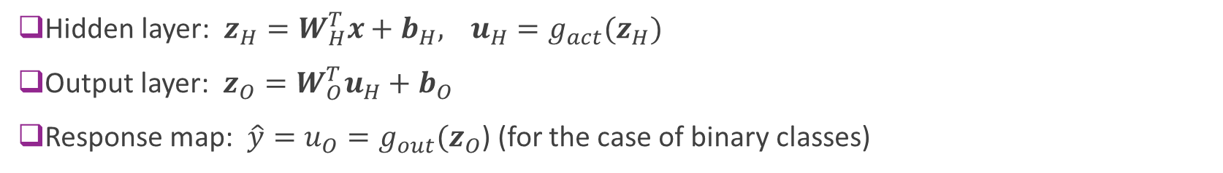

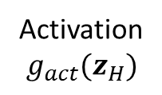

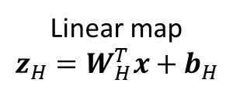


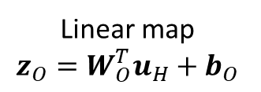
General Neural Net Block Diagram
Hidden layer: $z_{H}=W_{H}^{T}x+b_{H},$ $u_{H}=g_{act}(z_{H})$
Output layer: $z_{O}=W_{O}^{T}u_{H}+b_{O}$
Response map: $\hat{y}={u_{O}=g}_{out}(z_{O}$) (for the case of binary classes)
Linear map $$z_{H}=W_{H}^{T}x+b_{H}$$
Activation $g_{act}(z_{H})$
Linear map $$z_{O}=W_{O}^{T}u_{H}+b_{O}$$
Response map
$\hat{y}=u_{O}=g_{out}(z_{O}$)
$$x$$
$$z_{O}$$
Input
$$z_{H}$$
$$u_{H}$$
Hidden layer
Output layer

Slide 15
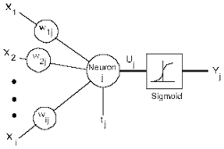




Terminology
Hidden variables: the variables $z_{H},u_{H}$
These are not directly observed
Hidden units: The functions that compute:
$z_{H,i}=\sum_{j}{W_{H,ji}x_{j}+b_{H,i}}, u_{H,i}=g(z_{H,i})$
The function $g(z)$ called the activation function
Output units: The functions that compute
$z_{O,i}=\sum_{j}{W_{O,ji}u_{H,j}+b_{O,i}}$
$$z_{H,i}$$
$$u_{H,i}$$
$$b_{H,i}$$

Slide 16
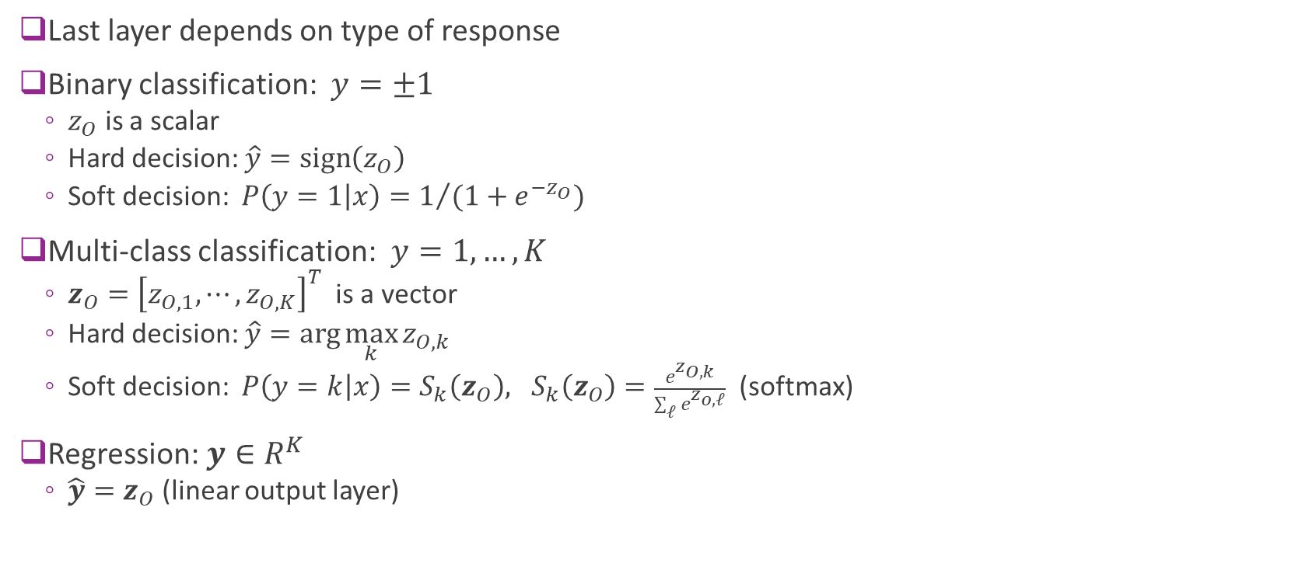
Response Map or Output Activation
Last layer depends on type of response
Binary classification: $y=±1$
$z_{O}$ is a scalar
Hard decision: $\hat{y}=\text{sign}\left(z_{O}\right)$
Soft decision: $P\left(y=1 | x\right)=1/{(1+e^{−z_{O}})}$
Multi-class classification: $y=1,…,K$
$z_{O}={\left[z_{O,1},⋯,z_{O,K}\right]}^{T}$ is a vector
Hard decision: $\hat{y}=\arg{\max_{k}{z_{O,k}}}$
Soft decision: $P\left(y=k | x\right)=S_{k}\left(z_{O}\right), S_{k}\left(z_{O}\right)=\frac{e^{z_{O,k}}}{\sum_{ℓ}{e^{z_{o,ℓ}}}}$ (softmax)
Regression: $y∈R^{K}$
$\hat{y}=z_{O}$ (linear output layer)

Slide 17
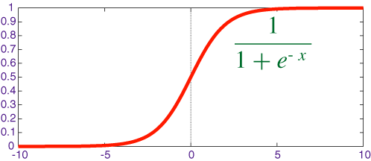
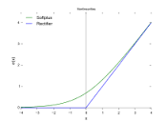

Hidden Activation Function
Two common activation functions
Sigmoid:
$g_{act}\left(z\right)=1/{(1+e^{−z} )}$
Benefits: Values are bounded
Often used for small networks
Rectified linear unit (ReLU):
$g_{act}\left(z\right)=max⁡(0,z)$
Can add sparsity (more on this later)
Often used for larger networks
Esp. in combination with dropout

Slide 18
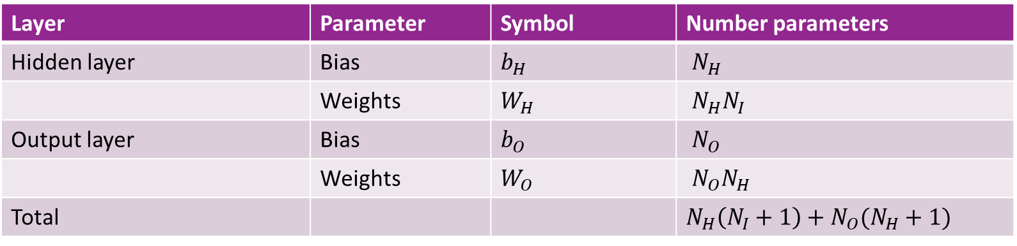
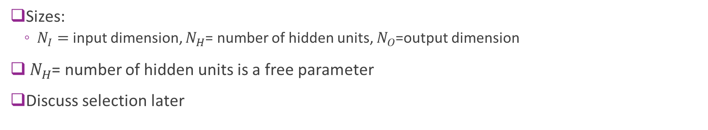
Number of Parameters
Layer | Parameter | Symbol | Number parameters
Hidden layer | Bias | $b_{H}$ | $N_{H}$
 | Weights | $W_{H}$ | $N_{H}N_{I}$
Output layer | Bias | $b_{O}$ | $N_{O}$
 | Weights | $W_{O}$ | $N_{O}N_{H}$
Total |  |  | $N_{H}\left(N_{I}+1\right)+N_{O}(N_{H}+1)$
Sizes:
$N_{I}=$ input dimension, $N_{H}$= number of hidden units, $N_{O}$=output dimension
$N_{H}$= number of hidden units is a free parameter
Discuss selection later

Slide 19
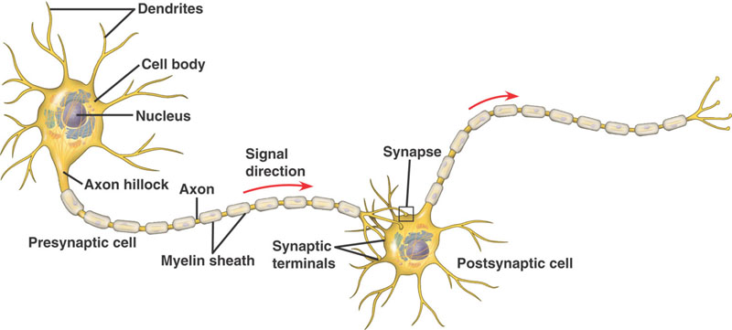
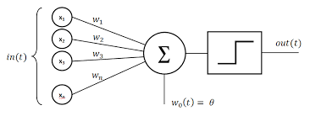
Inspiration from Biology
Simple model of neurons
Dendrites: Input currents from other neurons
Soma: Cell body, accumulation of charge
Axon: Outputs to other neurons
Synapse: Junction between neurons
Operation:
Take weighted sum of input current
Outputs when sum reaches a threshold
Each neuron is like one unit in neural network

Slide 20

History
Interest in understanding the brain for thousands of years
1940s: Donald Hebb. Hebbian learning for neural plasticity
Hypothesized rule for updating synaptic weights in biological neurons
1950s: Frank Rosenblatt: Coined the term perceptron
Essentially single layer classifier, similar to logistic classification
Early computer implementations
But, Limitations of linear classifiers and computer power
1960s: Backpropagation: Efficient way to train multi-layer networks
More on this later
1980s: Resurgence with greater computational power
2005+: Deep networks
Many more layers. Increased computational power and data
Enabled first breakthroughs in various image and text processing.
Next lecture

Slide 21
Outline
Motivating Idea: Nonlinear classifiers from linear features
Neural Networks
Neural Network Loss Function
Stochastic Gradient Descent
Building and Training a Network in Keras
Synthetic data
MNIST
Backpropagation Training

Slide 22

Training a Neural Network
Given data: $\left(x_{i},y_{i}\right), i=1,…,N$
Learn parameters: $θ=(W_{H},b_{H},W_{o},b_{o})$
Weights and biases for hidden and output layers
Will minimize a loss function: $L\left(θ\right)$ $\hat{θ}=\arg{\min_{θ}{L\left(θ\right)}}$
$L\left(θ\right)$ = measures how well parameters $θ$ fit training data $\left(x_{i},y_{i}\right)$

Slide 23
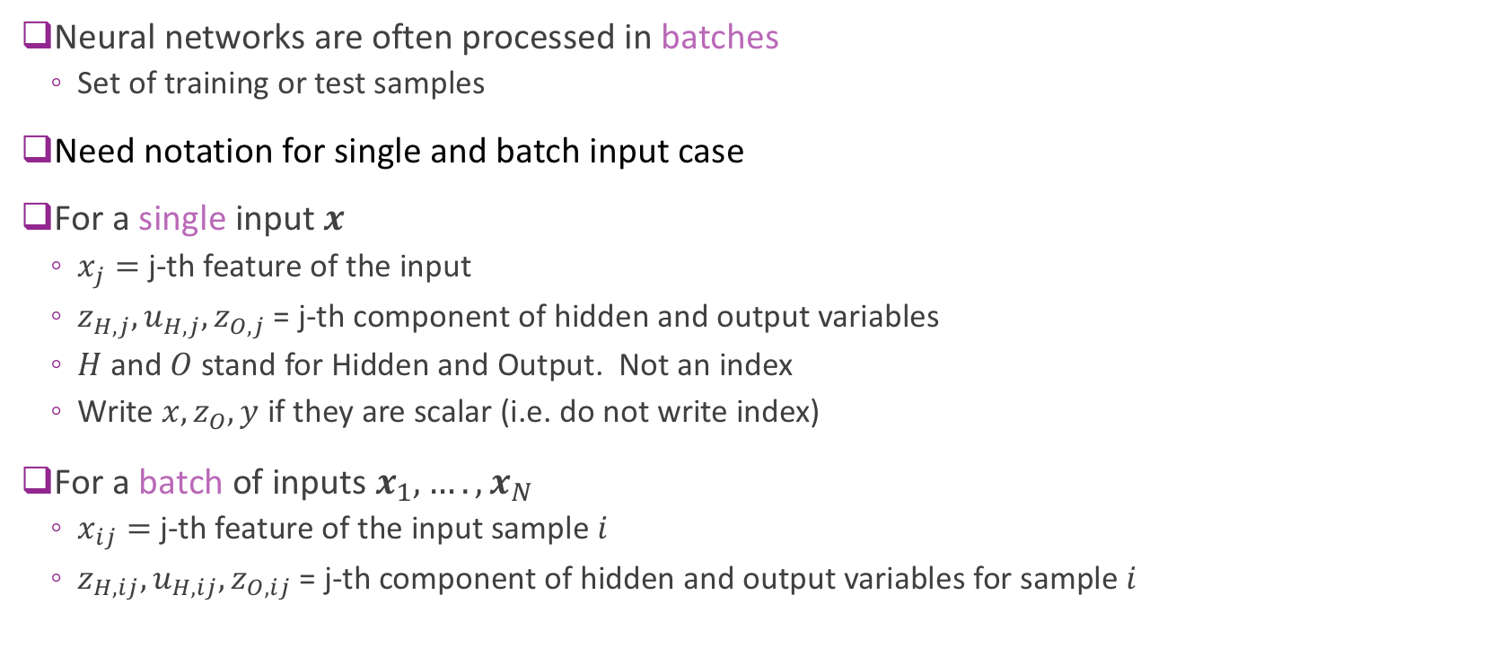
Note on Indexing
Neural networks are often processed in batches
Set of training or test samples
Need notation for single and batch input case
For a single input $x$
$x_{j}=$ j-th feature of the input
$z_{H,j},u_{H,j},z_{O,j}$ = j-th component of hidden and output variables
$H$ and $O$ stand for Hidden and Output. Not an index
Write $x,z_{O},y$ if they are scalar (i.e. do not write index)
For a batch of inputs $x_{1},….,x_{N}$
$x_{ij}=$ j-th feature of the input sample $i$
$z_{H,ij},u_{H,ij},z_{O,ij}$ = j-th component of hidden and output variables for sample $i$

Slide 24
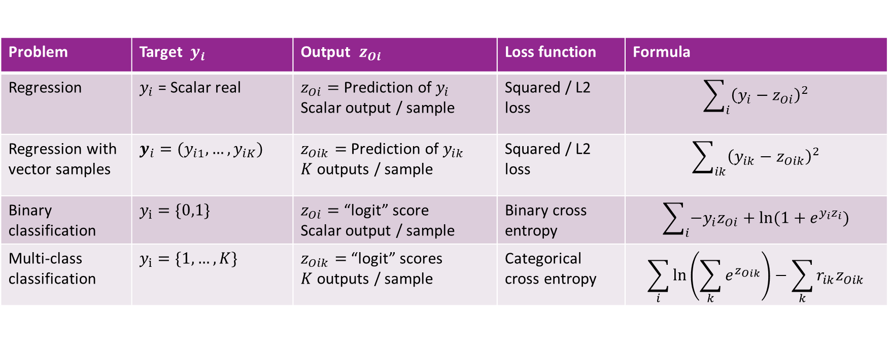
Selecting the Right Loss Function
Depends on the problem type
Always compare final output $z_{Oi}$ with target $y_{i}$
Problem | Target $y_{i}$ | Output $z_{Oi}$ | Loss function | Formula
Regression | $y_{i}$ = Scalar real | $z_{Oi}=$Prediction of $y_{i}$ Scalar output / sample | Squared / L2 loss | $$\sum_{i}{{\left(y_{i}−z_{Oi}\right)}^{2}}$$
Regression with vector samples | $y_{i}=(y_{i1},…,y_{iK})$ | $z_{Oik}=$Prediction of $y_{ik}$ $K$ outputs / sample | Squared / L2 loss | $$\sum_{ik}{{\left(y_{ik}−z_{Oik}\right)}^{2}}$$
Binary classification | $y_{i}=\{0,1\}$ | $z_{Oi}=$“logit” score Scalar output / sample | Binary cross entropy | $$\sum_{i}{−y_{i}z_{Oi}+ln⁡(1+e^{y_{i}z_{i}})}$$
Multi-class classification | $y_{i}=\{1,…,K\}$ | $z_{Oik}=$“logit” scores $K$ outputs / sample | Categorical cross entropy | $$\sum_{i}{ln⁡\left(\sum_{k}{e^{z_{Oik}}}\right)−\sum_{k}{r_{ik}z_{Oik}}}$$

Slide 25
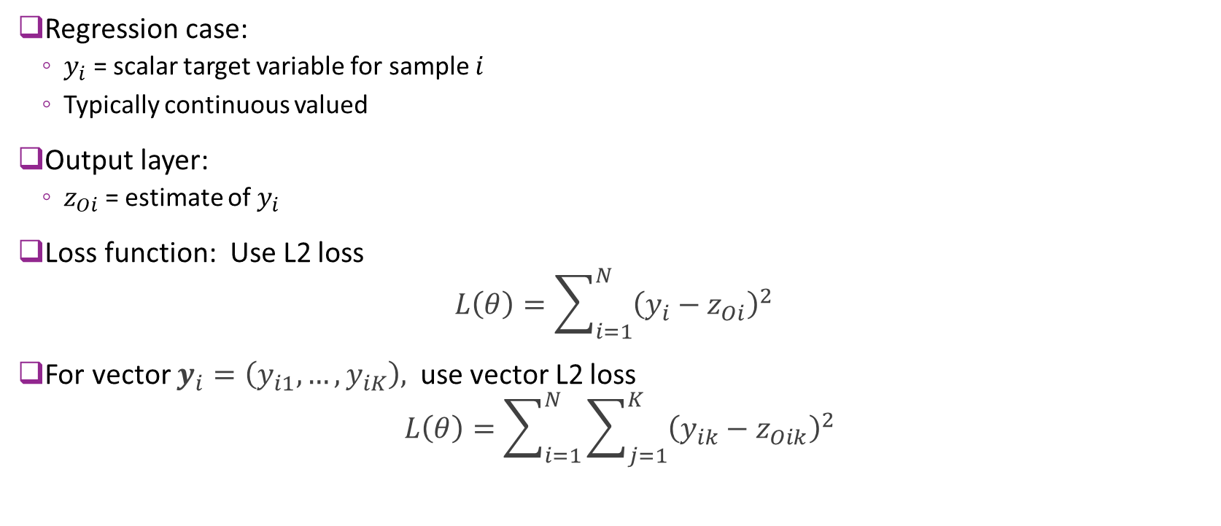
Loss Function: Regression
Regression case:
$y_{i}$ = scalar target variable for sample $i$
Typically continuous valued
Output layer:
$z_{Oi}$ = estimate of $y_{i}$
Loss function: Use L2 loss $L\left(θ\right)=\sum_{i=1}^{N}{{\left(y_{i}−z_{Oi}\right)}^{2}}$
For vector $y_{i}=\left(y_{i1},…,y_{iK}\right),$ use vector L2 loss
$$L\left(θ\right)=\sum_{i=1}^{N}{\sum_{j=1}^{K}{{\left(y_{ik}−z_{Oik}\right)}^{2}}}$$

Slide 26
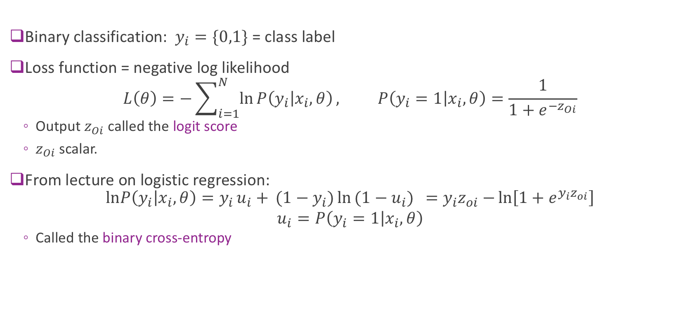
Loss Function: Binary Classification
Binary classification: $y_{i}=\{0,1\}$ = class label
Loss function = negative log likelihood
$$L\left(θ\right)=−\sum_{i=1}^{N}{\ln{P\left(y_{i} | x_{i},θ\right)}}, P\left(y_{i}=1 | x_{i},θ\right)=\frac{1}{1+e^{{−z}_{Oi}}}$$
Output $z_{Oi}$ called the logit score
$z_{Oi}$ scalar.
From lecture on logistic regression: $lnP\left(y_{i} | x_{i},θ\right)=y_{i}u_{i}+{ (1−y_{i}})\ln{(1−u_{i}){ }=y_{i}z_{oi}−}\ln\left[1+e^{y_{i}z_{oi}}\right]$
$$u_{i}=P\left(y_{i}=1 | x_{i},θ\right)$$
Called the binary cross-entropy

Slide 27

Loss Function: Multi-Class Classification 1
$y_{i}=\{1,…,K\}$ = class label
Output: $z_{Oi}=(z_{O,i1},…,z_{O,iK})$
$K$ outputs. One per class
Also called the logit score
Likelihood given by softmax:
$$P\left(y_{i}=k | x_{i},θ\right)=g_{k}\left(z_{Oi}\right), g_{k}\left(z_{Oi}\right)=\frac{e^{z_{O,ik}}}{\sum_{ℓ}{e^{z_{O,iℓ}}}}$$
Assigns class highest probability with highest logit score

Slide 28
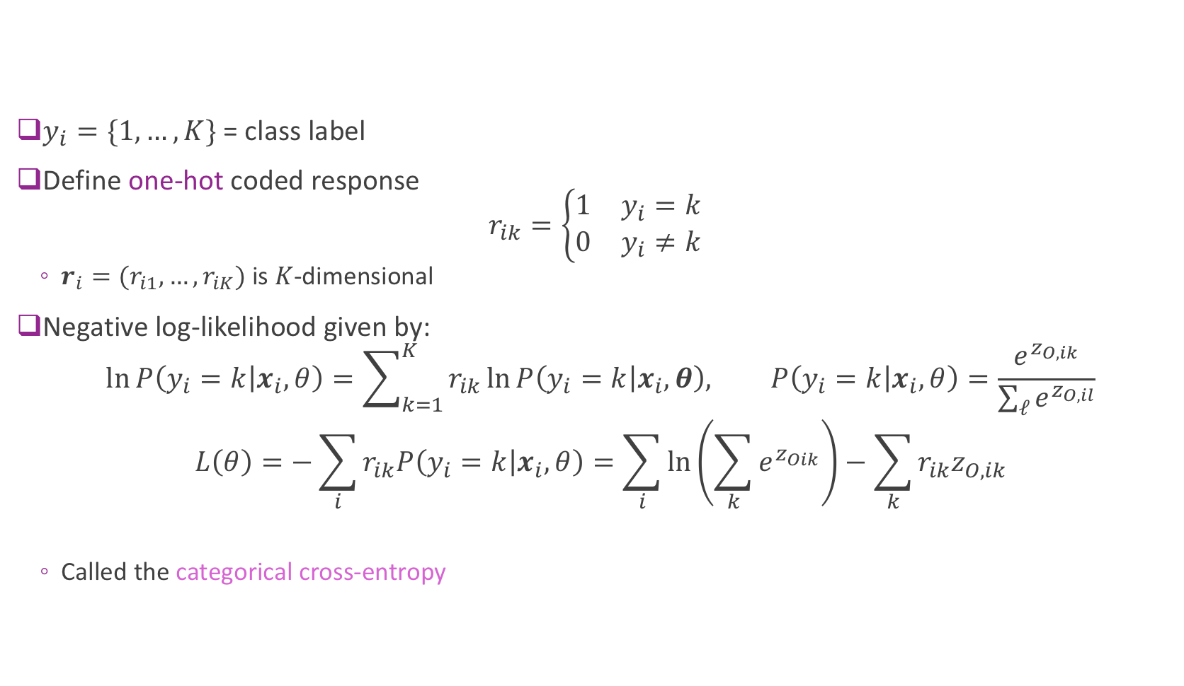
Loss Function: Multi-Class Classification 2
$y_{i}=\{1,…,K\}$ = class label
Define one-hot coded response $r_{ik}=\left\{\begin{matrix}1 & y_{i}=k \\ 0 & y_{i}≠k\end{matrix}\right.$
$r_{i}=(r_{i1},…,r_{iK})$ is $K$-dimensional
Negative log-likelihood given by:
$$\ln{P\left(y_{i}=k | x_{i},θ\right)}=\sum_{k=1}^{K}{r_{ik}\ln{P\left(y_{i}=k | x_{i},θ\right), P\left(y_{i}=k | x_{i},θ\right)=\frac{e^{z_{O,ik}}}{\sum_{ℓ}{e^{z_{O,il}}}}}} \\ L\left(θ\right)=−\sum_{i}{r_{ik}P\left(y_{i}=k | x_{i},θ\right)}=\sum_{i}{ln⁡\left(\sum_{k}{e^{z_{Oik}}}\right)−\sum_{k}{r_{ik}z_{O,ik}}}$$
Called the categorical cross-entropy

Slide 29
Outline
Motivating Idea: Nonlinear classifiers from linear features
Neural Networks
Neural Network Loss Function
Stochastic Gradient Descent
Building and Training a Network in Keras
Synthetic data
MNIST
Backpropagation Training

Slide 30
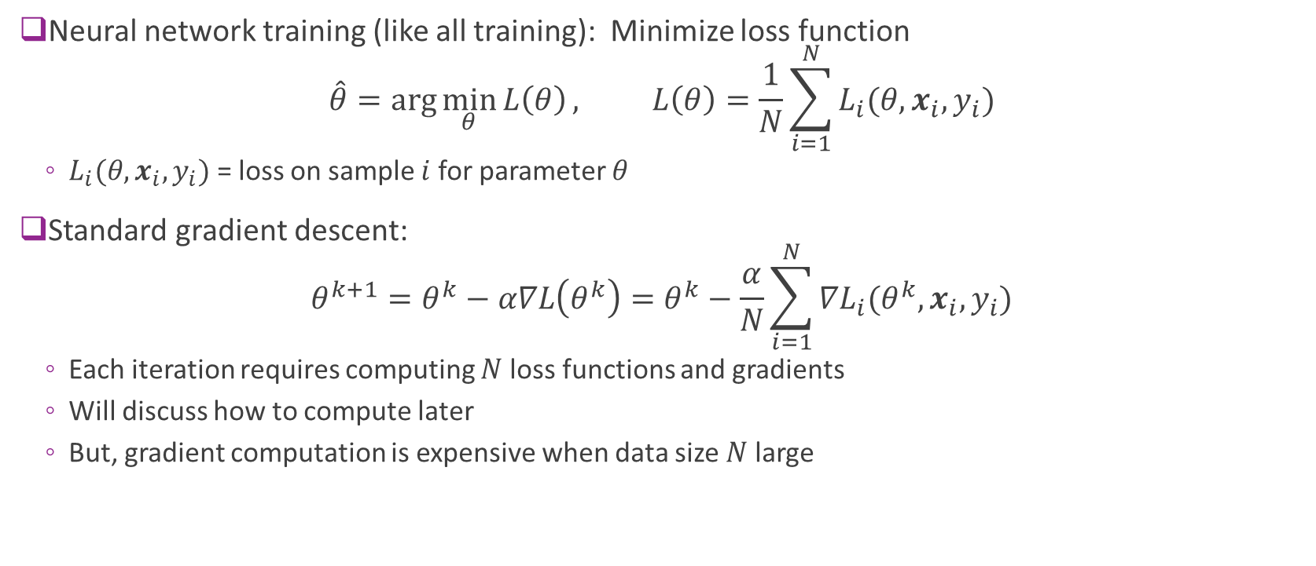
Problems with Standard Gradient Descent
Neural network training (like all training): Minimize loss function $\hat{θ}=\arg{\min_{θ}{L\left(θ\right)}}, L\left(θ\right)=\frac{1}{N}\sum_{i=1}^{N}{L_{i}(θ,x_{i},y_{i})}$
$L_{i}(θ,x_{i},y_{i})$ = loss on sample $i$ for parameter $θ$
Standard gradient descent: $θ^{k+1}=θ^{k}−α∇L\left(θ^{k}\right)=θ^{k}−\frac{α}{N}\sum_{i=1}^{N}{{∇L}_{i}(θ^{k},x_{i},y_{i})}$
Each iteration requires computing $N$loss functions and gradients
Will discuss how to compute later
But, gradient computation is expensive when data size $N$ large

Slide 31
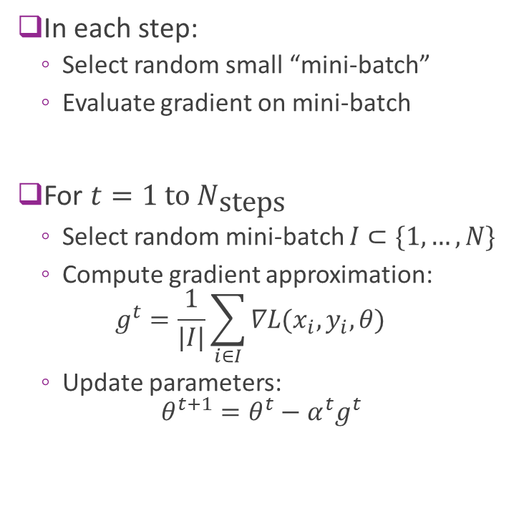
Stochastic Gradient Descent
In each step:
Select random small “mini-batch”
Evaluate gradient on mini-batch
For $t=1 \text{to} N_{\text{steps}}$
Select random mini-batch $I⊂\{1,…,N\}$
Compute gradient approximation: $g^{t}=\frac{1}{|I|}\sum_{i∈I}{∇L(x_{i},y_{i},θ)}$
Update parameters: $θ^{t+1}=θ^{t}−α^{t}g^{t}$
Full batch of training records
e.g. 50,000 in MNIST
Randomly selected mini-batch
e.g. 100 records

Slide 32
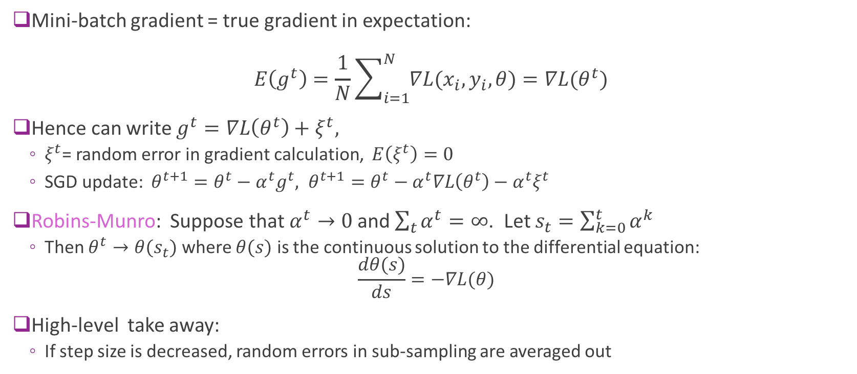
SGD Theory (Advanced)
Mini-batch gradient = true gradient in expectation: $E\left(g^{t}\right)=\frac{1}{N}\sum_{i=1}^{N}{∇L(x_{i},y_{i},θ)}=∇L(θ^{t})$
Hence can write $g^{t}=∇L\left(θ^{t}\right)+ξ^{t},$
$ξ^{t}$= random error in gradient calculation, $E\left(ξ^{t}\right)=0$
SGD update: $θ^{t+1}=θ^{t}−α^{t}g^{t}, θ^{t+1}=θ^{t}−α^{t}∇L\left(θ^{t}\right)−α^{t}ξ^{t}$
Robins-Munro: Suppose that $α^{t}→0$ and $\sum_{t}{α^{t}}=∞$. Let $s_{t}=\sum_{k=0}^{t}{α^{k}}$
Then $θ^{t}→θ(s_{t})$ where $θ(s)$ is the continuous solution to the differential equation: $\frac{dθ(s)}{ds}=−∇L(θ)$
High-level take away:
If step size is decreased, random errors in sub-sampling are averaged out

Slide 33
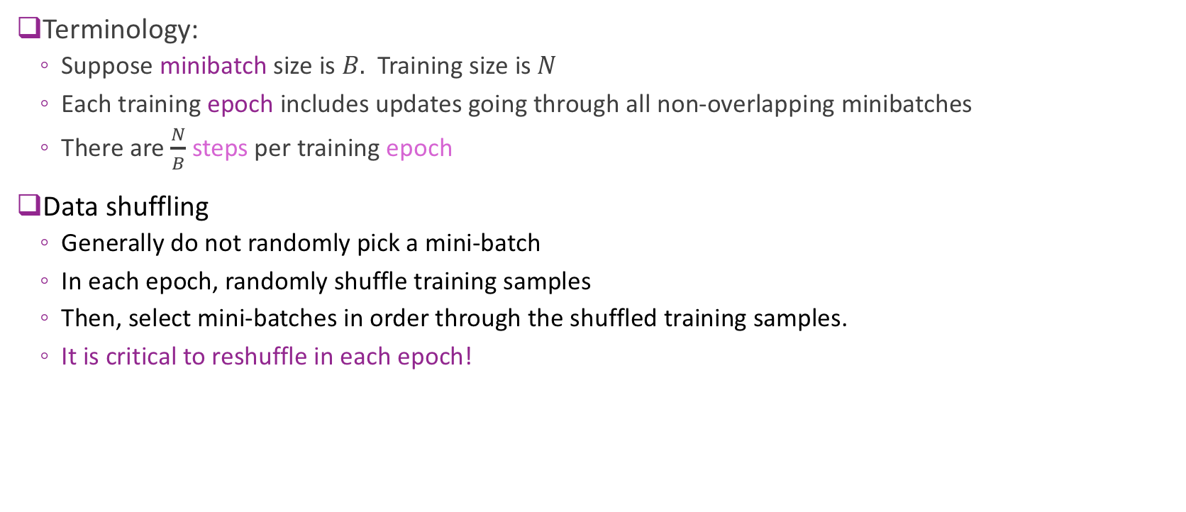
SGD Practical Issues
Terminology:
Suppose minibatch size is $B.$ Training size is $N$
Each training epoch includes updates going through all non-overlapping minibatches
There are $\frac{N}{B}$ steps per training epoch
Data shuffling
Generally do not randomly pick a mini-batch
In each epoch, randomly shuffle training samples
Then, select mini-batches in order through the shuffled training samples.
It is critical to reshuffle in each epoch!

Slide 34
Outline
Motivating Idea: Nonlinear classifiers from linear features
Neural Networks
Neural Network Loss Function
Stochastic Gradient Descent
Building and Training a Network in Keras
Synthetic data
MNIST
Backpropagation Training

Slide 35
Deep Learning Zoo

Slide 36
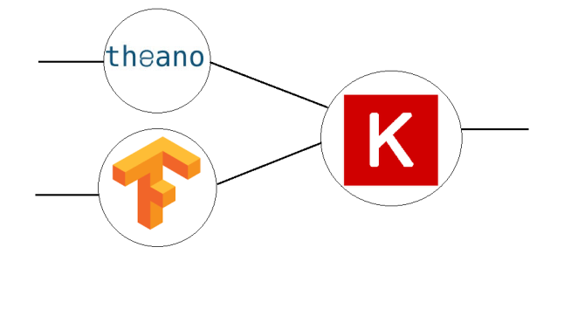
Keras Package Python Deep Learning Library
High-level neural network language in Python
Runs on top of a backend
Much simpler than raw backend language
Very fast coding
Uniform language for all backend
Keras has been incorporated into TF
But…
Slightly less flexible
Not as fast sometimes
In this class, we use Keras
Keras
High-level language
Low-level backend
(e.g. Tensorflow, Theano, CNTK, …)

Slide 37
Keras Recipe
Step 1. Describe model architecture
Number of hidden units, output units, activations, …
Step 2. Select an optimizer
Step 3. Select a loss function and compile the model
Step 4. Fit the model
Step 5. Test / use the model

Slide 38
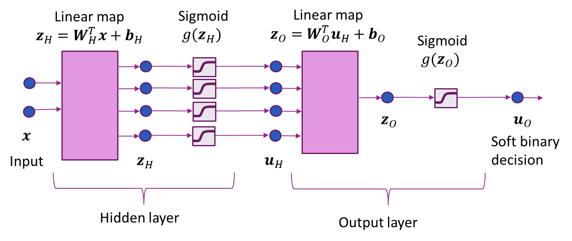
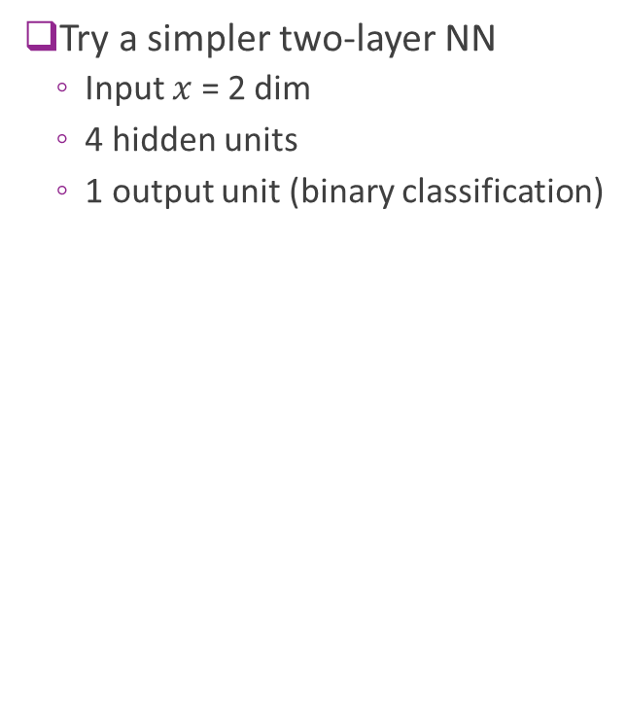
Synthetic Data Example
Try a simpler two-layer NN
Input $x$ = 2 dim
4 hidden units
1 output unit (binary classification)

Slide 39
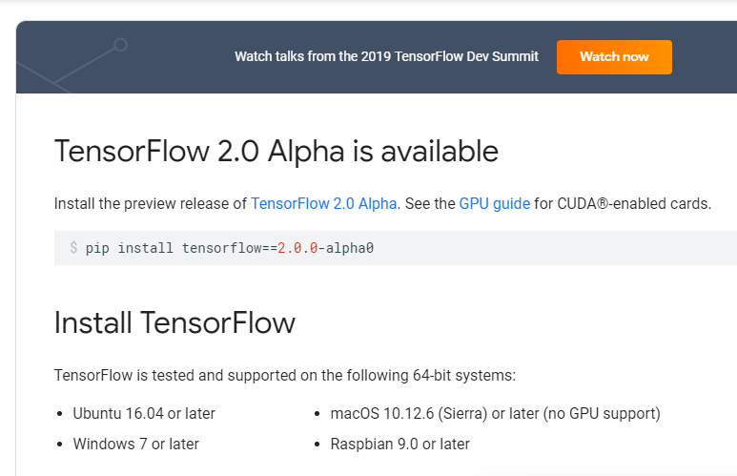
Step 0: Import the Packages
Install Tensorflow
For this lab, you can use the CPU version
If you are using Google Collaboratory, TF is pre-installed
https://www.tensorflow.org/install

Slide 40


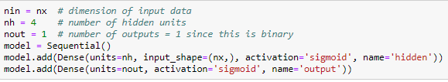
Step 1: Define Model
Load modules for layers
Clear graph (extremely important!)
Build model
This example: dense layers
Give each layer a dimension, name & activation

Slide 41
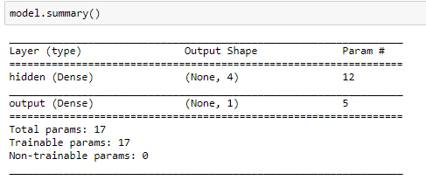
Step 1: Continued
Print the model summary
For each layers
Shows dimensions and shape
Note shapes:
(None, 4)
Batch size
This is not fixed
Dim per sample in batch

Slide 42
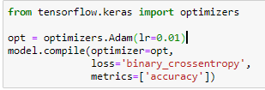
Step 2, 3: Select an Optimizer & Compile
Adam optimizer generally works well for most problems
In this case, had to manually set learning rate
You often need to play with this.
Use binary cross-entropy loss
Metrics indicate what will be printed in each epoch

Slide 43
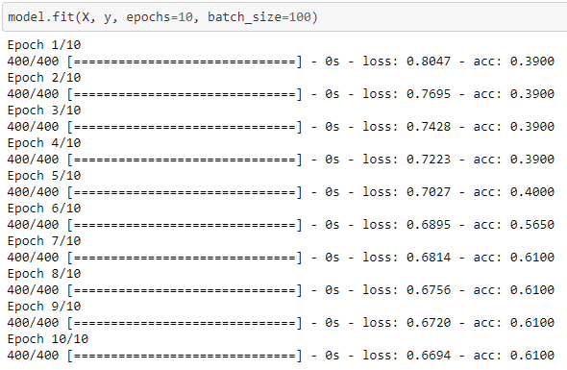
Step 4: Fit the Model
Use keras fit function
Specify number of epoch & batch size
Prints progress after each epoch
Loss = loss on training data
Acc = accuracy on training data

Slide 44
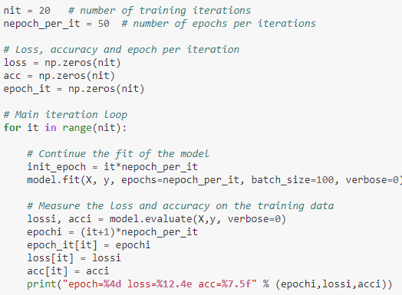
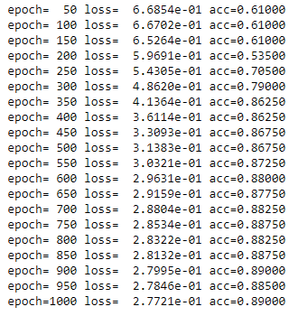
Fitting the Model with Many Epochs
This example requires large number of epochs (~1000)
Do not want to print progress on each epoch
Rewrite code to manually print progress
Can also use a callback function

Slide 45
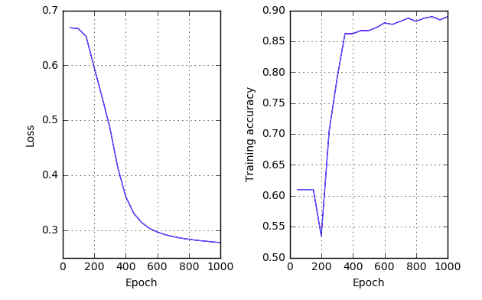
Performance vs Epoch
Can observe loss function slowly converging

Slide 46
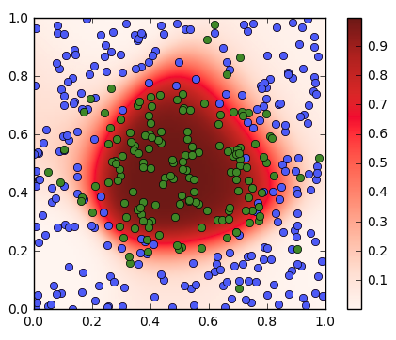


Step 5. Visualizing the Decision Regions
Feed in data $x=(x_{1},x_{2})$ over grid of points in $\left[0,1\right]×\left[0,1\right]$
Use predict to observe output for each input point
Plot outputs $u_{O}=sigmoid(z_{O})$

Slide 47



Visualizing the Hidden Layers
Create a new model with hidden layer output
Feed in data $x=(x_{1},x_{2})$ over $\left[0,1\right]×\left[0,1\right]$
Predict outputs from hidden outputs
Each hidden layer is a logistic regression layer with a different separating line!

Slide 48

In-Class Exercise
Go to in class exercise in github

Slide 49
Outline
Motivating Idea: Nonlinear classifiers from linear features
Neural Networks
Neural Network Loss Function
Stochastic Gradient Descent
Building and Training a Network in Keras
Synthetic data
MNIST
Backpropagation Training

Slide 50

Recap: MNIST data
Classic MNIST problem:
Detect hand-written digits
Each image is 28 x 28 = 784 pixels
Dataset size:
50,000 training digits
10,000 test
10,000 validation (not used here)
Can be loaded with sklearn and many other packages

Slide 51


Simple MNIST Neural Network
784 inputs, 100 hidden units, 10 outputs
Why 78500 parameters in hidden layer?

Slide 52


Fitting the Model
Run for 20 epochs, ADAM optimizer, batch size = 100
Final accuracy = 0.972
Not great, but much faster than SVM. Also CNNs we study later do even better.

Slide 53

Training and Validation Accuracy
Training accuracy continues to increase
Validation accuracy eventually flattens and sometimes starts to decrease.
Should stop when the validation accuracy starts to decrease.
This indicates overfitting.

Slide 54
Outline
Motivating Idea: Nonlinear classifiers from linear features
Neural Networks
Neural Network Loss Function
Stochastic Gradient Descent
Building and Training a Network in Keras
Synthetic data
MNIST
Backpropagation Training

Slide 55

Stochastic Gradient Descent
Training uses SGD
In each step:
Select a subset of sample for minibatch $I⊂\{1,…,N\}$
Evaluate mini-batch loss $L\left(θ^{t}\right)= \sum_{i∈I}{L_{i}(θ^{t},x_{i},y_{i})}$
Evaluate mini-batch gradient $g^{t}= \sum_{i∈I}{{∇L}_{i}(θ^{t},x_{i},y_{i})}$
Take SGD step: $θ^{t+1}=θ^{t}−αg^{t}$
Question: How do we compute gradient?

Slide 56

Gradients with Multiple Parameters
For neural net problem: $θ=(W_{H},b_{H},W_{o},b_{o})$
Gradient is computed with respect to each parameter:
$$∇L\left(θ\right)=[∇_{W_{H}}L\left(θ\right),∇_{b_{H}}L\left(θ\right),∇_{W_{O}}L\left(θ\right),∇_{b_{O}}L\left(θ\right)]$$
Gradient descent is performed on each parameter: $W_{H}←W_{H}−α∇_{W_{H}}L\left(θ\right),$ $b_{H}←b_{H}−α∇_{b_{H}}L\left(θ\right),$ $….$

Slide 57









Computation Graph & Forward Pass
Neural network loss function can be computed via a computation graph
Sequence of operations starting from measured data and parameters
Loss function computed via a forward pass in the computation graph
$z_{H,i}=W_{H}x_{i}+b_{H}$
$u_{H,i}=g_{act}(z_{H,i})$
$z_{O,i}=W_{O}u_{H,i}+b_{O}$
$L=\sum_{i}{L_{i}(z_{O,i},y_{i}) }$
$$L(θ)$$
Hidden variable
Observed variable
Trainable variable
$$x$$
$$z_{H}$$
$$u_{H}$$
$$z_{O}$$
$$W_{H},b_{H}$$
$$W_{O},b_{O}$$
$$y$$

Slide 58



Forward Pass Example in Numpy
Example network:
Single hidden layer with $N_{H}$ hidden units, single output unit
Sigmoid activation, binary cross entropy loss

Slide 59








Back-Propagation on A Two Node Graph
Back Propagation:
A way to compute gradients
Iterative procedure that works in reverse
Consider a simple 2 node computation graph
Each component is a vector:
$x=\left(x_{1},…,x_{N}\right), z=(z_{1},…,z_{M})$
First we compute $\frac{∂J}{∂z_{i}}$
Then compute $\frac{∂J}{∂x_{j}}$ from multi-variable chain rule: $\frac{∂J}{∂x_{j}}=\sum_{i=1}^{n}{\frac{∂J}{∂z_{i}}\frac{∂z_{i}}{∂x_{j}}}$
Variables computed in forward pass
$$z=f(x)$$
$$J=g(z)$$
$$x$$
$$z$$
$$J$$
$$\frac{∂J}{∂x_{j}}$$
$$\frac{∂J}{∂z_{i}}$$
Gradients computed in reverse pass

Slide 60


Back-Prop on a General Computation Graph
Backpropagation:
Compute gradients backwards
Work one node at a time
First compute all derivatives of all the variables
${∂L}/{∂z_{O}}$
${∂L}/{∂u_{H}}$ from ${∂L}/{∂z_{O}},{∂z_{O}}/{∂u_{H}}$
${∂L}/{∂z_{H}}$ from ${∂L}/{∂u_{H}},{∂u_{H}}/{∂z_{H}}$
Then compute gradient of parameters:
${∂L}/{∂W_{O}}$ from ${∂L}/{∂z_{O}},{∂z_{O}}/{∂W_{O}}$
${∂L}/{∂b_{O}}$ from ${∂L}/{∂z_{O}},{∂z_{O}}/{∂b_{O}}$
${∂L}/{∂W_{H}}$ from ${∂L}/{∂z_{H}},{∂z_{H}}/{∂W_{H}}$
${∂L}/{∂b_{H}}$ from ${∂L}/{∂z_{H}},{∂z_{H}}/{∂b_{H}}$

Slide 61

Back-Propagation Example (Part 1)
Continue our example:
Single hidden layer with $M$hidden units, single output unit
Sigmoid activation, binary cross entropy loss
$N$ samples, $D$ input dimension
Loss node:
$L=\sum_{i}{L_{i}(z_{O,i},y_{i})}$
$L_{i}{(z}_{oi})=−(y_{i}\ln{P\left(y_{i}=1 | x_{i},θ\right)+(1−y_{i})}\ln{P\left(y_{i}=0 | x_{i},θ\right))=y_{i}z_{oi}−}\ln\left[1+e^{y_{i}z_{oi}}\right]$
$\frac{∂L}{∂z_{O,i}}=$ $y_{i}−\frac{e^{y_{i}z_{oi}}}{1+e^{y_{i}z_{oi}}}$

Slide 62

Back-Propagation Example (Part 2)
Node $z_{O}$
$z_{O}=u_{H}W_{O}+b_{O}$
$z_{Oi}=\sum_{m}{{u_{H,im}W}_{Om}+b_{O}}$
Gradient:
$\frac{∂z_{O,i}}{∂W_{O,m} }=u_{H,i,m}$
$\frac{∂z_{O,i}}{∂b_{O} }=1$
Other partial derivatives are zero
Apply chain rule:
$\frac{∂L}{∂W_{O,m}}=\sum_{i}{\frac{∂L}{∂z_{O,i}}\frac{∂z_{O,i}}{∂W_{O,m}}}=\sum_{i}{\frac{∂L}{∂z_{O,i}}u_{H,im}}$
$\frac{∂L}{∂b_{O}}=\sum_{i}{\frac{∂L}{∂z_{O,i}}\frac{∂z_{O,i}}{∂b_{O}}}=\sum_{i}{\frac{∂L}{∂z_{O,i}}}$

Slide 63

Back-Propagation Example (Part 3)
Node $z_{O}$
$z_{O}=u_{H}W_{O}+b_{O}$
$z_{Oi}=\sum_{m}{{u_{H,im}W}_{Om}+b_{O}}$
Gradient:
$\frac{∂z_{O,i}}{∂u_{H,ij}}=W_{O,j}$, m=1,…,M
Other partial derivatives are zero
Apply chain rule:
$\frac{∂L}{∂u_{H,ij}}=\frac{∂L}{∂z_{O,i}}\frac{∂z_{O,i}}{∂u_{H,ij}}=\frac{∂L}{∂z_{O,i}}W_{O,j}$

Slide 64

Back-Propagation Example (Part 4,…)
Compute $\frac{∂L}{∂W_{H}}$, $\frac{∂L}{∂b_{H}}$
Following previous procedures, in class
Summary:
Forward pass: Compute hidden nodes and loss
Backward pass: Compute gradients

Slide 65
Initialization and Data Normalization
Solution by gradient descent algorithm depends on the initial solution
Typically weights are set to random values near zero.
Small weights make the network behave like linear classifier.
Hence model starts out nearly linearly
Becomes nonlinear as weights increase during the training process.
Starting with large weights often lead to poor results.
Normalizing data to zero mean and unit variance
Allows all input dimensions be treated equally and facilitate better convergence.
With normalized data, it is typical to initialize the weights to be uniform in [-0.7, 0.7] [ESL]

Slide 66

Regularization
To avoid the weights get too large, can add a penalty term explicitly, with regularization level $λ$
Ridge penalty
$$R\left(θ\right)=\sum_{d,m}{w_{H,d,m}^{2}+\sum_{m,k}{w_{O,m,k}^{2}={\left\|w_{H}\right\|}^{2}+{\left\|w_{O}\right\|}^{2}}}$$
Total loss
$$L_{reg}\left(θ\right)=L\left(θ\right)+λR\left(θ\right)$$
Change in gradient calculation
Typically used regularization
L2 = Ridge: Shrink the sizes of weights
L1: Prefer sparse set of weights
L1-L2: use a combination of both

Slide 67

Regularization in Keras
Activity regularization tries to make the output at each layer small or sparse.

Slide 68
Choice of network parameters
Number of layers (typically not more than 2)
Number of hidden units in the hidden layer
Regularization level
Learning rate
Determined by maximizing the cross validation error through typically exhaustive search

Slide 69
Learning Objectives
Mathematically describe a neural network with a single hidden layer
Describe mappings for the hidden and output units
Manually compute output regions for very simple networks
Select the loss function based on the problem type
Build and train a simple neural network in Keras
Write the formulas for gradients using backpropagation
Describe mini-batches in stochastic gradient descent
Importance of regularization
Hyperparameter optimization

Slide 70
Lab for this unit
Music instrument classification based on music signals
Use hand-crafted features for audio (MFCC)
Train a neural net
Optimize the learning rate

