Slide 1
Lecture 11 Principal Component Analysis
EE-uy 4563 / EL-Gy 6143: Introduction to machine learning
Prof. Sundeep rangan

Slide 2
Outline
Dimensionality reduction
Principal components and directions of variance
Approximation with PCs
Computing PCs via the SVD
Face example in python
Training models from PCs
Low rank approximations and recommender systems

Slide 3
Dimensionality Reduction
Many modern data sets have very high dimension
Want to reduce dimension:
Simplify classification / regression tasks on the data set
Visualize data
Find underlying commonalities in data

Slide 4
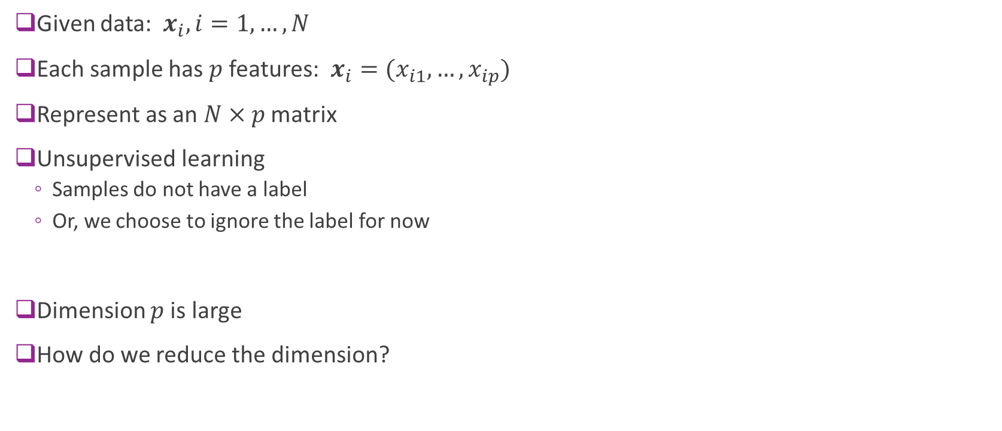
Data Definitions
Given data: $x_{i}, i=1,…,N$
Each sample has $p$ features: $x_{i}=(x_{i1},…,x_{ip})$
Represent as an $N×p$ matrix
Unsupervised learning
Samples do not have a label
Or, we choose to ignore the label for now
Dimension $p$is large
How do we reduce the dimension?

Slide 5
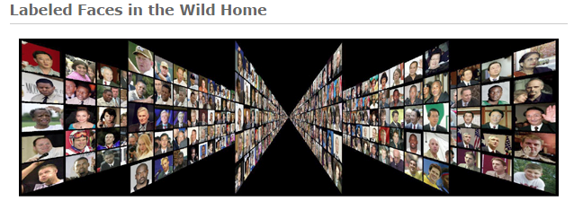
Example: Faces
Face images can be high-dimensional
We will use 50 x 37 = 1850 pixels
But, there may be few degrees of freedom
Can we reduce the dimensionality of this?
Data Labelled Faces in the Wild project
http://vis-www.cs.umass.edu/lfw
Large collection of faces (13000 images)
Taken from web articles about 10 years ago

Slide 6

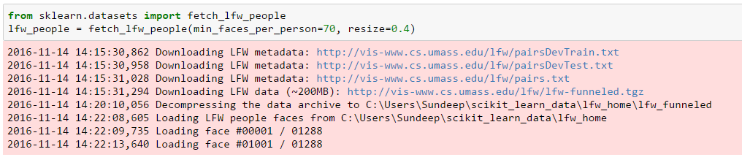
Loading the Data
Built-in routines to load data is sciket-learn
Can take several minutes the first time (Be patient)

Slide 7
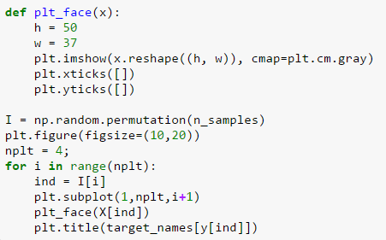
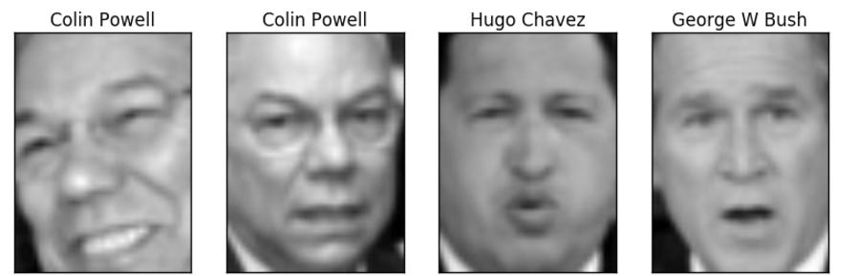
Plotting the Data
Some example faces
You may be too young to remember them all

Slide 8
Outline
Dimensionality reduction
Principal components and directions of variance
Approximation with PCs
Computing PCs via the SVD
Face example in python
Training models from PCs
Low rank approximations and recommender systems

Slide 9
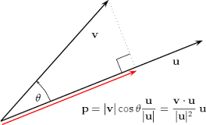




Projections
Given a vectors $z$ and $v$
Projection of $z$ onto $v$ is: $\hat{z}={\text{Proj}}_{v}\left(z\right)=αv, α= \frac{v^{T}z}{v^{T}v}=\frac{\left\|z\right\|}{\left\|v\right\|} cos θ$
Let $V=\left\{αv\right|α∈R\}$ = vectors on the line spanned by $v$
Theorem: ${\text{Proj}}_{v}\left(z\right)$ is closest point in $V$ to $z$: $\hat{z}=\arg{\min_{w∈V}{{\left\|z−w\right\|}^{2}}}$
$$z$$
$$v$$
$$\hat{z}$$

Slide 10
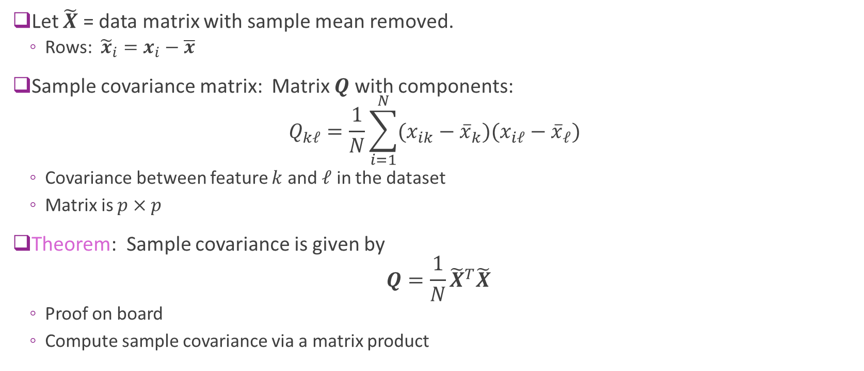
Sample Covariance Matrix
Let $\tilde{X}$ = data matrix with sample mean removed.
Rows: ${\tilde{x}}_{i}=x_{i}−\overline{x}$
Sample covariance matrix: Matrix $Q$ with components: $Q_{kℓ}=\frac{1}{N}\sum_{i=1}^{N}{(x_{ik}−{\overline{x}}_{k})(x_{iℓ}−{\overline{x}}_{ℓ})}$
Covariance between feature $k$ and $ℓ$ in the dataset
Matrix is $p×p$
Theorem: Sample covariance is given by $Q=\frac{1}{N}{\tilde{X}}^{T}\tilde{X}$
Proof on board
Compute sample covariance via a matrix product

Slide 11
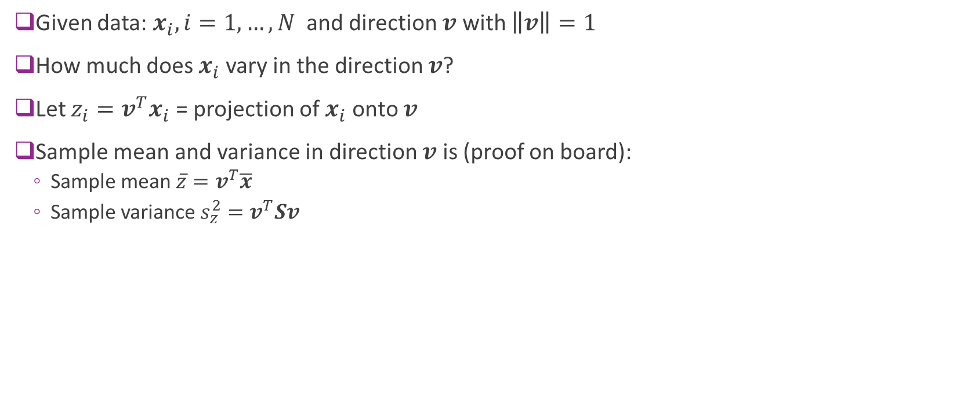
Directional Variance
Given data: $x_{i}, i=1,…,N$ and direction $v$ with $\left\|v\right\|=1$
How much does $x_{i}$ vary in the direction $v$?
Let $z_{i}=v^{T}x_{i}$ = projection of $x_{i}$ onto $v$
Sample mean and variance in direction $v$ is (proof on board):
Sample mean $\overline{z}=v^{T}\overline{x}$
Sample variance $s_{z}^{2}=v^{T}Sv$

Slide 12
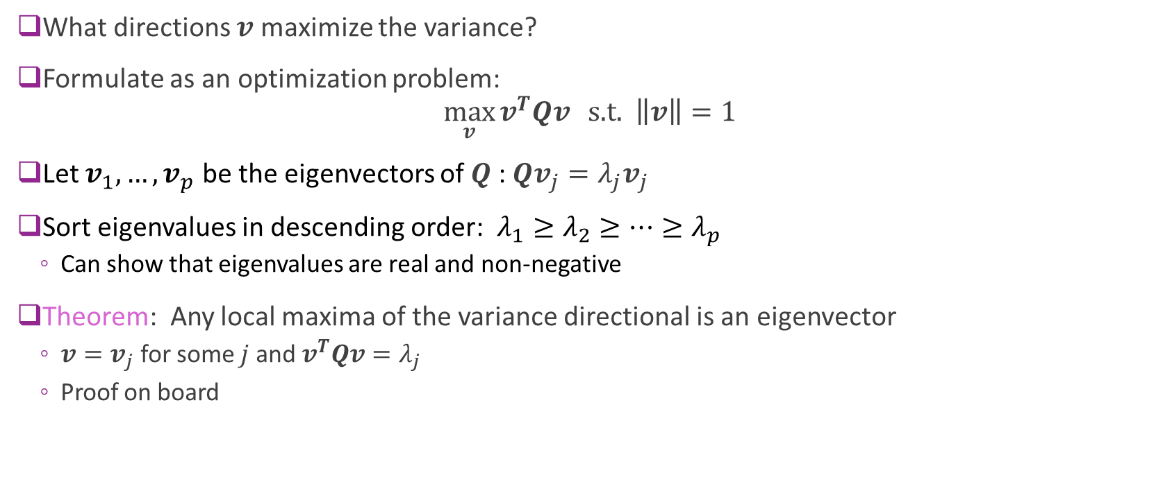
Maximizing Directional Variance
What directions $v$ maximize the variance?
Formulate as an optimization problem: $\max_{v}{v^{T}Qv} \text{s}\text{.}\text{t}\text{. } \left\|v\right\|=1$
Let $v_{1},…,v_{p}$ be the eigenvectors of $Q$ : $Qv_{j}=λ_{j}v_{j}$
Sort eigenvalues in descending order: $λ_{1}≥λ_{2}≥…≥λ_{p}$
Can show that eigenvalues are real and non-negative
Theorem: Any local maxima of the variance directional is an eigenvector
$v=v_{j}$ for some $j$ and $v^{T}Qv=λ_{j}$
Proof on board

Slide 13
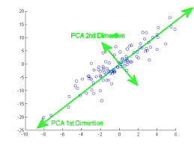
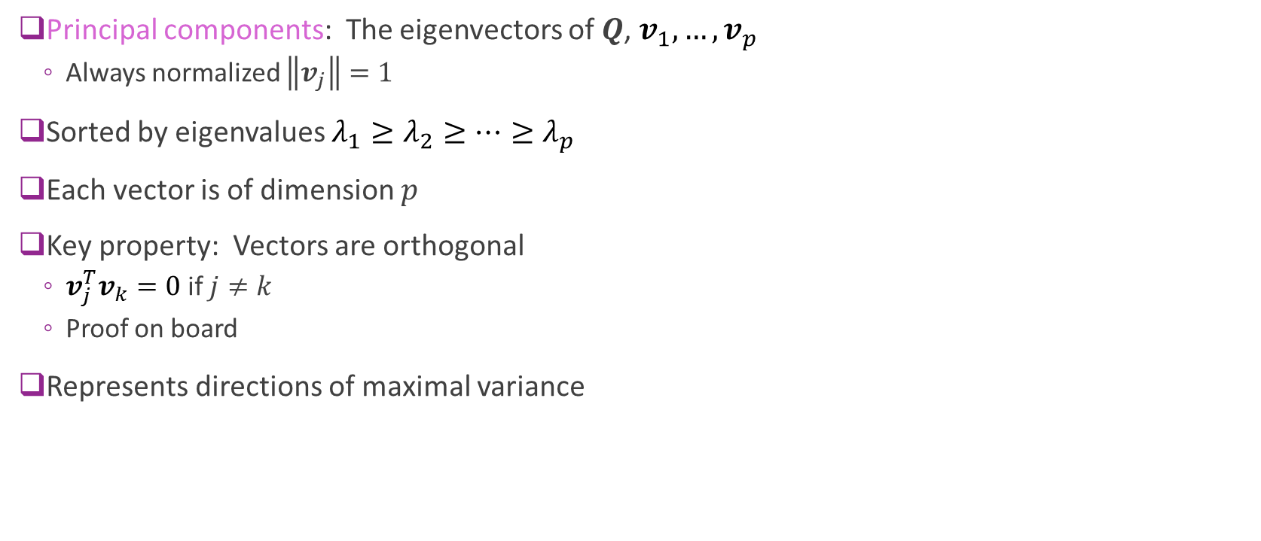
Principal Components
Principal components: The eigenvectors of $Q$, $v_{1},…,v_{p}$
Always normalized $\left\|v_{j}\right\|=1$
Sorted by eigenvalues $λ_{1}≥λ_{2}≥…≥λ_{p}$
Each vector is of dimension $p$
Key property: Vectors are orthogonal
$v_{j}^{T}v_{k}=0$ if $j≠k$
Proof on board
Represents directions of maximal variance

Slide 14
Outline
Dimensionality reduction
Principal components and directions of variance
Approximation with PCs
Computing PCs via the SVD
Face example in python
Training models from PCs
Low rank approximations and recommender systems

Slide 15
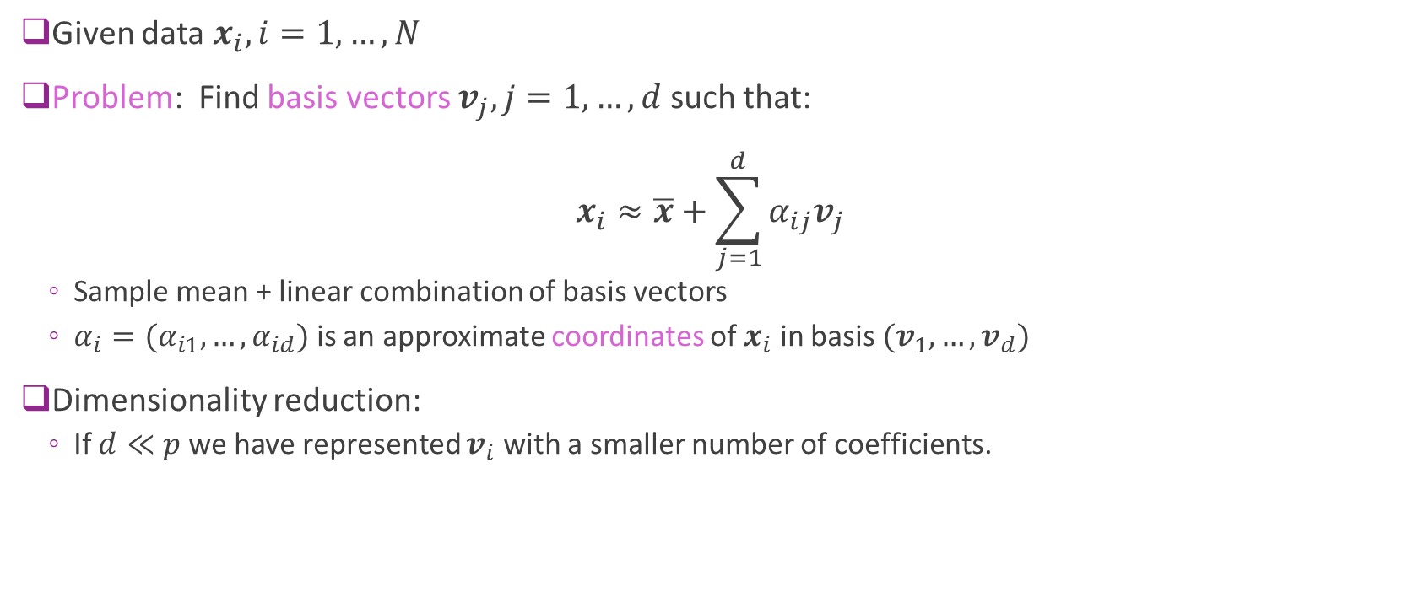
Low-Dimensional Representations
Given data $x_{i}, i=1,…,N$
Problem: Find basis vectors $v_{j}, j=1,…,d$ such that: $x_{i}≈\overline{x}+\sum_{j=1}^{d}{α_{ij}v_{j}}$
Sample mean + linear combination of basis vectors
$α_{i}=(α_{i1},…,α_{id})$ is an approximate coordinates of $x_{i}$ in basis $(v_{1},…,v_{d})$
Dimensionality reduction:
If $d≪p$ we have represented $v_{i}$ with a smaller number of coefficients.

Slide 16
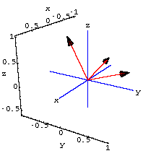
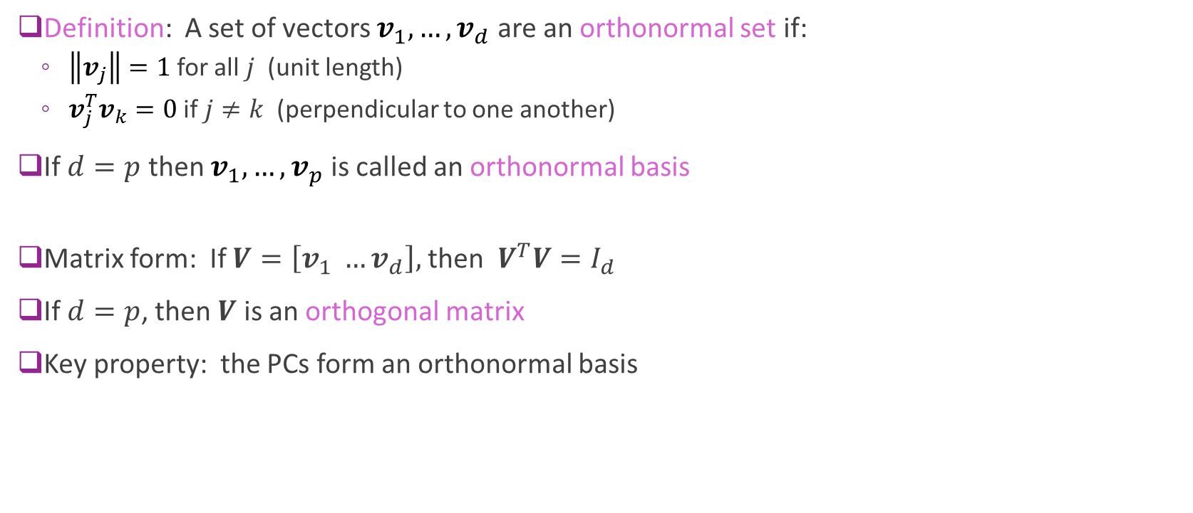
Orthonormal Sets and Bases
Definition: A set of vectors $v_{1},…,v_{d}$ are an orthonormal set if:
$\left\|v_{j}\right\|=1$ for all $j$ (unit length)
$v_{j}^{T}v_{k}=0$ if $j≠k$ (perpendicular to one another)
If $d=p$ then $v_{1},…,v_{p}$ is called an orthonormal basis
Matrix form: If $V=\left[v_{1} …v_{d}\right],$ then $V^{T}V=I_{d}$
If $d=p$, then $V$ is an orthogonal matrix
Key property: the PCs form an orthonormal basis

Slide 17

Coefficients in an Orthonormal Basis
Suppose $v_{1},…,v_{p}$ is an orthonormal basis
Given a vector $z$, can write $z=\sum_{j=1}^{p}{α_{j}v_{j}}, α_{j}=v_{j}^{T}z$
Simple expression for computing coefficients in an orthonormal basis
Matrix form: $α=V^{T}z, z=Vα$

Slide 18

Approximating the Data Matrix
Given data $x_{i}, i=1,…,N$
Let $v_{1},…,v_{p}$ be the PCs
Find coefficient expansion of each data sample: $x_{i}=\overline{x}+\sum_{j=1}^{p}{α_{ij}v_{j}}, α_{ij}=v_{j}^{T}(x_{i}−\overline{x})$
Now consider approximation with $d$ coefficients: ${\hat{x}}_{i}=\overline{x}+\sum_{j=1}^{d}{α_{ij}v_{j}}$

Slide 19

Average Approximation Error
Let ${\hat{x}}_{i}$ = approximation with $d$ PCs
Error in sample $i$: $x_{i}−{\hat{x}}_{i}=\sum_{j=d+1}^{p}{α_{ij}v_{j}}$
Theorem: Average error with a $d$ PC approximation is: $\frac{1}{N}\sum_{i=1}^{N}{{\left\|x_{i}−{\hat{x}}_{i}\right\|}^{2}}=\sum_{j=d+1}^{p}{λ_{j}}$
Sum of the smallest $p−d$ eigenvalues

Slide 20
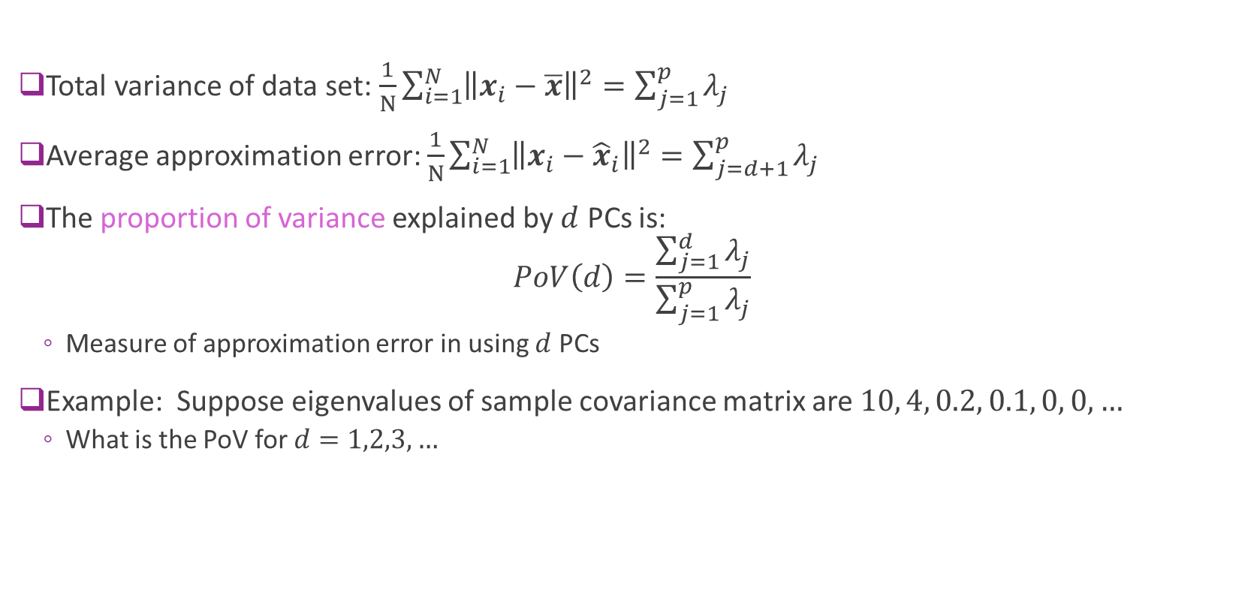
Proportion of Variance (PoV)
Total variance of data set: $\frac{1}{N}\sum_{i=1}^{N}{{\left\|x_{i}−\overline{x}\right\|}^{2}}=\sum_{j=1}^{p}{λ_{j}}$
Average approximation error: $\frac{1}{N}\sum_{i=1}^{N}{{\left\|x_{i}−{\hat{x}}_{i}\right\|}^{2}}=\sum_{j=d+1}^{p}{λ_{j}}$
The proportion of variance explained by $d$ PCs is: $PoV\left(d\right)=\frac{\sum_{j=1}^{d}{λ_{j}}}{\sum_{j=1}^{p}{λ_{j}}}$
Measure of approximation error in using $d$ PCs
Example: Suppose eigenvalues of sample covariance matrix are $10, 4, 0.2, 0.1, 0, 0, …$
What is the PoV for $d=1,2,3, …$

Slide 21
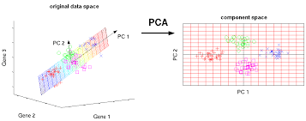
Visualizing the Representation
Finds a low-dimensional representation

Slide 22
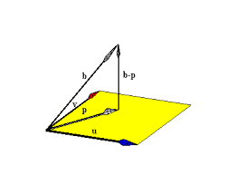
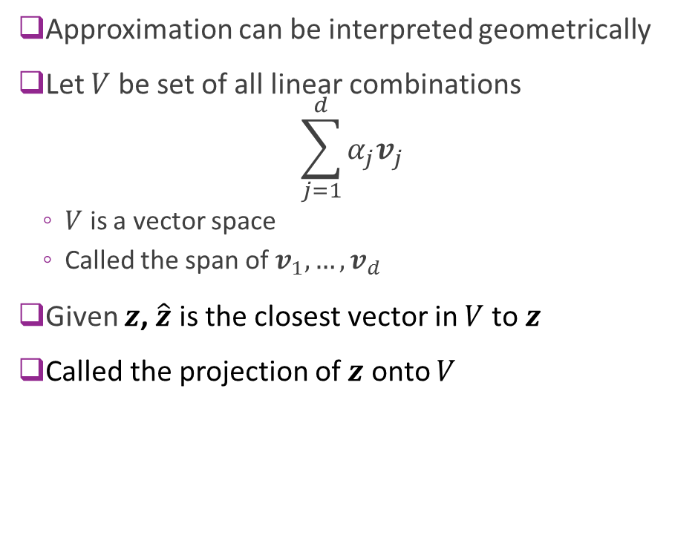




Geometry of Approximations
Approximation can be interpreted geometrically
Let $V$ be set of all linear combinations $\sum_{j=1}^{d}{α_{j}v_{j}}$
$V$ is a vector space
Called the span of $v_{1},…,v_{d}$
Given $z$, $\hat{z}$ is the closest vector in $V$ to $z$
Called the projection of $z$ onto $V$
$$z$$
$$z−\hat{z}$$
$$\hat{z}$$
Space spanned by $v_{1},…,v_{d}$

Slide 23
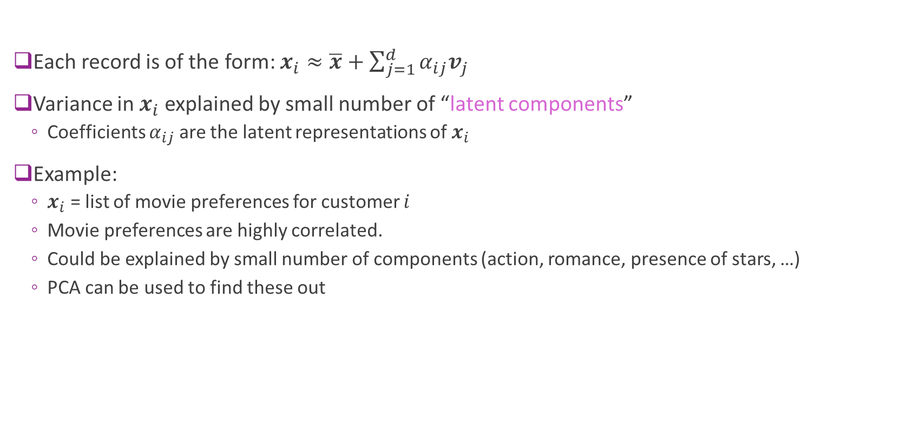
Latent Representations
Each record is of the form: $x_{i}≈\overline{x}+\sum_{j=1}^{d}{α_{ij}v_{j}}$
Variance in $x_{i}$ explained by small number of “latent components”
Coefficients $α_{ij}$ are the latent representations of $x_{i}$
Example:
$x_{i}$ = list of movie preferences for customer $i$
Movie preferences are highly correlated.
Could be explained by small number of components (action, romance, presence of stars, …)
PCA can be used to find these out

Slide 24
Example: USArrests
Arrests per capita in four categories
One record per US state
Visualize PCA in a biplot
See the scores (i.e. coefficients of each state)
Loading (PC vectors)
Fig from ISL 10.1

Slide 25
Outline
Dimensionality reduction
Principal components and directions of variance
Approximation with PCs
Computing PCs via the SVD
Face example in python
Training models from PCs
Low rank approximations and recommender systems

Slide 26
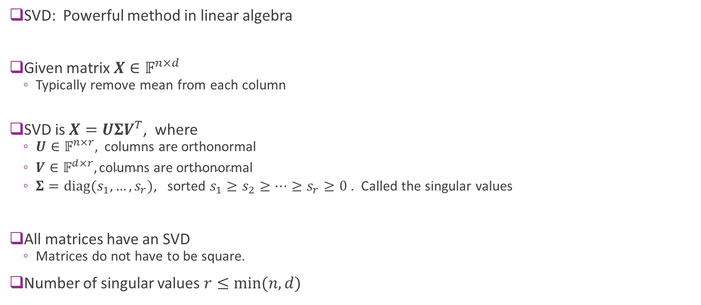
Singular Value Decomposition
SVD: Powerful method in linear algebra
Given matrix $X∈𝔽^{n×d}$
Typically remove mean from each column
SVD is $X=UΣV^{T}$, where
$U∈𝔽^{n×r},$columns are orthonormal
$V∈𝔽^{d×r}, \text{columns} \text{are} \text{orthonormal}$
$Σ=\text{diag}(s_{1},…,s_{r})$, sorted $s_{1}≥s_{2}≥⋯≥s_{r}≥0$ . Called the singular values
All matrices have an SVD
Matrices do not have to be square.
Number of singular values $r≤\min{(n,d)}$
Notes:
SVD is a powerful techniuque in all kinds of numerical linear algebra/ml/etc.
It's just a way to compute principal component analysis
SVD is kind of like an eigenvalue decomposition that it factors the matrix into three parts.
S is diagonal, rxr, sorted called singular values.
All marix in universe has svd. Even if not square.

Slide 27
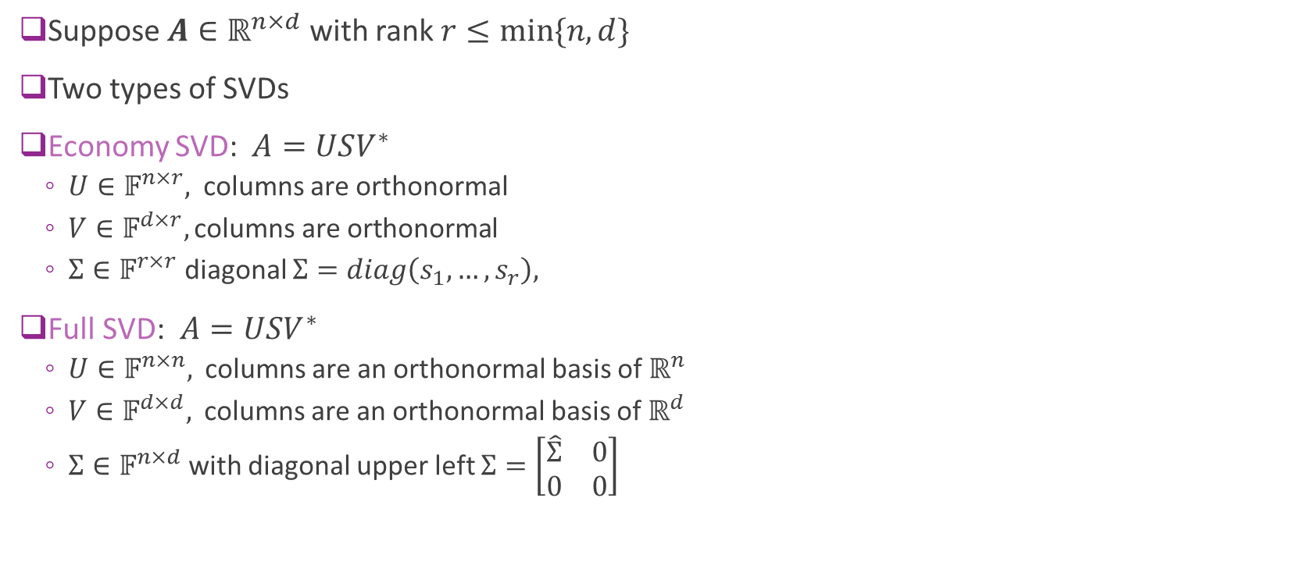
Economy vs. Full SVD
Suppose $A∈ℝ^{n×d}$ with rank $r≤min⁡\{n,d\}$
Two types of SVDs
Economy SVD:$A=USV^{∗}$
$U∈𝔽^{n×r},$columns are orthonormal
$V∈𝔽^{d×r}, \text{columns} \text{are} \text{orthonormal}$
$Σ∈𝔽^{r×r}$ diagonal $Σ=diag\left(s_{1},…,s_{r}\right),$
Full SVD:$A=USV^{∗}$
$U∈𝔽^{n×n},$ columns are an orthonormal basis of $ℝ^{n}$
$V∈𝔽^{d×d},$ columns are an orthonormal basis of $ℝ^{d}$
$Σ∈𝔽^{n×d}$with diagonal upper left $Σ=\left[\begin{matrix}\hat{Σ} & 0 \\ 0 & 0\end{matrix}\right]$

Slide 28
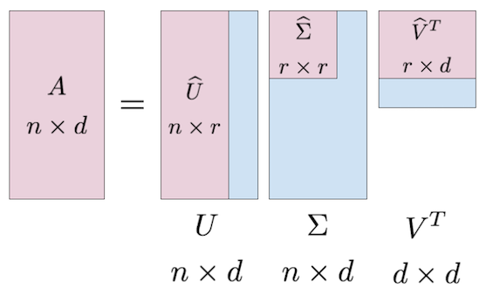
SVD Visualized
Pink matrices represent “economy” SVD
Blue represent “full SVD”
Tall
Diagonal
Fat

Slide 29
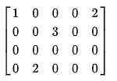
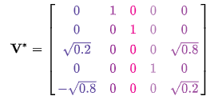
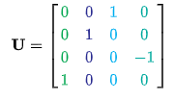
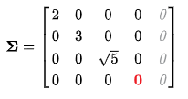

Example
Let $A=$
Then can check that $A=UΣV^{∗}$
Also verify that $UU^{∗}=I_{5}$ and $VV^{∗}=I_{5}$
This can be found by (cleverly) permute the rows of $A$
But, in general, use a computer to compute SVD

Slide 30
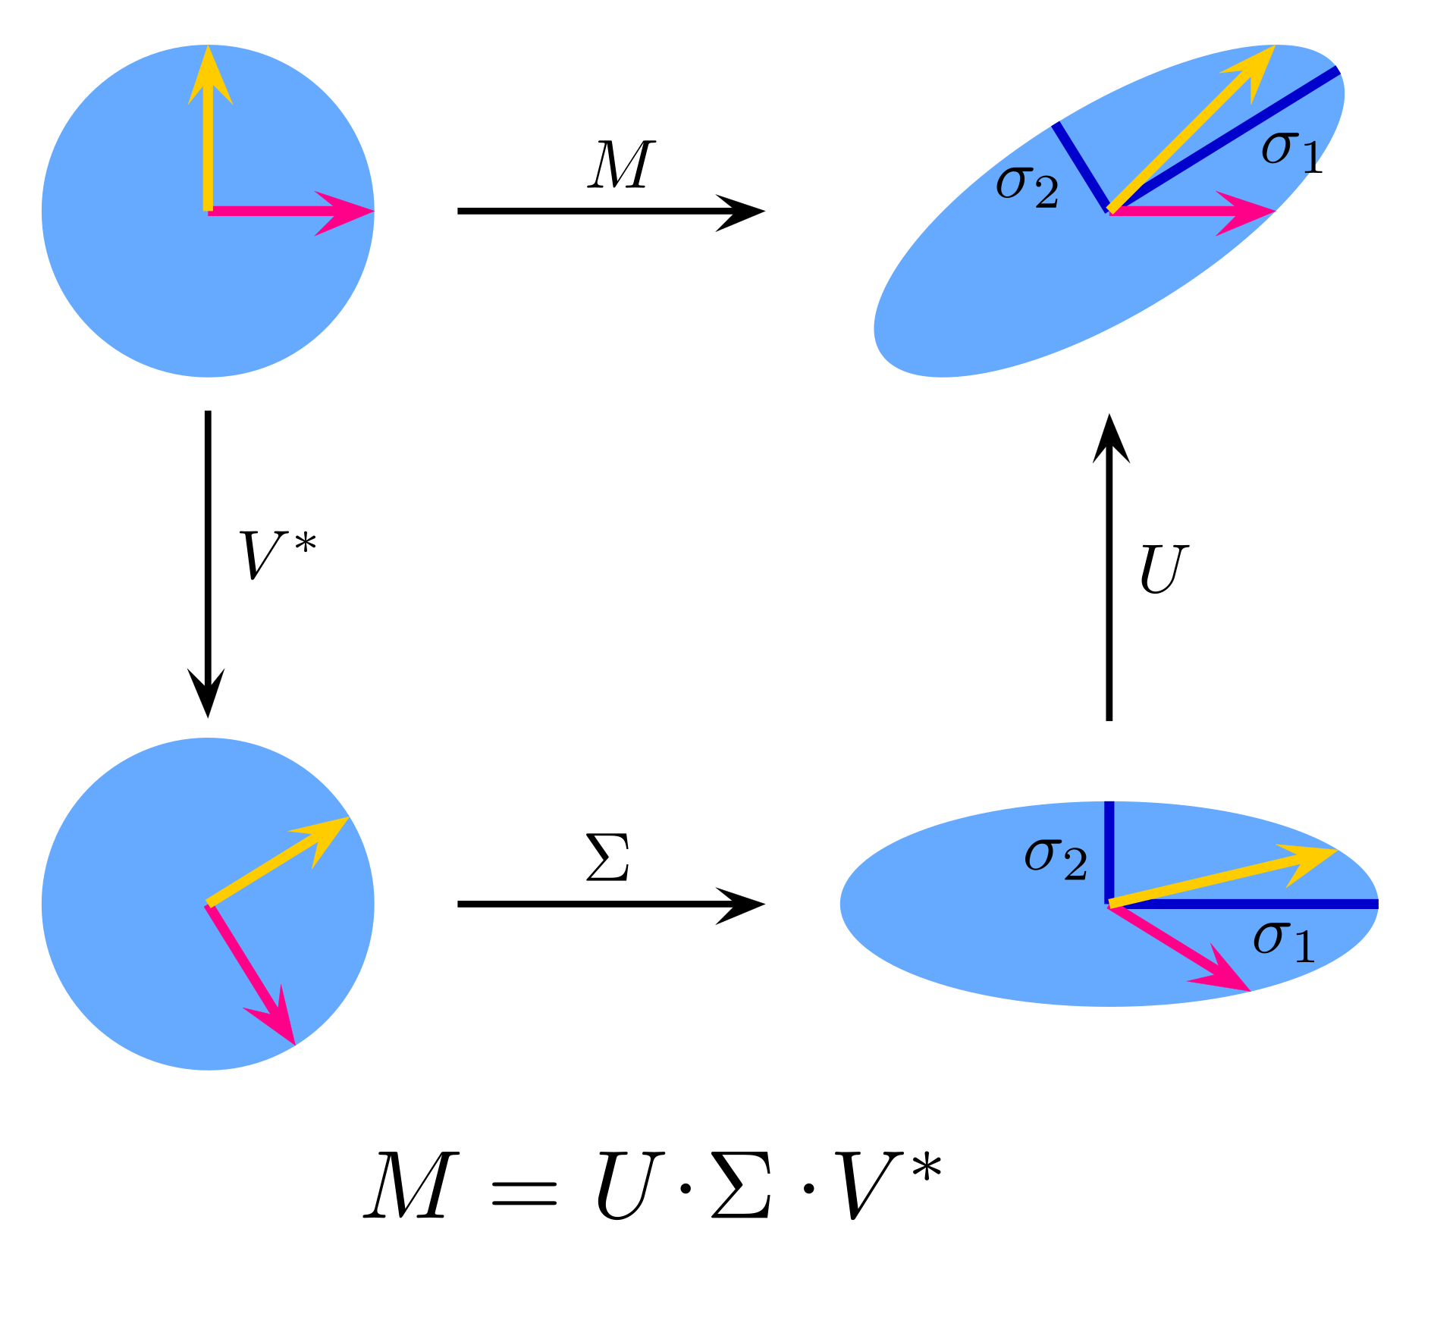
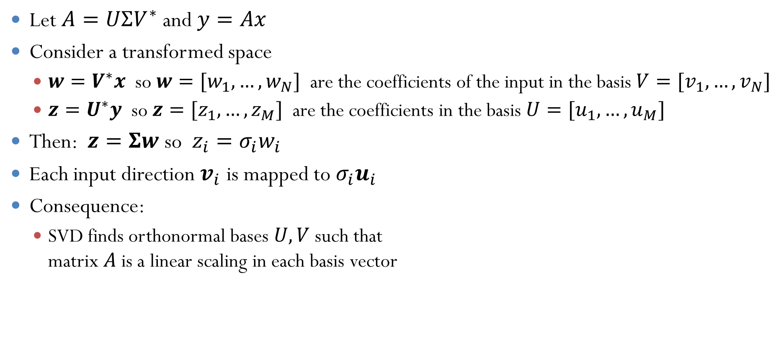


Geometric Interpretation
Let $A=UΣV^{∗}$ and $y=Ax$
Consider a transformed space
$w=V^{∗}x$ so $w=[w_{1},…,w_{N}]$ are the coefficients of the input in the basis $V=[v_{1},…,v_{N}]$
$z=U^{∗}y$ so $z=[z_{1},…,z_{M}]$ are the coefficients in the basis $U=[u_{1},…,u_{M}]$
Then: $z=Σw$ so $z_{i}=σ_{i}w_{i}$
Each input direction $v_{i}$ is mapped to $σ_{i}u_{i}$
Consequence:
SVD finds orthonormal bases $U,V$ such that matrix $A$ is a linear scaling in each basis vector
$$x$$
$$y$$
_{A}
_{A}

Slide 31
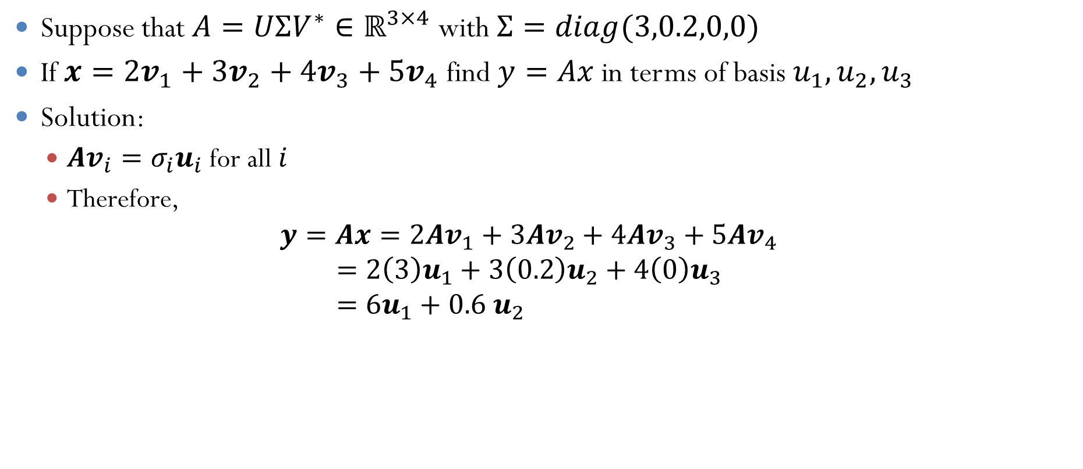
Example Problem
Suppose that $A=UΣV^{∗}∈ℝ^{3×4}$ with $Σ=diag(3,0.2,0,0)$
If $x=2v_{1}+3v_{2}+4v_{3}+5v_{4}$ find $y=Ax$in terms of basis $u_{1},u_{2},u_{3}$
Solution:
${Av}_{i}=σ_{i}u_{i}$ for all $i$
Therefore, $y=Ax=2{Av}_{1}+3{Av}_{2}+4Av_{3}+5{Av}_{4}$
$$=2{\left(3\right)u}_{1}+3{\left(0.2\right)u}_{2}+4\left(0\right)u_{3} \\ =6u_{1}+0.6 u_{2}$$

Slide 32
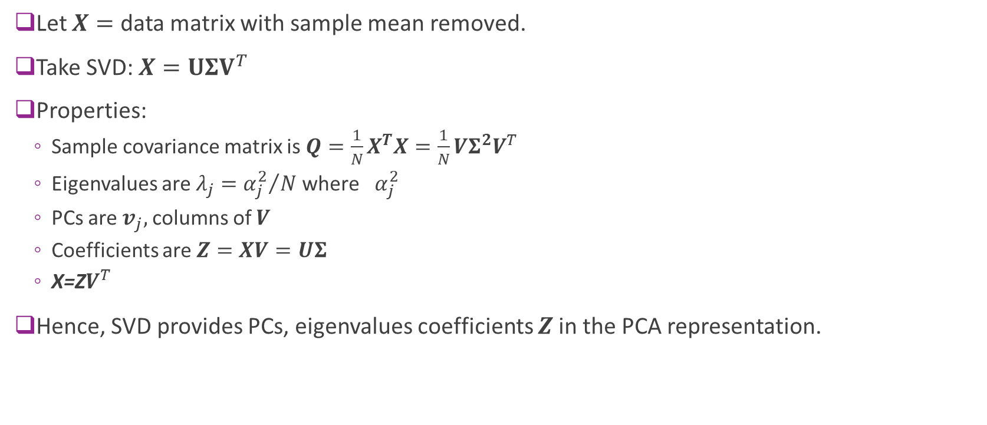
Computing the PCA via SVD
Let $X=$ data matrix with sample mean removed.
Take SVD: $X={UΣV}^{T}$
Properties:
Sample covariance matrix is $Q=\frac{1}{N}X^{T}X=\frac{1}{N}VΣ^{2}V^{T}$
Eigenvalues are $λ_{j}={α_{j}^{2}}/N$ where${ α}_{j}^{2}$
PCs are $v_{j},$ columns of $V$
Coefficients are $Z=XV=UΣ$
X=Z$V^{T}$
Hence, SVD provides PCs, eigenvalues coefficients $Z$in the PCA representation.
Notes:
How do we use the SVD to compute PCA?
Take data matrix X, remove the mean. Each row of x, subtract out the mean
The alphas j are singular values of
Xvd u,sigma v and then Z Nxp take the k first columns of that big Z matrix. And the new basis are the first k columns of v. V is pxp
X=ZV'

Slide 33
Outline
Dimensionality reduction
Principal components and directions of variance
Approximation with PCs
Computing PCs via the SVD
Face example in python
Training models from PCs
Low rank approximations and recommender systems

Slide 34

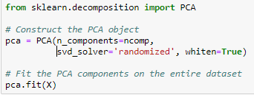
Computing the PCA
Manually compute the PCs with SVD
Remove the mean
Use broadcasting
Compute the SVD
Use sklearn builtin PCA function
Construct a PCA object
Call fit: Computes mean and PC components
Stores values internally in the pca class

Slide 35
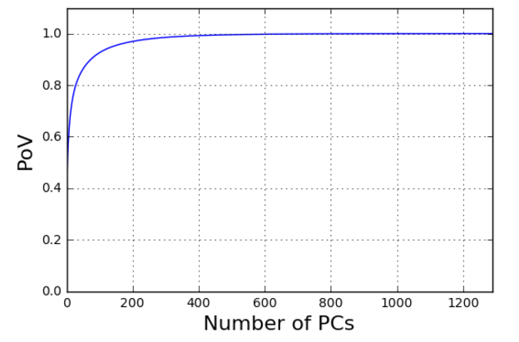
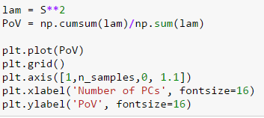
Finding the PoV
Most variance explained in about 400 components
Some reduction

Slide 36

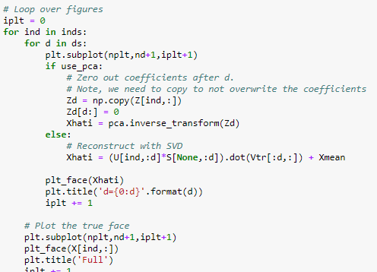
Plotting Approximations
Reconstruction using sklearn method
Uses the inverse_transform method
Reconstruction using SVD
Note use of broadcasting

Slide 37
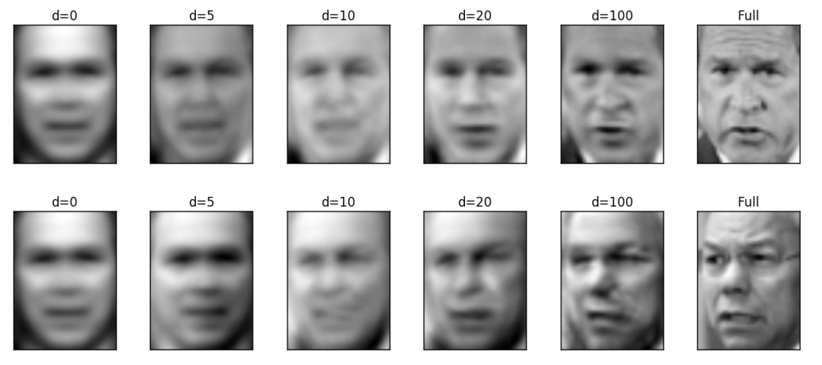
Plotting the Approximations

Slide 38
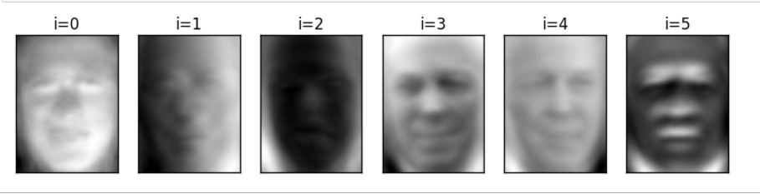
Plotting the PCs
The PCs can be plotted as well

Slide 39





State-of-the-Art: Auto-Encoders
PCA is a simple example of an autoencoder
Tries to find low-dim representation
Restricted to linear transforms
Not very good for images and complex data
$$α=V^{T}x$$
$$\hat{x}=Vα$$
$$x$$
High-dim object
$$α$$ Low-dim representation
$$\hat{x}$$
Approximation

Slide 40
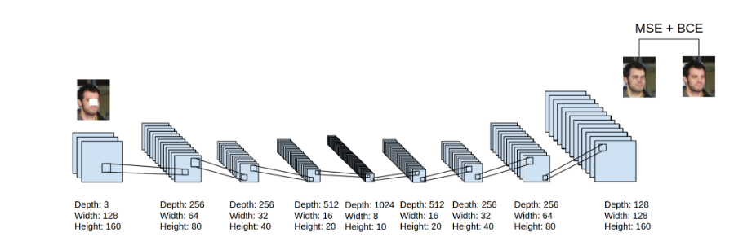
Deep Auto-Encoders
Can use deep networks for learning complex latent representations and their inverses
http://www.cc.gatech.edu/~hays/7476/projects/Avery_Wenchen/
https://swarbrickjones.wordpress.com/2016/01/13/enhancing-images-using-deep-convolutional-generative-adversarial-networks-dcgans/ (Code in Theano not tensorflow)

Slide 41
Outline
Dimensionality reduction
Principal components and directions of variance
Approximation with PCs
Computing PCs via the SVD
Face example in python
Training models from PCs
Low rank approximations and recommender systems

Slide 42
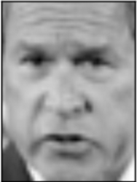
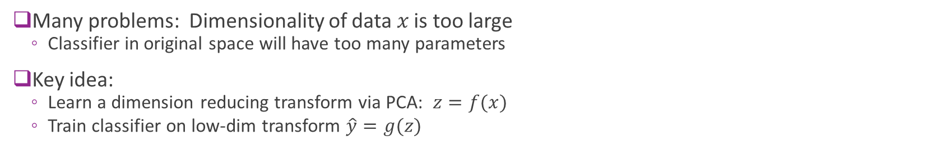

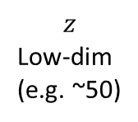
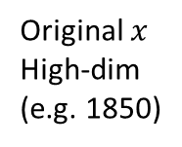
Classification Using PCs
$$\hat{y}=g(z)$$
$$z$$
Low-dim (e.g. ~50)
“George Bush”
PCA transform
Classifier
Original $x$
High-dim (e.g. 1850)
Many problems: Dimensionality of data $x$ is too large
Classifier in original space will have too many parameters
Key idea:
Learn a dimension reducing transform via PCA: $z=f(x)$
Train classifier on low-dim transform $\hat{y}=g(z)$

Slide 43
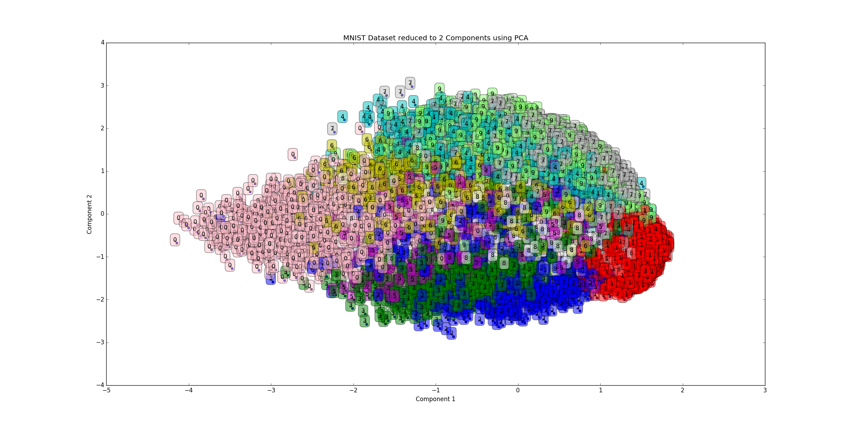
Why This Would Work?
PCA works if: classes are separable in transformed domain
Example to right:
MNIST digits plotted in two PCs
Can mostly separate the classses

Slide 44
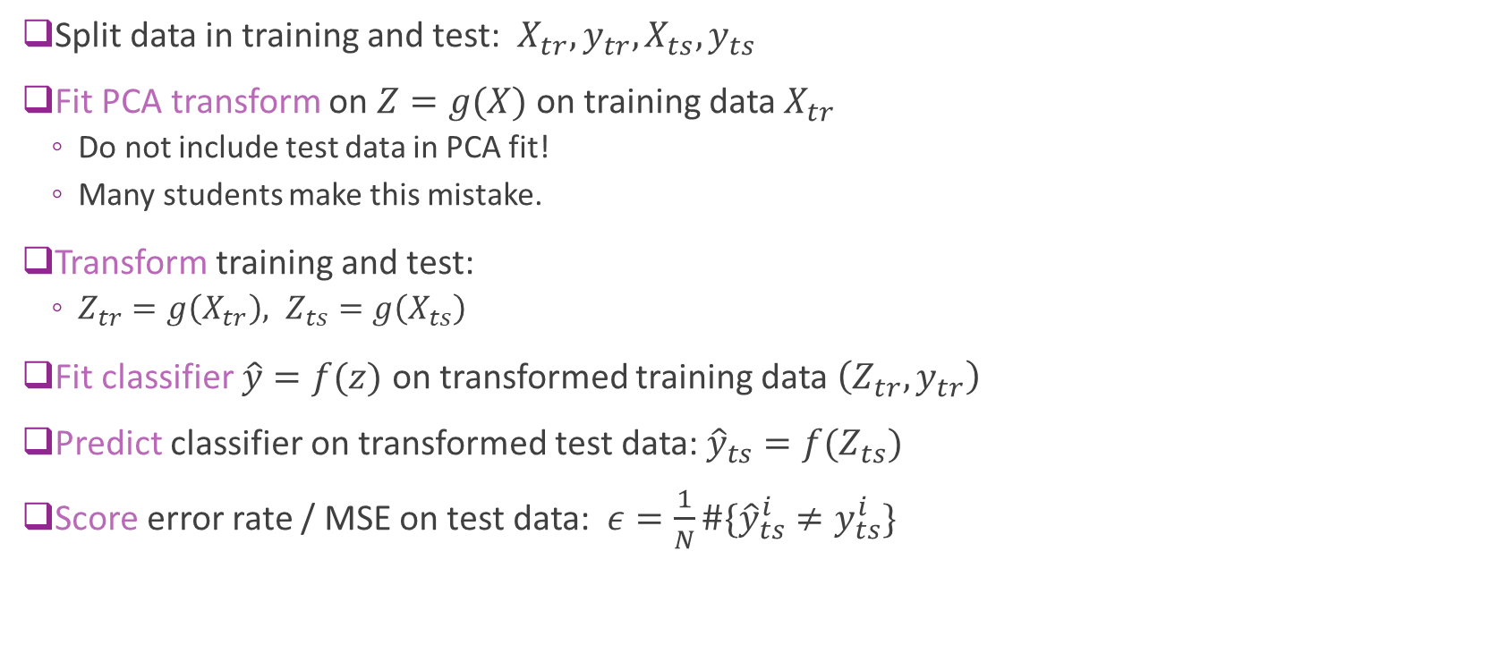
Training and Testing
Split data in training and test: $X_{tr},y_{tr},X_{ts},y_{ts}$
Fit PCA transform on $Z=g(X)$ on training data $X_{tr}$
Do not include test data in PCA fit!
Many students make this mistake.
Transform training and test:
$Z_{tr}=g\left(X_{tr}\right), Z_{ts}=g\left(X_{ts}\right)$
Fit classifier $\hat{y}=f(z)$ on transformed training data $\left(Z_{tr},y_{tr}\right)$
Predict classifier on transformed test data: ${\hat{y}}_{ts}=f(Z_{ts})$
Score error rate / MSE on test data: $ε=\frac{1}{N}\#\{{\hat{y}}_{ts}^{i}≠y_{ts}^{i}\}$

Slide 45

Cross-Validation
To find number of PCs and other parameters use cross-validation
Split data in training and test: $X_{tr},y_{tr},X_{ts},y_{ts}$
For each set of parameters:
Fit PCA transform on $Z=g(X, \text{numPCs})$ on training data $X_{tr}$
Transform training and test: $Z_{tr}=g\left(X_{tr}\right), Z_{ts}=g\left(X_{ts}\right)$
Fit classifier $\hat{y}=f(z)$ on transformed training data $\left(Z_{tr},y_{tr}\right)$
Predict classifier on transformed test data: ${\hat{y}}_{ts}=f(Z_{ts})$
Score (e.g. error rate / MSE) on test data: $ε=\frac{1}{N}\#\{{\hat{y}}_{ts}^{i}≠y_{ts}^{i}\}$
Select the parameters with lowest score

Slide 46

Example: SVM classification with PCAs
Parameters to search
Number of PCs and gamma
Fit on the training data.
This is in the loop!
Transform the data
Fit classifier on transformed training data
Test on the transformed test data
Score on test data

Slide 47



Example: Parameter Search
Search over:
Number of PCs $∈\left\{25,50,75,100,200\right\}$
$γ∈\{0.001,0.004, 0.01, 0.1\}$
Plotted is the test accuracy
Best test accuracy $≈85\%$
Test Accuracy

Slide 48


Examples
Correct images
Error images
Original
Reduced
Original
Reduced

Slide 49
Outline
Dimensionality reduction
Principal components and directions of variance
Approximation with PCs
Computing PCs via the SVD
Face example in python
Training models from PCs
Low rank approximations and recommender systems

Slide 50

Low-Rank Approximations
SVD can be used for a low-rank approximation
SVD can be written: $X={UΣV}^{T}=\sum_{j=1}^{r}{α_{j}u_{j}v_{j}^{T}}$
Consider $k−$term approximation: $X_{k}=\sum_{j=1}^{k}{α_{j}u_{j}v_{j}^{T}}$
Properties:
$X_{k}$ is rank $k$
$X_{k}=U_{k}Σ_{k}V_{k}^{T}$
Error is ${\left\|X−X_{k}\right\|}_{F}^{2}=\sum_{i}{\sum_{j}{{\left(X_{ij}−X_{k,ij}\right)}^{2}}}=\sum_{j=k+1}^{r}{α_{j}^{2}}$
If $s_{k+1,}…,s_{r}$ is small then matrix is well approximated by rank $k$ matrix

Slide 51



Low-Rank Approximation Visualized
=
V_{k}’
$$X_{k}$$
U_{k}
$$Σ_{k}$$
N X k
k X k
k X p
N X p
Can show: Reconstructed matrix $X_{k}$ is optimal rank $k$ approximation

Slide 52


Recommender Systems
How do you recommend a movie to a user?
MovieLens dataset:
Get past ratings from users
Make recommendations for future

Slide 53

Ratings Matrix
Data can be represented as ratings matrix
Users x movies
Problem: Most users have only rated a small fraction
Need to estimate unseen entries
Very sparse
How can we do complete this matrix
Movies
Users

Slide 54

Latent Factor Model for Ratings
Idea: Ratings for movies dependent on small number of latent factors
E.g. Action, famous actors, genre, …
Mathematically model as: $R_{ij}≈{\hat{R}}_{ij}=b_{i}^{u}+b_{j}^{m}+\sum_{k=1}^{K}{A_{ik}B_{jk}}$
$R_{ij}=$Rating of movie $j$ by user $i$
$b_{i}^{u}=$Bias of user $i$
$b_{j}^{m}=$Bias of movie $j$
$K$ = number of latent factors. Typically small $K≪N_{user},N_{movies}$
$A_{ik}=$ Preference of user $i$ to factor $k$
$B_{jk}=$ Component of factor $k$ in movie $j$

Slide 55
More to be added
These slides are still under construction.
More will be added on low rank approximations and embedding layers.

