Slide 1
Summary and Review
EE-uy 4563/El-GY 9123: Introduction to machine learning
Prof. Yao Wang

Slide 2
Topics covered
Supervised learning:
Regression
Classification
Various methods
Unsupervised learning
Principle component analysis
Clustering

Slide 3
General concepts in supervised learning
Training vs. testing
Loss function for training
Regression: RSS or MSE for regression
Classification: Log Likelihood or Log posterior probability, cross entropy
Regularization: constrain the model parameters based on some prior knowledge
Performance metric (for test samples)
Regression: RSS
Classification: Accuracy, confusion matrix, sensitivity, specificity, precision, recall, ROC curve, AUC
Cross validation to estimate the test performance
Cross validation for model selection or hyper parameter optimization
K>2 folds are needed when we have limited data
Bagging (model averaging)

Slide 4
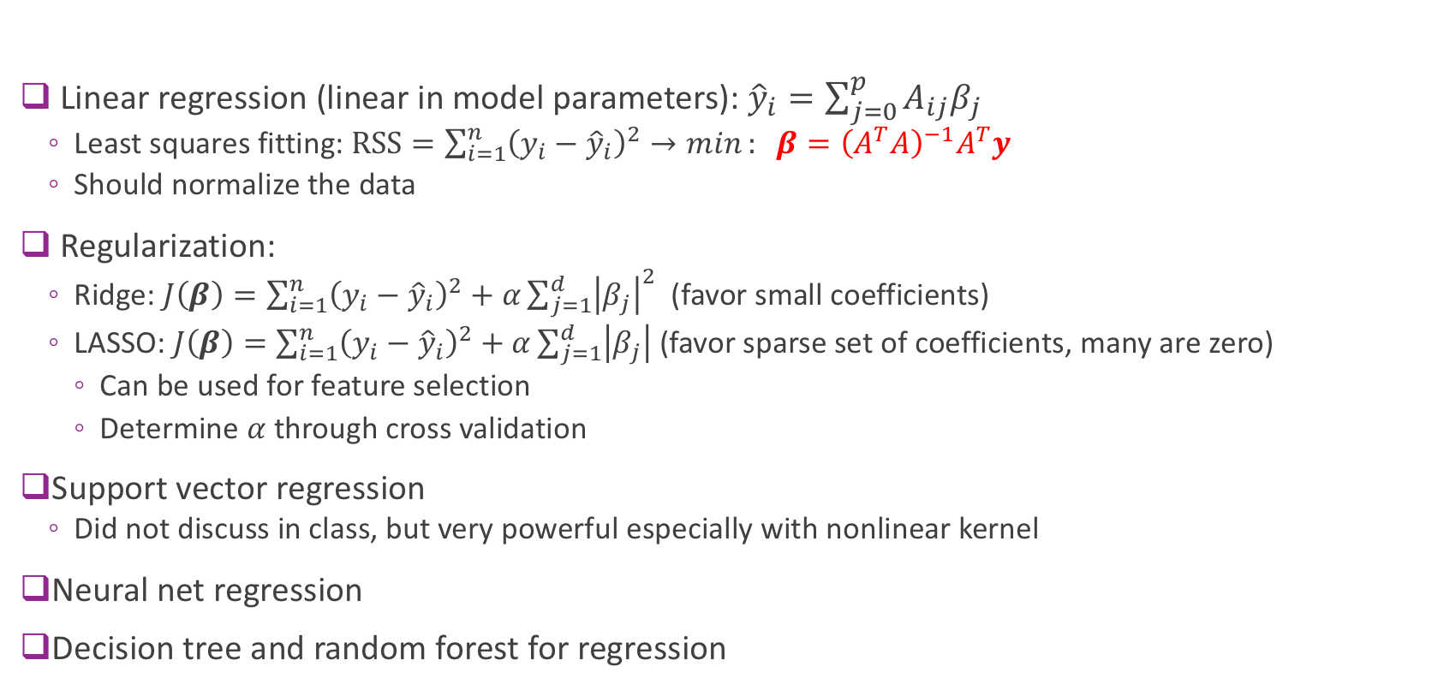
Regression methods
Linear regression (linear in model parameters): ${\hat{y}}_{i}=\sum_{j=0}^{p}{A_{ij}β_{j}}$
Least squares fitting: $\text{RSS}=\sum_{i=1}^{n}{{\left(y_{i}−{\hat{y}}_{i}\right)}^{2}→min}: β={\left(A^{T}A\right)}^{−1}A^{T}y$
Should normalize the data
Regularization:
Ridge: $J\left(β\right)=\sum_{i=1}^{n}{{\left(y_{i}−{\hat{y}}_{i}\right)}^{2}}+α\sum_{j=1}^{d}{{\left|β_{j}\right|}^{2}}$(favor small coefficients)
LASSO: $J\left(β\right)=\sum_{i=1}^{n}{{\left(y_{i}−{\hat{y}}_{i}\right)}^{2}}+α\sum_{j=1}^{d}{\left|β_{j}\right|}$ (favor sparse set of coefficients, many are zero)
Can be used for feature selection
Determine $α$ through cross validation
Support vector regression
Did not discuss in class, but very powerful especially with nonlinear kernel
Neural net regression
Decision tree and random forest for regression

Slide 5
Classification methods
Logistic regression
Support vector classifier
Neural net: fully connected
Neural net: convolution layers + fully connected
Decision trees and random forest

Slide 6
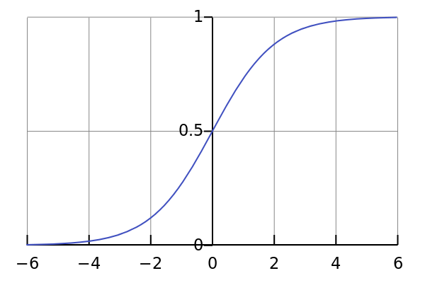
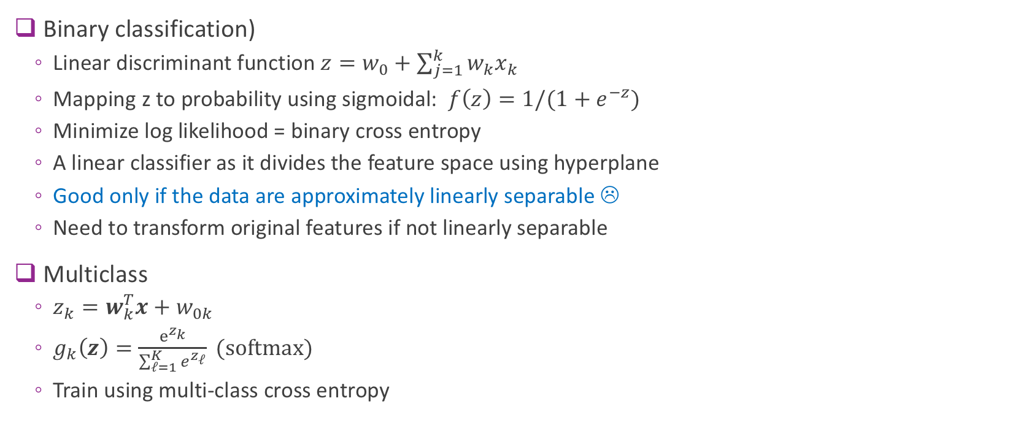
Logistic regression
Binary classification)
Linear discriminant function $z=w_{0}+\sum_{j=1}^{k}{{w_{k}x}_{k}}$
Mapping z to probability using sigmoidal: $f\left(z\right)=1/(1+e^{−z})$
Minimize log likelihood = binary cross entropy
A linear classifier as it divides the feature space using hyperplane
Good only if the data are approximately linearly separable ☹
Need to transform original features if not linearly separable
Multiclass
$z_{k}=w_{k}^{T}x+w_{0k}$
$g_{k}\left(z\right)=\frac{e^{z_{k}}}{\sum_{ℓ=1}^{K}{e^{z_{ℓ}}}} (softmax)$
Train using multi-class cross entropy

Slide 7

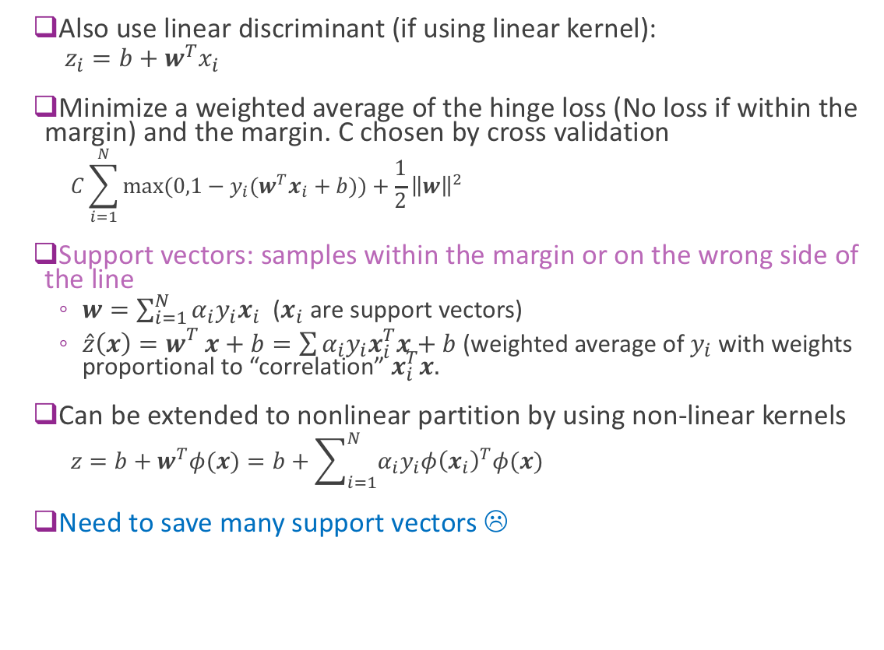



Support vector machine
Also use linear discriminant (if using linear kernel):
$z_{i}=b+w^{T}x_{i}$
Minimize a weighted average of the hinge loss (No loss if within the margin) and the margin. C chosen by cross validation
$$C\sum_{i=1}^{N}{max⁡(0,1−y_{i}(w^{T}x_{i}+b))}+\frac{1}{2}{\left\|w\right\|}^{2}$$
Support vectors: samples within the margin or on the wrong side of the line
$w=\sum_{i=1}^{N}{α_{i}y_{i}x_{i}}$ ($x_{i}$ are support vectors)
${\hat{z}\left(x\right)=w}_{}^{T}x+b=\sum{α_{i}y_{i}x_{i}^{T}x}+b$ (weighted average of $y_{i}$ with weights proportional to “correlation” $x_{i}^{T}x.$
Can be extended to nonlinear partition by using non-linear kernels
$$z=b+w^{T}φ(x)=b+\sum_{i=1}^{N}{α_{i}y_{i}φ{\left(x_{i}\right)}^{T}φ(x)}$$
Need to save many support vectors ☹
Low $C=C_{1}$
$$C_{2}$$
$$C_{3}$$
High $C_{4}$

Slide 8
Neural networks
Stacks of logistic regression layers
Nonlinear mapping after each linear combination is important!
In principle, two layers with sufficient number of hidden nodes can realize any function

Slide 9
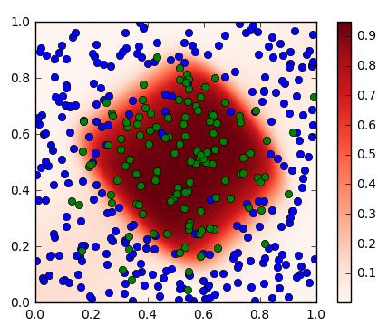
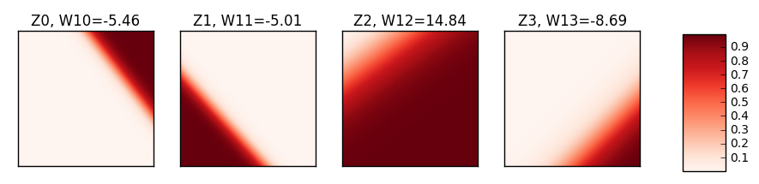


Step 1 Outputs and Step 2 Outputs
$$x_{1}$$
$$x_{0}$$
Each output from step 1 is from a linear classifier with soft decision (Logistic regression)
Final output is a weighted average of step 1 outputs using the weights indicated on top of the figures

Slide 10
Training a neural net
Minimize either RSS (for regression) or cross entropy (for classification) plus some regularization term
Optimize parameters using gradient descent: Chain rule -> error backpropagation
Stochastic gradient descent
Batches, epochs
Looking at the loss curves (training and validation) to determine when to stop
Using Keras
Step 1. Describe model architecture
Number of hidden units, output units, activations, …
Step 2. Select an optimizer
Step 3. Select a loss function and compile the model
Step 4. Fit the model
Step 5. Test / use the model
Need to know how to organize your data and labels in tensors

Slide 11
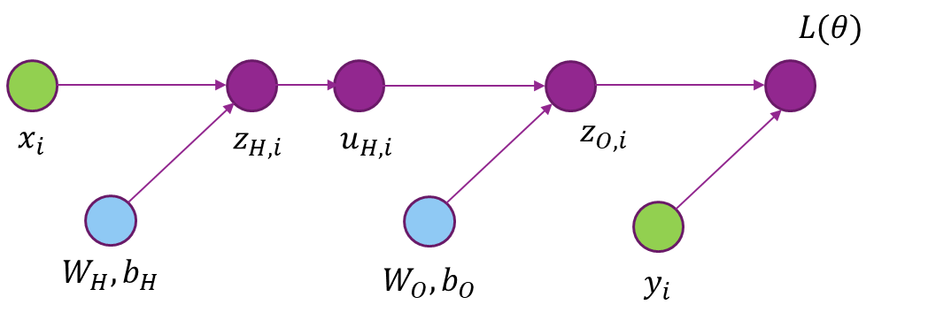
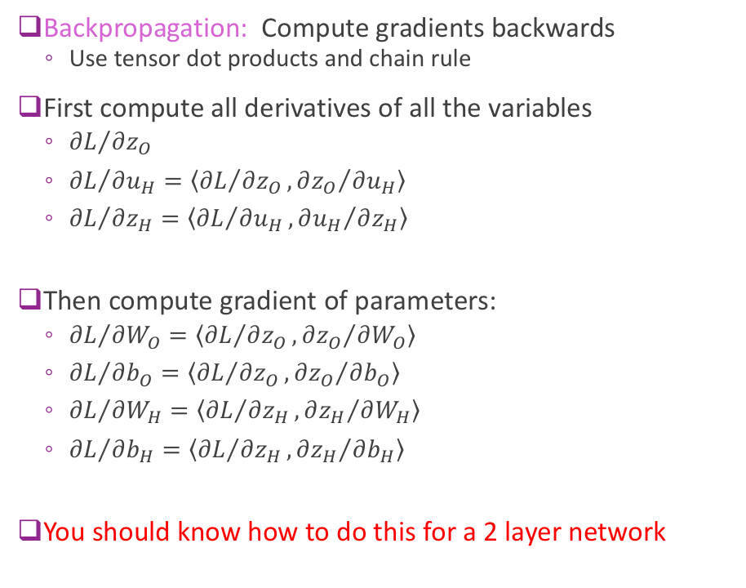
Gradients on a Computation Graph
Backpropagation: Compute gradients backwards
Use tensor dot products and chain rule
First compute all derivatives of all the variables
${∂L}/{∂z_{O}}$
${∂L}/{∂u_{H}}=\left\langle {∂L}/{∂z_{O}},{∂z_{O}}/{∂u_{H}}\right\rangle$
${∂L}/{∂z_{H}}=\left\langle {∂L}/{∂u_{H}},{∂u_{H}}/{∂z_{H}}\right\rangle$
Then compute gradient of parameters:
${∂L}/{∂W_{O}}=\left\langle {∂L}/{∂z_{O}},{∂z_{O}}/{∂W_{O}}\right\rangle$
${∂L}/{∂b_{O}}=\left\langle {∂L}/{∂z_{O}},{∂z_{O}}/{∂b_{O}}\right\rangle$
${∂L}/{∂W_{H}}=\left\langle {∂L}/{∂z_{H}},{∂z_{H}}/{∂W_{H}}\right\rangle$
${∂L}/{∂b_{H}}=\left\langle {∂L}/{∂z_{H}},{∂z_{H}}/{∂b_{H}}\right\rangle$
You should know how to do this for a 2 layer network

Slide 12
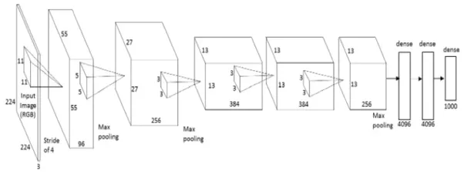
Convolutional neural networks
Restrict the linear weighting to be local kernels sliding over all signal positions (convolution filters)
Appropriate only for input signals for which “neighborhood” is meaningful (spatial or temporal data)
Multiple signals over the same spatial/temporal extent are treated as “channels” and use fully connected weighting across channels – Multichannel convolution
Ex. color signals with 3 channels as input, multiple feature maps in the intermediate layers
Need fully connected layer at the end for a regression or classification task

Slide 13
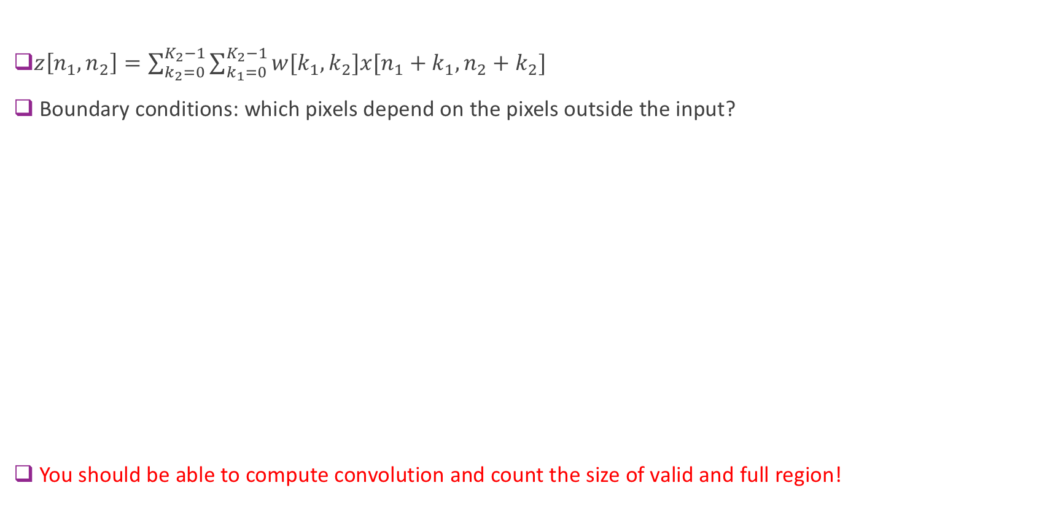
Convolution without reversal
$z\left[n_{1},n_{2}\right]=\sum_{k_{2}=0}^{K_{2}−1}{\sum_{k_{1}=0}^{K_{2}−1}{w[k_{1},k_{2}]x[n_{1}+k_{1},n_{2}+k_{2}]}}$
Boundary conditions: which pixels depend on the pixels outside the input?
You should be able to compute convolution and count the size of valid and full region!

Slide 14
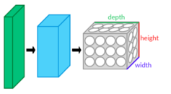
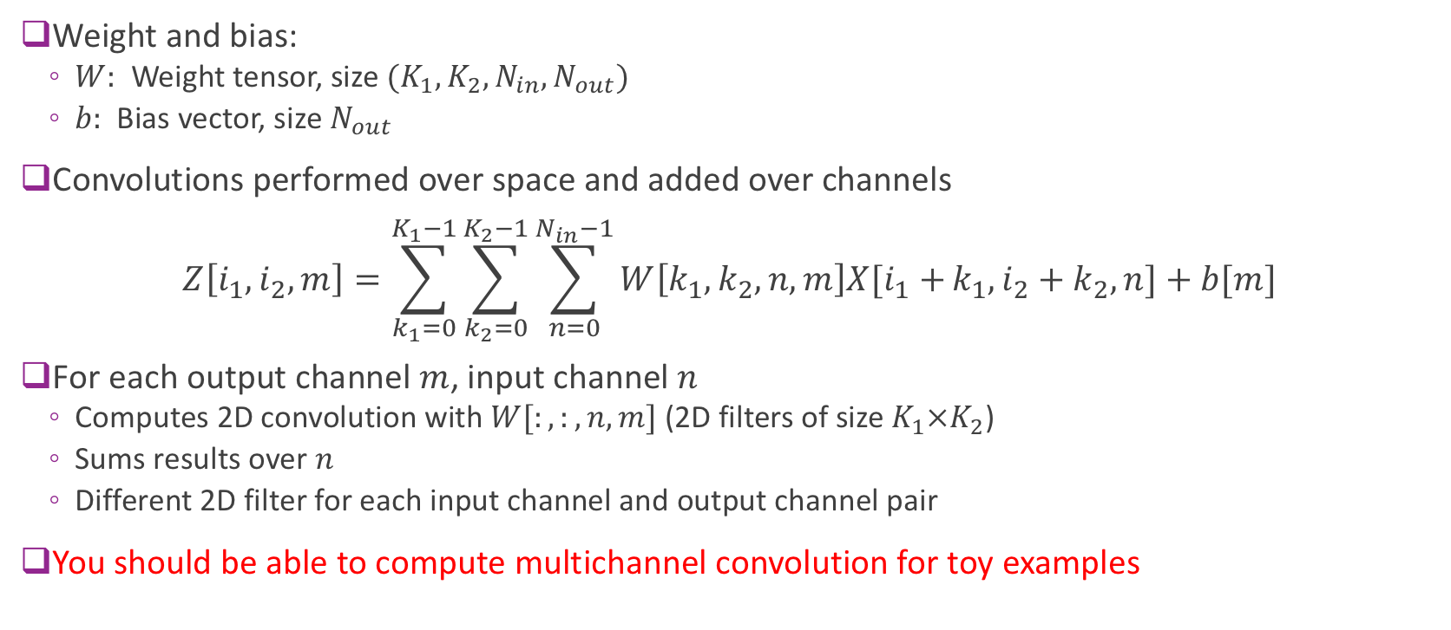
Convolutions with Multiple Channels
Weight and bias:
$W:$ Weight tensor, size $(K_{1},K_{2},N_{in},N_{out})$
$b:$ Bias vector, size $N_{out}$
Convolutions performed over space and added over channels $Z\left[i_{1},i_{2},m\right]=\sum_{k_{1}=0}^{K_{1}−1}{\sum_{k_{2}=0}^{K_{2}−1}{\sum_{n=0}^{N_{in}−1}{W\left[k_{1},k_{2},n,m\right]X[i_{1}+}}}k_{1},i_{2}+k_{2},n]+b[m]$
For each output channel $m$, input channel $n$
Computes 2D convolution with$W[:,:,n,m]$ (2D filters of size ${K_{1}×K}_{2}$)
Sums results over $n$
Different 2D filter for each input channel and output channel pair
You should be able to compute multichannel convolution for toy examples

Slide 15
Deep networks
Many layers: conv + fully connected, 100K+ parameters
You should be able to determine the number of parameters based on a given network structure
Need large training dataset to train
Data augmentation to increase data size
When the input is raw signal, the first few layers learn the feature representation
Regularization is important
Batch normalization
Drop out
L1 norm on weights
L2 or L1 norm on activations (output at intermediate layers)
Transfer learning
Reuse front end layers of a learnt network for a different task

Slide 16
Autoencoders
CNN is not limited to classification/regression
Can be used to map an image to image, speech to speech, or even image to speech
Denoising
Segmentation
Language translation
Image to caption
Encoded features for signal reconstruction can be used to learn features without labels.

Slide 17
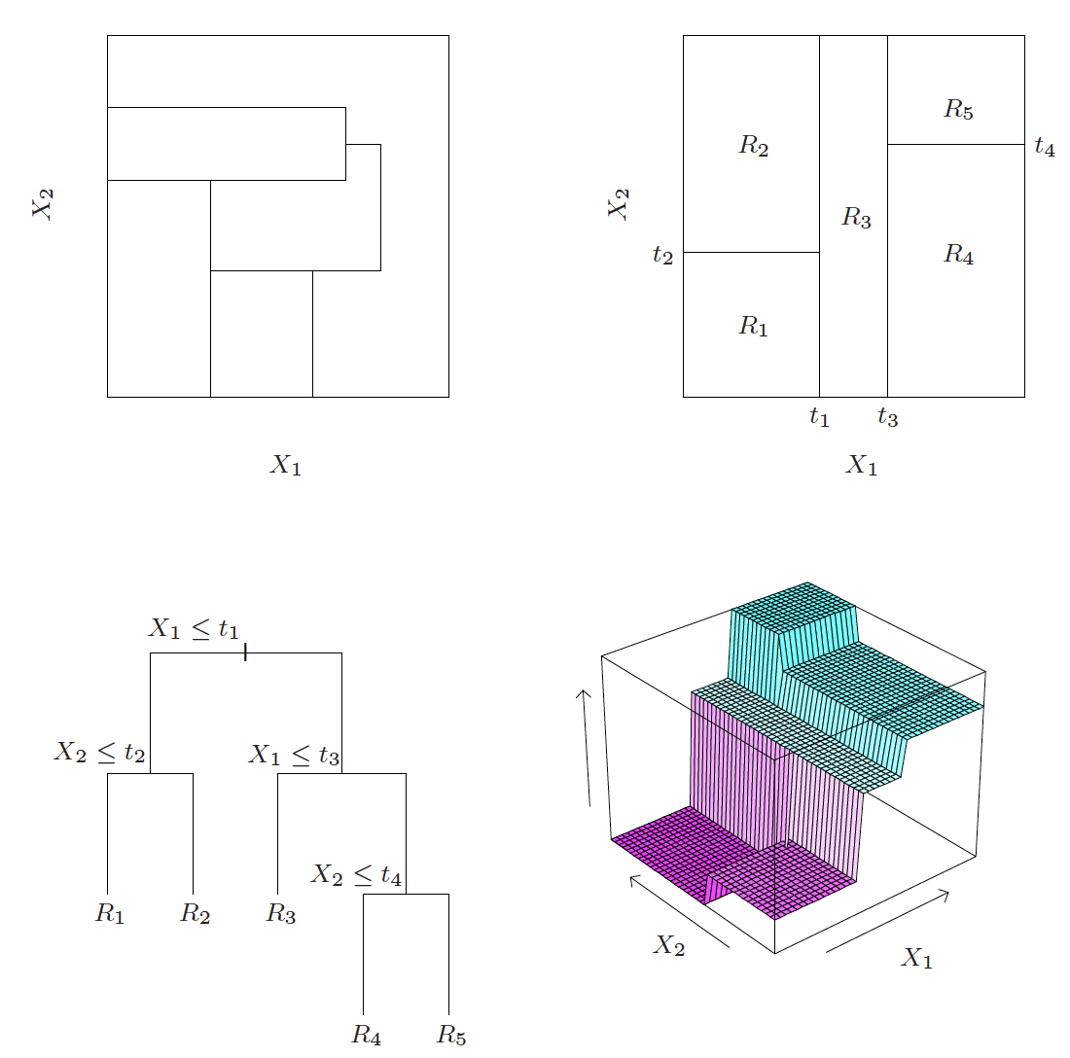
Decision trees
Can reproduce any function (space partitioning) represented by the training data if we do not constrain the leaf node size and tree depth
At each node, choose which feature as the splitting variable and the threshold to maximize loss reduction for the current node
Overcome overfit by
pruning.
using multiple trees! (Bagging)
Random forest: generating multiple independent trees
Can generate feature ranking based on the loss reduction by these features ☺
A single tree or a few trees is easy to interprete! and important for adoption!

Slide 18
Unsupervised learning --- Clustering
Very important for understanding data without manual labels
Do all patients with a certain disease fall into some “unknown” sub-categories (so that a targeted treatments can be developed for each)
Underlying assumption:
Samples are similar within the same cluster, and different among different clusters
Similarity is captured by a chosen distance metric over a chosen feature space
Clustering performance is as good (or bad) as the features used!
K-means and EM-GMM can lead to meaningful clusters only when the clusters are separable in the feature space chosen and the number of clusters is known
Unsupervised feature learning (e.g. autoencoders, spectral embedding) can be used to learn the features

Slide 19
K-means and GMM clustering
K-means: Represent each cluster by its mean (centroid), assign a sample to the nearest centroid
GMM: Represent each cluster by its mean and covariance matrix and prior probability, assign a sample by computing the posterior probability (soft assignment)
Clusters are determined iteratively (EM algorithm)
E-step: Determine cluster assignment (nearest neighbor in K-means)
M-step: Determine cluster parameters (centroid update in K-means)
Greedy algorithm: Sensitive to initial solution

Slide 20
What features to use?
Given many hand-crafted features, how to select the useful features?
Ideally, try all combination of subsets of features (may not be feasible)
Applying L1 norm on weights as a regularization term (applicable to linear regression, logistic regression, Neural net)
Using decision tree / random forest to generate feature ranking
Forward/backward feature selection
Feature dimension reduction by PCA
Using PCA on original features, use PCA coefficients with higher variances
Mathematically sound, but does not “select” among all original features
Useful for both supervised and unsupervised problems!
Feature learning using deep networks
Applicable when you have raw data and very large datasets
Can train the network end-to-end for a classification/regression task
Can use auto-encoder structure just for feature learning
Other feature learning methods
Spectral embedding

Slide 21
Principle component analysis
Decompose a raw signal (vector) as a weighted sum of some principle components (basis vectors)
Determine the principle components to maximize the variances captured
Eigenvectors of the covariance matrix of the signals
Unsupervised: does not need to know “labels” for the given sample vectors
Properties of PCs
Orthonormal to each other
Energy preservation
Energy compaction
PCA is powerful for feature dimension reduction because it decorrelates original features and concentrate the total energy to a few coefficients
Often used as the first step to convert raw features to reduced/normalized features for classical regressors/classifiers/clustering

Slide 22
So, which method should I use?
Sadly, no simple answer
Given a problem, rule out the unsuitable methods
Regression? Classification? Clustering?
Available amount of data with ground truth label, known or unknown features, is feature selection necessary?
Visualize the data! (Are data linearly separable or at least form some clusters?)
When you have limited data and plausible features: Ideally try out all plausible methods, each one with optimized parameters and feature subset through cross validation
When you have lots of data:
Convnets with many conv layers if your input signal has spatial/temporal structures
Neuralnets with a few dense layers otherwise
Simply divide the data into a training and testing set
Data preprocessing (Very important!):
Data imputation (filling in missing entries), hot encoding for categorical features, data normalization and whitening
Big open challenge – How to do machine learning with limited data!

