Slide 1
TOPIC : TOTOLOGY
Name: Sadia Sharmin Ani
Id no: 11703013
Dept: Public Adminastration
10th Batch
Comilla University

Slide 2





Topology provides different configurations that are used to create a network
Topology is a pattern of computers devices and describe the way in which these devices are connected
Topology can be physical or logical Different types of topologies are
Single node
,Star,Bus,Ring, Mesh,Treeand Hybrid

Slide 3
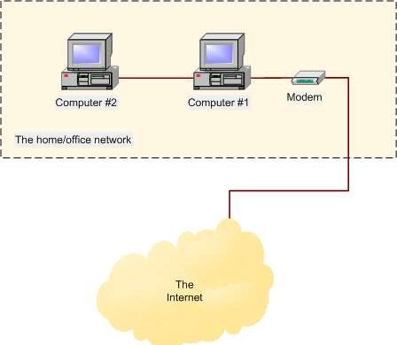
In a single node topology the server or host having all the information for the network

Slide 4

In bus topology, devices share a common cable to send and receive data.
Server is connected at one end of the backbone cable and other devices are connected at different positions along the cable known as trunk
Data is sent to all devices along the cable as the message arrives at each device ,it checks the destination address, encoded in the message.
If the adders matches if accepts data. if not match device ignores the data

Slide 5
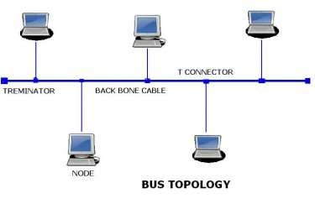


of bus topology:
Easy to connect a device
Requires less cable
Work better for smaller networks
of bus topology:
Entries network gets affected if t
break in the main cable
Difficult to detect the fault device
Heavy traffic and additional of devices degrades the performance
here is a

Slide 6

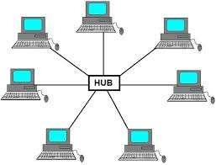
Multiple devices are connected to a central connection point known as hub or switch.
Using copper or fiber optic cables devices are attached to the hub

Slide 7
Advantages and Disadvantages of star topology
Easy to install, configure and manage
Increased devices causes traffic which
makes the network slow
Easy to detect faulty device
Requires more length than a linear topology
Easier to expand
Had failure leads to network failure
Hud provides a centralized management
More expensive

Slide 8

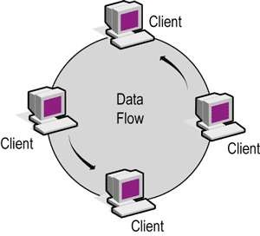
Each device is connected to adjacent devices forming a circle
Data flow only in one direction ,clock or anti clock wise direction
Each device is act as a repeater. it amplifies the signal transmission and transmits it to the next device

Slide 9

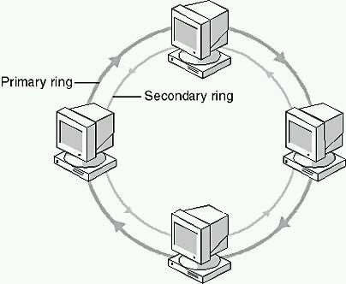
Dual ring topology consists of two concentric rings primary and secondary
Primary ring carries data in one direction whereas secondary ring carries data in opposite direction
Secondary ring is used if primary ring stops working

Slide 10
Advantages and Disadvantages of Ring topology
Easier to manage as compared to bus network | More cable wires compared to bus topology are required
Handle a large volume of traffic | One faulty device effect entire network
Provides a good communication over a long distance | Addition and charges of devices can effect the network

Slide 11

◻ Each device is connected to each and every node in the network with redundant interconnections at least two paths to and form every node.
Two types of mesh topologies 1.Fullmesh
2.Partial mesh
in full mesh topology each device is connected directly to each other.
In partial mesh topology some of the devices are connected to all the others

Slide 12
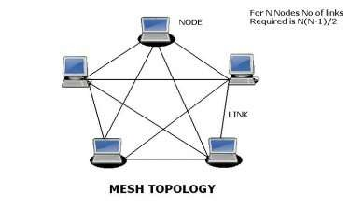
Advantages and disadvantages of mesh topology
Provides redundant paths which help in sending data using an alternate path if a specific path fails to send data | More cabling is required as compared to bus, star and ring topologies
Entire network does not get affected by one faulty device | Each link from one device to another requires an individual nic
Centralized management is not requires as in star topology | Very expensive as compared to bus, star and ring topologies
Easy to detect the faulty device | Difficult to reconfigure

Slide 13

A tree topology combines the characteristics of linear bus and star topology.
Group of star networks are connected to the linear bus backbone
Twisted pair cable is commonly used by tree topology Multiple such hub devices which are connected directly
to a tree bus

Slide 14
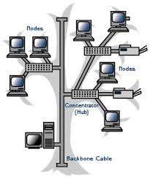
Advantages and Disadvantages of tree topology
 | Point to point wiring for each device | More difficult to configure as compared to other topologies
 | Easy to detect a fault device | Fault in the backbone affects the entire network
 | Easy to expand a network | More expensive than other topologies

Slide 15

Hybrid topology is a combination of different network topologies
The commonly used combination of topologies is star bus or star ring
It has the ability to identify non operating devices and maintain the structure of the network bus or star ring

Slide 16
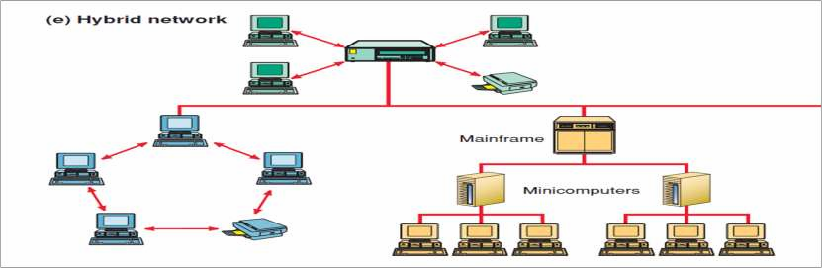
Advantages and Disadvantages of hybrid topology
Useful for implementing larger network | More cabling is required as compared to all other topologies
Handles larger volume of traffic | Mau( Multistation access unit) is required
Easy to detect and remove faulty devices | Installation and reconfiguration is difficult

