Slide 1
Fix Race Condition in lis-gcr-order-inf-svc when Processing LOE_MESSAGE_QUEUE in Sender for Sending Messages to GCRS (LIS-10672) (lis-gcr-order-inf-svc)
CP3
5th Jun 2026
1

Slide 2
Agenda
Background
Design Review

Slide 3
Background
Same LOE_MESSAGE_QUEUE is processed by multiple transactions during high loading
Common Scheduler is triggered per 30 seconds
1st Transaction starts
Retrieve OUTSTANDING messages again after finishing batches
process more than 30 seconds due to high loading
2nd Transaction starts
Pick up the same OUTSTANDING message with 1st Transaction
Same message is sent to GCRS repeated
Status is updated to SUCCESS and then FAILED as a result

Slide 4
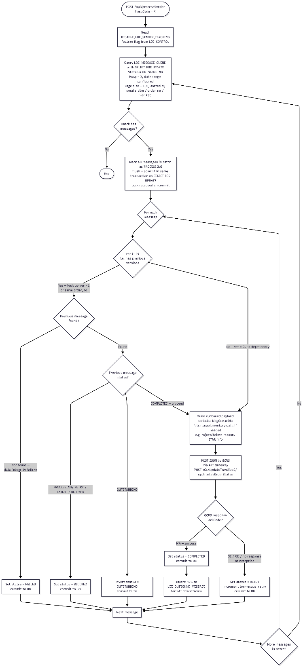
Message Processing Mechanism
Retrieve OUTSTANDING, RETRY messages
Send Hosp = <Input Param from lis-common-scheuduler>
Date Range = 1 month (Configurable)
Page Size = 100 (Configurable)
Sort by Create Date Time, Order No., Version No.
Pessimistic Locking
Update status to PROCESSING
Commit to database

Slide 5
Message Processing Mechanism
Check previous version messages (if exists)
Any PROCESSING, RETRY, FAILED, BLOCKED
Update to BLOCKED if exists
Prepare JSON message from LOE_MESSAGE_QUEUE
Send message to GCRS
Update LOE_MESSAGE_QUEUE
Update status to COMPLETED if success response
Update status to RETRY / FAILED if failure response
Further retrieve OUTSTANDING messages

Slide 6
Q&A

