Slide 1
UNIVERSITI TEKNOLOGI MALAYSIA
Thesis Presentation
Fake News Detection Using Machine Learning
Name : Abdullahi Abdirizak Adam (MCS231037)
Supervisor : Prof.Madya Dr.Mohd Shahizan Othman
FACULTY OF COMPUTING, UNIVERSITI TEKNOLOGI MALAYSIA

Slide 2
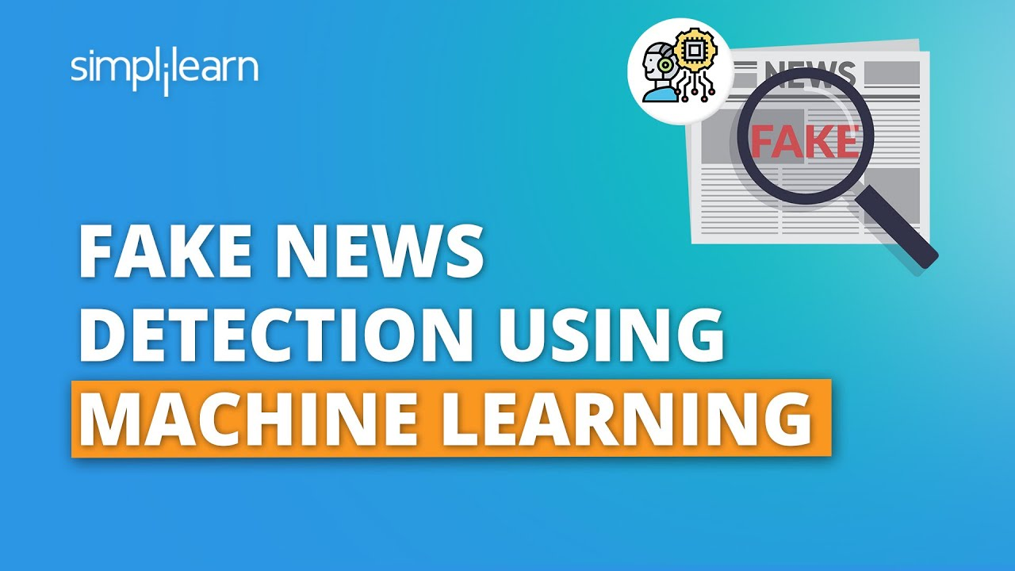
PRESENTATION CONTENTS
1
RESEARCH INTRODUCTION
2
Literature Review
3
Methodology
4
INITIAL RESULTS

Slide 3
RESEARCH INTRODUCTION

Slide 4
INTRODUCTION
Problem Background:
Research Problem:
Fake news undermines trust, disinforms the public, and affects societal decisions. Current detection methods are manual and unscalable.
Existing detection approaches lack scalability, flexibility, and accuracy, necessitating machine learning-based solutions.
Objectives:
Research Questions:
How can textual content distinguish fake news?
Which ML algorithms are most effective?
How can detection systems achieve scalability and real-time processing?
Develop preprocessing techniques for fake news datasets.
Implement an LSTM-based classification model.
Evaluate performance based on accuracy, precision, and recall.

Slide 5
LITERATURE REVIEW

Slide 6
LITERATURE REVIEW
Key Theories:
Use of NLP techniques (e.g., tokenization, GloVe embeddings) and LSTM for long-term dependency learning.
Previous Studies:
Accuracy rates of models like Naïve Bayes (95%) and SVM (94.93%). LSTM outperforms traditional methods.
Research Gap:
Need for scalable, accurate models leveraging advanced NLP and deep learning techniques.

Slide 7
RESEARCH METHODOLOGY

Slide 8
RESEARCH METHODOLGY
Data Sources:
Kaggle datasets of fake and real news.
Analysis Methods:
Preprocessing (e.g., tokenization, lemmatization), GloVe embeddings, and LSTM architecture.
Variables:
Word count, character count, sentiment scores, and linguistic patterns.

Slide 9
INITIAL FINDINGS

Slide 10
INITIAL FINDINGS
Visuals:
Confusion matrix heatmap.
Word clouds for fake and real news categories.
Key Insights:
LSTM achieved higher precision and recall compared to traditional ML models.
Clear distinction in textual patterns between fake and real news.

Slide 11
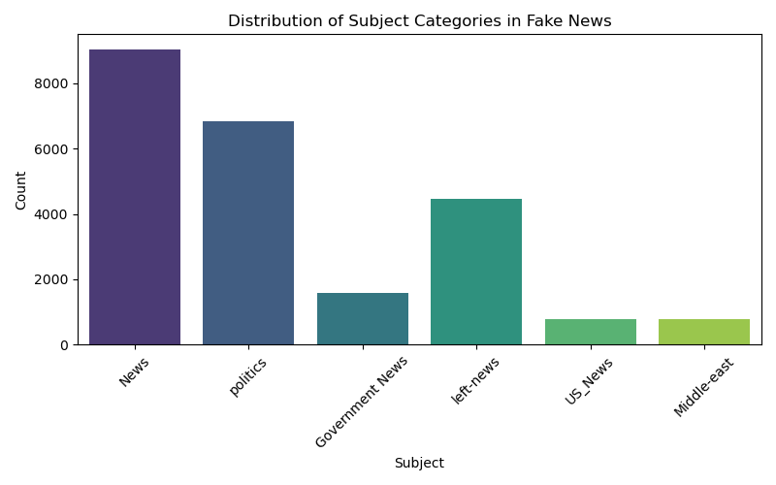
This Figure visualizes the distribution of subject categories in the fake news dataset. It shows the count of different categories represented in the dataset. This plot is helpful for understanding the balance (or imbalance) in the data, which can be important for machine learning models

Slide 12
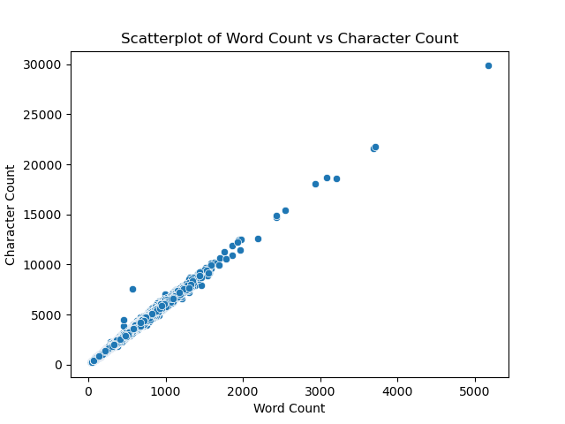
This Figure visualizes the relationship between the number of words and the number of characters in each article of the real news dataset. Each point represents an individual news article, with its position determined by its word count and character count. This scatterplot is helpful for understanding the distribution of article lengths and identifying any patterns or anomalies in text length.

Slide 13
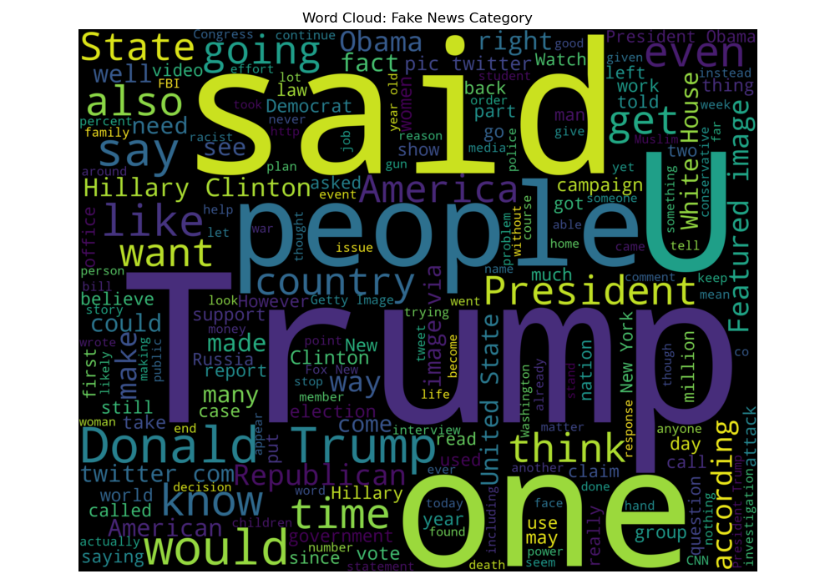
This Figure shows for the fake news category highlights the most frequent terms within the fake news dataset, with larger words indicating higher frequency. This visualization is particularly useful for uncovering the most prominent themes and topics present in the articles classified as fake news.

Slide 14
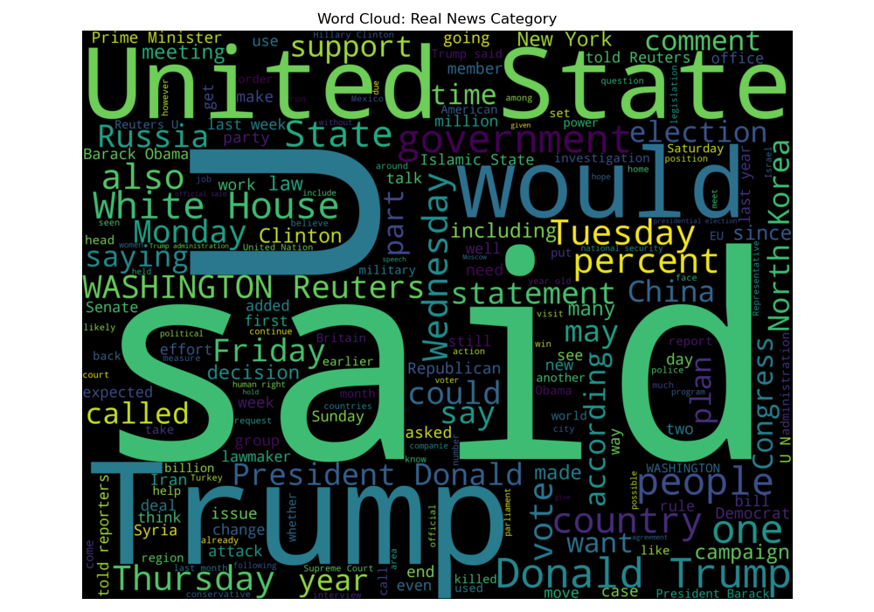
This Figure shows for the real news category illustrates the most frequent terms within real news articles. Just like the fake news word cloud, it visualizes key topics or recurring words, helping to distinguish the language and themes present in authentic news coverage.

Slide 15
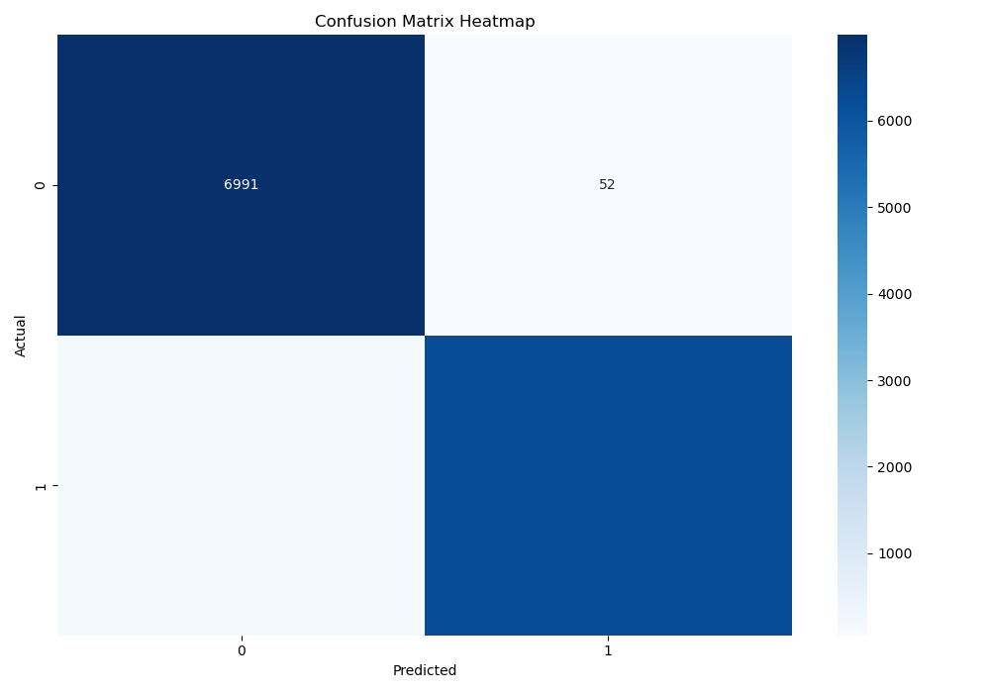
This Figure is the powerful tool for evaluating the classification performance of the binary classification model, which distinguishes between fake and real news. This matrix is used to visualize the results of model predictions by showing the counts of true positives (correctly predicted fake news), true negatives (correctly predicted real news), false positives (real news incorrectly predicted as fake), and false negatives (fake news incorrectly predicted as real).

Slide 16
Discussion, Conclusion and Future Works

Slide 17
Discussion
Interpretation:
The LSTM model effectively captured linguistic nuances of fake news.
Implications:
Enhances automated detection in real-time, aiding digital platforms.
Comparison:
Outperformed traditional models in accuracy and scalability.

Slide 18
Conclusion
Summary:
Preprocessing, feature engineering, and LSTM modeling achieved robust fake news detection.
Contributions:
Combines advanced NLP and ML for societal impact and academic value.
Recommendations:
Future work should explore multilingual datasets and explainable AI.

Slide 19
Future Works
Limitations:
Focused only on English-language datasets.
Excluded multimedia content.
Next Steps:
Expand to multilingual datasets.
Incorporate explainable AI frameworks.

Slide 20
YouTube video link
https://youtu.be/DSk6SgIkVOE

Slide 21


