Slide 1
Started with plotting simple variables

Slide 2
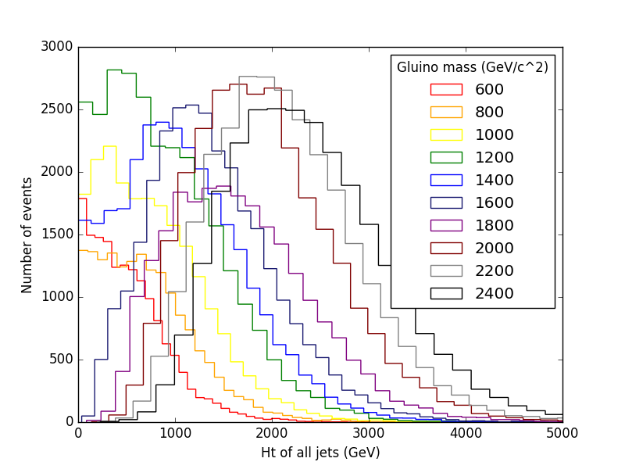
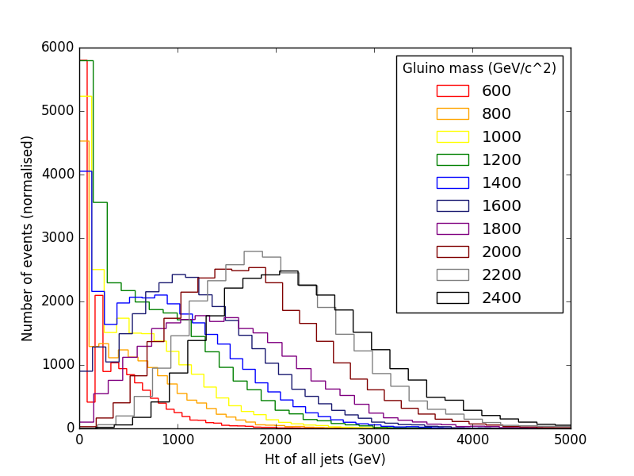
Pt>30Gev/c, eta<2.4
Pt>150 Gev/c, eta<2.4
Then calced and plotted dynamic variables,like ht, then looked at how they varied with ctau, llp mass.

Slide 3
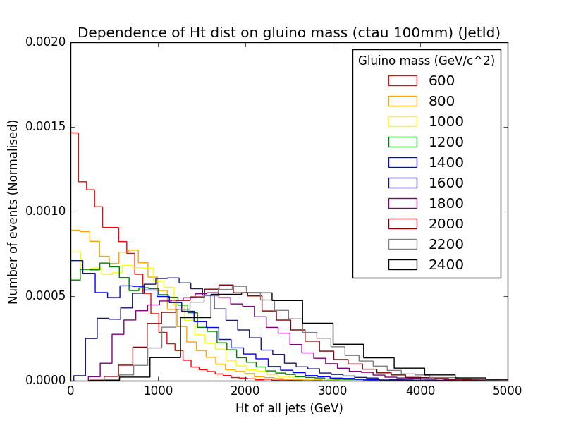
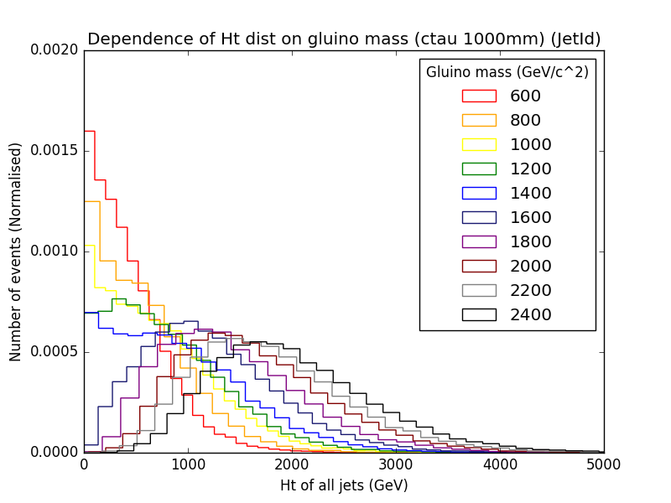
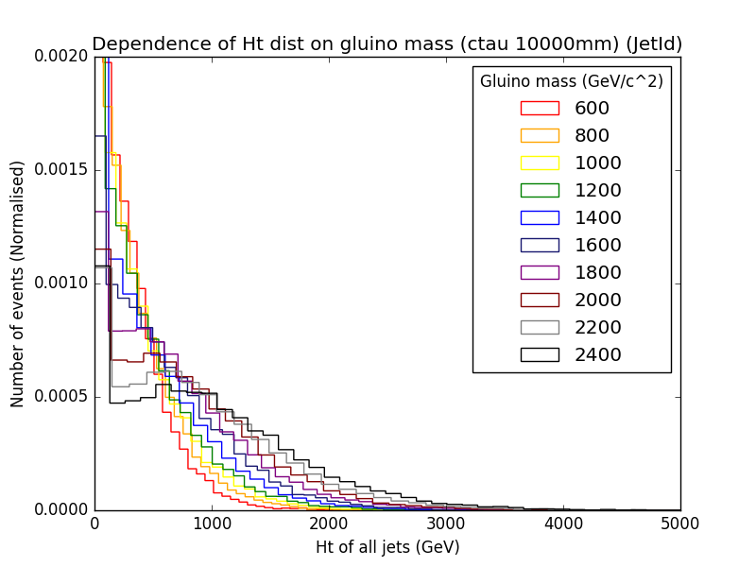
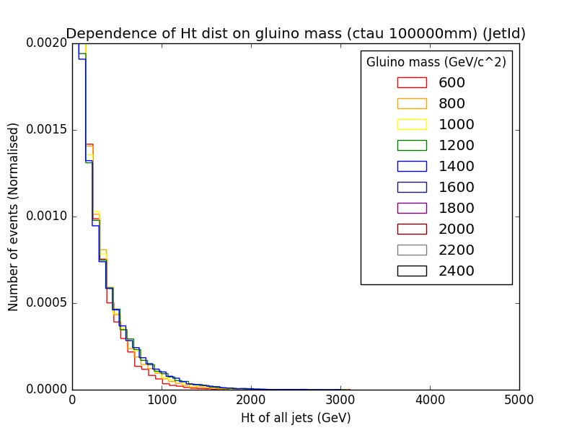
(all pt>30,
eta<2.4)

Slide 4
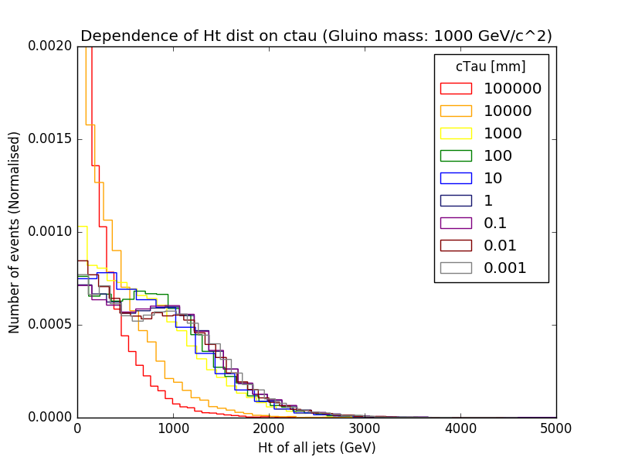
Ht ctau plot at one llp mass

Slide 5
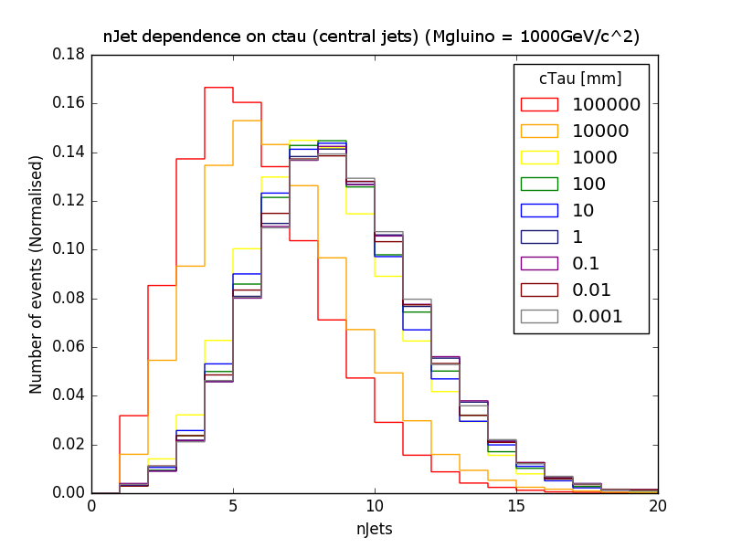
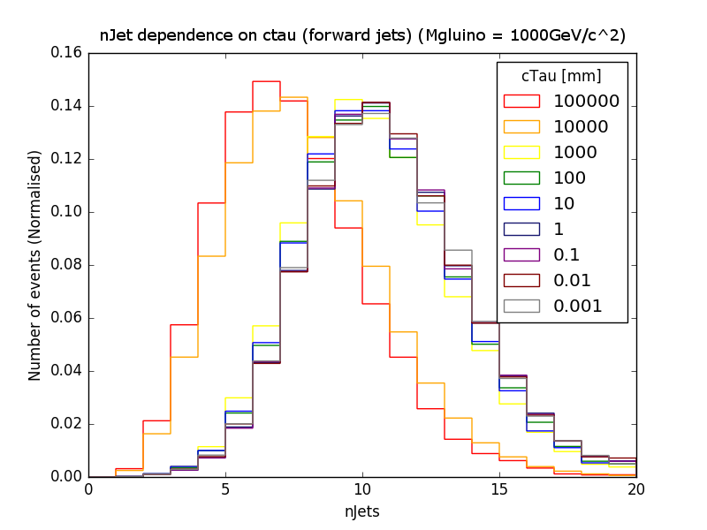
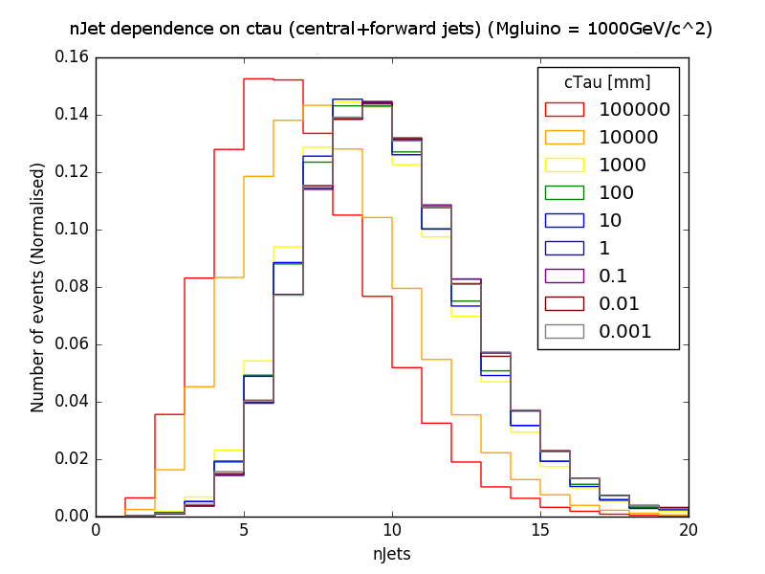
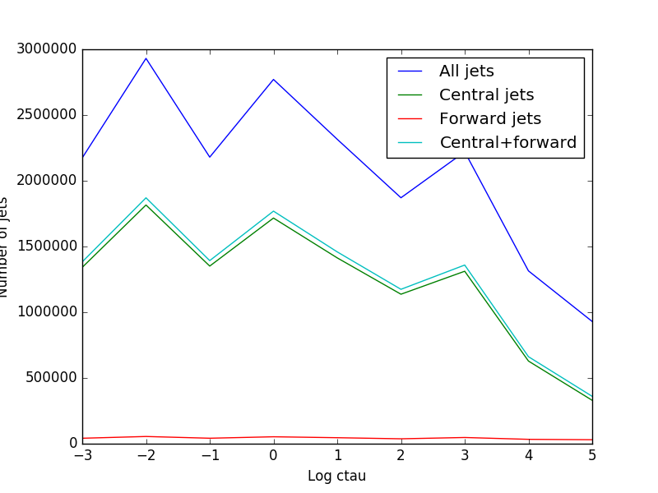
Looked at number of jets and ctau, central/forward etc.

Slide 6
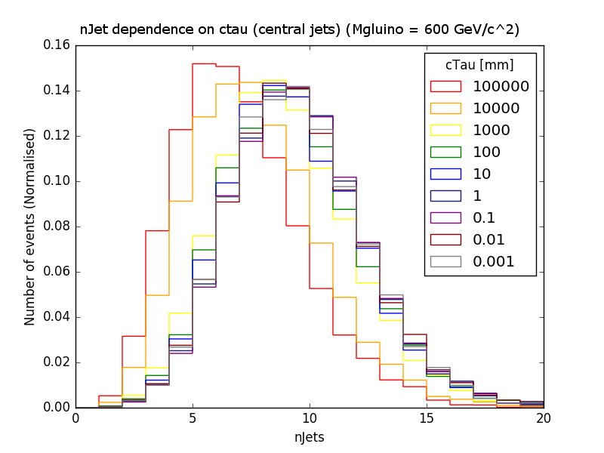

Slide 7
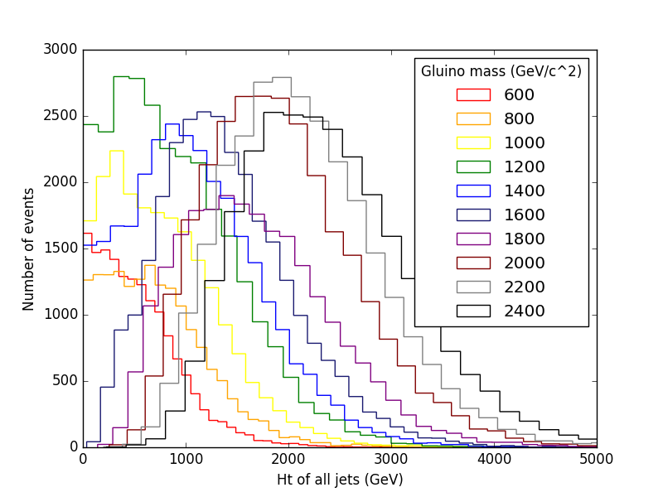
No jetID
jetID
Then looked at jetid, which didn’t seem to be doing much. Comparison plots, number of jets plot.

Slide 8
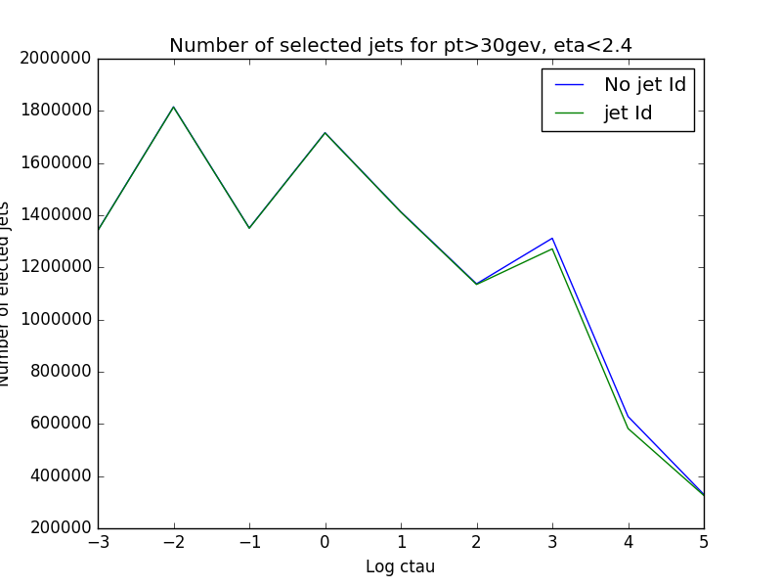
Number of selected jets

Slide 9
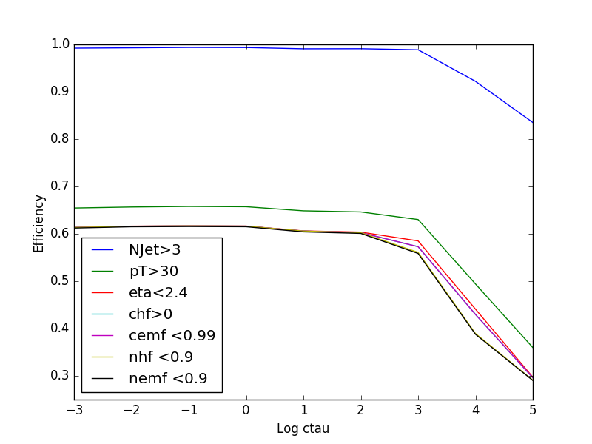
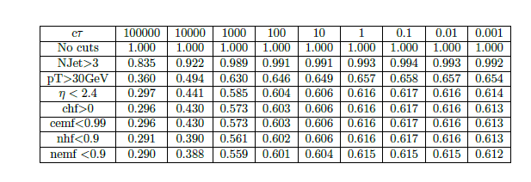
Looked at efficiencies of some of the cuts, combined into cutflow
150
Cuts are applied
cumulatively
150 GeV

Slide 10
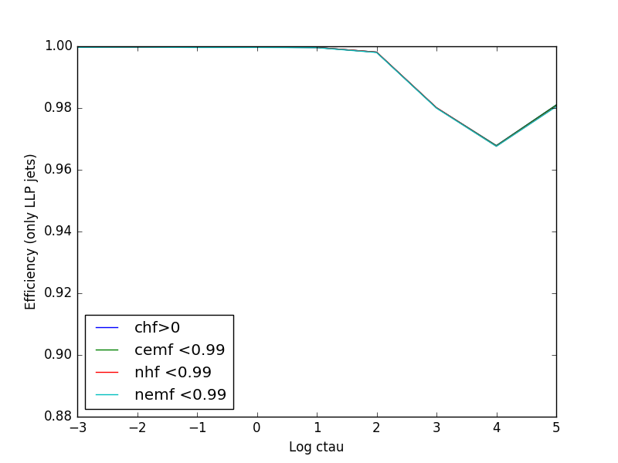
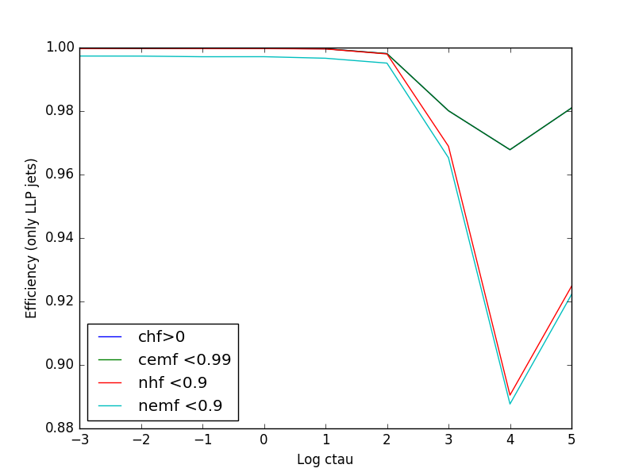
Tight JetId
Loose JetId
Both cut at pt > 30Gev/c, eta<2.4

Slide 11
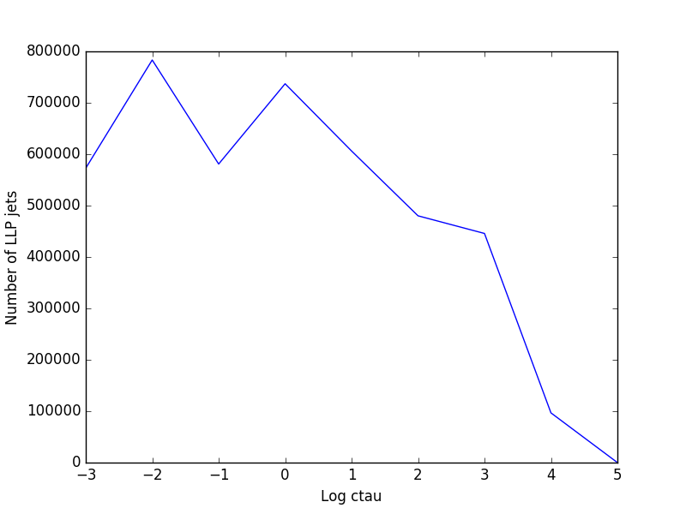

Jet numbers: 572800, 783310, 580895, 737073, 606250, 480134, 445799, 96768, 117

Slide 12
Looked at the gluino jets, first iding by invariant mass. Checked the same mass thing. Then id’d by most similar invariant masses.

