Slide 1


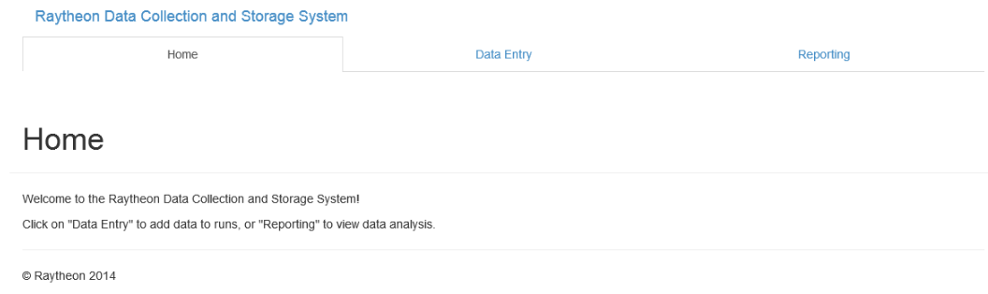
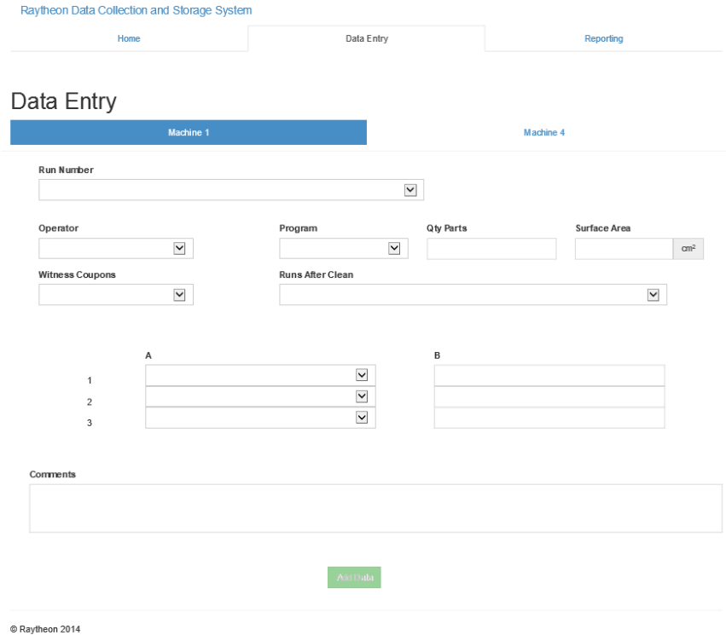
Raytheon
Coating Team Data Collection
List of authors
Corey Hall, cjh092020@utdallas.edu, Zachary Barnes, zxb110130@utdallas.edu, Gwendolynn Eskridge, gce090020@utdallas.edu
CS 4485.001
Department of Computer Science
Erik Jonsson School of Engineering & Computer Science
University of Texas at Dallas
Richardson, Texas 75083-0688, U.S.A.
Abstract
Results
The main purpose of this project was to replace Raytheon’s existing data collection system. The old data collection system wasn’t automated and required a lot of maintenance attention. Our project is easier to use, and allows the coating team to manually enter required data at their own convenience, opposed to requiring data entry at run-time.
Architecture
Our project consists of a “Windows Service” that automatically collects data files from a specified location. These data files will get processed by 1 of 4 data parsers depending on the location of the file and/or the file type. Certain parameters are collected from the data and saved in a SQL database, where our web-app allows the user to view the data collected as well as enter any necessary manual data.
Impact
Summary
This project is built for very specific requirements given by Raytheon. After this project is delivered, it will be used by Raytheon exclusively. Maintenance on our project should be very minimal, and will be long lasting. We hope that it will make the coating team’s data collection process much more efficient than it was before, allowing them to be more productive in the work place.
This project required knowledge in many different fields of development. The requirements were very specific in order to comply with the machines that are outputting the data, but we believe that we delivered exactly what Raytheon wanted: An easily maintainable project that will save time and money in the long run.

