Slide 1

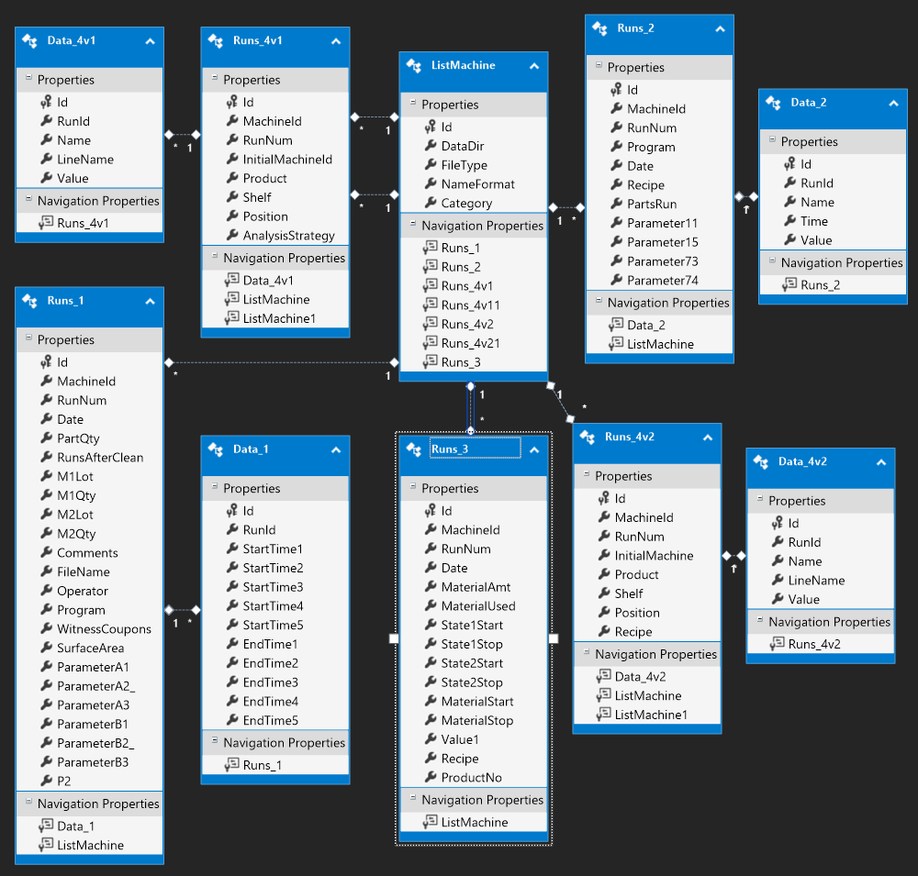
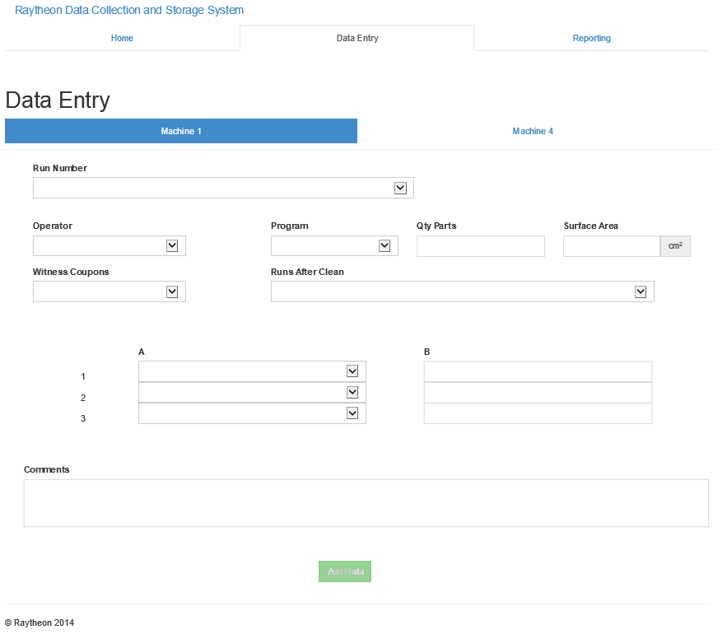
Raytheon Coating Team Data Collection
Zachary Barnes, Corey Hall, Gwendolynn Eskridge
Goal: Develop a parser to store machine output to a database
Approach:
Create a windows service using .Net to read files on creation.
parse files given rules from Raytheon
Store the resulting values in a database
Create a web app for manual data entry

