Slide 1


Vectors and Arrays
By Jimmy Le
Email: jimmyle2008@gmail.com

Slide 2


Table of Contents
Lesson 1: Generating Vectors
Lesson 2: Element-by-Element Operations
Lesson 3: Using Built- In Functions For Vectors
Lesson 4: Indexing, Assigning, and Removing Vector Elements
Lesson 5: Logical Operations
Lesson 6: Generating Arrays
Lesson 7: Using Built-In Functions with Arrays
Lesson 8: Indexing, Assigning and Removing Array Elements

Slide 3
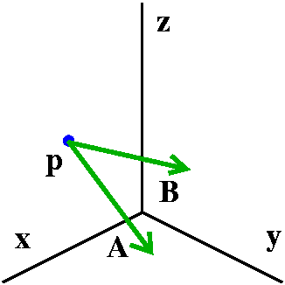
Vectors and Arrays Lesson 1: Generating Vectors
By Jimmy Le
Email:jimmyle2008@gmail.com

Slide 4
3 Main Ways to Generate Vectors
Direct Entry
Technique: Enter in sequence numbers enclosed by square brackets
Technique: Enter in format:
<start> :<step>:<end>
<start> - enter number you want to start with
<steps> - how much you want to increment by
<end> - how much should it increment up to
*End number is NOT always included
Colon Operator
Technique: Enter in format :
linspace(<start>, <end><# pts>
<start> - enter number you want to start with
<end> - enter number you want to end with
<# pts> - how many EQUALLY spaced points you would like to have in between start and end points
*End number is ALWAYS included
Linspace

Slide 5



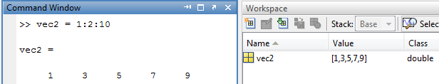

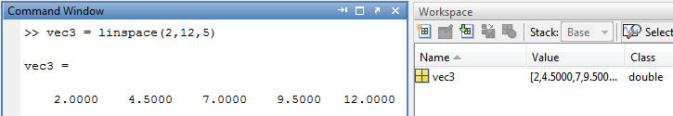
3 Main Ways to Generate Vectors
Direct Entry
Colon Operator
Linspace

Slide 6
Commonly Generated Vectors
COLON OPERATOR
* Remember vectors can by any length
Description of Vector | Colon Format Used | Vector (tested in MATLAB)
Default Step is 1 | 1: 5 *By default step is 1* | [1 2 3 4 5]
Reverse 1:5 | 5: -1 : 1 | [5 4 3 2 1 ]
All Evens b/w 1 and 5 | 1:2:5 | [1 3 5]
All Odds b/w 1 and 5 | 2:2:5 | [2 4 ]
Empty Vector | 5: 2: 1 or 2:-2:5 | Empty matrix: 1-by-0
LINSPACE
5 equally spaced numbers b/w 1 and 5 | linspace(1,5,5)→ 1:5 *same * | [1 2 3 4 5 ]
100 equally spaced numbers b/w 0 and 5 | linspace(1, 5) *By default, number of points is 100 if you don’t specify* | [1.0000 1.0404 1.0808 … 5.0000] *100 points is generated just can’t fit them all*

Slide 7
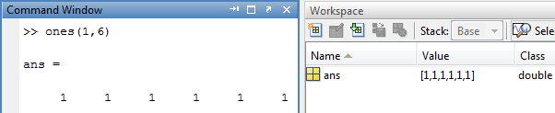
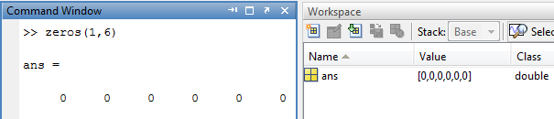
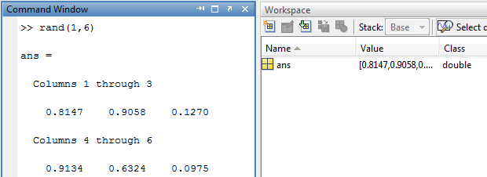
Ones, Zeros, Rand Generators
ones(rows , columns)
generates a row vector of ones
zeros(rows , columns)
generates a row vector of zeros
rand(rows , columns)
generates a row vector of random numbers between 0 and 1
NOTE:
# of rows in a vector is always 1
# of columns in a vector is the # of elements it contains

Slide 8
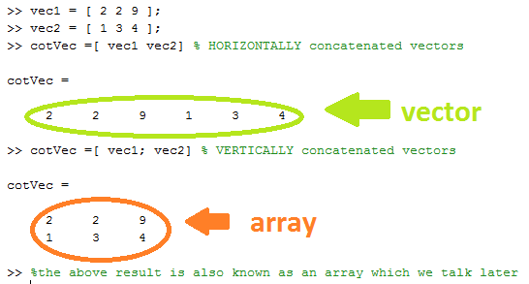
Concatenation
To concatenate two or more vectors together , enclose the two vectors together with square brackets
The length of the vector will be the sum of the lengths of the vectors concatenated together

Slide 9
Checkpoint (1/1)
Will the colon operator always include its start and end points? How about linspace?
Will the command vec = linspace(0,5,5) generate the same vector produced by the command vec = 0:1:5?
Will the command vec = linspace(0,8) generate the same vector produced by the command vec = linspace(0,8,100)?
Will the command vec = 0:40 generate the same vector produced by the command vec = 0:1:40?
Will the command vec = 1: -2: 10 generate the same vector produced by vec = -2: 1 : -4?
CHANGE COLOR FOR ANSWERS
No, Yes
No because linspace will generate equally spaced points between start and end points while colon operator will increment by whatever step specified from start until it reaches the end point or just before the end point
Yes , if you do not specify a third input for number of points, MATLAB will use the 100 points as the default input
Yes , the default number of steps for the colon operator is 1 if not specified
Yes, both will generate empty vectors

Slide 10
Checkpoint (2/2)
Using the colon operator how do you generated this vector [ 5, 10,15,20, 25]?
Will this command generate a vector of all even numbers vec = 2:2:9?
The rand function can only generate random numbers between what two numbers?
Just for Fun : If we both just started up MATLAB, I ran the command vec = rand(1,3) and you the same command, will we get the same result? In other words is the rand function truly random or it pseudo-random?
CHANGE COLOR FOR ANSWERS
5:5:25
Yes
0 and 1
Yes, pseudo-random

Slide 11
Vectors and Arrays Lesson 2: Element-By-Element Operations
By Jimmy Le
Email:jimmyle2008@gmail.com

Slide 12
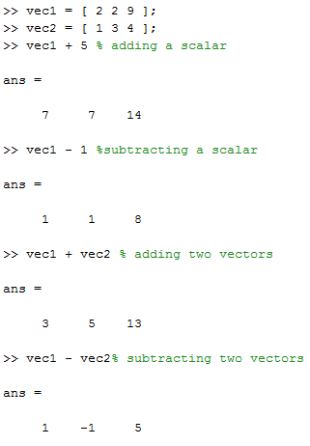
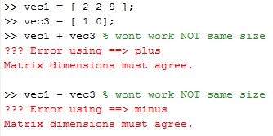
Adding and Subtracting Vectors
Same Size or Scalar
To add or subtract two or more vectors , the vectors have to be the same size
Only exception to the above is if you add or subtract with a scalar (vector of length 1)
Not the Same Size

Slide 13
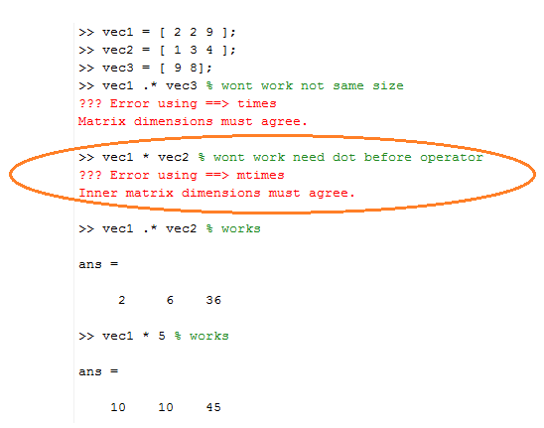
Multiplication, Division, and Exponentiation with Vectors
Multiplying, dividing , and exponentials require:
The two vectors operated on to be the same size or one of them has to be a scalar
A period or dot must be placed before the mathematical operator to indicate element-by-element operations instead of matrix operations
Indicates matrix multiplication instead element-by-element multiplication

Slide 14
Checkpoint (1/1)
When performing element-by-element operations on two vectors what has to be true about one of the vectors ?
What three mathematical operations require a dot or a period before it in order to perform element-by-element operations?
If vec1 = [ 1 3 9 8] , vec2= [ 0 4 8 7] and result = vec1 + vec2. then the value of result in the command window is?
Using the same vectors defined in problem 3, result = vec1 * vec2 in the command window is ?
CHANGE COLOR FOR ANSWERS:
One of the vectors have to be the same length or a scalar ( a 1 x 1 vector)
Multiplication, division, and exponentiation
result >> [1,7,17,15]
??? Error using ==> mtimes Inner matrix dimensions must agree.

Slide 15
Vectors and Arrays Lesson 3: Built-In-Function For Vectors
By Jimmy Le
Email:jimmyle2008@gmail.com

Slide 16
Commonly used Built-In Functions
Function Name | Description *assuming every function takes in a vector as its input* | Example
length(vec) | returns the number of elements it contains | l = length( [ 2, 9, 1] ) l >> 3
size(vec) | returns number of rows of the vector for first output and the number of columns of the vector for second output | [ r c ] = size( [ 2, 9, 1] ) r>> 1 c >> 3
find(vec) | produces a vector of positions | p = find( [ 2 ,9, 1] ) p >> [ 1, 2, 3]
sum(vec) | returns sum of all the elements within the vector | s = sum([ 2 ,9, 1]) s >> 12
mean(vec) | returns mean of all the elements within the vector | m = mean([ 2, 9, 1]) m>> 4
median(vec) | returns median of all elements within the vector | m =median( [2,9,1] ) m >> 2

Slide 17
Commonly used Built-In Functions
Function Name | Description *assuming every function takes in a vector as its input* | Example
min(vec) | returns the minimum value of the vector for the first output and returns the position where the minimum was located as the second output | [m p] = min([ 2 ,9, 1]) m>> 1 p>> 3
max(vec) | returns the maximum value of the vector for the first output and returns the position where the maximum was located as the second output | [m p ] = max([ 2 ,9, 1]) m>> 9 p >> 2
round(vec) | returns each element of the vector rounded conventionally | r = round( [2.1, 9.2 , 1.5] ) r >> [ 2 , 9 , 2]
ceil(vec) | returns each element of the vector rounded up | c = ceil ( [2.1, 9.2 , 1.5] ) c >> [ 3, 10, 2]
floor(vec) | returns each element of the vector rounded down | f = floor( [2.1, 9.2 , 1.5] ) f >> [ 2, 9 ,1]

Slide 18
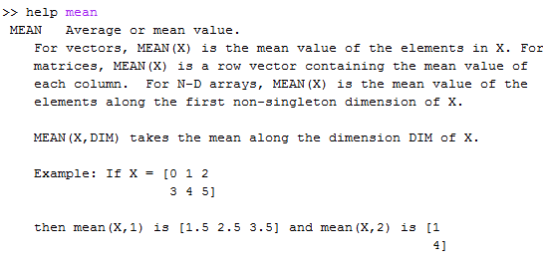
Commonly used Built-In Functions
Function Name | Description *assuming every function takes in a vector as its input* | Example
diff (vec) | returns a vector where 2nd element subtracts 1st element, 3rd subtracts 2nd element and so on | d = diff( [2,9,1] ) d >> [7 ,-8 ]
prod(vec) | Returns product of all the elements with the vector | p = prod( [2,9,1] ) p = 18
sort(vec) | Returns sorted vector element as the first output and the sorted indexes as the second output | [ s i ] = sort( [ 2,9,1]) s >> [ 1,2,9] i >>[3,1,2]
Help
In case you forget what a function does or need help with a function simply type in:
help <function_name>

Slide 19
Checkpoint (1/1)
How many outputs does min and max function have and what are they?
How many outputs does sort have and what are they?
If a vector length is considered to be N long, then the vector length returned by the diff function expressed in terms of N is ?
With the same givens from problem 3, the vector length return by the find function?
Did you know??? For the size function, if you only specify one output to it, how many values do you get for that one output?
CHANGE COLOR FOR ANSWERS:
2 outputs, first output specifies the minimum value in the vector and second output specifies the position the minimum value is located. Maximum function works similarly.
2 outputs, the first output returns the vectors sorted and the second output returns indices sorted
N – 1
N
2 values, first value is the number of rows and second value is number of columns

Slide 20
Vectors and Arrays Lesson 4: Indexing, Assigning, and Removing Vector Elements
By Jimmy Le
Email:jimmyle2008@gmail.com

Slide 21
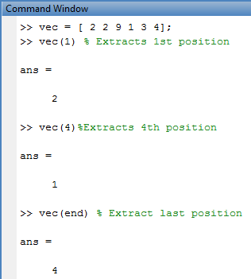

What is Indexing?
Indexing into a vector is a means of selecting a subset of elements from the vector, where each element has two properties: a value and a position
Format for Indexing
<name of vector> ( position(s))

Slide 22
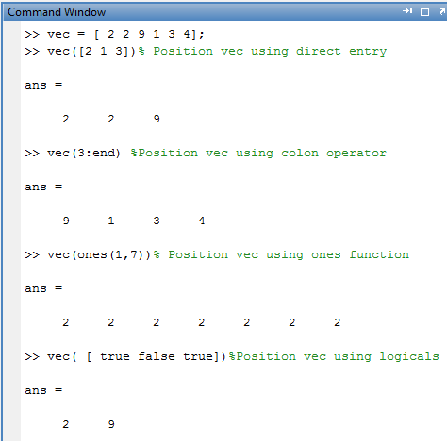
Using a Vector to Index
You can index multiple times by simply using a position vector
where the position vector itself is generated through the ways we talked about before such as using:
direct entry
colon operator
ones()
*logical vectors
* A logical vector is a vector that contain true and false as its elements, when indexing only elements are true are extracted*

Slide 23
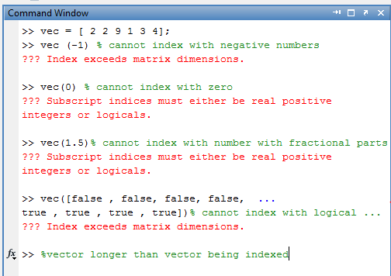

4 Basic DO NOT(s) when Indexing
2
Do not index with numbers with fractional parts, only integers
If the numbers are fractions use ceil() function to round up
1
Do not index with negative numbers or zero
3
When ACCESSING an element, do not index with an integer that is larger than the vector’s length
4
Do not index with logical vector longer than the vector being indexed into
*NOTE: the … “false ,” tells MATLAB to continue read up to the next line

Slide 24
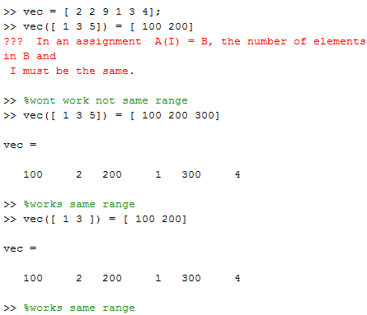
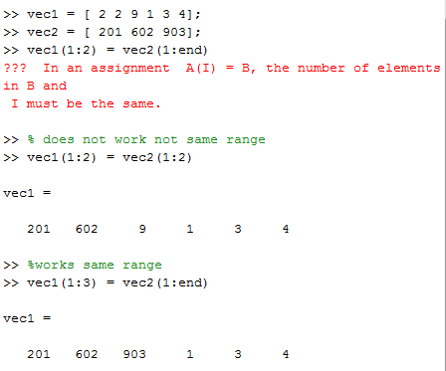
Assigning values when Indexing
When assigning multiple values to a vector, given the format :
vec(<range of positions>) = multiple assigned values , then the
< range of positions> must be equal to < range of assigned values>
Assigning Multiple Values
Assign Multiple Vector Values

Slide 25
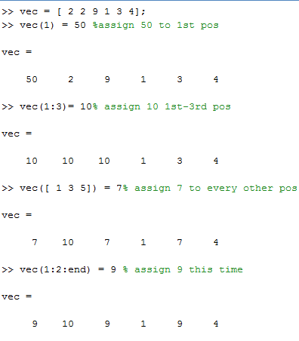
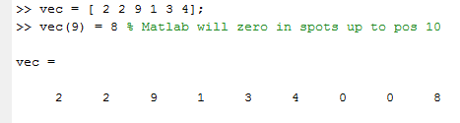
Assigning values when Indexing
You can assign values at certain positions in vectors by indexing .
If you index a value outside a vectors length and you are ASSIGNING a value to it , MATLAB will zero in the spots up to the position you’ve assigned.
Assigning a Single Value
Assign a value outside length

Slide 26
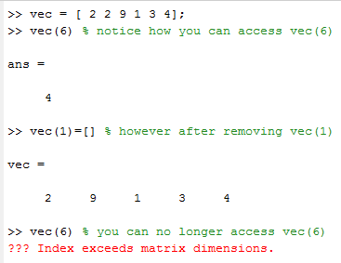
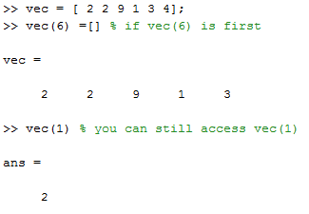
Removing Vector Elements
Remove First to Last Position: Causes Shifts
To remove elements of a vector: assign two square brackets like so: [] to the element being removed
WORD OF CAUTION: the vector length is shortened by the same amount of element removed
All element positions are shifted left
PREVENTION SHIFT: get into habit removing from last to first position unless you’re told to do otherwise
Remove Last to First Position: No Shifts

Slide 27
Checkpoint (1/1)
If linspace is used to generate a position vector so you can index into a vector, why should you always use round, ceil or floor with it?
If vecA = [ 2 4 5 6] and vecB = [ 7 1 2], then after this command is ran : vecA ([ 1 3]) = vecB(1), what would appear on the command window?
With the same givens in problem 2, then after this command is ran, vecA(0:2) = vecB(1:2), what would appear on the command window?
Again with starting off with same given as problem 2, vecA([ 4 1]) = vecB( [ 4 1]), what would appear on the command window?
CHANGE COLOR FOR ANSWERS:
The linspace function at times can produce values that are fractions and you are not allowed to index with fractions instead only with positive integers; thus by using the round, ceil, or floor function you can produce integer values and use them to index
vecA>> [7, 4, 7, 6]
??? Subscript indices must either be real positive integers or logicals. ( can’t index with 0)
??? Index exceeds matrix dimensions. ( there is no fourth element for vecB)

Slide 28
Vectors and Arrays Lesson 5: Logical Operations
By Jimmy Le
Email:jimmyle2008@gmail.com

Slide 29
What is Logic in General ?
Logic could be defined as our ability to distinguish between which elements are true and which are false
In computer science, we base our decision to determine whether an element is true or false on a condition
True
If the condition is met by the element (meaning all the element has satisfied all the requirements of the condition), then the element is considered true ; thus, it occurs or executes
Otherwise the element is labeled as false; thus, it does not occur or executes
False
*Relational and logical operators are used to create such conditions

Slide 30
Using Relational Operators
Relational Operator | Name | Application/ Result | Description
== | equal to | e = 1 == 1 e >> true e = 2 == 1 e >> false | == only returns true if the two values are the same or equivalents of each other. Otherwise it returns false.
~= | not equal to | n = 1 ~= 1 n >> false n = 2 ~= 1 n >> true | ~= only returns false if the two values are the same or equivalents of each other. Otherwise it returns true.
>= | greater than or equal to | g = 2 >= 1 g >> true g = 1 >= 1 g >> true g = 0 >= 1 g >> false | >= returns true if in the following format: value1 >= value2 , value1 is greater than value2 or if value1 is equal to value2
<= | less than or equal to | l = 2 <= 1 l >> false l = 1 <= 1 l >> true l = 0 <= 1 l >> true | <= returns true if in the following format: value1 <= value2 , value1 is less than value2 or if value1 is equal to value2

Slide 31
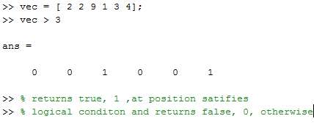
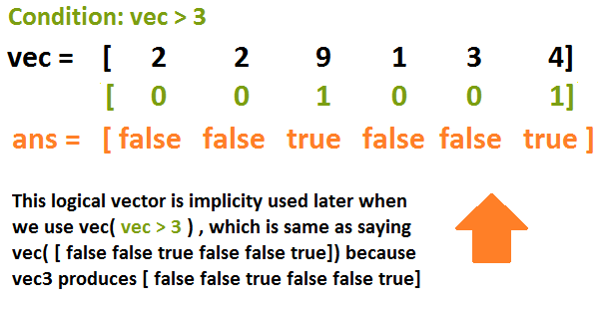
Using Relational Operators
Relational Operator | Name | Application/ Result | Description
> | greater than | g = 2 > 1 g >> true g = 1 > 1 g >> false g = 0 > 1 g >> false | > only returns true if in the following format: value1 > value2 , value1 is greater than value2
< | less than | l = 2 < 1 l >> false l = 1 < 1 l >> false l =0 < 1 l >> true | only returns true if in the following format: value1 < value2 , value1 is less than value2
Application

Slide 32
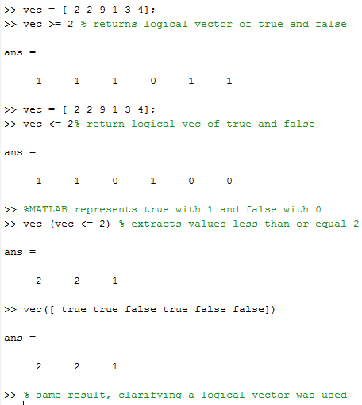
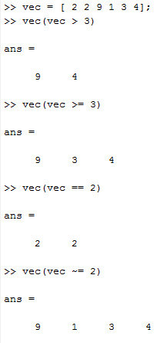
Indexing with Relational Operators
Conditions are defined such as: vec > 2 , vec < 2 , vec ==2
produce logical vectors
These conditions are then used to index into the vector.
Format : <vector_name>(<condition>)
EXAMPLES:
How Relational Operators Work

Slide 33
Using Logical Operators
Logical Operator | Name | Application/ Result | Description
& | AND | a = true & true a >> true a = true & false a >> false a = false & false a >> false | AND can only returns true when both values that are compared are true. Otherwise the result is false.
| | OR | o = true | true o >> true o = true | false o >> true o = false | false o >> false | OR can only returns false when both values that are compared are false. Otherwise the result is true.
~ | NOT | n = ~false n >> true n =~true n >> false | NOT operator returns the opposite value operated on

Slide 34
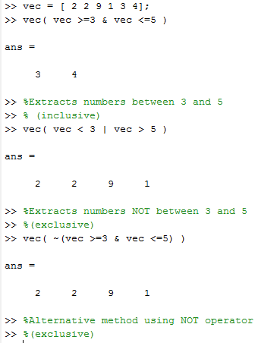
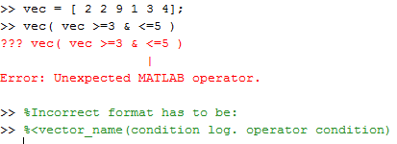
Indexing with Logical Operators
How Logic Operators Work
Need for indexing with logical operators occurs when there is a need for two or more conditions to be true
Format:
<vector_name>( <condition> <logical operator> <conditon>)
Fundamental Error

Slide 35
Helpful logical functions
Function | Name | Application/Result | Description
all(log.vec) | ALL | a = all( [ true true true] ) a >> true a = all( [true false true] ) a >> false a = all( [false false false] ) a >> false | ALL can only return true if all the elements inputted are true. Otherwise it returns false. *ALL is like a chain of ANDs
any(log.vec) | ANY | a = any( [ true true true] ) a >> true a = any( [true false true] ) a >> true a = any( [false false false] ) a >> false | ANY can only return false if all the elements inputted within it are false. Otherwise it returns true. *ANY is like a chain of ORs

Slide 36
Checkpoint (1/2)
Relational operators compares two elements, and evaluates them to be ______ or ______.
Together the relational operator and the two elements make up what is known as a _________.
When a logical vectors is used to index into a vectors, whichever positions are listed as _____ in the logical vector , indicated by MATLAB with _______, then those are the positions extracted from the vector.
When two or more conditions need to be true in indexing a vector, a ____ _______ should be used with two conditions.
HIGHLIGHT FOR ANSWERS
True,false
Condition
True, 1s
Logical operator
Logical operator

Slide 37
Checkpoint (2/2)
vec = [ 1, 2, 3, 4];
When this command: vec > 3 is ran in the command window, what is the class of the vector produced? What is the actual vector produced in command window?
When this command: vec(vec > 3), what is the class of the vector produced? What is the actual vector produced in command window?
Why does this statement error out: vec ==1 & == 2? How do you fix it?
When the command:vec([ 1 0 1 1]), what is the results displayed in command window?
HIGHLIGHT FOR ANSWER
Logical, [ 0 0 0 1]
Double , [ 4]
vec ==1 & == 2, the problem lies in the second condition, the equality operator needs another element to compare with 2. To fix this, we change the command to vec ==1 & vec == 2. Now vec can be compared with == to 2. Before there was nothing there to compare it with; thus MATLAB threw an error.
ans >> [ 1 3 4]
Logical operator
Logical operator

Slide 38



Vectors and Arrays Lesson 6: Generating Arrays
By Jimmy Le
Email:jimmyle2008@gmail.com

Slide 39
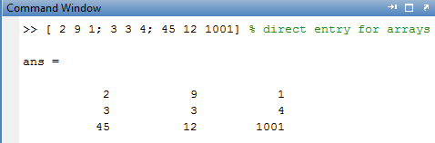
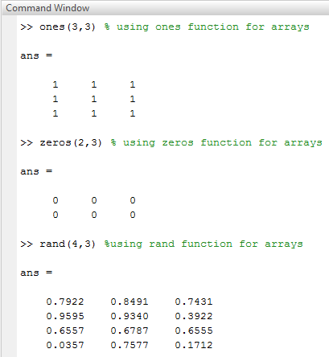
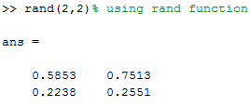
4 Main Ways to Generate Arrays
Technique: Enter in a sequence numbers , end each row with a semicolon before starting a new row, number of elements for each row must be the same!
Direct Entry
ones (rows, cols)
zeros (rows, cols)
rand (rows, cols)
Technique: specify the number of rows and columns you want

Slide 40
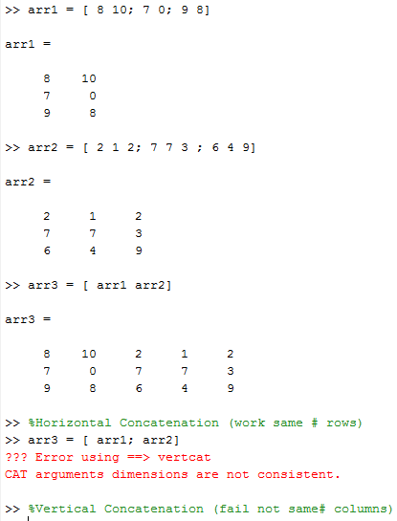
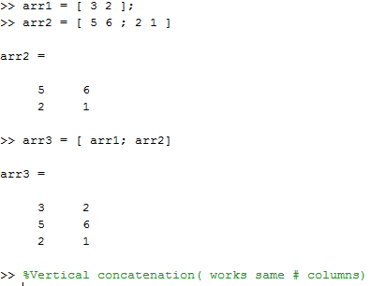
Concatenation
To horizontally concatenate two arrays together, numbers of rows of each array has to be the same
To vertically concatenate two arrays together, number of columns of each array has to be the same
Horizontal Concatenation
Vertical Concatenation

Slide 41
Checkpoint (1/1)
Create a 5 x 5 array of 100s.
arr1 = [ 3 4 1], arr2 = [ 1 8 9; 3 4 5], then arr3 =[ arr1 arr2] would display what in the command window?
arr1 = [ 3 4 ], arr2 = [ 1 8 ; 3 4 ], then arr3 =[ arr1 ; arr2] would display what in the command window?
Using the same givens from problem 3,arr3 =[ [arr1;[ 4 2]] arr2 ] would display what in the command window?
CHANGE COLORS FOR ANSWERS
arr = ones(5,5).* 100
??? Error using ==> horzcat
CAT arguments
dimensions are not
consistent.
3. arr 3 =
3 4
1 8
3 4
4. arr3 =
3 4 1 8
4 2 3 4 1s
Logical operator
Logical operator

Slide 42
Vectors and Arrays Lesson 7: Built-In Function For Arrays
By Jimmy Le
Email:jimmyle2008@gmail.com

Slide 43
Built-In Functions With Arrays
Function Name | Description *assuming every function takes in a vector as its input* | Example
length(arr) | returns the maximum value of the two dimensions; | l = length( [ 2,9,2,1 ; 1,4,3,1] ) l >> 4
size(arr) | returns number of rows of the array for first output and the number of columns of the array for second output | [ r c ] = size( [ 2,9,2,1 ; 1,4,3,1] ) r>> 2 c >> 4
find(arr) | returns a column vector of positions of the arrays positions | p = find( [ 2,9,2,1 ; 1,4,3,1] ) p >> [ 1 ; 2 ; 3 ; 4 ; 5 ; 6 ;7 ; 8]
sum(arr) *similarly:* mean(arr) median(arr) min(arr) max(arr) prod(arr) diff(arr) | ‒ returns sum of each column ‒ to get sum of entire array use : sum( sum(arr)) ‒ to get sum of all row vectors use: sum( arr ‘) , where the apostrophe ‘stands for transpose | s = sum( [ 2,9,2,1 ; 1,4,3,1] ) s >> [3, 13, 5, 2] s = sum(sum( [ 2,9,2,1 ; 1,4,3,1] )) s >> 23 s = sum( [ 2,9,2,1 ; 1,4,3,1] ‘) s >> [ 14, 9]

Slide 44
Built-In Functions With Arrays
Function Name | Description *assuming every function takes in a vector as its input* | Example
round(arr) | returns each element of the array rounded conventionally | r = round( [ 2.1, 9.3, 2.5, 1.6 ; 1.7, 4.9, 3.6, 1.4] ) r >> [ 2 , 9 , 3 , 2 ; 2 , 5 , 4 , 1]
ceil(arr) | returns each element of the array rounded up | c = ceil( [ 2.1, 9.3, 2.5, 1.6 ; 1.7, 4.9, 3.6, 1.4] ) c >>[ 3 , 10 , 3 , 2 ; 2 , 5 , 4 , 2]
floor(arr) | returns each element of the array rounded down | f = floor([ 2.1, 9.3, 2.5, 1.6 ; 1.7, 4.9, 3.6, 1.4] ) f >> [ 2, 9 , 2, 1 ; 1 , 4 , 3 , 1]
sort(arr) | ‒ returns each column sort in ascending order ‒ to return each row sorted in ascending order use: sort(arr,2) | s = sort(( [ 2,9,2,1 ; 1,4,3,1] ) s >> [ 1 , 4 , 2 , 1 ; 2 , 9 , 3 , 1 ] s = sort(( [ 2,9,2,1 ; 1,4,3,1] , 2) s >> [ 1 , 2 , 2 , 9 ; 1 , 1 , 3 , 4 ]

Slide 45
Built-In Functions With Arrays
Function Name | Description *assuming every function takes in a vector as its input* | Example
reshape(arr, r, c) | Returns the array reshaped according to the number of rows and columns inputted | r = reshape( [ 2,9,2,1 ; 1,4,3,1] ,4,2) r >> [ 2 , 2 ; 1 , 3 ; 9 , 1; 4 , 1]
Checkpoint (1/2)
arr = [3 4 ; 9 7 ; 1 8]
What are the results for the follow command on the arr:
length(arr)?
length(mean(arr))?
[ c r] = size(arr)? Values for c and r?
CHANGE COLOR FOR ANSWERS
arr = [3 4 9 ; 7 1 8]
3
2
c >> 3 , r >> 2

Slide 46
Checkpoint (2/2)
arr = [ 2 1 3 ; 5 8 2]
What command should be used to obtain the sum of each column vector in arr ? Row vector ?
If we wanted the sum of the row vectors to be a column vector, what command should be used instead?
How do we take the sum of all the elements in arr? The mean of all the elements?
Did you know: the sum function can take a second input for which dimension to take the sum of; thus using that knowledge can you take the sum of all the rows of arr as a column vector ( without having to use transposes)?
CHANGE COLORS FOR ANSWERS
arr = [2,1 3 ; 5 8 2]
sum(arr), sum(arr’)
(sum(arr’))’
sum(sum(arr)),
mean(mean(arr))
4. sum(arr,2)

Slide 47
Vectors and Arrays Lesson 8: Indexing, Assigning, and Removing Array elements
By Jimmy Le
Email:jimmyle2008@gmail.com

Slide 48
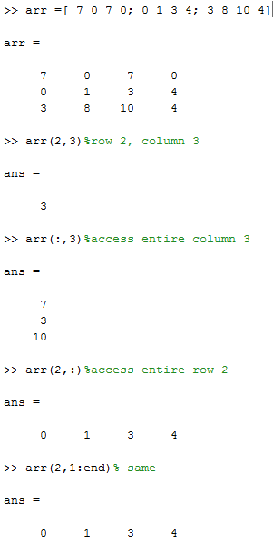
Two Indices with Arrays
To index an array, first specify rows and then columns
Format:
<array_name>(<row>,<column>)
Use the colon operator : to access entire rows or columns
array( :, 2) , will access entire second column
array(1,:) , will access entire first row
The above colon operator’s usage is equivalent to 1:end

Slide 49
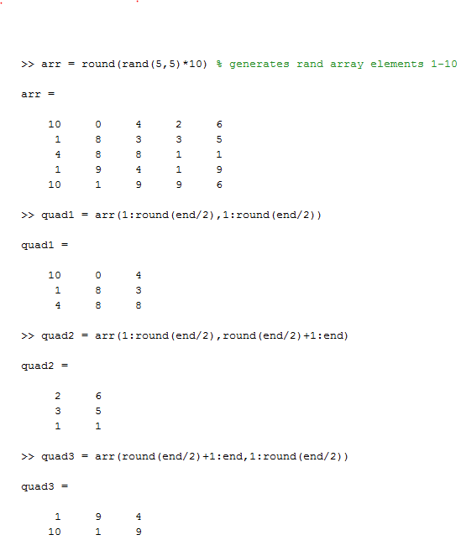
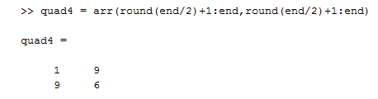
Split Array into Quadrants
To split an array into 4 quadrants use the two types of indices:
1:round(end/2)
round(end/2)+1:end
for row or column index
round() is need in case of odd dimensions
round(end/2) +1 is needed to prevent overlap

Slide 50

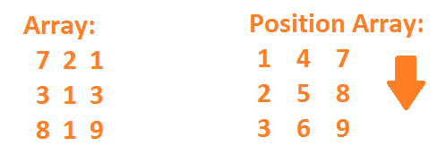
Single Index with Arrays
In a vector MATLAB counts vector’s positions from left to right to
In an array, MATLAB counts array’s position from top to bottom in successive columns

Slide 51
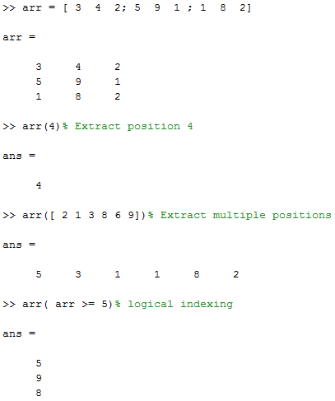
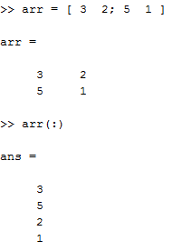
Applications of Single Indexing
Remember for arrays MATLAB counts down
If logical indexing is used MATLAB will return back a column vector
Simply indexing with a colon : you can turn the entire array into a column vector

Slide 52
Rules Indexing with Arrays
The four rules that applied to indexing vectors also applies to indexing arrays:
Do not index with negative numbers or zero
Do not index with numbers with fractional parts, only integers
When ACCESSING an element, do not index with an integer that is larger than the number of rows or columns of an array
Do not index with logical vector longer than the number of rows or columns of an array being indexed into
Yes even the error messages are the same

Slide 53
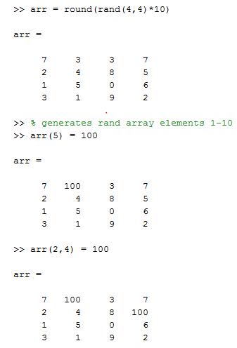
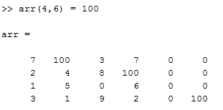
Assigning Values with Arrays
Like with vectors, its possible to assign a new value to a single element in an array through indexing
If you index a value outside a array’s dimensions and you are ASSIGNING a value to it , MATLAB will zero in the miss spots

Slide 54
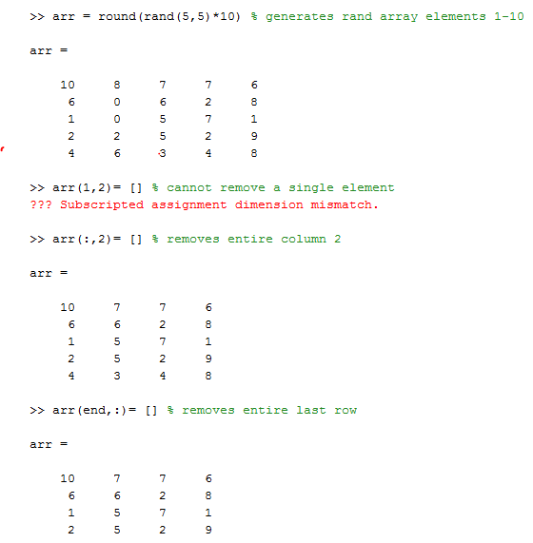
Removing Array Elements
Removed of array elements require use of two square brackets [] as with vectors
Only complete rows and columns can be removed from an array
Otherwise MATLAB will throw an error because the array’s rectangular shape is no longer maintained

Slide 55
Checkpoint (1/2)
arr = [ 2 3 ; 6 3 ; 7 9];
What command can you enter into MATLAB in order to get the following results? (Assuming you back with the given arr every time.)
arr = 3 ;
arr = [ 2 3 ; 6 3 ]?
arr = [ 3 2; 3 6; 9 7]?
arr = [ 2 3 0; 6 3 2; 7 9 0]?
arr = [ 7 9; 2 3; 6 3]?
arr = [ 6 3]?
CHANGE COLORS FOR ANSWERS
For the future purpose, know how to get the answer both ways.
arr = arr(2,2) or arr = arr(5)
arr(3,:) = [] or arr = arr(1:2,:)
arr = arr(:,end:-1:1) or arr(:, [ 2 1])
arr(2,3) = 2 or arr = [arr [ 0; 2; 0 ]]
arr([ 3 1 2],:)
arr= arr(2,:) or arr([ 1 3],:) =[]

Slide 56
Checkpoint (2/2)
arr = [ 3 5 2; 2 3 4; 2 1 4]
What two commands can gives ans/arr = [ 3 5 2; 2 3 4]?
Given arr(4,3) = 1; and arr(3,4) is typed in the command window what is the value displayed? (Hint: Draw it out)
a= arr(1,2) == arr(2),
b = arr(3,1) == arr(3), what are the values of a and b?
[ c r] = size(arr) , what are the values of c and r? (Hint: It’s not a typo)
CHANGE COLORS FOR ANSWERS
arr(3,:) =[] , arr(1:2,:)
Error because although I created a new fourth row, there is no fourth column, thus if you try to access the fourth column you get error
a >> false, b >> true
c >> 4 , r >> 3 , remember the output names does not matter, I can name then bob and john if I wanted to

