Slide 1

Cell Arrays Refresher
By Jimmy Le
Email: jimmyle2008@gmail.com

Slide 2
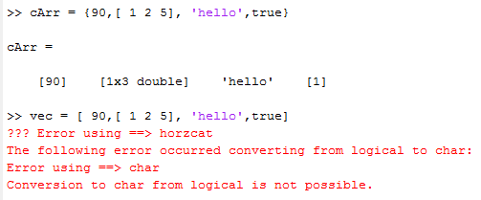

Why we use Cell Arrays?
We can use them to store heterogeneous data in a single collection
Heterogeneous Data meaning char, double, logical and various other data types
Impossible to do with vectors
HETERGENEOUS DATA:
HOMOGENEOUS DATA
Attempted to store heterogeneous data as a vector

Slide 3
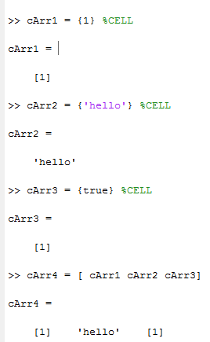
Creating and Concatenating Cell Arrays
Create a cell by simply putting curly brackets around the value:
Always concatenate cells with [] square brackets
USING {} CURLY BRACKETS IS WRONG for concatenation
Doing so creates nested cells

Slide 4
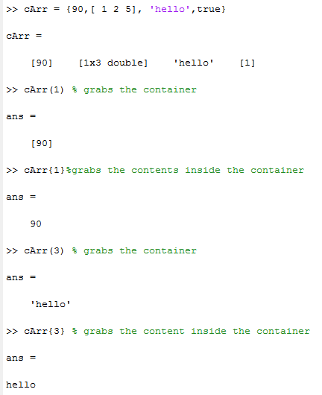
Indexing Into Cell Array
Use () to access the container
Use {} curly braces to access the content of the cell
SELF-CHECK
Referencing to cArr on the left:
What is the class(cArr{end})?
What is the class (cArr(end))?
What is the class(cArr(2))?
What is the class(cArr{2})?

Slide 5
SELF_Check Answers
Logical
Cell
Cell
double

Slide 6
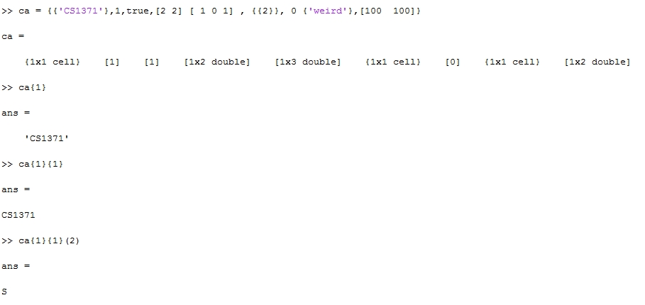
Indexing Into Nest Cell Arrays
SELF-CHECK
What is the length of ca?
How many cells is ‘weird’ nested in?
How do I get the “e” in ‘weird’?
How many cells is the 2 nested in?
How do I get the nested 2?

Slide 7
SELF-CHECK ANSWERS
9
2
ca{8}{1}(2)
3
ca{6}{1}{1}

Slide 8
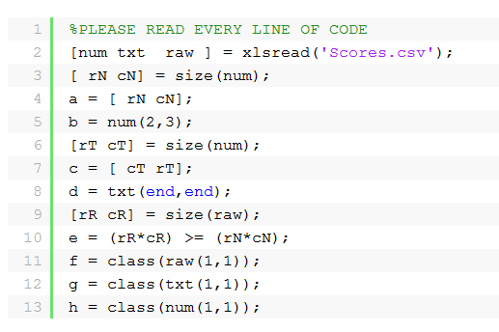
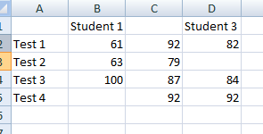
SELF CHECK:
Scores .csv:
What are the values of a,b,c,d,e,f,g, and h?

Slide 9
SELF CHECK:
Question Display
Name: avgMinMax() Inputs(1): a string indicating the file's name Outputs(0): no outputs Description: Create a function that will take in a excel file contain student's test grades. You can assume the following about the excel file the first row is will always contain the student's names
the first column will also always contain what test the student took
second row and on , also the second column and on, you will find only numbers which represents the student's test scores.
Now add a header called 'Max Average' to the end of the student's names in the first row. Then calculate the Max Average and store it underneath the 'Max Average' header. Then after you are done write the file out to as an excel file with the same name as the original file name except the word '_editted' is now attached to it. Test Case: avgMinMax('Student.csv') *your raw variable should look like the following:

