Slide 1





If Statements
By Jimmy Le
Email: jimmyle2008@gmail.com

Slide 2


Table of Contents
If Statements
What are If Statements?
If-Else Statements
ElseIf Statements
Nested If Statements
Switch Statements
Multiple Switch Values

Slide 3

What are If Statements?
An if statement consists of a condition and a code block that :
executes if that condition is evaluated to be true and
does not execute if that condition is evaluated to be false
Format:
if( < condition 1>)
code block 1
end
What an If Statement Looks Like:
Tracing: num >> 5
num passes through the first condition ( num > 3) , which evaluates to be true because (5 > 3).
result is assigned the value ‘number is greater than 3’
num >> 2
num passes through the first condition ( num > 3) , which evaluates to be false because (2 > 3).
result is not assigned a value because the code block did not execute

Slide 4
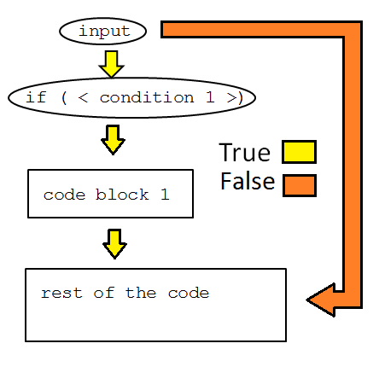
Structure of If Statements
When an if statement ‘s condition evaluated to be true as indicated by the yellow arrows, the execution flow goes smoothly from top to bottom without skipping any code block( meaning all code blocks are executed)
When if statement’s condition is evaluated to be false indicated by the orange arrows, code block 1 is skipped out in the execution.

Slide 5
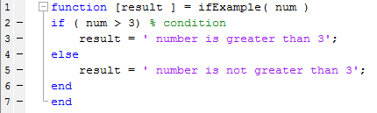
If-Else Statements
An if-else statement is used
if a code block needs to be executed when the condition is true and
another code block needs to be executed when the condition is false
Format:
if( < condition 1>)
code block 1
else
default code block
end
What an If-Else Statement Looks Like:
Tracing: num >> 3
First condition is evaluated true, code 1 block below the if statement executes, result is assigned ‘ number is greater than three’
Num >> 2
First condition is evaluated false, default code block below the else statement executes, result is assigned ‘number is not greater than three’

Slide 6
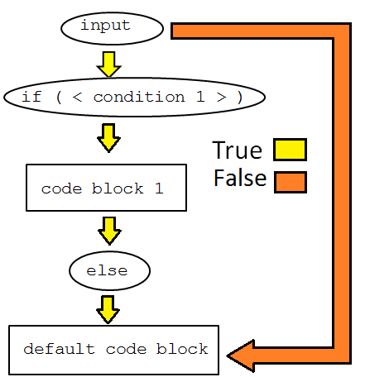
Structure of If-Else Statements
The if and the else statement are mutually exclusive, meaning the code below the if statement CANNOT be executed if the code block below the else statement is executed and vice versa.
Code block below the if statement will execute only if the condition is true
Code block below the else statement will only execute if the condition is false.
An condition cannot be evaluated both true and false at the same time; thus is the reason why both code blocks cannot be executed at the same time.

Slide 7
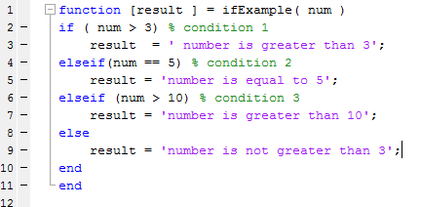
Elseif Statements
Elseif statements are used to check multiple conditions whereas
if and if-else statements can only check one condition
Format:
if( < condition 1 >)
code block 1
elseif ( < condition 2 >)
code block 2
elseif ( < condition 3 >)
code block 3
. . .
elseif ( < condition n >)
code block n
else (optional/ not required)
default code block
end
What an Elseif Statement Looks Like:
Tracing: num >> 5
Condition 1 is evaluated false, nothing happens.
Condition 2 is evaluated true, result is assigned ‘ number is equal to 5’
num >> 2
Conditions 1 -3 are evaluated false, (default code block executes) result is assigned ‘ number is not greater ’

Slide 8
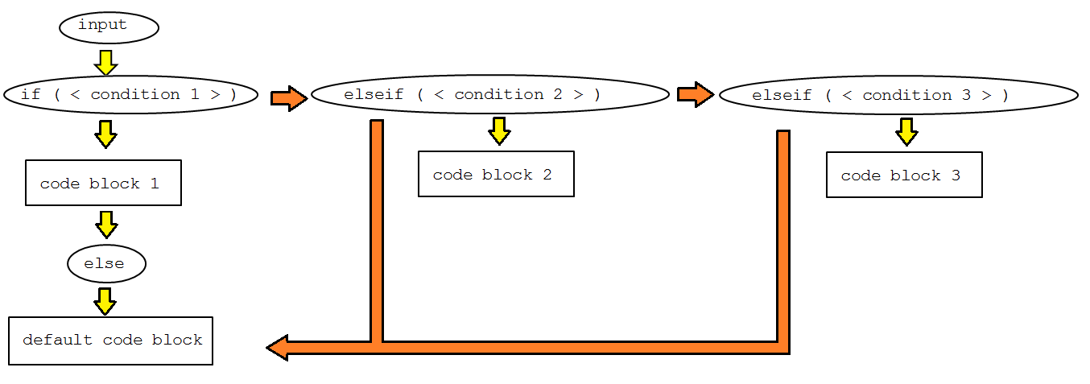
Structure of Elseif Statements
Elseif statements , if and else are also mutually exclusive from on another
Meaning only one of the elseif , if and else statement can be true at a time ; thus, meaning only one code block can be executed.
It’s possible to have infinite elseif statements between the if and else statement , but doing so also makes your code more complex.

Slide 9
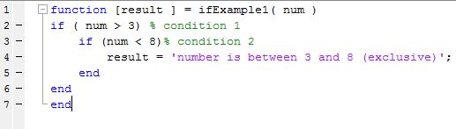
Nested If Statements
A nested if statement is an if statement which contains another if statement
Code block 1 will execute only if condition 1 is met
Code block 2 will execute only if condition 1 and condition 2 are met
Format:
if( < condition 1 >)
code block 1
if( < condition 2 >)
code block 2
end
end
What an Nest If Statement Looks Like:
Tracing : num >> 4
condition 1- 2 is true, result is assigned ‘number is between 3 and 8 (exclusive)’
num >> 10
condition 1 is true and condition 2 is false, the code block is skipped and nothing happens because there is no more code

Slide 10
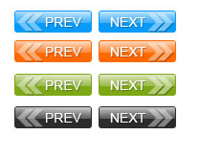

Switch Statements
By Jimmy Le
Email: jimmyle2008@gmail.com

Slide 11
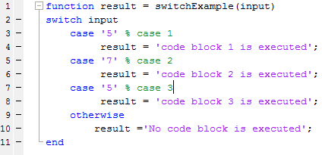
What are Switch Statements?
A switch statement consists of : inputs, two or more cases, code blocks following the cases.
Each case has at a minimal one value
Only one code block is executed in a switch statement.
Cases are compared with the input in the order from top to bottom
Format:
switch <input>
case <parameter1>
code block 1
case <value 2>
code block 2
case <value 3>
code block 3
otherwise
default code block
end
What does a Switch Statement Look Like:
Tracing: input >> ‘7’
case 1 ‘s value does not match with input’s value so input goes on to case 2
case 2’s value matches with input’s value so the code block below case 2 executes
input >> ‘5’
Case 1 matches with input so code block below case 1 executes only.
Case 3 is ignored because although it matches up with input it was not the first case to match up with input.

Slide 12
Multiple Switch Values
Switch cases can have multiple values, but they have to be enclosed by {} brackets
In our previous example, only strings were specified as parameters, but numbers work as well also,
Format:
switch <input>
case {< value1, value2 >}
code block 1
case {< value 3,value4, value5 >}
code block 2
case <value 6>
code block 3
otherwise
default code block
end

Slide 13
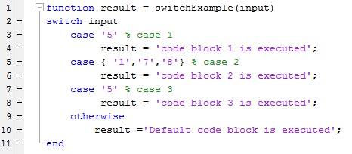
Multiple Switch Values Ex:
Tracing: input>> ‘5’
case 1’s value matches up with input’s value, the code block below case 1 executes, result is assigned = ‘code block 1 is executed’
input>> 8
Case 1’s value does not match with input’s value, input’s value is passed for comparison with case 2One of case 2’s values match up input’s value ; thus, the code block below case 2 is executed, result is assigned = ‘code block 2 is executed’
input>> 7 or input>> 1
Both these values will end up to have the same result as input>> 8
input>> 10
None of the cases’ values match up with input’s values, the code block under otherwise executes , result is assigned =‘code block is executed’

Slide 14
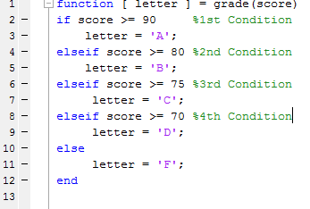
Checkpoint (1/2)
What are the values of the following variables after the command listed has been ran from the command window:
X = grade(90)?
Y = grade(89)?
Z = grade ( 1000)?
One = grade( 80000)?
Two = grade(8)?
Three = grade(-10)?
A = grade( true)?
B = grade(false)?
C = grade(1)?
D = grade(0)?
CHANGE COLORS FOR ANSWERS:
X >> ‘A’
Y >> ‘B’
Z >> ‘A’
One >> ‘A’
Two >> ‘F’
Three >> ‘F’
A >> ‘F’
B >> ‘F’
C >> ‘F’
D >> ‘F’

Slide 15
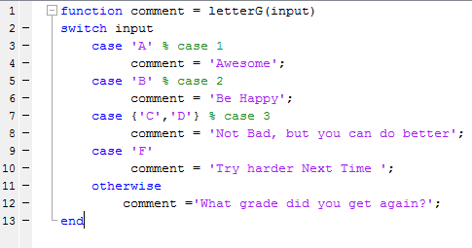
Checkpoint (2/2)
What are the values of the following variables after the command listed has been ran from the command window:
X = letterG(90)?
Y = letterG(89)?
Z = letterG(‘A’)?
One = letterG(‘F’)?
Two = letterG(‘a’)?
Three = letterG(‘b’)?
A = letterG( true)?
B = letterG(false)?
C = letterG(1)?
D = letterG(0)?
CHANGE COLORS FOR ANSWERS:
X >> ‘What grade did you get?’
Y >> ‘What grade did you get?’
Z >> ‘Awesome’
One >> ‘Try harder Next Time’
Two >> ‘What grade did you get?’
Three >> ‘What grade did you get?’
A >> ‘What grade did you get?’
B >> ‘What grade did you get?’
C >> ‘What grade did you get?’
D >> ‘What grade did you get?’

