Slide 1



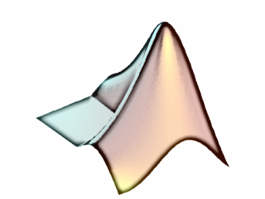
Functions and their Workspace
By Jimmy Le
Email: jimmyle2008@gmail.com

Slide 2

Table of Contents
What Are Functions?
Creating Functions
Savings Functions
Correct Function Headers
Incorrect Function Headers
Function Workspaces
Calling Functions

Slide 3
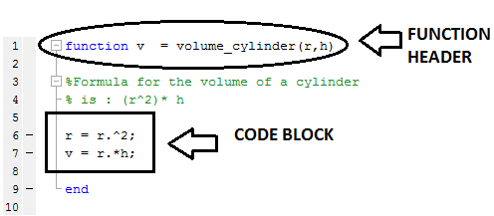
What are Functions?
A function put simply is code block that has a name and is reusable much like a script in the extent you can run it at any point in MATLAB
A function differs from a script in the sense that a function can accept input and output parameters whereas a script is hard-coded
What a Function Looks Like:
The “end” at the end of the function explicitly tells you the code block has ended
Format:
function [<out1> <out2> …] = <function name>( <input1>, <input2>…)
<code block>
end

Slide 4
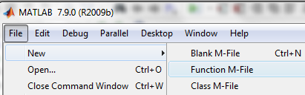
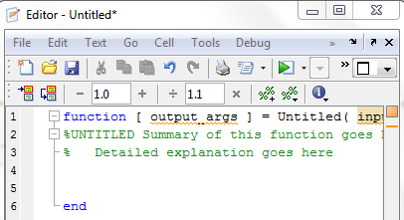
Creating Functions
To create a function in MATLAB, go to the File pull down menu, then select New and finally Function M-File, which has the function header format setup for you.
You can also choose a Blank M-File , but the function header format will not be there.
Best advice is to use the Function-M-File until you feel comfortable with function header format, then utilize the Blank M-File.
File >> New >> Function-M-File
What Function M-File Looks Like:

Slide 5
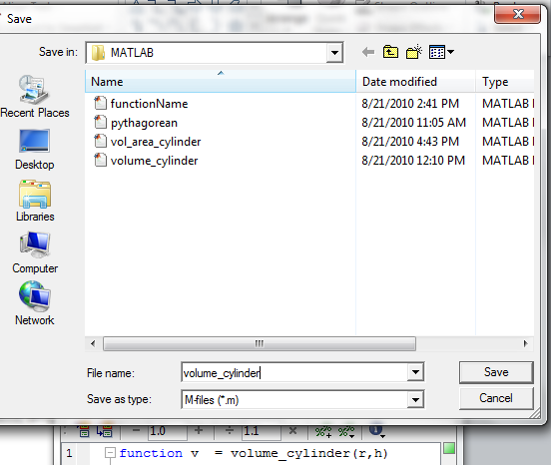
Saving Functions
REQUIREMENT FOR SAVING:
When you are done writing a function and wish to save, always save your function the same as the name of your function
ADVICE FOR SAVING:
Whenever you’re asked to write a function and the function name is specified as a given , just copy and paste the function name as to prevent any sudden typos. Also make sure you saved the function to your current folder so MATLAB can access it
.

Slide 6
Correct Function Headers
There are a multiple ways to specify a correct function header
Description | Format
Two or More Outputs | function [out1 out2 …] = functionName( in1, in2, …)
One Output | function out1 = functionName (in1, in2,…)
No Outputs | function functionName( in1, in2, …)
Two or More Inputs | function [out1 out2 …] = functionName( in1, in2, …)
One input | function [out1 out2 …] = functionName( in1)
No Inputs | function [out1 out2 …] = functionName()
No Outputs or Inputs | function functionName() or function functionName
Characteristics of Correct Function Headers:
When there are multiple outputs, these outputs are enclosed by square brackets[ ].
The square brackets [ ] only enclosed only outputs located left of assignment
Parentheses ( )enclose only inputs located right of assignment
Comma are used to separate the inputs (optional for outputs)
When no output is specified the assignment operator is not present

Slide 7
Incorrect Function Headers
There are a multiple ways to specify a incorrect function header
Error Description | Format
Need [] for outputs | function (out1 out2 …) = functionName( in1, in2, …)
Need () for inputs | function [out1 out2 …] = functionName[ in1, in2, …]
Need , for inputs | function [out1 out2 …] = functionName( in1 in2 …)
Need function | [out1 out2 …] = functionName( in1, in2, …)
Need function name | function [out1 out2 …] = ( in1, in2, …)
Need function | functionName()
Is this function header correct?
function [in1 in2 …] = ( out1, out2, …)
CHANGE COLOR FOR CORRECT ANSWER:
Yes it is correct because as listed in the characteristics of correct function headers, the outputs are located on the right of the assignment and the inputs are located on the left of the assignment operator always. Here if you got the answer wrong you got tricked because the outputs were labeled as in1 and in2 , and the inputs were labeled as out1 and out2. Remember location location……

Slide 8
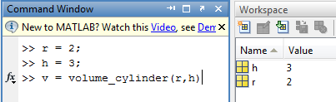
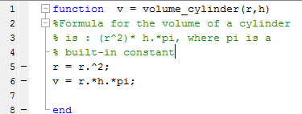
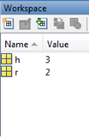
Function Workspaces
When a functions is called , the function then has its own separate workspace from the MATLAB command window workspace
STARTED EXECUTING FUNCTION UP TO LINE 2
Command Window Workspace
Function Workspace
The above figure display a snapshot has been taken right at the point which function volume_cylinder has taken in its input parameters r and h.
The variables names and values are the temporarily same for both workspaces, but keep in mind they are still SEPARATE WORKSPACES.

Slide 9
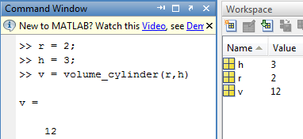
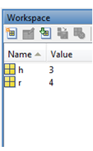
Function Separate Workspaces
FINISHED EXECUTING FUNCTION:
Command Window Workspace
Function Workspace
c
X
Once the function finishes its execution, function’s workspace is deleted X before it has the chance to affect the variables in command window workspace .
EXCEPTION: The only variables from the function workspace that gets defined or updated in the command window workspace the outputs.
Everything else in the command window workspace is left unaffected by the function workspace
Notice how r in the function workspace is updated from value 2 to value 4 at the end of the function’s execution.
This r is NOT listed as an output for the function therefore, it has no effect on the command windows workspace
Notes:
r

Slide 10
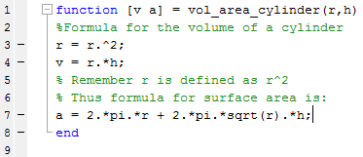
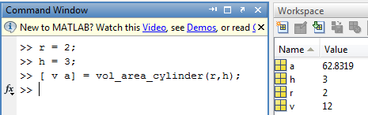
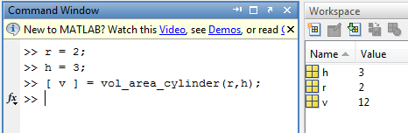
Calling Functions
Once a function is written and saved properly , the function can be called from the command window simply my typing in the name of the function and specifying any inputs or outputs parameters if necessary
Same function with surface area of cylinder added
Calling the Function Specifying Two Outputs
Calling the Function Specifying One Output
Notice how the function is not obligated to return all its outputs, but only one specified by the user

Slide 11
Checkpoint (1/2)
What is the general format for a function header?
What goes after the function header?
What should a function be saved as?
If a function is not in your ________, MATLAB cannot access that function; therefore, you cannot run it.
For a function header, _____ are located on the left of the assignment regardless on how they are named and ____are located on the right of the assignment also regarded on how they are named.
The minimal requirement for a function header is what?
CHANGE COLORS FOR ANSWERS
function [out1 out2 …] = functionName( in1, in2, …)
Code block
Function name
Current folder
Outputs, inputs
Function functionName

Slide 12
Checkpoint (2/2)
1. Which of the following function headers are correct?
function [c] = pythag(a,b)
function drawCircle
function [s m1 m2] = stats(data num)
function (e1 e2 e3) = boss(salary)
function account[ b1,b2,b3]
function = makeMoney(m1,m2,m3)
2. Given the following function:
function ca = circle_area(d)
d = d./2
ca = pi.*d^2
end
What are the variables and their values in the workspace after the commands are entered in the command window?
>> d = 2;
>> a = circle_area(d);
CHANGE COLOR FOR ANSWERS
1a) yes
1b) yes
1c) no , you need a comma between the inputs
1d) no you need square brackets around the outputs
1e) no you need parentheses around the inputs
1f) no you should not have an assignment operator there
d >> 2
a >> 3.14

