Slide 1
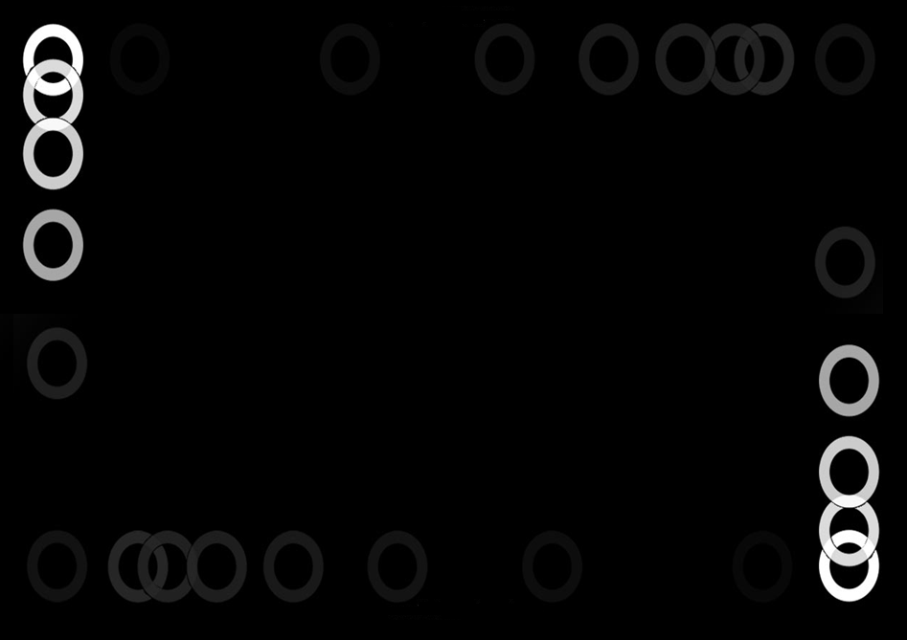
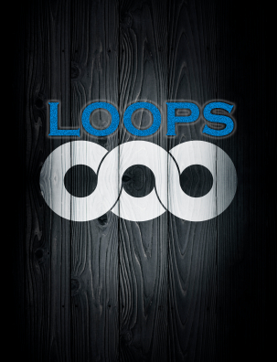
For and While
By Jimmy Le
Email: jimmyle2008

Slide 2
Announcements
Administration - Test 1 Grades Out - Get feedback by going to the assignments section
- Have one week to make a regrade request.
- If you are worried about your grade, please contract your professor as soon as possible
Homework 06 - Back at the average of the two homeworks again.

Slide 3
How Recitation will Run
For and While Loops:
I will lecture introducing the basic material for about 10-15 mins
For the next 4-5 mins, you will solve exercises located in the t-square recitation resources , Jeremy and I will go around to help people having trouble
The we will have 5 minutes of asking questions and then the cycle starts again for the next topic
Cell Arrays
Jeremy will teach it.

Slide 4

Why use Iteration?
Computers are often used to automate repetitive tasks.
Repeating identical or similar tasks without making errors is something that computers do well and people do poorly.

Slide 5
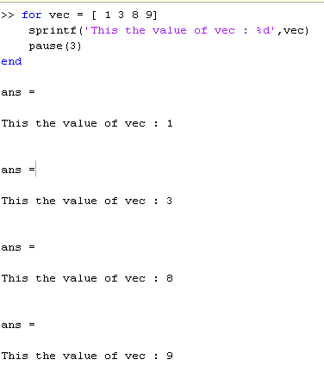
For Loops
General form:
for var = vector
<code block>
end
For loops always run a set number of times
Specified by the length of the vector
The values the var will take is each value in the vector
Even if the vector changes, that does not change what the variable values will be

Slide 6
Direct Access
Indexing
VS
The loop variable becomes the values in the vector:
Format:
vector = [3 7 2 1 9]
for var = vector
<code block>
end
The loop variable becomes the values of the index in the vector
Format:
vec = [3 7 2 1 9]
for var = 1:length(vec)
<code block>
end

Slide 7
While Loops
General form:
while <logical condition>
<code block>
end
While loops run while the logical condition evaluates to true and will continue until the logical condition becomes false (terminating condition )
Termination condition = ~(<logical condition>)
All variables used in the logical condition must exist /initialized beforehand

Slide 8
Difference between For and While
Every for loop can be converted to a while loop
Only some while loops can be converted to a for loop
For loops generally useful when iterating over a collection, like vectors or lengths
For loops also good when you want to do something a known number of times
While loops useful when you think to yourself I must do this UNTIL something happens, or WHILE this happens

