Slide 1




Strings
By Jimmy Le
Email: jimmyle2008@gmail.com

Slide 2
Table of Contents
What are Strings?
Strings and Ascii Values
String Built In- Functions
strtok()
sprintf()
Indexing With Strings
Math With Strings
Concatenating with Strings

Slide 3
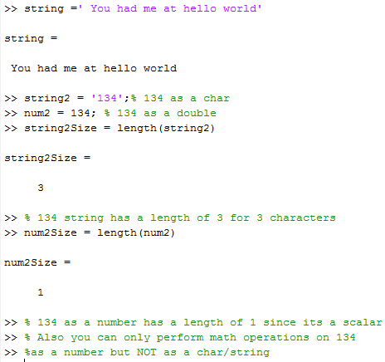
What are Strings?
In MATLAB, a string is essentially a sequence of symbols that are chosen from the ascii table.
Strings are data type char (not strings , a common mistake)
When a string is defined into MATLAB, you must have singe quotes enclosing it like so:
Format: ‘ <string>’
A number written as a string is completely different from a number that we use to do math.

Slide 4
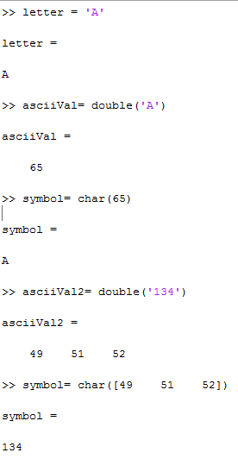

Strings and Ascii Values
When a string is turned into a double using the double function, the resulting values are ascii values (numbers).
When a numbers is turned in a char using the char function, the results values are symbols and characters
To distinguish the difference between the two, doubling the previous string ‘134’, gives use three ascii values each one corresponding to the symbol 1, 3 , and 4.

Slide 5
String Built In- Functions
Function Name | Description *assuming every function takes in a vector as its input* | Example
S = str2num (string) | Converts a string into its numerical form | S = str2num(‘999’) S ➔ 199
S = num2str (number) | Converts a number into its string form | S = num2str(999) S ➔ ‘199 ‘
L = strcmp(str1,str2) | Compares two strings to see if they are the same and returns a true if the two strings are exactly the same | L = strcmp(‘apple’, ‘apple’) L ➔ true
L = strcmpi(str1,str2) | Compares two strings to see if they are the same and returns a true if the two strings are exactly the same ignoring the casing | L = strcmp(‘ApPle’, ‘apple’) L ➔ true

Slide 6
String Built In- Functions
Function Name | Description *assuming every function takes in a vector as its input* | Example
L = ischar(vec) | Returns true if the input is a string and false otherwise | S = ‘I am a string’ L = ischar(S) L → true
L = isspace(vec) | Returns true if the input is a space and false otherwise | S = ‘ ‘ S1 = ‘I am a space’ L = isspace(S) L1 = isspace(S1) L → true L→ false
S = lower(string) | Returns a string with all its characters lowercased | s = ‘I am a FuNkY StRinG!’ s1 = lower(s) s1 → i am a funky string!
S = upper(string) | Returns a string with all its character uppercased | s = ‘I am a FuNkY StRinG!’ s1 = upper(s) s1 → I AM A FUNKY STRING!

Slide 7
strtok()
Description *assuming every function takes in a vector as its input* | Example
Strtok takes in a string S, and then it will return a collection of characters, token, T, all the way up to the first delimiter, D, yet not including it A good rules of thumb is that the token will 99.9% of time NEVER include the delimiters. Strtok will also ignore leading delimiters. If you do not specify a delimiter, blanks spaces are set as the delimiter by default. | [T R] = strtok(‘red, blue, green’ ,‘,’) T → red R → , blue, green %Notice how leading delimiters are %ignored. The comma in front of “blue” %is ignored, while the comma after %“blue” is recognized as the official %delimiter. [T1 R1] = strtok(R,’,’) T1 → blue R1 → , green [T2 R2] = strtok(R1,’,’) T2 → green R2 →Empty string: 1-by-0

Slide 8
sprintf()
Description *assuming every function takes in a vector as its input* | Example
Sprintf returns a string formatted in the way you want %s, %i , and %f are called placeholders, where the placeholder is substituted with the value of the variable in which they are listed You can have multiple place holders but they have to correspond to the right variables %s is used for strings %i is used for integers %f is used for real numbers | %String formatting with other strings S = sprintf('Hi my name is %s ','Jimmy') S → Hi my name is Jimmy %String formatting with variables name = ‘jimmy’; S1 = sprintf('Hi my name is %s ', name) S1 → Hi my name is Jimmy %String formatting with numbers S2 = sprintf('I am a CS %i TA',1371) S2 → I am a CS 1371 TA %Multiple placeholders number = 1371 S3 = sprintf('I am %s ,a CS %i TA',name,number) S3 → I am Jimmy ,a CS 1371 TA

Slide 9
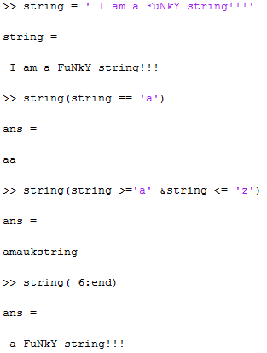
Indexing With Strings
Strings can be indexed the same way as vectors.
Logical indexing is mainly performed because you don’t have to know the ascii values that way
Ex: string(string >='a‘ & string <= 'z') , tells you that you want to get all the lowercase letters between ‘a’ and ‘z’ and you do this without directly knowing what the ascii values are.
If you do need the ascii value of a character or symbol simply use the double function.
In general, you should know capital letters have a lower ascii value than lowercase letters.
Also the letter ‘a’ will always be less ascii – wise than the letter ‘z’.

Slide 10
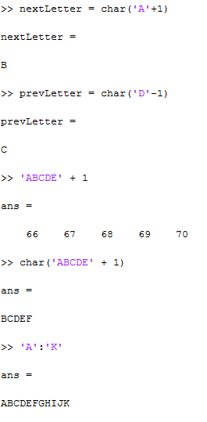
Math With Strings
When you perform mathematical operations on strings, the string goes from type char to double.
A good rule of thumb whenever you perform a mathematical operation on an element, that element will change to type double.
Therefore, when you apply math operators make sure you use the char function to change it back into a string unless that’s not what you want.
To go from one letter to the next one, simply add 1 to the letter and char it
To go from one letter to the previous one, simply subtract 1 to the letter and char it

Slide 11
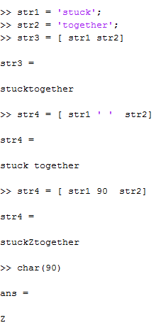
Concatenating with Strings
You concatenate a string together the same way you would with a vector with square brackets [ ].
However, when you concatenate string, there will be no space in between the strings
To add a space, simply concatenate a string containing a space between the two strings .
When a number is concatenated with a string , the number is changed to a character according to its ascii value.

Slide 12
Checkpoint (1/2)
string1 = ‘I am a string’
string2 = ‘ I am string1’s friend’
What is the class of string1 and string2?
string1 = string1 + 1
What is the class of string 1 after the above command is ran?
Concatenate string1 and string 2 together with a space in between and store the result in string3
Remove all the spaces in string3 and store is as string4
Using sprintf and the s1 , which stores string ‘not’, revise to string2 to say ‘ I am not string1’s friend’.

Slide 13
Checkpoint (2/2)
%The spaces are intentional
[ R T] = strtok(‘ the outputs are right’)
[R1 T1] = strtok (T )
[R2 T2] = strtok(T1)
[R3 T3] = strtok(T2)
[R4 T4] = strtok(T3)
What are the values for R, R1, R2, R3 ,R4 and T, T1, T2, T3,T4?
Answers: Try working it by hand, because I m trying to prep you for the test because the answers will seem a lot clearer and this might be the mind setup you’re looking for.

