Slide 1
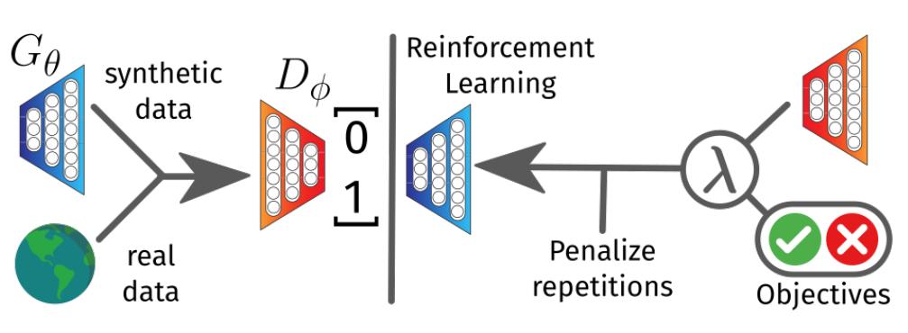
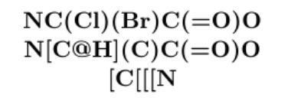
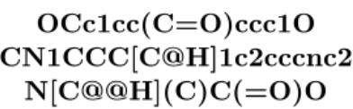
Input : Target[Tg], sequence length
Generator
Output : homopolymer
Feedback :
Optimization
from two conditions
Reinforcement
candidates
Discriminator
Input : homopolymer dataset

