Slide 1
Resource Management of Satellite Communication System
Seung Hyun Oh
20230609

Slide 2
Why we have to manage Resource?
In order to satisfy the growing traffic demand
Limitation of resources (Power, Bandwidth, Time interval, Beam and Antenna)
Payload design is going to be more smaller (Cost of Satellites is diminished, nowdays)
Compared to GEO, NGEO (especially LEO) has more complexity algorithm for optimization
Increasing number of NGEO satellites in the space, incurs interference
CR(Cognitive Radio)-based algorithm

Slide 3
Cognitive Radio
Cognitive Radio Schemes
Overlay method
a) NGEO satellites share the spectrum of a GEO satellite
b) Based on energy detection (ED)
Underlay method
c) Power control-based method
d) Precoding-based schemes
Beamforming algorithm
SU(Secondary User)s can access PU(Primary User)’s spectrum
: Sharing spectrum resources.
Interference alignment

Slide 4
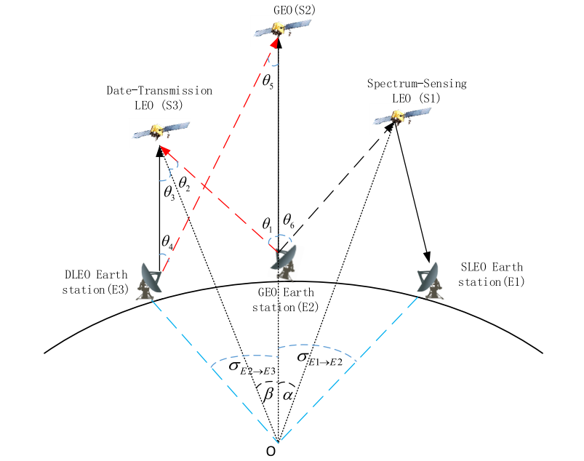
Cognitive satellite network
Problem Setting
In order to satisfy the growing traffic demand

Slide 5
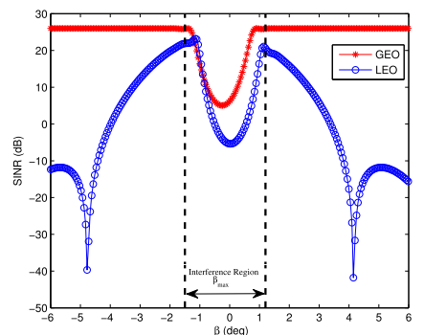


Cognitive satellite network
Problem Setting

Slide 6
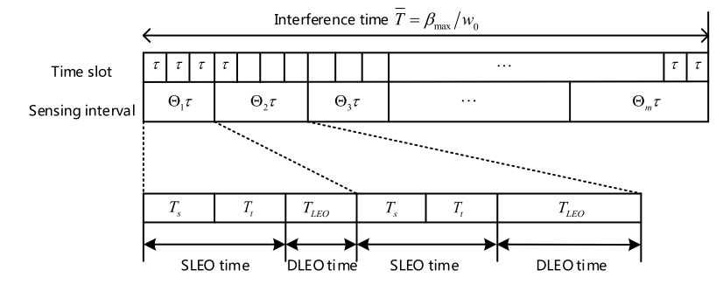
Cognitive satellite network
Problem Setting

Slide 7
References

