Slide 1
Cognitive Radio Network of Satellite Communication System
Seung Hyun Oh
20230609

Slide 2
Why we have to manage Resource?
In order to satisfy the growing traffic demand
Limitation of resources (Power, Bandwidth, Time interval, Beam and Antenna)
Payload design is going to be more smaller (Cost of Satellites is diminished, nowdays)
Compared to GEO, NGEO (especially LEO) has more complexity algorithm for optimization
Increasing number of NGEO satellites in the space, incurs interference
CR(Cognitive Radio)-based algorithm

Slide 3
Cognitive Radio
Cognitive Radio Schemes
Overlay method
a) NGEO satellites share the spectrum of a GEO satellite
b) Based on energy detection (ED)
Underlay method
c) Power control-based method
d) Precoding-based schemes
Beamforming algorithm
SU(Secondary User)s can access PU(Primary User)’s spectrum
: Sharing spectrum resources.
Interference alignment

Slide 4
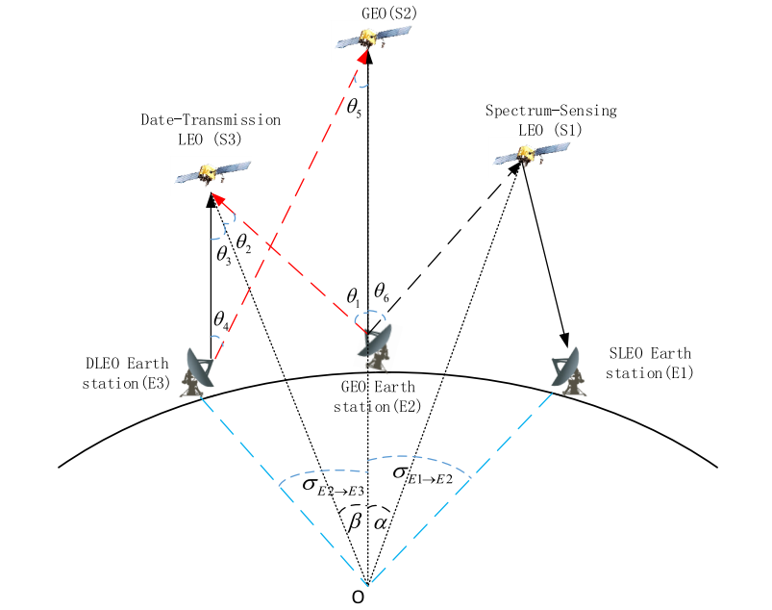
Cognitive satellite network
Scenario : Adapting Overlay method & Underlay method to Satellite network
In order to maximize average throughput,
- Set the rules of each satellite for sharing spectrum or detecting(sensing) spectrum of GEO

Slide 5
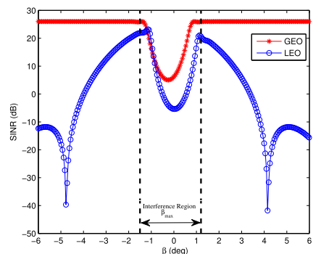


Cognitive satellite network
Interference region

Slide 6
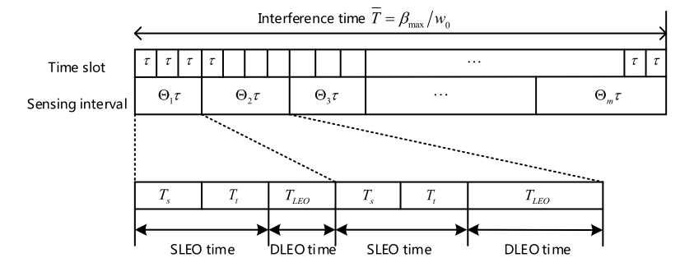
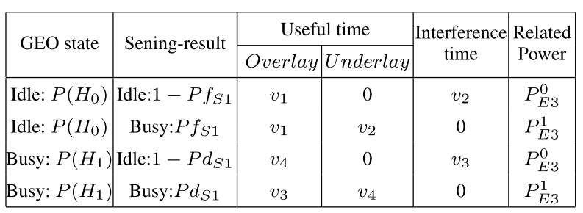
Cognitive satellite network
Time slot of Spectrum-sharing

Slide 7
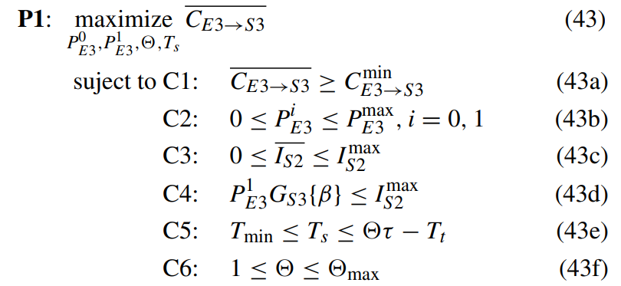
Cognitive satellite network
Optimization Problem Formulation
수식 정리 중입니다.

Slide 8
Contributions & Conclusion
Using Overlay method and Underlay method in Cognitive Radio to Satellite network,
It leads to increase of using resources such as power, spectrum.
Average throughput is improved, Interference is diminished.
GEO can get compensation in this scenario.
If GEO can’t reach to other satellites, because of channel state,
Giving spectrum to LEOs, and LEOs give the portion of sending for GEO

