Slide 1
Team - Rush Hour
Challenge 1 – Radiclean
Haolin Wu
Bruce How
Shubham Saxena

Slide 2
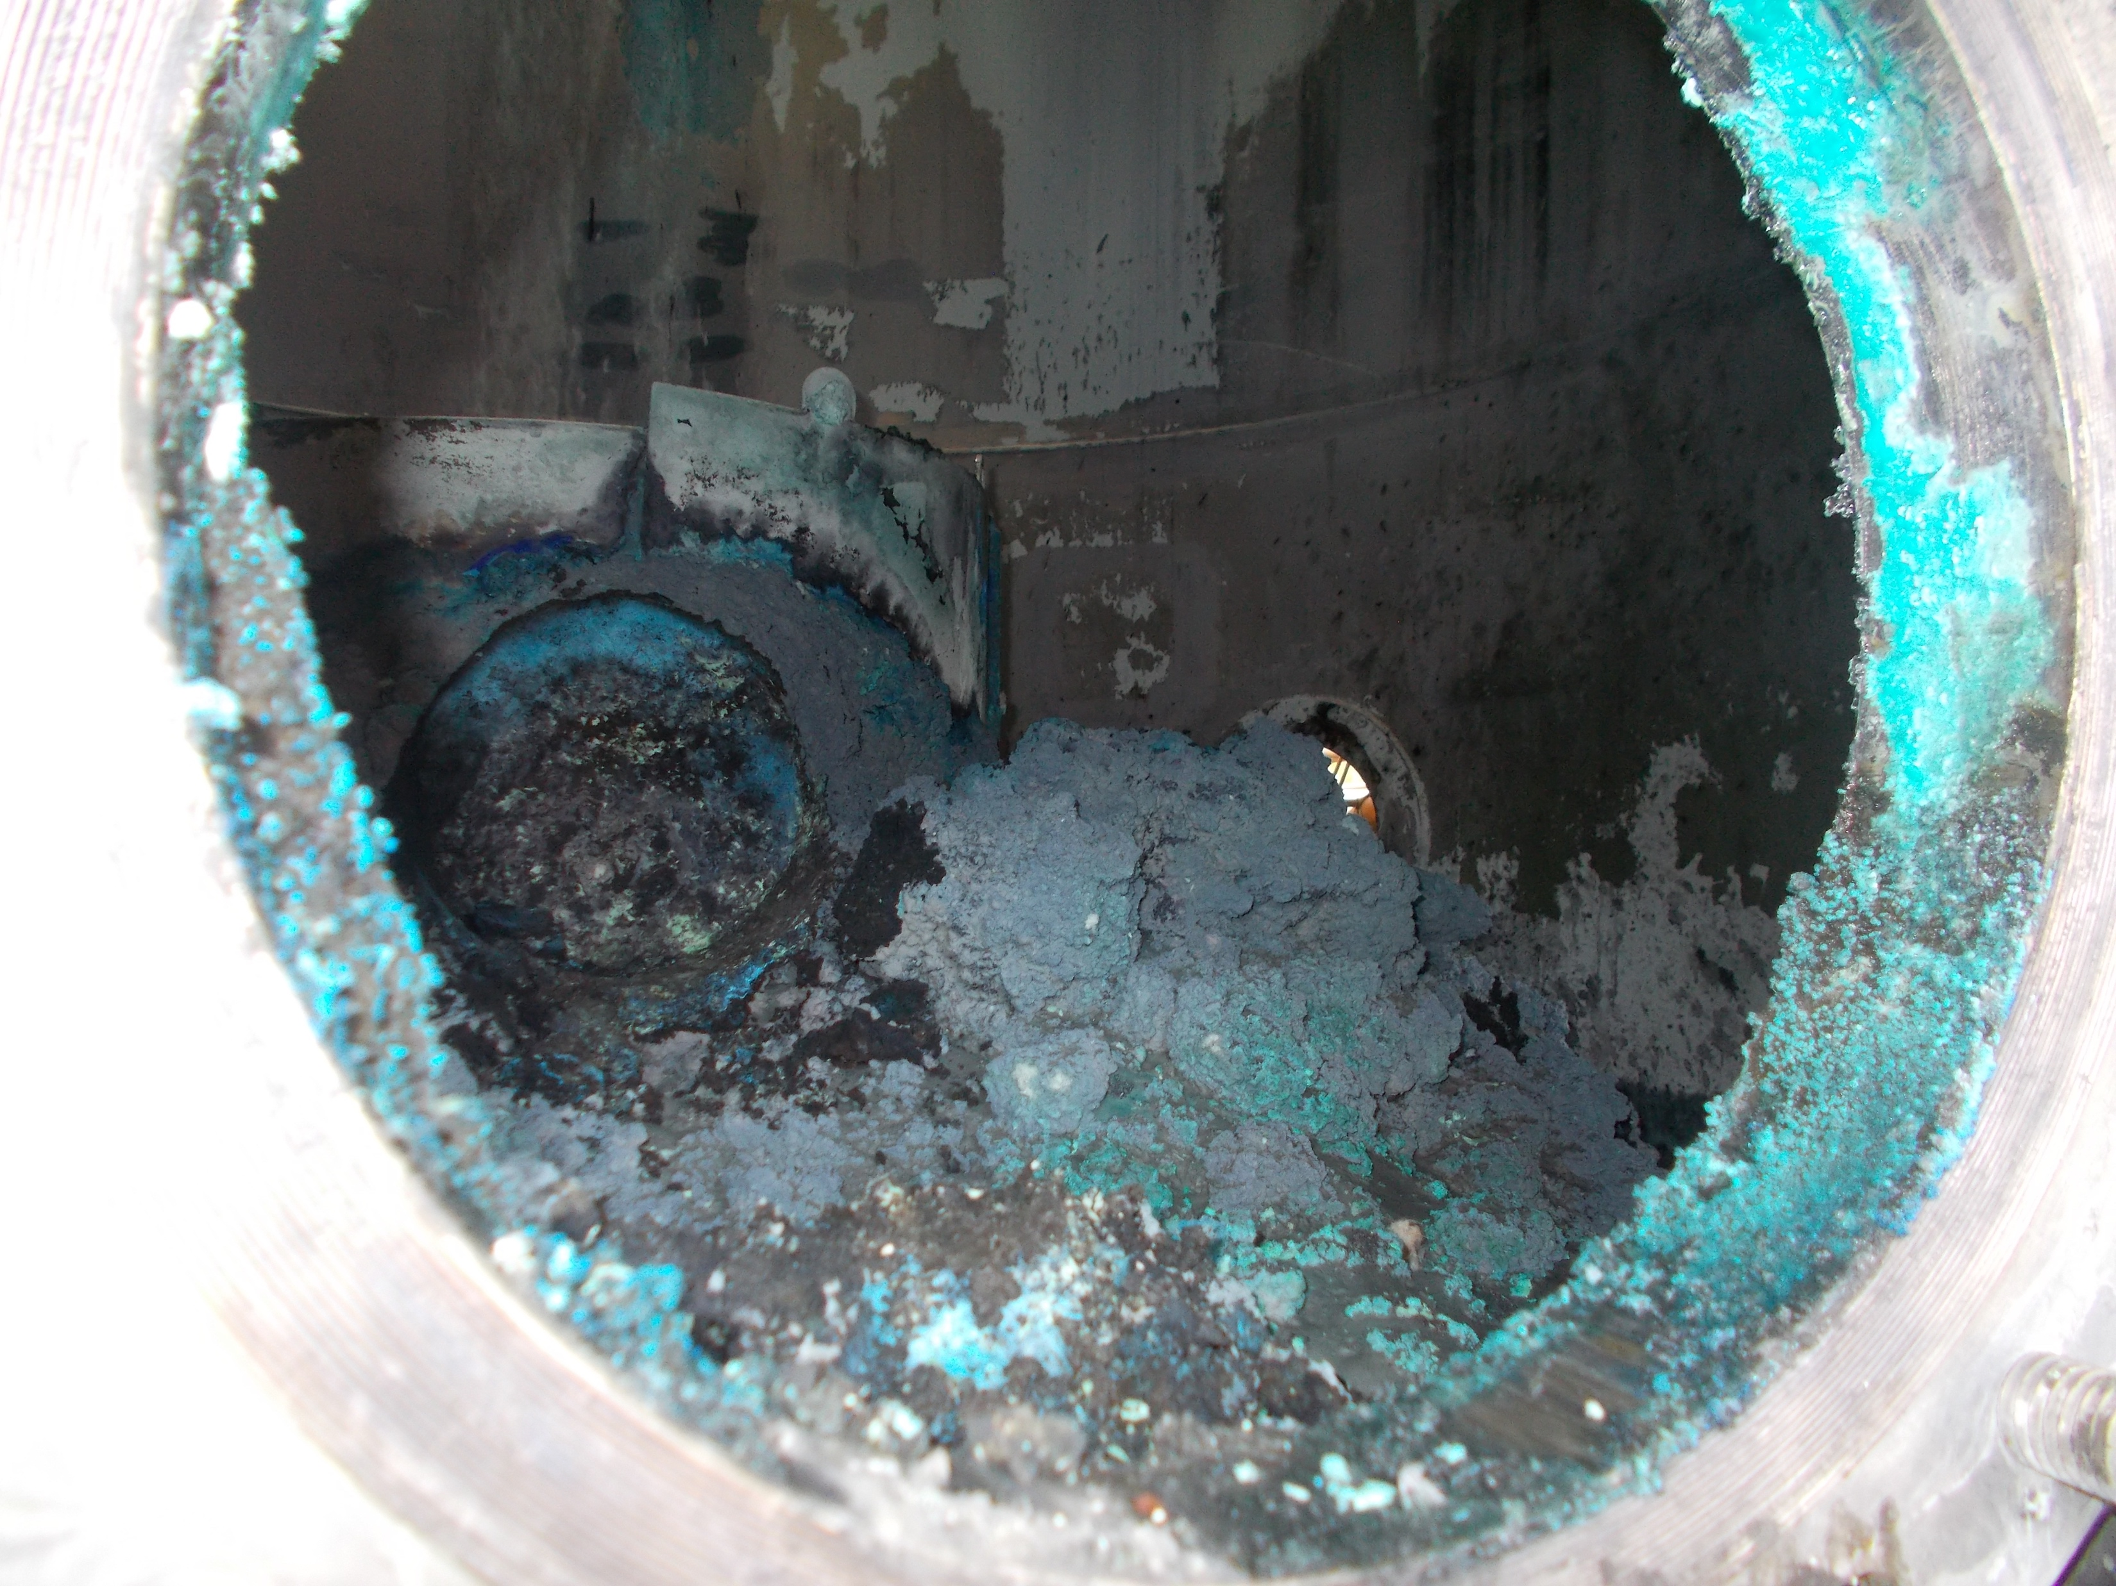
What is the problem?
Build-up of Copper sulphate crystals
Periodic maintenance that punches a hole in the bottom line of NiW
But we couldn’t change the process chemistry.

Slide 3
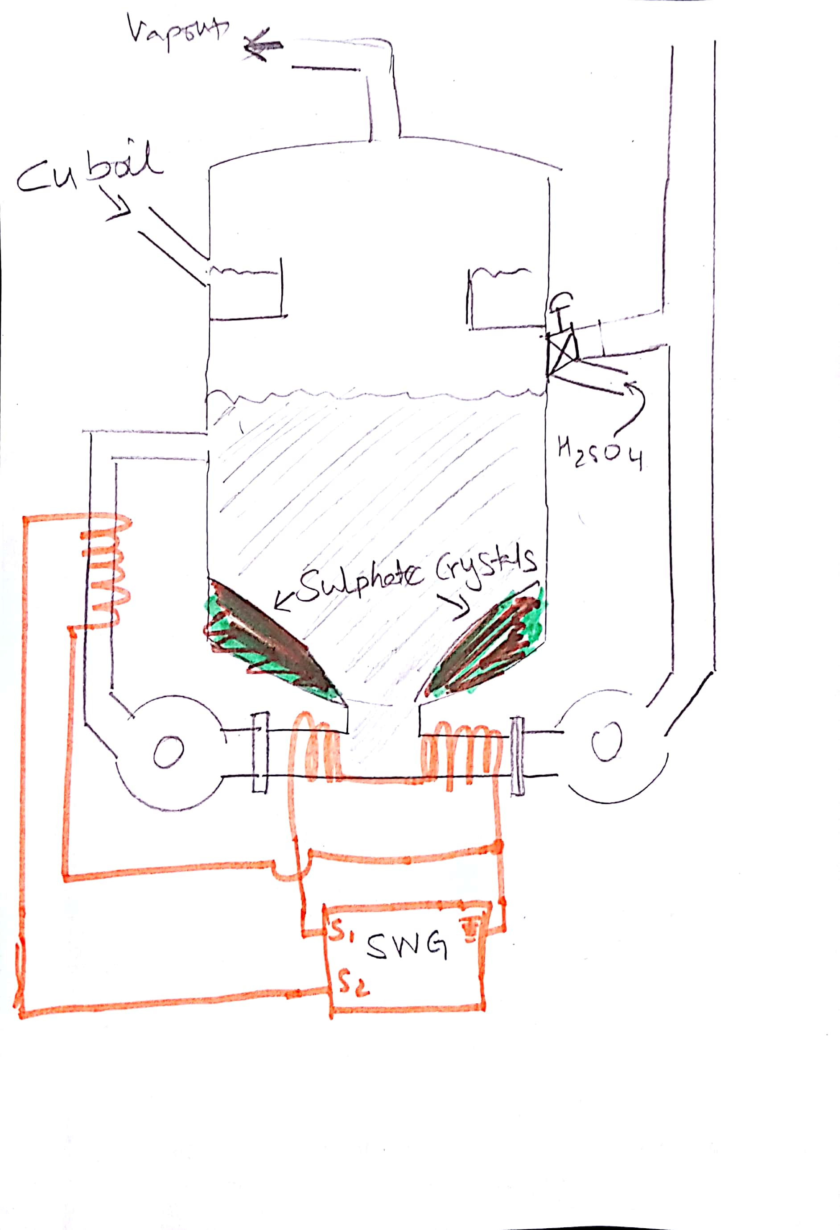
How our solution works?
Wrap a copper coil carrying a current.
This creates a magnetic flux
The coil exerts a force on the ions inside the pipe

Slide 4
Advantages
Reduced crystal size
Higher turbulence in the pipe
Higher thermal efficiency of the reboiler
Better flow
Modular design
Has it worked before?
Similar applications in water treatment - significant descaling effect

Slide 5
Data Analysis
Our system doesn’t have to be kept online at all times
Used data to determine a control system logic
Key process variables – Temperature & Current
Trends we found as crystals increase
reboiler’s temperature decreases
pump’s current increases

Slide 6
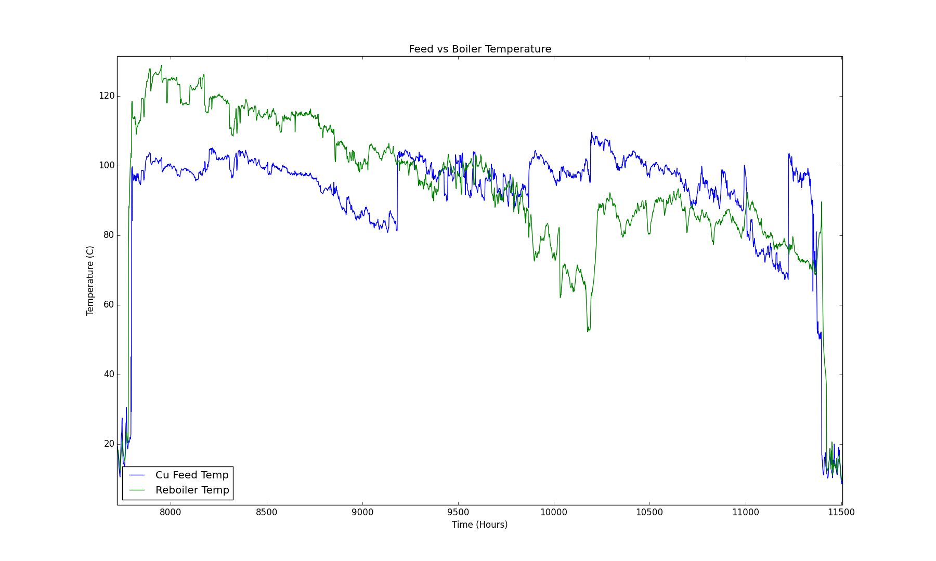
Ideal time to enable stage one
Point of interest

Slide 7
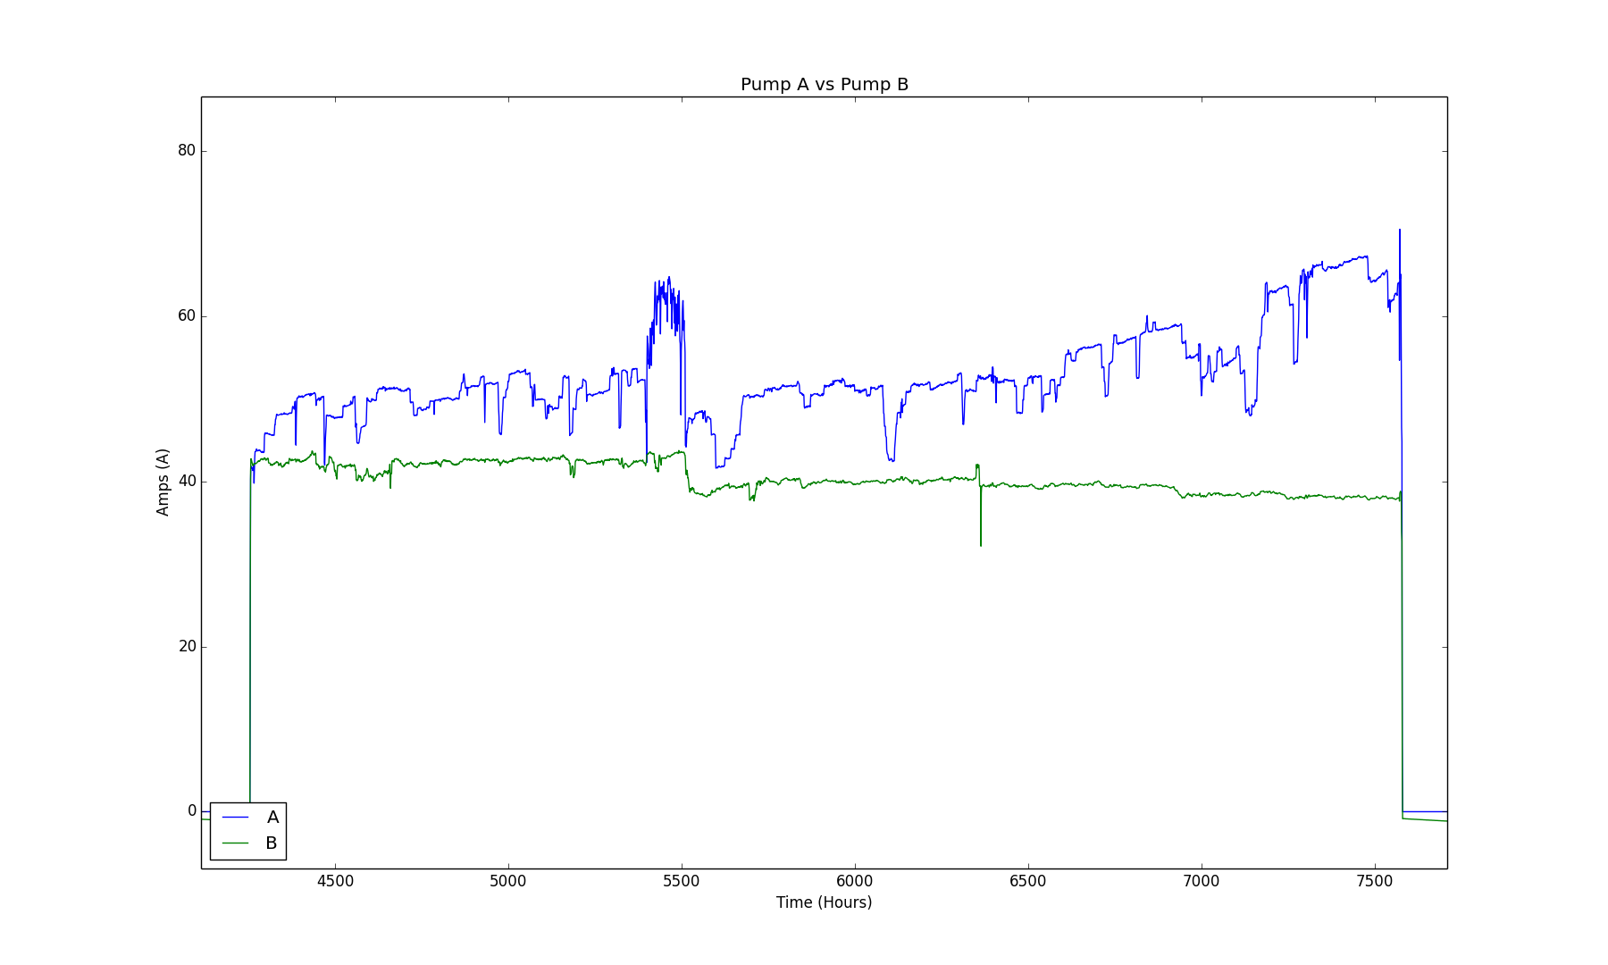
Ideal time to enable stage one

