Slide 1
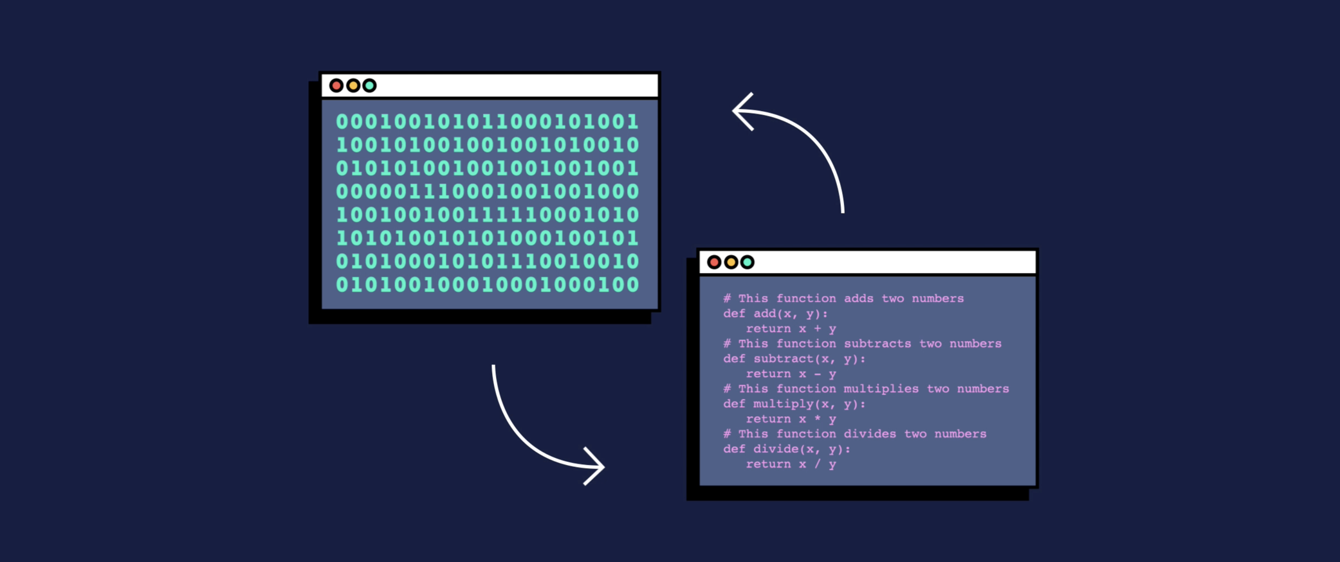
Java Spring track
SE. Salaheldin Mohamed

Slide 2

Software Engineering

Slide 3
Software
Software refers to a set of instructions or programs that tell a computer what to do and how to do it.
It can include operating systems, applications, games, and more.
Software can be either closed source (i.e., owned and controlled by an individual or company) or open source (i.e., freely available for use and modification by anyone).

Slide 4
Software Engineering
Software Engineering is the process of designing, developing, testing, and maintaining software.

Slide 5
Software Development
Software development is the process of creating software, including requirements gathering, design, coding, testing, and maintenance.

Slide 6
Computer Programming.
Computer programming is the process of writing computer programs, which are sets of instructions that tell a computer what to do.
A computer program is written in a programming language that the computer can understand.

Slide 7
Languages?

Slide 8
Why Languages?
For Communication Between each other.

Slide 9
Computer Language.
For Communication between Human and Computer
(3 types of Computer Language.)

Slide 10
Machine Language (low level language).
very difficult to understand by the users.
The only language which can be understood by the computer.
All the instructions of machine language are written in the form of binary numbers 1's & 0's.

Slide 11
Assembly Language (middle level language).
Difficult to understand by the users.
Instructions are created using symbols such as letters, digits and special characters.
We use predefined words called mnemonics.
- We use a translator called Assembler to translate mnemonics into machine language.

Slide 12
High Level Languages.
Can be understood by the users.
Set of predefined words known as Keywords and a set of rules known as Syntax to create instructions.
Needs to be converted into the low-level language to make it understandable by the computer.
We use ( Compiler or Interpreter) to convert Hight-level Language to Low-level Language

Slide 13

Java Programming

Slide 14
Why Java?
🤔

Slide 15
Why Java?
works on different platforms
(Windows, Mac, Linux, etc.)
It is one of the most popular programming language
has a large demand in the current job market
It is easy to learn and simple to use

Slide 16
Why Java?
open-source and free
secure, fast
huge community
it makes it easy to switch from Java to vice versa for programmers

Slide 17
Java Applications
Web Applications.
Mobile Applications.
Desktop Applications.
Games.
Web Services.
Big Data.

Slide 18

JetBrains IntelliJ IDE
The best JAVA IDE 2023

Slide 19
Why IntelliJ?
You can get it for free.

Slide 20
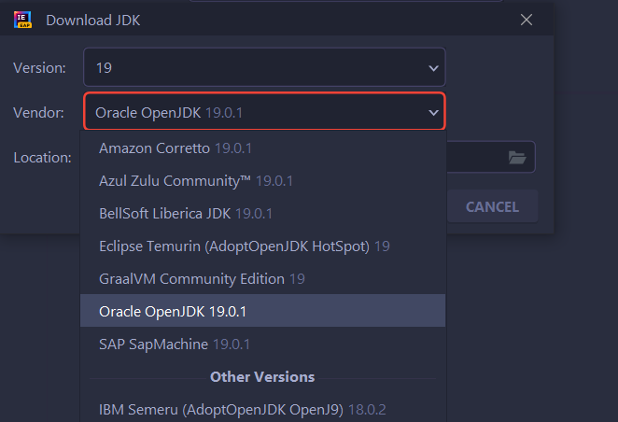
Why IntelliJ?
Provides latest versions of JDKs.

Slide 21


Why IntelliJ?
Multi-platform﻿.
provides consistent experience on Windows, macOS, and Linux.

Slide 22


Why IntelliJ?
Everything In One Place
Build tools like Maven and Gradle.

Slide 23

Why IntelliJ?
Database.
developers love to be able to see and query their databases from within the IDE.

Slide 24

Why IntelliJ?
Improves Code Comprehension.
We can see a class’s structure, find usages, or navigate to a declaration to find the context of a particular class, variable, or method.

Slide 25
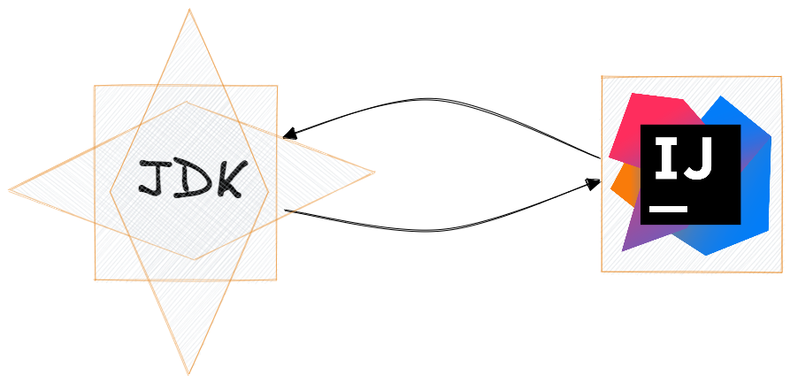
IDE vs JDK

Slide 26
🤔
CAN IT WORKS WITHOUT IDE

