Slide 1
Introduction to system dynamics modeling
The following slides will teach you:
the basic concepts
how to construct a model
how to fix a model
how to design a model
Notes:
Save as 567x425 pixels. File names are Slide01.jpg to Slide74.jpg.

Slide 2
System dynamics is general
System dynamics has been applied in many areas:
Ecosystems
Management
Sociology and policy
Health
and many others
You are about to learn a very important skill!

Slide 3
What is a system dynamics model?
“system”
refers to a part of the real world
such as the reproduction of rabbits in a specific farm
“the dynamics of a system”
refers to how the system changes over time
time is treated as a sequence of discrete “ticks”
such as a sequence of weeks or a sequence of minutes
“a model of the dynamics of a system”
is something you construct.
It should predict the system’s behavior over time
Such as predicting the growth in rabbits population over the next 3 months.

Slide 4
Who uses system dynamics models in the real world?
Researchers use system dynamics models to understand complex systems and make decisions.
Before engineers build a complex system, they usually build a model of it.
They experiment with the model to test and improve their design.
Only when the model works perfectly do they start to build the system.
Professionals construct and run system dynamics models that contain thousands of nodes!

Slide 5
An example of a very simple system
A bottle initially holds 100 bacteria. They grow quickly. On average, 40% of the bacteria reproduce each hour, each producing one new bacterium.
The system changes over time
In particular, the number of bacteria increases
Create a model:
How would we construct a model of the bacteria population and its increase, over a period of 8 hours (8 “ticks”)?

Slide 6
Manually modeling the population:
You do the same calculation for each tick:
Initial population = 100
Births = 40% of population = 0.4 x 100 = 40 new bacteria
Population at hour 1 = initial population + births = 100 + 40 = 140
Births at hour 1 = 40% of population = 0.4 x 140 = 56
Population at hour 2 = 140 + 56 = 196
Births at hour 2 = 0.4 x 196 = 78
Population at hour 3 = 196 + 78 = 274
etc…
A bottle initially holds 100 bacteria. They grow quickly. On average, 40% of the bacteria reproduce each hour, each producing one new bacterium.

Slide 7
It would be much nicer if you could just write down the basic quantities of the model and how their values change, and let some software do the arithmetic.
Systematically modeling the population:
Population
Initially: Value = 100
Subsequently: New value = value + births
Births
At all times: Value = birthrate x population
Birthrate
At all times: Value = 0.4
A bottle initially holds 100 bacteria. They grow quickly. On average, 40% of the bacteria reproduce each hour, each producing one new bacterium.

Slide 8
Each box represents a quantity of the model, and is called a node. The arrows show the inputs to calculations, i.e. the quantities necessary in order to calculate the new value of this quantity for the current time tick.
How to use our modeling software
The notation to use
Population
Initially: Value = 100
Subsequently: New value = value + births
Births
At all times: Value = birthrate x population
Birthrate
At all times: Value = 0.4

Slide 9
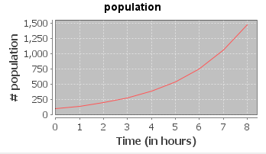
How to use our modeling software
The notation to use
Each node has these properties:
Entity | Example
A name | Population
A type | Accumulator
A set of inputs | “births” is an input of “population”
A calculation of its value | NewValue = CurrentValue + births
A graph of its value over time

Slide 10
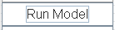
How to use our modeling software
The notation to use
Entity | Example
A name | Population
A type | Accumulator said to increase
A set of inputs | “births” is an input of “population”
A calculation of its value | NewValue = CurrentValue + births
A graph of its value over time
1) You define these
2) Then you run the model (click on the button)
3) Then the software computes the graph

Slide 11
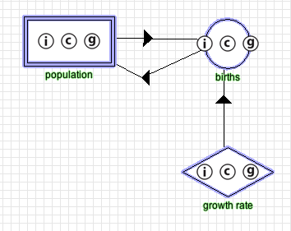
How to use our modeling software
The notation to use
This is what our bacteria example would look like with our software:
Each little circle’s letter indicates a property of the node:
i → input
c → calculation
g → graph
The arrows, which indicate inputs, have arrowheads in the middle.
To see other information about a node (e.g., its calculation or its graph), click anywhere on the node, which opens the node editor

Slide 12
How to use our modeling software
The notation to use
Our bacteria example would be modeled in the software like so:
The shape of a node displays its type, as explained in the next slide

Slide 13
The Types of Nodes
Fixed Value– The node’s value is a given number, that does not change as time passes.
In our bacteria example:
Value = 0.40 representing the proportion of population reproducing per hour
Function – The node’s value is a function of its inputs.
In our bacteria example:
Value = population x growth rate
Accumulator – The node possesses an initial value and builds its next value upon its current value and its inputs.
In our bacteria example:
Initial Value = 100
Next Value = Current Value + births

Slide 14
Introduction to system dynamics modeling
During this session you will learn:
the basic concepts
how to construct a given model
how to fix a model
how to design a model

Slide 15
The Types of Nodes
Fixed Value– The node’s value is a given number, that does not change as time passes.
In our bacteria example:
Value = 0.40 representing the proportion of population reproducing per hour
Function – The node’s value is a function of its inputs.
In our bacteria example:
Value = population x growth rate
Accumulator – The node possesses an initial value and builds its next value upon its current value and its inputs.
In our bacteria example:
Initial Value = 100
Next Value = Current Value + births

Slide 16
In the first introduction problem, you will learn how to create a model with a single node : a fixed value.
Introduction Problem 1
click to create a new node

Slide 17
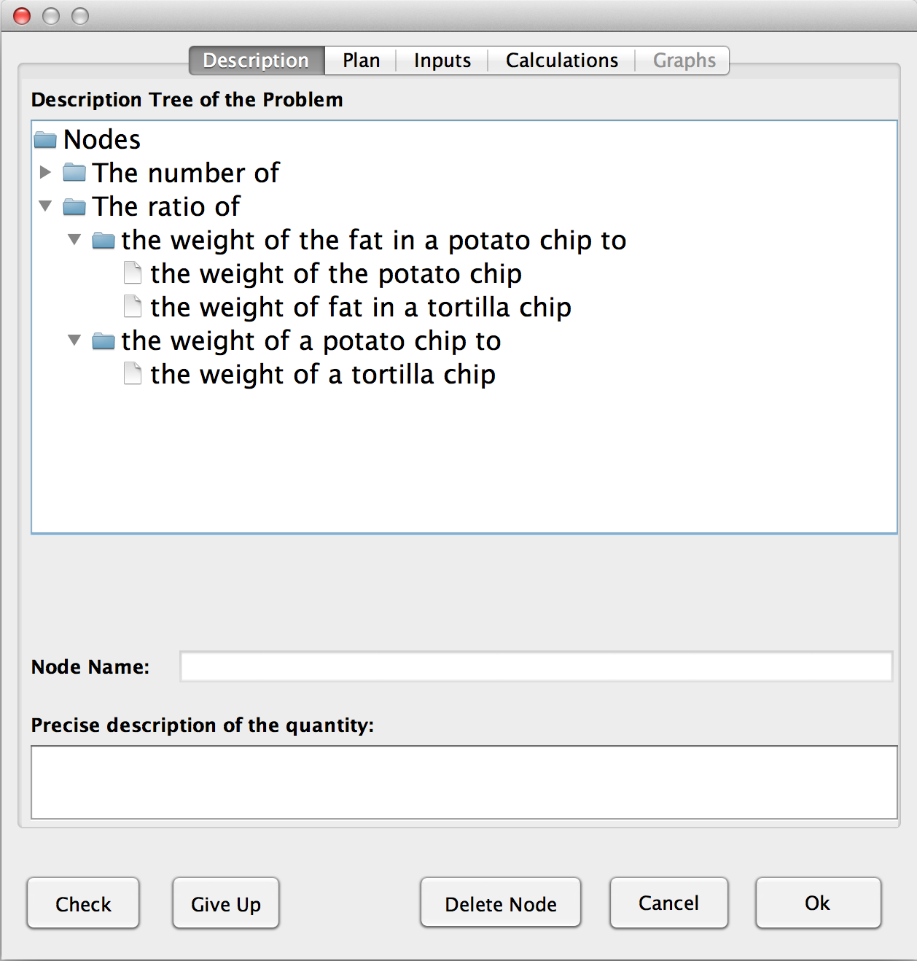
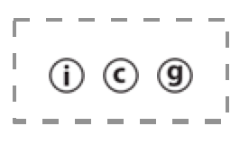
The Description tab is for you to describe the quantity that the node refers to
Click on tiny icons to open and close “folders” until the names, chained together, are the description you need, then click on it.
Description tab
Select
“the ratio of the weight of a potato chip to the weight of a tortilla chip”
2) Click on the “Check” button
This is the description in a more easily read form.
The system then creates a short name that appears below the node symbol
Node Name

Slide 18
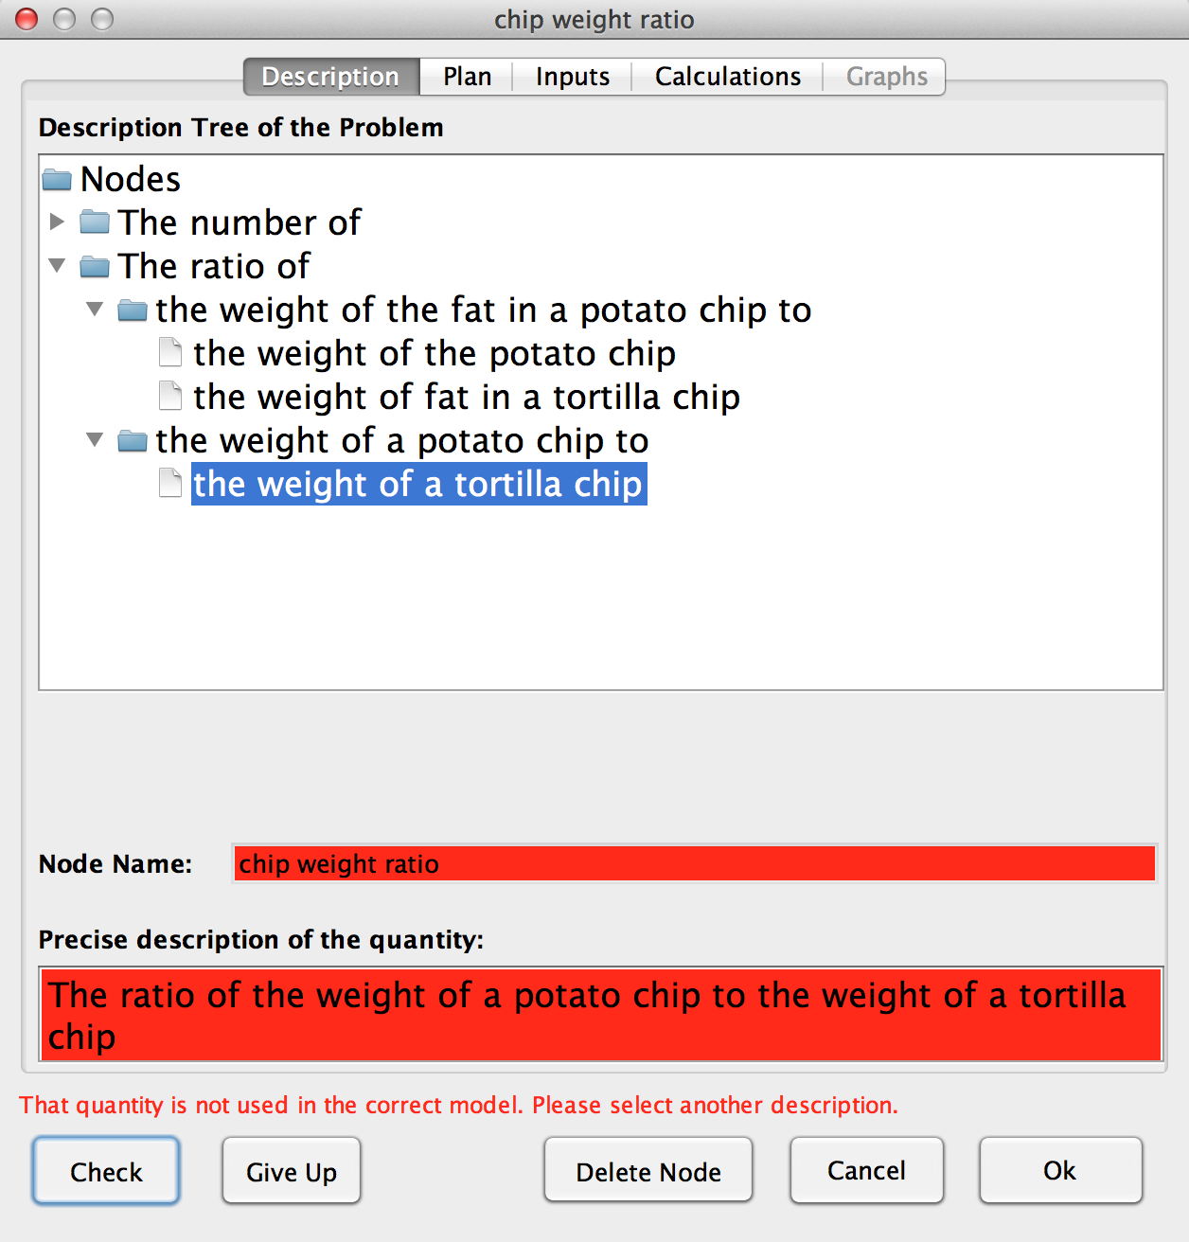
Description tab
“the ratio of the weight of a potato chip to the weight of a tortilla chip” is not part of the quantities necessary to create the system.
Therefore the description turned red.
Read the situation again, and find the right node to create, then “check”

Slide 19
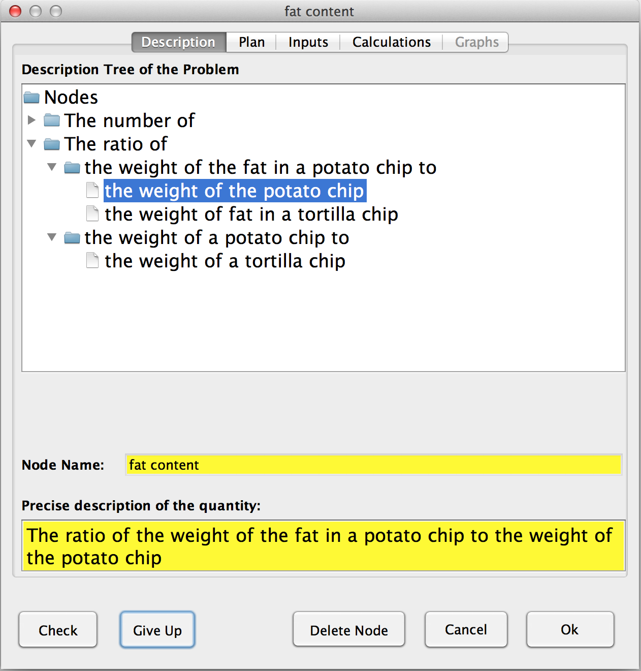
“Give Up” turns parts of the node yellow. Study the correct answer so you can do it on your own next time.
If you have failed several times, you can let the system solve it for you
Notes:
Save as 567x425 pixels.

Slide 20
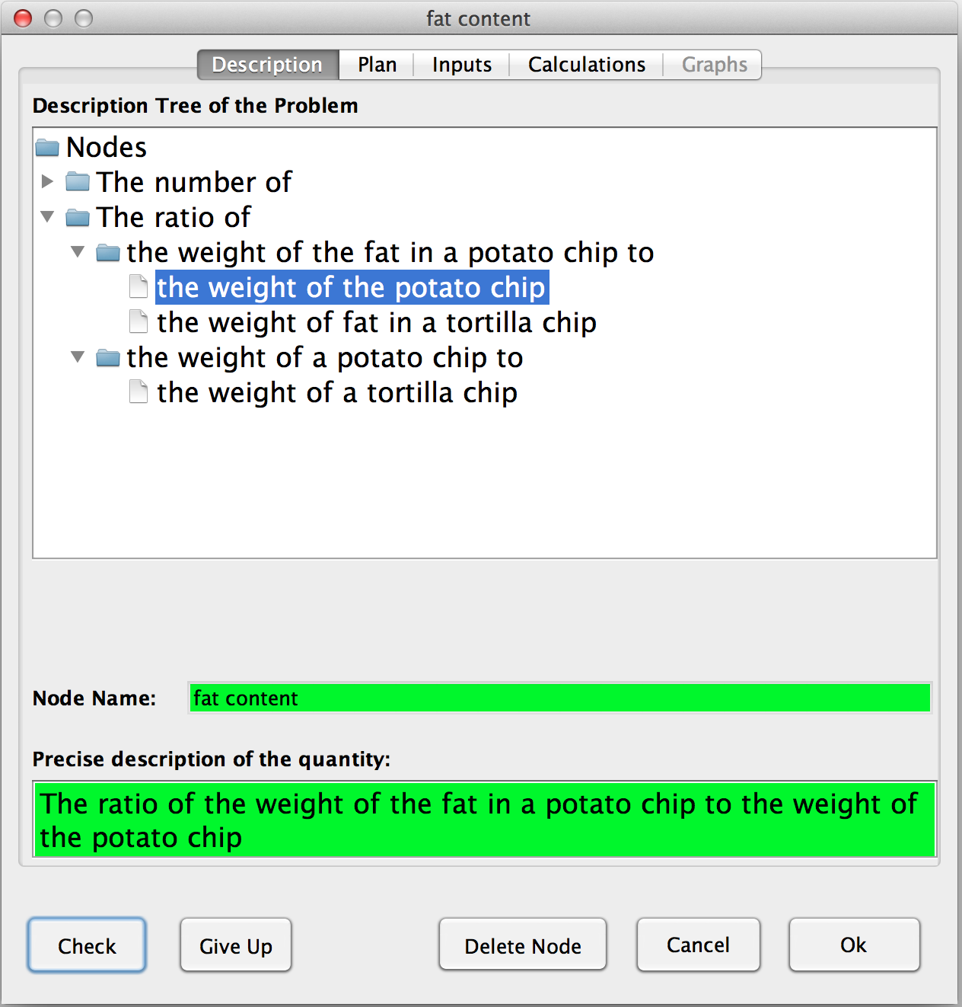
Node name is always here.
Description tab
You have found the right description of the node you want to create, therefore it turned green!
When you get green, click on the Plan tab

Slide 21
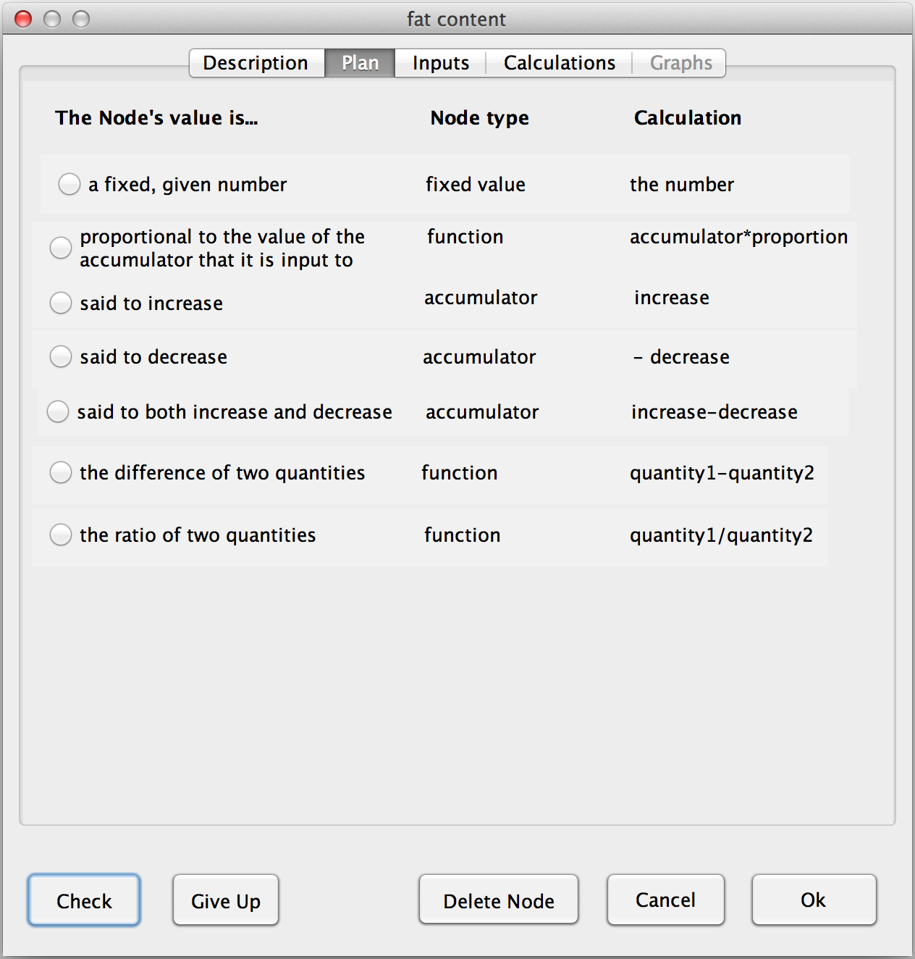
Plan tab
The PLAN TAB helps you decide how a nodes value is specified (first column), which then determines the node’s type (second column) and the node’s calculation (third column).
Read the situation again, then click on the row that best describes how the value of the “fat content” node is determined, and then click on the Check button.”

Slide 22
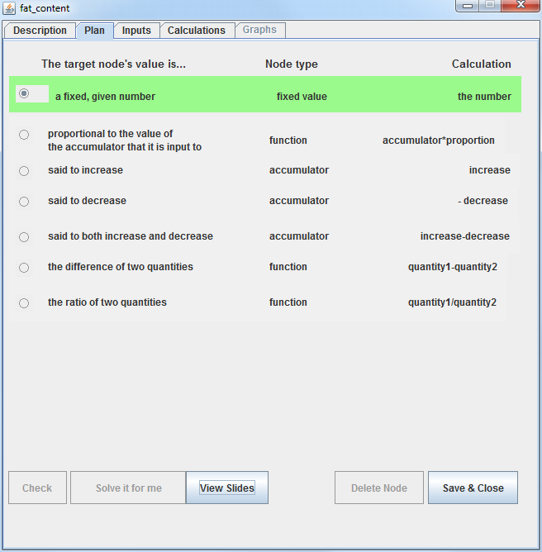
When you get green, click on the Inputs tab
Plan tab
Because the problem statement says, “By weight, potato chips are 35% fat,” you know that the value of the “fat content” is a fixed, given number, 0.35.
As you will see in a moment, that establishes a plan for filling out the remaining tabs, inputs, and calculations.

Slide 23
The INPUTS TAB allows you to define the inputs to the calculation of this node's value before having to think about the mathematical details of the calculation itself.

Slide 24
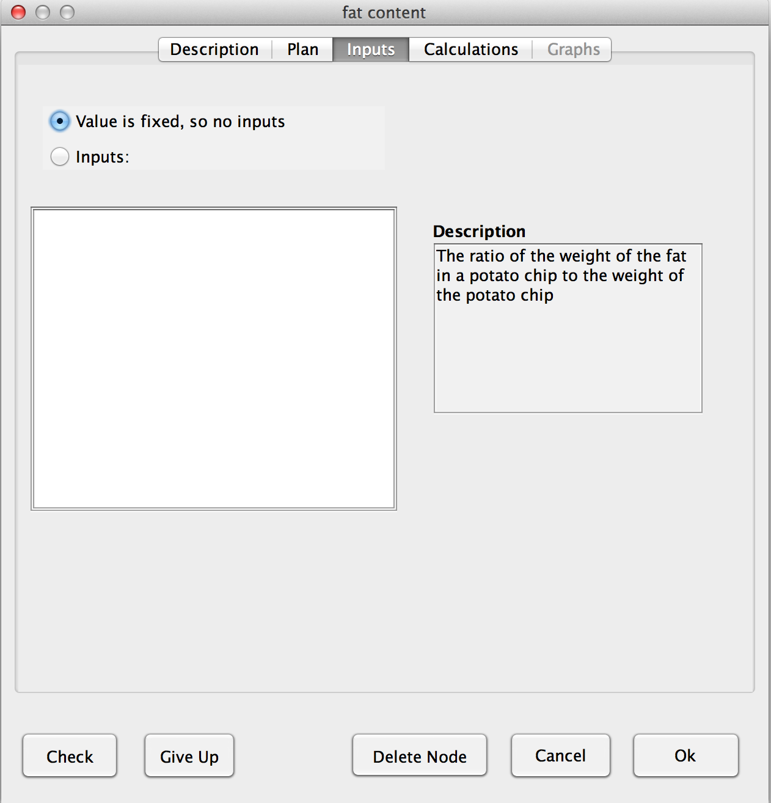
Inputs tab
In the plan tab, this node was defined as a "fixed value", you need to select this option here.
The node value is “fixed value” so you don’t need to calculate it from inputs
Handy to see the definition here.
(2) Click to check correctness

Slide 25
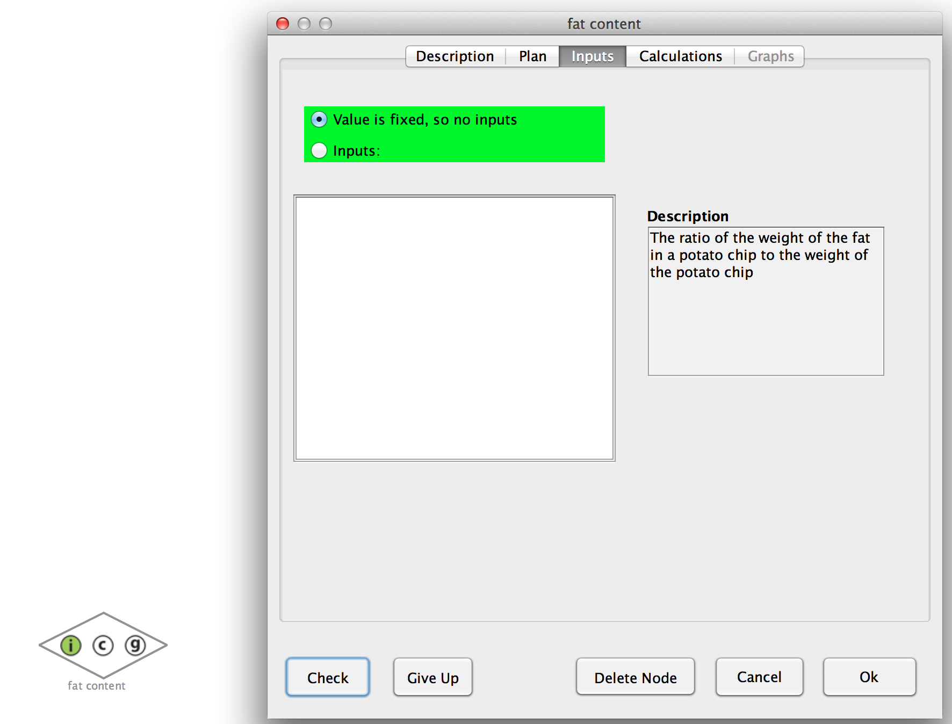
Inputs tab
As the inputs tab is checked, the node type is defined as “fixed value”, and the shape of the node becomes a diamond
And the “I” indicator becomes green because the inputs are correct

Slide 26
The CALCULATION TAB allows you to specify the formula or number that determines the node’s value, using the inputs from the inputs tab.

Slide 27
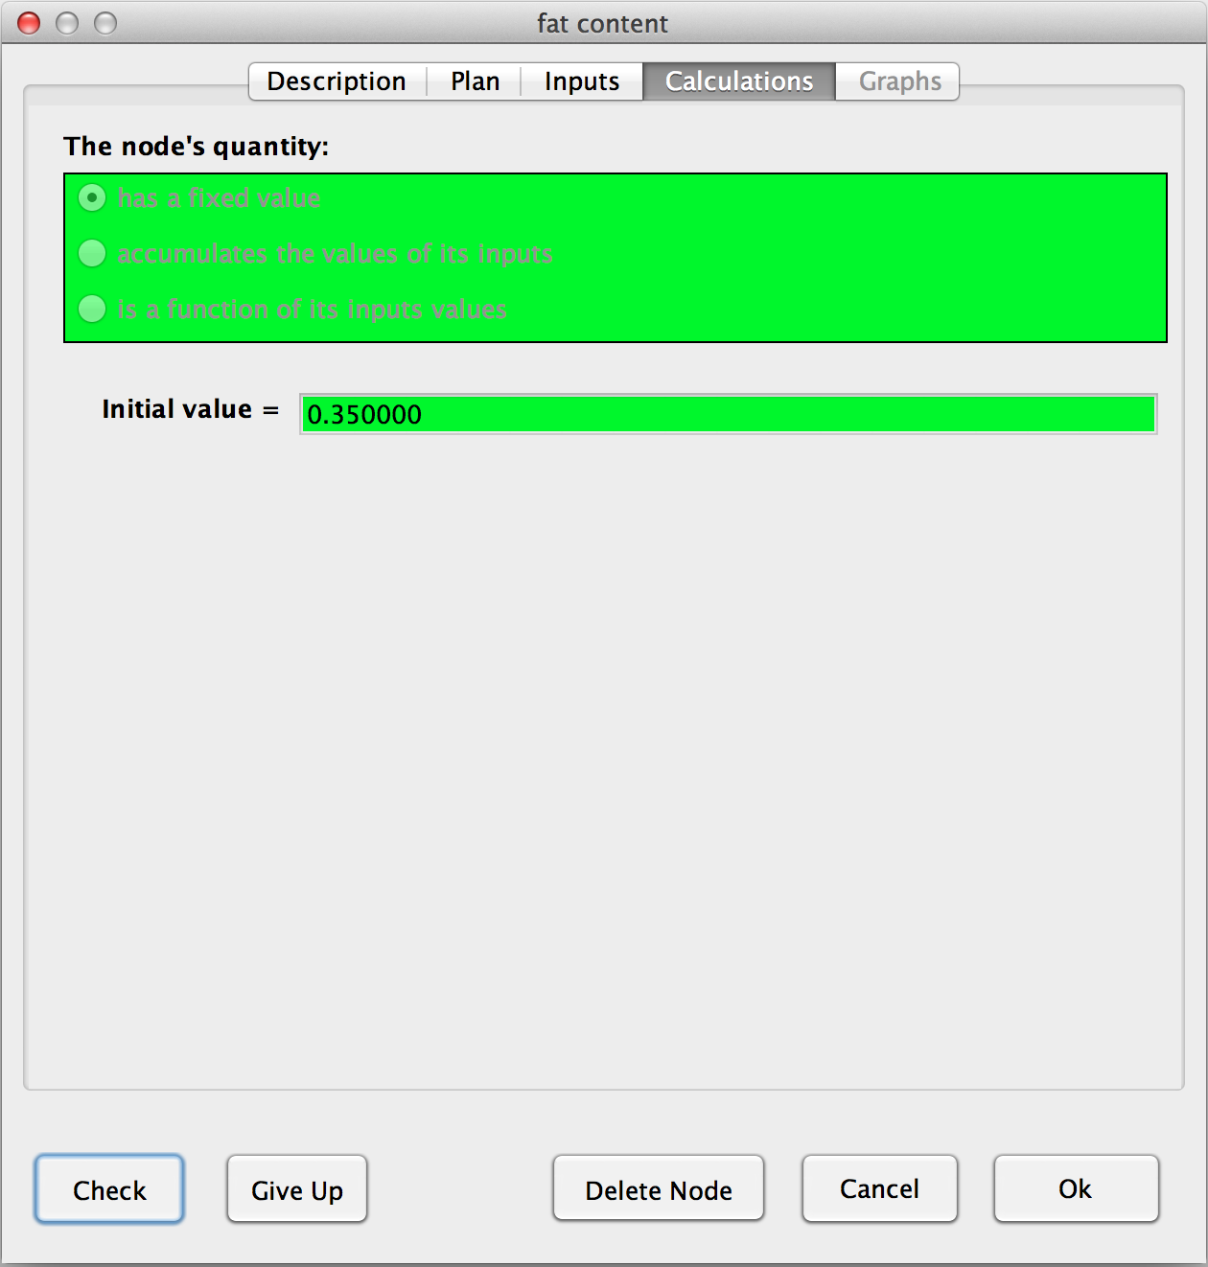
Calculation tab
(1) Type the given value (0.35) here. No commas.
(3) When correct, close node editor.
(2) then check correctness

Slide 28
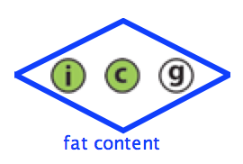
Blue border means the node is done
Click to run the model. “Running” means doing all the calculations in the model.
This refers to the input tab
This refers to the calculation tab
This refers to the graph tab
These circles are green if correct, red if incorrect, yellow if given up on, and white if not checked yet.

Slide 29
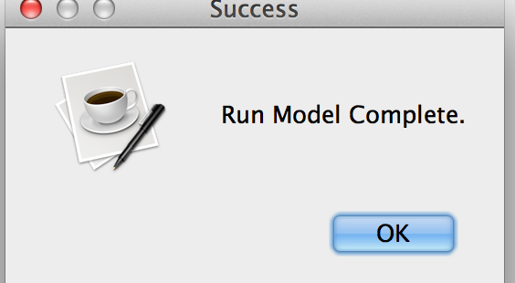
You should get the message “Model run complete!” If not, then something is wrong with your model, so edit it and try again.
click OK

Slide 30
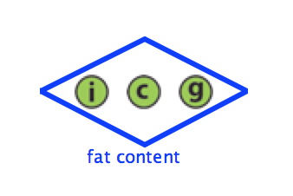
Double click on the node in order to open the node editor.

Slide 31
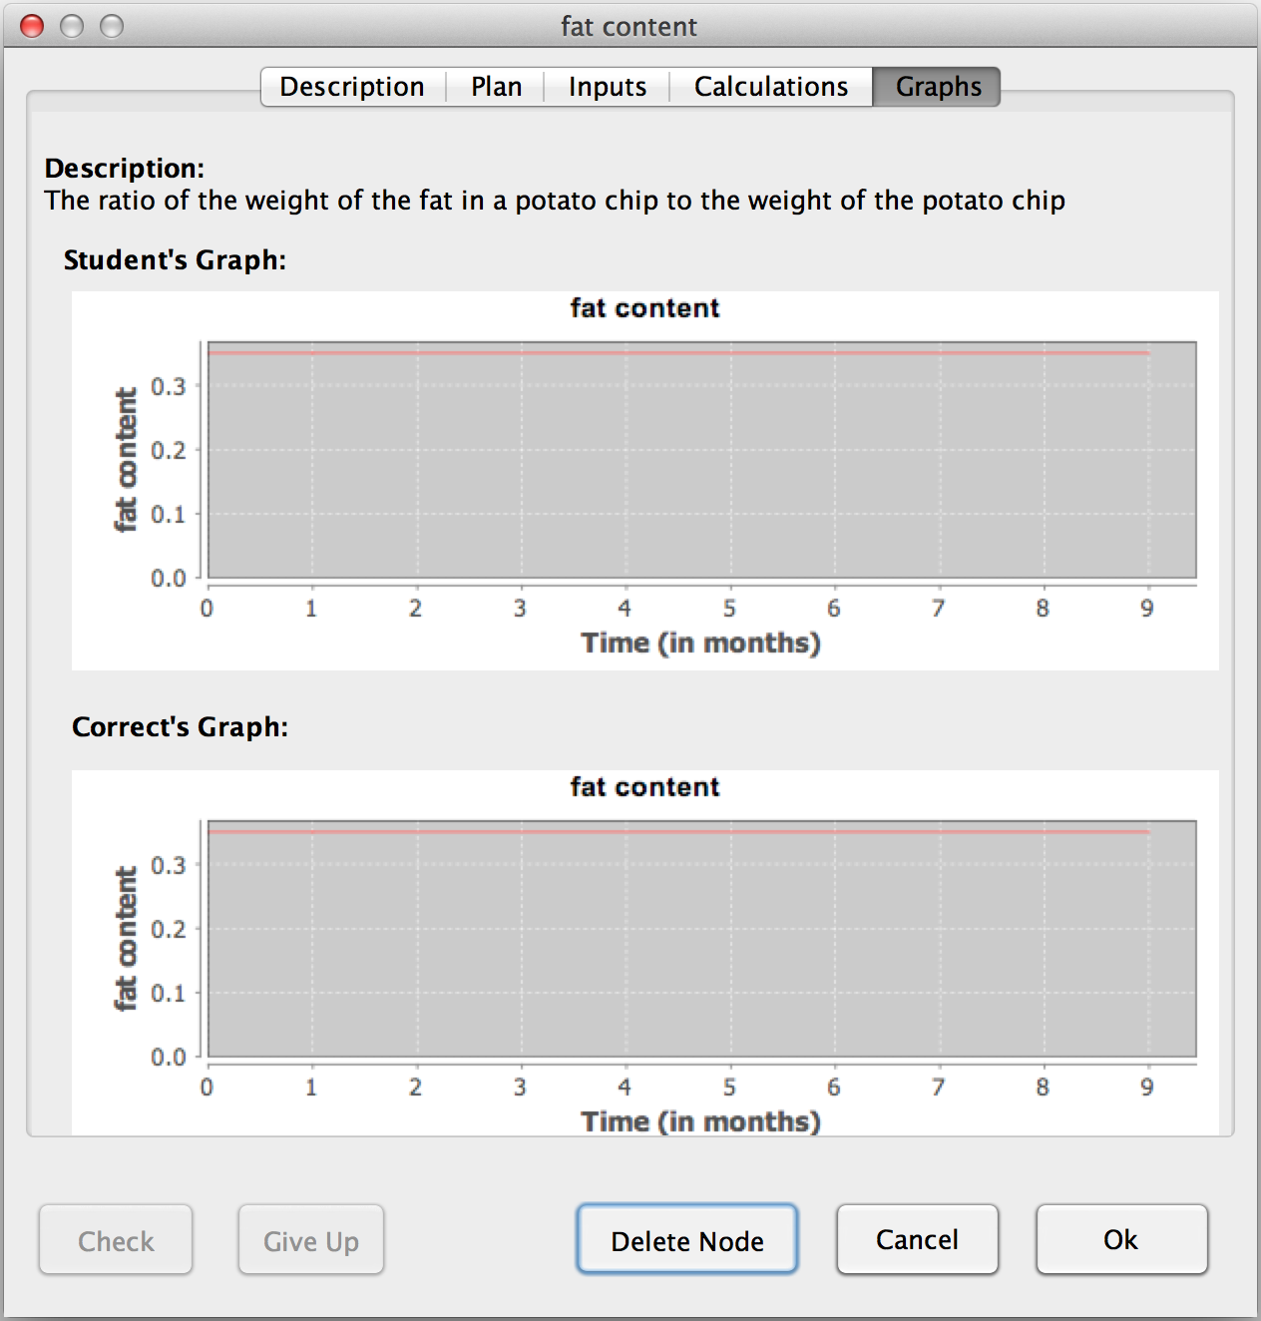
Graph tab
Your model’s graph (labeled “User’s graph”) is the same as the expected graph, so this node’s value is correctly modeled.
You can now close the node

Slide 32
The Done button is usually gray (disabled). When your model is both correct and complete, then it darkens (enabled). Click on it. This is the only way to move to the next problem.
click Done to move to next problem

Slide 33
In this introduction problem, you will discover how to create a model with a function. In order to facilitate things, two nodes are already created: the “fixed values” of the problem. Follow these slides to add a third, a Function node, to the model.
Introduction Problem 2

Slide 34
The Types of Nodes
Fixed Value– The node’s value is a given number, that does not change as time passes.
In our bacteria example:
Value = 0.40 representing the proportion of population reproducing per hour
Function – The node’s value is a function of its inputs.
In our bacteria example:
Value = population x growth rate
Accumulator – The node possesses an initial value and builds its next value upon its current value and its inputs.
In our bacteria example:
Initial Value = 100
Next Value = Current Value + births

Slide 35
You are looking for a quantity that is not a fixed value given in the problem description, but a value that
Function Node
you need to calculate using other quantities’ values, and
The calculation does not depend on this node’s old value.
(2) Once you know what the missing quantity is, Create a new node, and fill the description tab

Slide 36
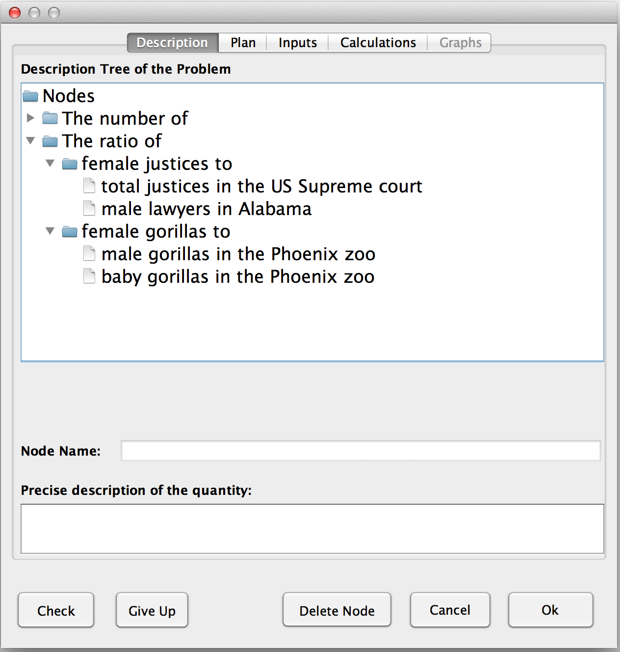
Function Node : Description
The quantity missing is “The ratio of female justices to total justices in the Supreme court”
(2) When correct, go to Plan tab
(1) Check correctness

Slide 37
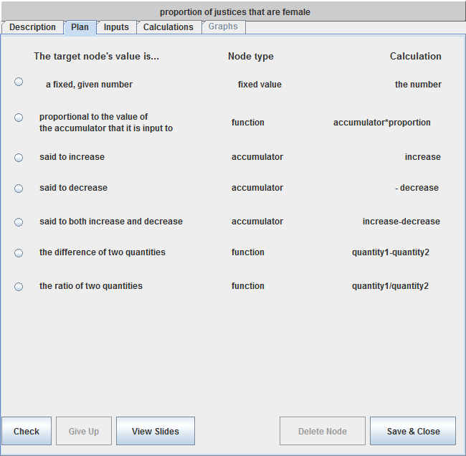
Function Node : Plan
There are three types of function nodes:
Read the situation again, and define what type of function node you need to create.

Slide 38
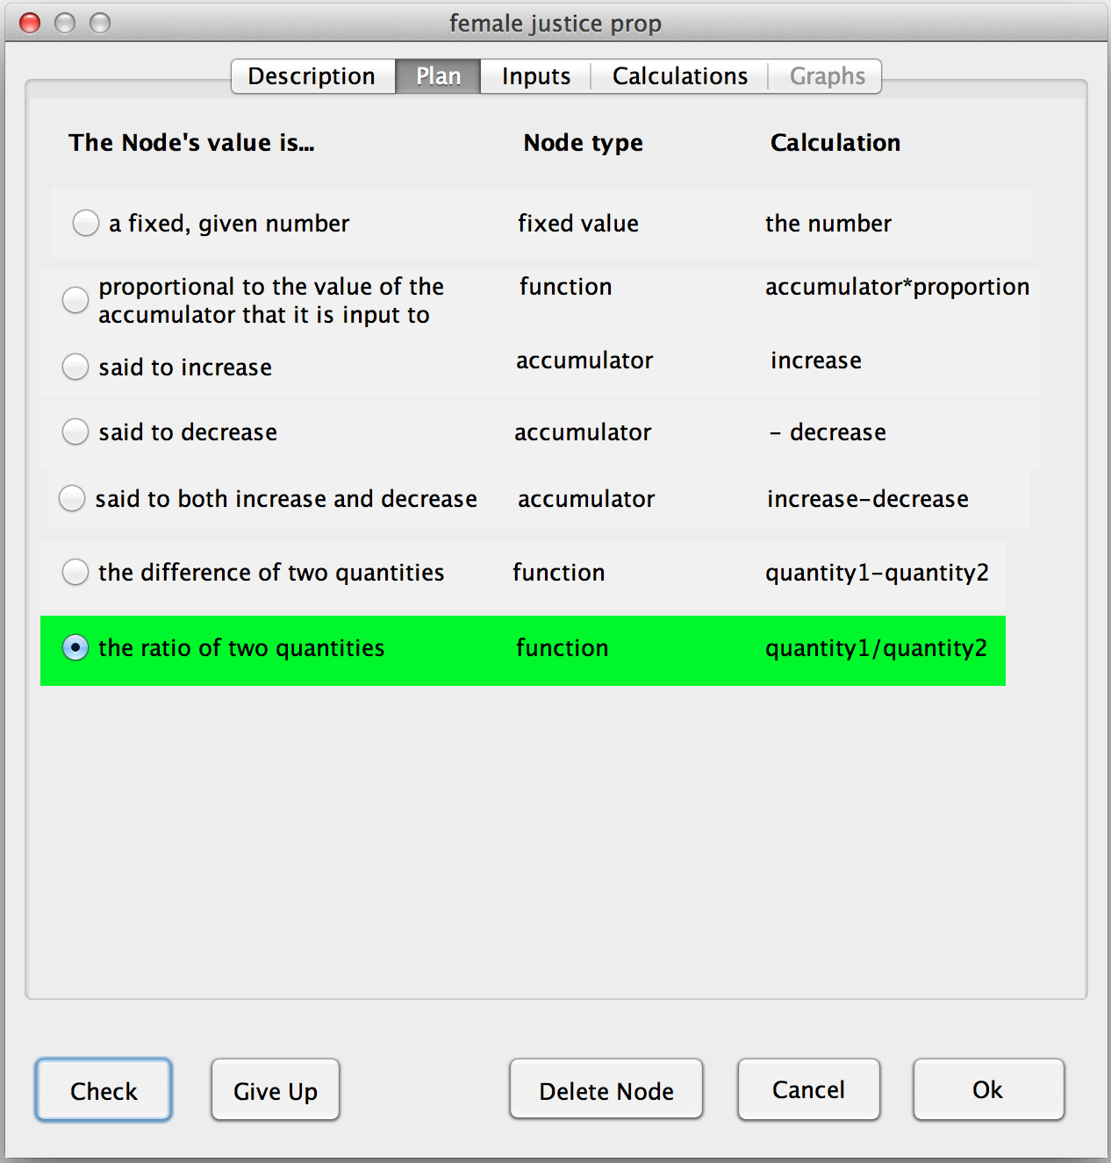
Function Node : Plan
“The ratio of female justices to total justices in the Supreme court” quantity corresponds to the ratio of two other quantities
(2) When correct, go to Inputs tab
(1) Check correctness

Slide 39
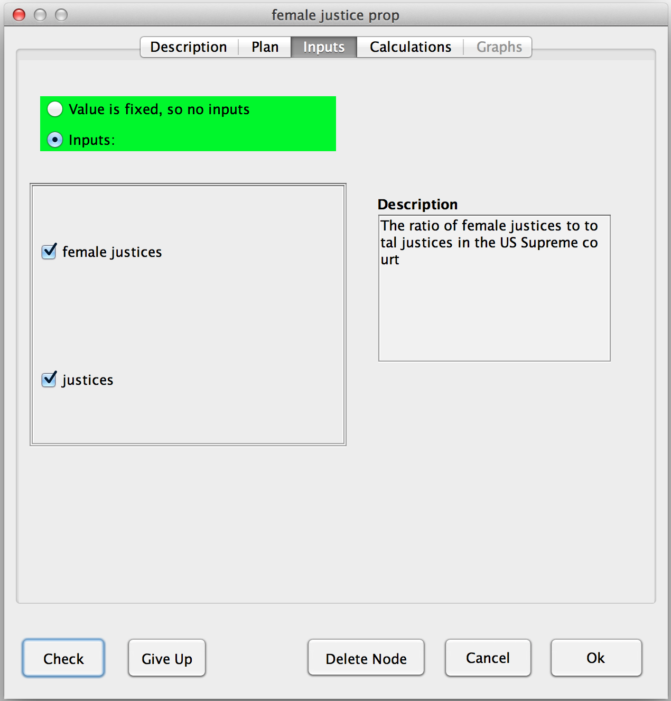
The node’s value is calculated using the two existing nodes, so
Function Node : Inputs
(1) Select Inputs
(2) Choose both inputs : to calculate the ratio, you need both quantities
click here & here
(4) When correct, go to Calculations tab
(3) Check correctness

Slide 40
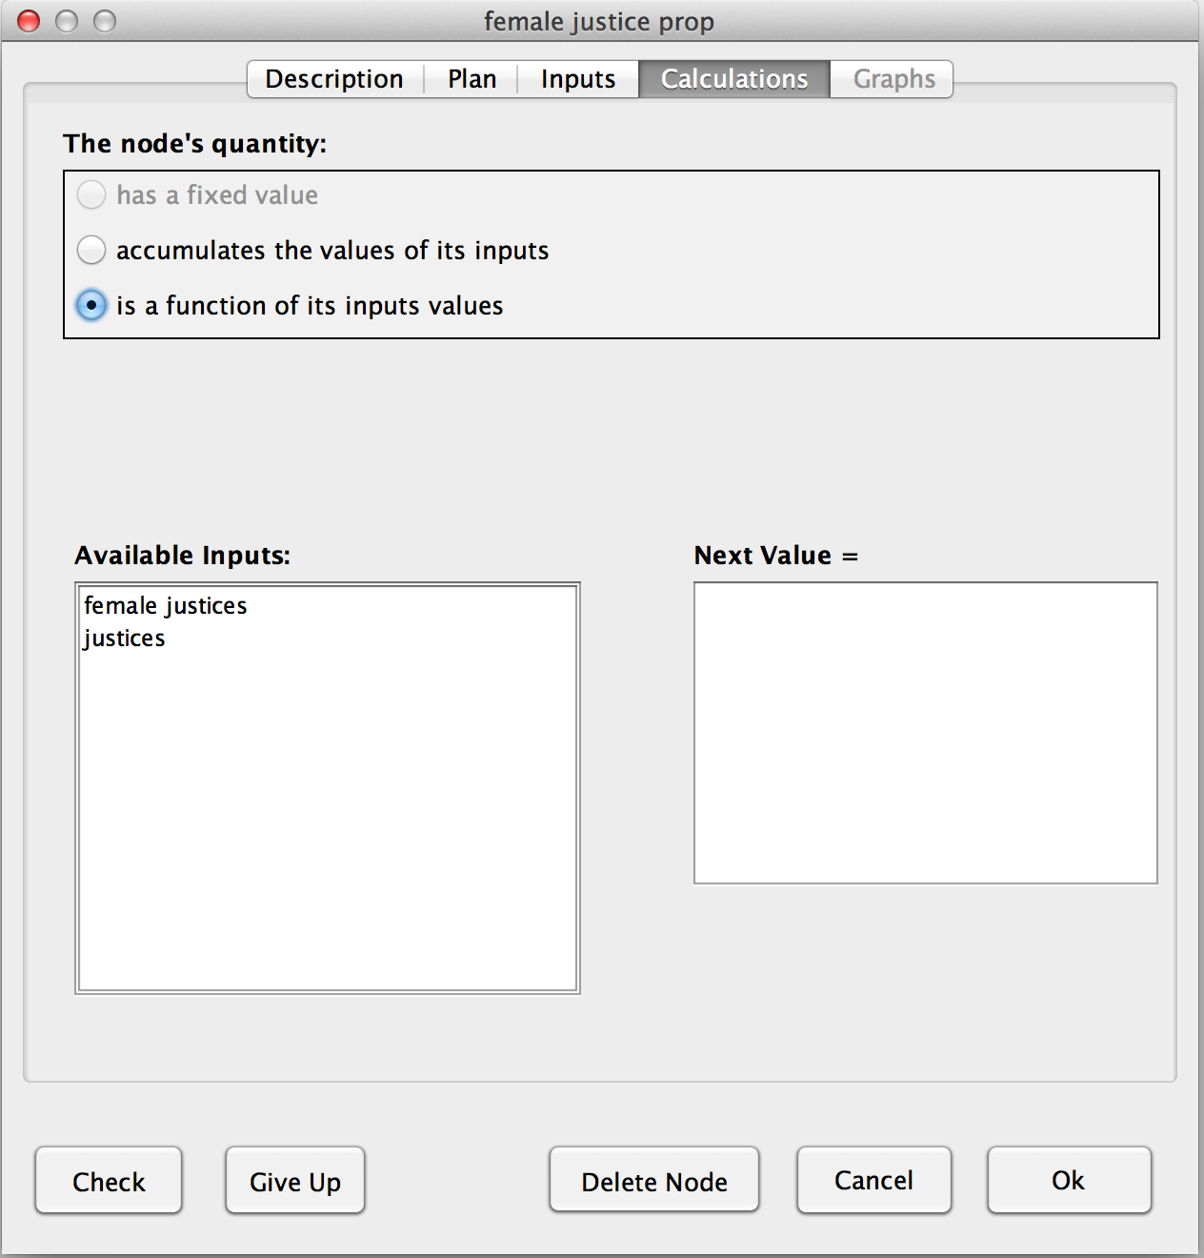
Function Node : Calculation
The node’s type is defined as a function in the Plan tab, so
(1) Click here
We want the calculation to be: Next Value = female_justices/justices
(2) Enter the calculation by clicking on the names of nodes and typing arithmetic operators such as +, -, *, / and ^.
(4) When correct, close the node
(3) Check correctness

Slide 41
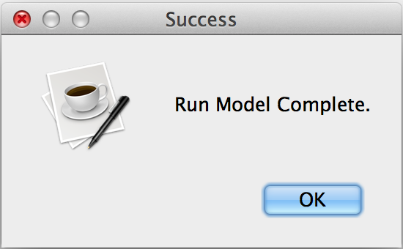
You can now run the model to check if it is correct.
Function Node
(1) Run your model
(2) Click OK
(3) When its enabled, click Done to move to next problem
You should get this

Slide 42
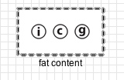
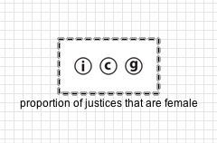
Type of Nodes
Fixed Value or Function
vs
In Problem 1, the value of the node you created was given and thus constant for all time ticks.
In Problem 2, the value of the node you created was NOT given. Even though its value was constant for all time ticks and you could have calculated the valueby hand, that would not model what the situation says. Thus, you created a Function node. In general, the values of Function nodes are not constant. This was just a special case to illustrate the difference between Fixed Value nodes and Function nodes.

Slide 43
In this introduction problem, you will discover how to create a model with an accumulator. In order to facilitate things, two nodes are already created: the “fixed values” of the problem. Follow these slides to add a third, an Accumulator node, to the model.
Introduction Problem 3

Slide 44
The Types of Nodes
Fixed Value– The node’s value is a given number, that does not change as time passes.
In our bacteria example:
Value = 0.40 representing the proportion of population reproducing per hour
Function – The node’s value is a function of its inputs.
In our bacteria example:
Value = population x growth rate
Accumulator – The node possesses an initial value and builds its next value upon its current value and its inputs.
In our bacteria example:
Initial Value = 100
Next Value = Current Value + births

Slide 45
You are looking for a quantity that is not a fixed value given in the problem description, but a value that:
Accumulator Node
has an initial value on the first tick
and its subsequent values are calculated from both its current value and other node’s values.

Slide 46
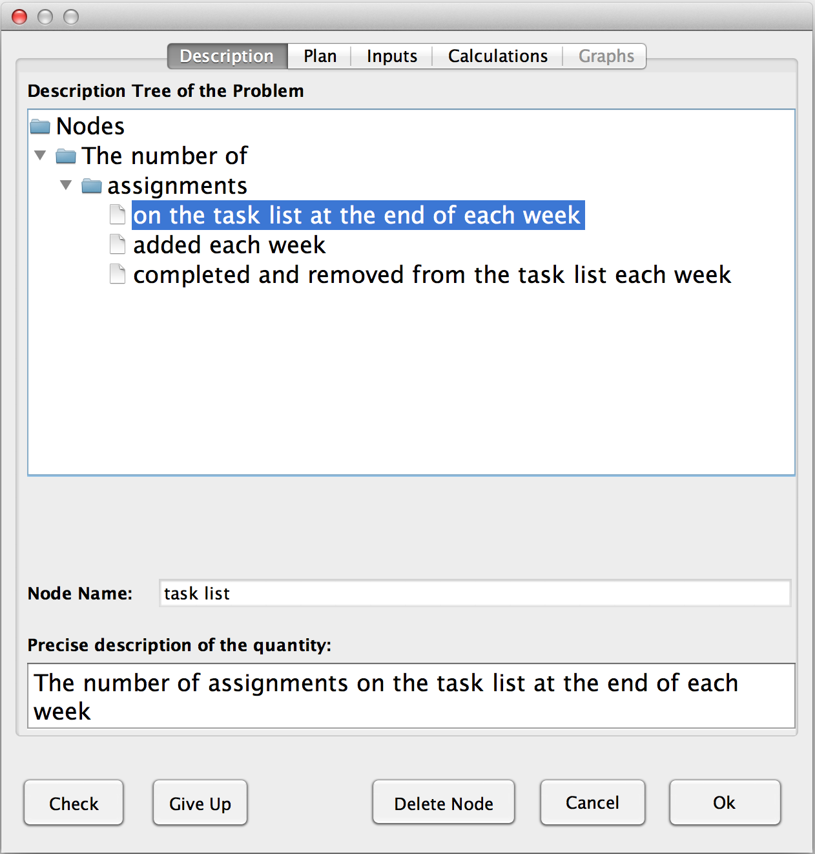
Accumulator Node : Description
The quantity missing is “The number of assignments on the task list at the end of each week”
(2) When correct, go to Plan tab
(1) Check correctness

Slide 47
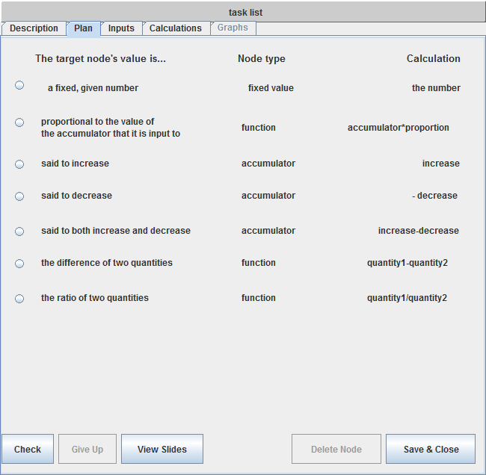
Accumulator Node : Plan
There are three types of accumulator nodes:
Read the situation again, and define what kind of accumulator node you need to create.

Slide 48
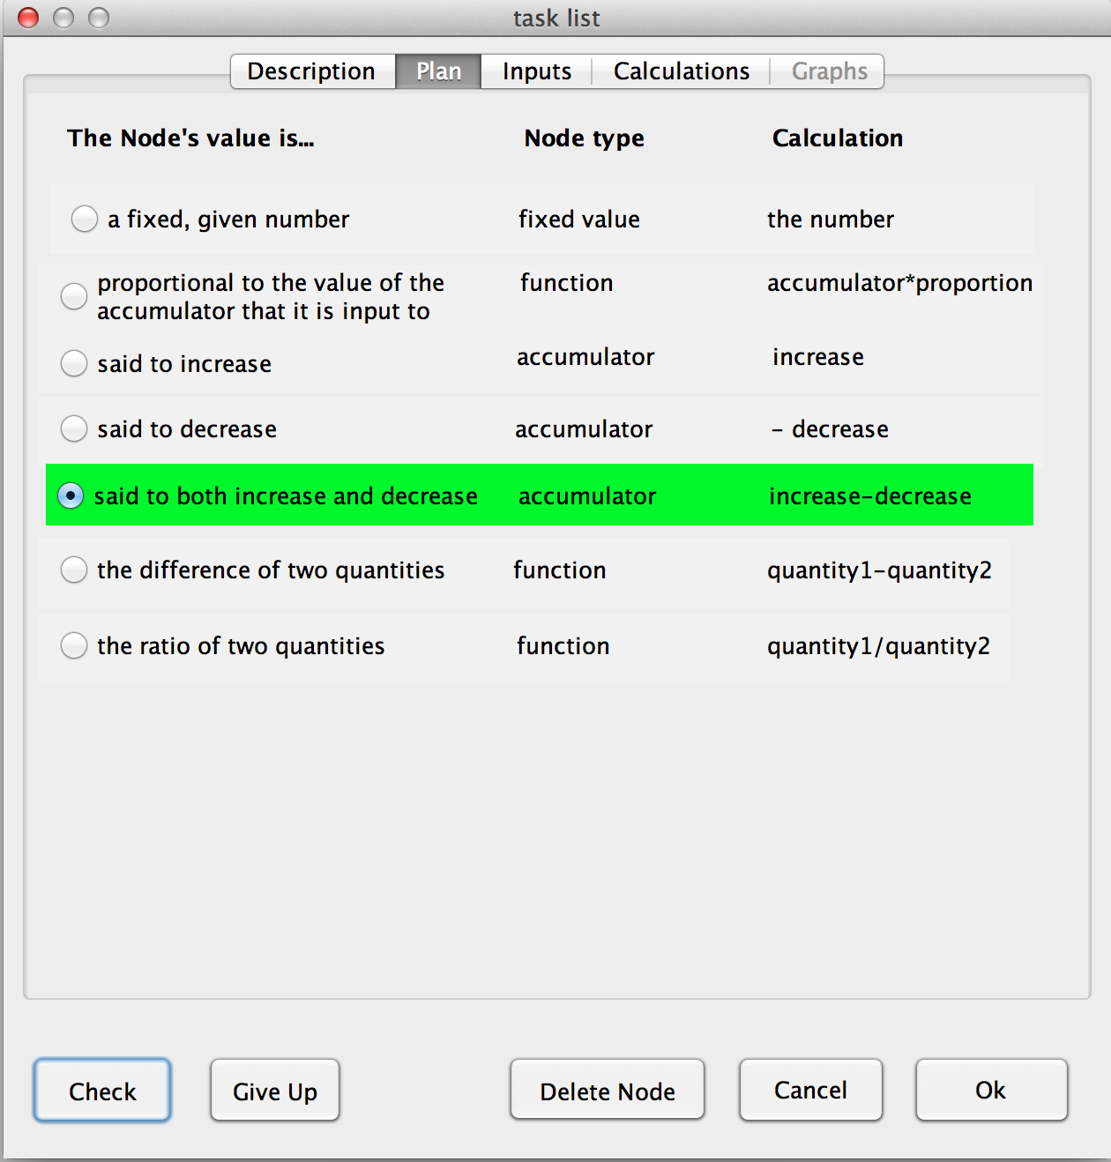
Accumulator Node : Plan
“The number of assignments on the task list at the end of each week” changes by adding the new assignments and removing the ones completed
(2) When correct, go to Inputs tab
(1) Check correctness

Slide 49
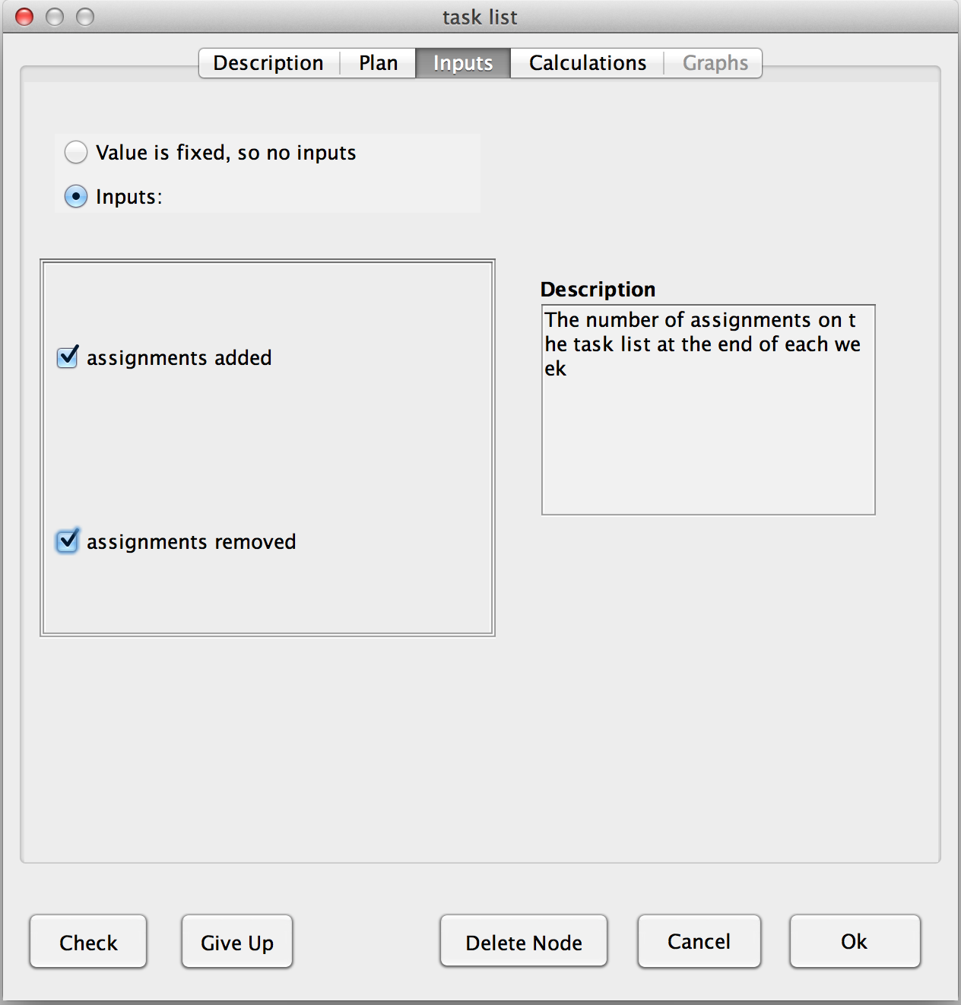
Accumulator Node : Inputs
The node’s value is calculated using the two existing nodes, so
(1) Select Inputs
click here & here
(2) Choose both inputs : to calculate the length of the task list, you need both quantities
(3) Check correctness
(4) When correct, go to Calculations tab

Slide 50
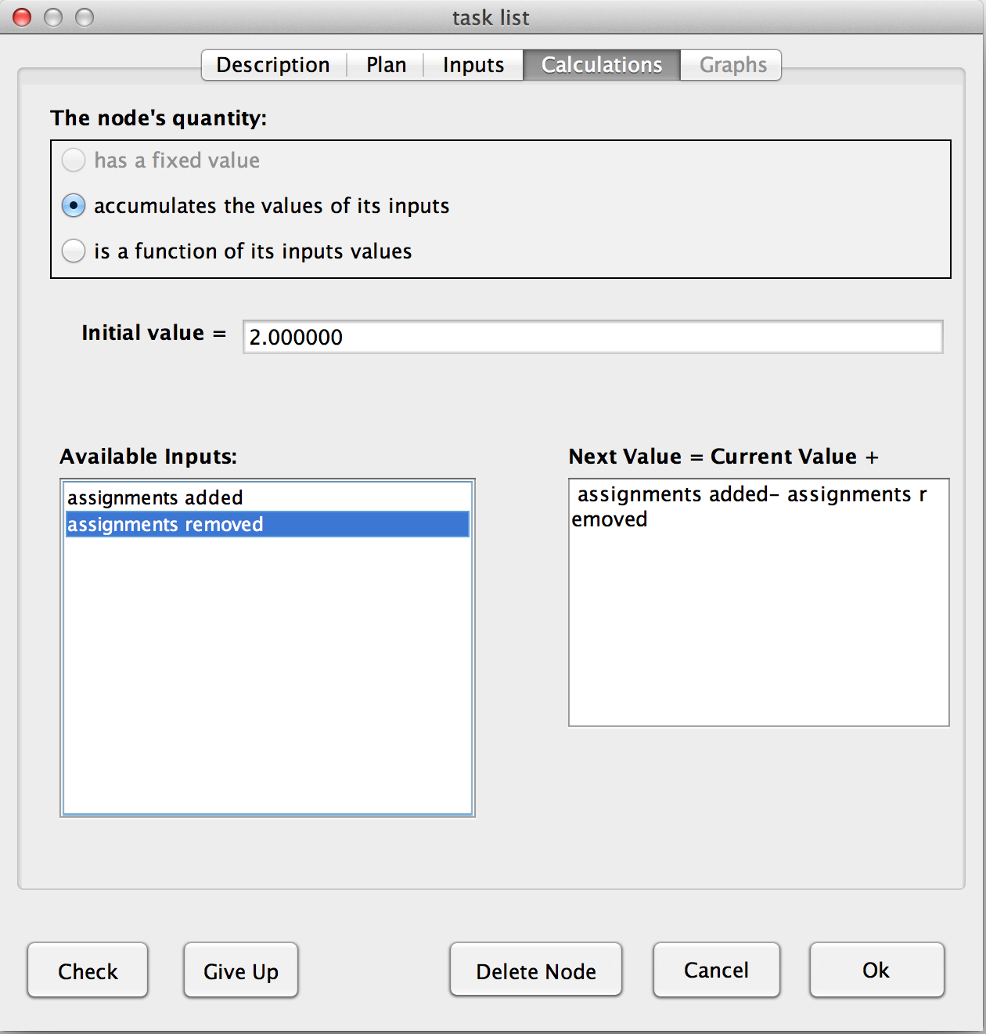
Accumulator Node : Calculation
The node’s type is defined as an accumulator in the Plan tab, so:
(5) When correct, close the node
(1) Click here
(2) An accumulator node has a number as its initial value. Enter “2” here.
(3) An accumulator node gets its next value from its current value plus an algebraic expression. Enter the expression here. It represents the change (increase or decrease) in the node’s value each time tick.
We want the calculation to be: Next Value = Current Value + assignments added – assignments removed
(4) Check

Slide 51
You can now run the model to check if it is correct.
Accumulator Node
(1) Run your model
(2) Click OK
(3) When its enabled, click Done to move to next problem
You should get this

Slide 52
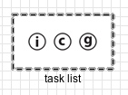
Type of Nodes
Function or Accumulator
vs
In Intro Problem 3, the calculation depends on the node's prior value. Thus, it has to have an initial value (which was 2 assignments) and a calculation of it’s next value that includes it’s current value:
In Intro Problem 2, the calculation of the value did not depend the node’s current value, but only on the values of other nodes.
Next Value = female_justices / justices
Next Value = Current Value
+ assignments added
– assignments removed

Slide 53
Introduction to system dynamics modeling
During this session you will learn:
the basic concepts
how to construct a given model
how to fix a model
how to design a model

Slide 54
Why do models need “fixing”?
When professionals construct a model, they check its predictions against some facts they know to be true. If the model’s predictions don’t match the facts, then something in the model is wrong and needs “fixing”.
Sometimes you may make a mistake when building your model. The Run Model button still works, but it produces predictions (graphs) that don’t match the correct graphs. If this happens to you, then you will have to fix your model.

Slide 55
Intro problem 4 teaches you how to fix a model. It gives you a model that has one wrong item in it. Using the graphs, you should find the problem, fix it, run the model and click on the Done button. Follow the yellow bubbles to learn how.
Introduction Problem 4

Slide 56
Fixing a model
(1) Run the model
(2) Click OK
(3) Look closely at the colors that appear on the model, before going to the next slide

Slide 57
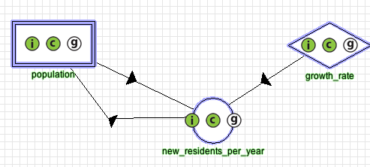

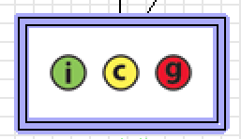
Blue border means the node is completely defined (but could either be correct or incorrect)
This refers to the input tab
This refers to the calculation tab
This refers to the graph tab
These circles are green if correct, red if incorrect, yellow if given up on, and white if not checked yet.

Slide 58
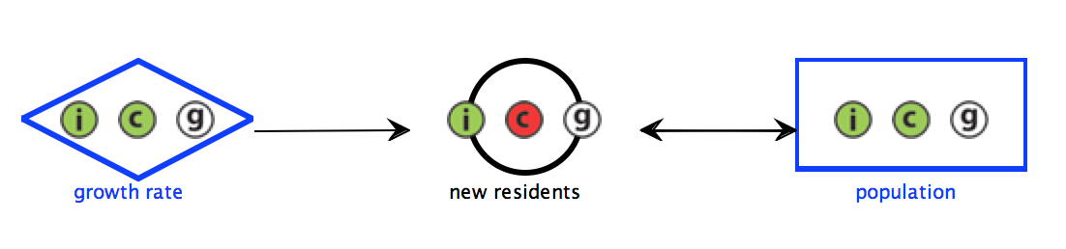
What is the error (or errors)?
If the “i” indicator of a node is red, then the node’s Inputs tab has an error on it, and you should fix that before doing anything else. If the “c” indicator is red and the “i” indicator is green, then the Calculation tab has an error on it. If the “g” indicator is red but the other indicators are green, then that node has no error in it. Its graph is incorrect because an error somewhere else is sending incorrect numbers to this node.
The problem seems to be here, so open the node to review it. The inputs tab is correct, but the calculation tab needs work.

Slide 59
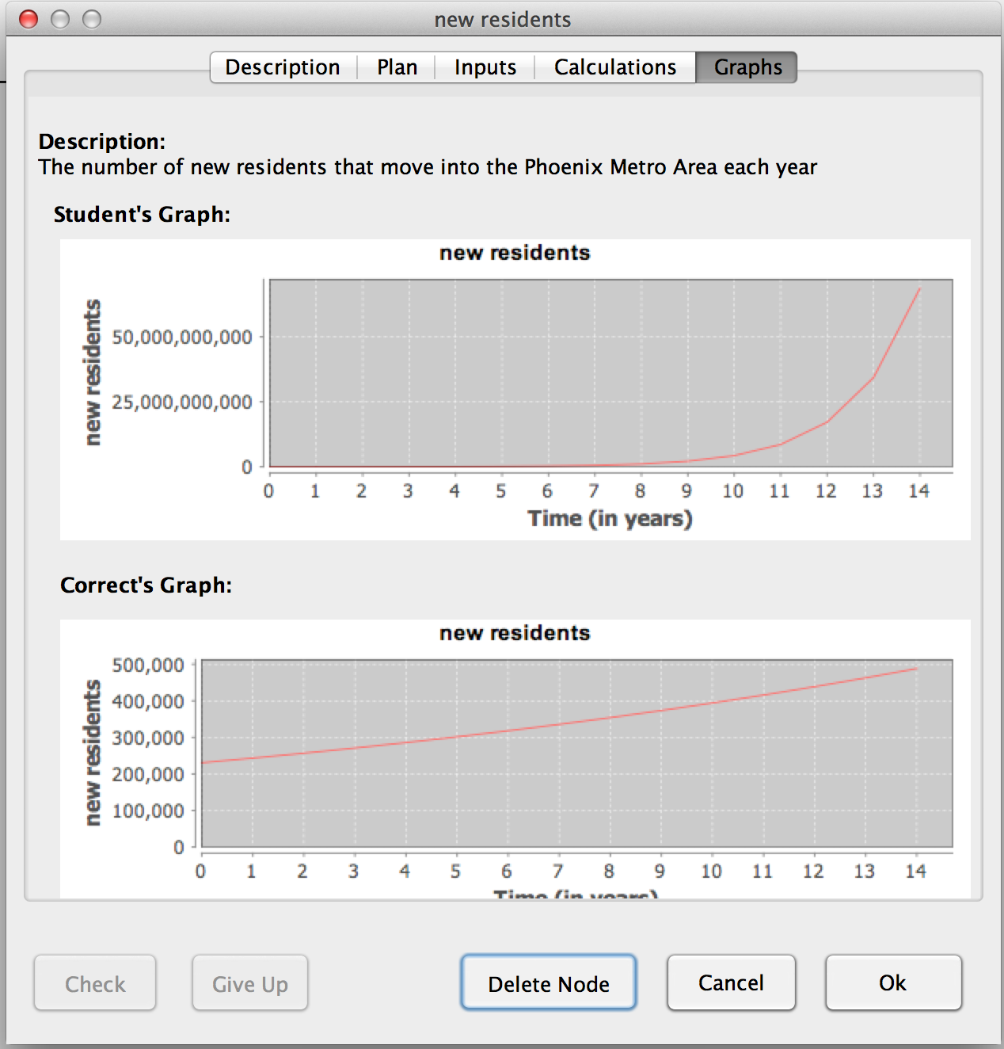
(1) Click here
Yours
Correct
The value is rising too rapidly. Let’s check the calculation.

Slide 60
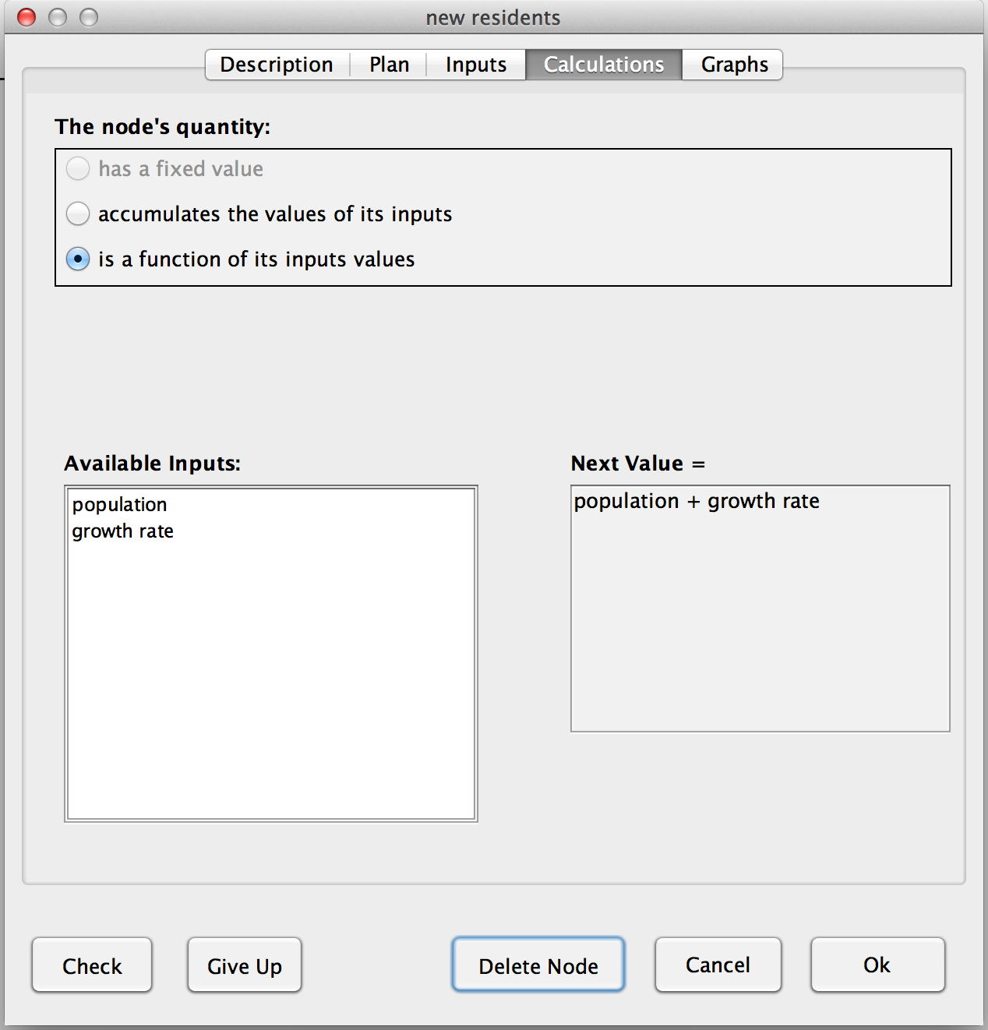
(1) If you can’t see where the problem is immediately, then check
Found the mistake! There is a “+” where there should be a “X
”
(2) Edit the calculation to fix the problem
(4) When correct, close node.
(3) Check again

Slide 61
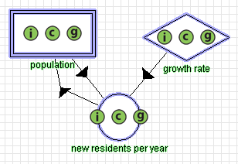
Run the model, and all graph “g” indicators turn green. You found all the problems! Click the Done button.

Slide 62
Introduction to system dynamics modeling
During this session you will learn:
the basic concepts
how to construct a given model
how to fix a model
how to design a model

Slide 63
Avoiding confusion
Problems often mention quantities that are unnecessary for the model.
To avoid confusing yourself by creating useless nodes, use the “target node strategy:”
Explained on the next slide
The target node strategy is guaranteed to create the minimal number of nodes.
It also vastly simplifies the planning of nodes.

Slide 64
The target node strategy
Getting started: The situation tab always asks you to graph a quantity. Create a node for this quantity and select its description. Call it the target node.
Note: This is the only time you will use the Create Node button that is near the Run Model button.
Finish the target node without leaving it: Fill out the plan, input and calculation tabs. Don’t stop halfway to work on another node.
Exception: When filling out the Inputs tab, and you need a quantity as an input that hasn’t been defined yet as node, then click on the Create A New Node button that is located ON THE INPUTS TAB. Use this button only to create inputs.
When you have finished and closed the target node:
If all nodes are finished (blue borders), then click on Run Model.
Otherwise, pick any unfinished node (gray border) as the next target node and go to step 2.

Slide 65
Why does the target node strategy prevent useless nodes?
A node is “useless” if it is not an input to anything and graphing it is not required by the Situation.
Except for the first node you created, which is required by the Situation, all the nodes you created are inputs to something.
After you create a new node with the Create a New Node button on the Inputs tab, it is automatically selected as an input.
Note: If you created a node this way, and later decide to uncheck it as input, be sure to delete it, too.
So your final model has no useless nodes.

Slide 66
Planning is easier
Filling out the Plan tab is easier if you follow the target variable strategy,
because there are only three cases:
This node is the first node you created, or
This node is an input to a Function, or
This node is an input to an Accumulator
Easy cases: See next slide
Easy cases: See next slide
Harder case: See slide after that

Slide 67
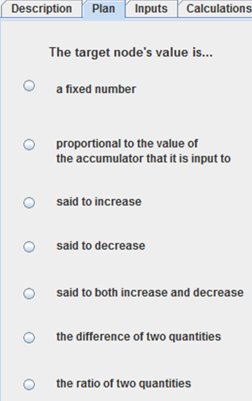
If the target node is an input to a Function or is the first node you create, then here are the cases:
The situation states a numeric value for a quantity that does not change over time.
The situation says the quantity changes by a certain amount.
e.g., “The population grows by 5.5% a year
e.g., “The water level sank by 1.5 inches a week”
e.g., “Although the rabbits ate 25% of the carrot plants every night, Jack planted 10 new plants every day.”
Otherwise, it’s a function of other quantities.
e.g., “The budget deficit is the money spent minus the money received.”
e.g., “The fat content is the weight of the fat divided by the weight of the food”

Slide 68
If the target node is an input to an Accumulator, then here are the cases:
The situation says that the increase or decrease is a certain number per time tick
e.g., “Diana checks out 4 library books a week”
The situation says that the increase or decrease per tick is by a certain percentage or proportion of the accumulator.
e.g., “The Detroit population shrinks by 5.5% a year” so “shrinkage” is proportional to “population”
e.g., “Half the rabbit population has babies every year” so “babies” is proportional to “population”

Slide 69
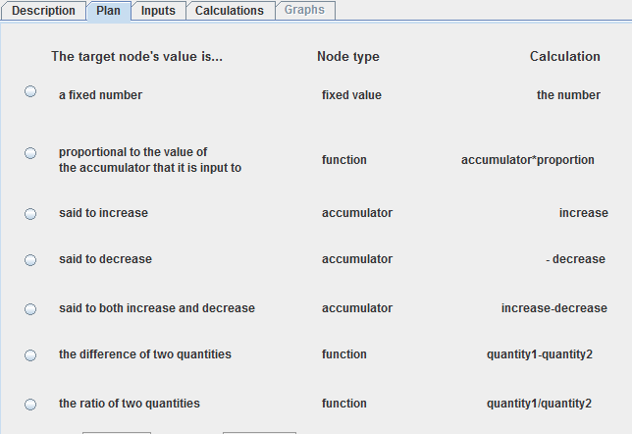
Once you have selected a plan, filling out the other tabs is easy
Helps you fill out the Inputs & Calculation tabs
Helps you fill out the Calculation tab

Slide 70
Introduction to system dynamics modeling
You have finished the introduction and may begin solving problems on your own.
You may always refer back to these slides by clicking on the Help button in the menu bar at the top of the main window.

