Slide 1
Introduction to system dynamics modeling
Add date, your name, school etc. here if you want

Slide 2
System dynamics is general
System dynamics has been applied in many areas:
Ecosystems
Management
Sociology and policy
Health
and many others
You are about to learn a very important skill!

Slide 3
Terminology: Models vs. Systems
Definitions
System refers to something in the real world that you want to understand
Model refers to something you construct that represents a system
Example
Electricity usage in Santa Monica = a system
Set of equations representing it = a model
Usage = industrial + domestic + AC*(temperature – 72) where industrial, domestic & temperature are variables
and AC and 72 are constants.

Slide 4
More examples of modeling
System | Model
A cart rolls down a 30-degree inclined plane… | Set of equations
Atomic explosion | Simulation program
Cash flow in a small business | Spreadsheet
A museum lobby | 1/100 scale model constructed of cardboard
Tooth decay | Concept map
Airflow around wing | 1/10 size wing in air tunnel

Slide 5
Terminology: Executable models can be “run” by a computer
System | Model
A cart rolls down a 30-degree inclined plane… | Set of equations
Atomic explosion | Simulation program
Cash flow in a small business | Spreadsheet
A museum lobby | 1/100 scale model constructed of cardboard
Tooth decay | Concept map
Airflow around wing | 1/10 size wing in air tunnel
Executable
Not
executable

Slide 6
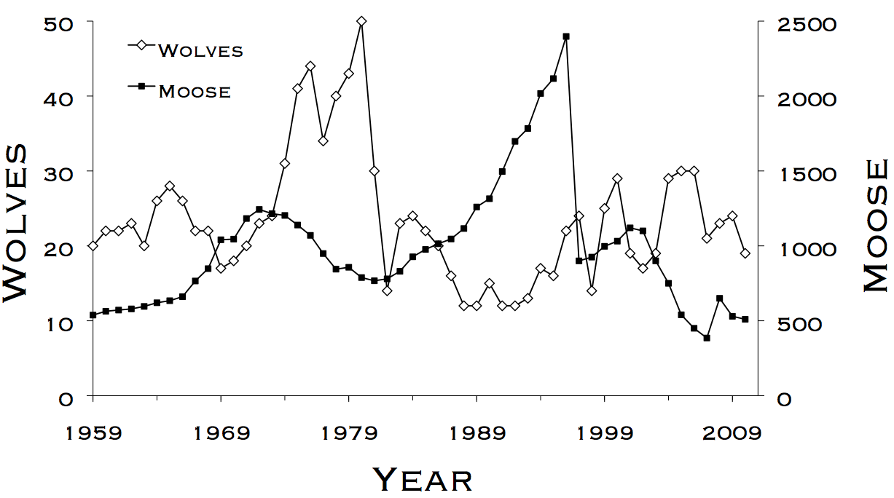
Terminology: Dynamic systems & behaviors
Definitions
A dynamic system is one that changes over time
The behavior of a dynamic system is that change
Example
System = wolves and moose on Isle Royale
Behavior =

Slide 7

A system dynamics model predicts/explains the behavior of a dynamic system
System:
Behavior of the system:
The wolves and moose of Isle Royale
Model:
Predictions of the model:
Let:
m be moose population, initially 500.
w be wolf population, initially 10.
A, B, C & D be constants (parameters)
Then:
Δm = m(A─Bw)
Δw = ─w(C─Dm)

Slide 8
Who uses system dynamics models in the real world?
Researchers use such models to understand complex systems and make decisions.
Before engineers build a complex system, they usually build a model of it.
They experiment with the model to test and improve their design.
Only when the model works perfectly do they start to build the system.
Professionals construct and run models that contain thousands of quantities!

Slide 9

Dragoon is software for…
Constructing simple executable models of dynamic systems

Slide 10
An example of a very simple system
A bottle initially holds 100 bacteria. They grow quickly. On average, 40% of the bacteria reproduce each hour, each producing one new bacterium.
The system changes over time
In particular, the number of bacteria increases
Create a model:
How would we construct a model of the bacteria population and its increase, over a period of 8 hours?

Slide 11
Manually modeling the population:
You do the same calculation for each tick:
Initial population = 100
Births = 40% of population = 0.4 x 100 = 40
Population at hour 1 = initial population + births = 100 + 40 = 140
Births at hour 1 = 40% of population = 0.4 x 140 = 56
Population at hour 2 = 140 + 56 = 196
Births at hour 2 = 0.4 x 196 = 78
Population at hour 3 = 196 + 78 = 274
etc…
A bottle initially holds 100 bacteria. They grow quickly. On average, 40% of the bacteria reproduce each hour, each producing one new bacterium.

Slide 12
It would be much nicer if you could just write down the basic quantities of the model and how their values change, and let some software do the arithmetic.
Systematically modeling the population:
Population
Initially: Value = 100
Subsequently: New value = value + births
Births
At all times: Value = birthrate x population
Birthrate
At all times: Value = 0.4
A bottle initially holds 100 bacteria. They grow quickly. On average, 40% of the bacteria reproduce each hour, each producing one new bacterium.

Slide 13
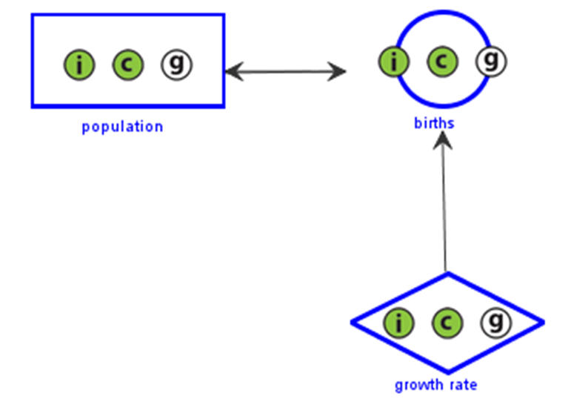
How To Use Dragoon: Definitions
ACCUMULATOR:
An accumulator has an initial value and calculates its next value using its current value and its inputs.
The population of the bacteria is an example of an accumulator because it has an initial value of 100 and grows by the number of births each hour.

Slide 14
How To Use Dragoon: Definitions
FUNCTION:
A function calculates its current value based on its inputs alone, without referring to its old value.
The number of births each hour is an example of a function because it takes the birth rate and current population as inputs outputs the number of births in that hour.

Slide 15
How To Use Dragoon: Definitions
Parameters:
A parameter does not change as time passes.
The growth rate is an example of a parameter because it is always 0.4.

Slide 16
How To Use Dragoon: Definitions
NODE:
A node is a shape representing a quantity and its calculation.
Accumulators, functions, and parameters are all nodes.
Accumulators are represented as squares.
Functions are represented as circles.
Parameters are represented as diamonds.

Slide 17

How To Use Dragoon: Definitions
INPUTS:
An input is a quantity that is used to calculate the value of a node.
Inputs are represented as arrows in Dragoon.
The input for population is births.
The inputs for births are population and growth rate.
Growth rate is fixed, so it has no inputs.

Slide 18

Mathematical names
Dragoon name | Mathematical name
Parameter | Parameter
Accumulator | Integral function
Function | A function that does not include integration
The concept of integration is taught in calculus courses. An accumulator with two inputs, x and y, would be written as:
$$∫x+y dt$$
Just remember that an accumulator is a special kind of function. You do not need to know calculus to understand how it works.

Slide 19
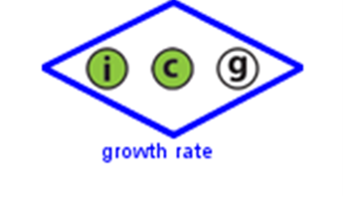
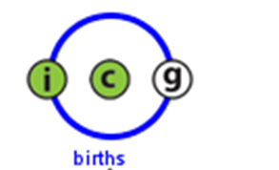
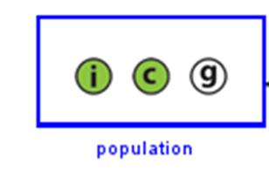
Review
Parameter – The node’s value is a given number that does not change as time passes.
In our bacteria example:
Value = 0.40 representing the proportion of population reproducing per hour
Function – The node’s value is a function of its inputs alone.
In our bacteria example:
Value = population x growth rate
Accumulator – The node possesses an initial value and builds its next value upon its current value and its inputs.
In our bacteria example:
Initial Value = 100
Next Value = Current Value + births

