Slide 1


FAMILY MONEY
Money that
behaves.
A mobile-first money app for people who care where money goes — and what it should do next.
MONEY, WITH MEMORY.
Rules that keep working
after you press send.
getkin.space
SOLO FOUNDER • HACKATHON PROTOTYPE
KIN • 2-MINUTE PITCH

Slide 2
02
THE PROBLEM
Sending money is easy. Trusting what happens next isn’t.
Families need more than a transfer: they need money to arrive with intent.
$129B
6.36%
The missing layer
India’s estimated remittance inflows in 2024
Global average cost to send remittances
Money lands — but its purpose can get lost.
Parents can’t easily set rules after sending.
A huge flow of money — often supporting everyday family needs.
The World Bank’s latest surfaced benchmark: Q3 2025.
Families stitch together transfers, chats and reminders.
WORLD BANK • 2024 ESTIMATE
WORLD BANK • RPW Q3 2025
Context, not a Kin performance claim: global average cost is still above the UN SDG target of 3%.
SOURCES: WORLD BANK, REMITTANCES AND MIGRATION (2024 ESTIMATE); REMITTANCE PRICES WORLDWIDE, Q3 2025

Slide 3
03
THE IDEA
Kin turns a payment into a promise.
Send money with rules attached — and make those rules feel simple.
TODAY
WITH KIN
“Here’s the money.”
“Here’s what this money is for.”
The sender loses visibility once it lands.
ALLOWANCE
FAMILY POT
SAVINGS CIRCLE
Release over time
Pool for a shared goal
Save together by rules
Positioning: programmable family money — not another generic wallet.
KIN • HACKATHON BUILD

Slide 4
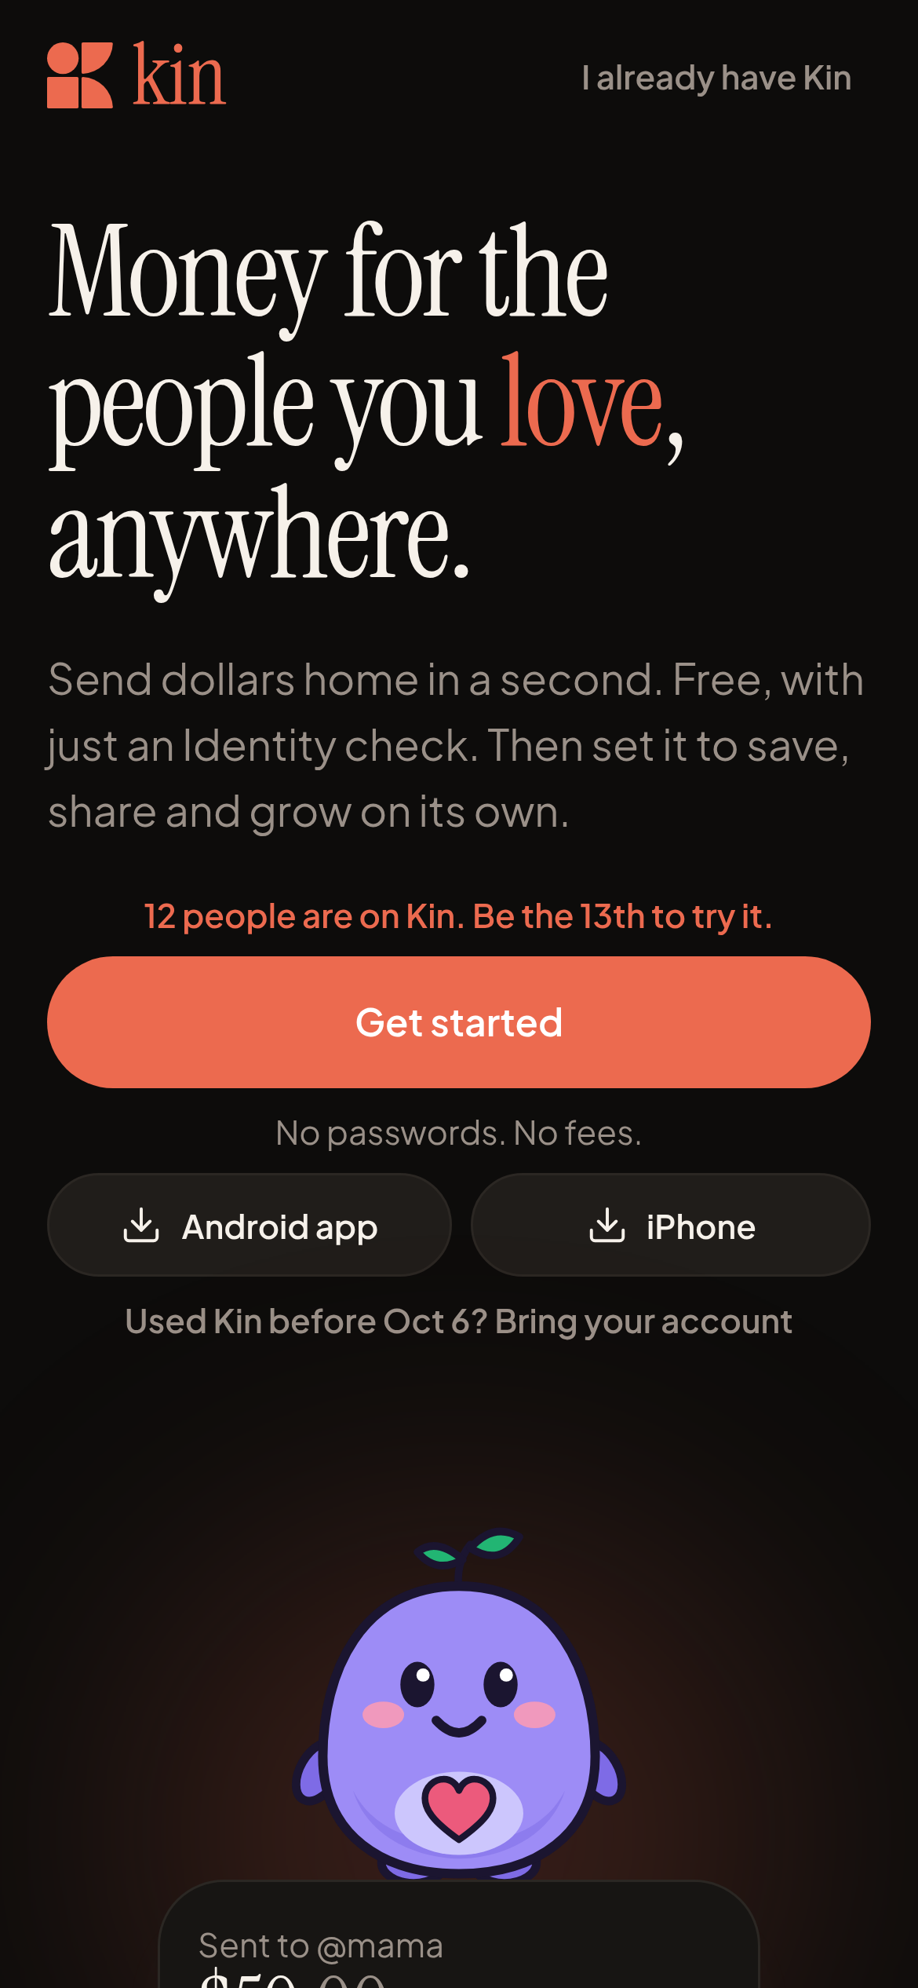
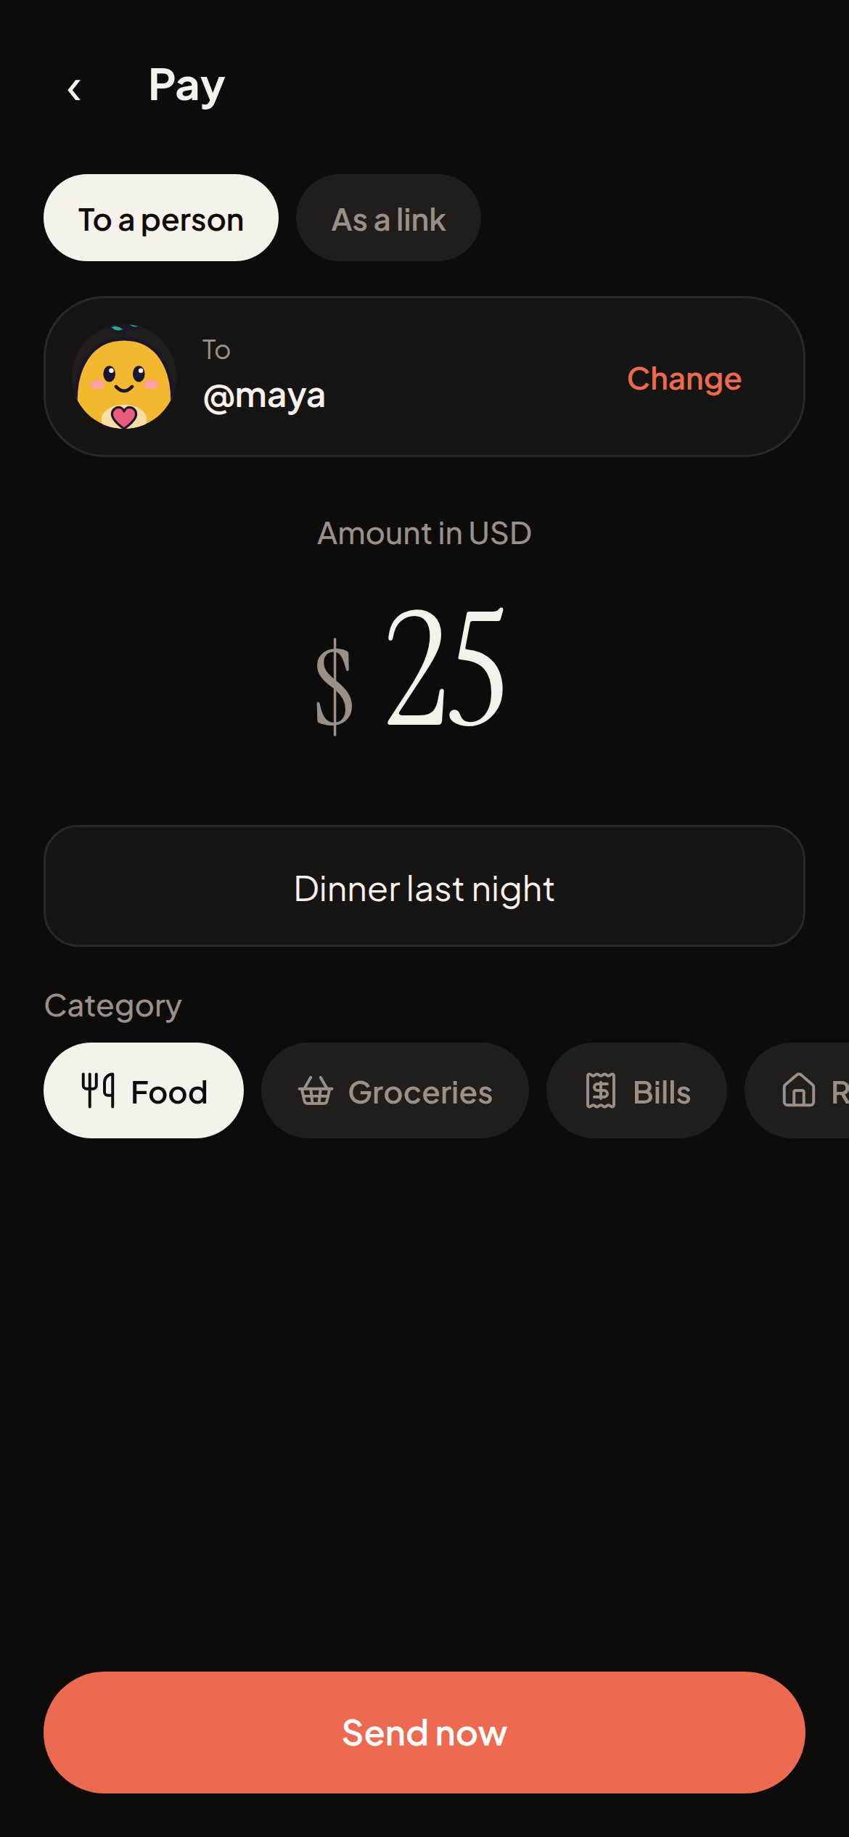
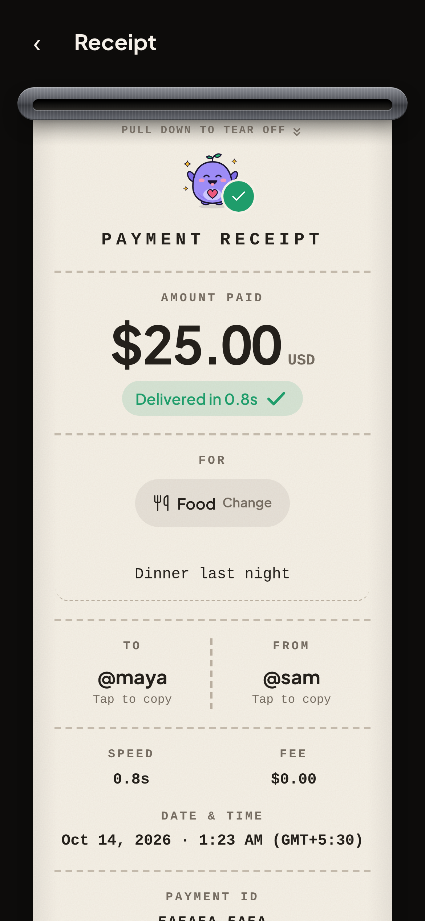
04
PRODUCT EXPERIENCE
Crypto complexity stays backstage.
A familiar flow: sign in, choose a person, see a clear receipt.
Real screens from getkin.space: 01 sign up with a passkey · 02 pay @maya · 03 printed receipt, delivered in 0.8s.
KIN • HACKATHON BUILD

Slide 5
05
WHAT MONEY CAN DO
A transfer is one moment. A rule can last for months.
Programmable features are the product’s edge — shown in the testnet build.
01
Live allowance
02
Emergency release
03
Savings circle
Release money on a schedule.
Unlock funds when needed.
Contribute toward a shared goal.
04
Family pot
05
Earmarked payment
06
Milestone escrow
Pool money for a specific purpose.
Keep rent or bills tied to intent.
Release when agreed steps are met.
TESTNET / PRACTICE MONEY
Other planned or prototype flows include AutoPay, dated gifts and savings jars.
KIN • HACKATHON BUILD

Slide 6
06
UNDER THE HOOD
Invisible rails. Verifiable state.
Kin combines account abstraction and smart contracts with a familiar consumer interface.
KIN APP
MERA
MONAD
AUSD
Next.js PWA / Android
Passkey account layer
Smart contracts
Agora stablecoin
Gasless relay • Aurora add-money route • Envio indexing • Alchemy notifications • Chainlink CRE planned / simulated
MAINNET
TESTNET
Add money, send / receive, and activity are live.
Programmable money flows are prototype / practice features.
INR cash-out is a labelled practice step today — no live INR payout. Mainnet AUSD conversions observed: 4.997 USDC → 4.998 AUSD; 0.999 USDC → 0.999 AUSD.
KIN • HACKATHON BUILD

Slide 7
07
EARLY EVIDENCE
Small sample. Real signals. No inflated claims.
Early-stage validation from documented tester activity and two mainnet add-money conversions.
6
5 / 6
2
independent testers
besides founder
used a feature beyond
signup
mainnet add-money
conversions observed
MAINNET CONVERSIONS
WHAT THIS DOESN’T PROVE
4.997 USDC → 4.998 AUSD • 0.999 USDC → 0.999 AUSD
No retention, scale or product-market fit claim.
Tester window documented in GTM notes: Sep 30–Oct 4. No user quotes or interviews are claimed.
KIN • HACKATHON BUILD

Slide 8
08
ROADMAP + ASK
Make money
keep its promise.
THE ASK
Help us close
the last mile.
Next: prove the full journey, from first deposit to responsible cash-out.
We’re looking for the right path to a compliant, usable INR payout experience.
NOW
Harden core flows
Reliability, edge cases, clearer recovery.
NEXT
Validate repeat use
CONNECT US WITH
Measure whether families return to rules-based money.
A licensed INR payout partner
and the relevant mainnet approvals.
UNLOCK
Build compliant INR exit
Secure licensed payout partner and required approvals.
getkin.space ↗
KIN • SOLO FOUNDER • HACKATHON PROTOTYPE
KIN • HACKATHON BUILD

